Slide 1
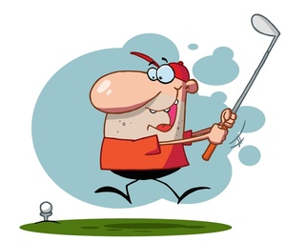
Get Ready
Get Set………
PETS TRAINING SESSION 2 2022 2023
Notes:
Welcome– everyone –well– we are getting closer now to our year and Mid-Atlantic PETS-We hope tonight will get you excited, thinking, planning and doing
Some administrative things: we will ask u all tp mute yourself during the presentation. If you have a question- we will unmute you and you can asl anytime during the presentation
We also will be recording this presentation-and will let you know how to reach.
So………………are we ready.

Slide 2
PETS TRAINING SESSION 2 2022 2023
Notes:
Our Rotary theme : Imagine rotary--- that our RI President Elect Jennifer Jones introduced this past week– is perfect for all of us– Just Imagine what opportunities and things we can accomplish with Rotary in this next year– hopefully in a more post covid world

Slide 3
Agenda
WELCOME
ADMINISTRATIVE RULES FOR THIS EVENING AND “TO DO’S”
OUR NEW ROTARY THEME
PREPARING FOR OUR YEAR
KEY ATTRIBUTES OF SUCCESSFUL CLUBS
OUR PE SURVEY AND OUR ATTRIBUTES
INDIVIDUAL CLUB DATA
WHAT IS TO COME AT PETS
THURSDAY EVENING FEBRUARY 23: OPTIONAL LEADERSHIP SESSIONS
FRIDAY ALL DAY AND EVENING:
RI President Elect-Jennifer Jones
Key Note Speaker: “It All Starts With Your Vision”
Key Note Speaker: The Rotary Foundation
RI Director : Valerie Wafer
Breakout sessions:
By Club Size: EZ Strategic Planning
Membership Growth
Community Assessment
District 7430 2 Breakout Sessions specific to our District
SATURDAY THROUGH LUNCH
Key Note Speaker: Leadership
Key Note Speaker: The Future of Rotary
Breakout Sessions:
Conflict resolution
Understanding your Membership trends
Diversity Equity and Inclusion
AG and DGE session
PETS TRAINING SESSION 2 2022 2023
Notes:
So let’s review our agenda---- ( you all can read it )- wait a few minutes --as you can see we have a busy agenda
Please: do some of the modules on the learning center as required– less than 50% of you have done them- it really will help you
If you have not yet registered for MAPETS—please do so—we have started hotel reservations and some of you are receiving confirmations– we realize that there are a few conflicts in attendance and will work with you
So let’;s get started

Slide 4
5 Attributes of Successful Clubs
PETS TRAINING SESSION 2 2022 2023
Notes:
To make your club successful—or we should see even more successful there are 5 key attributes to a successful club-we are going to go through them—then let’s see what u actually said from our questionnaire—then—let’s think about what’s next

Slide 5
Strong Leadership
PETS TRAINING SESSION 2 2022 2023
Notes:
Say it then go to next slide

Slide 6
Here is what our PE’s said
11% said Leadership was one of the top positive things about your Club
4% said encouraging members into Leadership position was one of top goals
PETS TRAINING SESSION 2 2022 2023
Notes:
Interesting– here is what you actually said about leadership– do we have some work to do?

Slide 7
To think about:
Should leadership be a priority in your club?
Will strong leadership help your club grow in all attributes of successful clubs?
How does leadership affect your club now and for the future?
What actions will you take as Club President?
PETS TRAINING SESSION 2 2022 2023
Notes:
Read these-------------------what do u think?

Slide 8
2nd attribute: Setting Clear Goals And Membership
PETS TRAINING SESSION 2 2022 2023
Notes:
Setting clear goals seems to be quite obvious doesn’t it– if everyone knows what the goals are– u can all work together—let’s see this video clip

Slide 9
Here’s what our PE’s said
4% PE’s indicated Membership goals positive
20.4% PE’s indicated Membership is top priority for next year: increasing,retaining,participation
PETS TRAINING SESSION 2 2022 2023
Notes:
Looks like many of us know we need to focus on membership – lets think of at least one new thing we can try with membership in our clubs for next year

Slide 10
To think about:
Why would membership NOT be a top priority for your club?
What actions will you specifically take with membership?
PETS TRAINING SESSION 2 2022 2023
Notes:
Membership is not just about numbers--- it is about all the activities we do in our clubs

Slide 11
3rd Attribute :Active In the local Community Many events and service projects

Slide 12
Here’s what you as PE’s said
27% PE’s said positive thing about their clubs is Active in the Community and service projects
18% PE’s indicate goals to include increasing community activity and service projects
PETS TRAINING SESSION 2 2022 2023
Notes:
Many of us have positive things to say about our community service – and working toward goals to increase and improve our service– that is what Rotary is all about!

Slide 13
To think about
How can you as Club Leader encourage community involvement with your service projects?
What can you do differently to utilize community service to attract members?
PETS TRAINING SESSION 2 2022 2023
Notes:
Key is– how can we utilize our community and our members to work together to have more impact?

Slide 14
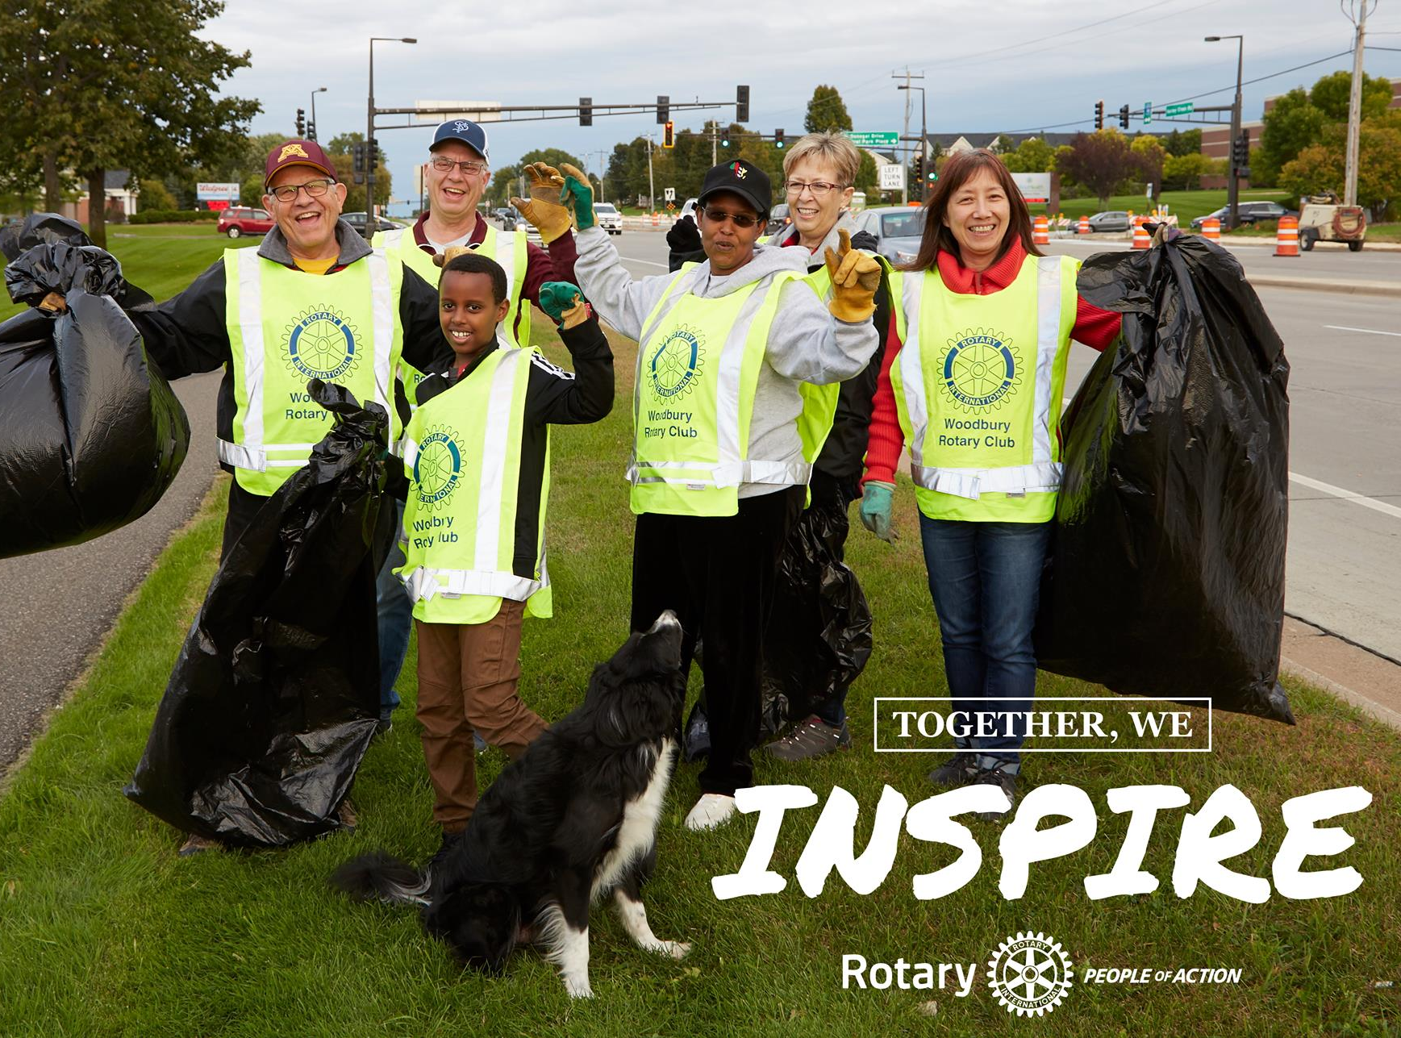
4th Attribute:Visibility in the community- Strong Public Image
It’s not just doing, it’s being seen doing!
Notes:
Clubs made active use of social media and more often than not, this was taken up by the club as a whole, rather than an individual or committee.
Here are some examples.: let’s look at thus video

Slide 15
Here is what you – our PE’s said
99% of Clubs have websites and update regularly
100% of clubs have facebook pages with about 90% being updated regularly
PETS TRAINING SESSION 2 2022 2023
Notes:
Wow – look at this….We say we all have and do public image

Slide 16
To think about…
If you are updating your Public Image– are you satisfied with participation and engagement results??
What is something new you could initiate with Public Image?
PETS TRAINING SESSION 2 2022 2023
Notes:
So ask yourselves– are you getting the “bang for your buck”? What can you try new next year?

Slide 17
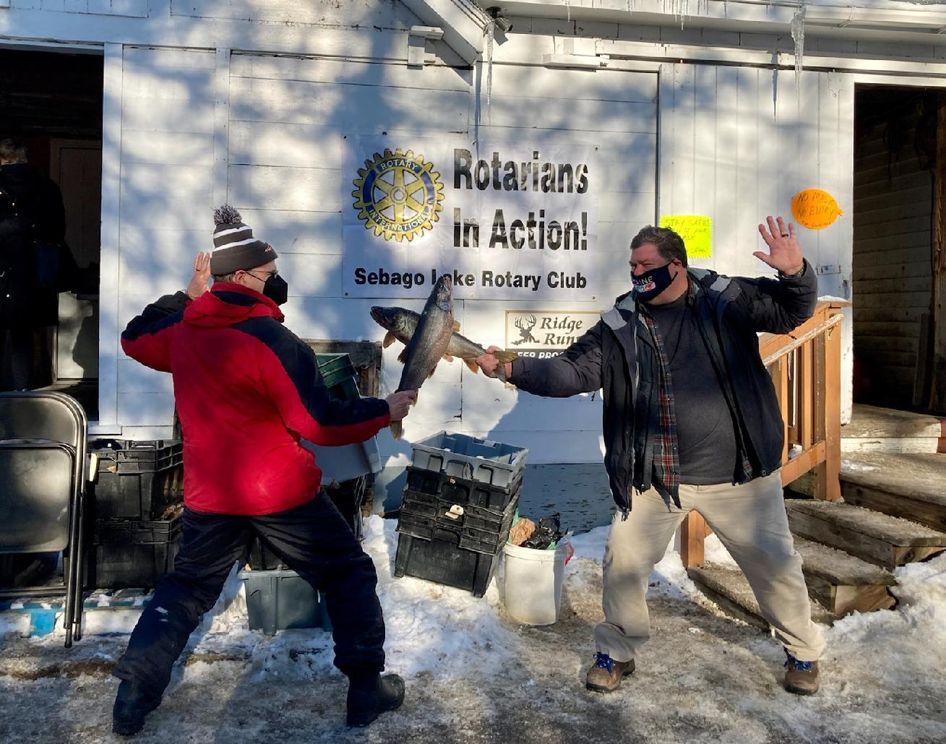
5th Attribute: Active, Intentional Member Engagement
Consistent meetings with mixed formats
Strong Meeting Programs
Friendly, Fun, Inclusive
New Member Onboarding
Engage members in committees/projects
Recognize all contributions by participants
Notes:
The key message to repeat here is that clubs were active and intentional about engaging their members – and ‘not yet Rotarians’.
Intro to video: These leaders make this point best.

Slide 18
Here is what you our PE’s said:
23% PE’s said top thing about their Rotary Club is membership engagement
11% PE’s said one goal is to expand member engagement
PETS TRAINING SESSION 2 2022 2023
Notes:
We know that in many cases covid has been a challenge to engage members…..let’s go beyond covid and think: involvement—what gets your membership excited about participation?

Slide 19
Summary: 5 Attributes to Successful Clubs
Strong Leadership
Setting Clear Goals and Membership
Active in the Community: Many events and service projects
Visibility in the community: Strong Public Image
Active Intentional Member Engagement
PETS TRAINING SESSION 2 2022 2023
Notes:
So here is the summary--- let’s think about how are u going to plan to make your club even more successful?

Slide 20
Think About These Attributes
Are you as the Leader of Your Club following and implementing these attributes?
Will each one of these attributes be a part of your club goals in 2022-2023?
At MAPETS , you will learn about some specific ideas to implement in your club
PETS TRAINING SESSION 2 2022 2023

Slide 21
Our District PETS sessions will include:
Key Elements to your Presidency
Membership
Foundation
Public Image
Our committees to support you
Planning:
Strategic Plan 2022-2025
District Goals 2022 2023
District Calendar 2022 2023
District Governor Visits draft schedule
Rotary Club central – discuss goals
PETS TRAINING SESSION 2 2022 2023
Notes:
In our District Sessions we will specifically discuss how we can plan and take action for our 2022-2023 rotary year to be successful—here is a review of the general topics

Slide 22
MARK YOUR CALENDAR
REGISTER FOR MAPETS AT MAPET.ORG
MARCH 5 2022: FOUNDATION GALA
APRIL 9, 2022: DISTRICT TRAINING ASSEMBLY ( FINAL PETS)
APRIL 22- APRIL 24, 2022 DISTRICT CONFERENCE
YOU CAN REGISTER AT ROTARY7430.ORG
PETS TRAINING SESSION 2 2022 2023
Notes:
Here is your next calendar “to do’s

Slide 23
Let’s
Swing…
TOGETHER!
PETS TRAINING SESSION 2 2021 2022
Notes:
Just as you are going to be the PE for the first time, same goes for me as DG, we are in this together.
My style – Team approach, Easy going – but expect the same amount of commitment from you as I plan to give.
Communication is key to a successful year.

Slide 24
PETS TRAINING SESSION 2 2022 2023

