Slide 1
Rotary Facebook Training

Slide 2
Welcome!

Slide 3
First Steps
Introductions
Name
Club
Position
Tenure
Are you a Facebook user?

Slide 4
Facebook Introduction

Slide 5
Facebook Introduction

Slide 6
Facebook Introduction
Worldwide, there are over 2.45 Billion Monthly Active Users
9% increase over prior year
1.62 Billion people on average log onto Facebook daily
8% increase over prior year
Age 25 – 34, at 29.7% of users is the most common age demographic

Slide 7
Facebook Introduction
Widely used by both genders
76% of females
66% of males
Highest traffic occurs mid-week between 1 to 3 pm
Every 60 seconds on Facebook:
510,000 comments are posted
293,000 statuses are updated
136,000 photos are uploaded

Slide 8
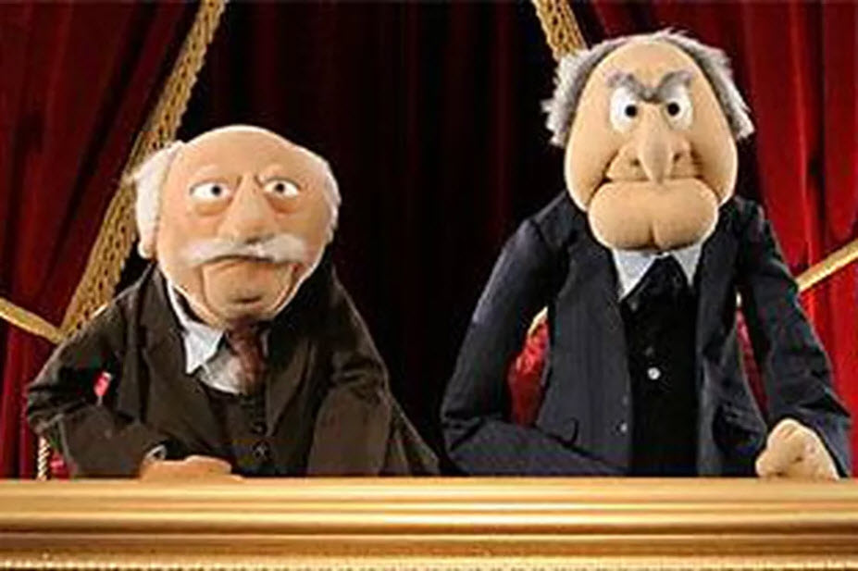
Why Facebook Is Important To Club Growth
Our greatest challenge – increasing membership
Low awareness of who we are and what we do

Slide 9
Why Facebook Is Important To Club Growth
Social Media is a great way to increase awareness of Rotary
Visual
Used by prime demographic groups
A powerful tool to stay in front of your target audience
Great way to promote events
Share the good we do
No large investment needed

Slide 10
Facebook Business Pages
Facebook added Business pages and ads in November 2007
Business page is the official FB representation of your organization
Different types of businesses have different features
Page is linked to page admins

Slide 11
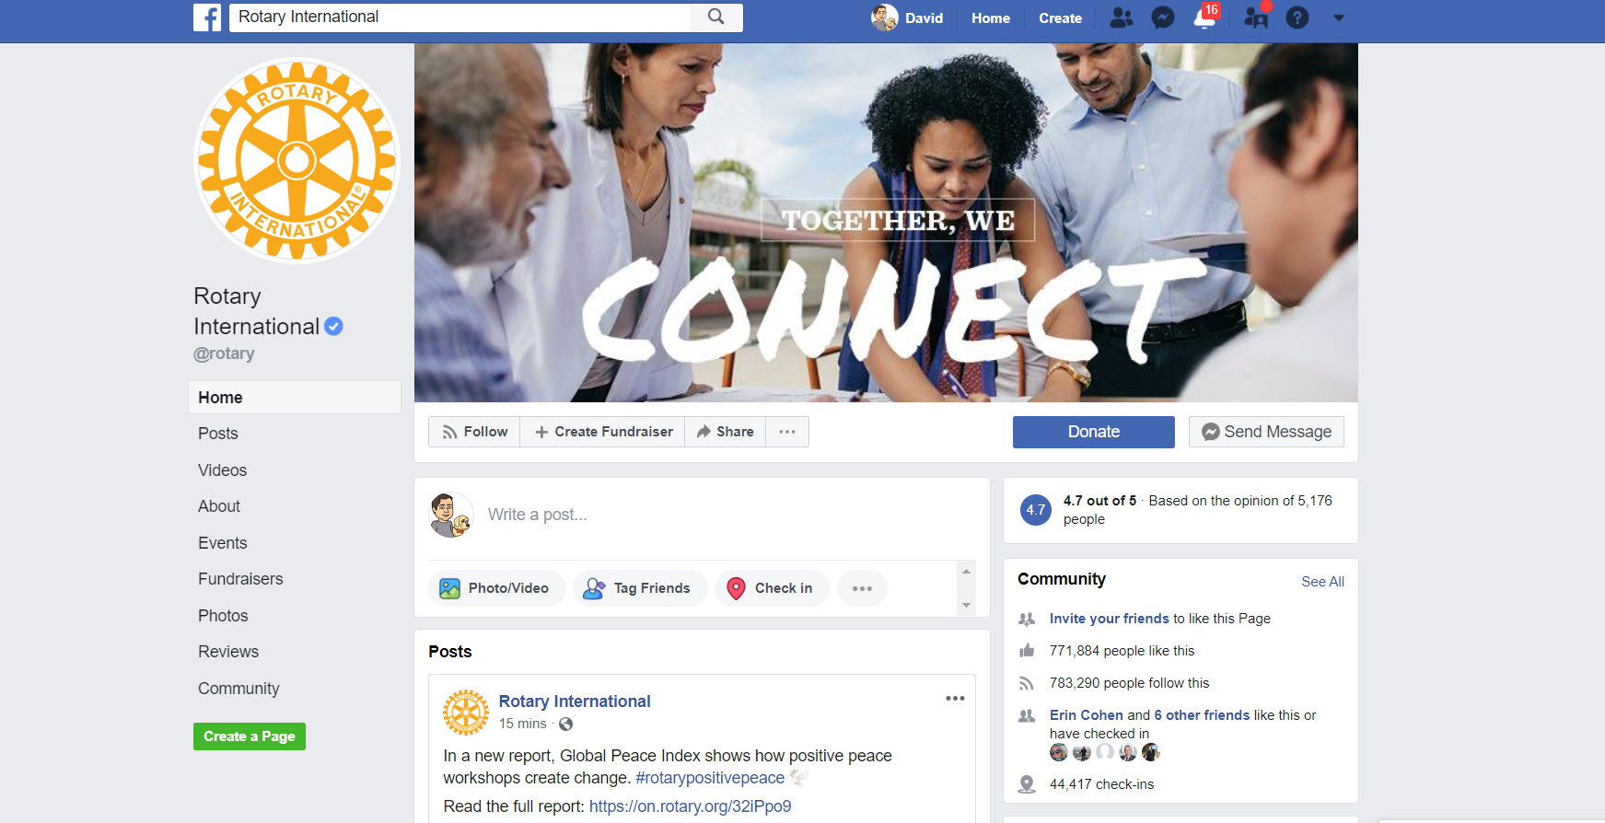
Profile Image
Cover Image
Tabs
Timeline

Slide 12
Facebook Business Pages
Timeline is a chronological view of your business posts
Posts are the focus because very few of people who have liked your page will actually visit your page – rather they will see your posts within their personal newsfeed
Business posts in your personal newsfeed will either be organic (meaning you have liked their page) or sponsored, meaning the organization is targeting you for their paid post boosts or ads

Slide 13
How Businesses Are Using Facebook
A variety of marketing strategies
Brand Awareness
Drive Traffic to Website
Lead Capture
Engaging with Customers
Selling Products
Should define goals and objectives up front
Organic and Paid Approach

Slide 14
How News Feeds Work
Facebook’s algorithm determines which posts to show in a person’s news feed.
While this shifts frequently, the current algorithm does not prioritize business posts into a person’s personal newsfeed.
Not listed chronologically

Slide 15
How News Feeds Work
What shows based on the person who made the post, and how interested you generally are in that person – the post itself and how many people are interested in that post.
If you interact with a person or page frequently, you’re more likely to see that person’s posts, comments, likes or status updates in your news feed. If a status update or post is getting a lot of views, comments or likes, it is more likely to show up in your news feed.

Slide 16
How News Feeds Work
An average person could be exposed to thousands of posts / status updates each day. The average user has 130 friends and is connected to another 50 groups, pages or events. Facebook uses their algorithm to try and show you the content you’re most interested in first.
Posts / status updates from a business is automatically downgraded by the algorithm. Business posts don’t get a lot of organic reach – average 1 – 7% will see your content.

Slide 17
How The Public Engages With Your Page
Like – users can select emotion (Like, Love, Haha, Wow, Sad, Angry
Comments – users can comment on your page or on a specific post
Sharing – users can share with a person(s) or to a page
Follow – shows interest in a page – impacts how often posts are shown

Slide 18
Messenger
Messages don’t show on your page
Messages are not seen by other FB users
Key is responding quickly

Slide 19
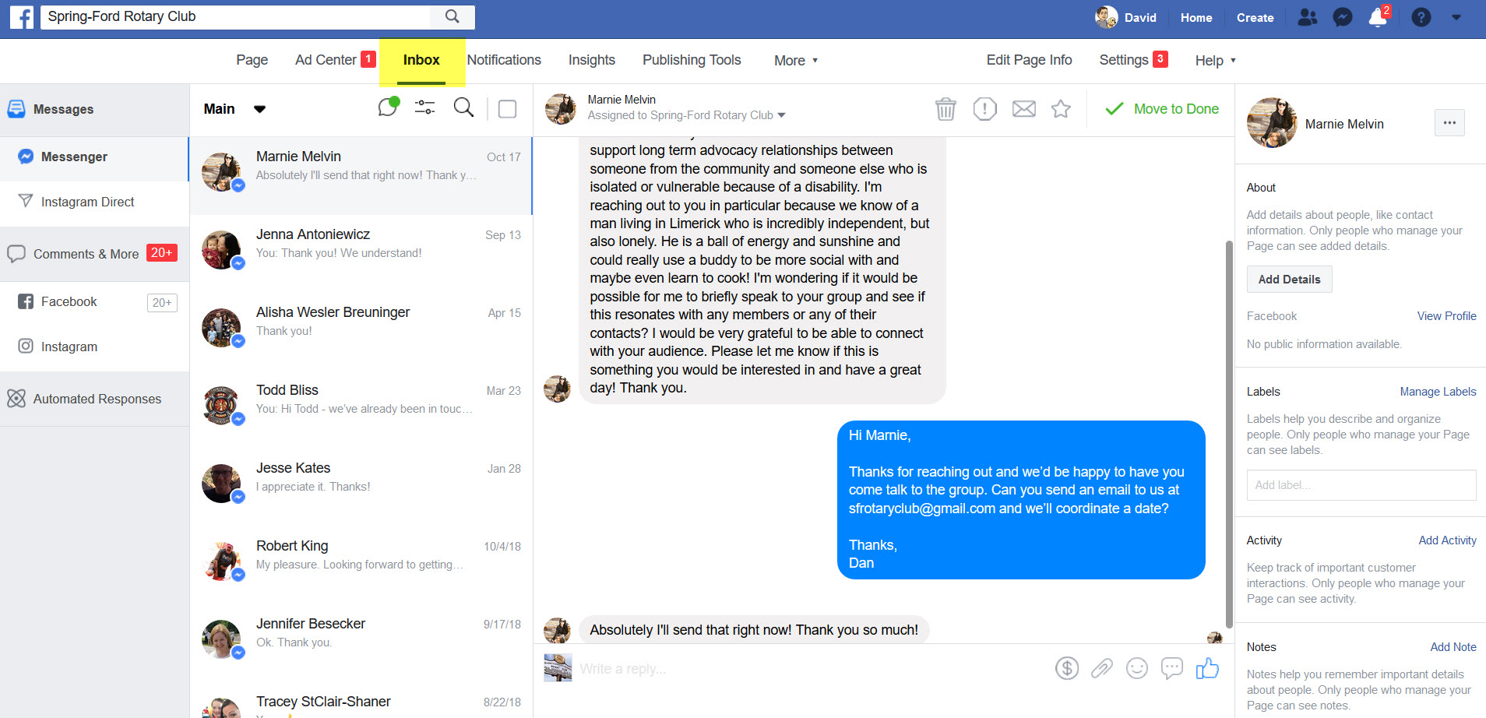
Inbox

Slide 20
Page Roles
You can provide multiple people access to help you run and manage your page
Editor – Can publish content and send Messenger messages as the Page, respond to and delete comments on the Page, create ads, see who created a post or comment, post from Instagram to Facebook, and view insights. If an Instagram account is connected to the Page, they can respond to and delete comments, send Direct messages, sync business contact info and create ads.
Moderator – Can send Messenger messages as the Page, respond to and delete comments on the Page, create ads, see who created a post or comment, and view insights. If an Instagram account is connected to the Page, they can respond to Instagram comments, send Direct messages and create ads.

Slide 21
Page Roles
Analyst – Can see which admin created a post or comment and view insights
Administrator - Can manage all aspects of the Page. They can publish and send Messenger messages as the Page, respond to and delete comments on the Page, post from Instagram to Facebook, create ads, see who created a post or comment, view insights, and assign Page roles. If an Instagram account is connected to the Page, they can respond to and delete comments, send Direct messages, sync business contact info and create ads.

Slide 22
Page Roles
Always have at least two administrators
Remove people as access no longer needed / required
Process of adding a page role: Only admins can add or remove page roles

Slide 23
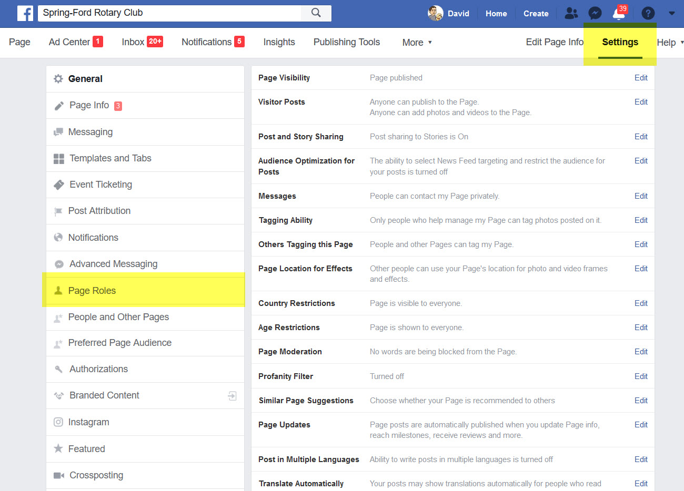
Understanding Page Roles
Adding Page Roles
Choose “Settings” in Admin Menu
Choose “Page Roles” in side menu

Slide 24
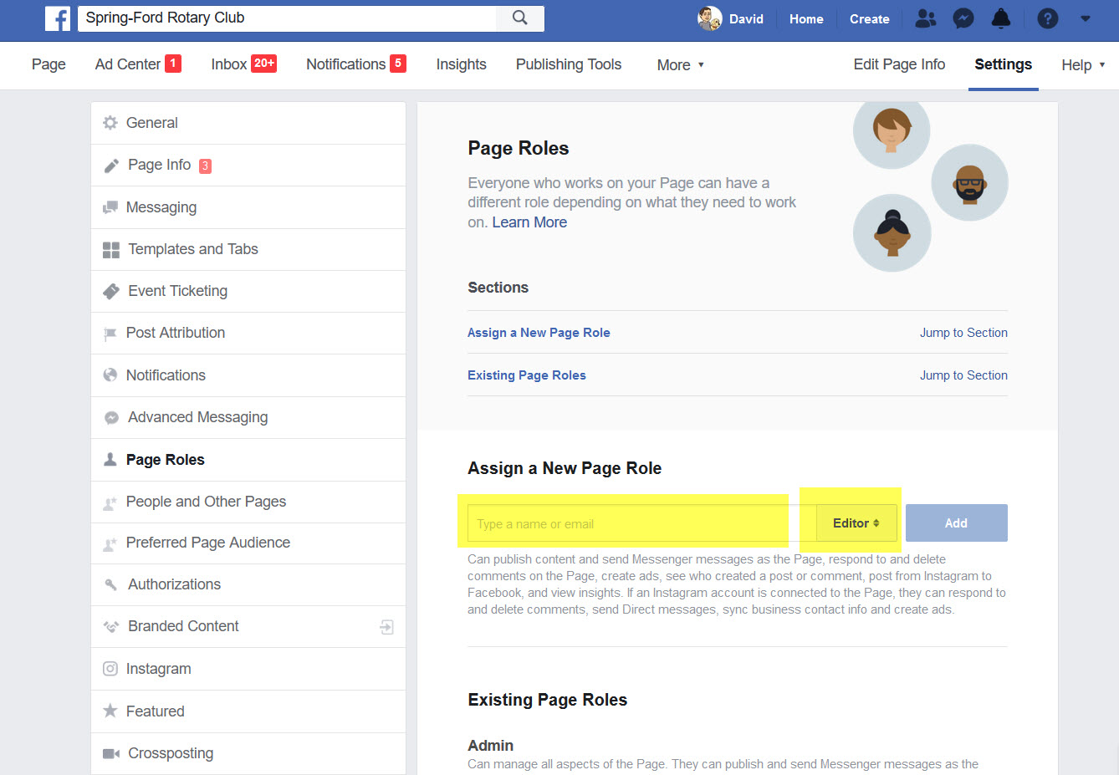
Understanding Page Roles
Assign a New Page Role
Enter user’s name or email
Select Role Level
Press “Add” button
Re-enter your FB password

Slide 25
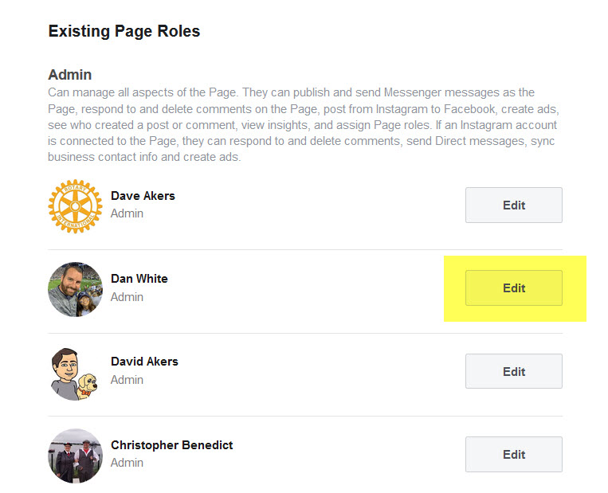
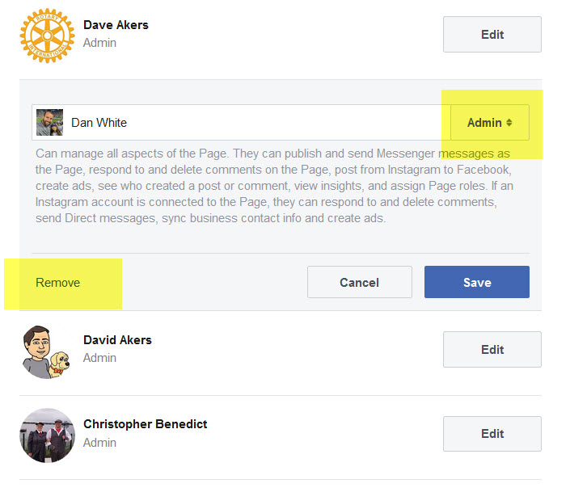
Understanding Page Roles
Removing / Changing a Page Role
Select “Edit” next to person to change / remove
If changing, select new Role Level
If removing, select the “Remove” button
Re-enter your FB password

Slide 26
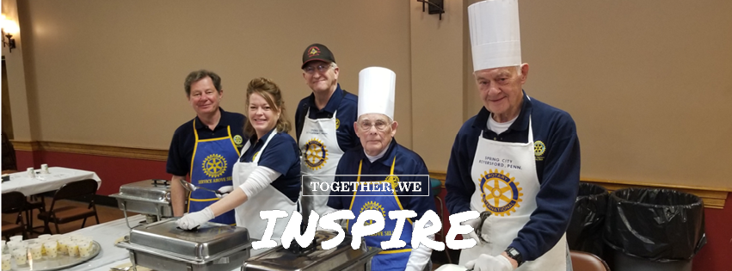
Optimizing Your Page
Imagery
Cover Image
Static Image or Looped Video
Recommended Image Size: 851px x 315px, png format, 72 dpi
Note that mobile shows as 560px x 315px (134 pixels lost on each side)

Slide 27
Optimizing Your Page
Imagery
Profile Image
Static Image
Recommended Image Size: 180px x 180px, png format, 72 dpi
Note that profile image shows inside a circle

Slide 28
Optimizing Your Page
About
About Section
Limited to 255 characters
Where/When do you meet
Invite Visitors
Our Story
Image recommended size: 1080px x 1920px, png format, 72 dpi
Start Date
When you club was founded
Mission
Why you do what you do

Slide 29
Creating Posts
Can create from main page
Simple posts
FB Live
Create and Event

Slide 30
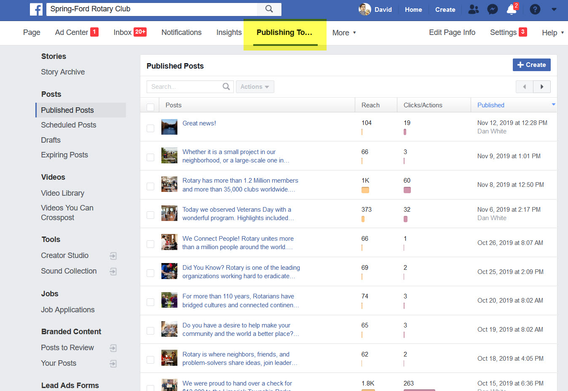
Publishing Tools
See Published Posts
Schedule Posts
Video Library

Slide 31
Creating Posts
Scheduled Posts
Will show any posts already scheduled
To create a new post, click on the “+Create” button

Slide 32
Creating Posts
Select your imagery option
Upload from your computer
Original image should be 1200px x 1200px – but it will be automatically reduced to 470px x 470px

Slide 33
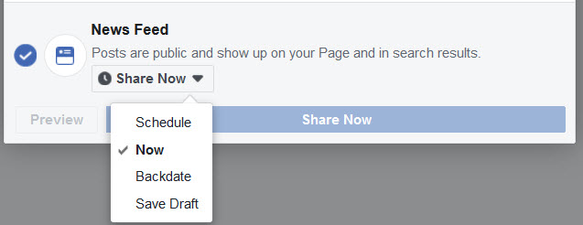
Creating Posts
Sharing Options
Schedule
Now
Backdate
Save Draft

Slide 34
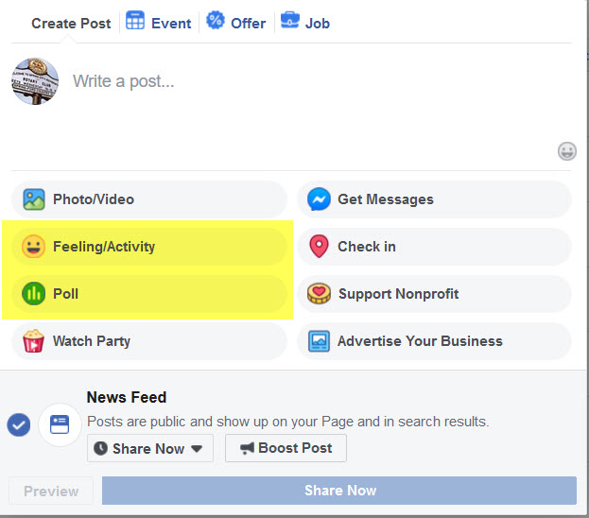
Creating Posts
Feeling / Activity
Selecting this gives dropdown of several options
Poll
Selecting this allows you to build out a poll (2 options)
Select length of time poll is open
1 day
1 week
Custom

Slide 35
Posting Best Practices
Photos
Include People
Tag people in photo (@David Akers)
Video
Mobile news feed shows more videos than photos
Optimize for Mobile – Grab attention fast, optimize video for watching without sound – don’t link to a non-mobile-optimized website page

Slide 36
Posting Best Practices
When and How Frequently?
Best time
Whenever your target audience is in the best state of mind to consider your message
Schedule
Content trumps scheduling
Frequency
Minimum of 2 times per week

Slide 37
Posting Best Practices
Post Length
What is appropriate post length?
Too long and part will be hidden
Be as succinct as possible
Hashtags
Not necessary on FB posts
Can be used to get point across
Include Links
Hyperlink to a website will automatically pull images from page

Slide 38
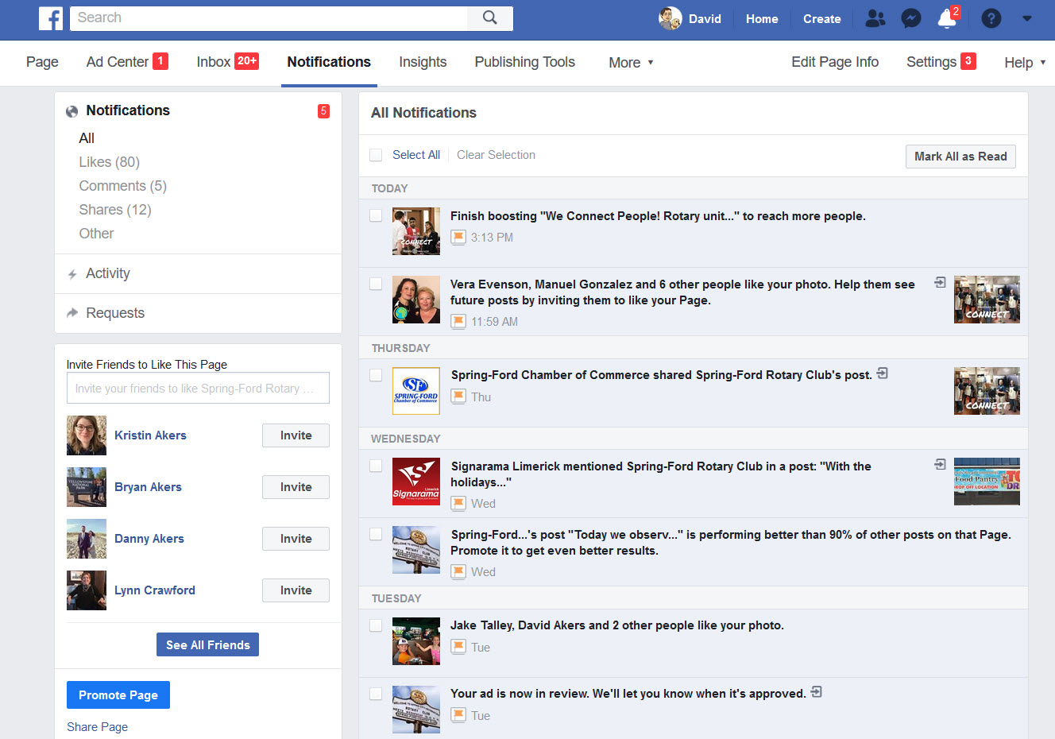
Notifications
View Information on page activity

Slide 39
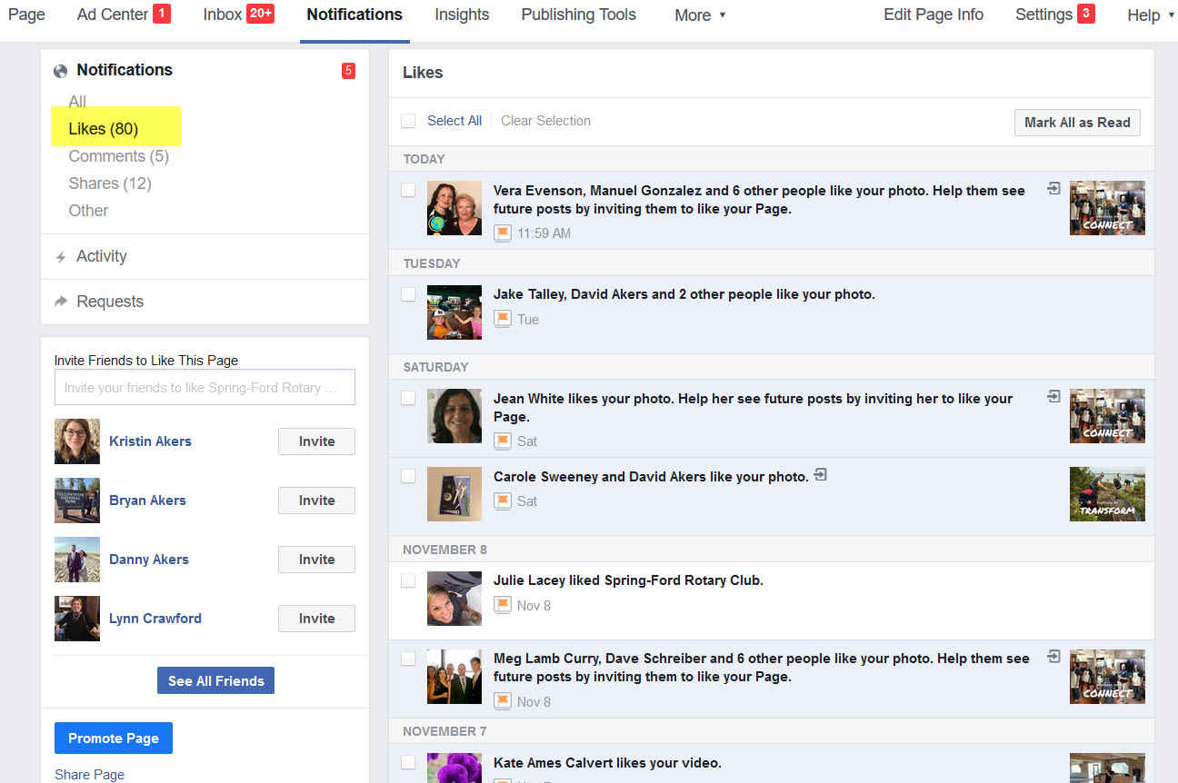
Notifications
View Information on page activity:
Likes

Slide 40
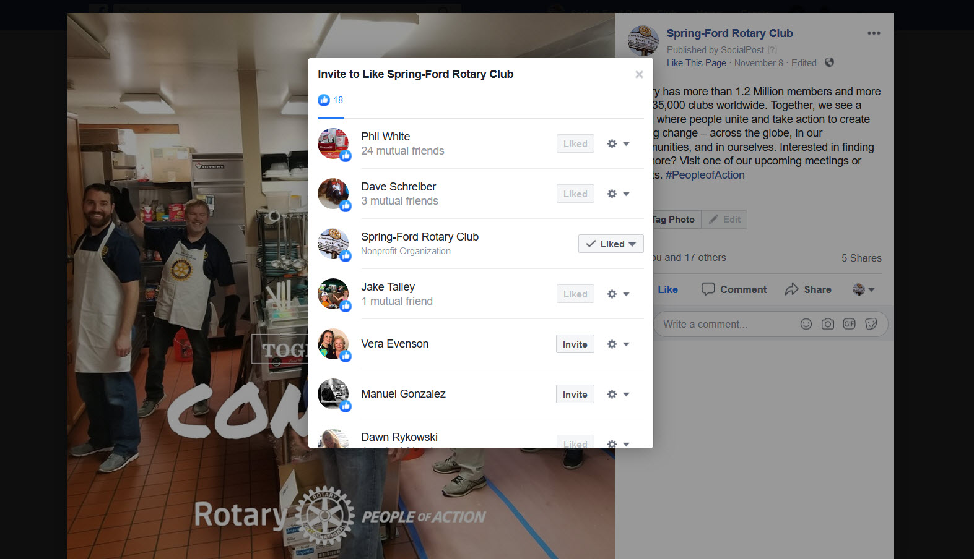
Notifications
Invite those that have liked or commented on a post to “Like” your page

Slide 41
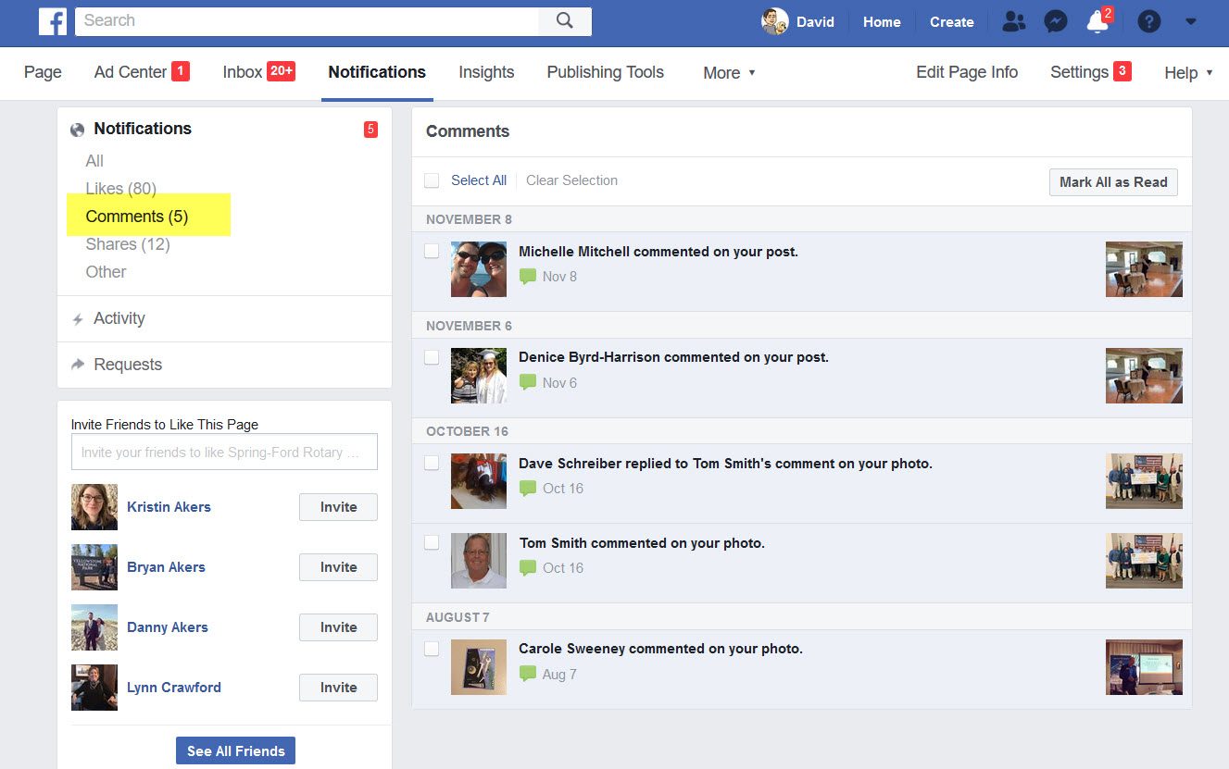
Notifications
View Information on page activity:
Comments

Slide 42
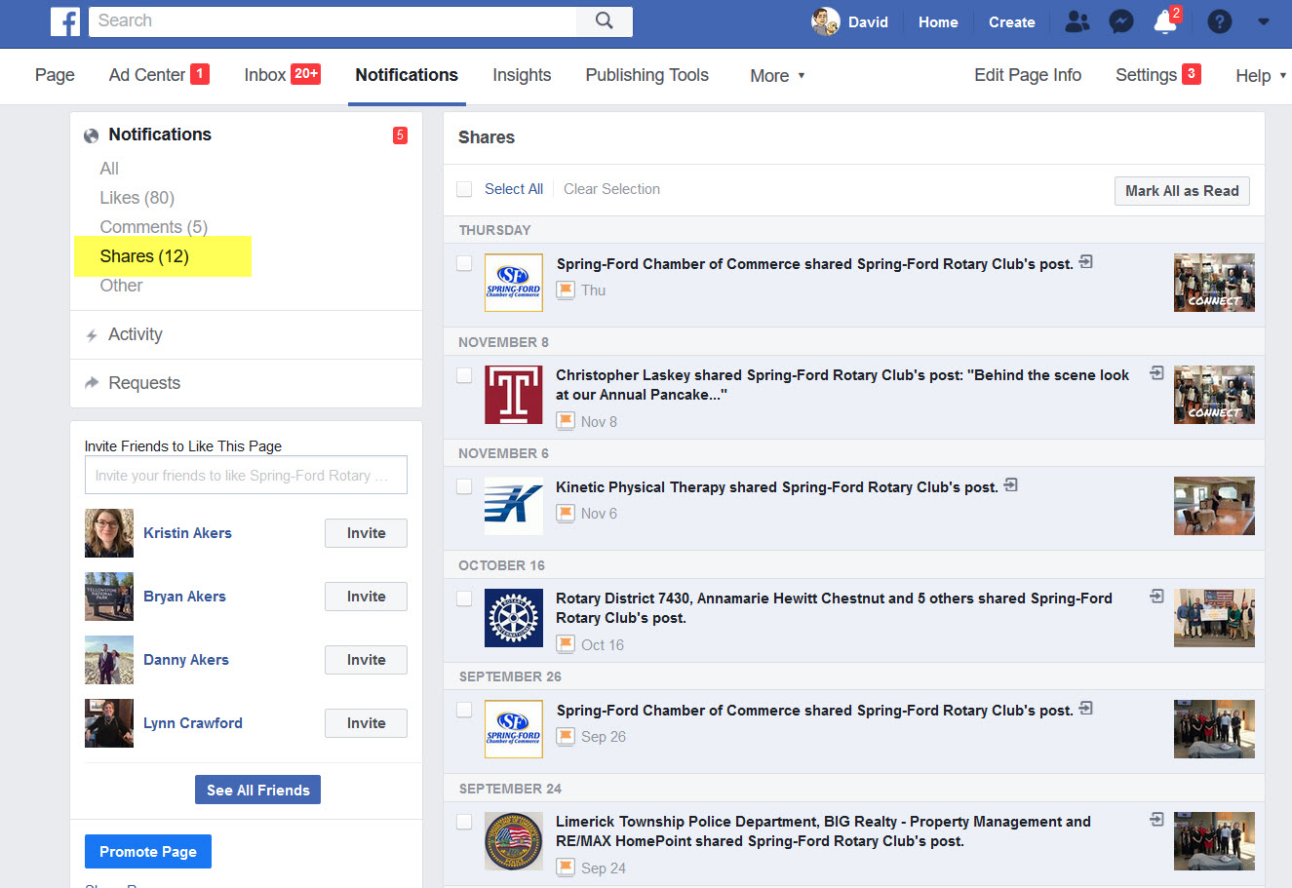
Notifications
View Information on page activity:
Shares

Slide 43
Facebook Insights
Allows you to measure and evaluate the performance of your business page.
Can give you valuable information about who your customer base is, such as who follows you, where they are, how old they are, and more.

Slide 44
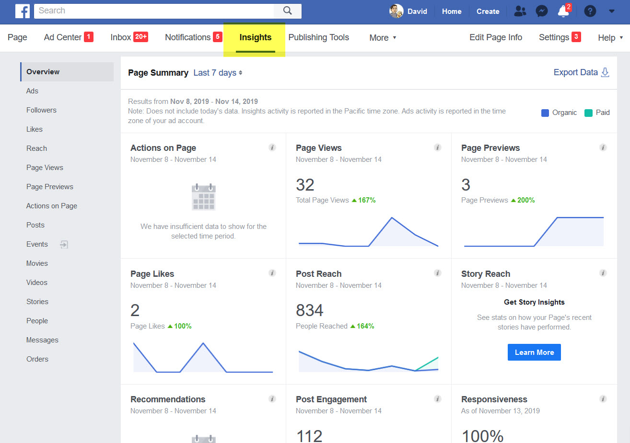
Facebook Insights

Slide 45
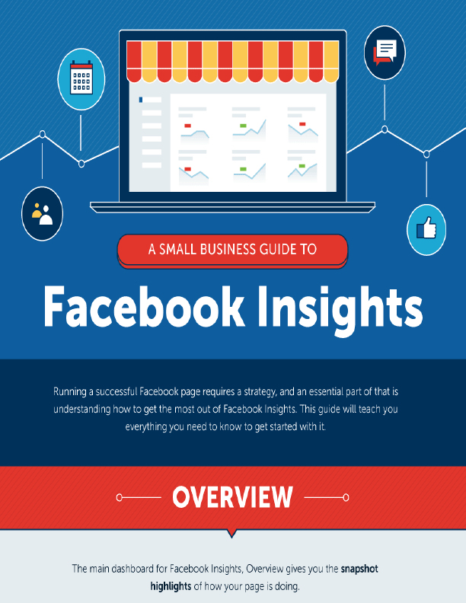
Facebook Insights

Slide 46
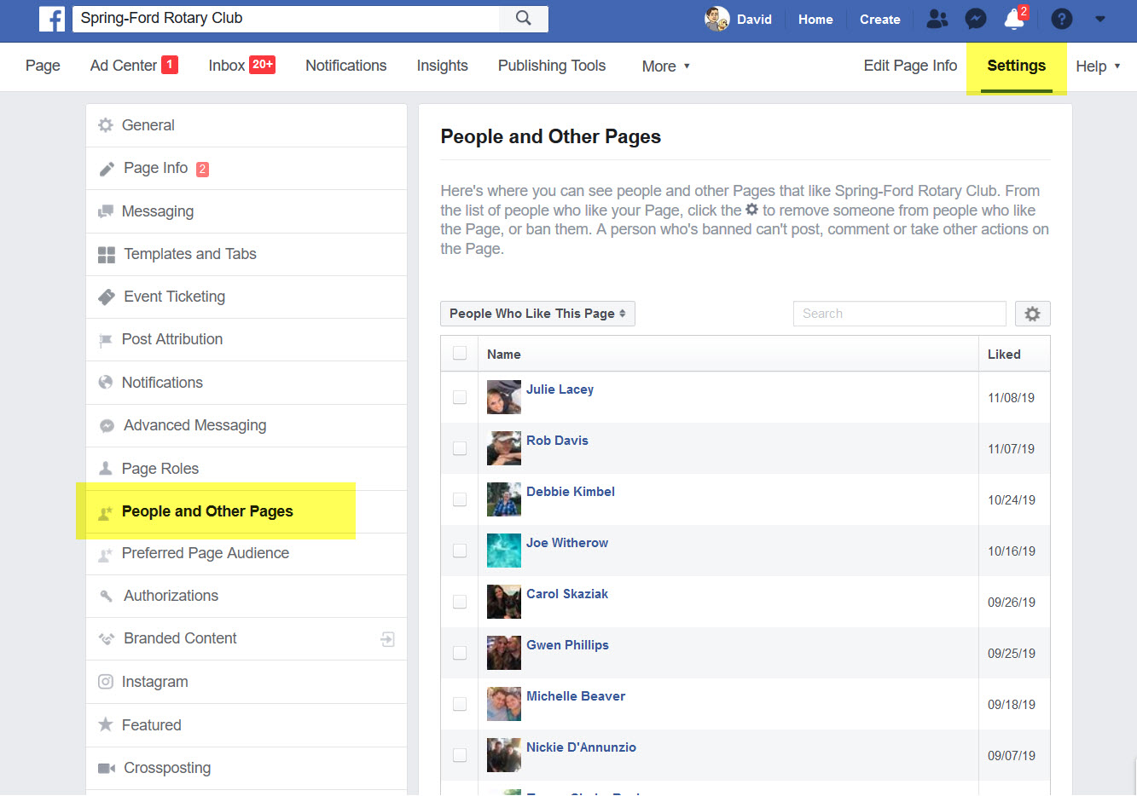
People and Other Pages

Slide 47
Events
Great way to promote your club events
Allows users to get information about your event without leaving your FB page
Users can mark their interest (Going, Maybe, Interested, Can’t Go)
Users can leave comments, post images, discuss event, ask questions Can provide link to ticket purchases
Key – Promote the event using FB Ads

Slide 48
Post Boosts
A boosted post is a post to your Page's timeline that you can apply money to in order to boost it to an audience of your choosing. This is the simplest way to advertise on Facebook.
Boosted posts differ from Facebook ads because they are not created in Ads Manager and don't have all of the same customization features.

Slide 49
Boosting a Post
Boosted posts are a great way to reach new people who are likely interested in your content but don't currently follow you on Facebook.

Slide 50
Boosting a Post
Features
Targeted: Boosted posts can be shown to the audience of your choosing. You can define a new audience based on things like location, interests and more.
Many placements: Placements on Facebook represent where your ad will appear. Boost posts can be shown on the Desktop News Feed, Mobile News Feed and Instagram.
Customizable budget: The amount you pay to boost your post is up to you. You can select a pre-populated budget or set a custom amount. Boosted posts require a minimum budget of $1 a day.
Scheduling: You'll set the amount of time you want your ad to run. You can choose from a custom duration (ex: 7 days) or set a custom end date.
Ad creative: The ad you create will look just like the Page post it's based on. The only difference is that your ad will appear with a Sponsored label in the top-left corner and will have a call-to-action button in the bottom-right corner if you choose to add one.
Access to insights: When you boost a post or create any ad from your Page, you'll be able to view your results and insights in the Ad Center tab.

Slide 51
Boosting a Post
Boosting A Post
Eligible posts will have a blue “Boost Post” button
Simply push button to start the process

Slide 52
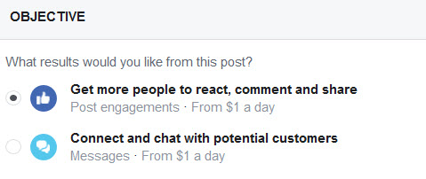
Boosting a Post
Objective
Get people to react, comment and share
Connect and chat with potential customers

Slide 53
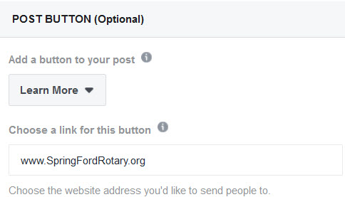
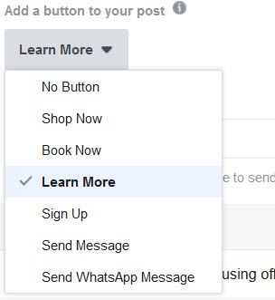
Boosting a Post
Post Button
This button will also appear on your original post on your Page. It can't be removed or changed after your post has been boosted.
Enter web address of where you want button to direct people to

Slide 54
Boosting a Post
Edit Audience
Detailed Targeting
Define your audience by including or excluding demographics, interests and behaviors.
Providing list and infographic for your reference

Slide 55
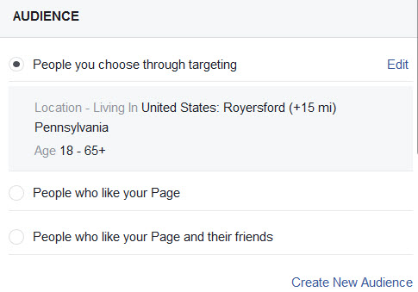
Boosting a Post
Audience
Allows you to select a broad or extremely defined audience of who will see your post
Select “Edit” to modify settings

Slide 56
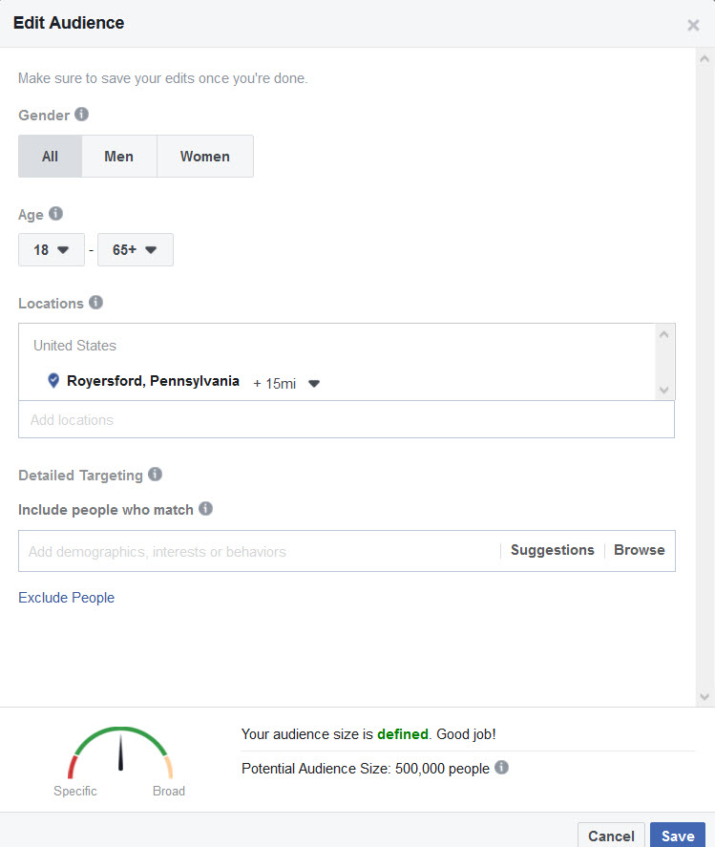
Boosting a Post
Edit Audience
Gender
Select Men, Women or All
Age
Select 13 – 65+

Slide 57
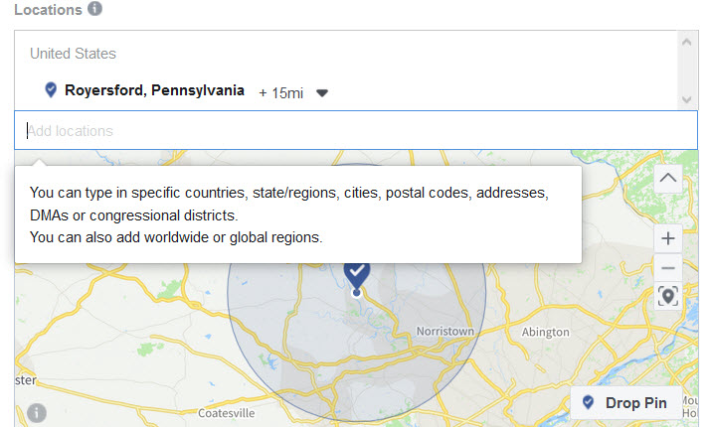
Boosting a Post
Edit Audience
Enter one or more global regions, countries, states/regions, cities, postal codes, addresses or Designated Market Areas ® to show or exclude your ad to people in those locations. Location targeting is not available in all countries

Slide 58
Boosting a Post
Edit Audience
Detailed Targeting
Define your audience by including or excluding demographics, interests and behaviors.
Providing list and infographic for your reference

Slide 59
Boosting a Post
Audience Size
Based on your criteria
Save the Audience

Slide 60
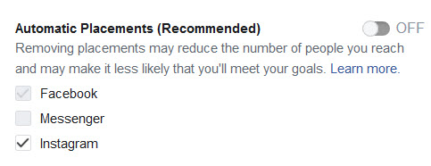
Boosting a Post
Automatic Placements
Defaults to “On”
If you turn off, your only option is to disable Instagram

Slide 61
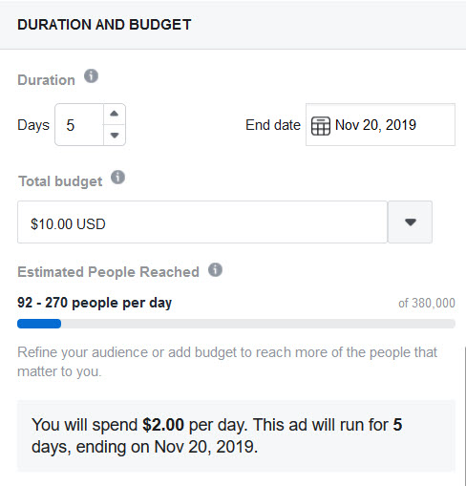
Boosting a Post
Duration and Budget
Choose how long you want your boost to run
# of Days
Specific End Date
Choose your total budget
The maximum you’ll spend
Choose from options or enter your own amount

Slide 62
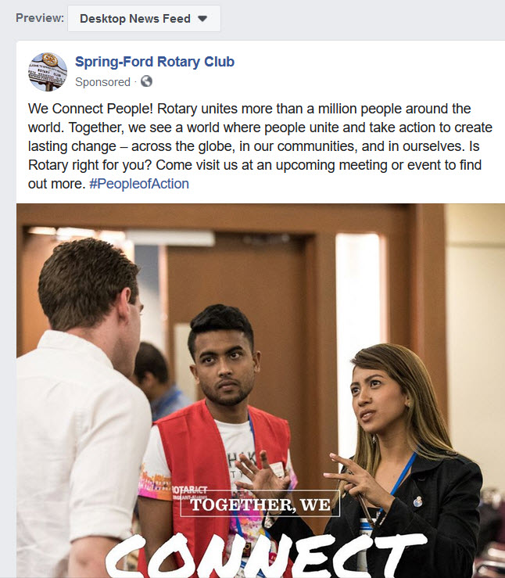
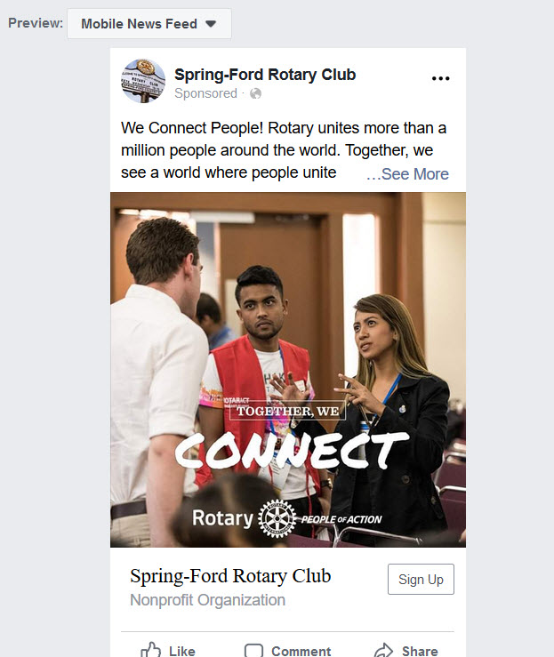
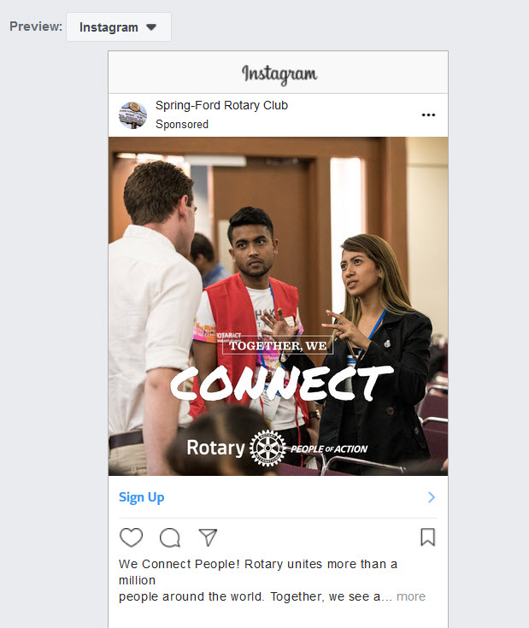
Boosting a Post
Preview
Shows you how your boosted post will show on Desktop News Feed, Mobile News Feed, Instagram.

Slide 63
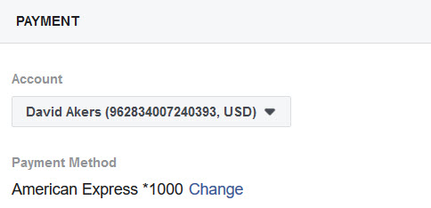
Boosting a Post
Payment
Select from an existing payment account, or if new, setup a payment account.

Slide 64
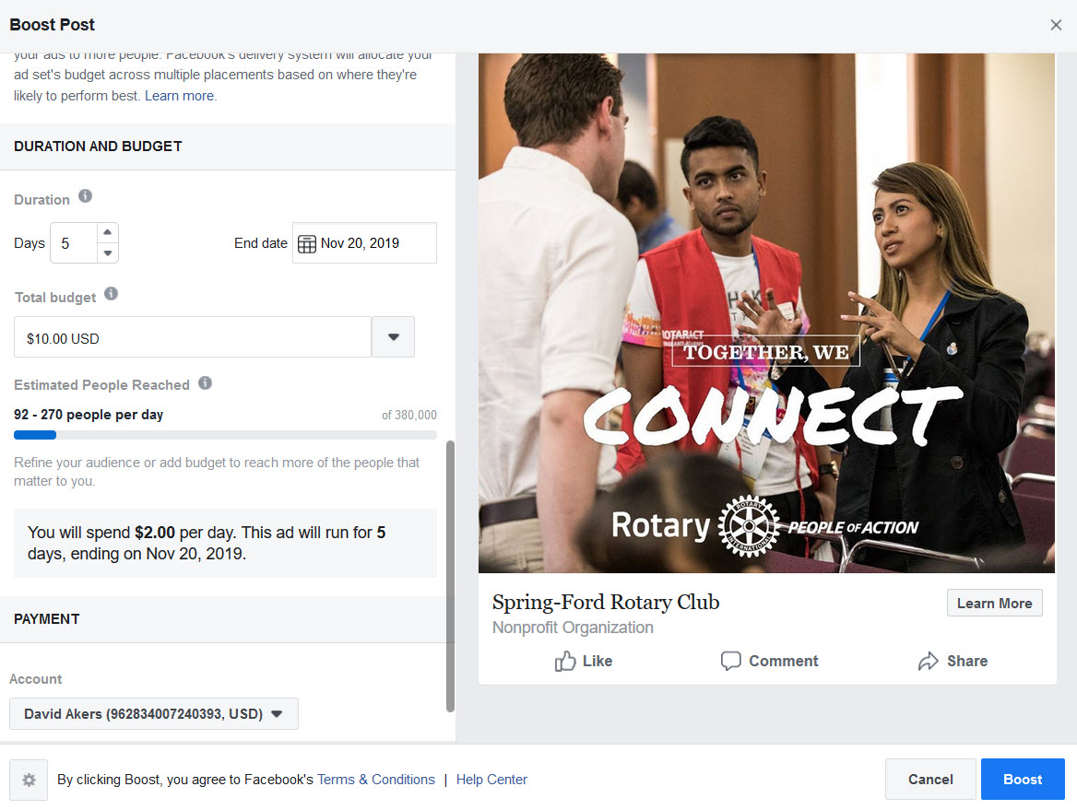
Boosting a Post
Boost
Once you’re happy with all settings, press the blue “Boost” button in bottom right corner

Slide 65
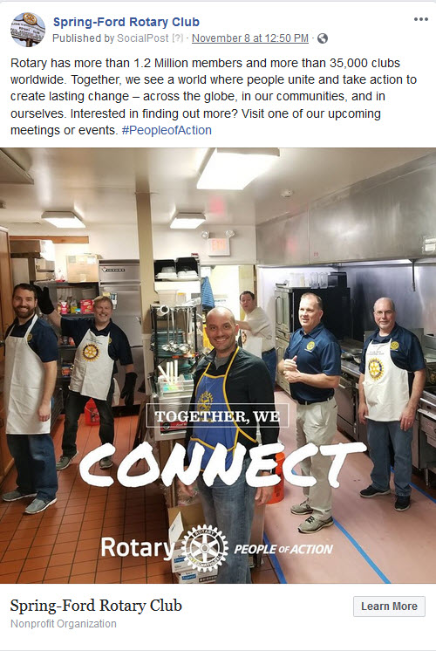
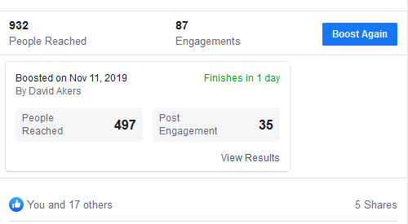
Boosting a Post
Proof is in the Pudding

Slide 66
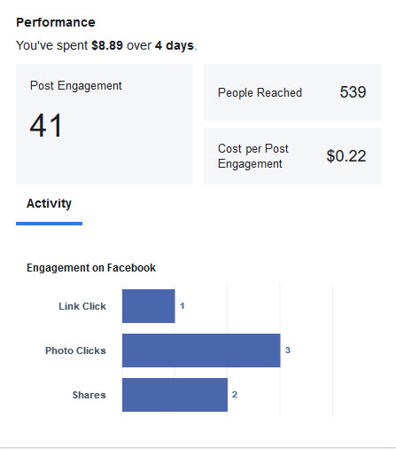
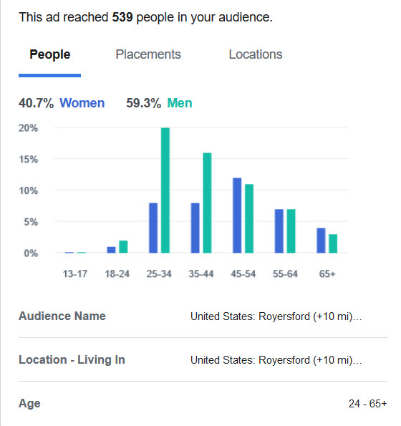
Boosting a Post
5-day boost
$25 budget

Slide 67
Facebook Ads
While boosting a post is still considered an ad, Facebook ads are created through Ads Manager and offer more advanced customization solutions.
There are many advertising objectives to help you reach your specific business goals and the audiences you care about most.
Ads are created in the Facebook Ads Manager

Slide 68
Facebook Ad Features
Choose different ad placements: When you boost a post, you'll be able to check or uncheck whether or not you want to place your ad in Instagram in addition to Facebook mobile and desktop News Feed. With Facebook ads, you get the added benefit of choosing placements in Facebook News Feed side ads, Messenger ads, Instagram stories, instant articles, and Audience Network.
Use specific ad objectives: Choosing an ad objective early on will help you to focus on which campaign type best aligns with your current business goals. Boosted posts allows you to focus on website clicks, Page engagement and local business promotions, but the full ads system in Ads Manager lets you choose objectives like store traffic, conversions, and lead generation. You can also create and manage ads through the Ads Manager mobile app.

Slide 69
Facebook Ad Features
Maintain creative control: With Facebook Ads created through Ads Manager, you can design an ad that fits your goals. Create carousel ads, add specific descriptions and add a call-to-action button that'll drive more of your audience to take action. These are only a few of the creative and formatting options available in Ads Manager that aren't available when boosting a post from your Page.
Use advance targeting capabilities: Boosting posts let you decide on interests, age and gender for your ad targeting. This helps you reach people who most likely care about your business. With Facebook ads, you can use more advanced tools to create overlapping audience types, lookalike audiences and more.

Slide 70
Facebook Ads Manager
The Ads manager is where you go to create and manage your campaigns. You can use the ads manager to:
Set up Facebook ad campaigns
Create new ad sets and ads
Manage Facebook ad bids
Target many different audiences
Optimize your ad campaigns
Keep track of your campaigns’ performance
A/B test your Facebook ad campaigns

Slide 71
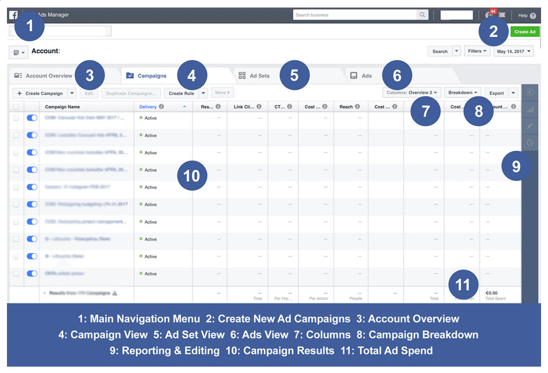

Slide 72
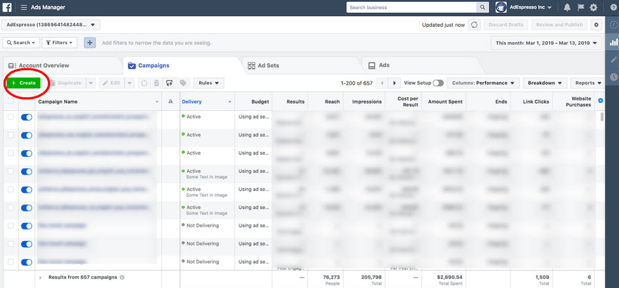
Creating a Campaign
In order to create a campaign, navigate to the “campaigns” tab. From there, click on the green “+Create” button.

Slide 73
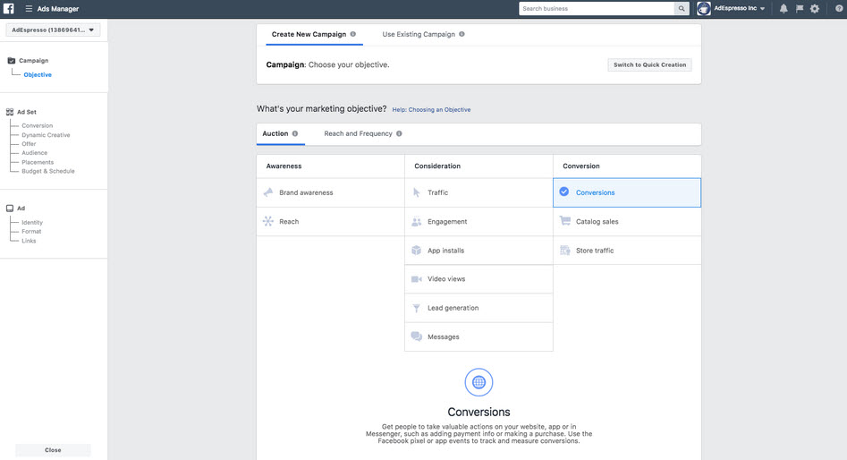
Creating a Campaign
Facebook’s platform does a good job guiding you through the creation.

Slide 74
Campaign Objectives
You can choose from a handful of campaign objectives that match your advertising goals. Facebook uses your selection to determine other elements of your campaign such as available ad formats, bidding options and the way it optimizes the campaign. Here’s the complete list of Facebook campaign objectives available:
Brand awareness
Local awareness
Reach
Traffic
Engagement
App installs
Video views
Lead generation
Conversions
Product catalog sales
Store traffic
Messages

Slide 75
Campaign Structure
Facebook’s campaign structure has three levels
A Facebook campaign can contain several Ad Sets and it has a unique campaign objective. Your campaign is basically just a container to help you better organize your advertising. The only attribute of the campaign is the objective you want to reach with it.
A Facebook ad set can include multiple ads and it has a unique audience targeting, budget, schedule, bidding, and placement. Ad sets are also the best units to use for Facebook A/B testing – remember to always place all the variations inside different ad sets.
The Facebook ad (basically what we’ve been creating so far in this guide), is the smallest unit of your campaign. Ads can have different URLs, ad image, and ad copy.

Slide 76
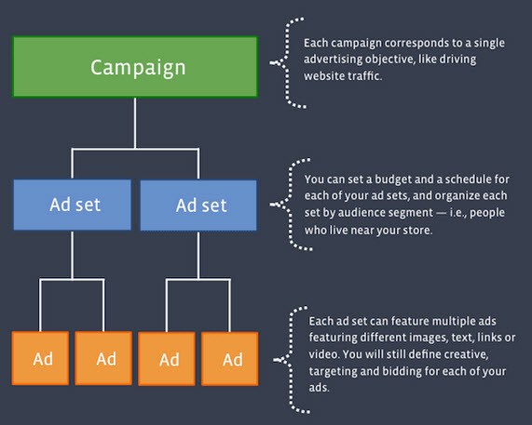
Campaign Structure

Slide 77
Creating a Campaign
Give your campaign a name
It is actually very important to adopt useful naming conventions for your campaigns when you start with Facebook advertising so you can easily organize your campaigns as you scale and run more of them. It also sets you up for hyper-efficient reporting later on when it comes time to analyze your results.

Slide 78
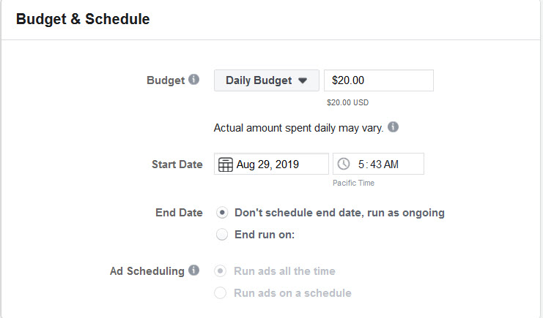
Budget & Schedule
Facebook gives you two budgeting options
1. Daily budget – Facebook will spend this sum on delivering your ads every day during your campaign. When you set your daily budget, you’re telling Facebook to get you roughly your daily budget’s worth of the results every day.

Slide 79
Budget & Schedule
Facebook gives you two budgeting options
2. Lifetime budget – Facebook will divide the total campaign budget more or less evenly across the campaign dates. If you set a lifetime budget, Facebook will ask you for the campaign dates, so that it can calculate the average spend for each day.

Slide 80
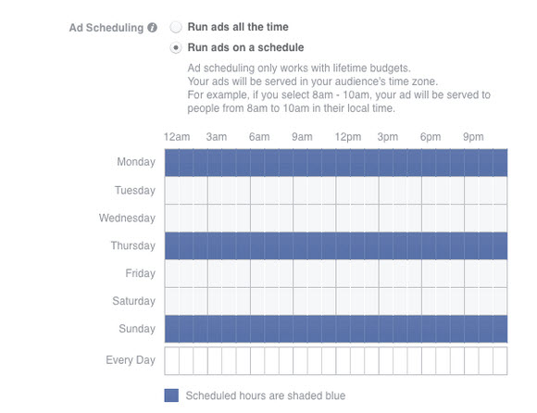
Budget & Schedule
If you select Lifetime Budget, Facebook gives you the ability to schedule when your ads run.

Slide 81
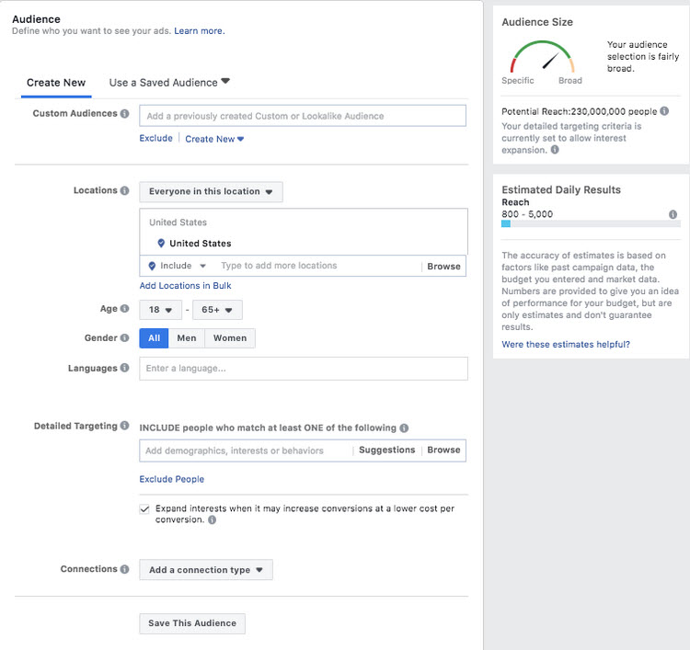
Choosing Your Audience
Look Familiar?
As you build your audience, Facebook will display your estimated daily reach and tell you if your audience is too big, too small or if it’s just right using the meter. You can target “likes” or interests on Facebook, behaviors or demographics, and create very specific audiences to target in your campaign.

Slide 82
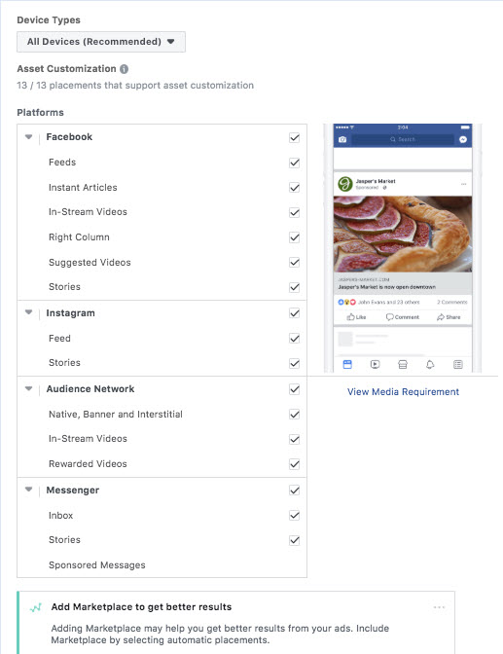
Ad Placement
By default, Facebook will have “Automatic Placements” selected which can include Facebook, Instagram and Audience Network, but generally will use the placements optimized to give you best results. You can also choose to edit your placements if you have some data on what placement works best for you.

Slide 83
Ad Placement
Here are the ad placements recommended by Facebook for every campaign objective:
Brand awareness: Facebook and Instagram
Engagement: Facebook and Instagram
Video views: Facebook, Instagram and Audience Network
App installs: Facebook, Instagram and Audience Network
Traffic (for website clicks and app engagement): Facebook and Audience Network
Product catalog sales: Facebook and Audience Network
Conversions: Facebook and Audience Network

Slide 84
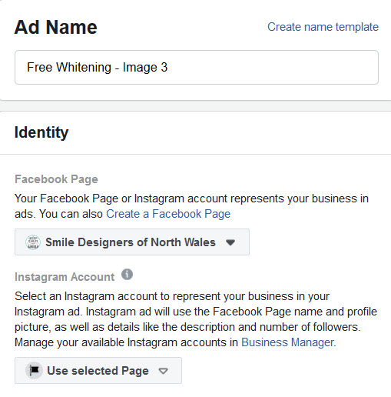
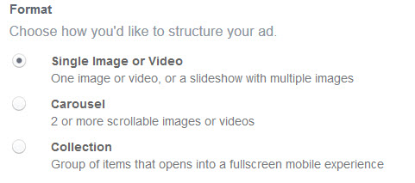
Creating Ads
Name each ad – unique to identify performance
Select Facebook Page
Select Format

Slide 85
Creating Ads
Imagery
Different placements (news feed, Instagram Stories, etc.) require different sized images.
To get the latest information, utilize Facebook’s Ad Guide
https://business.facebook.com/business/ads-guide

Slide 86
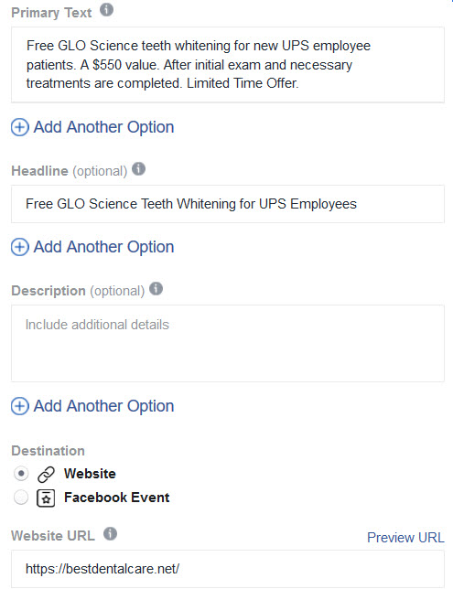
Creating Ads
Primary Text
This is the primary text for your ad that will appear in most placements. Keep it to 125 characters or less. The position of this text varies by placement.
Headline (Optional)
The headline will appear in most placements, but its position will vary by placement. Headlines over 40 characters may be cut off.

Slide 87
Creating Ads
Description (Optional)
The description will show in your ad if it's likely to resonate with the person seeing it. It will only appear in some placements, and its position will vary.
Destination
Enter the URL for the web page you want people to visit.

Slide 88
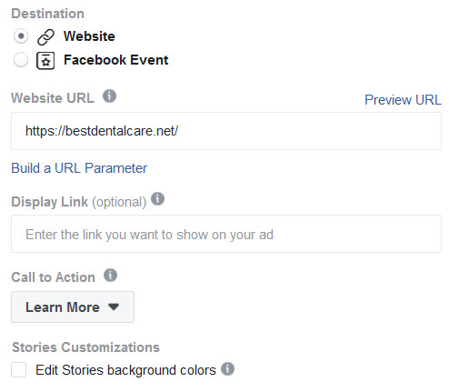
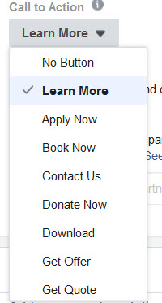
Creating Ads
Display Link (Optional)
The description will show in your ad if it's likely to resonate with the person seeing it. It will only appear in some placements, and its position will vary.
Call to Action
Show a button or link on your ad that represents the action you want people to take.

Slide 89
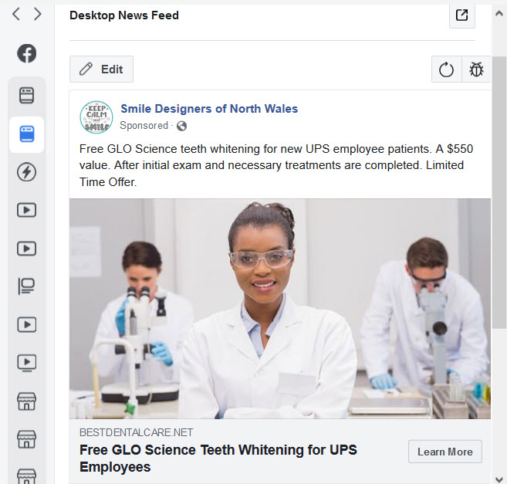
Creating Ads
Placement Edits
Allows you to make edits to variations based on placement.
Mobile News Feed
Desktop News Feed
Messenger
Instagram
Many more

Slide 90
Creating Ads
Publish
Once your Campaign, Ad Set and Ads are ready, press the green “Publish” button.
Ads will be reviewed by Facebook to ensure they meet advertising guidelines and standards.
You’ll be notified once they are approved or denied.

Slide 91
Building Your Fan Base
Great Content
Great Imagery
The Human Factor
Consistent Posting
Respond Quickly to Comments and Messages

Slide 92
Building Your Fan Base
Post Boosts
Facebook Ads – Develop a small marketing budget
Ask friends to like your club’s page
The Social Factor – Get Club Members to Like, Comment and Share

Slide 93
Questions?

