Slide 1


Slide 2

Youth Protection in Rotary Youth Programs
Ron Smith, PDG Sharon Rittenhouse
Youth Protection Officer (Blue Bell) District Administrator (W. Reading Wyomissing)
Darlene Scott Janet Kolepp
Youth Service Chair (Upper Perkiomen) District Governor (Bethlehem MS)

Slide 3

The Why…

Slide 4

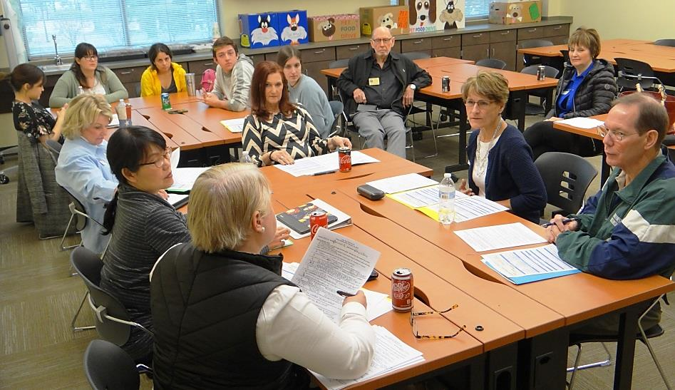
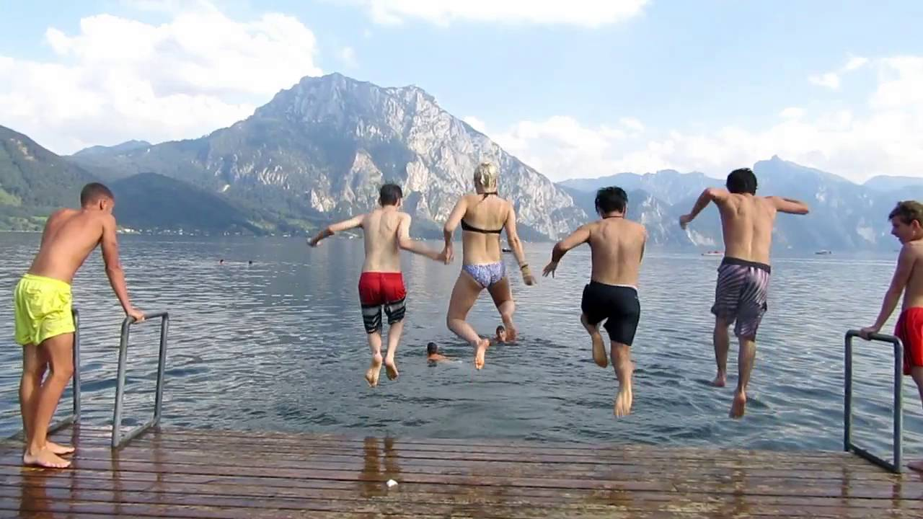
Our Promise
Our Students Our Committees Safety
“Rotary International strives to create and maintain a safe environment for all youth who participate in Rotary activities. To the best of their ability, Rotarians, Rotarians’ spouses, and partners, and other volunteers must safeguard the children and young people they come into contact with and protect them from physical, sexual, and emotional abuse.”
Rotary Code of Policies – Article 2.120

Slide 5
Statement of Conduct for Working with Youth
Rotary District 7430 is committed to creating and maintaining the safest possible environment for all participants in Rotary activities. It is the duty of all Rotarians, Rotarians’ spouses, partners, and any other volunteers to safeguard to the best of their ability the welfare of and to prevent the physical, sexual, or emotional abuse of children and young people with whom they come into contact.
In order to maintain Youth Programs, each Rotary Club must adopt the D-7430 student protection policies and procedures and implement them…

Slide 6
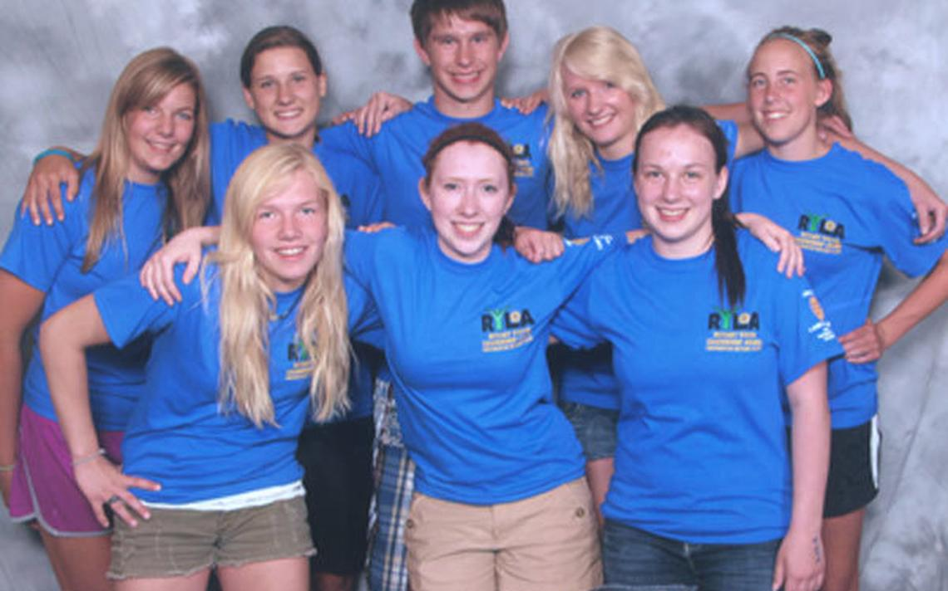
The What…

Slide 7
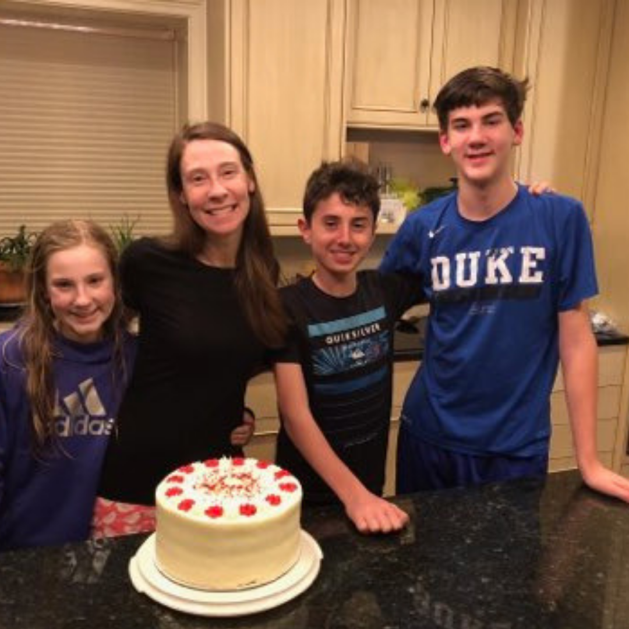
Key Elements for Youth Protection
A Written Policy
A District Youth Protection Officer
  Training
  Enforcement
  Support & Counsel
  Training
Systems for meeting legal & policy requirements…
  Participant & Volunteer Training
  Tracking Background Checks and Reference
  Reporting on Volunteer status
  Reporting of incidents
Club & Support System
  Club Youth Officers training in YP Policies and Procedures
  Counselors / Emergency contacts

Slide 8
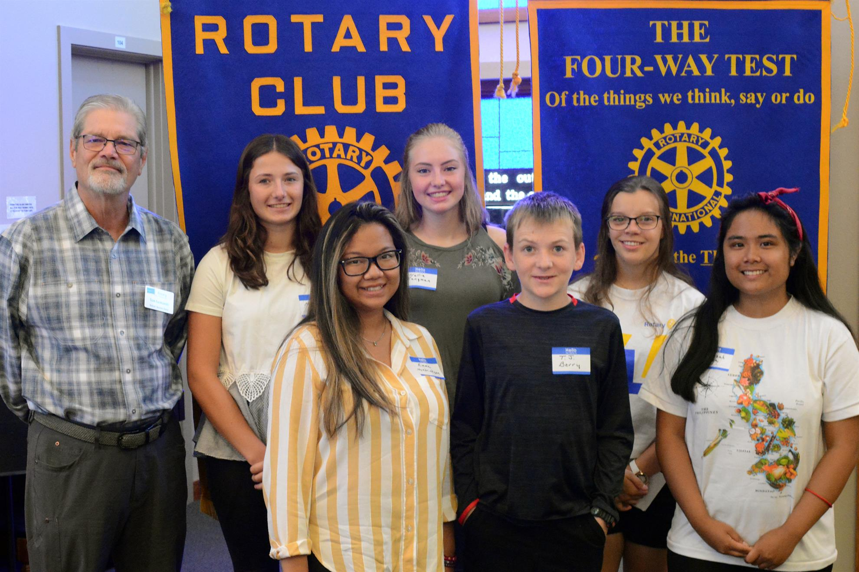
D-7430 Youth Protection Policy
Statement of Conduct for Working with Youth
Definitions
Volunteer / Youth/ Sexual abuse / Sexual harassment
Volunteer Application Process
Youth Protection Training
Core Elements of Youth Protection
Reporting
Other Responsibilities
Club Compliance

Slide 9
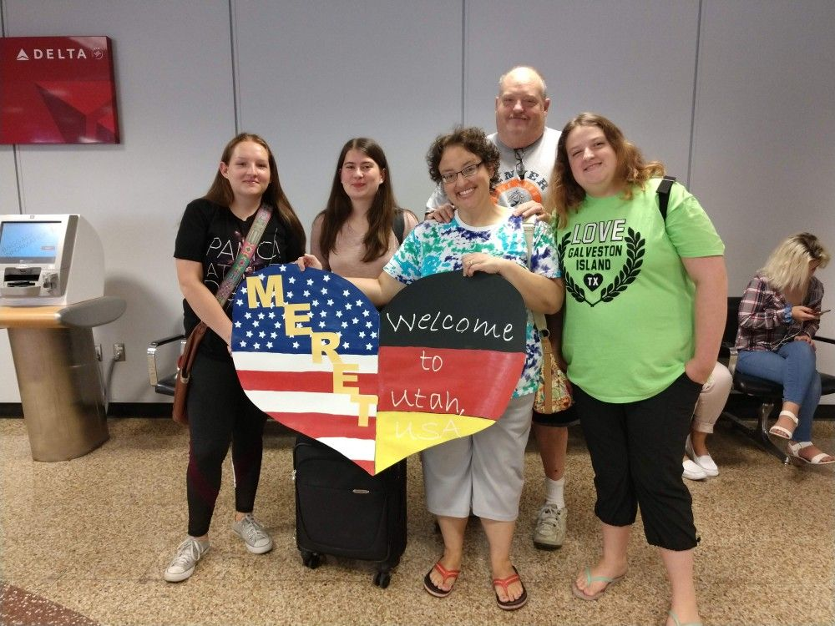
Core Elements of Youth Protection
Two-deep leadership
  Two Rotarian adult leaders/volunteers or one Rotarian volunteer, a teacher or a parent-both of whom are 21 years of age or older-are required on all trips and outings. If the activity is co-educational, leaders of both sexes must be present. The participating organization is responsible for ensuring that sufficient leadership is provided for all activities.

Slide 10
Core Elements of Youth Protection
No One-on-one contact between adults and participants …
except for two very specific circumstances, (with some exceptions Rotary Youth-Exchange program):
  1. When the adult are host family members…
  And / or
  2. When the adult is a volunteer participant in the Rotary Youth Exchange program…

Slide 11

Core Elements of Youth Protection
Respect of privacy. Adult leaders must respect the privacy of participants in situations such as changing into swimsuits or taking showers at activities and intrude only to the extent that health and safety require. They must also protect their own privacy in similar situations.
Separate accommodations. When attending overnight events, no youth is permitted to share a room with an adult other than their parents or guardians.
Proper preparation for high-adventure activities. Activities with elements of risk should never be undertaken without proper preparation, equipment, supervision, and safety measures.
No secret organizations. There are no secret organizations recognized in Rotary. All aspects of Rotarian programs are open to observation by parents and leaders.

Slide 12
Core Elements of Youth Protection
Constructive discipline. Discipline should be constructive and reflect the program’s underlying values.
Corporal punishment is never permitted.
Hazing is prohibited. Physical hazing and initiations are prohibited and may not be included as part of any Rotary activity.
Youth leader training and supervision. Adult leaders must monitor and guide the leadership techniques used by youth leaders, e.g. Rotex…

Slide 13
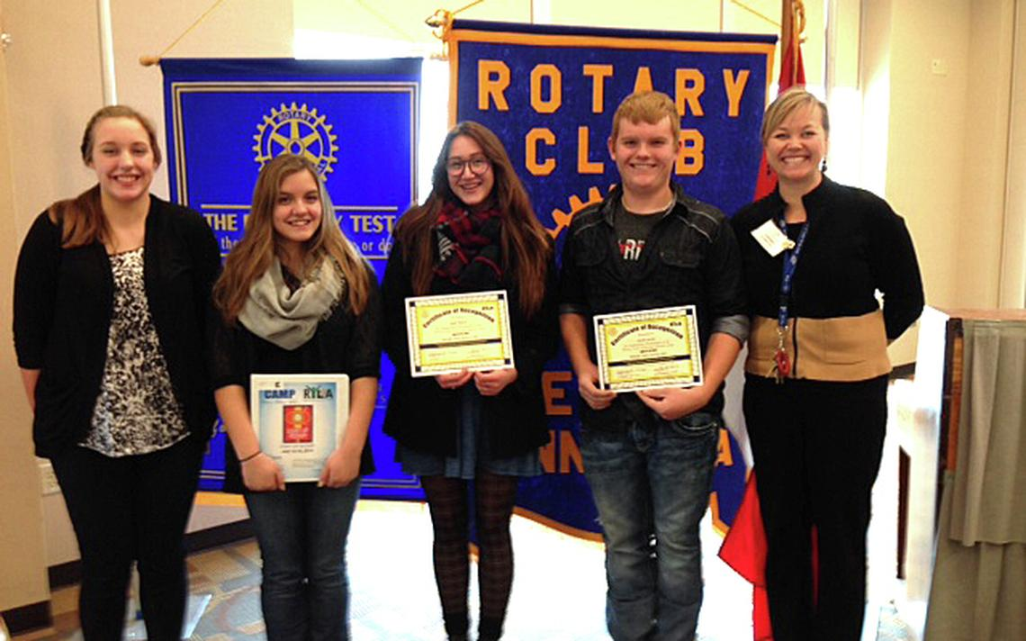
The How…

Slide 14

District Youth Protection Officer…
Develop/Maintains Policies & Procedures
Supports Students & Clubs
Provides for Training
  Students & Families
  Clubs
  District Volunteers
Communicates with …
  Families & Clubs
  District Leaders
  RI as directed
Report Incidents
  Maintains “tight chain of communications”
  Collaborates with Counselors / Emergency contacts
  Reports Authorities and RI
  Arranges Referrals as needed

Slide 15

District Youth Protection Administrator
Implements Processes
Supports Clubs
  Volunteer Registration & Approval
  Training
Maintains records
Tracks Compliance
Communicates with YPO / District Leaders
Assists in Reporting Incidents

Slide 16
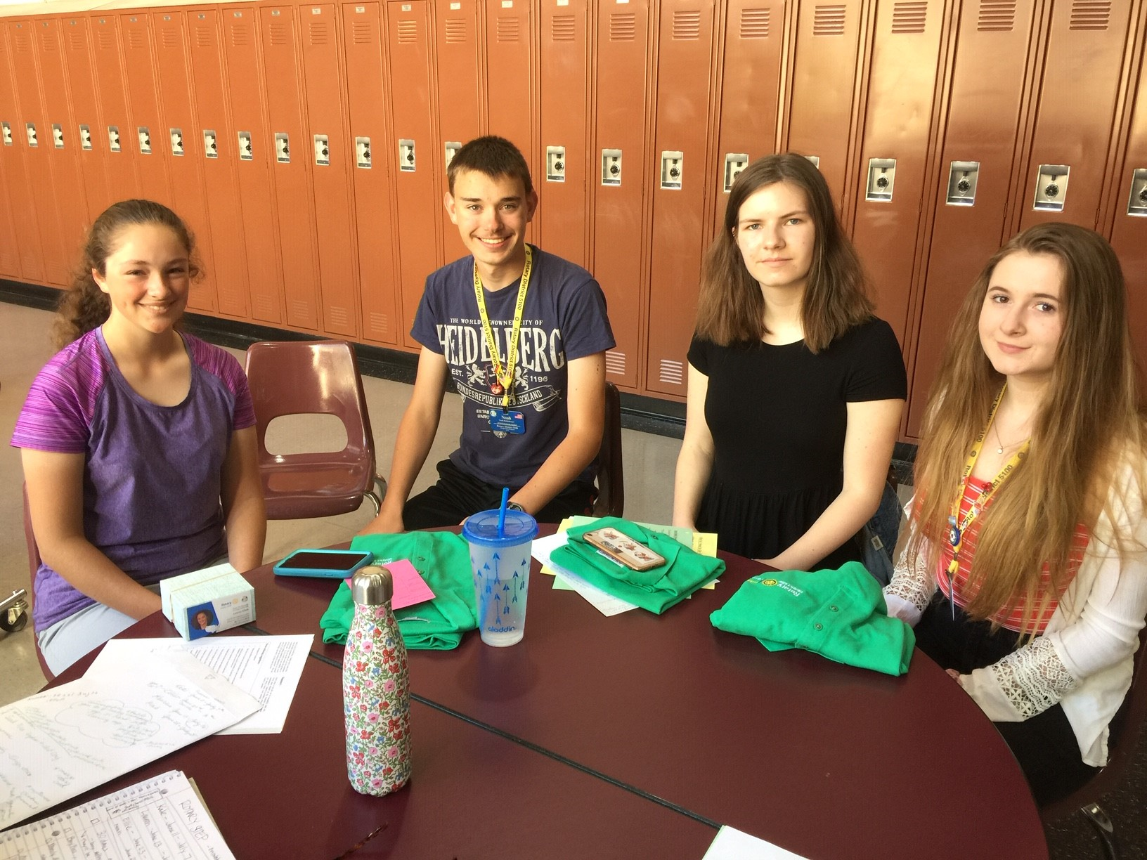
Club Youth Service Chair…
Understands policies and procedures,
procedures for reporting, investigating, and proper
handling of non-criminal offenses or historic cases that
law enforcement will not investigate.
Ensures Club Volunteers have completed all requirements…
Ensures that club volunteers are trained in responding to any problems or concerns that may arise during the exchange, including the prevention of physical, sexual, and emotional abuse or harassment.
Works with District to retain required student documentation.
Ensures each student get a list of local services / emergency contacts.

Slide 17

Reporting Incidents
If You receive a report of abuse or harassment…
Key words from Student to act on…
… I don’t feel safe or I don’t feel comfortable…
… I have been abused / harassed / hurt
Listen attentively and stay calm. Acknowledge that it takes a lot of courage to report abuse. It is appropriate to listen and be encouraging. Do not express shock, horror, or disbelief.
Assure privacy but not confidentiality. Explain that you will have to tell someone about the abuse/harassment to make it stop and to ensure that it doesn’t happen to others.
Get the facts, but don’t interrogate. Ask questions that establish what was done and who did it. Reassure the young person that he or she did the right thing in telling you. Avoid asking “why” questions. Remember your responsibility is to present the story to the proper authorities.

Slide 18
Reporting…
Be non-judgmental and reassure the youth
participant.
Record. Keep a written record of the conversation
Contact youth protection officers and contact legal authorities when abuse is alleged.
Communicate to students / families / District leaders
Report to Rotary contact(s).
Inform your Rotary contact —
District Youth Programs Chair
District YEP Chair (if applicable)
District Governor — who then will then contact and
File an Incident Report RI within 24 / 72 hours.
(from District Administrator)

Slide 19
Youth Service Volunteer
The Process for
Youth Protection Compliance

Slide 20




1. Identify the Volunteer
Club Youth Service Chair
Other Rotary Club Youth Activities

Slide 21
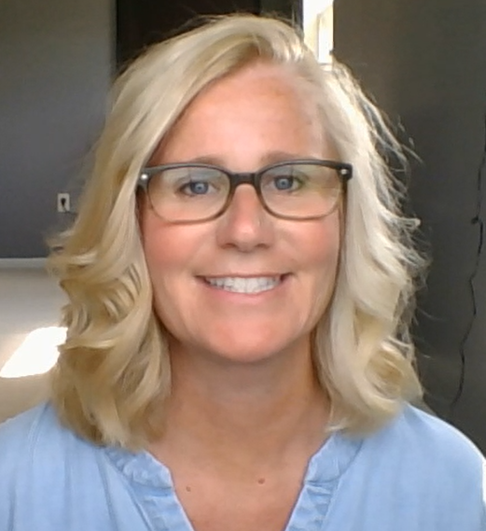
2. Contact District Administrator
Email Sharon Rittenhouse
rittenhousesharon@gmail.com
Provide the following:
Volunteer Name
Email Address
Role the volunteer will be serving
Detailed email will be sent to volunteer on how to complete the process.

Slide 22
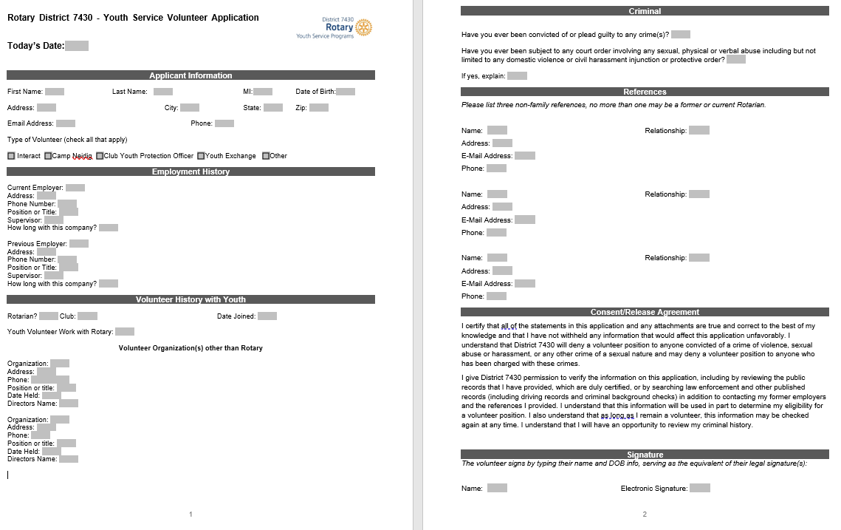
3. Complete Volunteer Application
Application will be completed once every 3 years
Youth Exchange Volunteers will only need to complete
the ESSEX
volunteer application

Slide 23

4. Complete Background Checks
Required Pennsylvania Clearances-
Completed every 5 years
PA Criminal State Check
PA Child Abuse Clearance
PA Swear and Affirm Disclosure Statement
NOTE: if you have not resided in PA for the last 10 years
You must obtain FBI Digital Fingerprinting
If you have this done already, please provide copies to District
ESSEX/One Source Background Check- Completed Annually
This Photo by Unknown Author is licensed under CC BY-SA

Slide 24
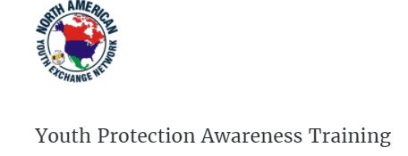
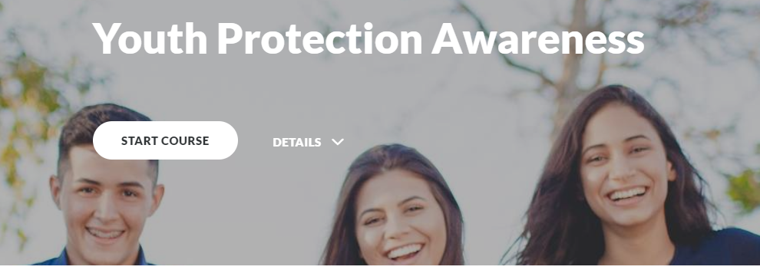
5. Youth Protection Awareness Training
Completed online
Evaluation when completed for certification
To be completed every three years

Slide 25

5. Complete Club Compliance Agreement
Once the volunteer has completed the Youth Service Volunteer process, Club President and the Youth Service Chair or Club Youth Volunteer must sign and return The Youth Protection Compliance Agreement and all necessary documents to District Administrator.
Form must be completed annually.

Slide 26
Youth Protection Resources
RI Student Protection Guide (775-EN—(816))
https://my.rotary.org/en/document/rotary-youth-protection-guide
District Website
www.rotarydistrict7430.0rg
District Youth Protection Officer Youth Protection Administrator
Ron Smith Sharon Rittenhouse
rsmith.rotary@gmail.com rittenhousesharon@gmail.com
(215)-896-6870 (484) 671-2122
Jane Kolepp Darlene Scott
District Governor Youth Services Chair
rotaryconnects@gmail.com 7430yechair@gmail.com

Slide 27
Our Promise
Our Students Our Committees Safety
Your Time and Dedication enables a safe, nurturing environment for our Rotary engaged Youth …
THANK YOU !!

Slide 28
Our Promise
Our Students Our Committees Safety
? QUESTIONS ?

Slide 29
You are now ready to serve!
Club Youth Service Chair

