Slide 1

Four Way Test Speech Contest
2025-2026
Type your Rotary club name here
Title Page Option

Slide 2
subhead
What is Rotary?
Notes:
Rotary is a worldwide organization of more than 1.2 million business, professional, and community leaders. Members of Rotary clubs, known as Rotarians, provide humanitarian service, encourage high ethical standards in all vocations, and help build goodwill and peace in the world.
There are 35,000 Rotary clubs in more than 200 countries and geographical areas. There are also over 21,000 Interact Clubs. Clubs are nonpolitical, nonreligious, and open to all cultures, races, and creeds. As signified by the motto Service Above Self, Rotary’s main objective is service — in the community, in the workplace, and throughout the world.

Slide 3
subhead
What does Rotary do?
Notes:
Rotary club membership represents a cross-section of the community's business and professional men and women. The world's Rotary clubs meet weekly and are nonpolitical, non-religious, and open to all cultures, races, and creeds.
The main objective of Rotary is service - in the community, in the workplace, and throughout the world. Rotary also supports programs for youth, educational opportunities and international exchanges for students, teachers, and other professionals, and vocational and career development.
The Rotary motto is Service Above Self.

Slide 4
subhead
The Four Way Test Speech Contest
Notes:
The Speech Contest is a District-wide program that is held on local (club), regional and District levels.

Slide 5
subhead
What is the Four Way Test?
Notes:
From the earliest days of the organization, Rotarians were concerned with promoting high ethical standards in their professional lives. One of the world’s most widely printed and quoted statements of business ethics is The Four-Way Test, which was created in 1932 by Rotarian Herbert J. Taylor (who later served as RI president) when he was asked to take charge of a company that was facing bankruptcy.
This 24-word test for employees to follow in their business and professional lives became the guide for sales, production, advertising, and all relations with dealers and customers, and the survival of the company is credited to this simple philosophy. Adopted by Rotary in 1943, The Four-Way Test has been translated into more than a hundred languages and published in thousands of ways. It asks the following four questions:
“Of the things we think, say or do:
Is it the TRUTH?
Is it FAIR to all concerned?
Will it build GOODWILL and BETTER FRIENDSHIPS?
Will it be BENEFICIAL to all concerned?”

Slide 6
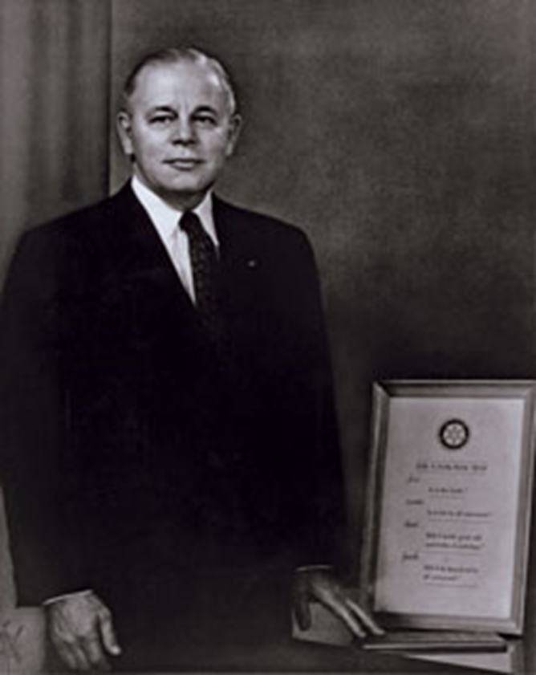
Herb taylor
Creator of the Four Way Test
Notes:
Herb Taylor, creator of The Four Way Test.

Slide 7
subhead
The Four Way Test:
Of the things we think, say or do
Is it the TRUTH?
Is it FAIR to all concerned?
Will it build GOODWILL and
BETTER FRIENDSHIPS?
Will it be BENEFICIAL to all concerned?
Notes:
The 4-Way Test

Slide 8
subhead
The Contest
Notes:
Students are asked to create and deliver a 5 to 7 minute speech on a subject of their choice, applying the tenets of the Four Way Test to guide their thinking and behavior regarding their chosen subject.
Club contest winners advance to Regional Contests. There are three Regional Contests . The three Regional Contest winners advance to the finals at the District Conference.

Slide 9
subhead
The Contest Rules
Notes:
RULES
Length of Speech
Speeches must be between 5 and 7 minutes in length. Penalty points will be subtracted for time infractions over or under the minimum or maximum.
Props
No props are to be used. Audience participation will be considered a prop. Penalty points will be subtracted for use of props at the rate of one point per infraction.
Speaker Aids
Lecterns and microphones are available for speakers at most clubs.
Notes
Contestants may use notes at the club level contest, one 3X5 card at the regional level contest. No notes are permitted at the District level contest.
High school students in Grades 9 through 12 are eligible to enter the contest. No student may be a contestant in more than one local club speech contest in any one year.
The champion of the Final District competition is ineligible to compete in subsequent years.
.

Slide 10
subhead
What should my speech be about?
Notes:
The subject of the speech is up to each student. The subject should be an issue that the student has dealt with or matter of special interest to her.

Slide 11
subhead
Who are the judges and what do they judge?
Notes:
Each contest has three judges. Judges can be Rotarians or members of the community who have been made familiar with the principles of Rotary and The Four Way Test.
Student speeches are judged based on the Content, Organization and Delivery of the speech. (A copy of the judges’ score sheet is on the next slide – and in the Contest Manual.)

Slide 12
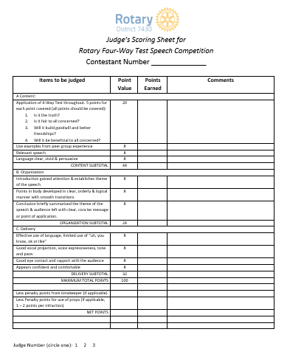
subhead
Notes:
Each contest has three judges. Judges can be Rotarians or members of the community who have been made familiar with the principles of Rotary and The Four Way Test.
Student speeches are judged based on the Content, Organization and Delivery of the speech. (A copy of the judges’ score sheet is on the next slide – and in the Contest Manual.)

Slide 13
subhead
What’s in it for you?
Notes:
Use the next three slides to discuss the prize monies available.
Also mention that public speaking is an important skill to practice and master.

Slide 14
subhead
$
$
$
$
$
$
$
$
$
$
$
$

Slide 15
Club level prizes
  First place - ???
  Second place - ????
  Third place - ?????
Prizes
Club level prizes
Notes:
Fill in the club awards and/or recognitions here.

Slide 16
Regional level prizes
  First place - $300
  Second place - $200
  Third place - $100
Prizes
Regional level prizes

Slide 17
District level prizes
  First place - $1,000
  First runner up - $500
  Second runner up - $350
  Third runner up - $250
Prizes
District level prizes
Notes:
.

Slide 18
Contest Dates
  Club Level – through March 5, 2026
  <Enter your club contest date here>
  Regional contests
    March 7, 2026
    Location TBD
  District finals
    March 28, 2026
    DeSales University
Contest dates

Slide 19
subhead
A sample speech
District 7430 2025 Champion, Julia:
Rotary District 7430 Four-Way Test Speech Contest Finals 2025 // Julia - First Place
Notes:
Show a video of a sample speech. (if available)

Slide 20
QUESTIONS

Slide 21
Four Way Test Speech Contest
2025-2026
Type your Rotary club name here
Title Page Option

