Slide 1
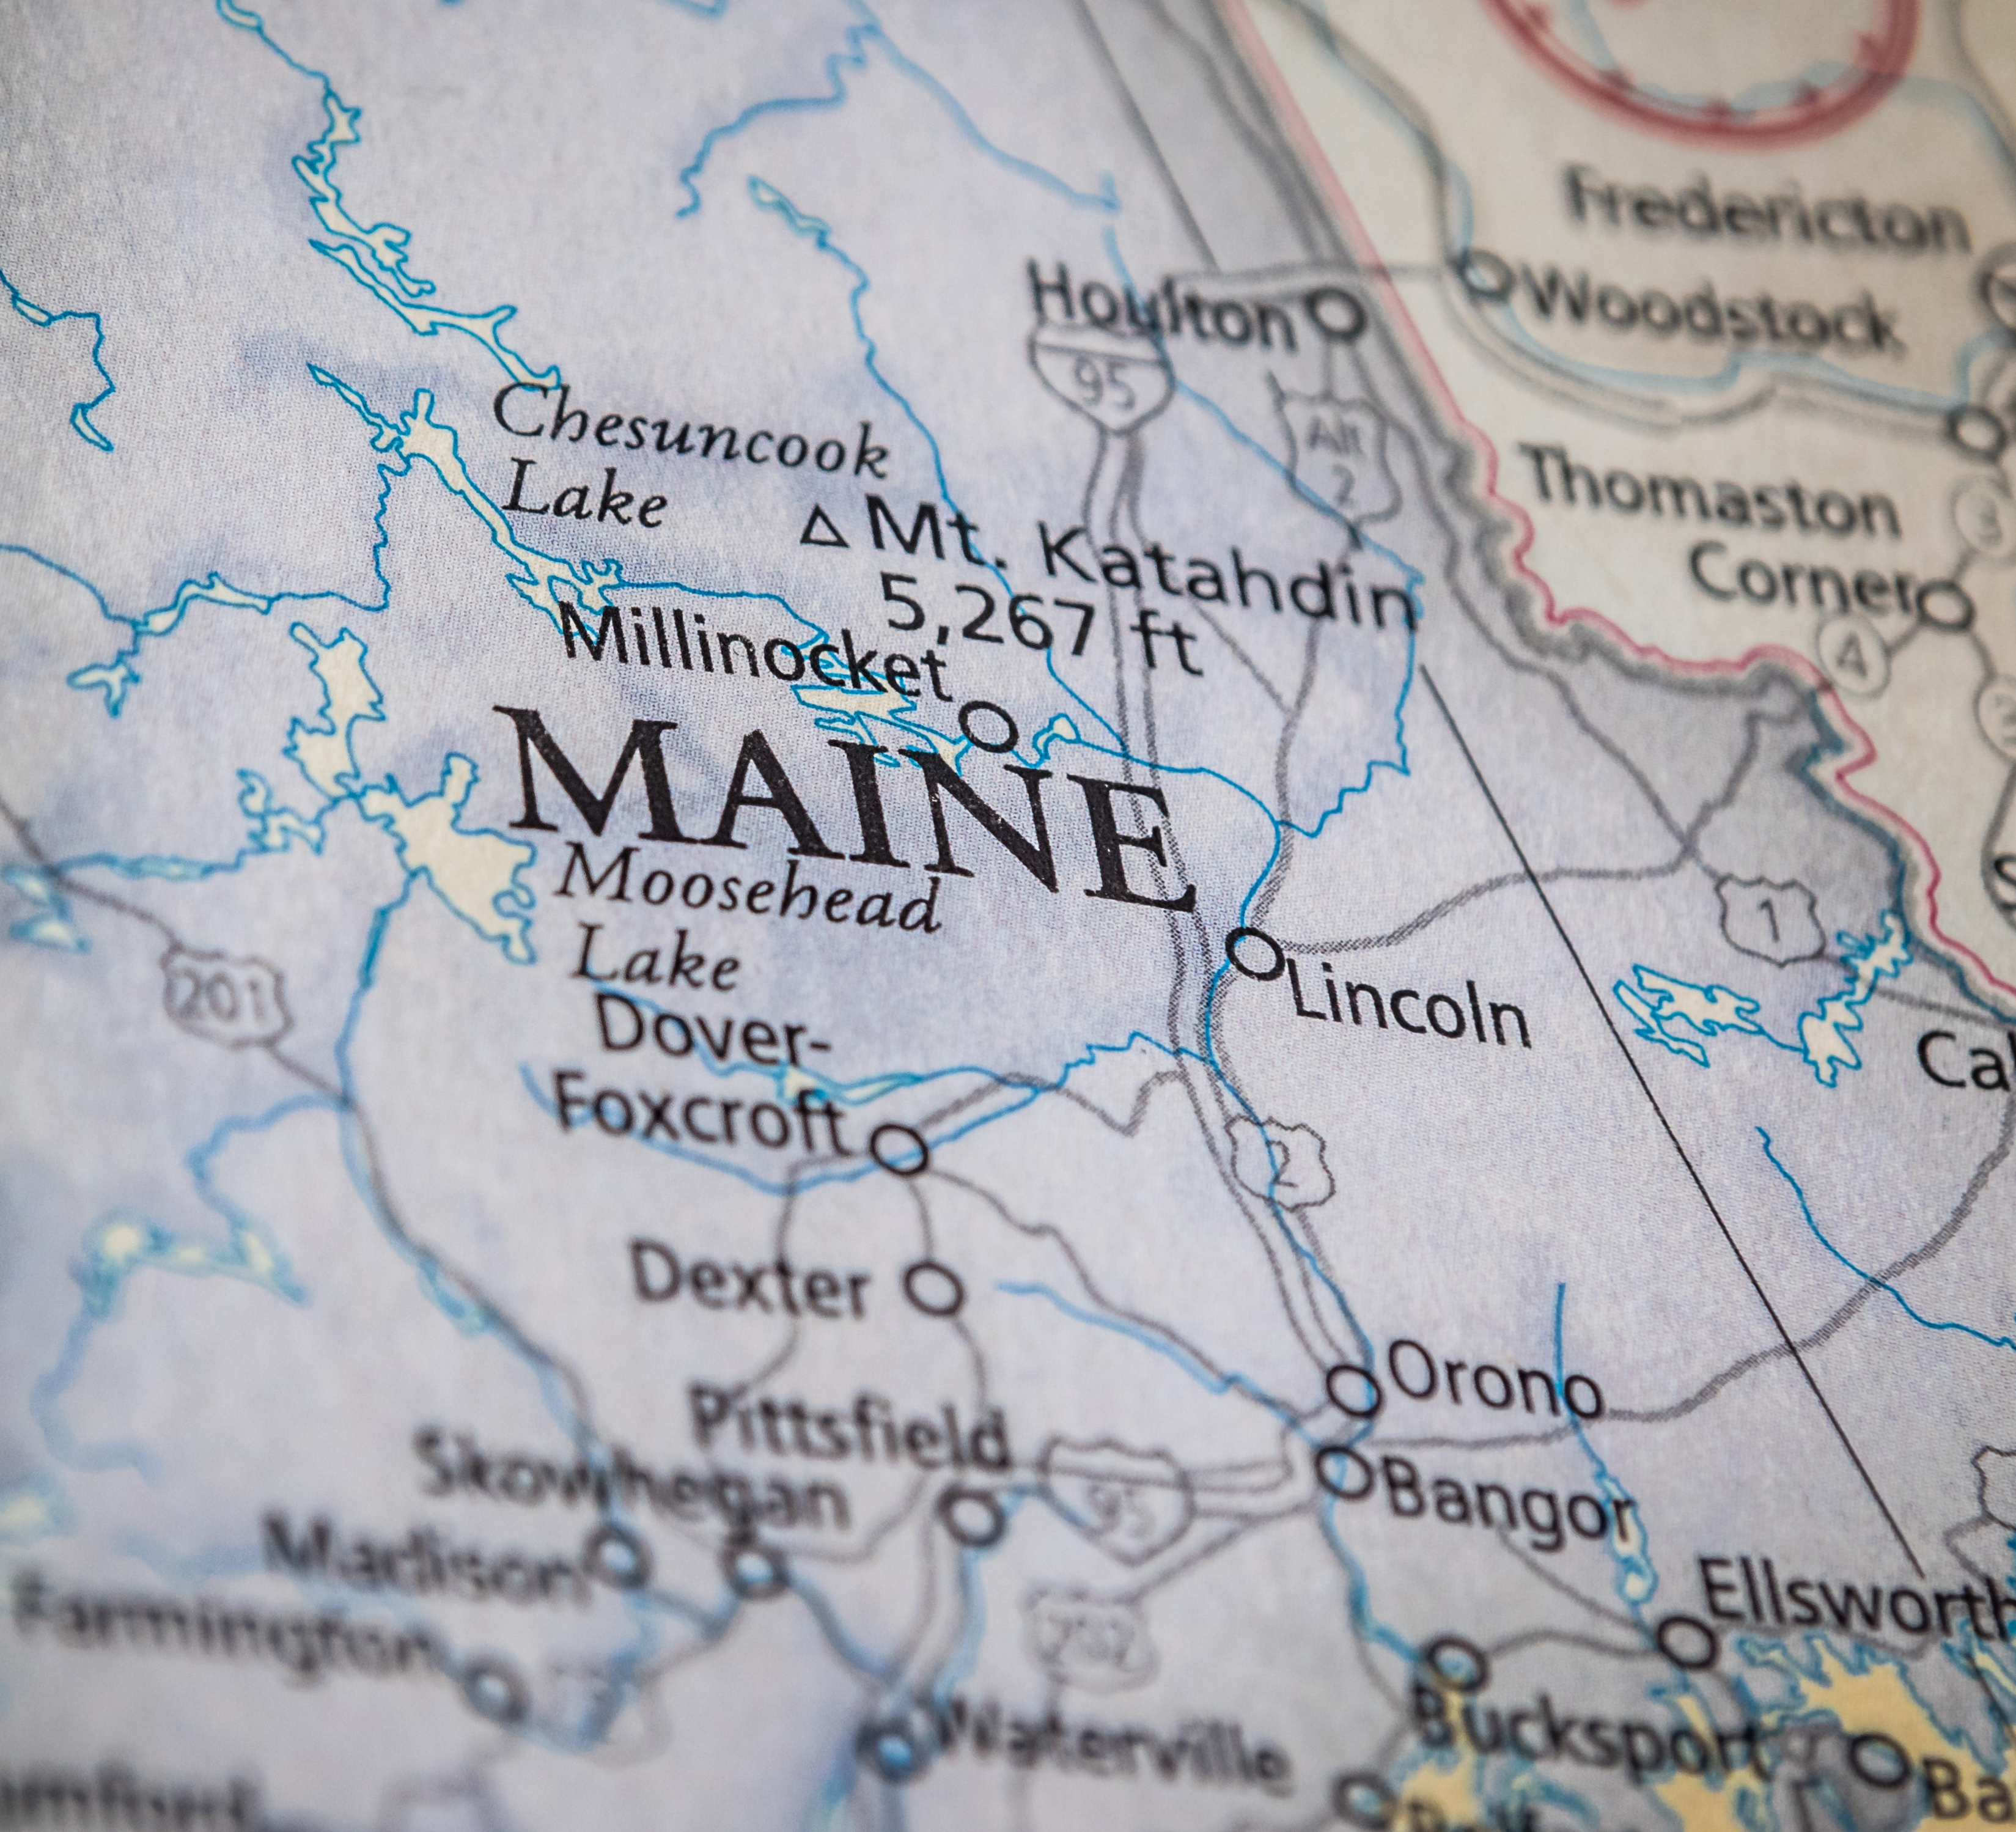
Rotary Indigenous Partnership Committee
HOULTON Band of MALISEET Indians
Medicine Wheel Healing GARDEN

Slide 2
“Native American Indians used plants for food, shelter, medicine, ceremonies and clothing”.
Maliseet Project Committee
Rich Campbell – Portland
Chris Hamilton – Damariscotta – Newcastle
George Klauber – Bridgeton lakes region
Brenda pollock – Biddeford-saco
Susan Young – Houlton band of maliseets

Slide 3
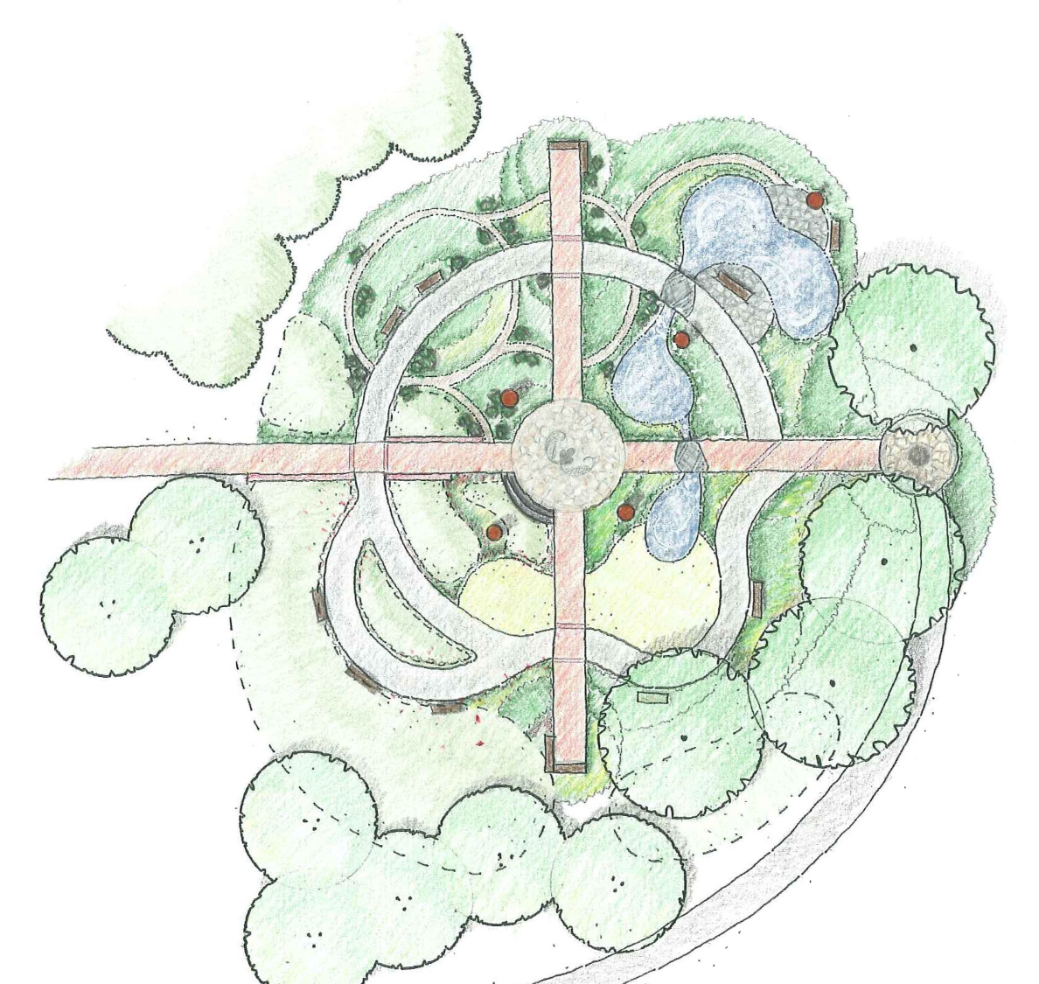
The Houlton band of Maliseet Indian’s Medicine Wheel Healing Garden Project
Committee Project Focus
Today, Native Americans frequently combine traditional healing practices with allopathic medicine to promote health and wellbeing. Ceremony, native herbal remedies, and allopathic medications are used side by side.

Slide 4
Project Timeline
Winter 2022
Hire CA to meet on site with HBMI & Rotary team to review and confirm project elements.
Identify partners.
Band with Biddeford-Saco Rotary Club.
Begin fundraising efforts.
Spring 2022
Rotary team and allies meet with Maliseet Community and local partners.
Complete schematic design and desired changes to existing plan.
Finalize surface materials, site furnishings, lighting cost improvements.
Official groundbreaking.
Summer 2022
Phase one of project.
Site demolition, removal plan, layout design, grading and drainage improvements, utilities and lighting plans.
CA will develop a more detailed schematic site plan and possibly with 3D representations.
Fall 2022
Phase two of project.
Site construction details and assemblies.
Identify type, quantity, size of plant materials including trees, shrubs, and groundcovers.
Summer 2023
Phase three of project.
Complete construction, identify volunteer projects, preparation of project maintenance manual and operational requirements.
Launch educational & wellness mission.

Slide 5
Learning about culture & sustainable harvesting of native plants & indigenous knowledge.
Houlton Maliseet Medicine Wheel Healing Garden Project
Healing Garden adjacent to the Maliseet Health Center
Initial Design completed & approved.
Estimated cost: $150,000

