Slide 1

Social Media Data and Recommended Best Practices
As of April 2020, there are now 3.81 billion social media users around the world, representing 49 percent of the world’s total population.
Juliana L’Heureux www.mainewriter.com
Email- Juliana@mainewriter.com

Slide 2

Social media platforms:
What is Social Media? Social media refers to websites and applications that are designed to allow people to share content quickly, efficiently, and in real-time.
Social media touches almost all internet users.
According to the annual study published by We Are Social and Hootsuite, the research states that the largest global platforms, in terms of active users, are:
Facebook
YouTube – be sure to check the links!
WhatsApp – American free ware
Facebook Messenger
Instagram
Pinterest- https://www.pinterest.com/rotary/_created/
Twitter- micro-blogging/ 280 characters but “glyp”=2
Tumblr-social media platform & micro-blogging: “Tumblelogs”
LinkedIn - employment-oriented online service
Others, but many are not familiar for Rotary’s purposes

Slide 3

What to know about social media?
By its nature, social media is a short attention span media—you have to catch attention quickly while readers are scrolling through dozens of posts at a time.
The purpose of this summary report is to encourage Rotarians to engage in more social media participation.
Social media is a highly competitive venture with a short attention span – IOW – get to the point!
Always attached images with your posts- many links will automatically attach an image.
Social media accounts must be active- nearly every day
Reach out to subscribers whenever possible- respond to comments in real time or add more content.

Slide 4


Slide 7

Reputation and risk management
1. Social media has had a huge impact on communications and has led to a total transformation of the speed and processes required to respond to issues and crises.
Gone are the days when organizations could evaluate the facts before establishing a response. Not every organization will have to deal with serious issues or a crisis, but every organization will encounter reputational issues with differing degrees of seriousness and impact.
Know your audience- give someone authority to “delete”.

Slide 8

Quick social media best practices
Be sure to share content when possible- cut and paste links to various social media especially to Instagram & LinkedIn
Never post pictures of children without explicit consent- some organizations have pre-authorized consents so always ask.

Slide 9

Social media – best practices: Identify key people and locations!
Please!

Slide 10



Social best practices- Always state the purpose of a picture.
Olympic athletes help Rotary to spread the polio message

Slide 11

Rotary social media best practices- Always check for any copyright or privacy issues!
As simple as asking, “Are you okay with this being posted on social media?”.
Always name Facebook and Twitter.

Slide 12

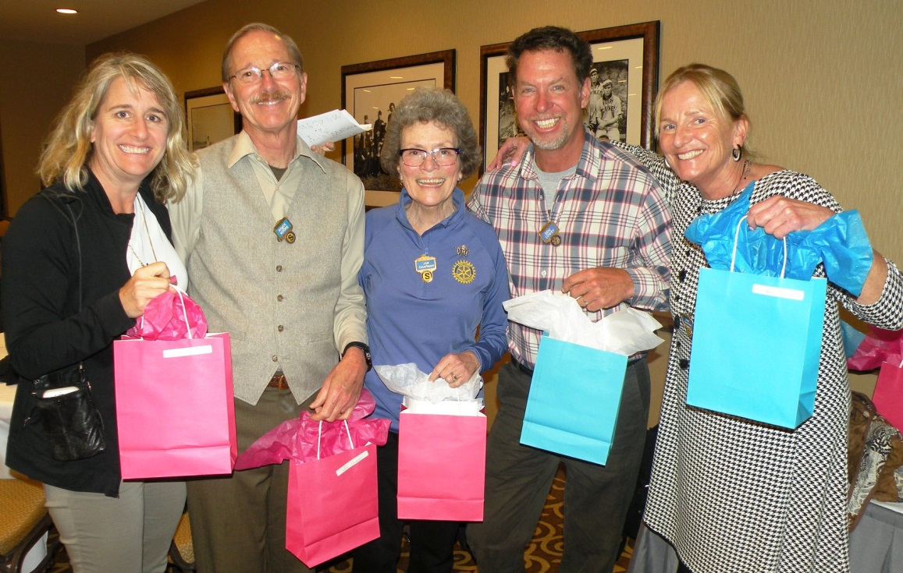
Everyone can “like” and “share”!
Always add the 5 “W’s”- Who, what, when, where, why?
Always try to take tight pictures and crop for posting.
Juliana@mainewriter.com

