Slide 1
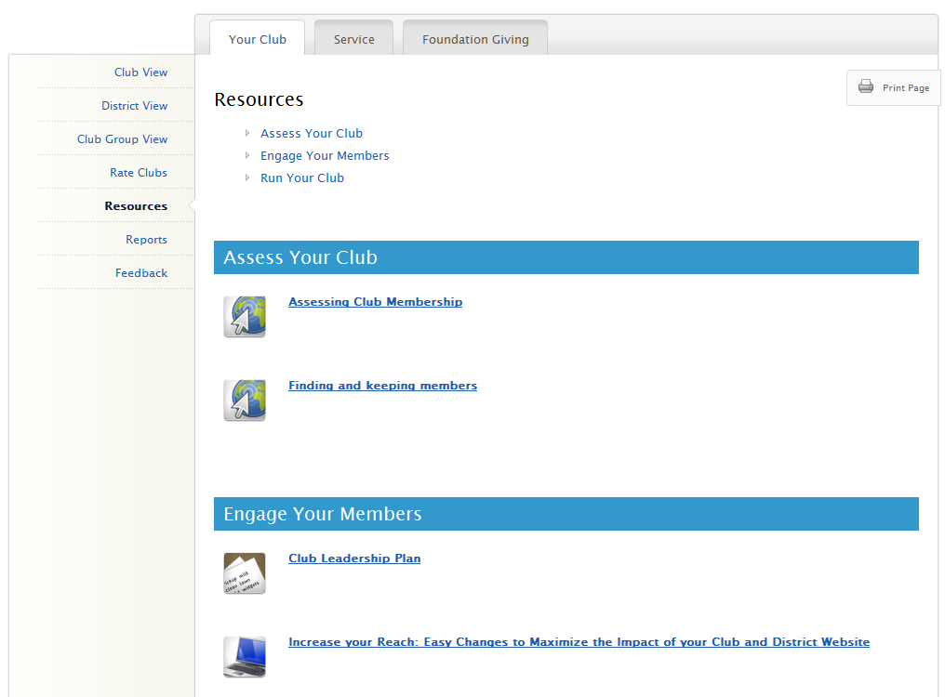
Introduction to Rotary Club Central
Entering Goals
District-level Features
Questions
Notes:
I’m happy to be here today to show you the features of the online goal-setting tool, Rotary Club Central.
This new tool will help club and district leaders to monitor club progress and achievements in three key performance areas: membership initiatives, service activities, and Rotary Foundation giving.
Rotary Club Central is available to all Rotarians, but has additional features depending on your officer role.
Today, we will cover the following…
-We’ll start with a tour of what everyone can see in Rotary Club Central. (CLICK)
-Then, we’ll go into who can enter goals, and how to enter them. (CLICK)
-Next, we’ll explore the features available to district level officers. (CLICK)
-Finally, you’ll have the chance to ask any questions that weren’t covered. (CLICK)

Slide 2
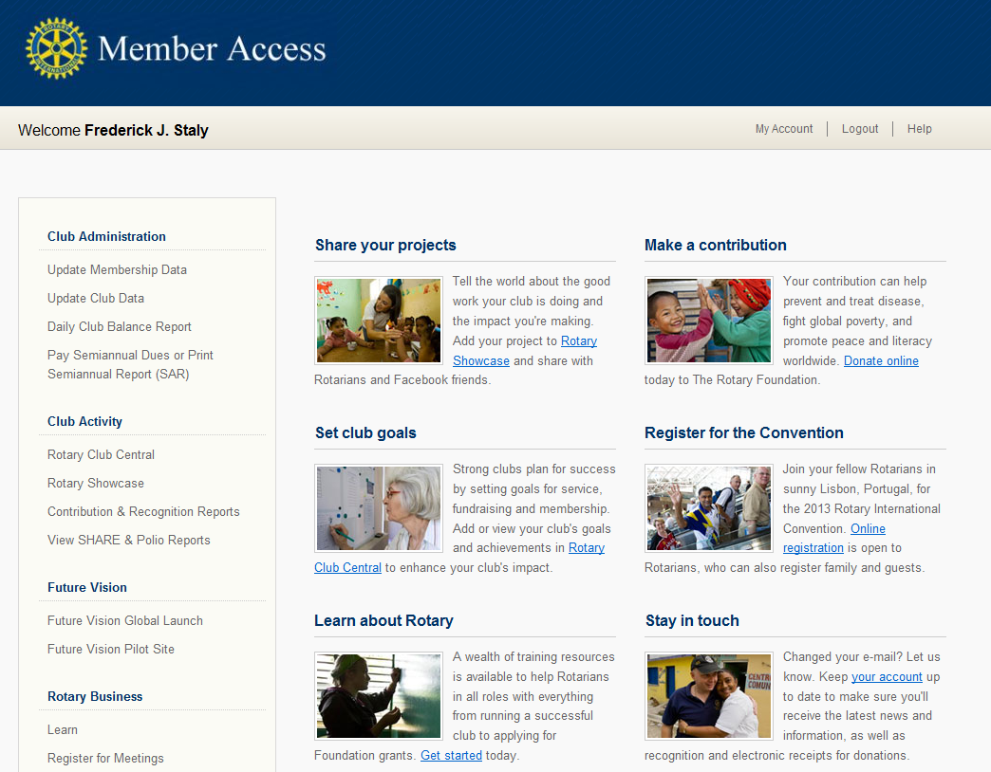
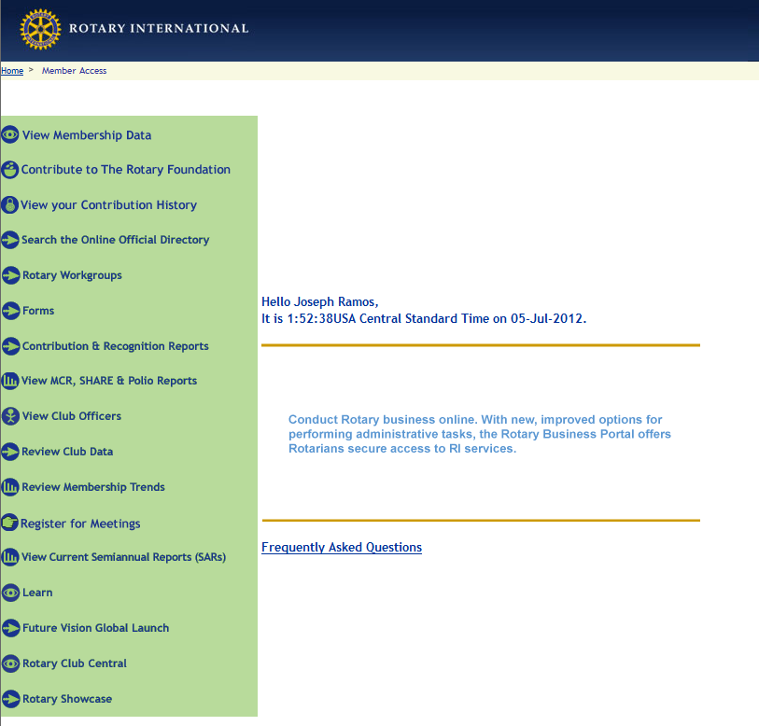
Rotary Club Central
John Q. Rotarian
Notes:
Rotary Club Central is accessible from the Member Access homepage at rotary.org. (CLICK)
You can click on Rotary Club Central under the Club Activity link. You can also click on the picture or link in the “Featured” list.

Slide 3
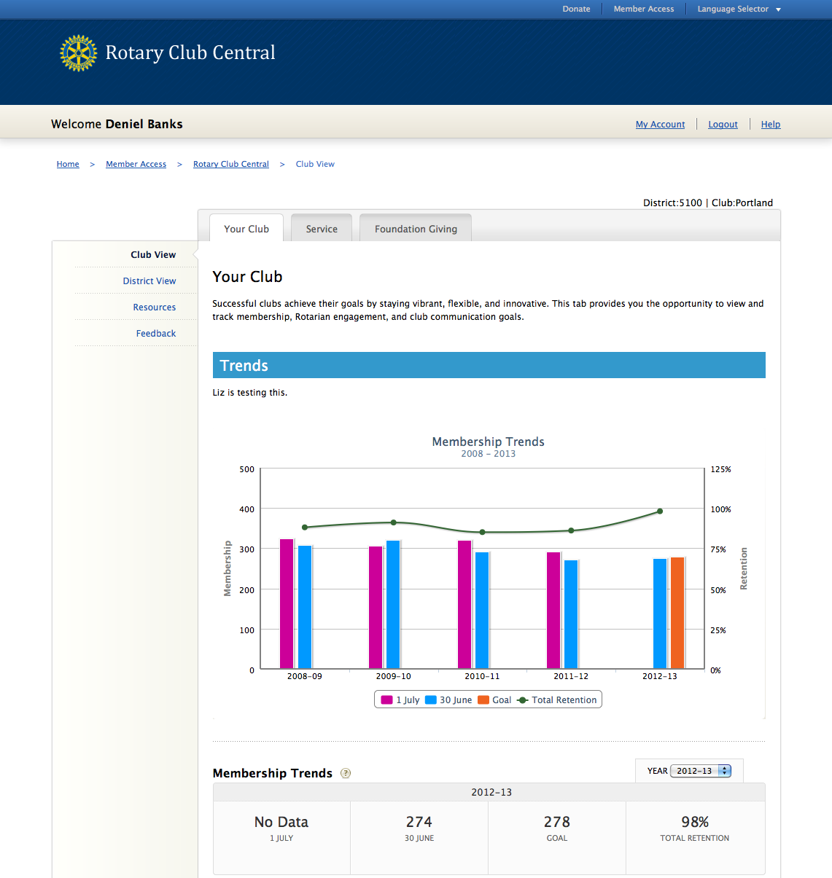
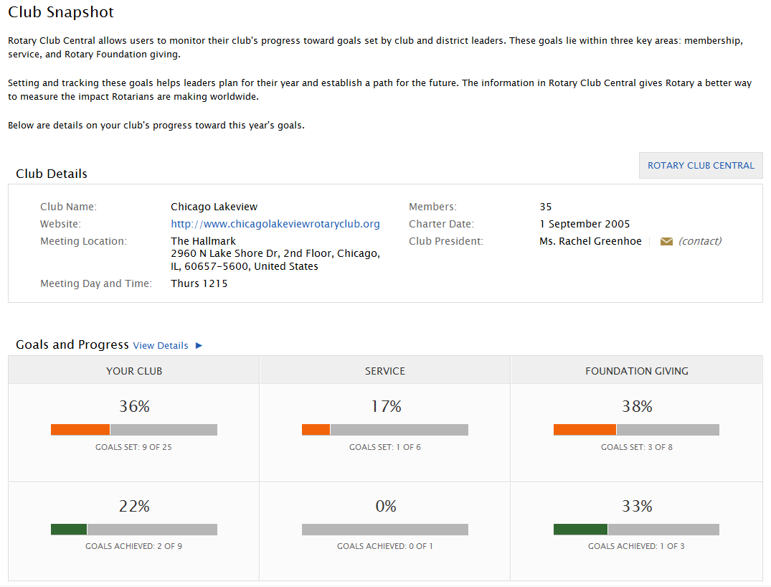
John Q. Rotarian
John Q. Rotarian
District: xxxx | Club: Anyclub
Your Rotary Club www.myrotaryclub.com
Paul Harris Hall 1560 N. Chicago Street Evanston, IL 60201
Wed 1430
25
1 January 1905
John Q. Rotarian
Notes:
This will take you to the Club Snapshot.
From here, you can see some of your club’s details (such as meeting location, website, charter date, members, etc.)
You can also see a summary of how many goals your club has set and achieved in each section of Rotary Club Central.
(CLICK)
To view or edit these goals, you can either click “Rotary Club Central” up by the Club Details or “View Details” next to Goals and Progress.

Slide 4
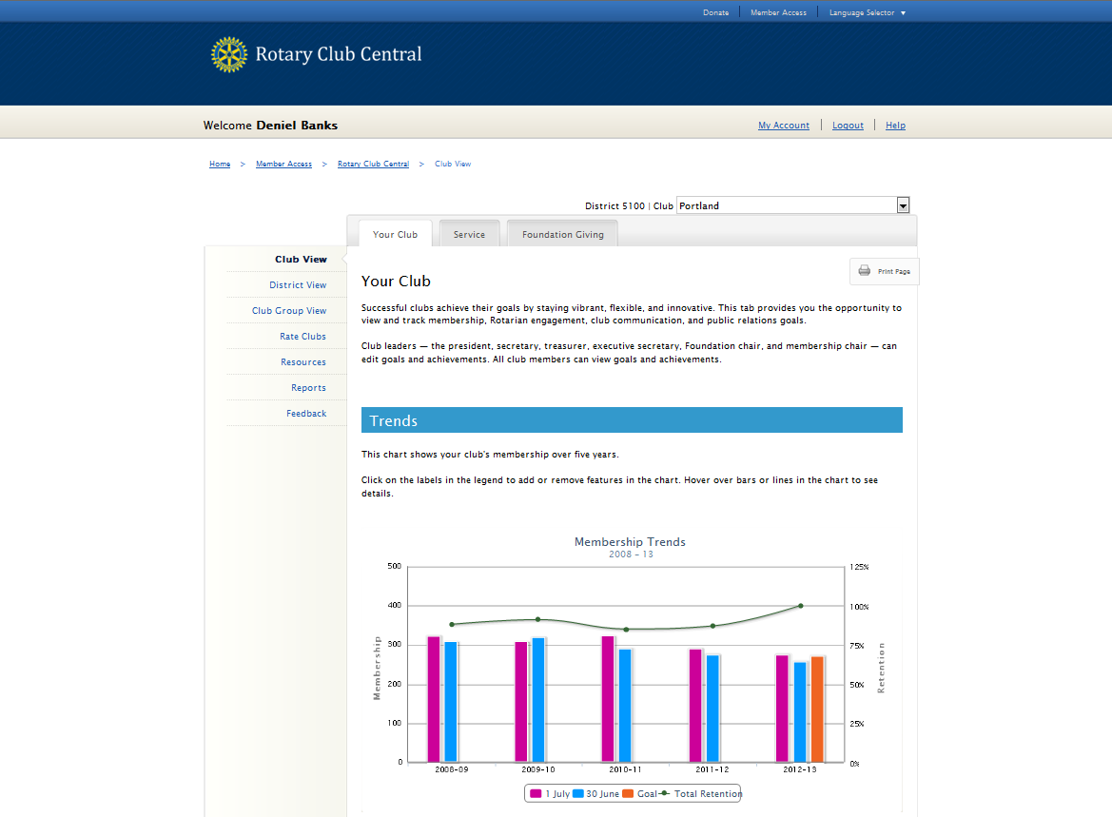
John Q. Rotarian
District: 0000 | Club: Your Club
Notes:
You will always begin at the Your Club tab.
(CLICK)
You can see that in addition to Your Club, there are tabs for Service and Foundation Giving
For Your Club, we start with the Trends section depicting your club’s membership retention over the last five years.

Slide 5
Your Club
Membership Retention Rotarian Engagement Club Communication Public Relations
Notes:
As you scroll down, clubs can set four main goals in this section:
(CLICK) -Membership Retention -Rotarian Engagement
-Club Communication
-and Public Relations. (speaker may wish to give examples for each major goal)

Slide 6
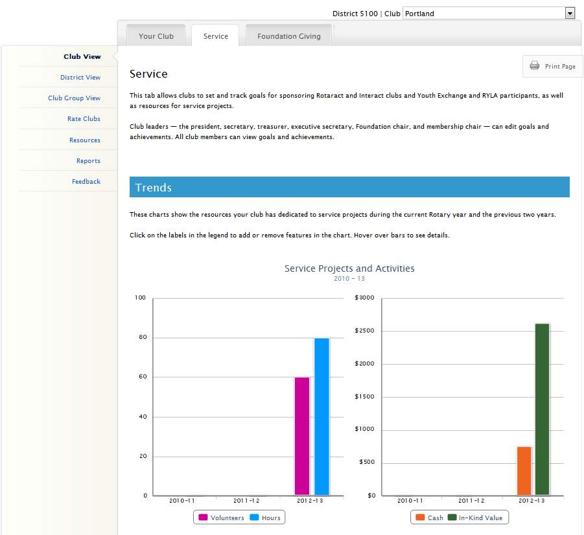
Notes:
Moving on to the Service tab, you’re presented with a trend graph displaying a breakdown of the impact achieved from your club’s service projects and activities over the last three years. The four impact measures are number of volunteers, total volunteer hours, cash donations, and in-kind donations.

Slide 7
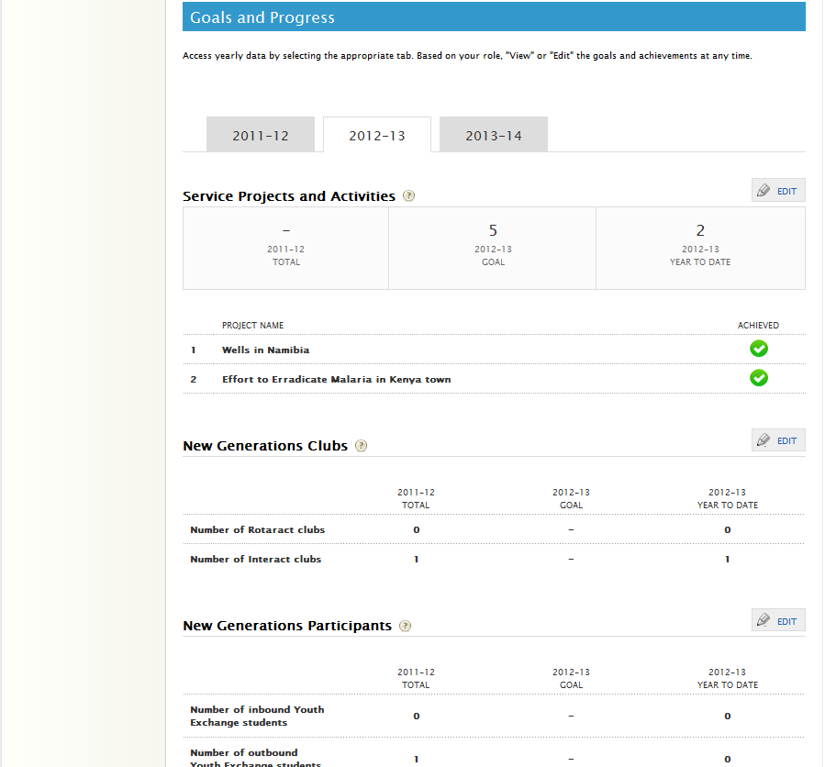
Service
Service Projects and Activities New Generations Clubs New Generations Participants
Notes:
Scrolling down, there are three main goals here, which are;
(CLICK)
-Service Projects and Activities
-New Generations Clubs (which includes sponsoring Rotaract and Interact clubs),
-and New Generations Participants (which covers Youth Exchange and RYLA).
(speaker may wish to give examples for each major goal)

Slide 8
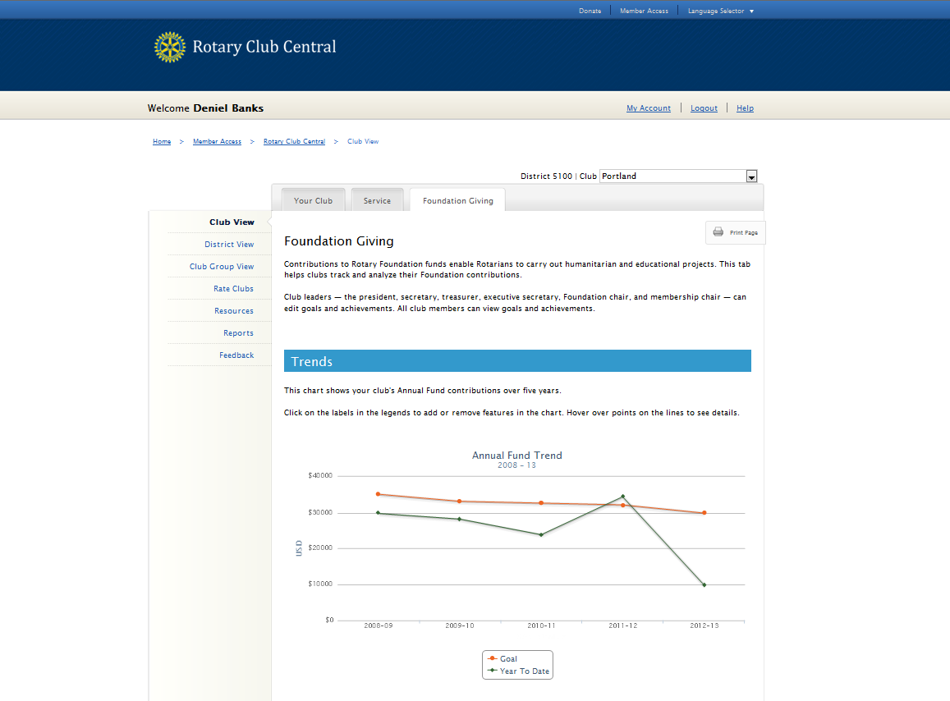
John Q. Rotarian
District: 0000 | Club: Your Club
Notes:
And lastly, on the Foundation Giving tab, this trend graph shows your club’s Annual Fund goals and giving over the last 5 years.
On all three tabs, you can view each trend graph in table form under each respective graph. These tables can be expanded out to show the numerical values for the last 5 years.

Slide 9
791 USD
791 USD
Foundation
Annual Fund Polio Plus Major Gifts and Benefactors
Notes:
Below the Annual Fund trends are the three main goals for Foundation giving:
(CLICK)
-The Annual Fund is broken out by Paul Harris Society, Sustaining Members, EREY, and other contributions.
-Then we have PolioPlus.
-And last we have Major Gifts and Endowment Fund, which includes Major Gifts, Bequest Society, and Benefactors.

Slide 10
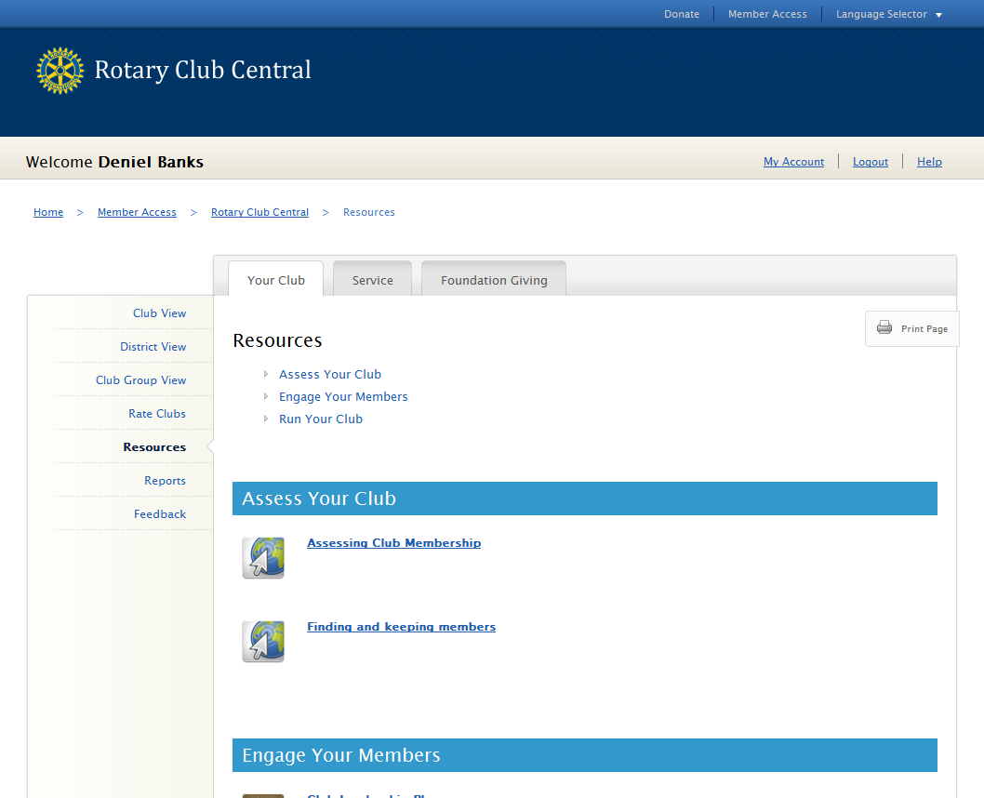
John Q. Rotarian
Notes:
Each tab has a link to resources on the left hand navigation bar.
(CLICK) This will give you access to publications, web pages, and even videos that can assist you in setting goals for your club.

Slide 11
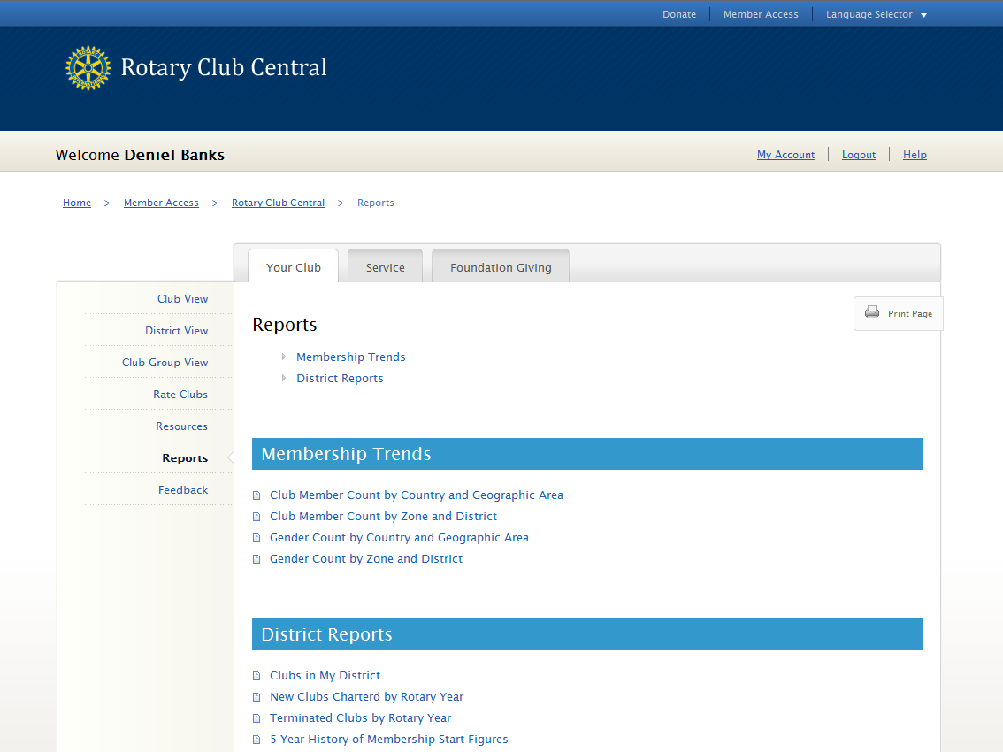
John Q. Rotarian
Notes:
On the left side beneath Resources, we have Reports.
(CLICK)
From here, you can view and download reports that are related to each of the three tabs. The reports you see will vary depending on your role.

Slide 12
Introduction to Rotary Club Central
Entering Goals
District-level Features
Questions
Notes:
So, now that we’ve covered the basics, let’s talk about entering goals.

Slide 13
Who can enter goals?
CLUB LEVEL
President Secretary
Treasurer
Foundation Chair Membership Chair Executive Secretary
DISTRICT LEVEL
District Governor
*Assistant Governors Committee Chairs
Executive Secretary
Notes:
Everyone in the club can view goals, but who specifically can enter and edit goals?
(CLICK)
At the club level, the president, secretary, treasurer, Foundation chair, membership chair, and executive secretary can all enter goals for the year they are in office?
(CLICK)
At the district level, the district governor, committee chairs, and district executive secretary can view and edit the goals for all clubs in the district for their year. The assistant governors may view all goals but only edit the goals for the clubs in their club group. This is so district officers can assist a club with reporting its goals in case the club is unable to do so. When goals are set on behalf of a club, an automated email is generated and sent to the club president listing the goal change and who made the change.
Ideally, club officers will enter their club’s goals during their elect year.
(CLICK)
However, current, incoming, and immediate past officers can view all year tabs, and edit goals and achievements for their own year at any time (even after their year is over).
So, let’s take a look at two examples of a club entering a goal.

Slide 14
791 USD
791 USD
Notes:
In this example we’ll be entering a goal for Annual Fund, on the Foundation Giving tab. Anyone who can edit goals in that particular year will see an “EDIT” button.
(CLICK)
Everyone else will see “VIEW” which allows them to see the goals in more detail, but not add or change goals and achievements. So, let’s click “EDIT”

Slide 15
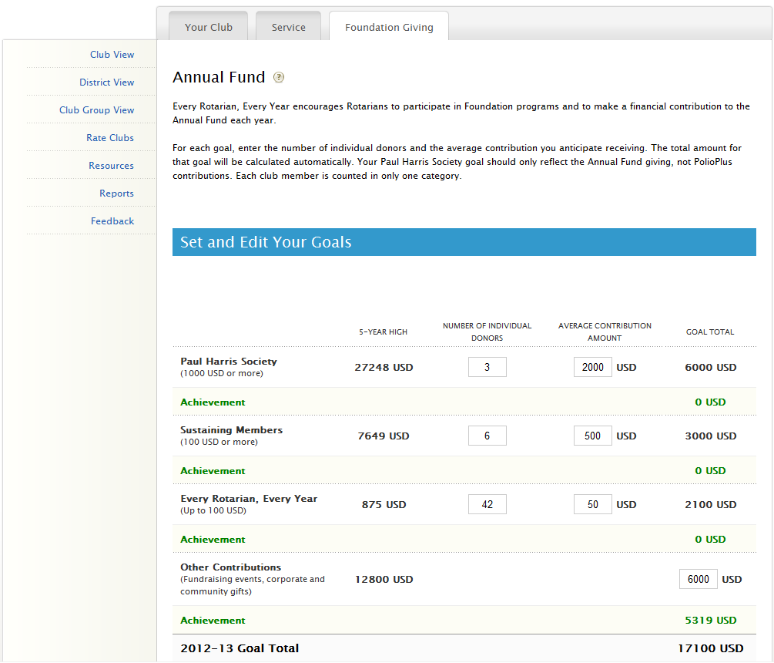
Notes:
From the edit page, you have instructions to help you fill out the supporting goals. For even more information you can click the question mark next to Annual Fund.
So, for this goal you will have to estimate a number of individual donors and then the average contribution amount for each goal level. As you fill in these sub-totals, you will see them automatically added to reflect your club’s total Annual Fund goal.
(CLICK)
Underneath each sub-goal is the club’s achievement towards that goal. You’ll notice this achievement information is automatically populated from Rotary International’s database and does not need to be entered by the user. This is updated daily.

Slide 16
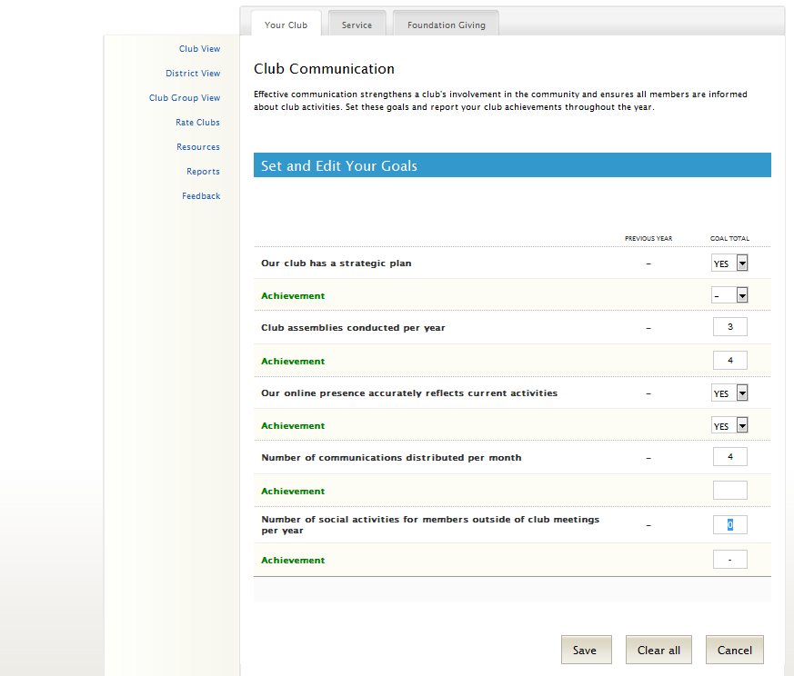
Numeric Monetary (USD) Percentage % Yes / No
Notes:
For the second example we use the Club Communication goal, found on the Your Club tab.
Some of these goals will require a value of YES or NO (such as “Our club has a strategic plan”), while others require a specific number goal (such as “the number of club assemblies conducted per year”)
(CLICK)
Unlike the previous example, these types of goals have self-reported achievements. Since RI does not collect this information, it is up to the officers to report their club’s achievement at the end of the Rotary year (or they may choose to update achievements periodically throughout the year).
Most of the goals in Rotary Club Central are entered in one of four ways. (CLICK) -There are numeric goals (for example, number of new members retained)
-Monetary goals (these are always in USD)
-Percentage goals (some goals provide the option of entering a percentage or numeric value)
-and Yes or No goals

Slide 17
Introduction to Rotary Club Central
Entering Goals
District-level Features
Questions
Notes:
At its heart, Rotary Club Central is a club-focused tool, however, there are some district-level features to help district officers assist clubs with their goals.

Slide 18
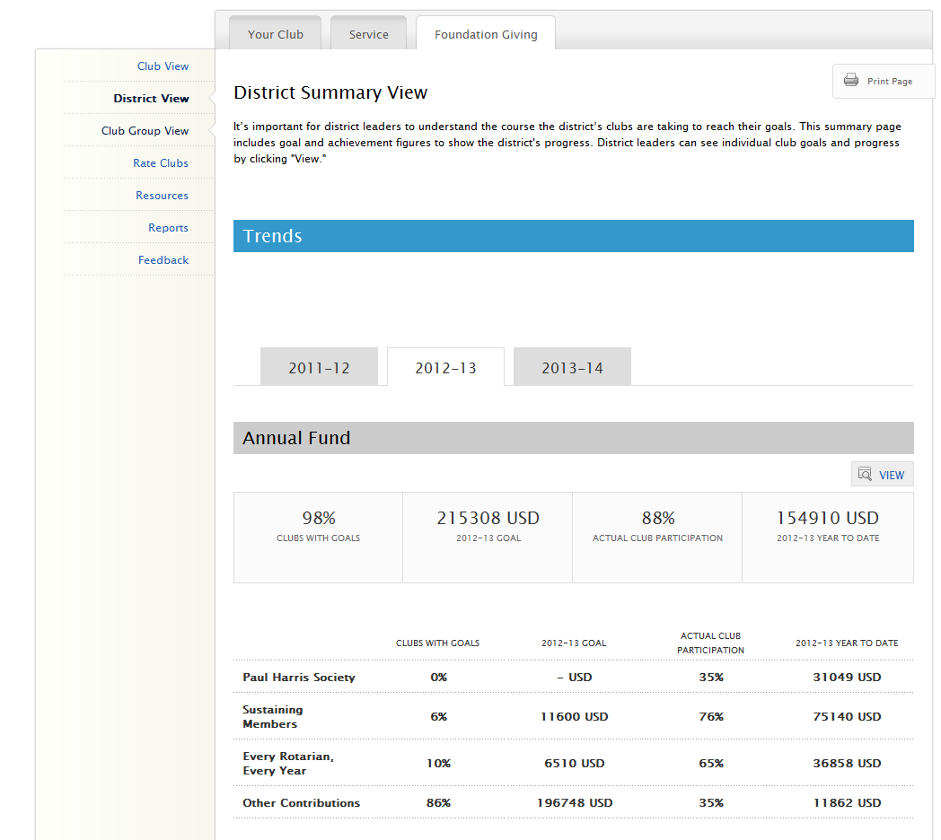
Notes:
The District View offers a summary of all goal and progress information for the district. (CLICK)
From this summary view, anyone can see the total % of clubs who have set a particular goal, the total goal for the district (based on clubs reporting), the percentage of clubs working towards achievement of that goal, and the total progress to date (for example, the total amount given to the Annual Fund from all clubs in the district). This can give the average club member or club leader an idea of how much their club is contributing to the total achievement of the district.
While all members can see the District Summary, district officers can go one step further by clicking “VIEW.” (CLICK)

Slide 19
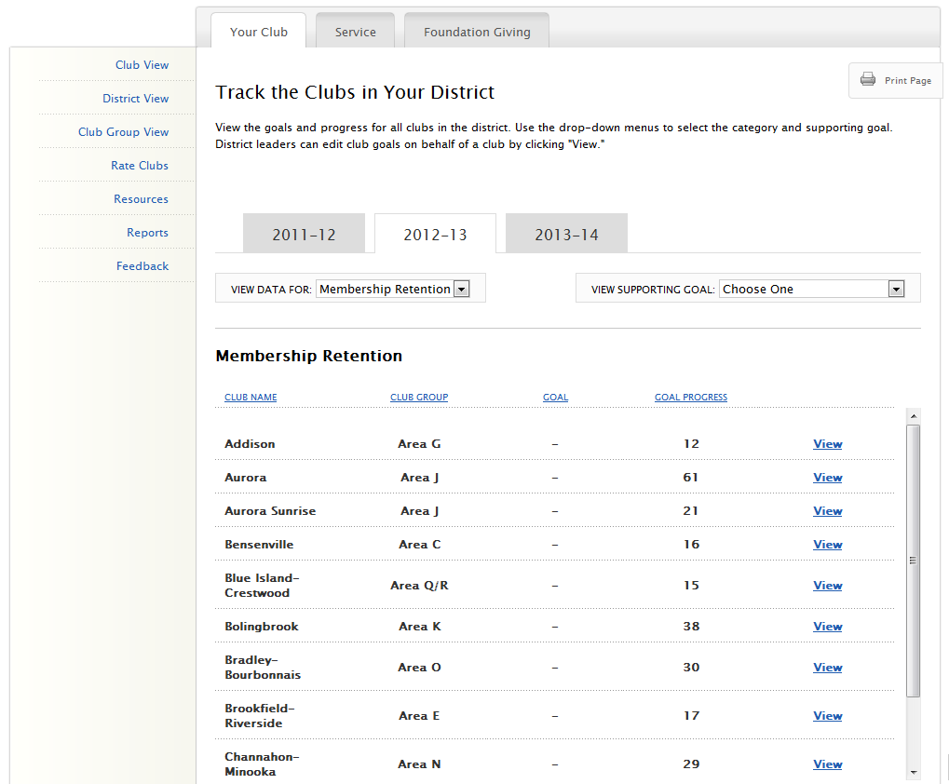
Atlantis
Atlantis Sunrise
Sesame Street
Gotham
Metropolis
Metropolis Sunset
Tattooine
Twin Peaks
Greendale
Notes:
From here, a district officer can see the progress of all the clubs in the district or choose a particular club to view their goals and achievements.
This helps you identify which clubs need more support and which are achieving their goals.
(CLICK)
You can use the two drop down menus to select a different major goal, and choose one of its supporting goals.
(CLICK)
Clicking “VIEW” will take you into the club view of that club where you can now view or edit that club’s goals.

Slide 20
Introduction to Rotary Club Central
Entering Goals
District-level Features
Questions
Notes:
Now, we have time to answer any questions you may have. (CLICK)

