Slide 1
What our Rotary Foundation can do for your Club

Slide 2
Presentation Outline
Role of The Rotary Foundation
6 Areas of Focus
District Grants a Club opportunity
Global Grants for larger projects
Polio Plus update
Where Foundation $$ come from

Slide 3
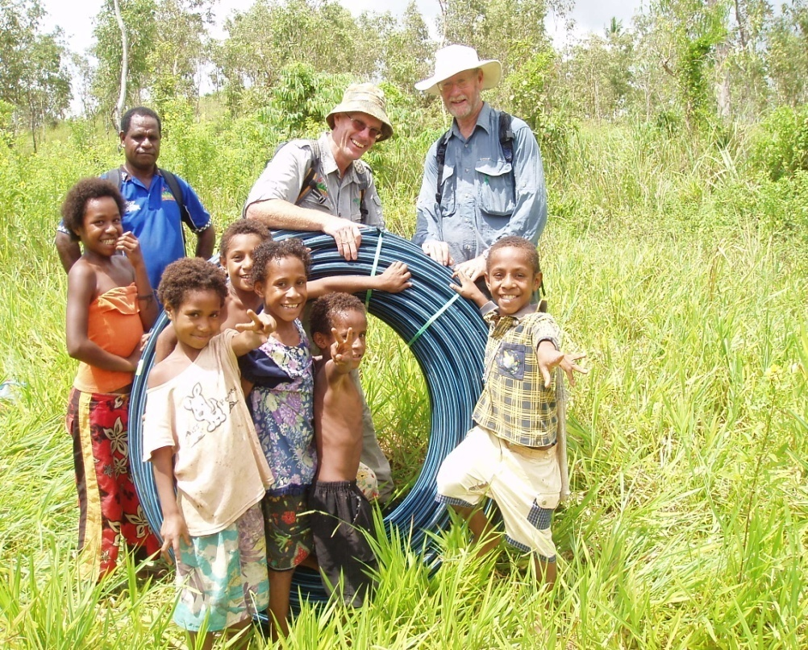
Role of our Rotary Foundation
To enable Rotarians to advance world understanding,
goodwill & peace
through:
improved health
support of education
alleviation of poverty

Slide 4
Foundation’s 6 Areas of Focus
Peace and conflict prevention/resolution
Disease prevention and treatment
Water and sanitation
Maternal and child health
Basic education and literacy
Economic and community development

Slide 5
Main Operational Programs
1. District Grants
2. Global Grants
including
Vocational Training Teams
Scholarships
3. World Polio eradication

Slide 6
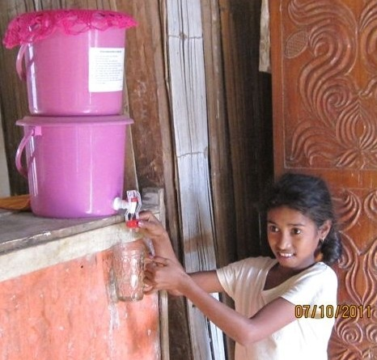
1. District 9700 Grant Projects
Partnership between District & Clubs
At least 1 Area of Focus
Humanitarian projects
Vocational or skills training
Scholarships (1 year)
Benefits local & international people
Target 15 - 20 District Grants each year
2014-15: 5 Projects, 7 Clubs, $10,000

Slide 7
District Grant Projects 2014-15
Club(s) Project Title $
Grenfell Rotary Park upgrade 3,000
Orange Vegetable gardens for kids 1,000
Wagga Darkness to Light Riverina 1,000
Young Heritage walking trail 3,000
4 Orange Medical skills to Solomon Is 2,000
Total $ Allocated $10,000

Slide 8
District Grants Projects 2013-14
Cootamundra Community Peace Rotunda
Leeton Community exercise path info
Orange Music education for disadvantaged
Wagga Life skills for visually impaired youth
W Wyalong Library books to remote schools
Orange Daybreak & 23 clubs Dream Cricket Kits

Slide 9
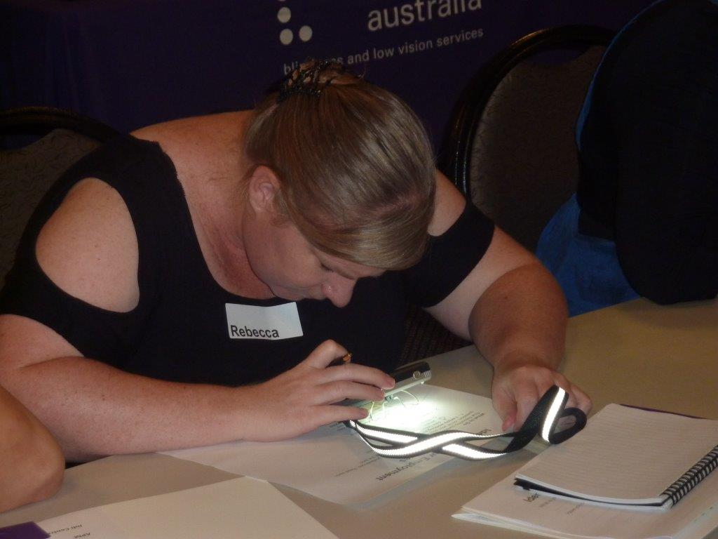
Riverina ‘Darkness to Light’ Forum Builds self-esteem & networking skills
Collaboration with
Vision Australia

Slide 10
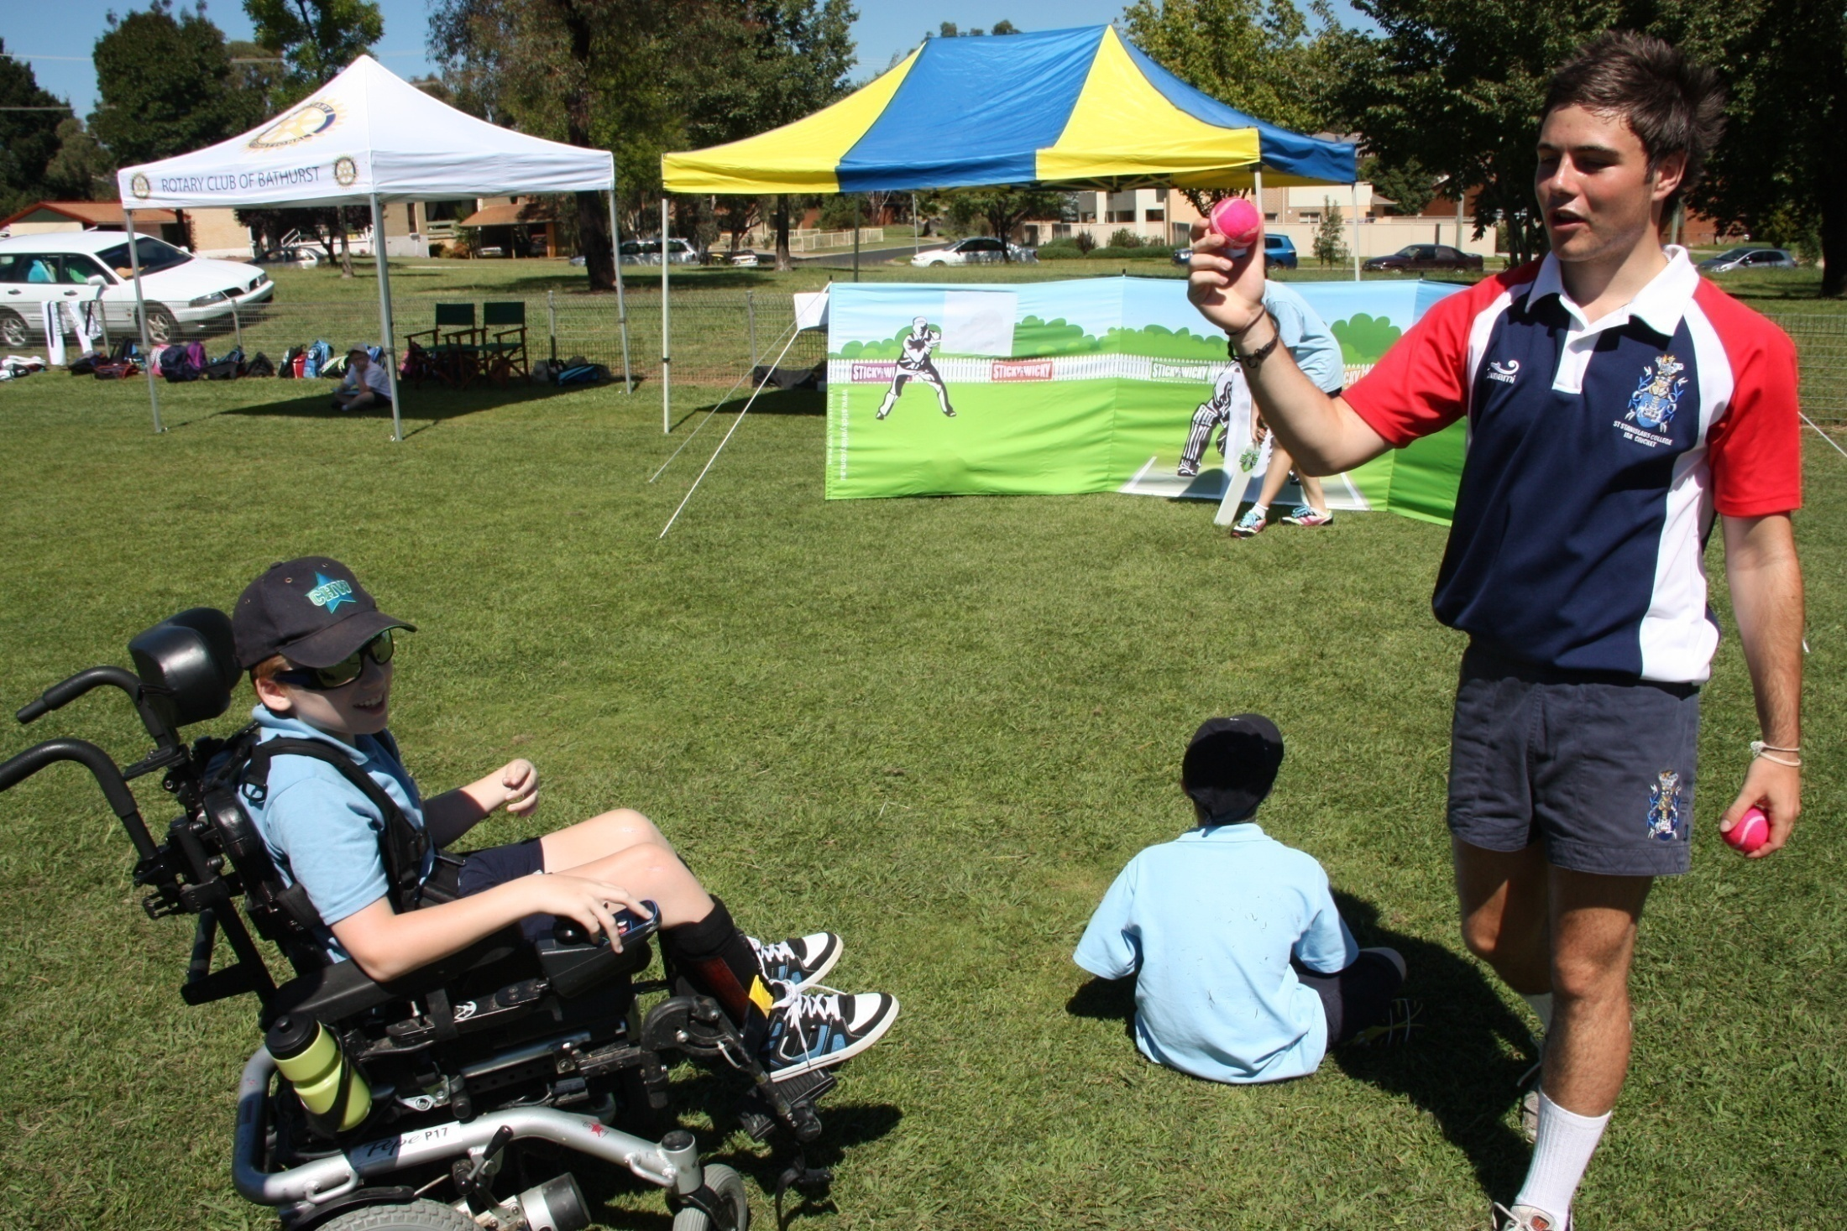
19 Dream Cricket Kits - 24 Clubs - $3,800

Slide 11
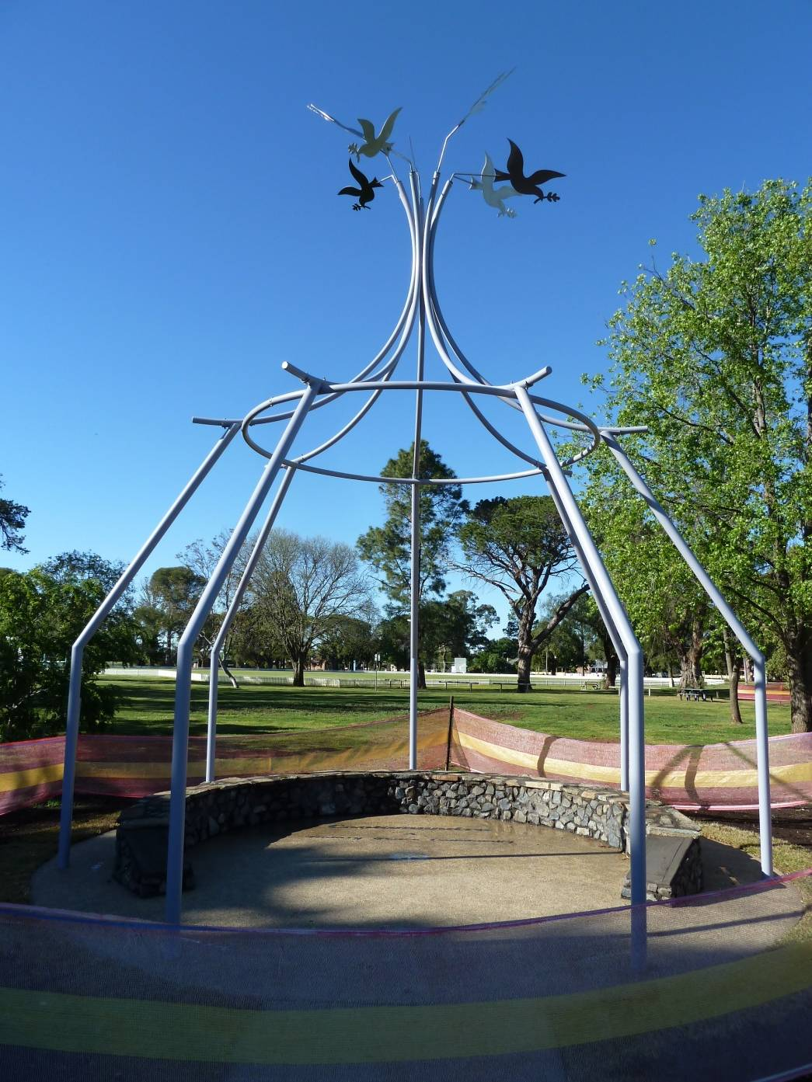
Cootamundra Peace Rotunda Multiple funding partners

Slide 12
District Grant Timetable
In President Elects’ year
November – Details at current Presidents Forum
January - Applications open
February - Discussion at PEs Seminar
1st April - Applications close
May - Grants announced at District Assembly
- - - - - - - - - - - - - - - - - - - - - - - - - - - - - - - - - - - - - - - - - - - - - - - - - - - - - - - - - - - -
In President’s year
July to March/April - Club conducts project
By 1st May - Final Report (Project & Financials)
Club claims approved Grant amount from District
May / June - Report provided to Foundation

Slide 13
2. Rotary Global Grants
Partnership projects between the Club &/or District and Rotary Foundation
International Club (D9700) & Host partner
Involves 1 or more Area of Focus
District Target 1 or 2 Grants (ongoing)
Global Grants underway or development
Teacher Training in Nepal – in progress
Educating children at-risk in Nairobi, Kenya

Slide 14
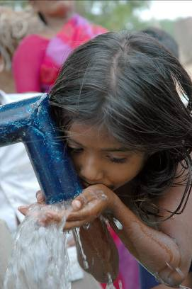
Characteristics of Global Grants
Larger grants (Min $30k)
World Fund matching $$$
Identified community need
Align with Focus Area(s)
Measurable results
Sustainable outcomes
Long-term benefits

Slide 15
Five Steps to Sustainable Projects
1. Needs analysis to help identify the problem & solutions;
2. Incorporate local resources & funding, regional input, and indigenous knowledge;
3. Determine most appropriate technology to address the issue;
4. Provide for ongoing maintenance; and
5. Teach community to operate equipment, & business skills to have project continue after Rotary involvement
Notes:
In other words, the Foundation needs to be convinced that the project will continue to benefit the community long after a Clubs (or Rotary's) involvement has ended.

Slide 16
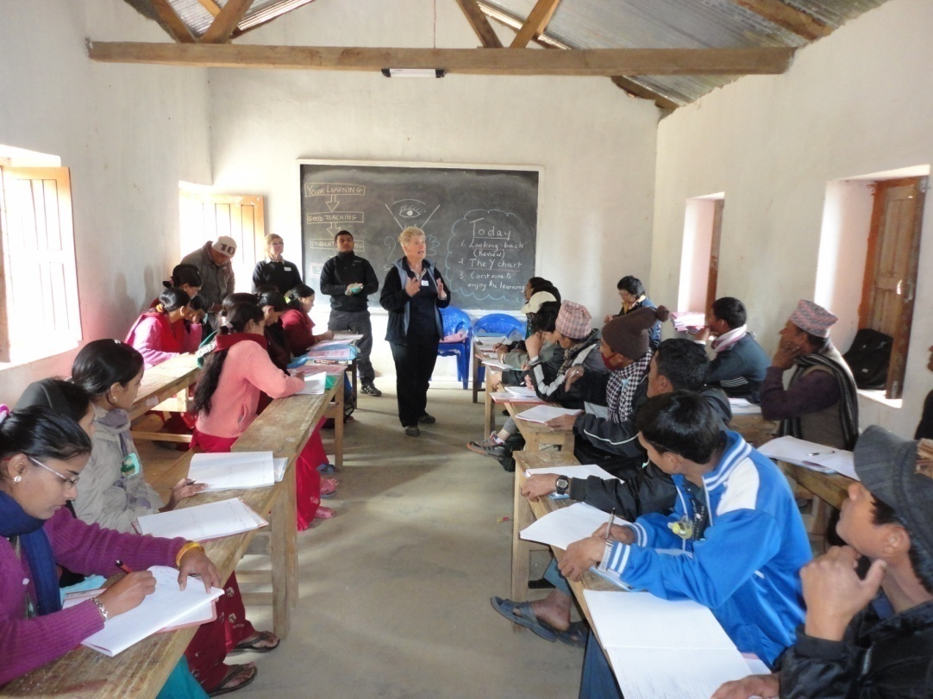
Teacher Training Team to Nepal
2 year $40k vocational Global Grant project
D9700 DDF allocation $20k
Foundation Global Grant $20k
Impact
350 teachers trained
26 schools impacted
5,500 students
20 selected teachers
undertake ‘Train the Trainer’ program

Slide 17
3. Rotary’s No 1 Challenge
“A polio free world by 2018”

Slide 18
Australian Rotarian Clem Renouf
RI President 1978-79
Initiated Rotary’s
END POLIO NOW
campaign in 1979
Global Polio Eradication
adopted in 1988
Now a worldwide multi-agency program

Slide 19
World Polio Outbreaks
Country | to Sept 2012 | to Sept 2013 | To Sept 2014
Pakistan | 30 | 28 | 138
Afghanistan | 17 | 4 | 8
Nigeria | 84 | 46 | 6
Ethiopia | 0 | 1 | ?
Somalia | 0 | 163 | ?
Kenya | 0 | 14 | ?
TOTAL | 131 | 256 | ?
"The job still needs to be done & we have a role"

Slide 20
4. Where Foundation $$ come from
Combination of:
Personal contributions - D9700 Centurions
Club Contributions to ‘Annual Programs’ Fund (returned as District Designated Fund)
Club contributions to ‘Polio eradication’
Special events eg. D9700 Foundation Dinner, End Polio film night ,Club events etc
Benefactor bequests

Slide 21
Foundation ‘Annual Funds’ Three Year SHARE Cycle
2011
2012
2012
2013
2013
2014
2014
2015
2015
2016
2016
2017
Funds from Annual Giving available to District 3 years after being contributed - through the SHARE Cycle
Contributions to Annual Programs Fund made in 2011-12 are now available in 2014-15
Contributions made in 2014-15 will be available in 2017-18

Slide 22
D9700 $ Contributions to Foundation
Contributions | 10 -11 | 11 -12 | 12 -13 | 13 -14
Annual Fund | 86,675 | 82,720 | 75,655 | 72,609
District Share in 3 years | 43,338 | 41,358 | 37,828 | 36,305
Clubs not contributing | 2 | 8 | 8 | 12
Polio Plus | 58,780 | 70,160 | 40,540 | 34,860

Slide 23
Information & Support
District Rotary Foundation Director
Ian Simpson
District Rotary Grants Coordinator
John McKenzie, Orange North
District Polio-Plus Coordinator
Graeme Callander, Wagga
Club Information Booklet
Club presentations

Slide 24
“It’s OUR Rotary Foundation”
“It’s worthy of YOUR support”

