Slide 1
Your role in Meeting Procedure
PETS 2015
Michael Milston
Orange Daybreak Rotary
Governor 2016-17

Slide 2
Why Me?
PETS 2015
I’ve been attending meetings, chairing meetings, observing meeting behaviour for over 35 years
At an average of 2 meetings a day that is 2,400pa
Over 80,000 meetings! I know meetings!!
Notes:
2 mins

Slide 3
What do you say about Meetings
PETS 2015
Speakers going over time
Inappropriate jokes / swearing / comments
People talking when someone else has the floor
Questions of speaker are too long, off the point, or another point of view
Lack of good speakers, AV failing, poor manners
Notes:
3 mins
Thanks to Geoffrey, Sue-anne, Greg, Bob, Jody, Sharon, Pauline, Wayne, Dawn, Bill, Tony, Gabriel

Slide 4
What to Do??
PETS 2015
Each issue is different,
Each of us are different and
Each way we deal with these issues will be depend on what we feel comfortable with
Let’s look at a Clip about “What to Say When…”
Notes:
2 mins + Clip 8 mins

Slide 5
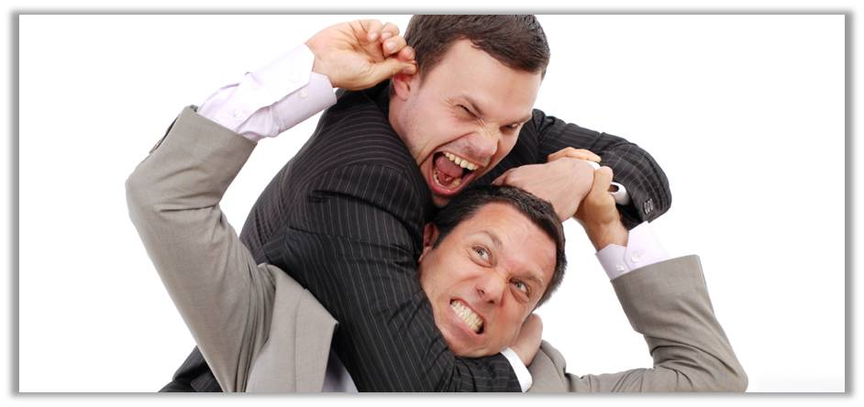
Making an Intervention
It will feel awkward, it will make you feel uncomfortable, and even be scared
This is not easy – IT IS HARD … BUT YOU CAN DO IT
The Chair’s role is to redirect behaviour – this is NOT laying blame
Notes:
2 mins
Recapping from the Video

Slide 6
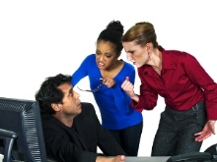
Making an Intervention
Choices when making an intervention:
1: TIMING – at start or end of meeting or when behaviour needs to be redirected
2: TYPE – a) Direct (talking to individual directly) b) Indirect (talking to the whole group)
Notes:
2 mins
Continuing from video recapping

Slide 7
Group exercise
Review the handout of items PEs identified
In your Groups each person select an item about which you will intervene
Over the next day or so talk to another President-elect about how you are going to deal with the intervention

Slide 8
