Slide 1
Club Website Options

Slide 2
Frank Devlyn 2000-01 RI President

Slide 3
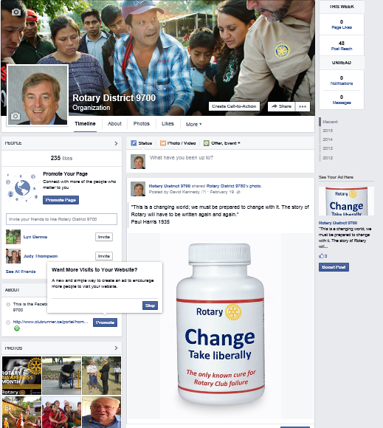
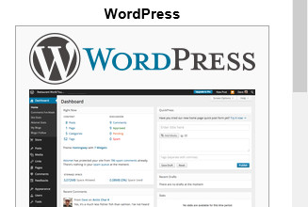
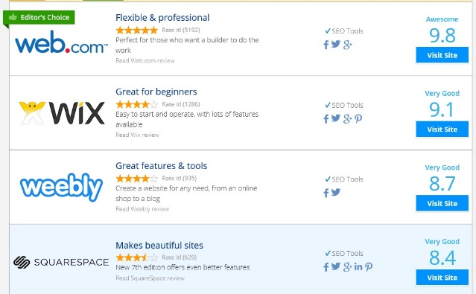
Your Options
Facebook
Website builders
CMS
Dreamweaver
ClubRunner

Slide 4
What do you want your website to do?
Rotary Stuff
Notes:
Life Long Learning

Slide 5
Don’t reinvent the wheel
Buy what your friends have
Notes:
Life Long Learning

Slide 6
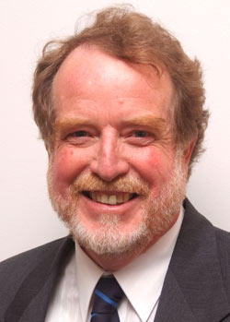
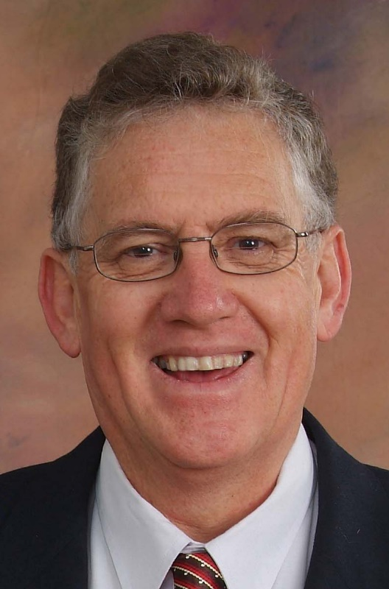
ClubRunner in District 9700
Notes:
Life Long Learning

Slide 7
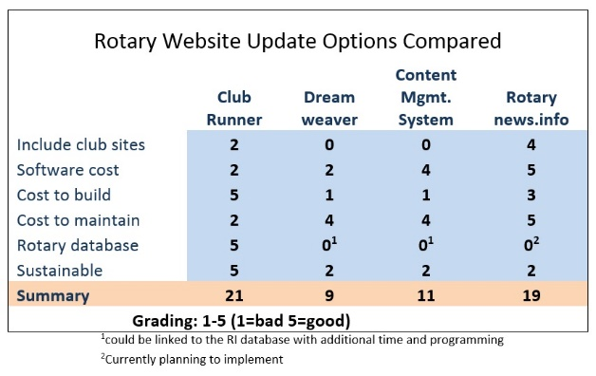
Website Options

Slide 8
District Website
(Clubrunner)

Slide 9
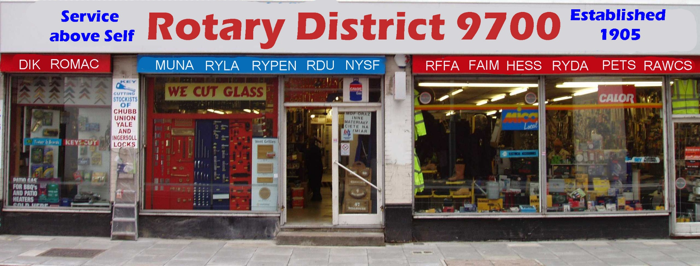
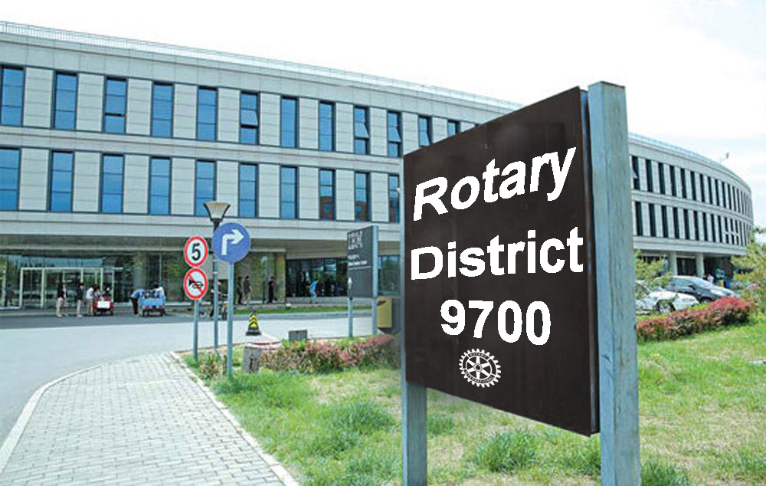
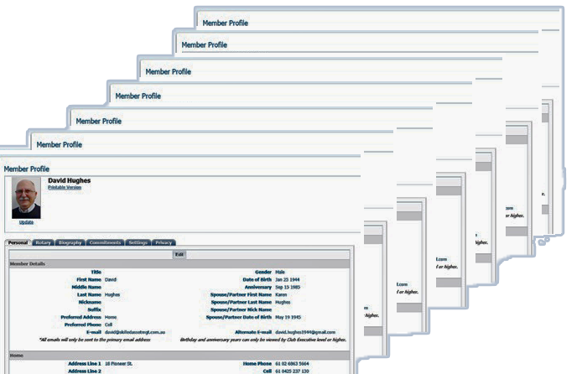
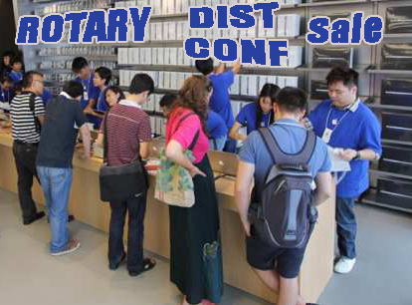
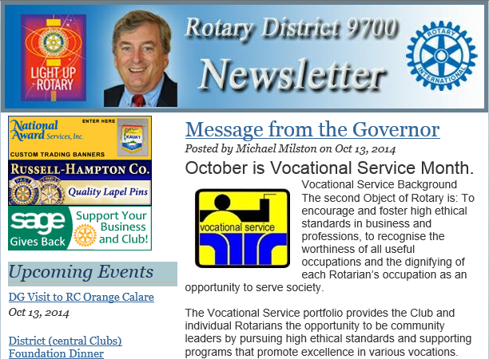
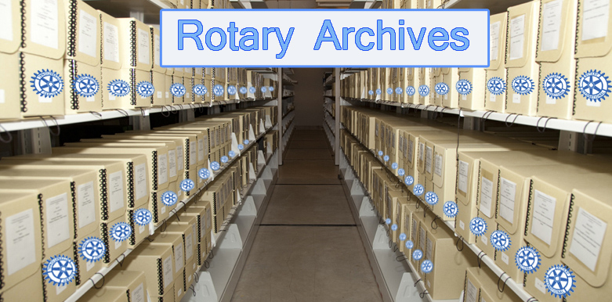
The District website
Shop Front
Database
Emails
Publisher
Events
Archives

Slide 10
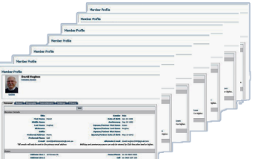
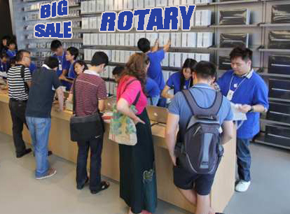
Website is…
Much more than a website
Shop Front
Database
Emails
Publisher
Events
Archives

Slide 11
ClubRunner Statistics
ClubRunner has grown by close to 100% per year for the last 10 years
Of the first 10 Rotary clubs chartered… 9 use ClubRunner
Over half of the Districts in America use ClubRunner (56%)
11 districts in Australia

Slide 12
Summary
Facebook
Website builders
CMS
Dreamweaver
ClubRunner

Slide 13
Questions?

