Slide 1
PETS 2015
PowerPoint Presentations Paul Murray

Slide 2
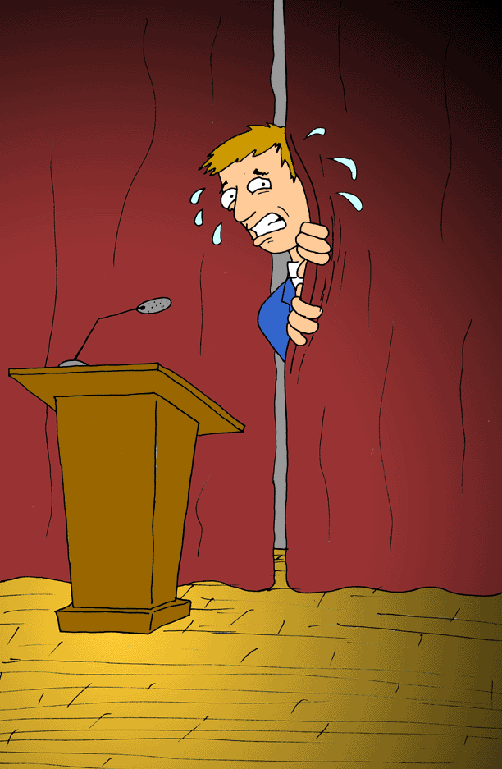
Notes:
It hard work.
The fear of public speaking is right up there with spiders and heights.
Public speaking is hard but Powerpoint helps
It’s a tool that helps get your message across

Slide 3
Notes:
I went to a business breakfast the Wagga City council put on. They had a Sydney presenter and he said you need to (1) keep it simple (2) have a high contrast screen and (3) speak to one main point per slide and try to make it a reconnizavle object. Make sure the audience knows what you are talking about. If they don’t know what you’re talking about…your lost. Can anybody in here guess what he was talking about?

Slide 4
MINUTES OF COMMITTEE MEETING OF TARCUTTA GARDEN CLUB
February 3rd, 2015 held at Paul and Carolyn Murrays
Meeting was opened by President Joan Kaczmarek at 12:40 pm
PRESENT: please see attendance book
APOLOGIES: please see attendance book
Minutes of November 4th Committee meeting were read by Carolyn and moved and seconded by Judy and Barb that they be accepted.
BUSINESS ARISING:
Membership number will be raised in General Business
TREASURER’S REPORT: Laurian reported a balance of $3,480.96. Moved and Seconded by Laurian and Carolyn that report be accepted
Notes:
Do you know what makes an audience very angry…..
Next
Impossible Challenges
Lots of text
Tiny pictures
You see the screen from a foot
Walk to the back of the room and look
That’s the audiences view

Slide 5
Tell the story
Notes:
Talk to your image…tell the story
People like stories
This is cowra Japanese gardens
By the way do you know that the District Conference is there

Slide 6
Do not run a slide show while speaking
Notes:
Do Not Run a slideshow in the background
While you talk
NEXT
When you …do no one listens to your information on MUNA or RYLA or ABC or the FBI
They just follow the pretty pictures especially of grandchildren

Slide 7
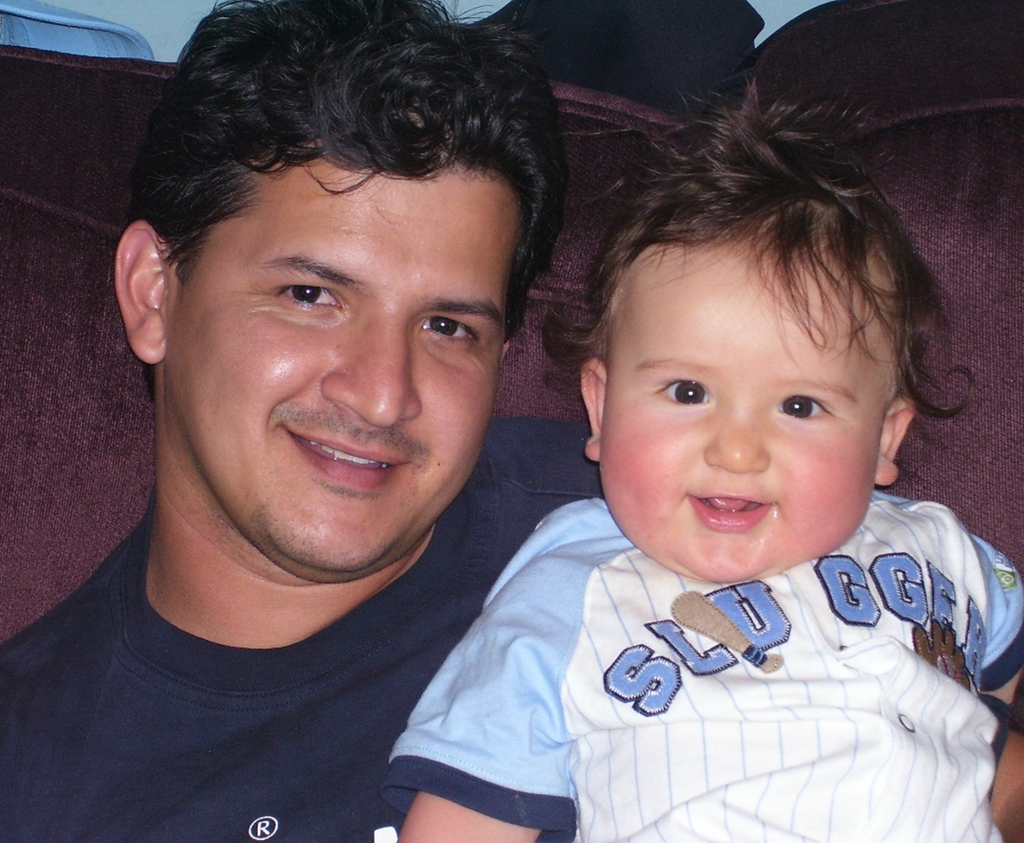
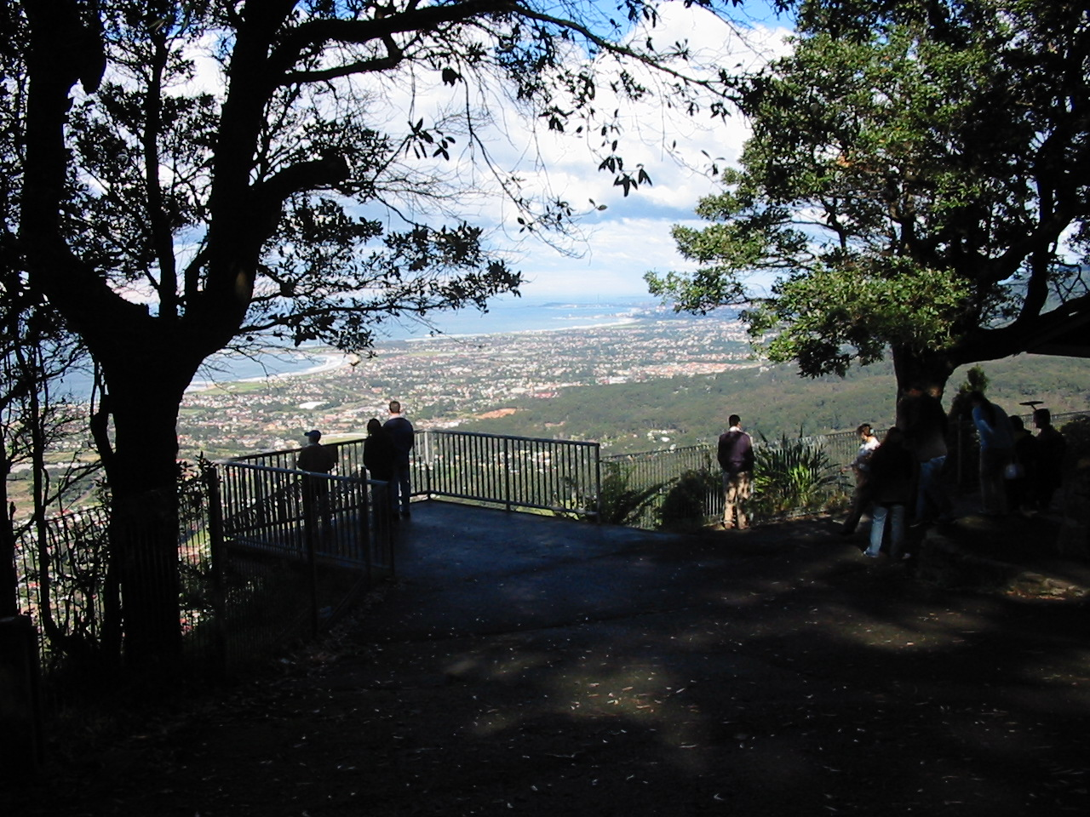
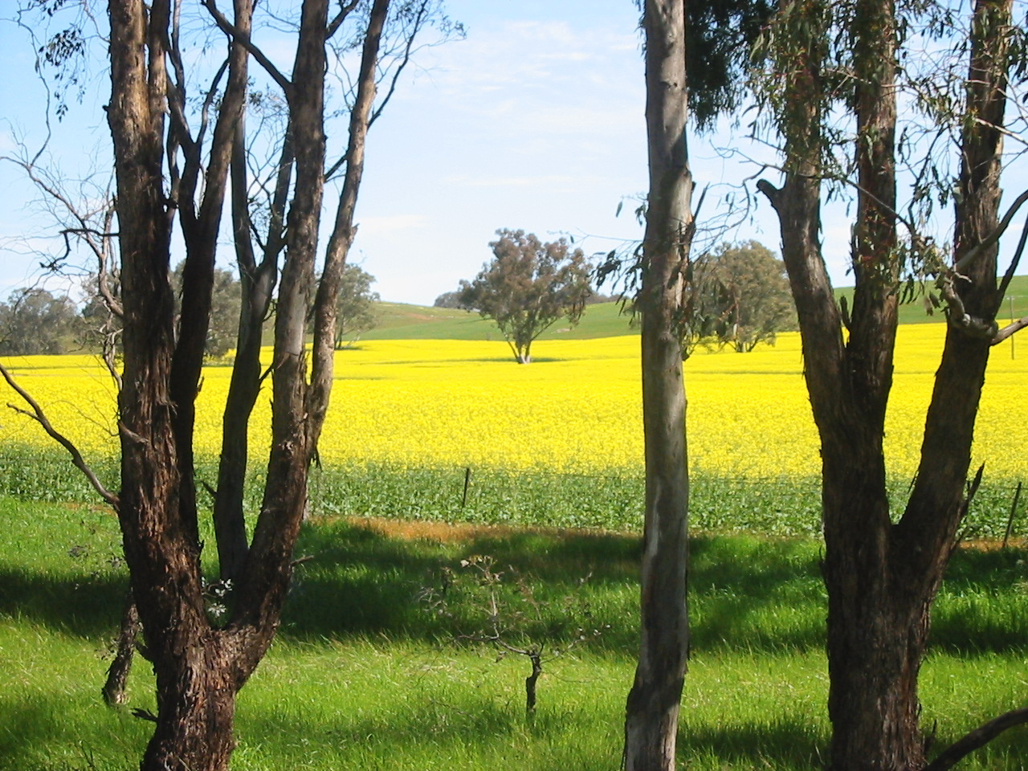
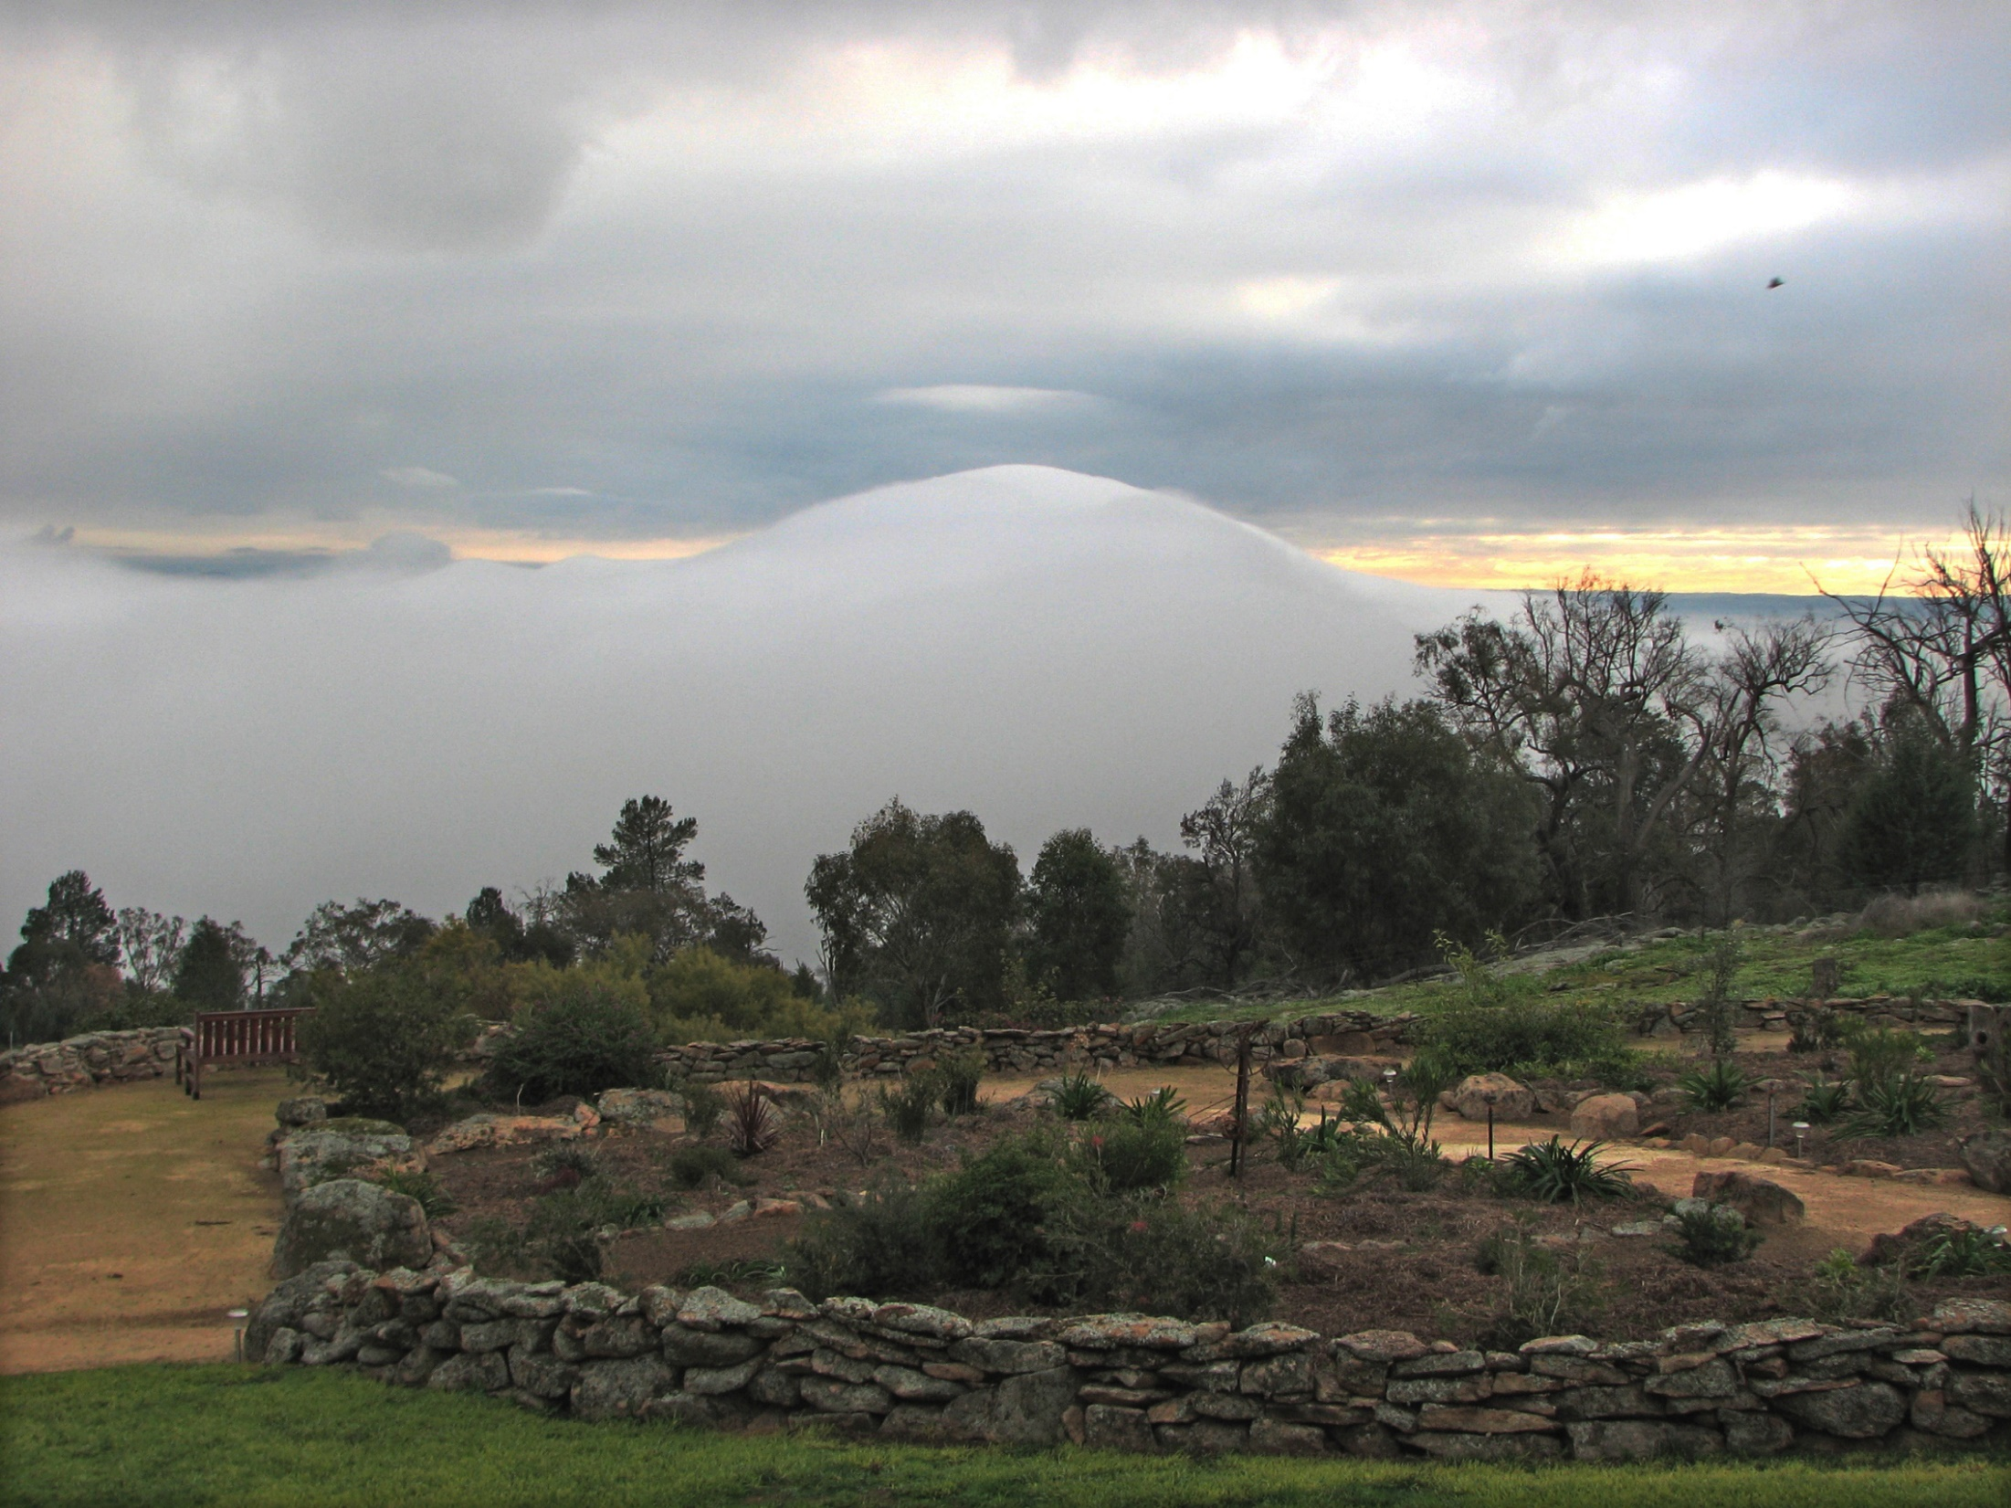
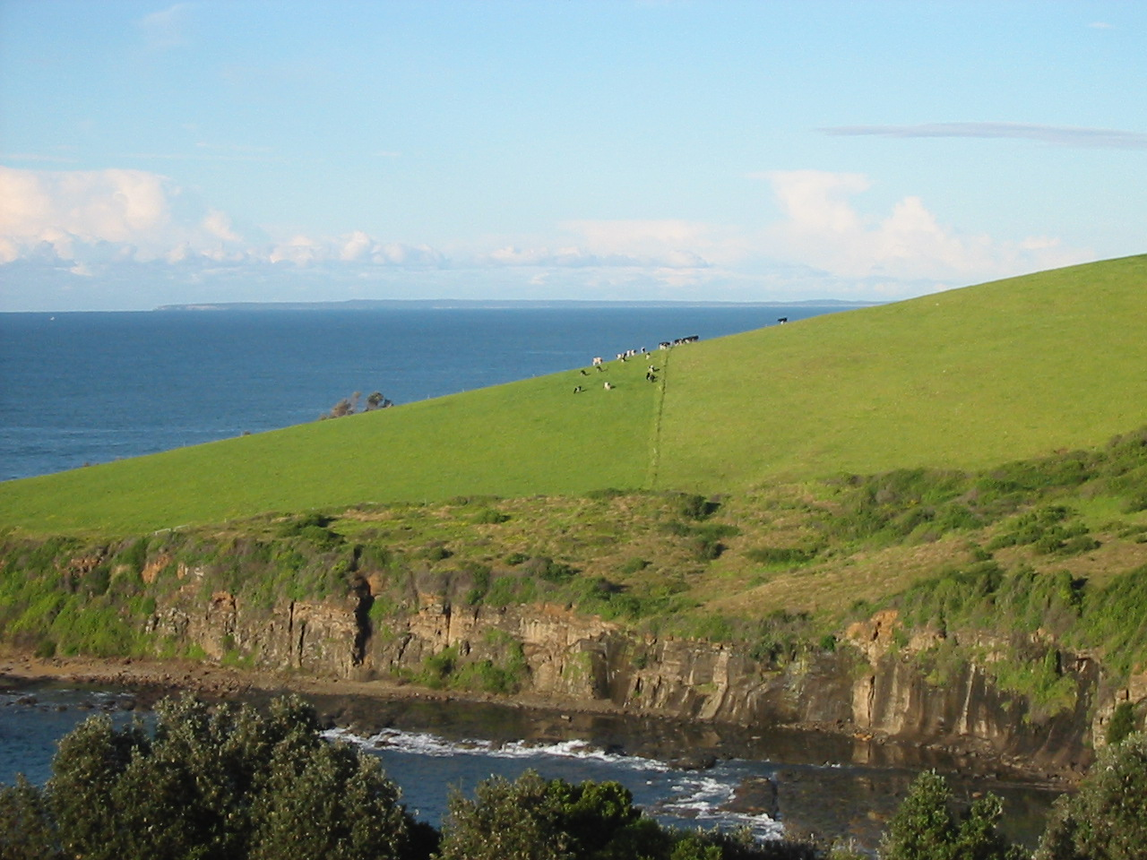
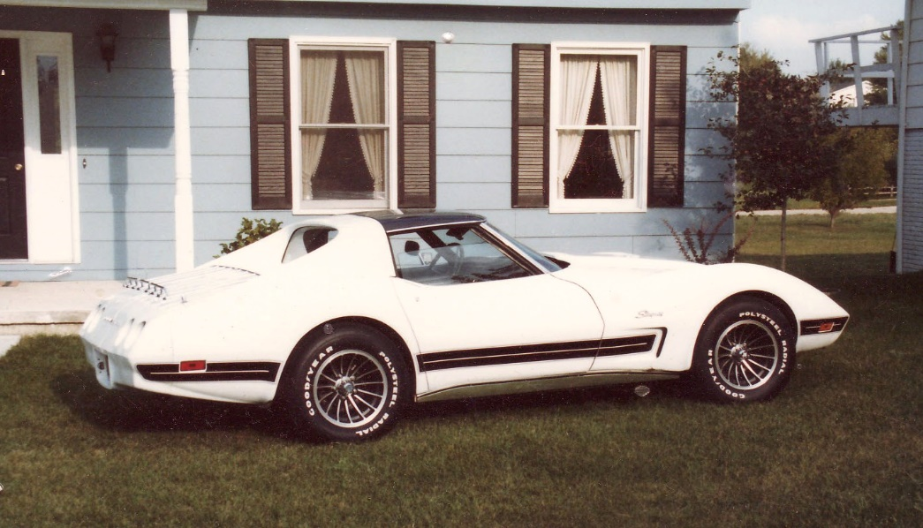

Slide 8
1
Photo per page
And fill the page

Slide 9
Notes:
This slide doesn’t do justice to any of these pictures

Slide 10
Notes:
And this is worse…smaller just to show the logos

Slide 11
Notes:
Often the picture speaks for itself…Here a PHF is awarded and friends enjoy the event

Slide 12
Important points
Prepare
Practice
Talk to the back Row
Good Animation
Bad Animations
Bad Animations

Slide 13
Important points
Prepare
Practice
Talk to the back Row
Good Animations
Bad Animations

Slide 14
Resources
Google - Images, Maps
Youtube, Wikipedia
RI, District 9700
Photos, cartoons

Slide 15
Click below for Death by PowerPoint video
http://youtu.be/KbSPPFYxx3o

Slide 16
PETS 2015
PowerPoint Presentations Paul Murray

