Slide 1
Matching District & Club Structures
Paul Murray

Slide 2
District Board Structure
Administration
Service Projects
Foundation
Youth
Membership
Public Image
Administration
Service Projects
Foundation
Youth
Membership
Public Image

Slide 3
The District Structure is used in all
our publications

Slide 4
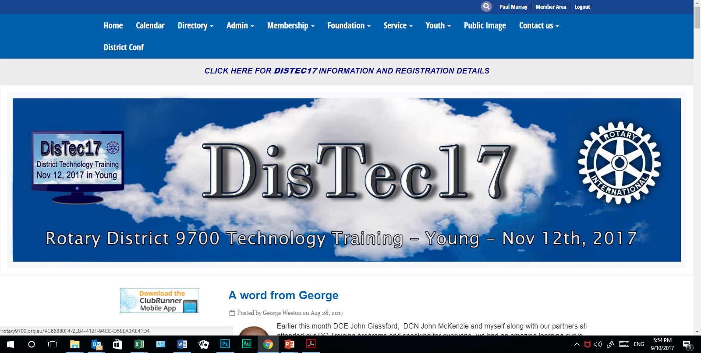
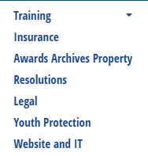
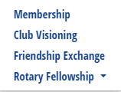
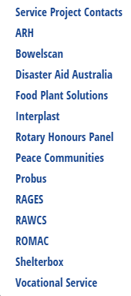
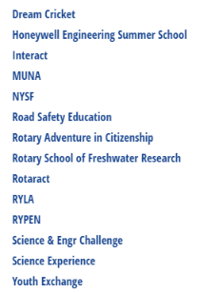

Slide 6
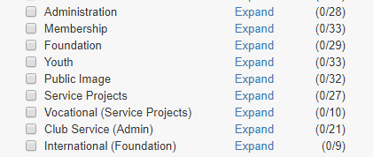
Club Matched Structures
Communications Problems
Unmatched Structures

Slide 7
International Svc
PREVIOUS
CURRENT
Club Service
Administration
Bulletin Editor
Ast bulletin Editor
Membership Development
Membership Classification
Programmes
Apologies Officer
Rotary Information
Risk management OH & S
Resource Committee
Sergeant at Arms
Asst Sergeant at Arms
Sprting/Social Activities
Club Historian
Property
Asst Treasurer
Attendance
Public Officer
District Conference
Internet Communications Officer
Service Projects
Community Svc
Foundation
Vocational Svc
Youth
Membership
Youth Service
Public Image

Slide 8
CURRENT
Administration
Bulletin Editor
Ast bulletin Editor
Membership Development
Membership Classification
Programmes
Apologies Officer
Rotary Information
Risk management OH & S
Resource Committee
Sergeant at Arms
Asst Sergeant at Arms
Sprting/Social Activities
Club Historian
Property
Asst Treasurer
Attendance
Public Officer
District Conference
Internet Communications Officer
Service Projects
Foundation
Youth
Membership
Public Image

Slide 9
How do we fix it - Short term
MAPPING
In Club Runner…….ForClubs>Define Club Executives
Set “Position” to the matching District Directors
Title
Position
Name

Slide 10
How do we fix it...Long Term
Update Club Structure
Plan it in 2018-19 year
Update ByLaws

Slide 11
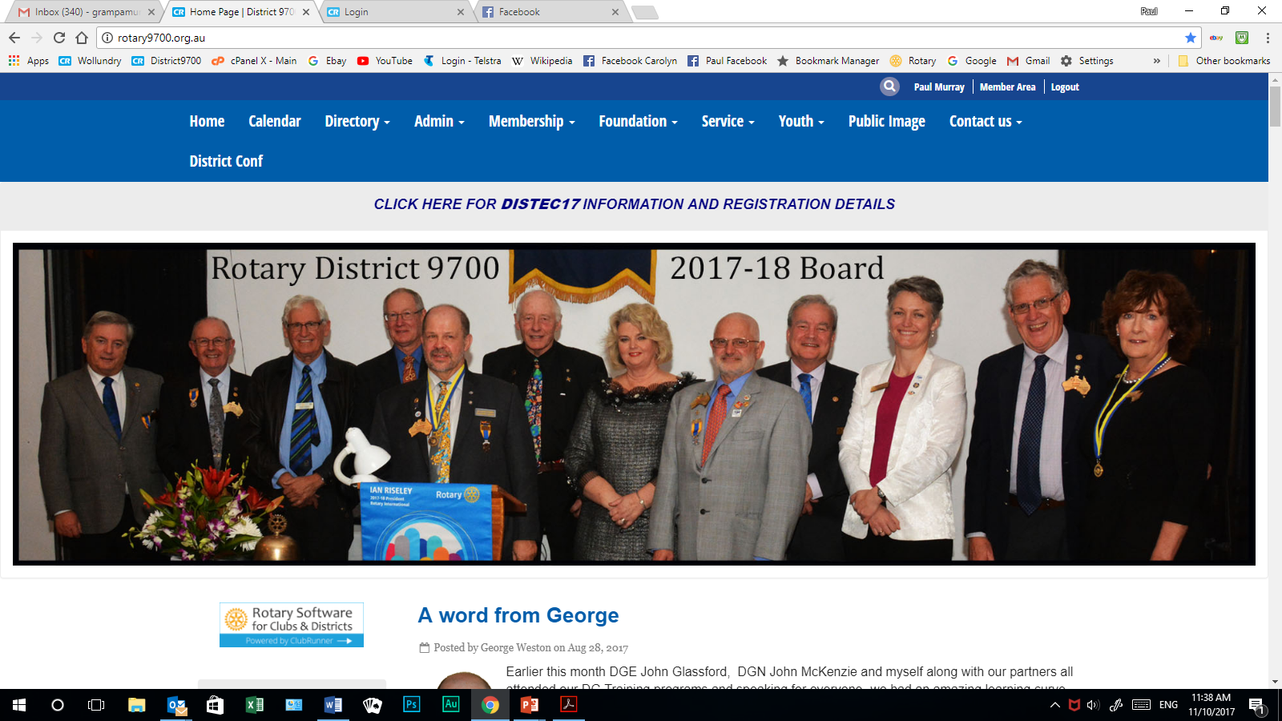
To download a “Bylaws” Template from our website
Go down to “Homepage Download Files”

Slide 12
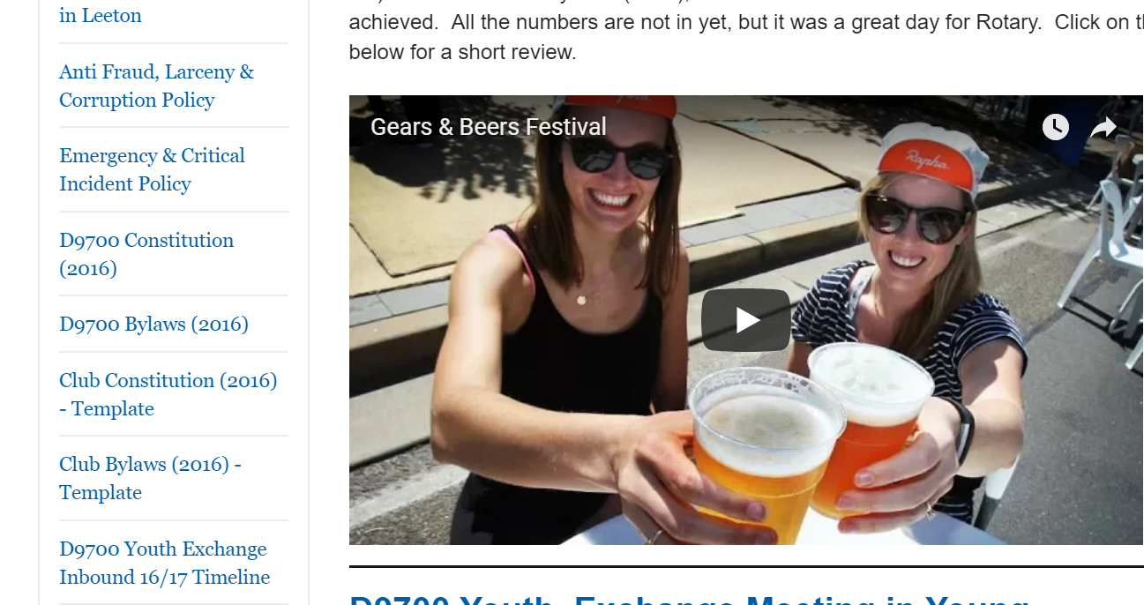

Slide 14
Summary
Need to match Club structures with District structures
Short term - Mapping
Long term - Restructure

Slide 15
Thank You

