Slide 1
Assigning Club Officers Correctly

Slide 2
District Board Structure
Administration
Service Projects
Foundation
Youth
Membership
Public Image

Slide 3
The District Structure is used in all
our publications

Slide 4
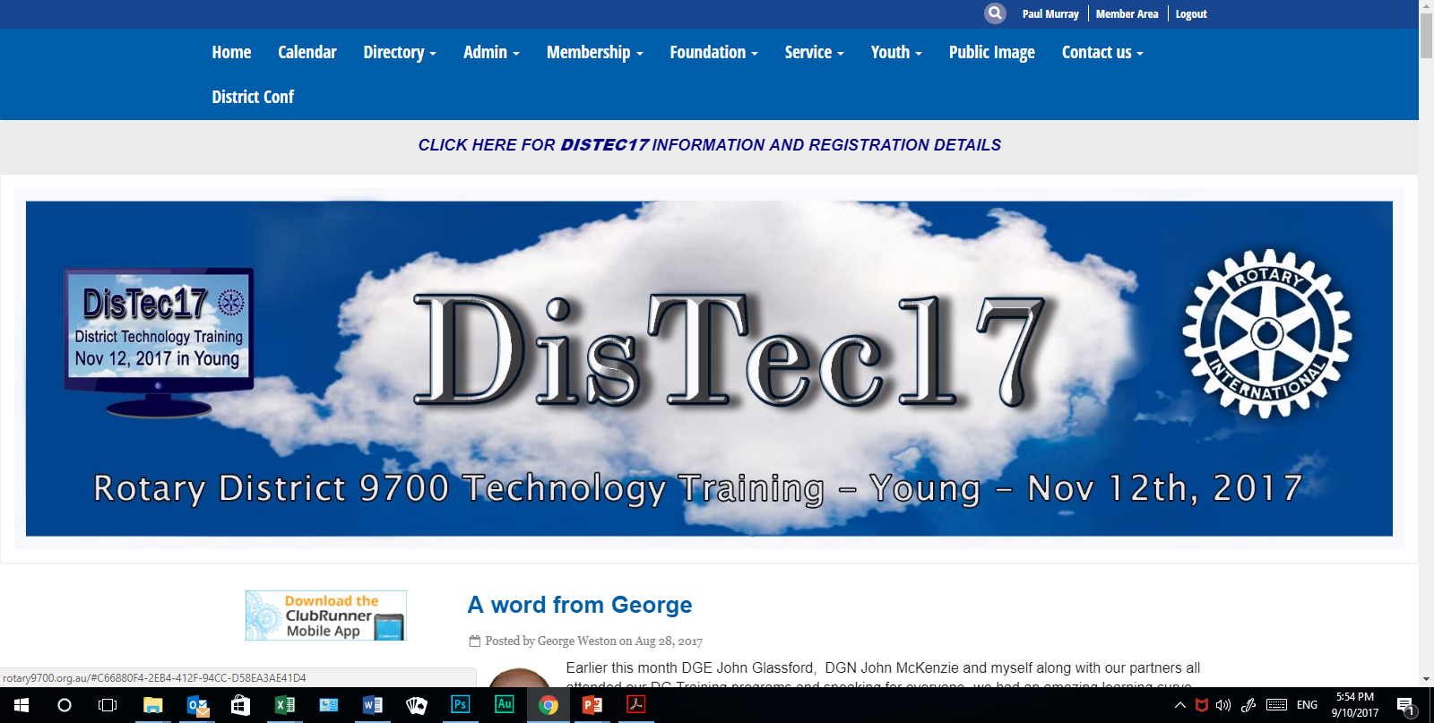
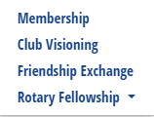
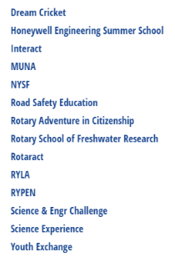

Slide 6
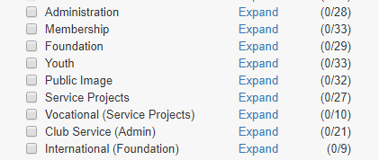
Club Matched Structures
Communications Problems
Unmatched Structures

Slide 7
International Svc
PREVIOUS
CURRENT
Club Service
Administration
Bulletin Editor
Ast bulletin Editor
Membership Development
Membership Classification
Programmes
Apologies Officer
Rotary Information
Risk management OH & S
Resource Committee
Sergeant at Arms
Asst Sergeant at Arms
Sprting/Social Activities
Club Historian
Property
Asst Treasurer
Attendance
Public Officer
District Conference
Internet Communications Officer
Service Projects
Community Svc
Foundation
Vocational Svc
Youth
Membership
Youth Service
Public Image

Slide 8
CURRENT
Administration
Bulletin Editor
Ast bulletin Editor
Membership Development
Membership Classification
Programmes
Apologies Officer
Rotary Information
Risk management OH & S
Resource Committee
Sergeant at Arms
Asst Sergeant at Arms
Sprting/Social Activities
Club Historian
Property
Asst Treasurer
Attendance
Public Officer
District Conference
Internet Communications Officer
Service Projects
Foundation
Youth
Membership
Public Image

Slide 9
How do we fix it...Long Term
Update Club Structure to match District
Plan it in 2018-19 year
Update ByLaws

Slide 10
How do we fix it - Short term
MAPPING
ToDo in ClubRunner: ForClubs>Define Club Executives
Set “Position” to the matching District Directors
Title
Position
Name

Slide 11
For Clubs>Defining Club Executives
Two (2) tasks
In current year, check our clubs to see if any have Positions that are not consistent with the 6 District. If you find one correct it.
Next year, Practice...add some executives. (They can be removed)

Slide 12
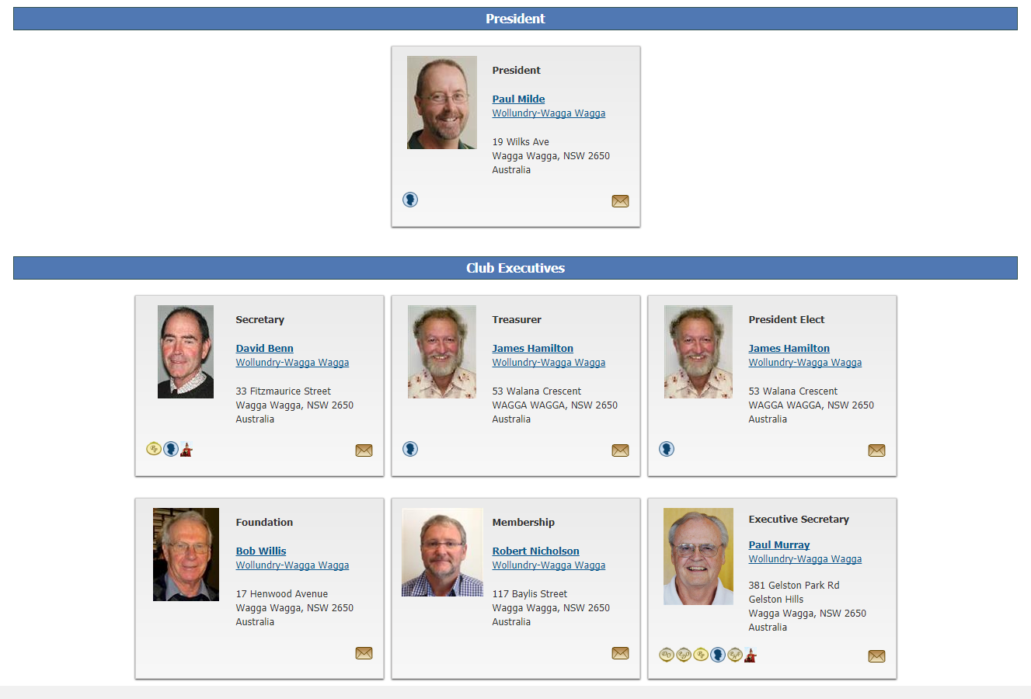
Updating Club Info
For Clubs>Edit Club Information

Slide 13
Committee Modules
Organization>District Committees>Website and IT

Slide 14
Well done

