Slide 1

MULTI-CLUB PROJECTS
ROTARY ADOPT A TREE PROMOTIONAL PLAN
Featuring examples from Berry Rotary Club’s action plan
Notes:
The Rotary Adopt A Tree (AAT) program was launched at the D9705 District Conference in March 2022 and Acting DG Michael Moore wrote to all Presidents asking them to consider promoting the program to their communities. All Club E-Reps were advised at the same time.
This document is designed to help your club develop a plan to promote the AAT program and suggests 7 different ways to do so.
Examples of the plan developed by Berry RC are shown to assist you
Your club can use this PowerPoint template to incorporate your specific local plan replacing the Berry RC content. Or use some other format (eg Word)

Slide 2
CLUB ROLE
Promote to your local community
Join future planting events
CLUB BENEFITS
Protect the environment
Involve your local community
Attract new members
Notes:
This slide shows the pull up banner that has been developed for the program which summarises the AAT program. Artwork for the banner can be downloaded from the environmental page on the District website and the banner produced by a local printer or Officeworks Online for about $100.
The roles of your club in supporting the program and the benefits of participation are shown above.
The opportunity to recruit new members is particularly significant as clubs seek to maintain and boost membership.

Slide 3




PROMOTIONAL OPTIONS FOR CLUBS
Social Media
BERRY RC: Promote via the Berry Community Facebook group and other social media networks in Berry
Notes:
This slide show the first option to promote AAT. (The following 6 slides show the other options)
Your club can promote AAT via any or all social media networks that are popular in your community – Facebook, LinkedIn, Twitter or Instagram. Also, via networks of friends.
This could be the most effective means of communicating broadly in your community
If you do not have a Rotary member familiar with social media, you could seek support from a younger family member of a Rotarian who is..
.

Slide 4
Local Media
BERRY RC: Arrange an article promoting Rotary Adopt A Tree
Notes:
This is the second option and involves you in promoting the AAT program in the local print media (newspaper, magazine) that has widespread coverage in your community.
Your club may already include articles about your events and projects in local media. This could simply be added to the mix.
Content for an article could be sourced from the AAT website or via your assigned Environmental Envoy.

Slide 5

Club or Community Events
BERRY RC: Display banner and hand out flyers at the Rotary command centre at this major event
Notes:
The next option is to promote AAT by having your Rotary members hand out flyers at events that you organise or participate in. The AAT pull up banner can be deployed to support the activity.
The flyer is shown on the first slide and artwork can be downloaded from the District website like the banner.
The cost of printing flyers is relatively small (e.g. 10,000 flyers for $600)

Slide 6
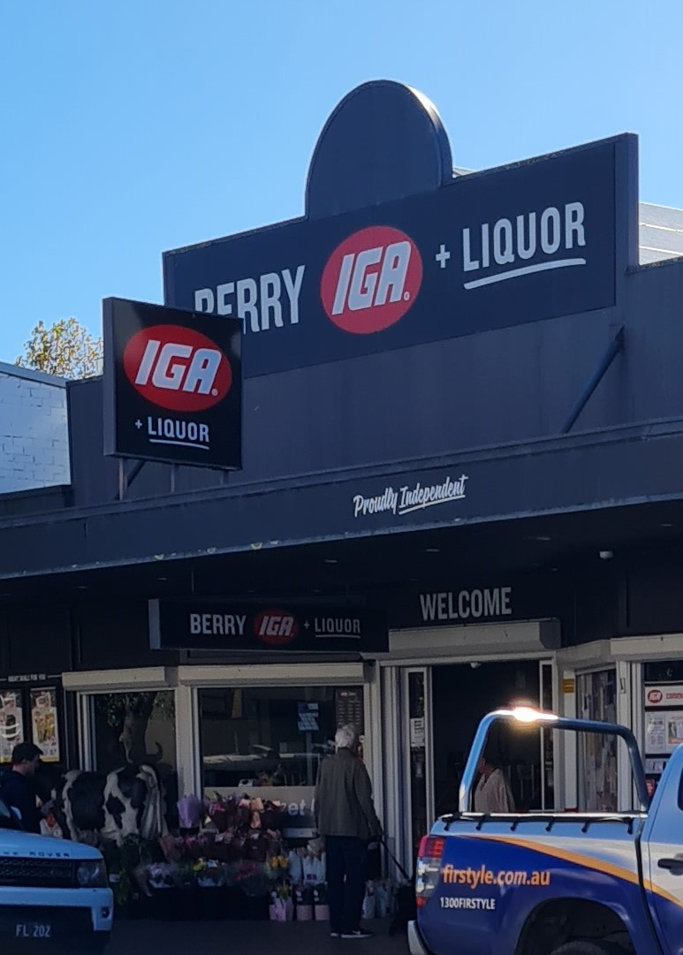
Businesses
BERRY RC: Arrange with the Berry IGA to have staff hand out flyers at check outs – starts 9 June
Notes:
If you have a large retail business in your area, you can ask them if they can hand out AAT flyers for a good cause.
D9675 organised a promotion with Bunnings. Berry RC has organised one with its local IGA. As an idea, you could ask your local supermarket to help you.
Berry RC will arrange a photo opportunity outside the IGA with the owner and some employees and we will post this to Facebook for publicity purposes in June.

Slide 7
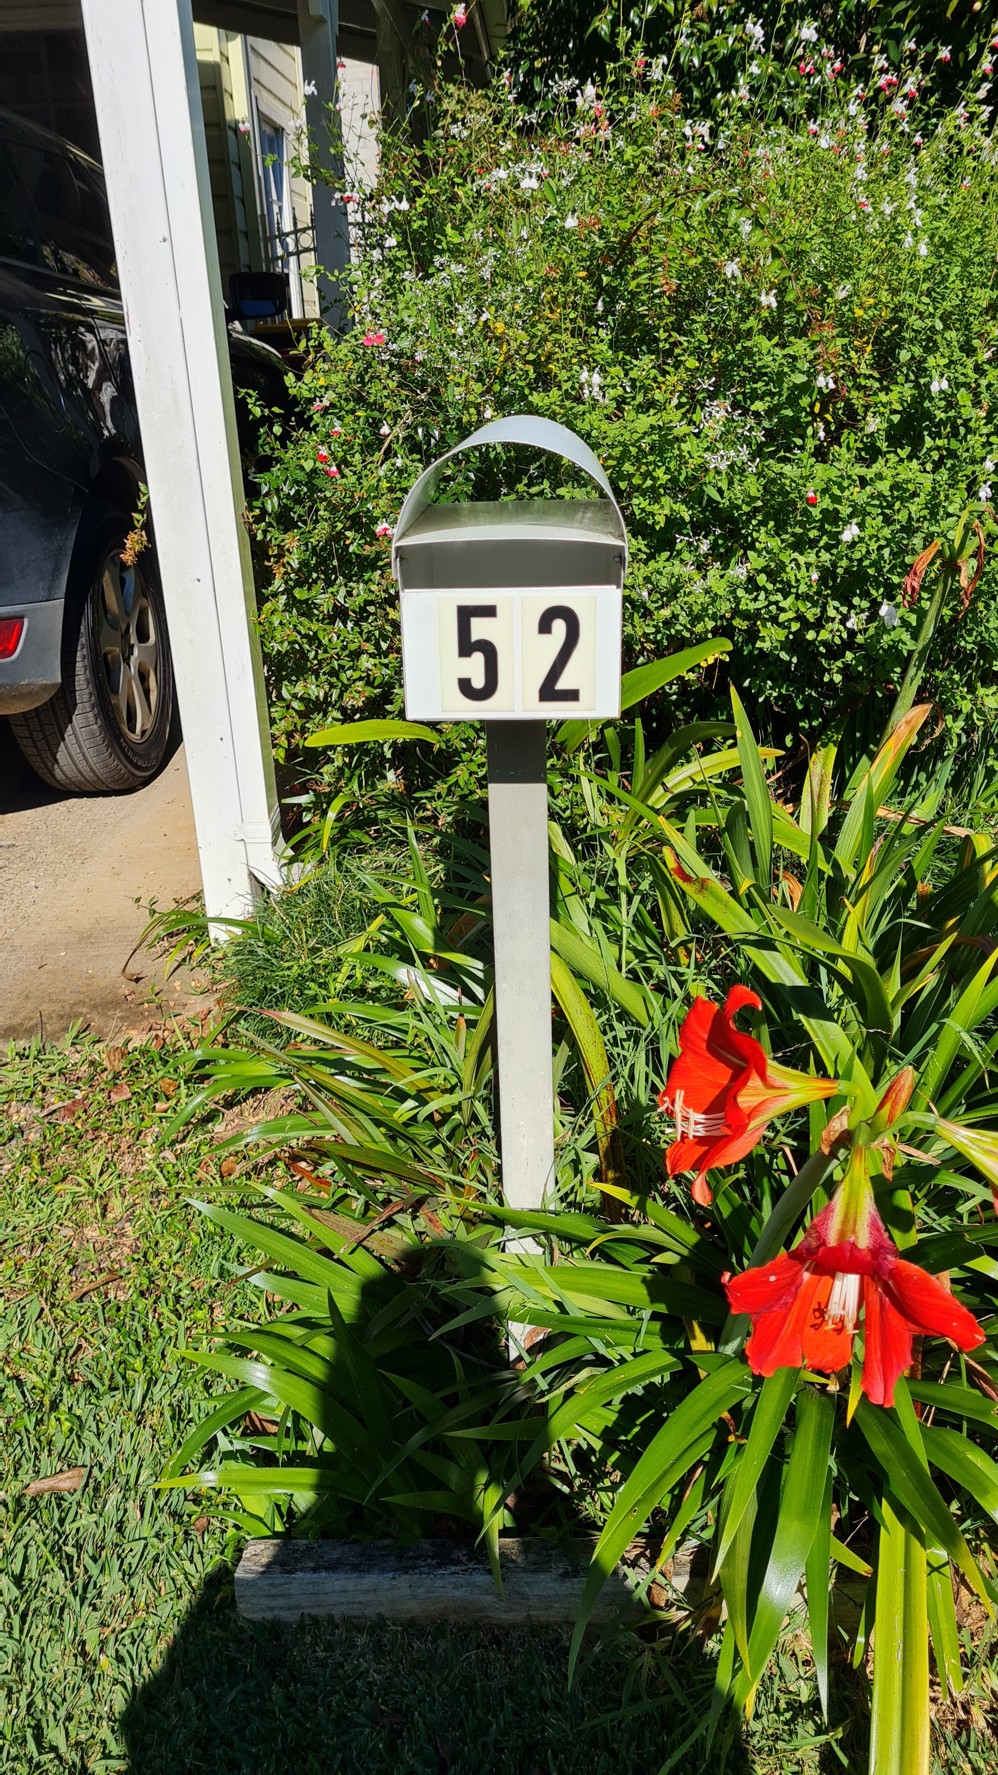
Home Delivery
BERRY RC: Pay local distribution business to deliver flyers to all homes
Notes:
The simplest option is to pay a distributor of promotional material to distribute AAT flyers to the letterboxes in your area. You can cover all the homes in your area with no need to ask for support from any of your members.
The distribution cost can be quite small

Slide 8
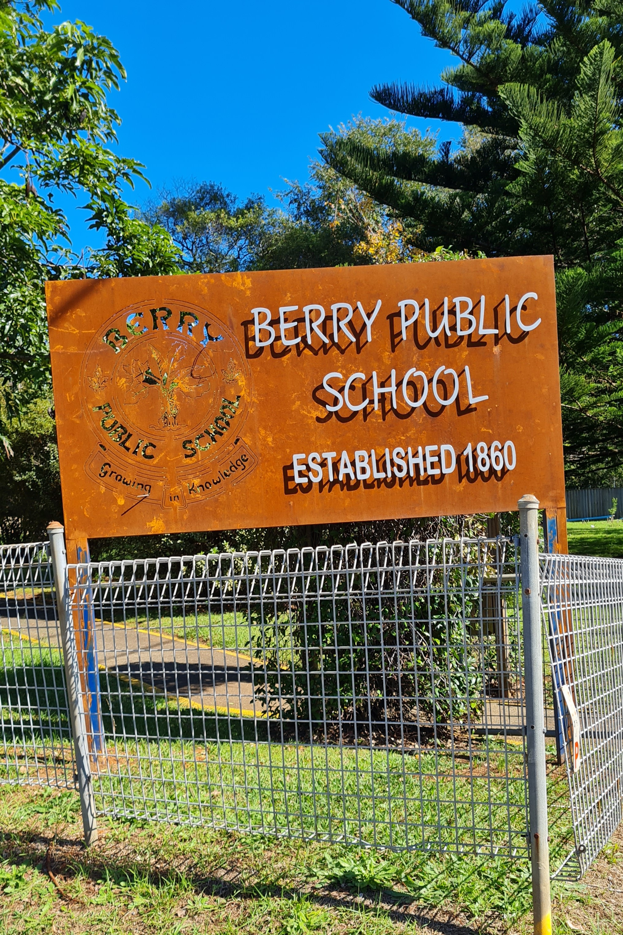
Local School Community
Not in Berry’s plan because school has a well-established plant propagation unit.
Other Clubs can gift tree donations to school children or arrange flyer distribution via the school
Notes:
Engaging with your local school community is a great way to promote Adopt A Tree. The members of the community are generally supportive of environmental initiatives.
This slide mentions two ways to involve the school:
Your club funding the gifting of tree adoptions to children
Arranging the distribution of flyers to parents

Slide 9

Speaker Gifts
Gift a tree donation to your speaker – he/she can adopt more trees and promote to friends and family
Notes:
Finally, why not gift a tree donation (to one or more trees) to your guest speakers instead of your normal gift. This could be done for a limited period of time or as a regular practice.

Slide 10
RESOURCES AND COSTS
Rotarians
Club E-Representative
Club Communications person
Assigned District Envoy
Flyer handouts by members
Costs (club/area dependent)
2 x Pull Up Banners* ($200)
10,000 DL Flyers ($600)
1,000 Letterbox drops ($100)
* Adopt A Tree and Rotary Area of Focus banners
Notes:
This slide highlights how little effort and cost is involved in promoting Adopt A Tree.

