Slide 1
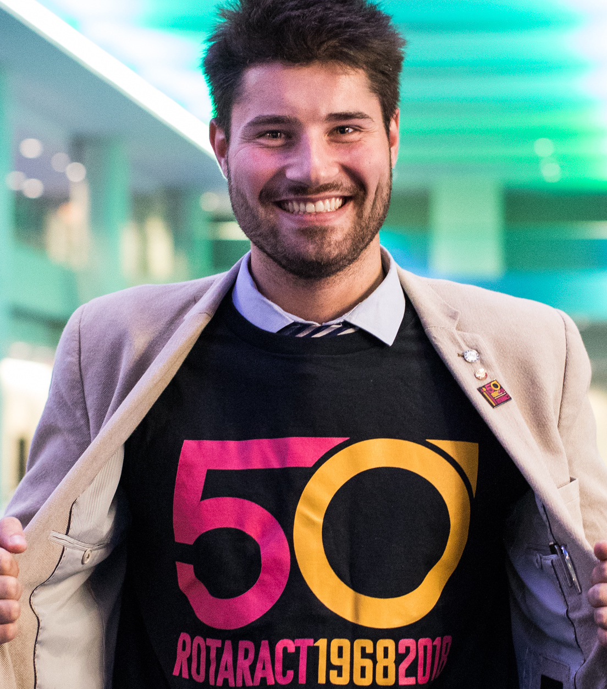
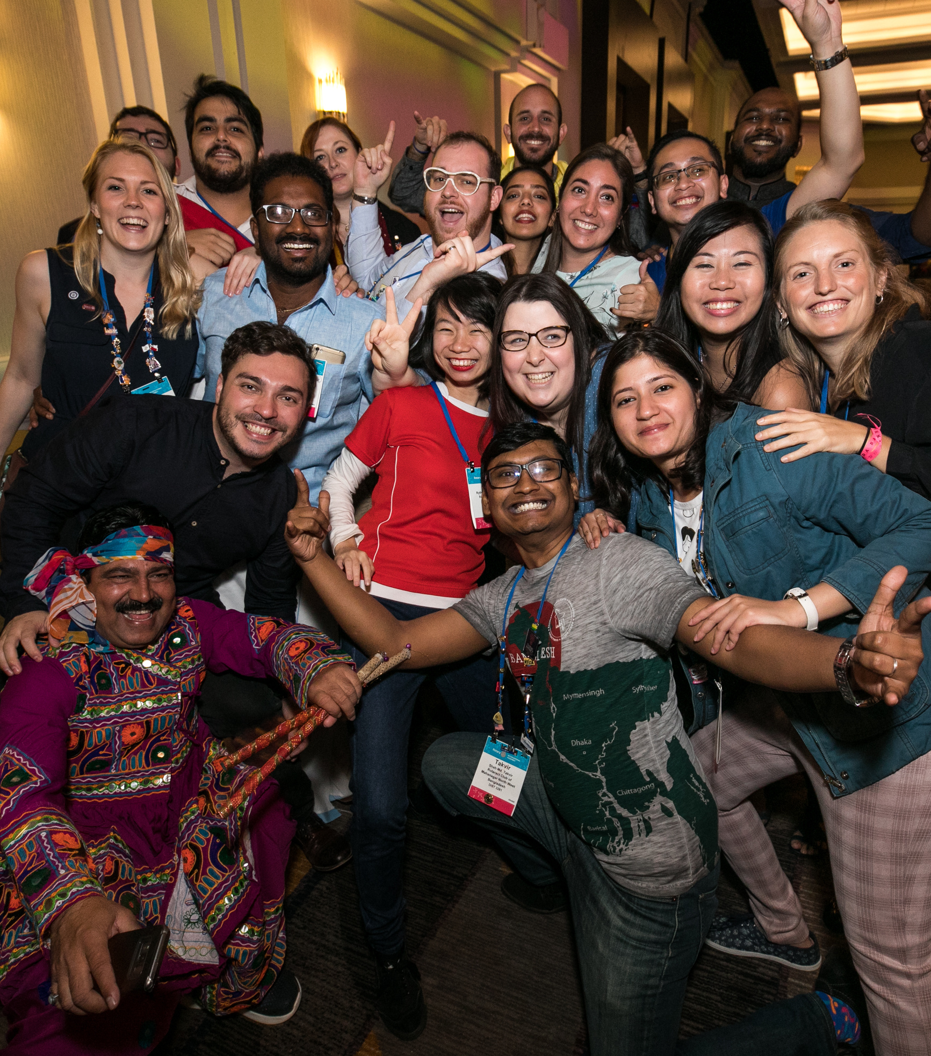

Slide 2
Rotaract ELEVATED
2019 Council on Legislation
The definition of membership in Rotary International expanded to include both Rotary and Rotaract clubs.
Rotaract clubs and Rotaractors viewed as members of RI rather than as program participants.

Slide 3
Grow Rotaract
October 2019 Board Decision
Rotary International has set goals for Rotaract to:
  Increase the number of Rotaractors reported to Rotary by 100 percent by 2022
  Increase the number of reported Rotaractors who join Rotary clubs by 20 percent by 2022
  Increase the number of reported Rotaractors to 1 million by 2029

Slide 4
Sponsorship Policy
October 2019 Board Decision
Rotaract clubs will be able to establish a new club with or without a sponsor.
Rotaract clubs will able to choose other Rotaract clubs as their sponsors.
Changes went into effect 1 July 2020

Slide 5
Age Policy
October 2019 Board Decision
Rotaract clubs will be open to all young adults at least 18 years old.
JANUARY 2020 Clarification: The Board agrees that a Rotaract club may, but is not required to, establish upper age limits, provided that the club (in accordance with its bylaws) obtain the concurrence of its members and the sponsor club(s) (if applicable).
Changes went into effect 1 July 2020

Slide 6
DUES SURVEY OBJECTIVES
The survey aimed to gather Rotaractors’ ideas about:
What’s an appropriate and fair amount for them to pay
How dues should be calculated
What clubs should receive in exchange for paying dues

Slide 7
IDEAL PER CAPITA DUES
The survey asked Rotaractors how much they should pay each year.* Their responses:
Average: $7.94
Median: $5.00
Maximum: $39.56
Majority: less than $10.00
*The highest values were omitted to provide more representative data.

Slide 8
IDEAL DUES BY CLUB TYPE
The average ideal per-person dues that community-based clubs suggested was $8.43.
For university-based clubs, it was $6.37.
*The highest values were omitted to provide more representative data.

Slide 9
DUES POLICY
January 2020 Board Decision
The Rotaract dues amount will be:
$5 for members of university-based clubs
$8 for members of community-based clubs
Annual dues will be collected starting 1 July 2022.

Slide 10
AWARDS POLICY
April 2020 Board Decision & June 2020 Trustee Decision
Rotaractors shall be eligible for nomination for the following awards:
ROTARY INTERNATIONAL
Avenues of Service Award
Significant Service Award
Service Above Self Award
Changes went into effect 1 July 2020
THE ROTARY FOUNDATION
District Foundation Service Award
Citation for Meritorious Service
Distinguished Service Award

Slide 11
FOUNDATION POLICY
A PAGE FOR BIG BOLDBULLET ITEMS
June 2020 Trustee Decisions
Rotaract clubs are allowed to be either the international or host sponsor of a global grant beginning 1 July 2022, provided they have previously partnered with a Rotary club on a global grant;
Grants Center will allow Rotaract clubs to be formally recognized as a donor or partner on a global grant application;
No rights or privileges previously afforded to Rotaractors as program participants will be revoked.

Slide 12
What can you do?
Discuss these changes with your club and district leaders.
Make sure Rotaractors have My Rotary accounts and that they’re listed as a member of their Rotaract club. Having an account will allow access to new products, services, and important information from Rotary.
Rotary will support clubs that struggle to pay any additional amount by exploring strategies such as fundraising, engaging local businesses, and working with their sponsors.

Slide 13

Resources
Summary of changes and frequently asked questions: on.rotary.org/RACpolicy2020
Dues Survey Findings Report:
on.rotary.org/RACdues
Email: rotaract@rotary.org

