Slide 1
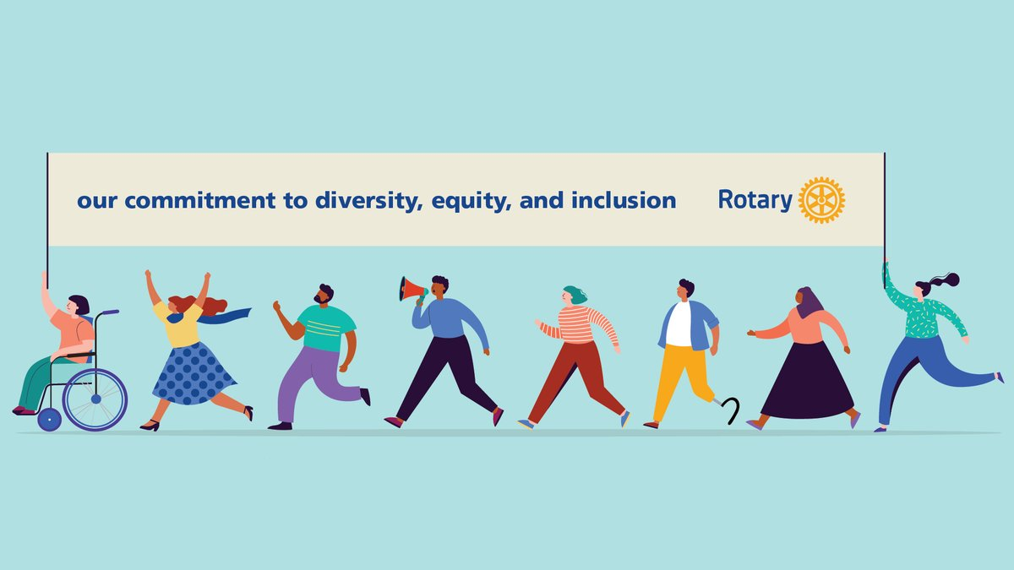

Slide 2
How do you define this concept?
What does it mean for Rotary?

Slide 3
DIVERSITY:
How do you define this concept? The presence of a range of attributes and qualities, including, but not limited to, differences in ethnic and cultural background, religion, language, sexual orientation, abilities, age, socio-economic status and geographic location (rural or urban).

Slide 4
EQUITY:
eliminating systematic barriers and prejudices to ensure that all people are treated fairly and have equal opportunities for education, employment and advancement. Equity recognizes that certain groups have long been disadvantaged in access to education and employment, and takes these differences into account to ensure a fair process and outcome.

Slide 5
INCLUSION:
Creating an environment and culture in which each person or group feels welcomed, respected, valued and supported.

Slide 6

HOW CAN YOU SUPPORT DEI IN OUR CLUB AND PROGRAMS?

Slide 7
    IMPROVING YOUR KNOWLEDGE AND ABILITY TO FACILITATE POSITIVE DISCUSSIONS ON THE DEI ISSUE THROUGH ROTARY'S ONLINE COURSES:
DCI - Basics
DCI - Intermediate
DCI Webinar Series

Slide 8
2. RAISING AWARENESS OF DIVERSITY, EQUITY AND INCLUSION IN YOUR CLUB BY:
Talking about the benefits of a club being diverse and inclusive, and developing an action plan for DCI
Inviting a local expert in diversity, equity and inclusion to speak at your club
Connecting with local associations that support DCI's efforts and collaborating with them on projects or events

Slide 9
Seeking out new voices when making appointments and encouraging people who have been underrepresented in these roles to take on positions of responsibility
Designing inclusive youth programs that instill a sense of belonging to Rotary over the long term
Appointing a DCI chair or forming a club DCI committee that will identify opportunities to learn, share and take action.

Slide 10

Our ability to achieve unity in diversity will be the beauty and test of our civilization. Mahatma Gandhi

