Slide 1
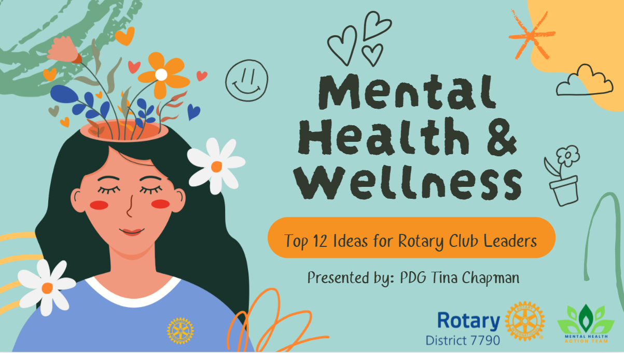
Notes:
Good evening! On behalf of our Rotary District Mental Health Action Team – I am pleased to present our Top 12 Ideas for Rotary Club Leaders to incorporate mental health and wellness within the Clubs! Let’s start the countdown!

Slide 2
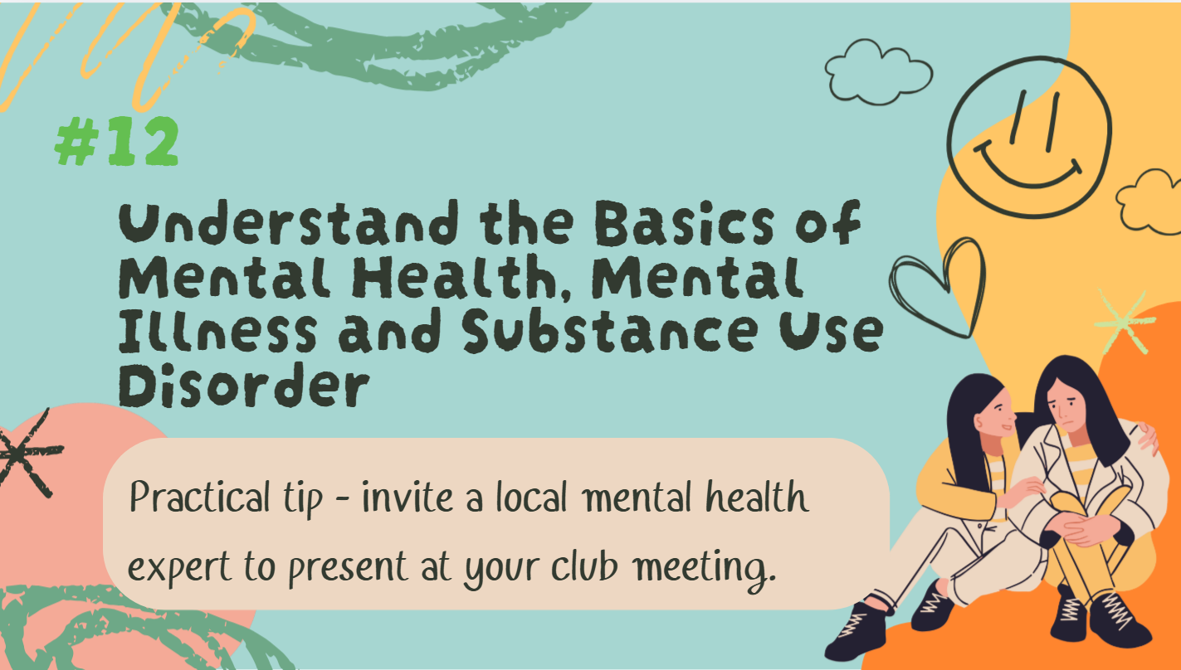
Notes:
Number 12. Understand the Basics of Mental Health, Mental Illness and Substance Use Disorder. For each item on our list, I’ll provide you with a practical tip that you can implement within your club. An easy way to understand mental health basics is to invite a local mental health expert to present at your club.

Slide 3
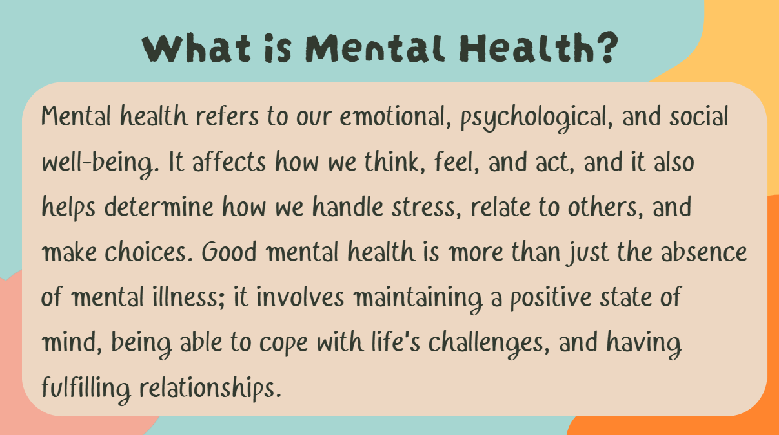
Notes:
Since understanding the basics is so important, I am going to take a few minutes to go over the basics for you this afternoon. First – let’s define mental health. Mental health is our emotional, psychological, and social well-being. It affects how we think, feel, and act. It helps determine how we handle stress, relate to other people, and make decisions. Having good mental health is more than just the absence of mental illness; it is maintaining a positive state of mind, being able to cope with life's challenges, and having fulfilling relationships.

Slide 4
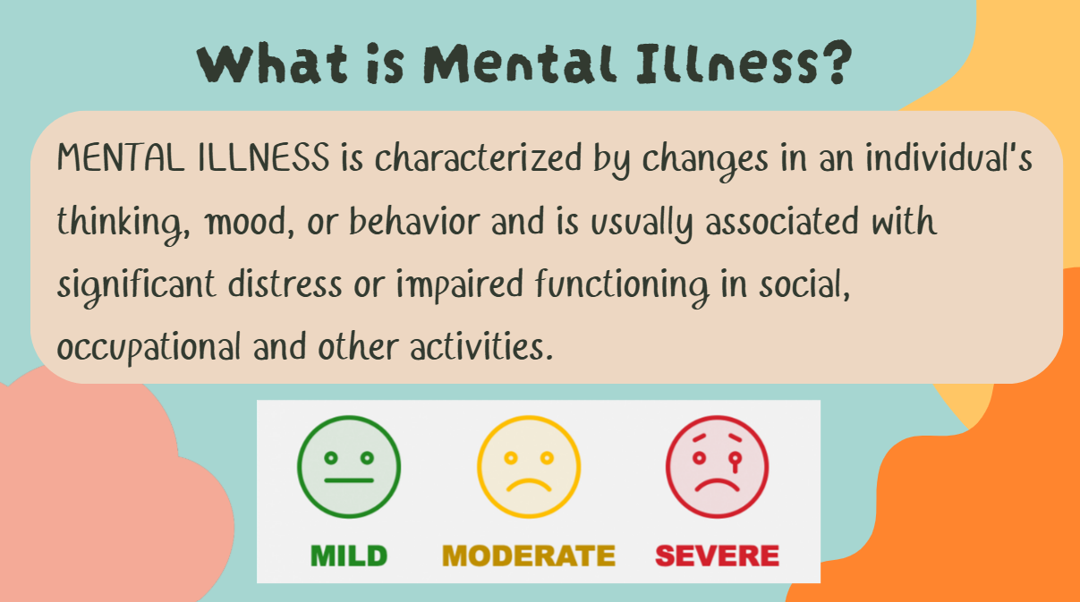
Notes:
Mental illness is defined by changes in an individual’s thinking, mood, or behavior and is usually associated with significant distress or impaired functioning in social, occupational and other activities. That is a key piece to remember – that mental illness affects one’s ability to participate in activities that they normally would enjoy. Mental illness can range from mild, sometimes temporary all the way to severe – which can be lifelong, what we call “severe and persistent mental illness: such as bipolar disorder and schizophrenia.

Slide 5
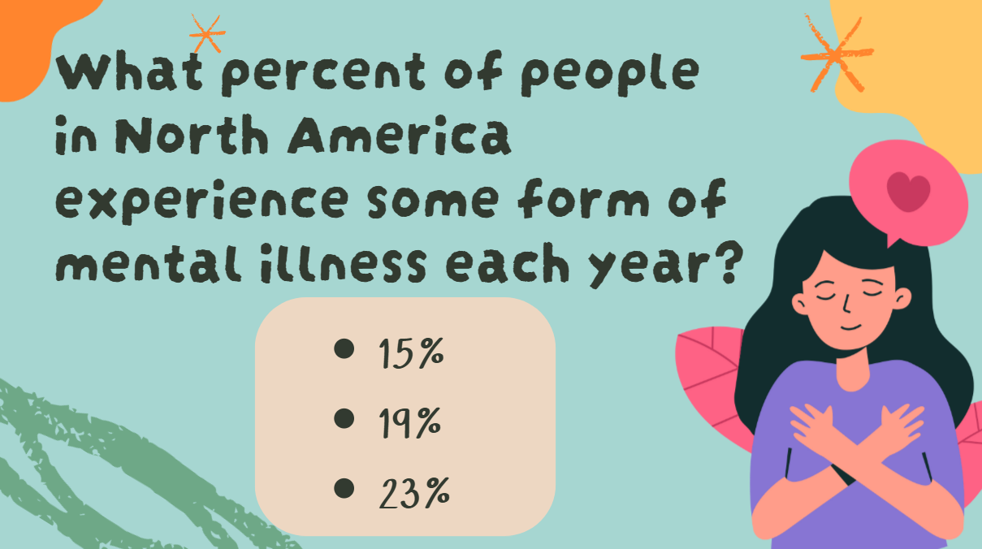
Notes:
Now – we’re going to have some audience participation. So our first question – what percent of people in North America do you think experience some type of mental illness each year? In fact it is a little over 23%. 1 in 4 adults and 1 in 5 young people will experience mental illness at one point in their lifetime. Which underscores how important it is that we address mental health.

Slide 6
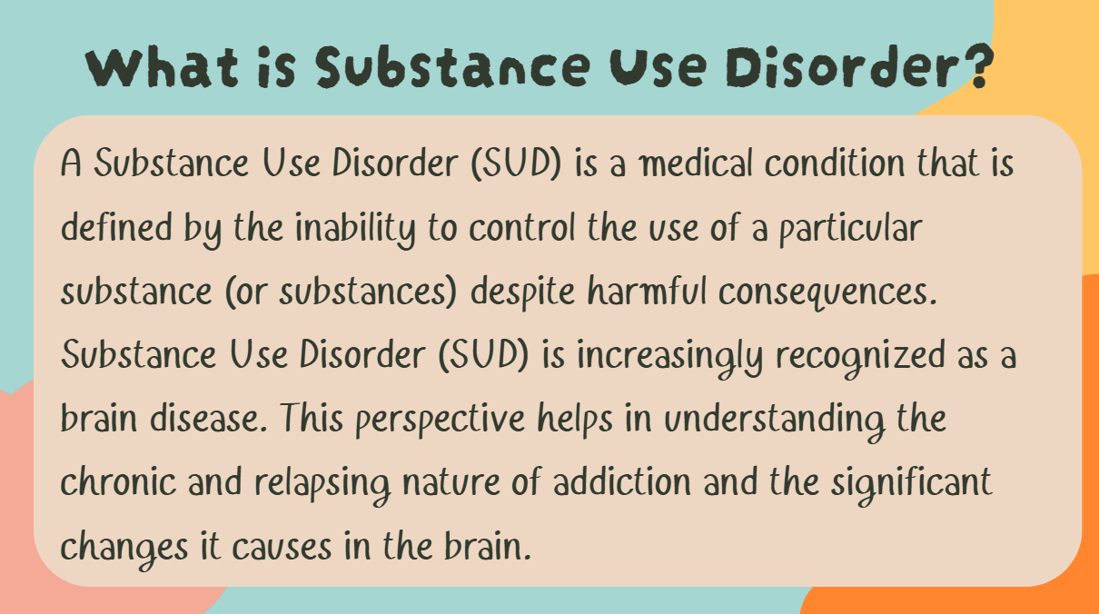
Notes:
A little but about Substance Use Disorder. Substance Use Disorder is a medical condition that is defined by the inability to control the use of a particular substance (or substances) despite harmful consequences. It is increasingly recognized as a brain disease. This helps in understanding the chronic and relapsing nature of addiction and the significant changes it causes in the brain. Anywhere from 16% - 21% of people will battle a substance use disorder in their lifetime. We could to a whole session about SUD, but it’s important to highlight because it is so pervasive and many people experience co-occurring mental illness and substance use disorder. Okay, let’s move on….

Slide 7
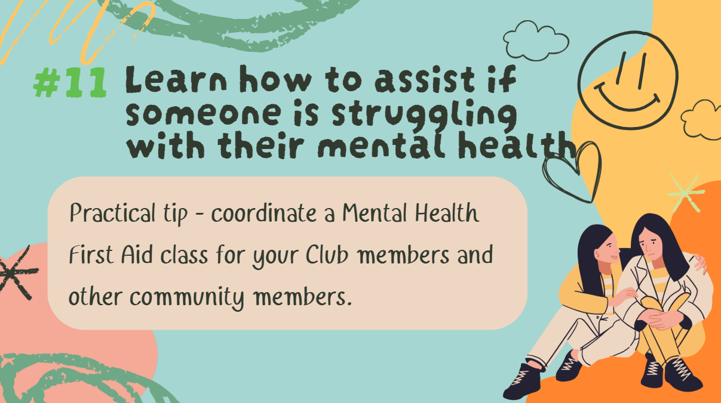
Notes:
Number 11. Learn how to assist if someone is struggling with their mental health.

Slide 8
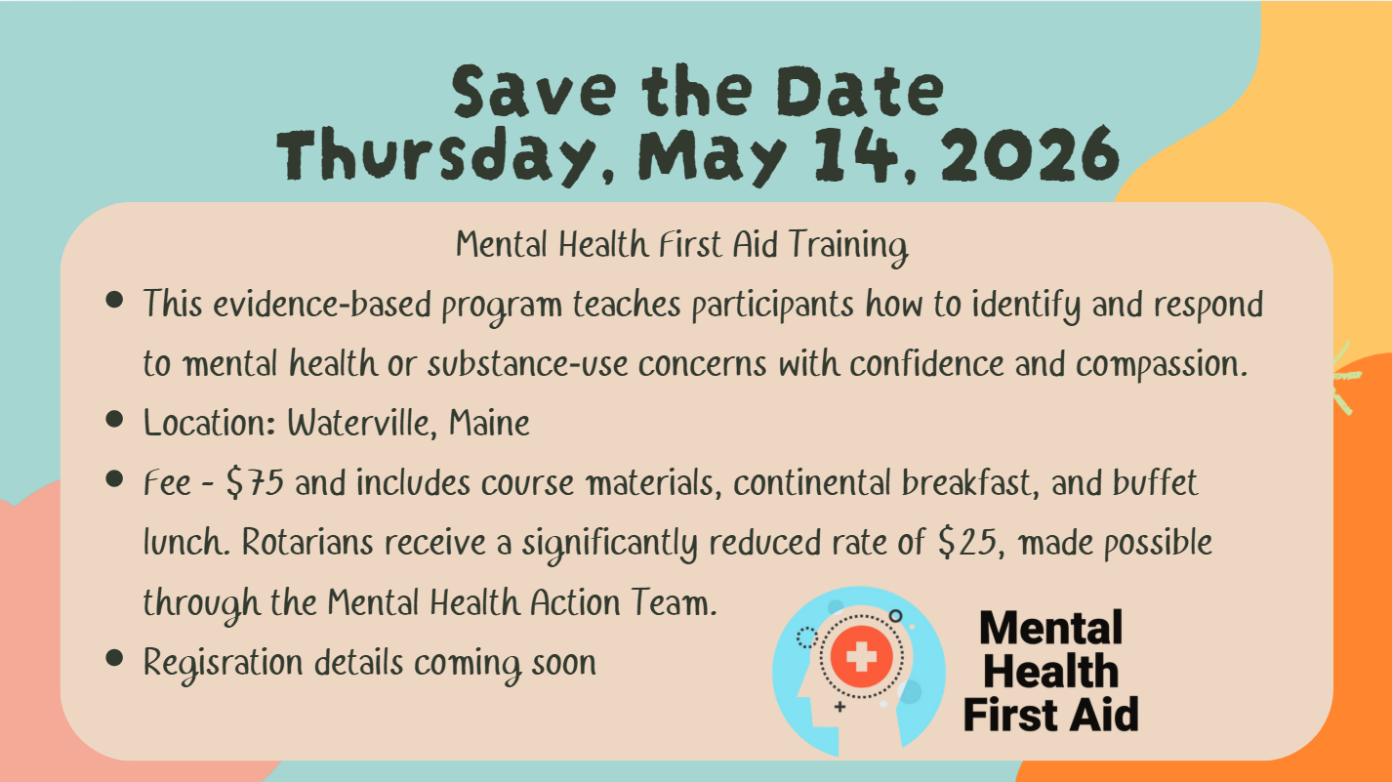

Slide 9
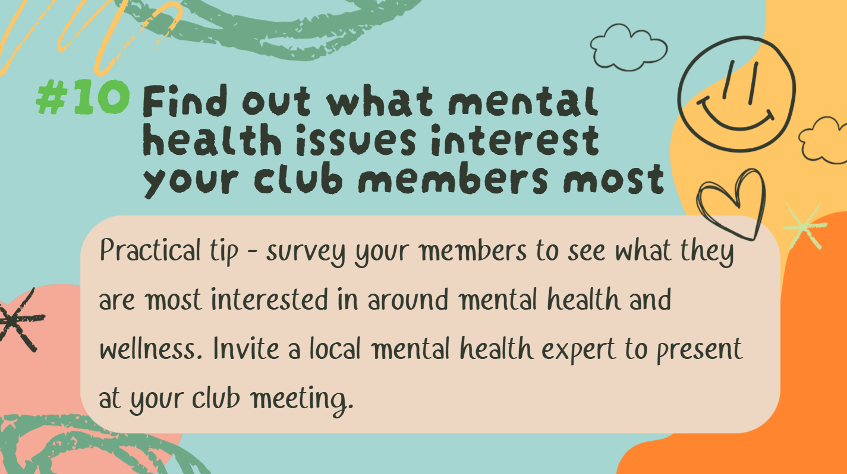
Notes:
Number 10 – Find out what mental health issue interests your club members most. Is it creating a culture of belonging? Is it suicide prevention? The opioid epidemic? Youth Mental Health? The only way to know is to ask!

Slide 10
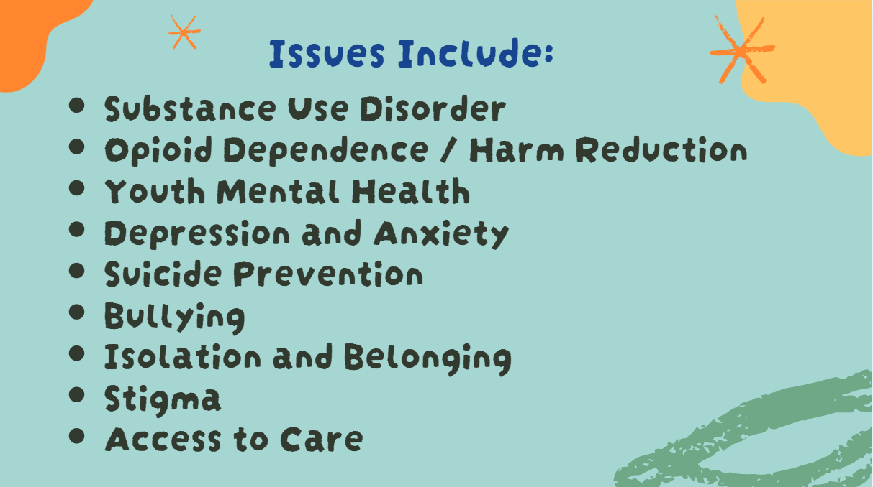
Notes:
Here are some topics that your club members might be interested in. You might remember that our MHAT asked each Club to fill out a survey so we could find out what interests you all most. When we did our survey, most clubs wanted to learn about general mental health awareness as well as substance use disorder and youth mental health. Of course with youth mental health we have some great partners with our Rotaracters and Interacters.

Slide 11
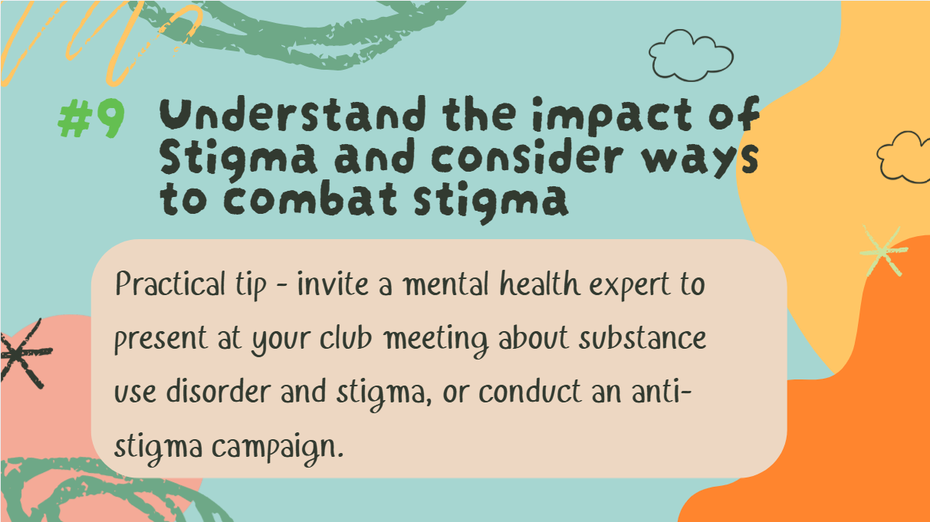
Notes:
Tip #9 - Understand the impact of Stigma and consider ways to address stigma in your community.

Slide 12
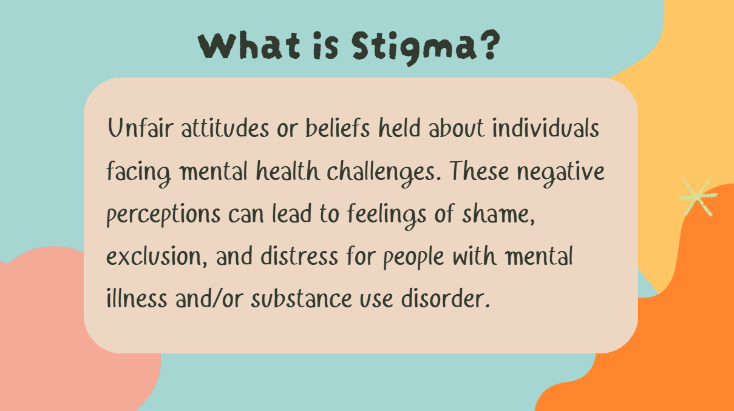
Notes:
What is Stigma? Stigma is unfair attitudes or beliefs held about people who are experiencing mental health challenges. These negative perceptions can lead to feelings of shame, exclusion, and distress for people with mental illness and/or substance use disorder.

Slide 13
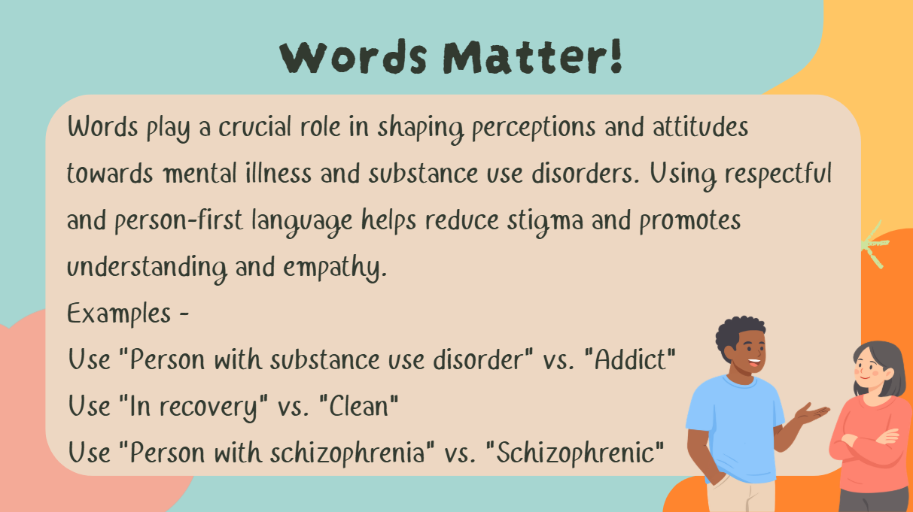
Notes:
One way to combat stigma is realizing that words matter. We talk about using “person-first” language. As an example - the term "addict" can be dehumanizing. Instead, we use "person with substance use disorder" which acknowledges the individual first, emphasizing that they are more than their disorder. Saying someone is "clean" implies that those who are not in recovery are "dirty," which is stigmatizing. Using "in recovery" focuses on the positive aspect of their journey without negative connotations. Referring to someone as "schizophrenic" equates their identity to their diagnosis, which can be stigmatizing. Instead, we say "person with schizophrenia" which emphasizes that they are a person first, who happens to have a medical condition. Have any of your Clubs done anti-stigma campaigns?

Slide 14
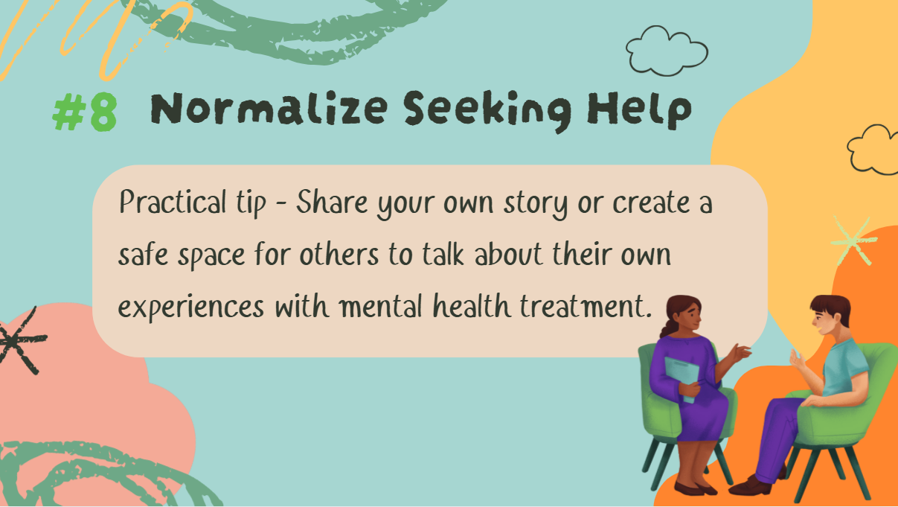
Notes:
Okay – number 8 – were going to go a little faster now! Normalize Seeking Help. This can be done by sharing your own story or creating a safe space for people to talk about their own experiences with mental health treatment.

Slide 15
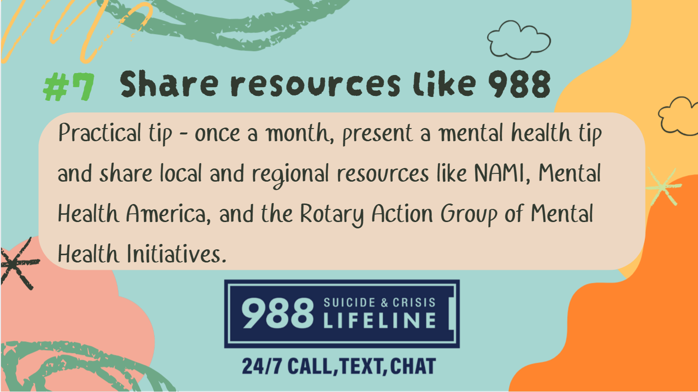
Notes:
Number 7 – Share resources like 988. 988 is the Suicide & Crisis Lifeline in the United States and Canada. It provides 24/7, free, and confidential support for people in distress, including those experiencing mental health crises, substance use issues, and suicidal thoughts. It available by phone, text or chat.

Slide 16
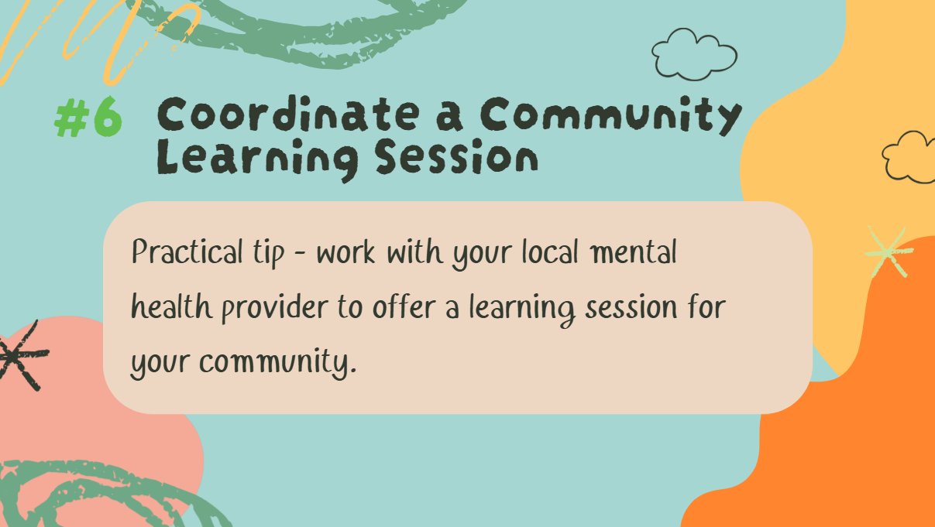
Notes:
Number 6 – Coordinate a Community Learning Session! Every community has local mental health experts that you can tap into for a community-wide presentation.

Slide 17
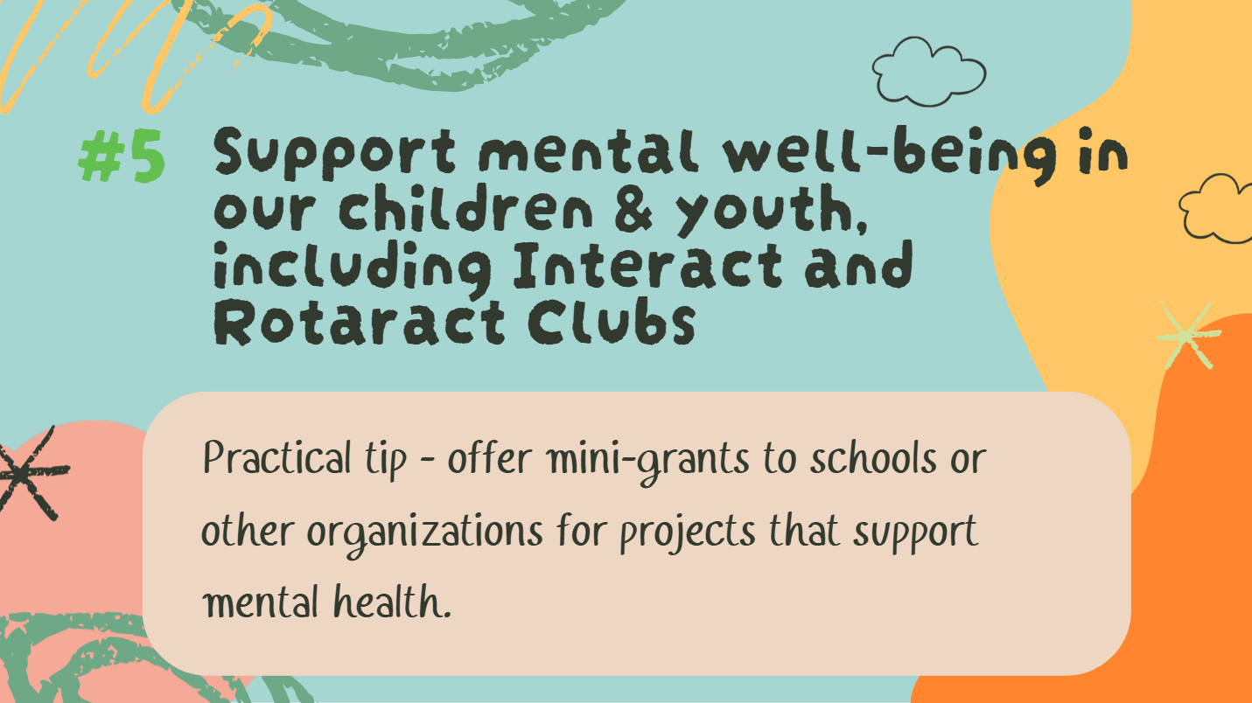
Notes:
Number 5 – Support mental well-being in our children and youth - Interact and Rotaract Clubs with their activities that are focused on mental health.

Slide 18
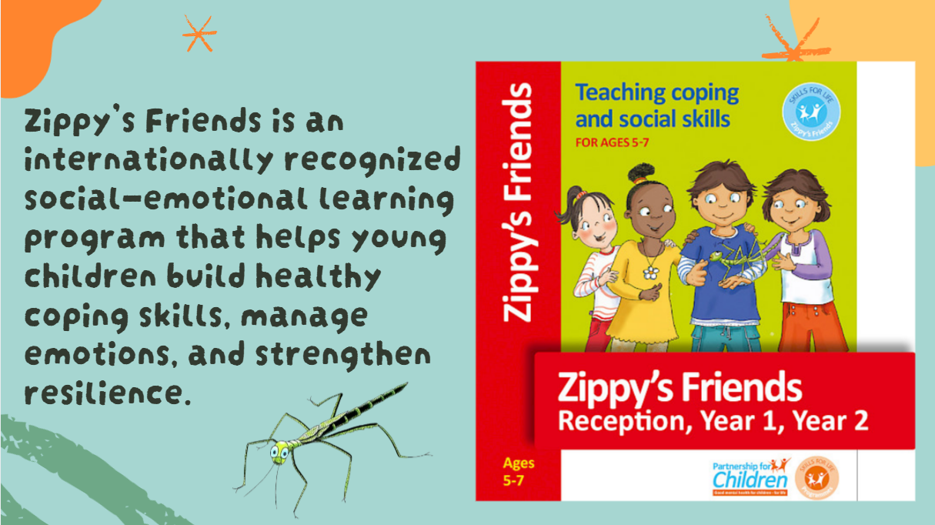
Notes:
Zippy’s Friends is an internationally recognized social‑emotional learning program that helps young children build healthy coping skills, manage emotions, and strengthen resilience. The curriculum is designed for use in elementary schools, child care settings, and other youth‑serving organizations, giving educators practical tools to support children’s mental well‑being. Our district is preparing to launch Zippy’s Friends through a Train‑the‑Trainer initiative led by the Rotary District Mental Health Action Team. This effort will equip a team of local trainers who can then train teachers, child care providers, and youth program staff to deliver the curriculum in their own settings.
We are looking for Rotarians and community members who are passionate about children’s mental health and interested in becoming certified trainers. This is a meaningful opportunity to help bring evidence‑based emotional wellness education to young children across our district.

Slide 19
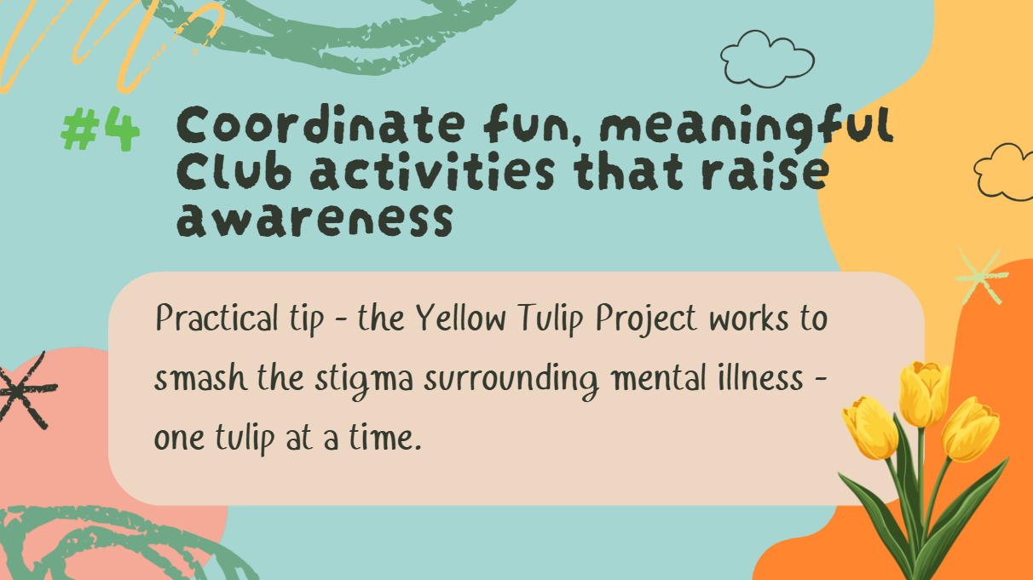
Notes:
Number 4. Coordinate fun, meaningful Club activities that raise awareness. I know several clubs are doing a variety of activities to raise awareness. The Yellow Tulip Project in case you are not familiar is a youth-driven movement dedicated to smashing the stigma around mental illness and promoting mental health awareness. The project uses yellow tulips as symbols of hope and happiness often featuring the planting and blooming of the Yellow Tulips.

Slide 20
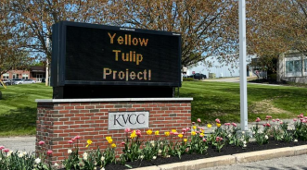
Notes:
Number 4. Coordinate fun, meaningful Club activities that raise awareness. I know several clubs are doing a variety of activities to raise awareness. The Yellow Tulip Project in case you are not familiar is a youth-driven movement dedicated to smashing the stigma around mental illness and promoting mental health awareness. The project uses yellow tulips as symbols of hope and happiness often featuring the planting and blooming of the Yellow Tulips.

Slide 21
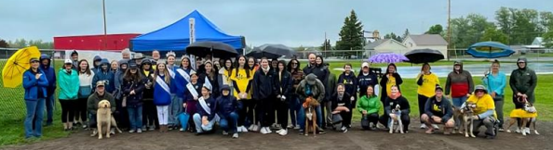
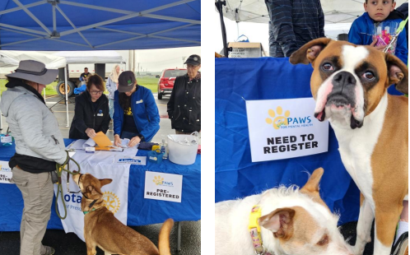
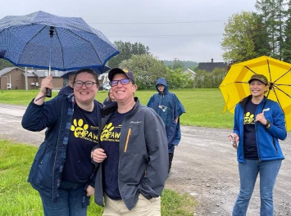
Notes:
Presque Isle – Paws for mental health walk

Slide 22
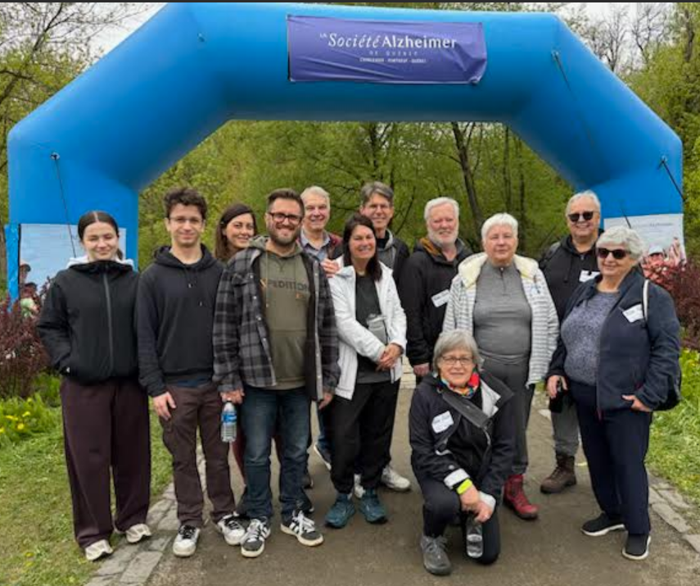
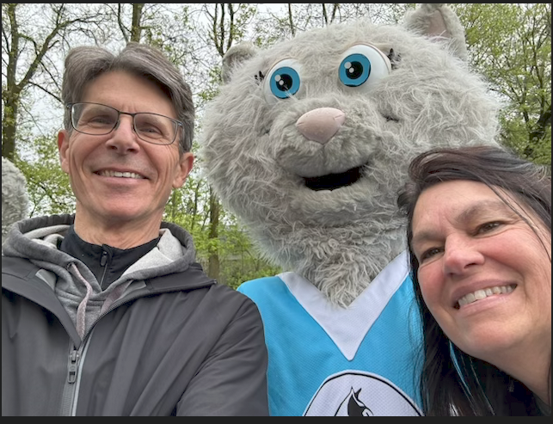
Notes:
a Société Alzheimer de Québec

Slide 23
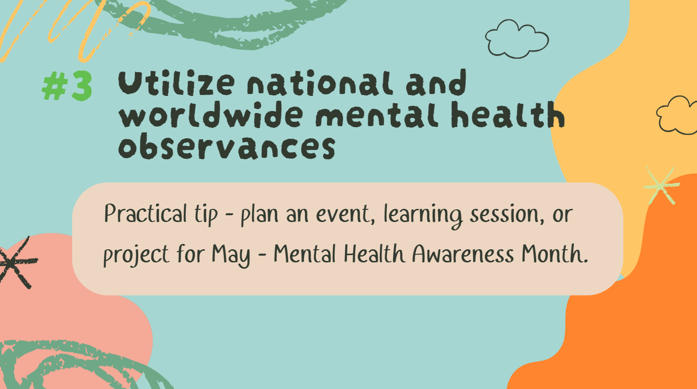
Notes:
Number 3 Use National and worldwide mental health observances to plan an event or project related to Mental Health.

Slide 24
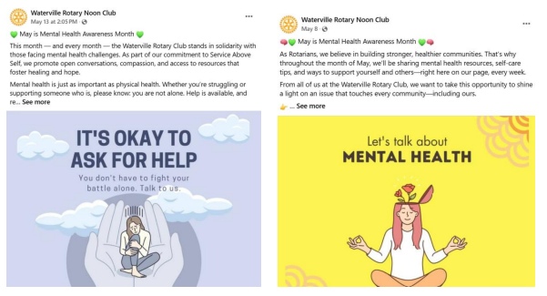

Slide 25
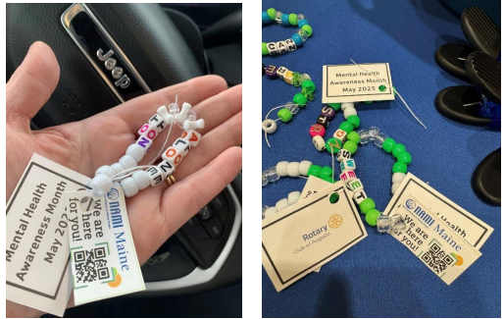
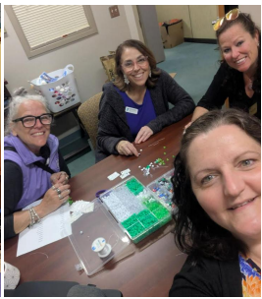

Slide 26
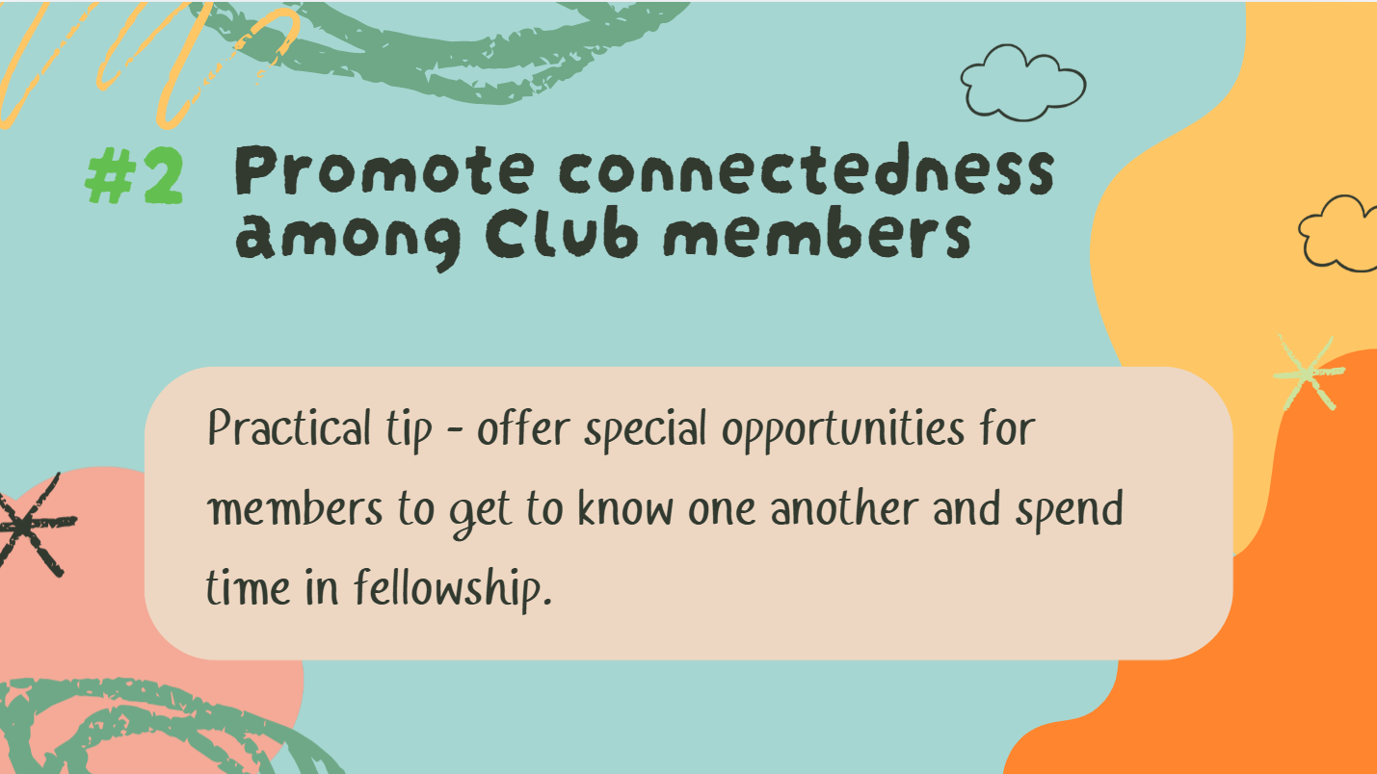
Notes:
Number 2 is – Promote Connectedness among Club members. Connectedness is vital for mental health because it provides emotional support, reduces the risk of mental and physical illnesses, improves mood, and fosters a sense of belonging and community. Rotary Clubs are designed to connect their members to each other, to their community and to the world.

Slide 27
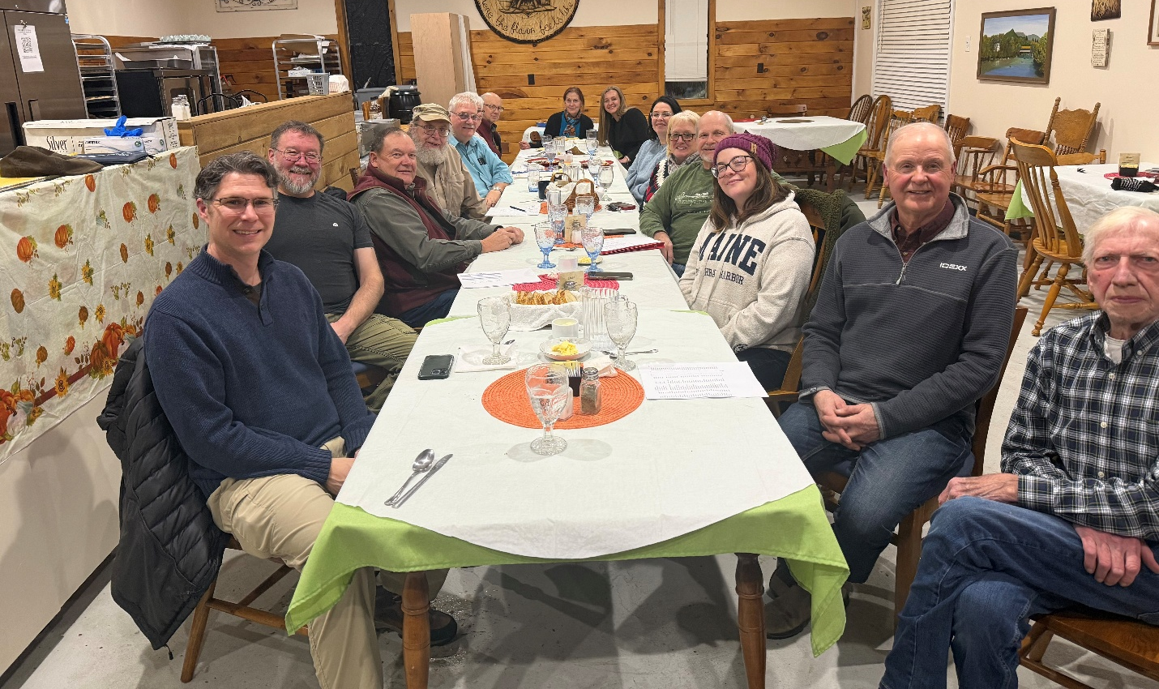
Notes:
Caribou

Slide 28
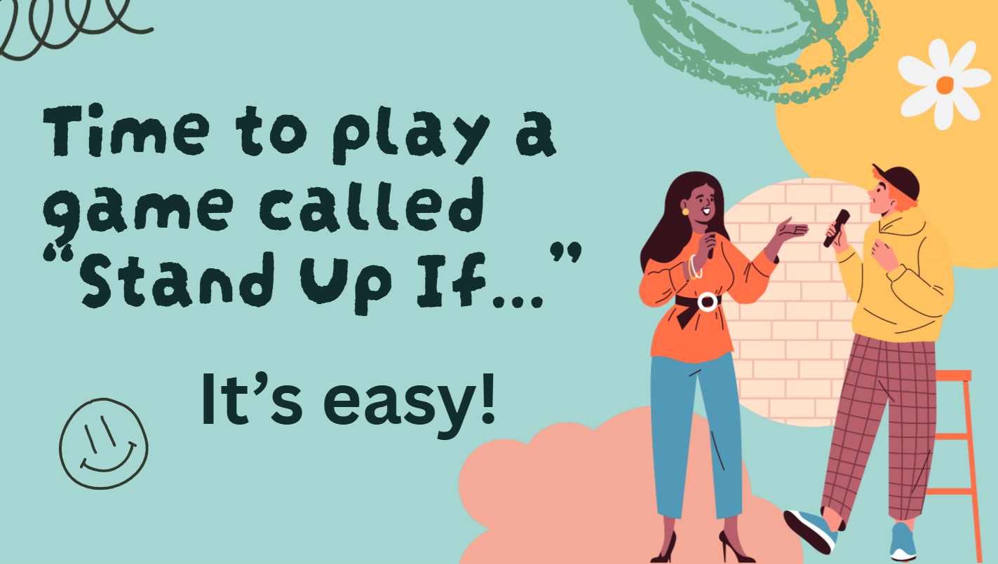
Notes:
To that end – we are going to do a fun and easy activity before I share with you our Number One Idea.

Slide 29
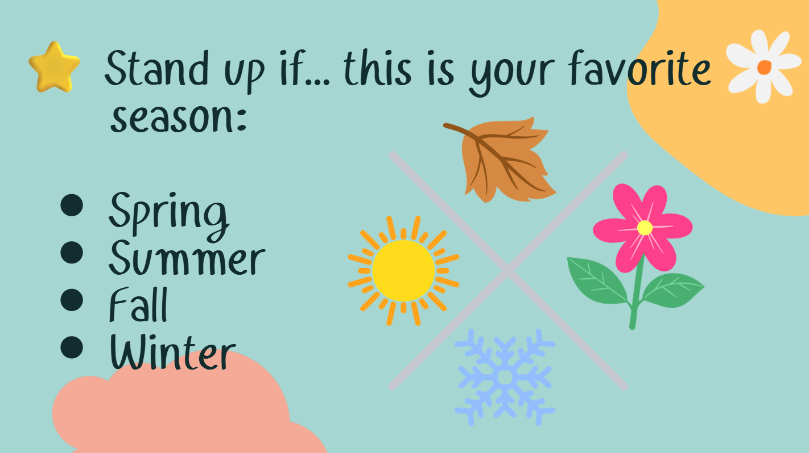
Notes:
Practice Round!

Slide 30
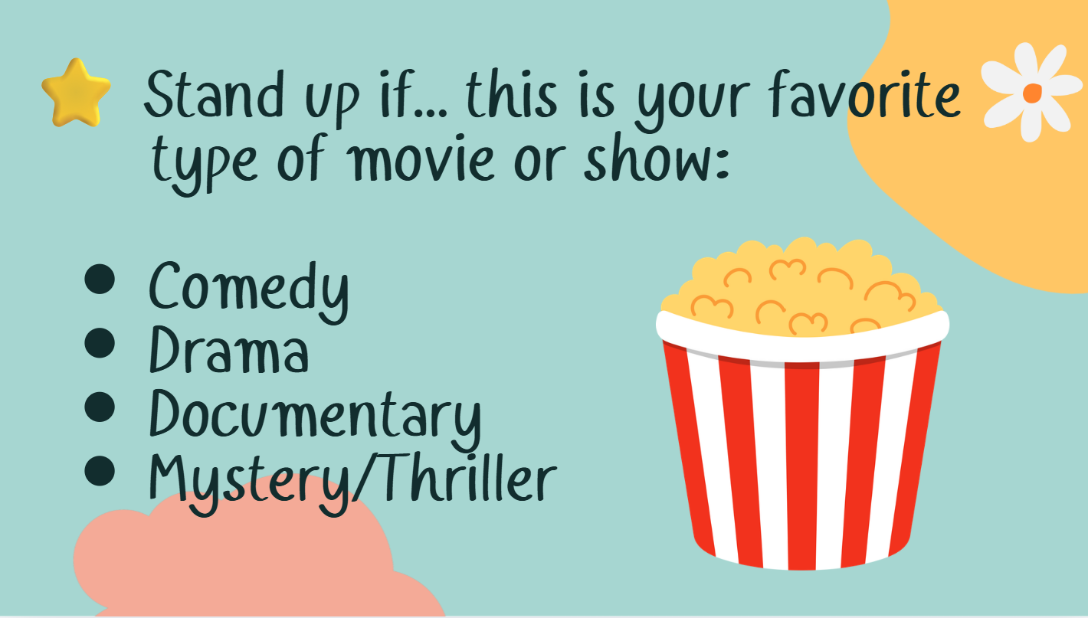

Slide 31
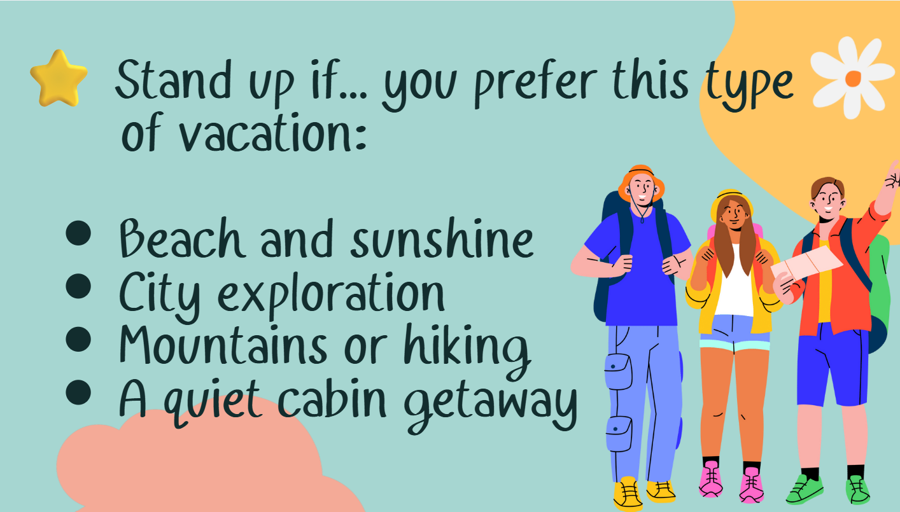

Slide 32
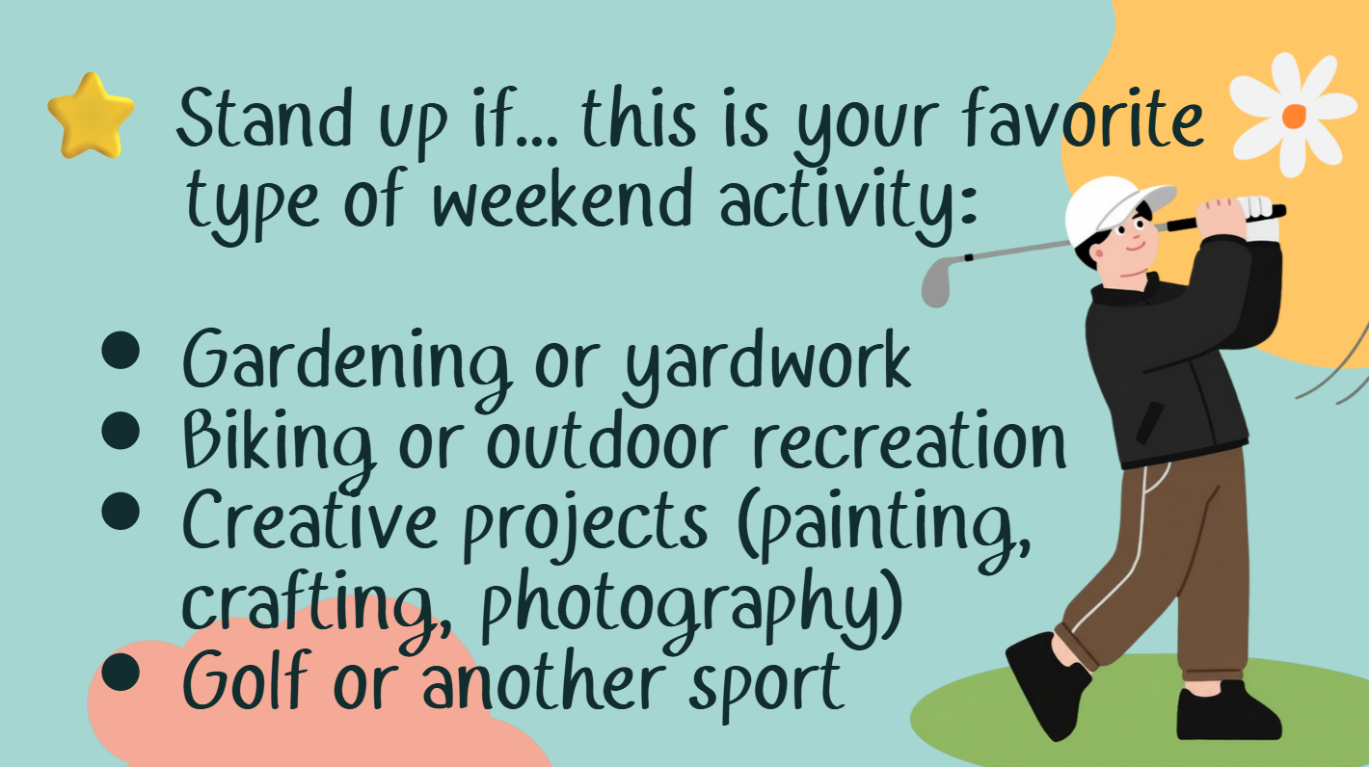

Slide 33
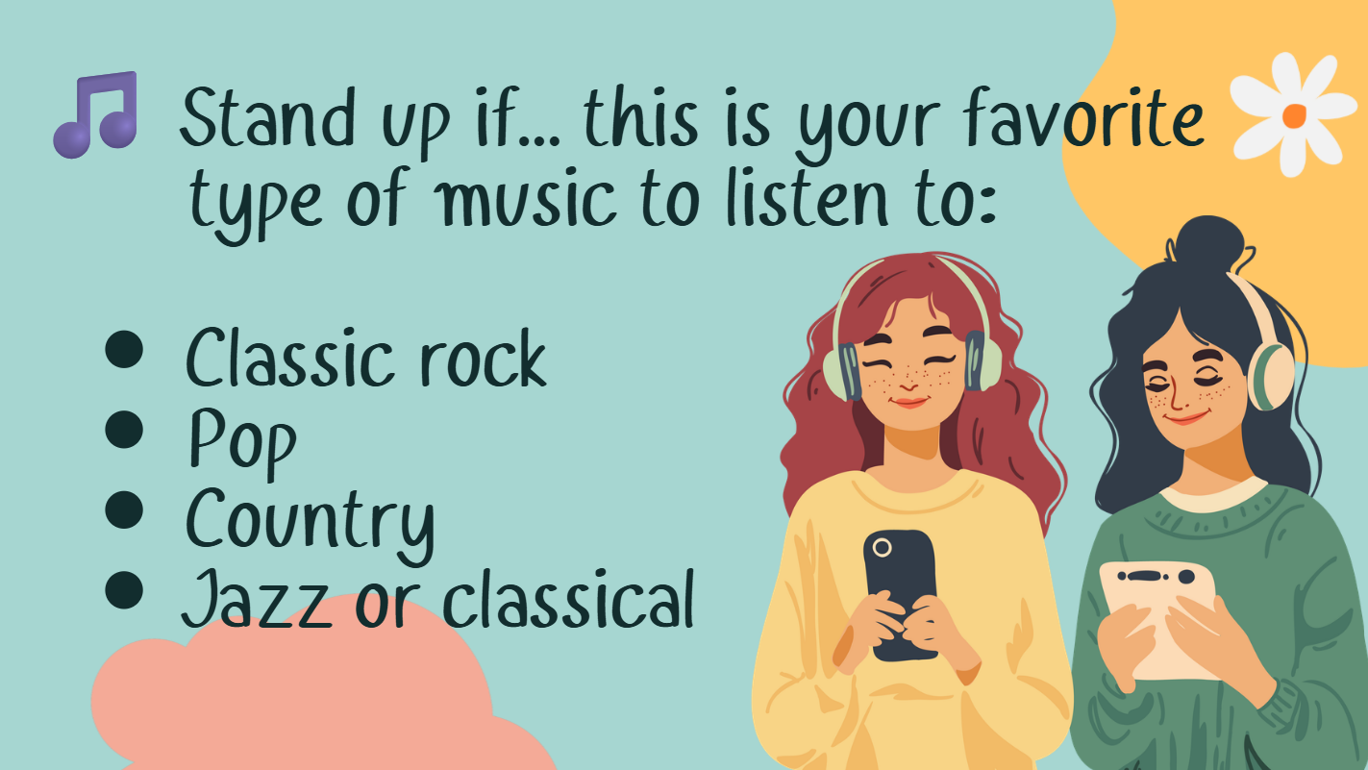
Notes:
If time, ask if one or two people want to share their favorite band and see if others agree.

Slide 34

Notes:
The whole idea of that activity is to understand the positive feelings of commonalities and creating connections. That’s one of the things I love about being a Rotarian is that we all have common values and are part of a connected community of people who want to engage in the service of others. Okay, let’s move on…

Slide 35
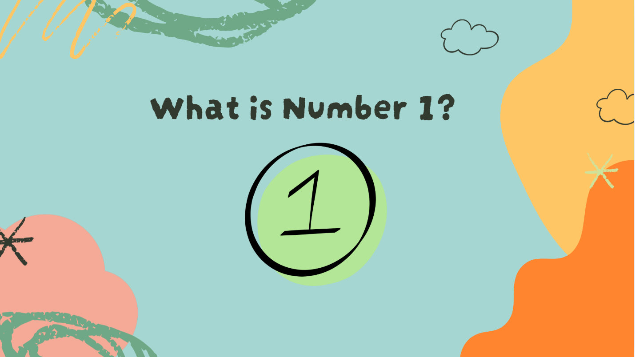
Notes:
Okay – our Number ONE Idea for Rotary Leaders around Mental Health and Wellness – Can anyone guess???

Slide 36
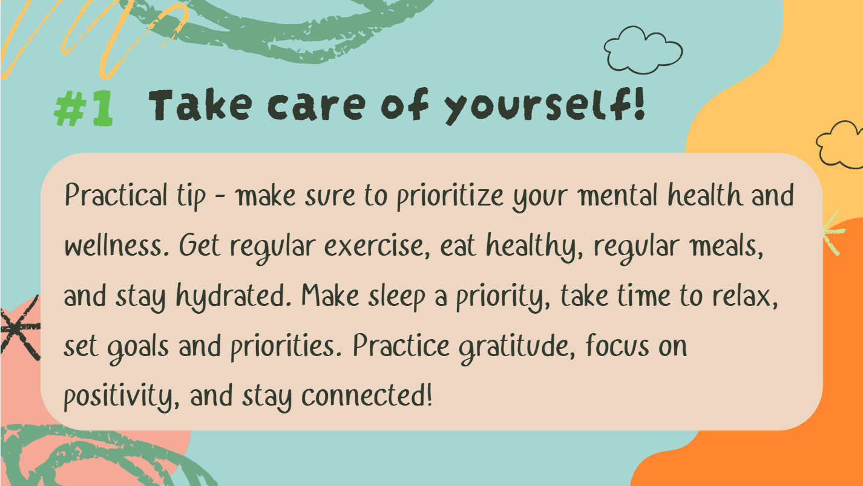
Notes:
YES! Take care of yourself!! This can be anything from mindful breathing, stretching, healthy snacks, journaling, here’s a new one a “digital detox” where you take a break from any screens, setting boundaries, and if you are struggling at all (or even if you are not) call or text a friend, family member or fellow Rotarian. So, my next and final question for you is…

Slide 37
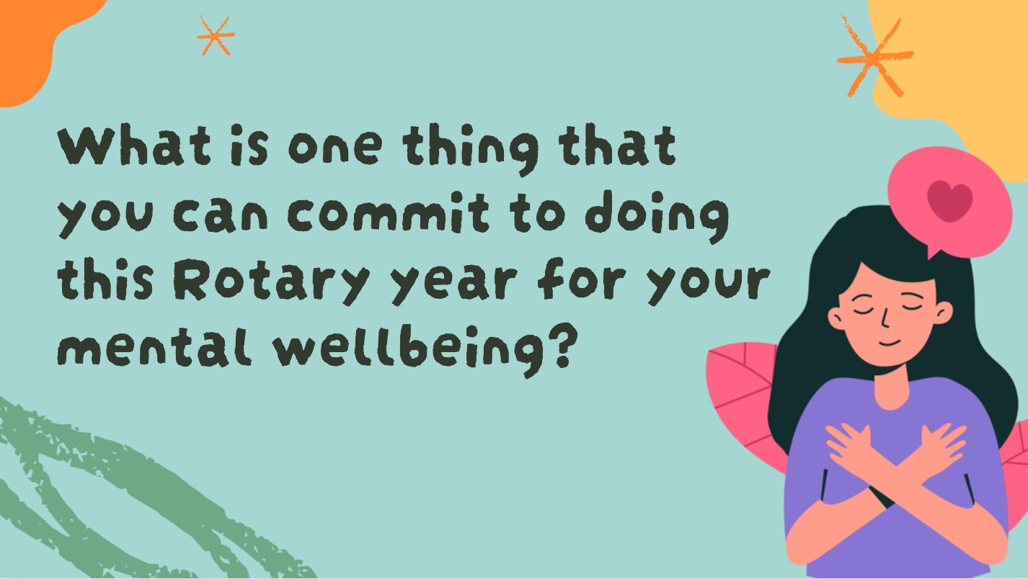
Notes:
What is one thing that you will commit to doing for your own mental wellbeing this year?

Slide 38

Notes:
Remember that the Mental Health Action Team is here to help. A special thank you to DGE Serge for his excited around the promotion of mental health during the upcoming Rotary Year. If there is time for a couple questions I can take them, if not – please come see me during one of our breaks. Thank you!

