Slide 1

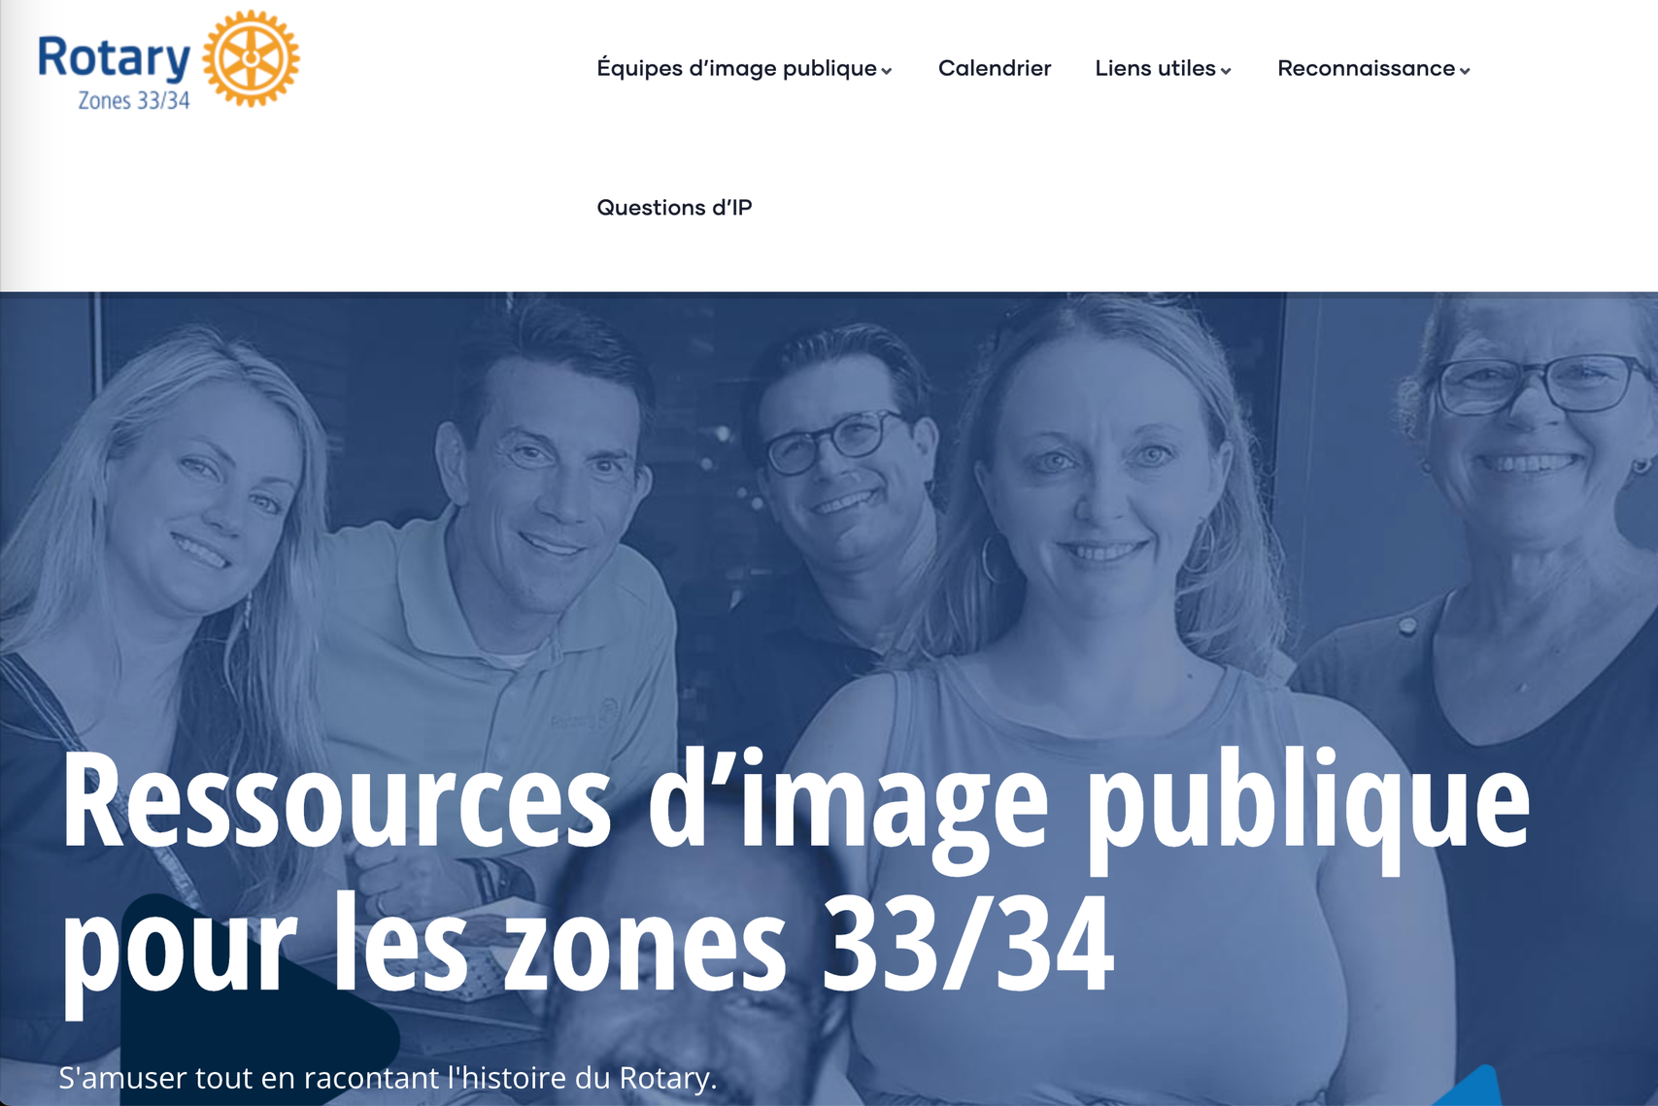
https://elevaterotary.org
Notes:
Zone 33/34 PI — What zone is our district in? Zone 28. Rotarians in Zone 28 are welcome to use the many resources provided by any zone, and this is the public image team from Zones 33/34. These active marketing and media professionals have developed a helpful Rotary public image hub. Google "Rotary Public Image" and their site will appear in the top 5 search results because it receives a lot of traffic and engagement. You can sign up to receive monthly live Zoom webinars on interesting topics such as LinkedIn, A.I., Instagram, etc…

Slide 2



Some Best Practices
THE
PUBLIC IMAGE
  Public Image Audit
  Website & Social Media
  Content Calendar
  Public Image Plan
  Branding
Notes:
Best practices using the tools and resources we have covered. Audit — Do it in June, identify who covers what. Identify all websites and social accounts, brochures and meeting signage, as well as any public-facing content. Managing social accounts — Zombie sites/socials? Stop them. Who has the account credentials? It shouldn’t be just one person. Create a club Google account with credentials shared among multiple members and use that Google account to host your social media, so that if someone retires from Rotary or moves away, your club still has access to its accounts. Regular updates? Engagement? Is information about where and when the club meets immediately visible? Is an open invitation to visit prominently displayed? Current Rotary logo? (Brand Center) Create a content calendar: June, July, or monthly — a month-by-month list and calendar of public image milestones for the Rotary year. This allows you to plan ahead for PI items such as social media posts and advertising media buys tied to firm Rotary dates like World Polio Day, as well as club dates/events. Comfortable with web tools and social media? Want to learn how to use social tools and perhaps explore using Canva or Buffer? These are social scheduling sites where you can “set it and forget it” for posting and engaging on sites like FB, Instagram, and X. Training videos: ElevateRotary.org Zone 33/34 PI. Canva for nonprofits. Public Image Plan — Meet with club leaders and find out what they will be doing throughout the year so you can help them amplify their efforts. Remember that public image is the tool that can make all other aspects of your club even stronger. Example PI plan in the PI training materials on the district website.
Branding — Make sure your Rotary websites, social pages, site, roadside signs, shirts, etc. comply with Rotary’s brand and style guidelines. Visit the Rotary Brand Center for guidance as well as easy-to-use templates and downloads. Rotary updated its logo in 2010, but many clubs still use the old logo even after 14 years. The Rotary Brand Center can help you refresh your club’s use of the Rotary logo.

Slide 3

Notes:
The old Rotary logo is not easy to identify here — it simply is not a strong and powerful brand compared to the others. For example, the words "Rotary International" appear enclosed and cluttered, and are difficult to distinguish compared to the words used in the other logos shown here.

Slide 4

Notes:
But when we use the current Masterbrand logo correctly, the Rotary logo stands out positively, even among these other well-known organizations. By Masterbrand, I mean the golden Rotary wheel but with our club name or district signature added. For example, "Rotary Club of", Rotary District, or Rotary Area of Focus added.

Slide 5

Notes:
Here are examples of correct use of the Rotary Masterbrand.
I created these two logos on the Brand Center in less than 2 minutes, and you can do it too!

Slide 6
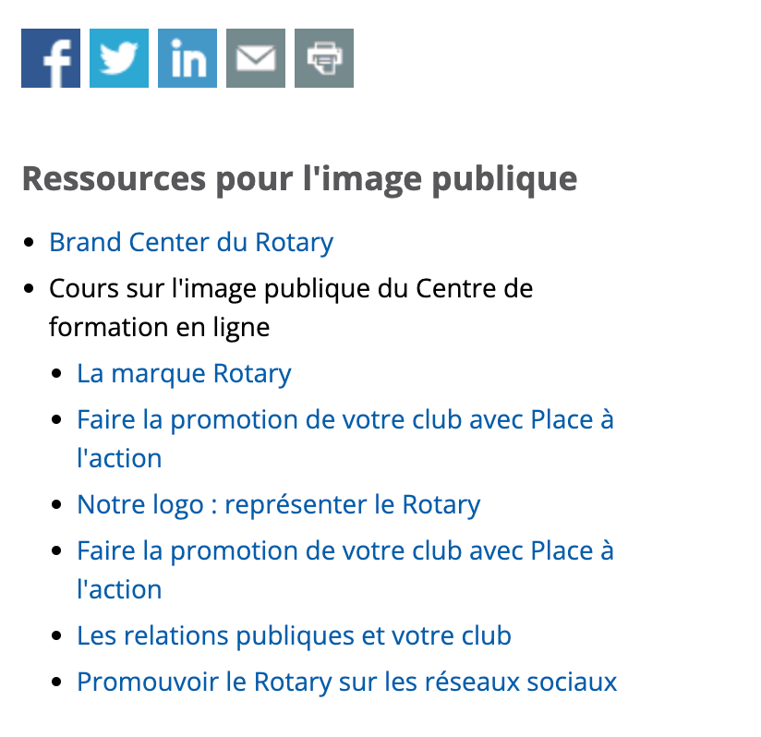


Slide 7
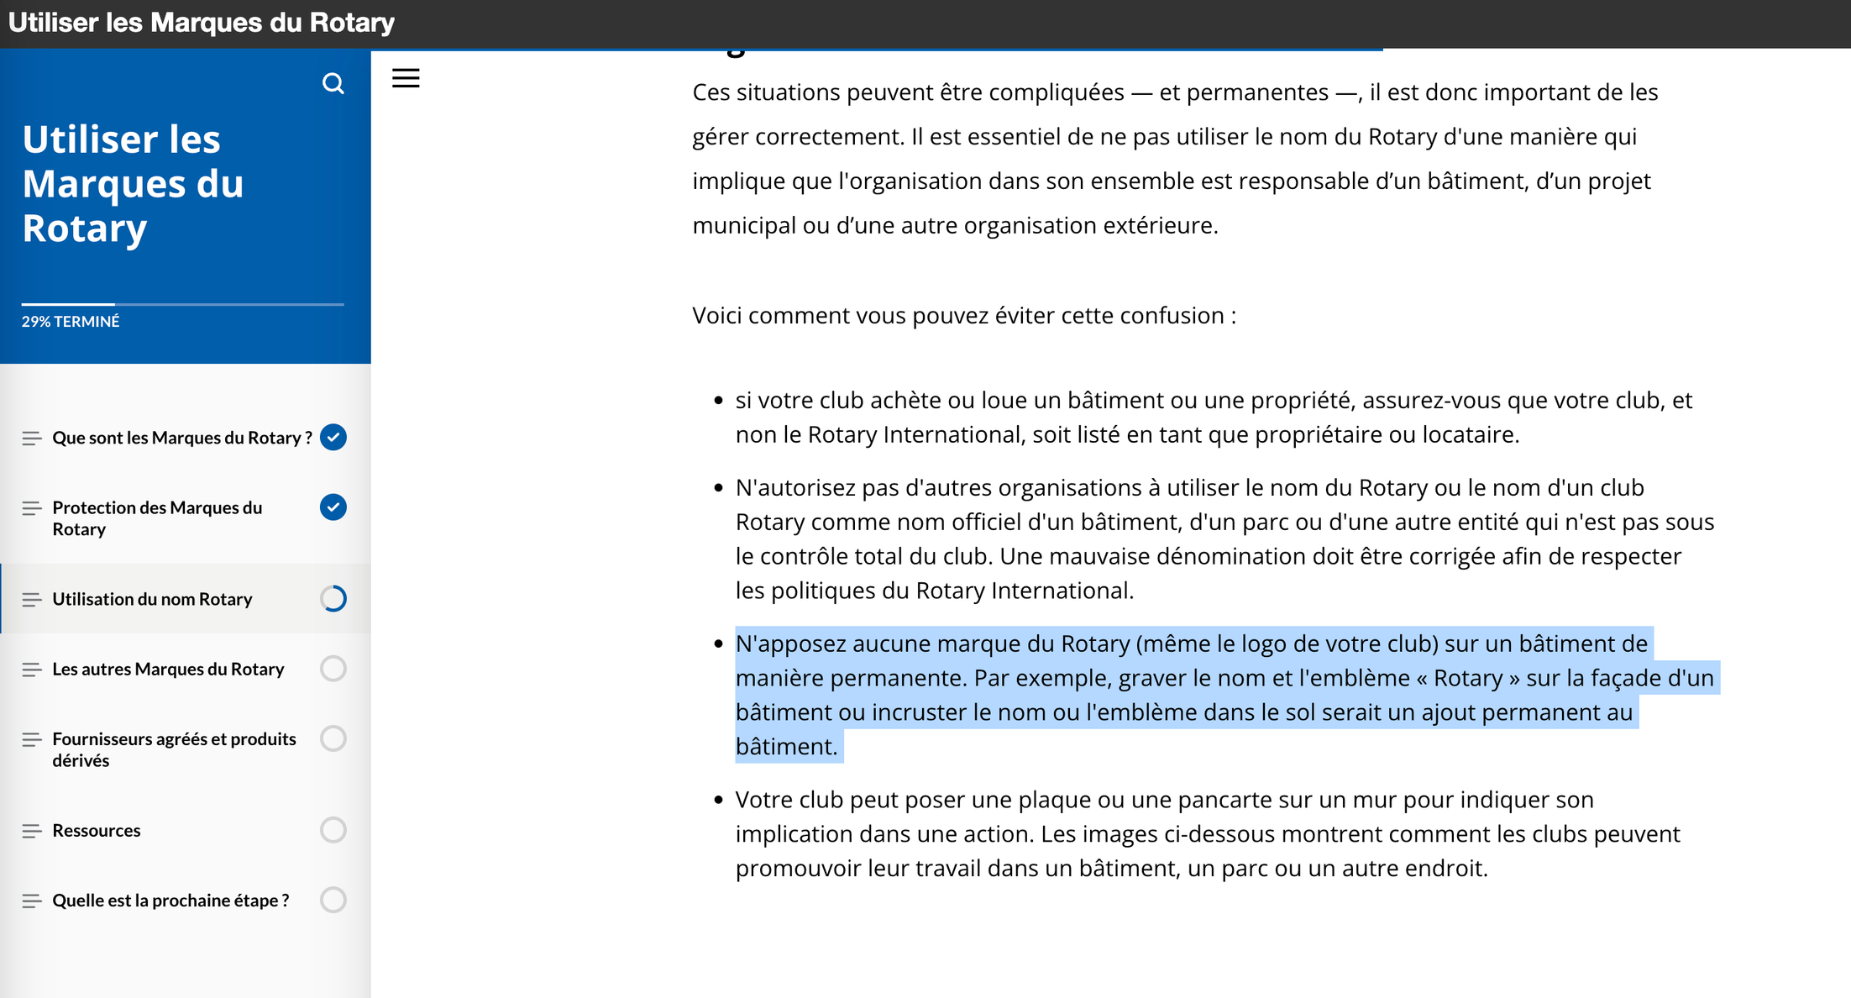

Slide 8
Our Message
One of the most important things we can do to talk about Rotary effectively and compellingly is to make sure we all use a consistent, unified message. You can use the presidential message for 2025-2026, “Together We See It Through,” to motivate members, attendees, and the public with an idea that aligns with our Action Plan and calls us to work together. Using the presidential message in your club and district communications helps convey Rotary’s global impact and strengthen Rotary name recognition locally and with potential partners. It can help people understand who we are and what we do, and may even inspire them to join us.
Visual Message
Co-branding Logo Templates
Remember that your club and district’s official logos are the primary way to promote Rotary in your community, but you can visually incorporate the presidential message by combining your club or district logo into a co-branding logo for the following materials:
Club or district newsletter templates
Rotary email signatures
District conference materials (badges, invitation templates, logos, etc.)
Online meeting backgrounds
Create or update your club, district, or zone co-branding logo using our templates.

Slide 9
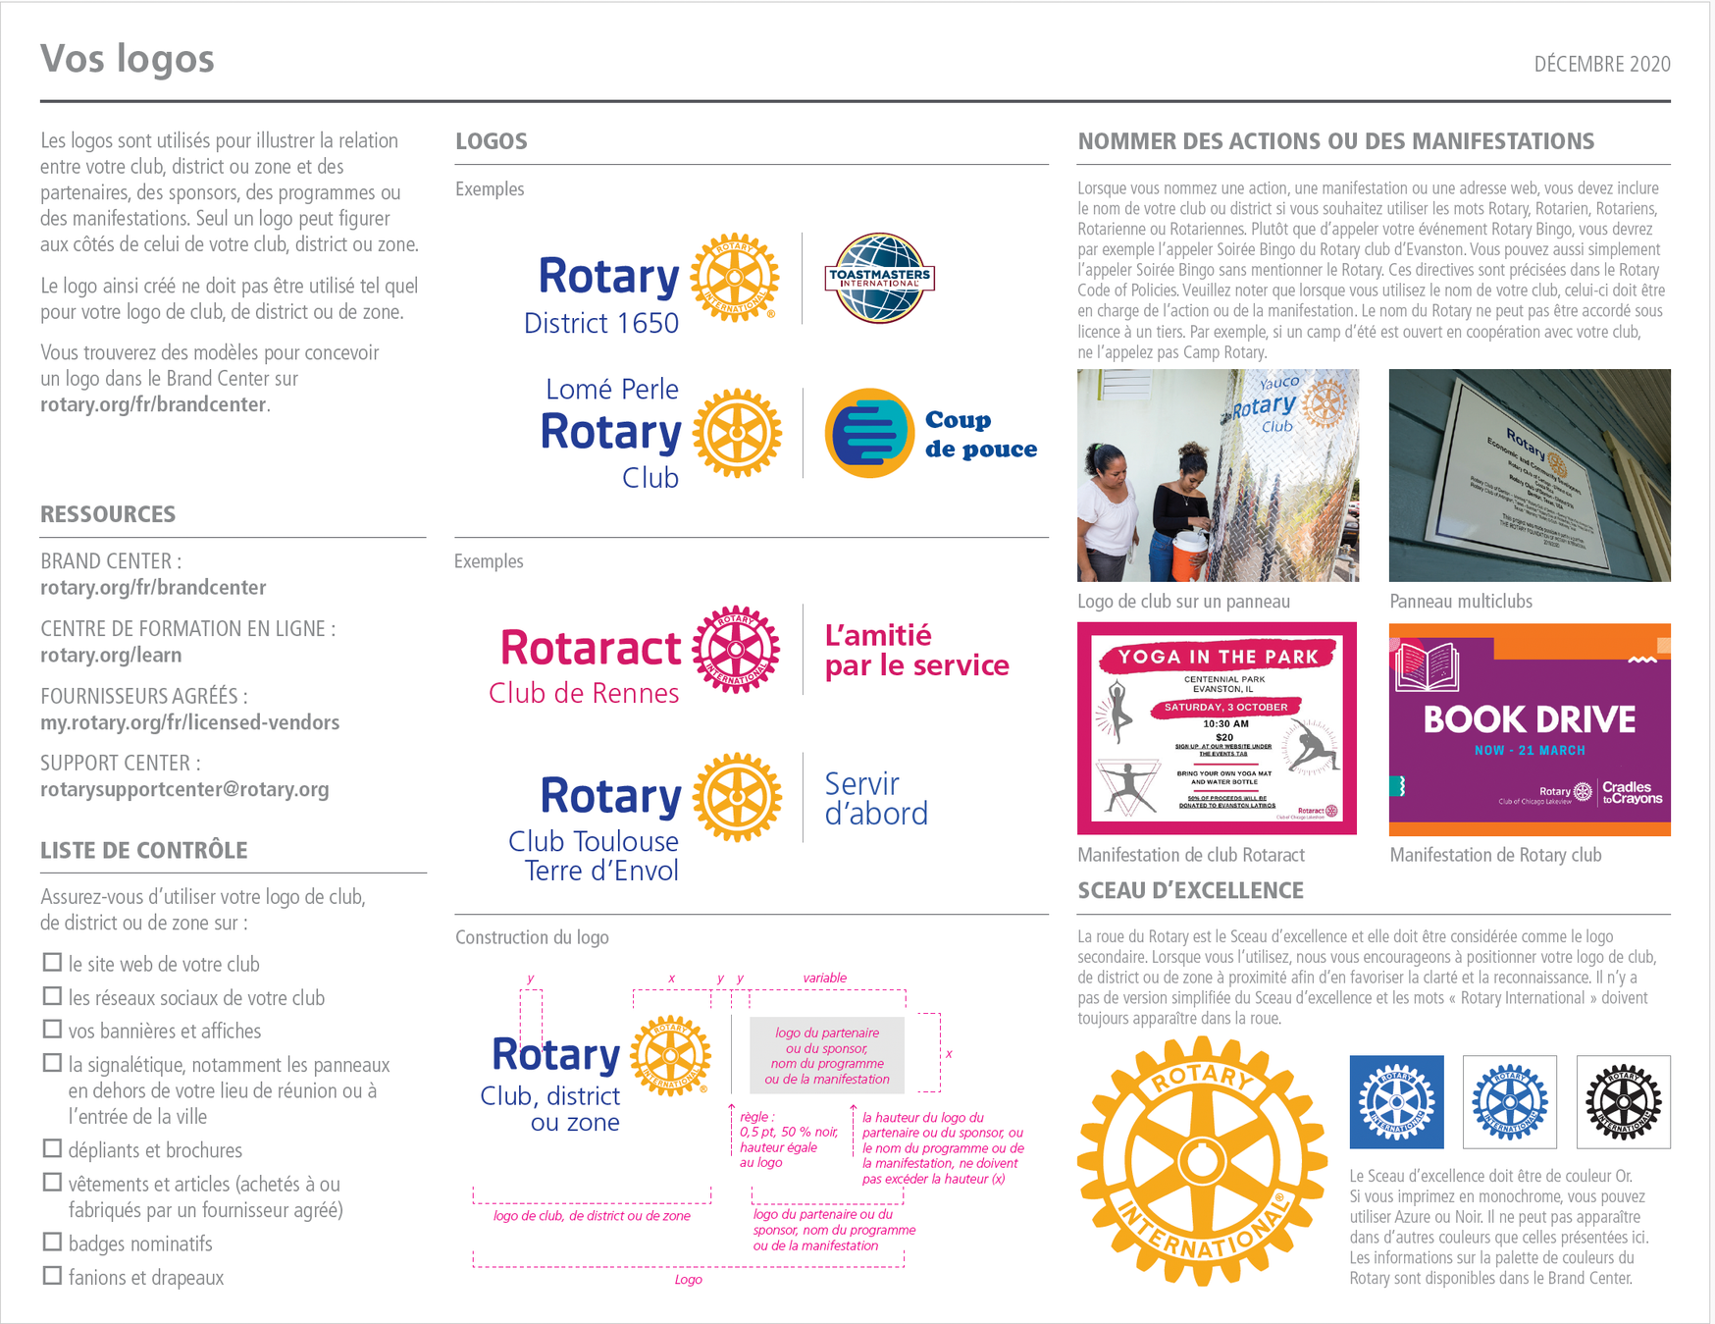

Slide 10


EXAMPLE FOR CLUBS TO USE
NOTE: THE SPACE BETWEEN THE VERTICAL LINE = WIDTH OF THE LETTER O (ROTARY)

Slide 11
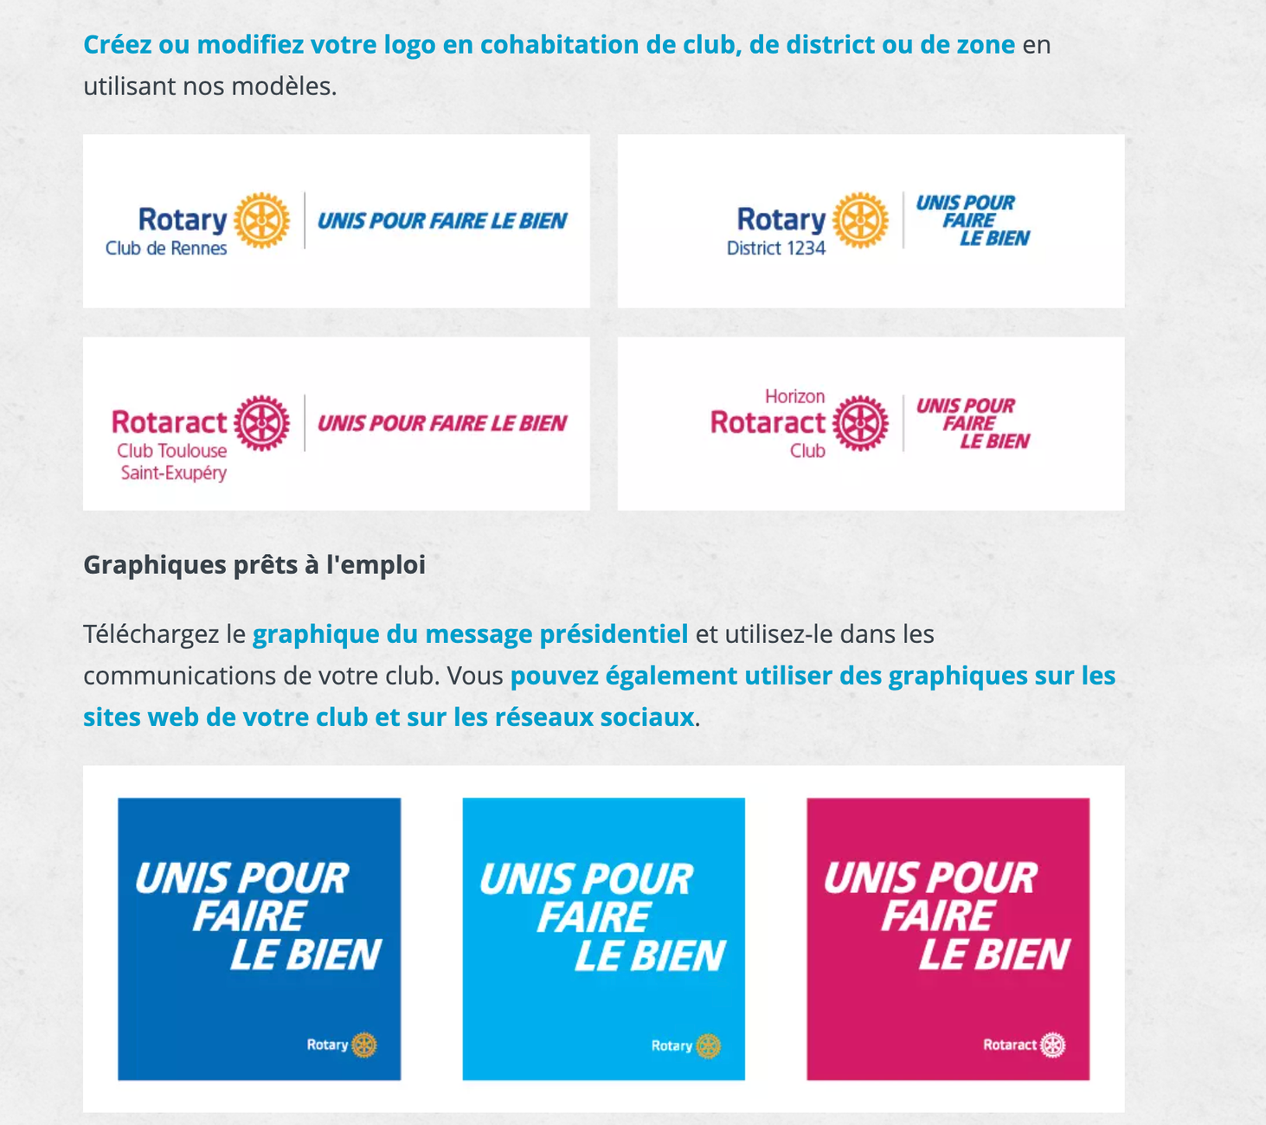

Slide 12

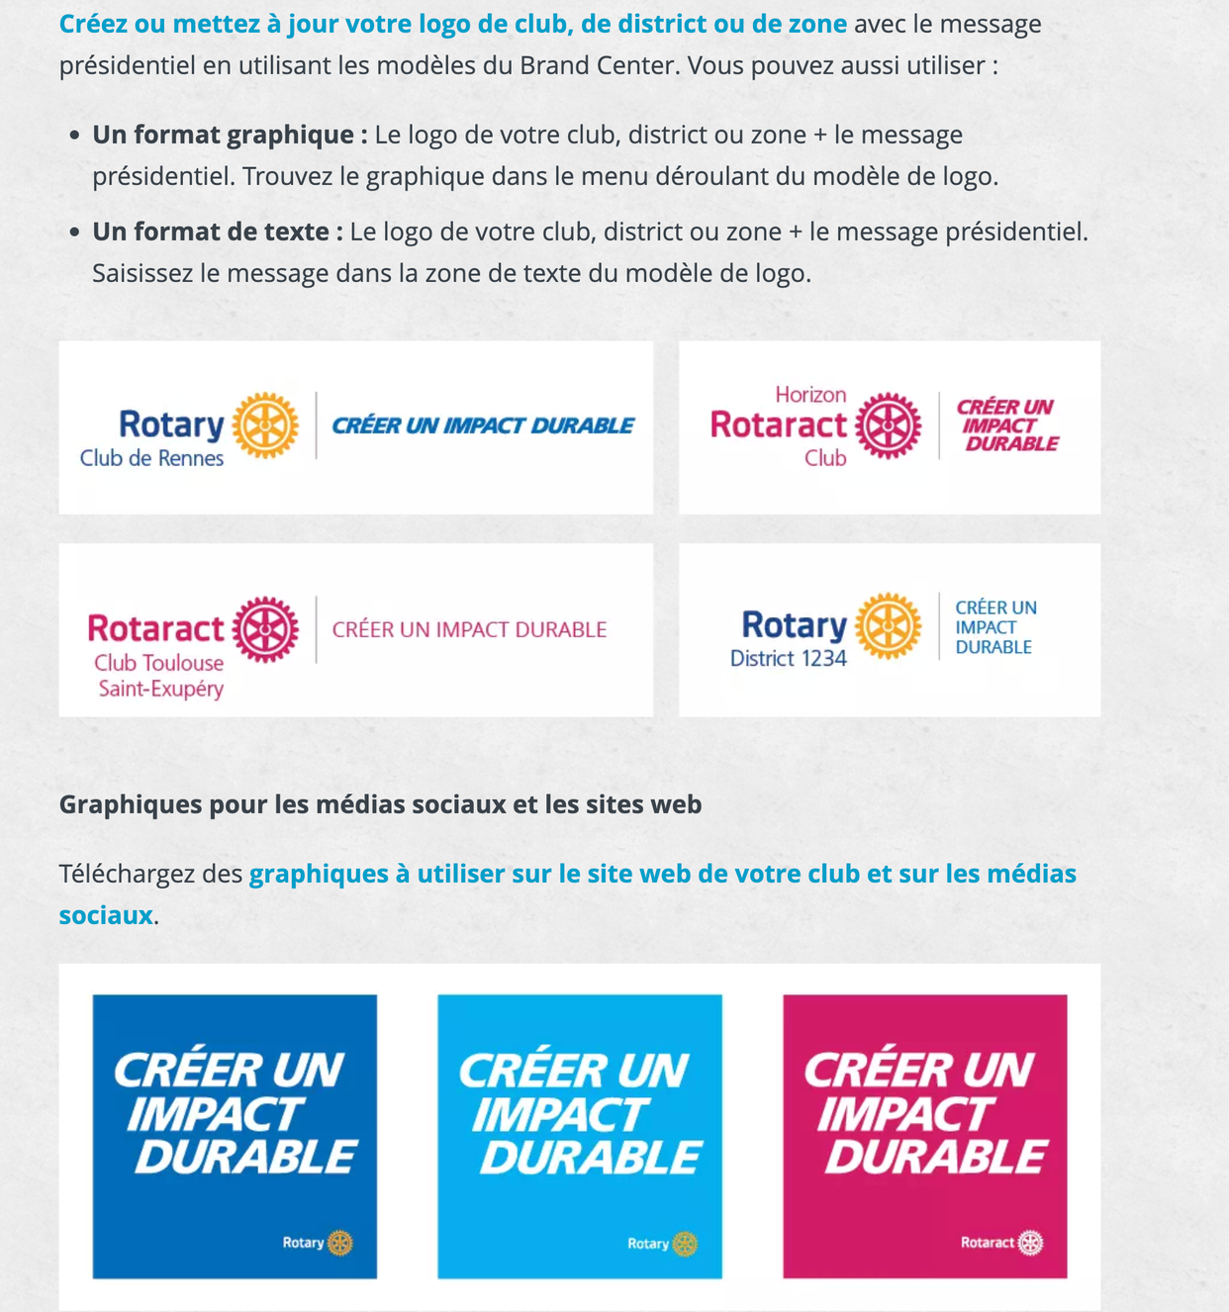
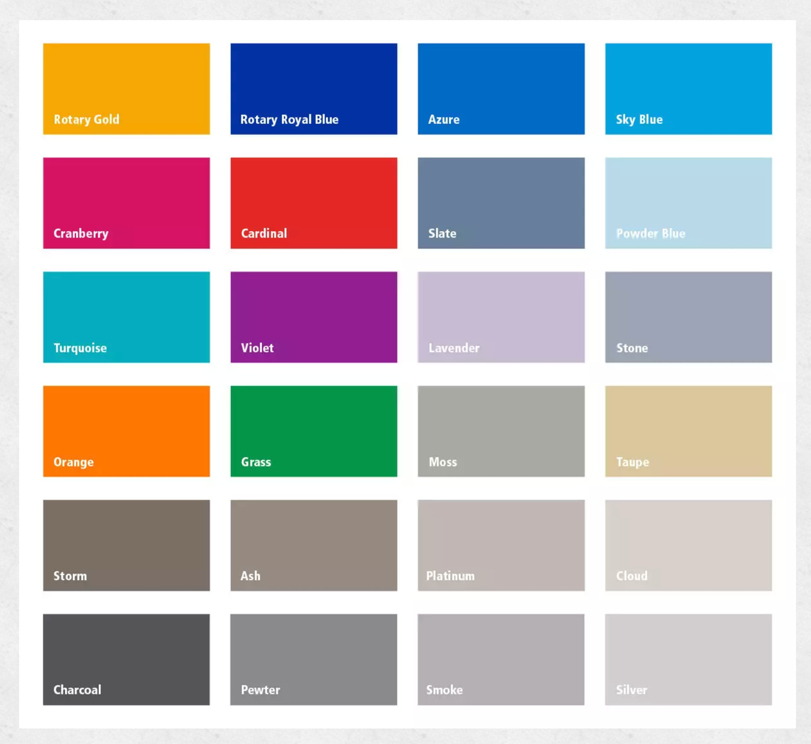

Slide 13
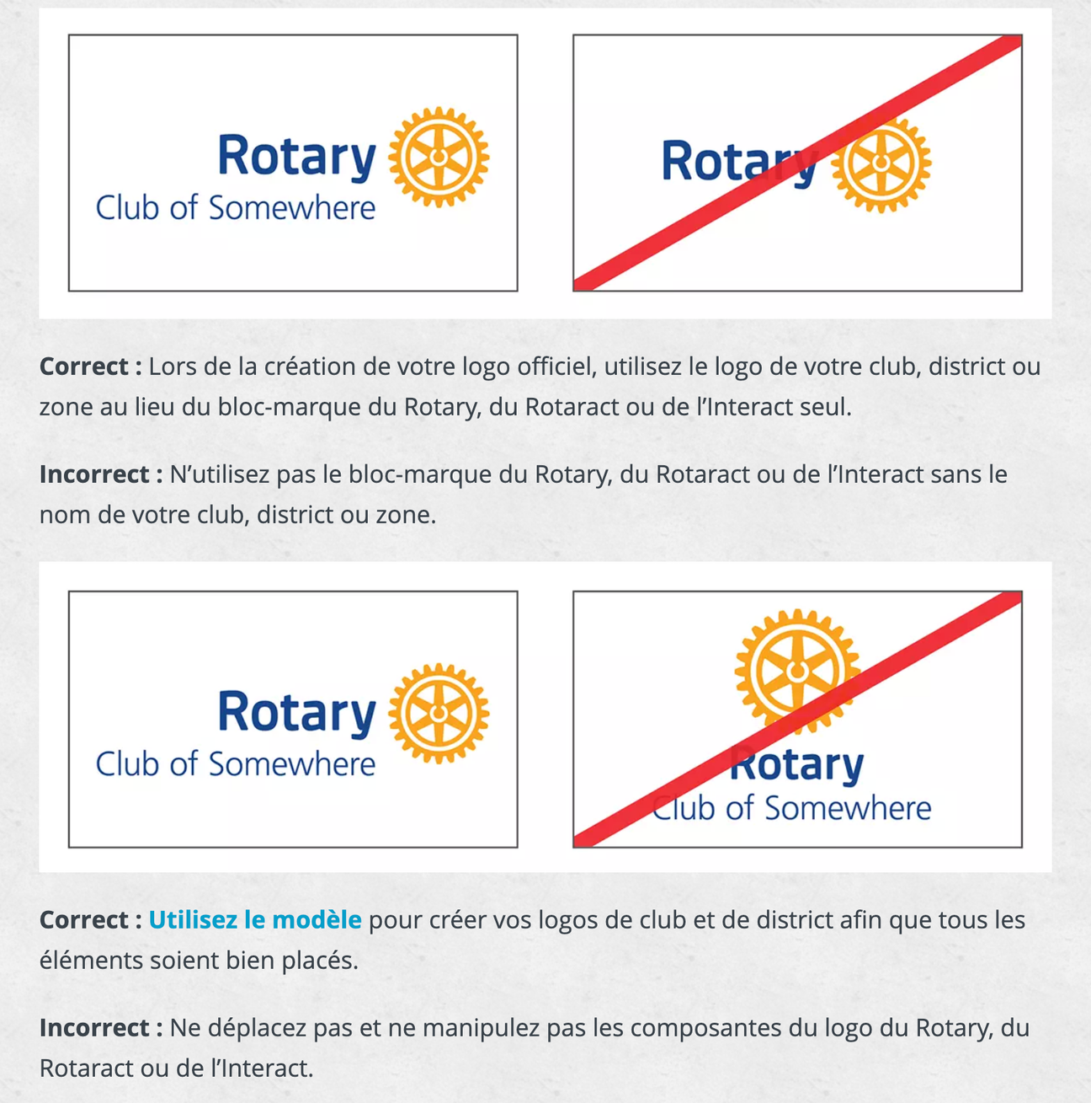

Slide 14
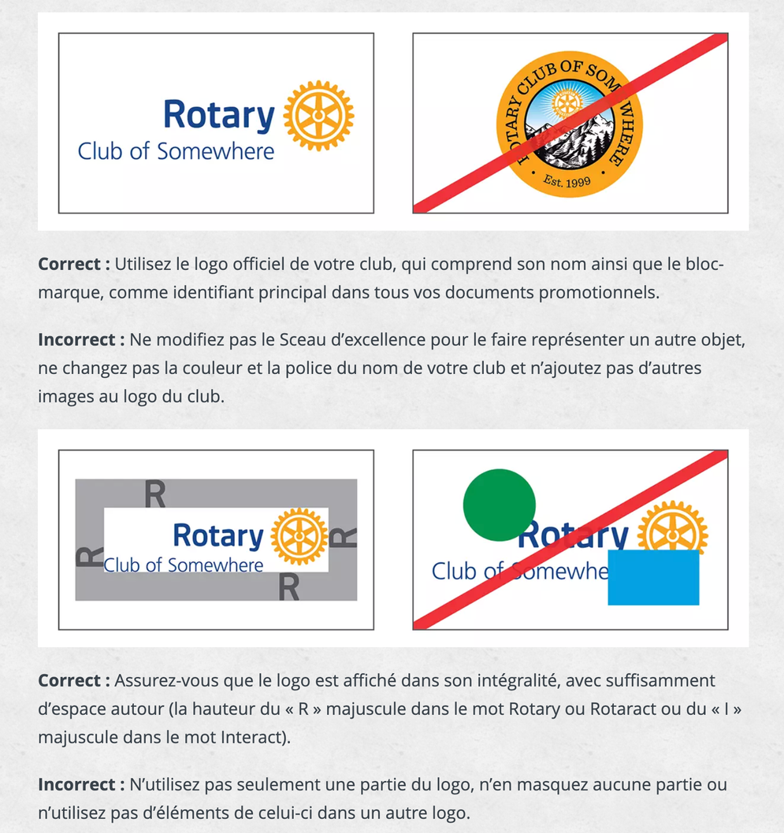
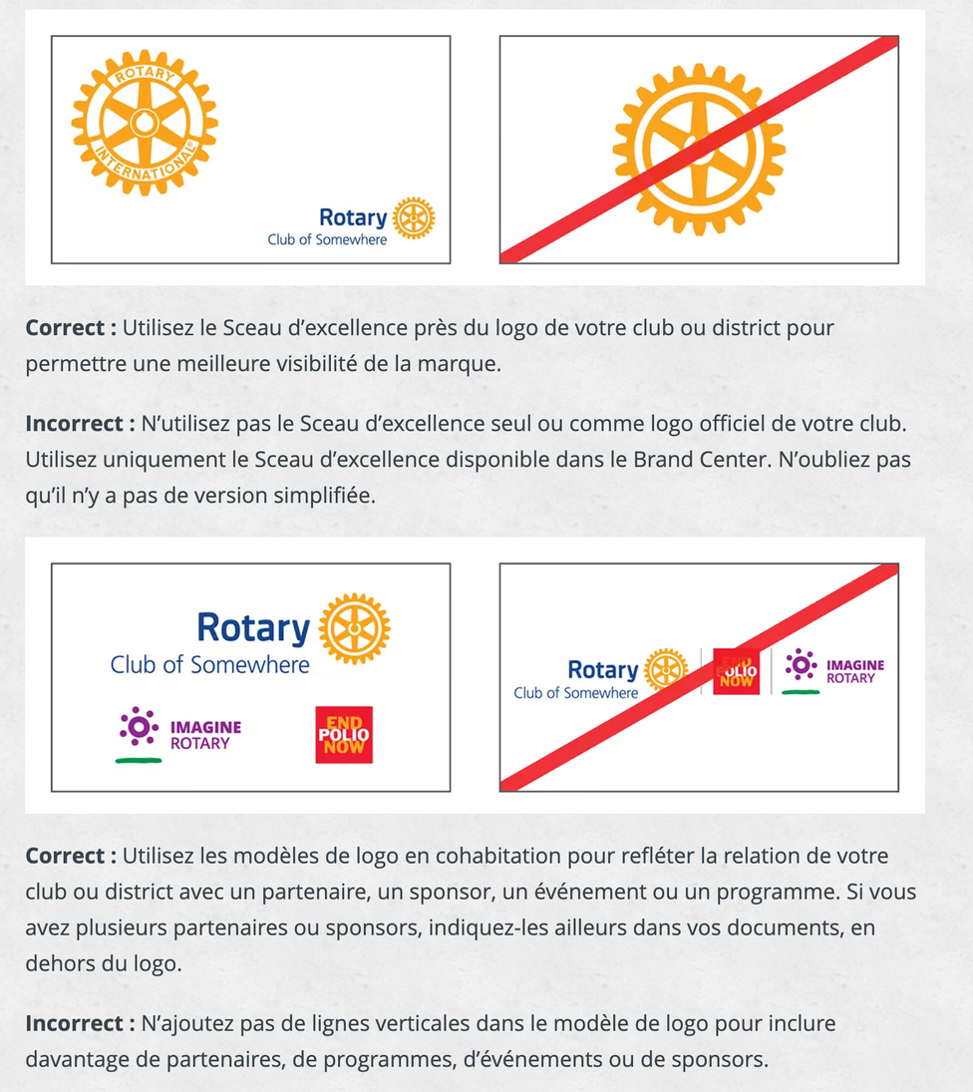
https://brandcenter.rotary.org/fr-fr/our-brand/brand-elements/logos-and-graphics/dos-and-donts

Slide 15
