Slide 1
Welcome to the Rotary club PowerPoint template
This template provides the styles, colors, and layout options to help you create your own Rotary club PowerPoint presentation.
You don’t have to use all the slides in your presentation. You can delete the slides you don’t want and duplicate those you would like more of. You can also change the order of the slides.

Slide 2
TUTORIAL:
Graphics
&
Photos
To insert graphics
(includes graphs, charts, etc.):
Take a screenshot of a graph or chart you created somewhere else (e.g., Excel) and follow the instructions below in “To replace photos.”
Create a graph or chart by going to the Insert tab, then clicking Chart in the Illustrations section. Choose the type, then put your data in the Excel window that opens. Double click on the chart to call up the data again later.
To replace photos (includes maps, graphs, charts, etc.):
Delete the existing photo, then copy and paste your own photo.
or
Delete the existing photo, then place your own via the Insert tab.
or
Right click the existing photo and select Change Picture.
To place your new photo behind text, a logo, etc.:
Right click on the photo and select Send to Back.

Slide 3
TUTORIAL:
Layout,
Colors
&
Fonts
Adjusting the dimensions of a photo
To crop a photo, right click on it and select Crop. Pull in the borders to where you want.
To enlarge a photo without distorting it, hold down the Shift key as you pull a corner in or out.
Adding new slides
Formatted slides are available when you click on New Slide in the Slides section of the Insert tab.
These slides follow the look and style of this PowerPoint template, but you will only be able to change the text in these slides.
Colors
For your convenience, the Rotary colors have been preset in the theme, and Rotary Leadership Colors and Secondary Colors appear on the pasteboard below every slide.
To change all the colors quickly, go to the Design tab and choose another color scheme in the Variants section.
To change a solid background to another color, right click, select Format Shape, and change the color in the Fill option. You can also change colors in the Design tab by selecting Format Background in the Customize section.
To change colors in a dual background to other colors, right click, select Format Shape, and change the colors in the Fill option by selecting Gradient fill. You can also change colors in the Design tab by selecting Format Background in the Customize section.
Fonts
We recommend using the Arial font because it is very readable both on screen and printed out.
Other brand options are Arial Narrow, Georgia, Open Sans, and Open Sans Condensed.

Slide 4
TUTORIAL:
Images,
Videos
&
Brand Guidelines
Use the following resources to find images, videos, and brand guidelines. Please keep in mind that we are people of action — and choose images that show action.
Brand Center https://brandcenter.rotary.org/en-GB
Brand Center Images https://brandcenter.rotary.org/en-GB/Images-Video/Images
Brand Center Videos https://brandcenter.rotary.org/en-GB/Images-Video/Videos
Voice and Visual Identity Guidelines https://brandcenter.rotary.org/en-GB/App/AssetDetails/b/www/Asset/Details/118?brand=www&returnUrl=https%3a%2f%2fbrandcenter.rotary.org%2fen-GB%2fGuidelines&page=1&pageSize=100&showadvancedsearch=False&showkeywordfilters=True&showselectedkeywordfilters=True&largeLayout=False&b=www&bs=www&k=42&k=17&pg=Public&view=Standard

Slide 5
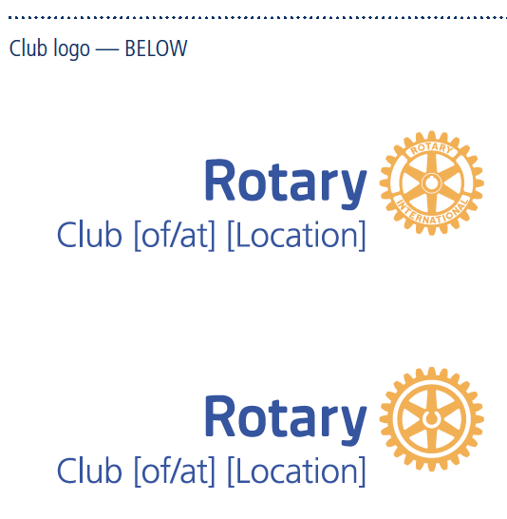
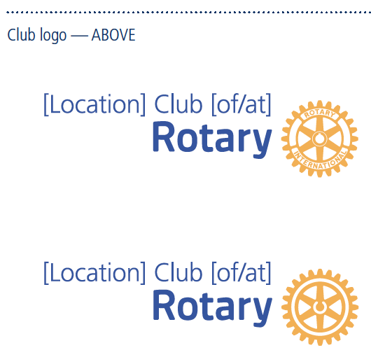
TUTORIAL: Signature System for Clubs
We have created special signature systems that allow you to identify your club on all your communications materials.
The Rotary club signature comprises the Masterbrand Signature plus the club name. You should use this signature system instead of the Masterbrand Signature alone on club-level communications.
Use the name on your charter or the name your club is known by in your community in your club logo. Because the word “Rotary” is already in the logo, you don’t need to repeat it. For example, the Rotary Club of Evanston, Illinois, USA, would add only “Club of Evanston” below the Masterbrand Signature.
The club name always appears on the same side as the wordmark, it should right-align with the “y” in Rotary. The positioning and the size relationship between the wordmark and the wheel can’t be altered.
You can use either the Masterbrand Signature or the Masterbrand Signature Simplified when you create your district or zone logo. We recommend using the simplified version if the logo will be smaller than 1.25 cm (0.5 inches) or will be embroidered.
Find templates for creating your club, district,
zone, or program logos in the Brand Center:
https://rotary.org/brandcenter

Slide 6
TITLE OF PRESENTATION
Type your Rotary club name here
Title Page Option

Slide 7
TITLE OF PRESENTATION
Type your Rotary club name here
Title Page Option

Slide 8
TITLE OF PRESENTATION
Type your Rotary club name here
Title Page Option

Slide 9
TITLE OF PRESENTATION
Place the Rotary logo with your club identifier here.
(See slide 5 of this template for club logo instructions.)
Title Page Option

Slide 10
TITLE OF PRESENTATION
Place the Rotary logo with your club identifier here.
(See slide 5 of this template for club logo instructions.)
Title Page Option

Slide 11
TITLE OF PRESENTATION
Place the Rotary logo with your club identifier here.
(See slide 5 of this template for club logo instructions.)
Title Page Option

Slide 12
TITLE OF PRESENTATION
Type your Rotary club name here
Title Page Option

Slide 13
TITLE OF PRESENTATION
Type your Rotary club name here
Title Page Option

Slide 14
subhead
MAKE A BOLD STATEMENT

Slide 15
subhead
MAKE A BOLD STATEMENT

Slide 16
MAKE A BOLD STATEMENT

Slide 17
TITLE
Your options:
Fill this text box with text
Fill this box with bullet points
Delete this box and insert a picture
Delete this box and insert a chart or graph
A few lines can go here.

Slide 19
BASIC BULLET POINTS
Use brief text
As bullet points
To get your
Information across

Slide 20
FOR TEXT/BULLET POINTS
PUT SUBHEAD HERE. DELETE IF NONE.
Use this space for longer text. Keep in mind that it’s not as interesting to have long blocks of text. Try not to use more than the amount of text shown here. Split content between slides, or…
Just use
Bullet points
You could also make a list
With numbers

Slide 21
JUST USE
BULLET POINTS
YOU COULD ALSO MAKE A LIST
WITH NUMBERS
BULLETS
Subhead

Slide 22
GRAPHICS SUBHEAD
A caption can go here. Replace the map image with a graphic from the web or from your documents.

Slide 23
“Quotations are often included as inspiration or to evoke philosophical thoughts from the reader.”
John Doe

Slide 24
‹#›
“Quotations are often included as inspiration or to evoke philosophical thoughts from the reader.”
John Doe

Slide 25
PROMINENT DATA
SUBHEAD
75%
Use this space to explain the interesting number that you are showing at right.

Slide 26
PROMINENT DATA
SUBHEAD
75%
Use this space to explain the interesting number that you are showing at right.

Slide 27
GRAPHS/CHARTS SUBHEAD
CHART TITLE
CHART TITLE
CHART TITLE
Caption
Caption
Caption

Slide 28
GRAPHS/CHARTS SUBHEAD
CHART TITLE
CHART TITLE
CHART TITLE
Caption
Caption
Caption

Slide 29
COLUMN CHART

Slide 30
COLUMN CHART

Slide 31
BAR CHART

Slide 32
BAR CHART

Slide 33
LINE CHART

Slide 34
LINE CHART

Slide 35
QUESTIONS

Slide 36
QUESTIONS

Slide 37
QUESTIONS

