Slide 1
ROTARY 101
D6270 Fall Seminar-Success Summit 10 Oct, 2015
VC Brian Monroe
Notes:
Thank you for joining us for today’s presentation-, Rotary 101

Slide 2
ROTARY 101-OBJECTIVES
Engage you and provide answers and a better understanding of Rotary at the Member, Club, District, Zone and International levels.
Elevate your awareness of how you can learn more about Rotary on your own
Motivate and inspire you to have fun and get involved at the Club, District and International levels
STRENGTHENING ROTARY |

Slide 3
WHO or WHAT is ROTARY?-SURVEY RESULTS
Never Heard of Rotary
Know Name Only
Some Familiarity
STRENGTHENING ROTARY |
Notes:
The fact is, Rotary’s own Public Image Surveys* told us that people do not know us.
Four in 10 have never heard of Rotary.
Another four in 10 have heard of our “name only.”
Only two in 10 claim to have “some familiarity” with Rotary…and unfortunately what they know is often colored by misperceptions and half-truths.
*Research: Rotary Public Image Surveys completed 2006 and 2010. Responses received from six nations: Argentina, Australia, Germany, Japan, South Africa, United States. Surveyed approximately 1,000 individuals in each of six nations by phone and online. Survey has a +/- 4% margin of error.

Slide 4
ROTARY 101-BUILDING BLOCKS OF OUR BRAND
ESSENCE
VALUES
VOICE
Our reason for being
Our beliefs
Our expression
STRENGTHENING ROTARY |
Notes:
Our brand strategy is made up of three components:
Essence—our reason for being: What we stand for, how we’re different, why people should care.
Value—our actions/behaviors/beliefs.
Voice—our expression/personality/tone.
We would not have been able to develop our essence, activate our values or create our voice attributes without our research.

Slide 5
ROTARY 101-ESSENCE STATEMENT
Rotary joins leaders from
all continents, cultures and occupations
to exchange ideas and take action
for communities around the world.
STRENGTHENING ROTARY |
Notes:
Our Directors and Trustees adopted a new essence statement for Rotary.
Rotary unites leaders from
all continents, cultures and occupations
to exchange ideas and take action
for communities around the world.
Our essence statement distills our strengths and differentiates us from other nonprofits. Our essence:
Clarifies Rotary’s role as connector; reinforces “category of one” status by removing traditional nonprofit descriptors.
Defines leadership by outlook (i.e., diverse perspectives and expertise) versus title; emphasizes Rotary’s greatest point of difference in relevant terms.
Balances friendship and fun with service and impact; is active and inspiring.
Balances community and global impact.

Slide 6
ROTARY 101-ESSENCE STATEMENT-J.E.T.
join leaders from
all continents, cultures and occupations
to exchange ideas and take action
STRENGTHENING ROTARY |
Notes:
Our Directors and Trustees adopted a new essence statement for Rotary.
Rotary unites leaders from
all continents, cultures and occupations
to exchange ideas and take action
for communities around the world.
Our essence statement distills our strengths and differentiates us from other nonprofits. Our essence:
Clarifies Rotary’s role as connector; reinforces “category of one” status by removing traditional nonprofit descriptors.
Defines leadership by outlook (i.e., diverse perspectives and expertise) versus title; emphasizes Rotary’s greatest point of difference in relevant terms.
Balances friendship and fun with service and impact; is active and inspiring.
Balances community and global impact.

Slide 7
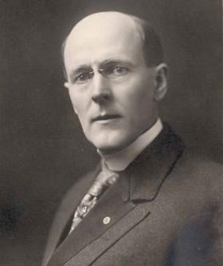
ROTARY 101- HISTORY of ROTARY
Paul Harris
Born in Racine, WI
First meeting 4 members on 23 February 1905
Club #1
First service club in the world
How many members now?
How many clubs now?
When were women invited to join?
STRENGTHENING ROTARY |

Slide 8
ROTARY 101-ORGAIZATIONAL STRUCTURE
STARTS WITH MEMBERS AT CLUB LEVEL
CLUBS ARE SUPPORTED BY DISTRICT (6270) AND CLUBS ARE MEMBERS OF RI
DISTRICTS ARE SUPPORTED BY ZONE(28)
ROTARY INTERNATIONAL PROVIDES GUIDANCE AND SUPPORT TO ALL
STRENGTHENING ROTARY |

Slide 9
ROTARY 101-ORGANIZATIONAL STRUCTURE
Members belong to Clubs
Clubs are members of RI and are organized into Districts
Districts are organized into Zones
RI

Slide 10
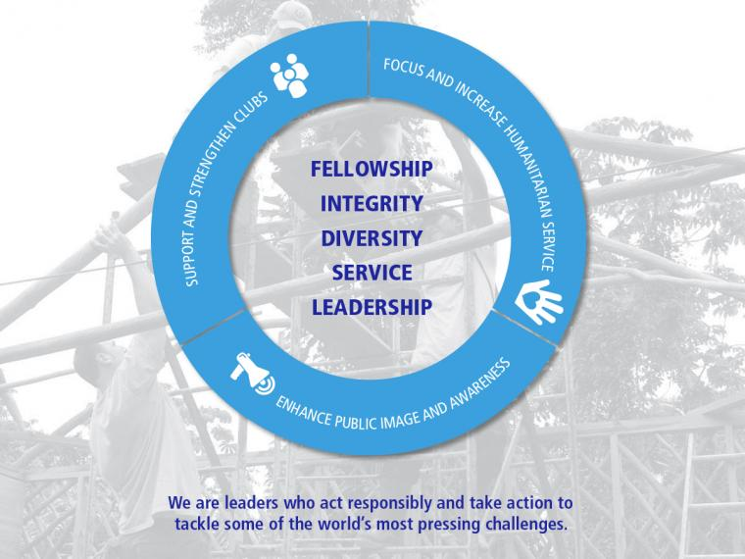
ROTARY INTERNATIONAL EXISTS & PROVIDES…..
Motto
Service Above Self
Guiding Principles
4-Way Test
Object of Rotary
Peace through understanding
5 Avenues of Service
6 Areas of Focus
STRENGTHENING ROTARY |
Notes:
The Goals for Support & Strengthen Clubs:- Foster Club innovation &flexibility- Encourage Clubs to participate in a variety of service activities
Promote membership diversity Improve member recruitment and retention Develop leaders- Start new & dynamic clubs-
Encourage strategic planning at club and district levels
Focus and Increase Humanitarian Service- Eradicate Polio

Slide 11
ROTARY 101-BUILDING BLOCKS OF OUR BRAND
ESSENCE
VALUES
VOICE
Our reason for being
Our beliefs
Our expression
STRENGTHENING ROTARY |

Slide 12
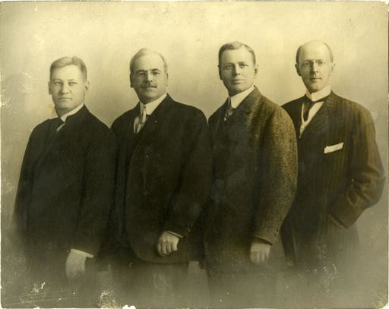
ROTARY 101-OUR VALUES & BELIEFS
Motto
“Service Above Self”
Guiding Principles
4-Way Test
Object of Rotary
Peace through understanding
5 Avenues of Service
6 Areas of Focus
STRENGTHENING ROTARY |
Notes:
1911-He Profits Most Who Serves Best- Service, Not Self then combined in 1950 with the addition of Service Above Self
1989 RI decided to focus on principle motto

Slide 13
ROTARY101-4-WAY TEST
ROTARY101-4-WAY TEST
ROTARY 101-THE FOUR-WAY TEST-OUR VALUES & BELIEFS
Of the things we think, say, or do:
Is it the TRUTH?
Is it FAIR to all concerned?
Will it build GOODWILL and BETTER FRIENDSHIPS?
Will it be BENEFICIAL to all concerned?
Notes:
Herbert J Taylor 1932-Chicago’s Club Aluminum 24 words- Adopted by RI in 1943 RI President 1954-55

Slide 14
ROTARY 101- THE OBJECT OF ROTARY-VALUES & BELIEFS
“to encourage and foster the ideal of service as a basis of worthy enterprise”
First: The development of acquaintance as an opportunity for service.
Second: High ethical standards in business and profession. The recognition of the worthiness of all useful occupations. The dignifying of each Rotarian’s occupation as an opportunity to serve society.
Third: The application of the ideal of service in one’s personal, business, and community life.
Fourth: The advancement of international understanding, goodwill, and peace through a world fellowship of business and professional persons united in the ideal of service.
STRENGTHENING ROTARY |

Slide 15
BUILDING BLOCKS OF OUR BRAND STRATEGY
ESSENCE
VALUES
VOICE
Our reason for being
Our beliefs
Our expression
STRENGTHENING ROTARY |
Notes:
Next, let’s look at our voice…how we express ourselves…what we say…and how we say it.

Slide 16
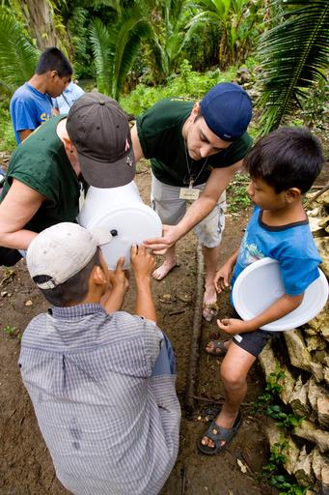
ROTARY 101- 5 AVENUES of SERVICE-HOW WE EXPRESS
Club Service
Community Service
Vocational Service
International Service
New Generations
STRENGTHENING ROTARY |

Slide 17
ROTARY’S 6 AREAS OF FOCUS
Peace and Conflict Prevention/Resolution
Disease Prevention and Treatment
Water and Sanitation
Maternal and Child Health
Basic Education and Literacy
Economic and Community Development

Slide 18
ROTARY 101- THE ROTARY FOUNDATION
Annual Fund
E.R.E.Y.- Every Rotarian Every Year
Permanent Fund
Our endowment fund
Polio Plus
Who are Paul Harris Fellows PHF) and how can you become one?
STRENGTHENING ROTARY |
Notes:
TRF was started by RI Pres Arch Klumph 1917- $26.50 Recent $ ______________ Charity Navigator 92% 4 Stars
In 1929, the Foundation made its first gift of $500 to the International Society for Crippled Children. The organization, created by Rotarian Edgar F. “Daddy” Allen, later grew into Easter Seals.
When Rotary founder Paul Harris died in 1947, contributions began pouring in to Rotary International, and the Paul Harris Memorial Fund was created to build the Foundation.
1978: Rotary introduced the Health, Hunger and Humanity (3-H) Grants. The first 3-H Grant funded a project to immunize 6 million Philippine children against polio.

Slide 19
ROTARY 101- ANNUAL THEMES
Notes:
RI President K.R. Ravindran chose Be a Gift to the World as his theme for 2015-16. Ravindran urges Rotary members to give the gifts of time, talent, and knowledge to improve lives in communities across the globe. "Through Rotary, we can take these gifts and make a genuine difference in the lives of others and in our world."

Slide 20
ROTARY 101- INFORM | INSPIRE | EMPOWER
Tools to assist you in elevating your awareness and knowledge of Rotary:
Read the “ABC’s of Rotary”
Explore your home Club’s history
Visit D6270 Website
Visit Rotary.org/My Rotary (sign up)/Rotary Club Central
STRENGTHENING ROTARY |
Notes:
Live Demo if possible

Slide 21
ROTARY 101- INFORM | INSPIRE | EMPOWER
We hope to motivate you to have fun and get involved at your Club, District and International Level:
STRENGTHENING ROTARY |

Slide 22
ROTARY 101- INFORM | INSPIRE | EMPOWER
Join an Avenue of Service Committee
Visit other Rotary Clubs
Invite a guest to a Club meeting
Attend a District Conference
Attend a District Foundation Dinner
Attend a District/Area Visioning Session
Volunteer for an International project
Attend a RI Convention
Explore Rotary Fellowships
Visit Rotary.org/My Rotary (sign up)/Rotary Club Central
STRENGTHENING ROTARY |
Notes:
Live Demo if possible

Slide 23
ROTARY 101- INFORM | INSPIRE | EMPOWER
QUESTION:
What is the first thing that you going to do to strengthen, improve and grow your Rotary Club and Rotary?
STRENGTHENING ROTARY |

Slide 24
ROTARY 101- INFORM | INSPIRE | EMPOWER
THANK YOU
&
PLEASE BE A
ROTARY
CHAMPION
Notes:
Thank You & Please Be a Rotary Champion.
By attending this session and listening to the presentation, you are already Rotary champions. Now that you’ve taken the time to learn more about this effort, you can use what you learned here today in your district conferences, regional seminars, and team trainings to share this message with the rest of the Rotary world.

