Slide 1


JUNE 2025 ALL HANDS MEETING
DISTRICT 5840

Slide 2

AGs:
Chris Kailipaka – Frio County, Jourdanton, Medina County, Pleasanton, Poteet
Eddue Amezcua / Gloria Wilson – Del Rio, Eagle Pass, Uvalde
Joyce Yannuzi – Blanco County, Canyon Lake, New Braunfels, New Braunfels Downtown, Wimberley
Karen Allen-Mirabeau – Randolph Metrocom, San Antonio Airport, San Marcos
Kyle Emmons – Alamo Heights, E-Club of D5840, San Antonio, Alamo Ranch, SA North Central
Lisa Herring – Ballinger, San Angelo, San Angelo Sunrise
Madeline Madden – Beeville, Cuero, Karnes City, Kenedy
Martin Hoenig – San Antonio Sunrise, San Antonio Oak Hills, Stone Oak
Melissa Sadler-Nitu – Gonzales, Seguin, Seguin Sunrise
Becky Goering – Mission Trail, SA Northeast, Pearl, SA West, SA South
Dick Baggett – Brady, Junction, San Saba
Ron Hubbard – Boerne, Boerne Sunrise, Fair Oaks Ranch, Dominion
Sarah Eckert – Dripping Springs, Fredericksburg, Fredericksburg Morning, Fredericksburg Nimitz
Ronni Pue – Kerrville, Kerrville Morning, SA Northwest
Executive ag
Dan Clark
DanClark@ibc.com
beaconboy23@gmail.com

Slide 3
subhead
Assistant Governor Updates
Gloria Wilson has replaced Eddie Amezcua as AG for Del Rio, Eagle Pass, and Uvalde
Kristi Shepherd from the Kerrville Rotary Club will replace Ronnie Pue as AG for the Kerrville, Kerrville Morning, Northwest Rotary Club
Clubs have been contacted by their AG and reminded to update goals by June 14th
AGs have also been reminded to finalize their Club Ratings by June 14th

Slide 4

RC OF BLANCO COUNTY
RC OF BOERNE SUNRISE
RC OF DEL RIO
RC OF FAIR OAKS RANCH
RC OF FREDERICKSBURG MORNING
RC OF FREDERICKSBURG-NIMITZ
RC OF JOURDANTON
RC OF KERRVILLE
RC OF NEW BRAUNFELS
RC OF OAK HILLS
RC OF SAN ANTONIO PEARL
RC OF PLEASANTON
RC OF SAN ANTONIO AIRPORT
RC OF SAN ANTONIO SOUTH
RC OF SAN MARCOS
CONGRATULATIONS

Slide 5


2024-25 PROMOTIONS

Slide 6

SUBMITTED MOST STORIES

Slide 7


ENGAGE MORE
GROW MORE

Slide 8
SUMMARY:
  Annual Fund Giving Goal: $187,440
  Annual Fund Giving to Date: $299,573
  Polio Fund Giving Goal: $54,185
  Polio Fund Giving to Date: $67,966
  Number of Paul Harris Fellows Awarded: 210
  Number of New Major Donors: 10
  Number of Paul Harris Society Members: 90
  Number of New Benefactors: 5
  Number of New Bequest Society Members: 4
  Number of Rotary Direct Participants: 93
foundation
Chair, IPDG Monica Gutierrez
monica97aggie@gmail.com
CONGRATULATIONS! We surpassed our Goals!!!!

Slide 9

subhead
Rotary Foundation Grant Training RY25-26
District Grants are funded by District Designated Funds (DDF) received from Rotary International based on a calculated percentage of the Annual Fund amount given three years prior, including Endowment Fund earnings.
These DDF dollars can be used to fund a variety of club projects.

Slide 10
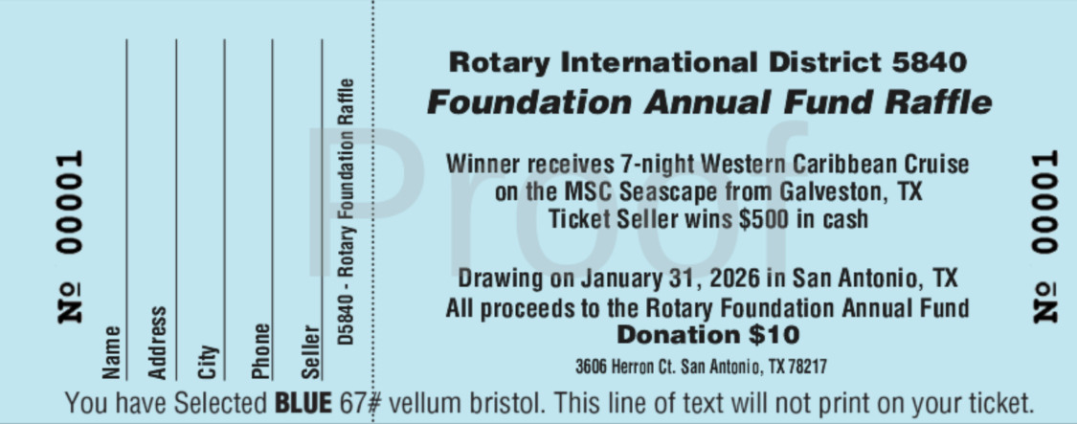
subhead
Rotary Foundation Raffle Tickets RY25-26
Ticket books will be distributed by club at the upcoming District Governor Installation on June 28, 2025. One ticket book per member.
Winner receives a 7-night Western Caribbean Cruise on the MSC Seascape from Galveston, TX.
Seller of winning ticket receives $500 in cash.
Ticket stubs (unstapled) will be collected by Assistant Governors or mailed to the address provided on the ticket by January 24, 2026.
Drawing will be on January 31, 2026 during Rotary Leadership Institute at Northwest Vista College in San Antonio, TX.
Note: Ticket sales are for net new donations, not planned giving or already donated funds.

Slide 11
Summary:
Grant Management Training on Zoom – May 15th
Review of the grant requests
Club Leadership Learning Seminar on Zoom – May 28th
Registered 92
Attended – 66
9 different breakouts sessions for each Club Committee Chairs
President Elect
President Nominee
Foundation
Membership
Public Image
Service
Youth Services
Secretary
Treasurer
Presentations available are listed on the District 5840 Website under President Resources
Upcoming events:
Rotary Learning Institute:
September 20, 2025
January 31, 2026
April 11, 2026
Learning Facilitator
Chair, Arden Riley
arden.riley@gmail.com

Slide 12
Team:
  Early Act – Darcee Grivel
  Interact – Mike Canales
  RYLA – Ron Greenberg
  Rotary Youth Exchange – Stephen Finch
  Youth Protection – Armen Barbajanian
YOUTH SERVICES
Chair, Cha Karulak
chakarulak@gmail.com

Slide 13
subhead
Early Act Updates
What progress have you made towards accomplishing the goals set by your District Committee at the District Leadership Workshop?
My committee was on a roll at the beginning of the year. Due to the inclement weather our Early Act (EA) Celebration was canceled and could not be rescheduled
Are there any upcoming events being planned or hosted by your District Committee?
The chair of the committee is working on the 2026 venue for the annual EA Celebration
Is there anything your committee needs help with to meet your goals?
A commitment was made to form an Early Act District Committee for this coming year and the chair is reaching out to find dedicated Rotarians. Goals will be updated for this coming Rotary year. Anyone interested in serving on this newly formed committee can contact Darcee who is a member of the Dominion Club at: darcee.earlyact@gmail.com
Are there any other important updates to share?
Locke Hill Elementary will not be renewing their EA Club.
I did have a CJ Prater from the Granbury Rotary Club reach out to me about EA. I will follow up with him!

Slide 14
subhead
Interact Updates
What progress have you made towards accomplishing the goals set by your District Committee at the District Leadership Workshop?
Nothing to report at this time
Are there any upcoming events being planned or hosted by your District Committee?
Nothing to report at this time
Is there anything your committee needs help with to meet your goals?
Not at this time
Are there any other important updates to share?
The East Central High School Interact Club had a stellar year and was recognized by this committee chair and DG Kristen. The club was awarded a gift of $100 to support their program.

Slide 15
subhead
RYLA Updates
What progress have you made towards accomplishing the goals set by your District Committee at the District Leadership Workshop?
None at this time
Are there any upcoming events being planned or hosted by your District Committee?
A meeting will be set to select team leaders (TL’s). After the TL’s have been selected, the first meeting of the TL’s will be in September for January 2026. This will be the first meeting for the TLs.
Is there anything your committee needs help with to meet your goals?
Not at this time
Are there any other important updates to share?
A meeting was held on May 20 with DGE Craig Hardy, Ron Greenberg, Niles Plumber, and Cha Karulak to discuss this year’s and next year’s RYLA budget.

Slide 16
subhead
Rotary Youth Exchange Updates
What progress have you made towards accomplishing the goals set by your District Committee at the District Leadership Workshop?
We presently are working on the goal for getting our 6 total outbound students (4 long term and two short term) positioned for their travel. The committee is also working on securing Visas for all incoming students given the recent changes by the U.S. State Department.
Are there any upcoming events being planned or hosted by your District Committee?
There are no upcoming events until our first orientation in September. Currently, our inbound students are completing their East or West coast trips and some will begin to return home to their native countries.
Is there anything your committee needs help with to meet your goals?
Presently none needed. Two of our inbound students are hoping to get their appointments for their Visa due to the present halt in this process. Not sure if there is any need for assistance at this time with this issue.
Are there any other important updates to share?
New outbound students will be leaving in August and short term students will be leaving in June and July. Also new inbound students will arrive during the month of June.

Slide 17
subhead
Youth Protection Updates
What progress have you made towards accomplishing the goals set by your District Committee at the District Leadership Workshop?
None at this time
Are there any upcoming events being planned or hosted by your District Committee?
None at this time
Is there anything your committee needs help with to meet your goals?
None at this time
Are there any other important updates to share?
Ongoing-There will be an effort made to determine if all youth service committees would need an emergency plan similar to the one created for the YRE program.
Link for Rotary International Youth Protection
https://my.rotary.org/en/knowledge-and-resources/resources-and-reference/youth-protection

Slide 18
  As of May 31, 2025 we have 53 clubs with 2,202 members
  This is a decrease of 5 net members so far
  Working with Pam to create a membership toolkit that can be easily accessible from the District website
MEMBERSHIP
Chair, Holly Croom
croomrealtygroup@gmail.com

Slide 19
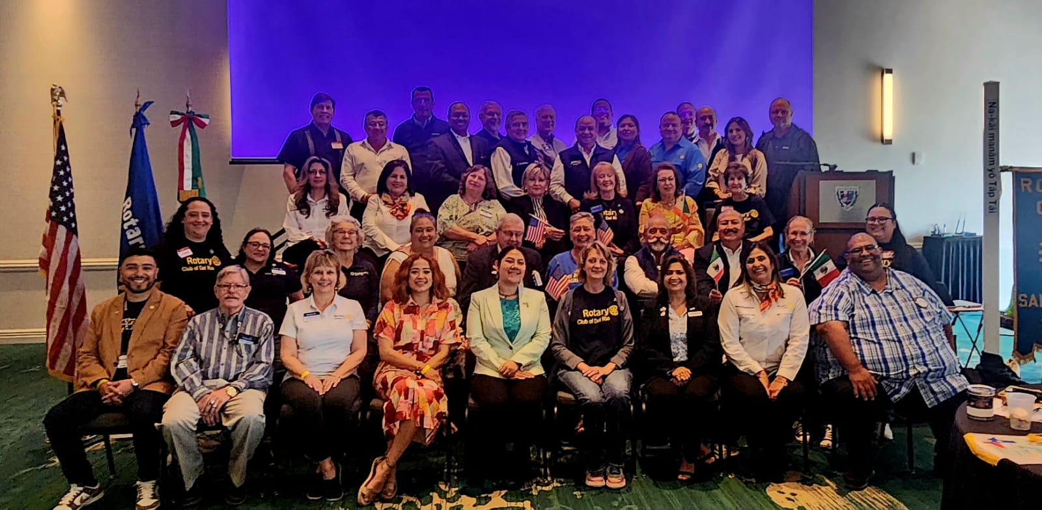
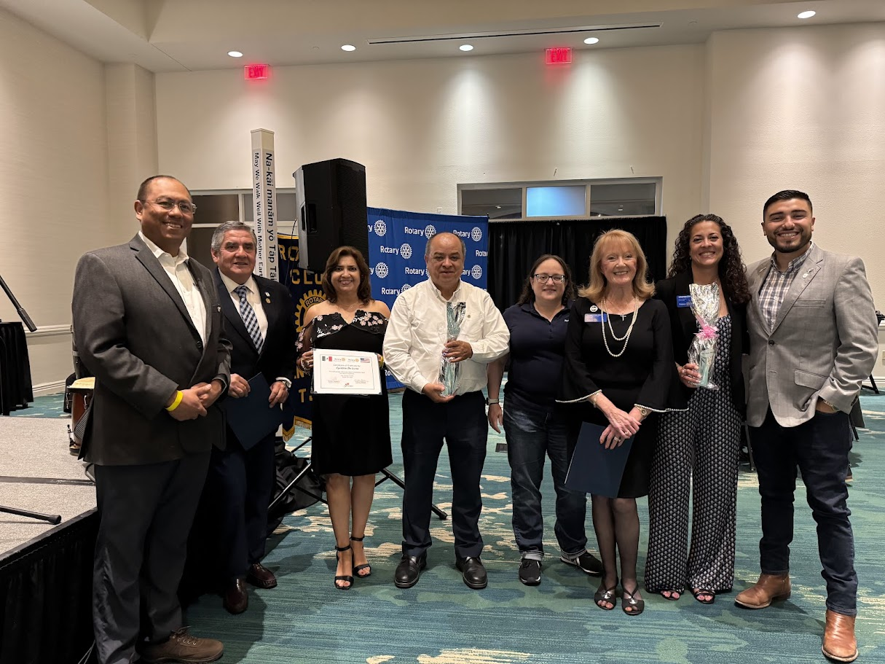
International Service Committee
Chair, Gloria Wilson
gloriageorgina@stx.rr.com

Slide 20
subhead
International Service Updates
Bi-National Conference was a success and allowed clubs to see the needs in communities close to us
We don’t have to travel far to make an international impact
Partnership continues with the San Marcos Rotary Club and the CD Acuna Rotary Club
Trip to Morgan’s Wonderland was another success this year!
Future initiatives include ways to provide products to girls in schools locally and abroad and spreading the work about Human Trafficking Awareness
Gloria will start cross training George Kychakoff from the Fair Oaks Rotary Club who will replace her RY 2026-2027

