Slide 1
How to Find and Retrieve
Foundation Reports
Go to www.rotary.org and
click on or tap My Rotary

Slide 2
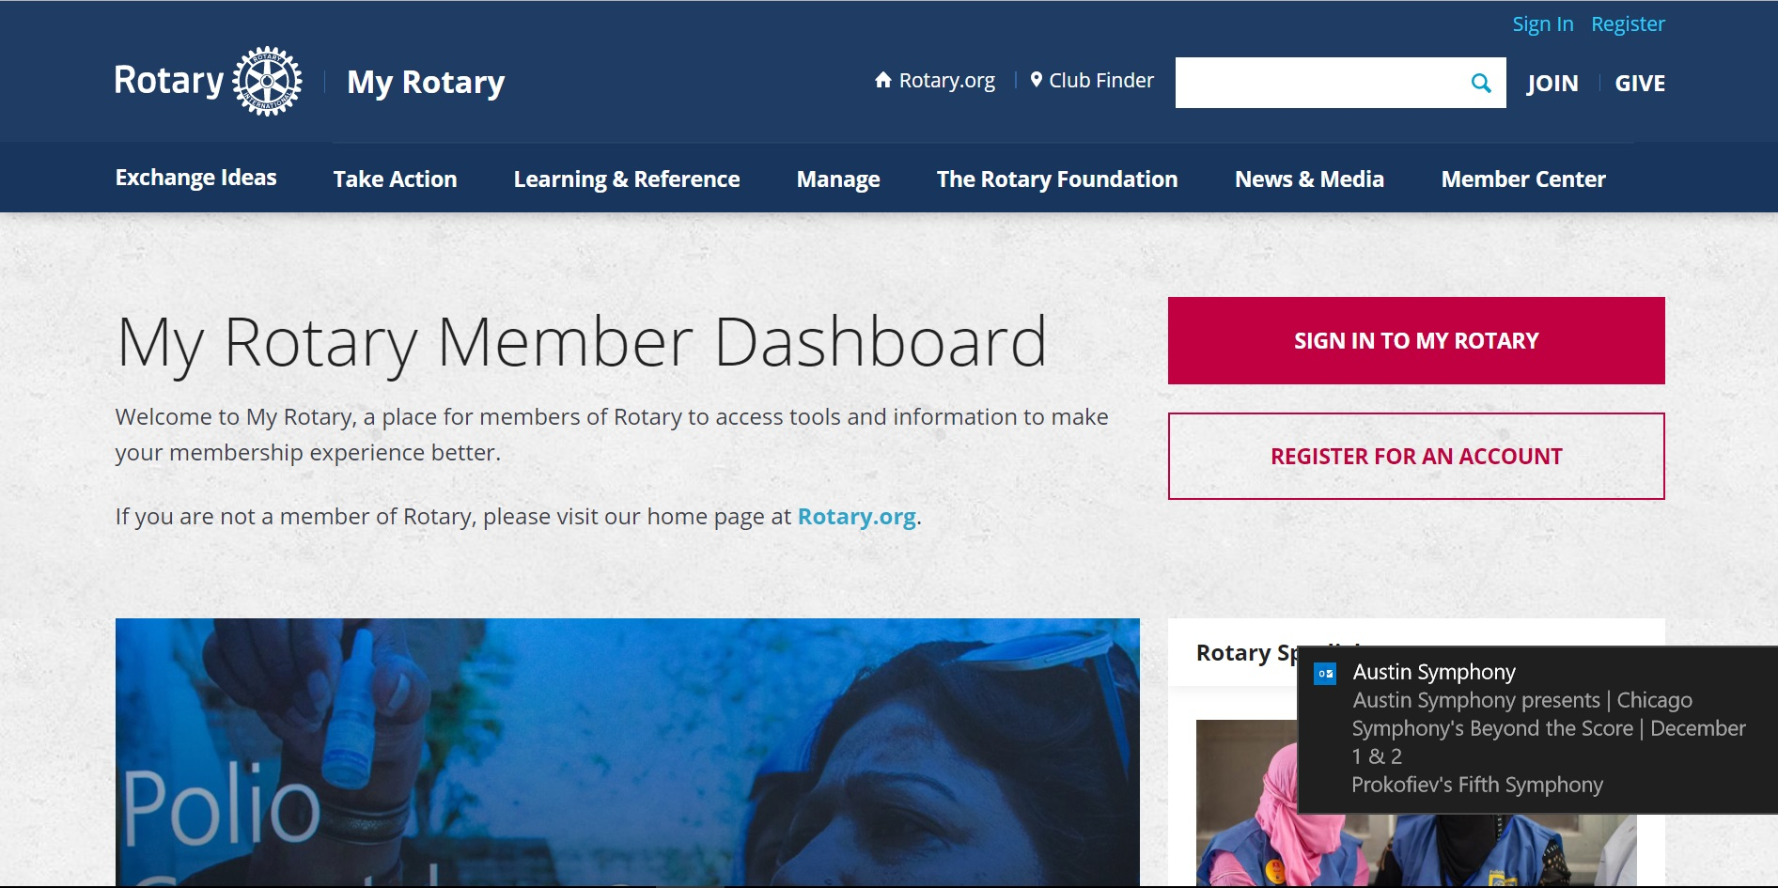
How to Find and Retrieve
Foundation Reports
Click on or tap
Sign in to My Rotary

Slide 3
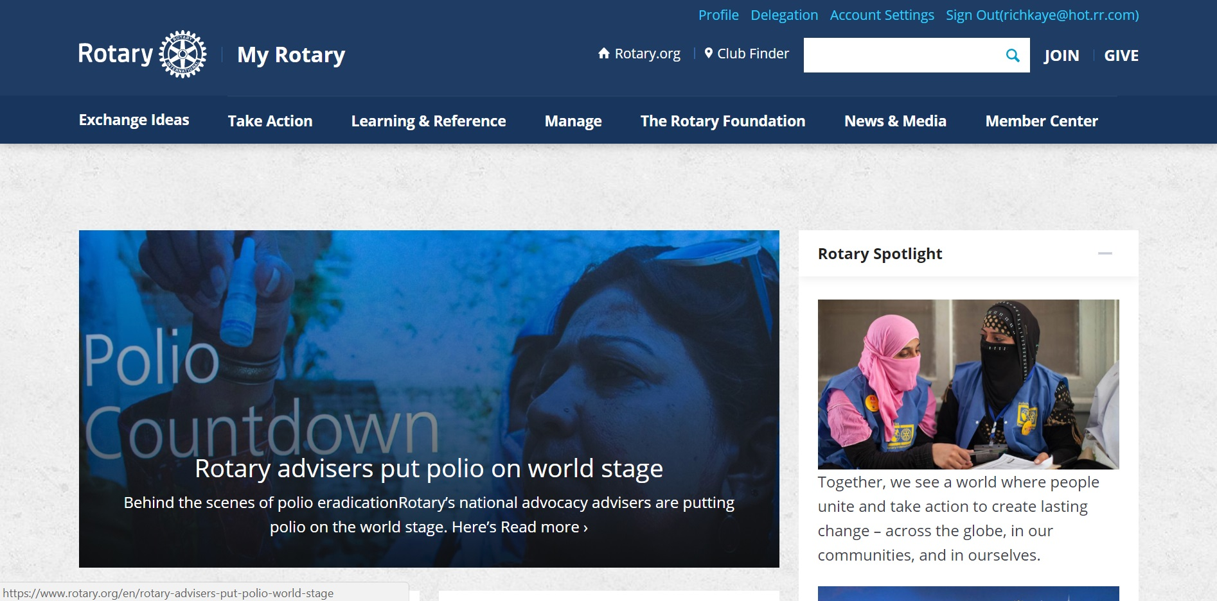
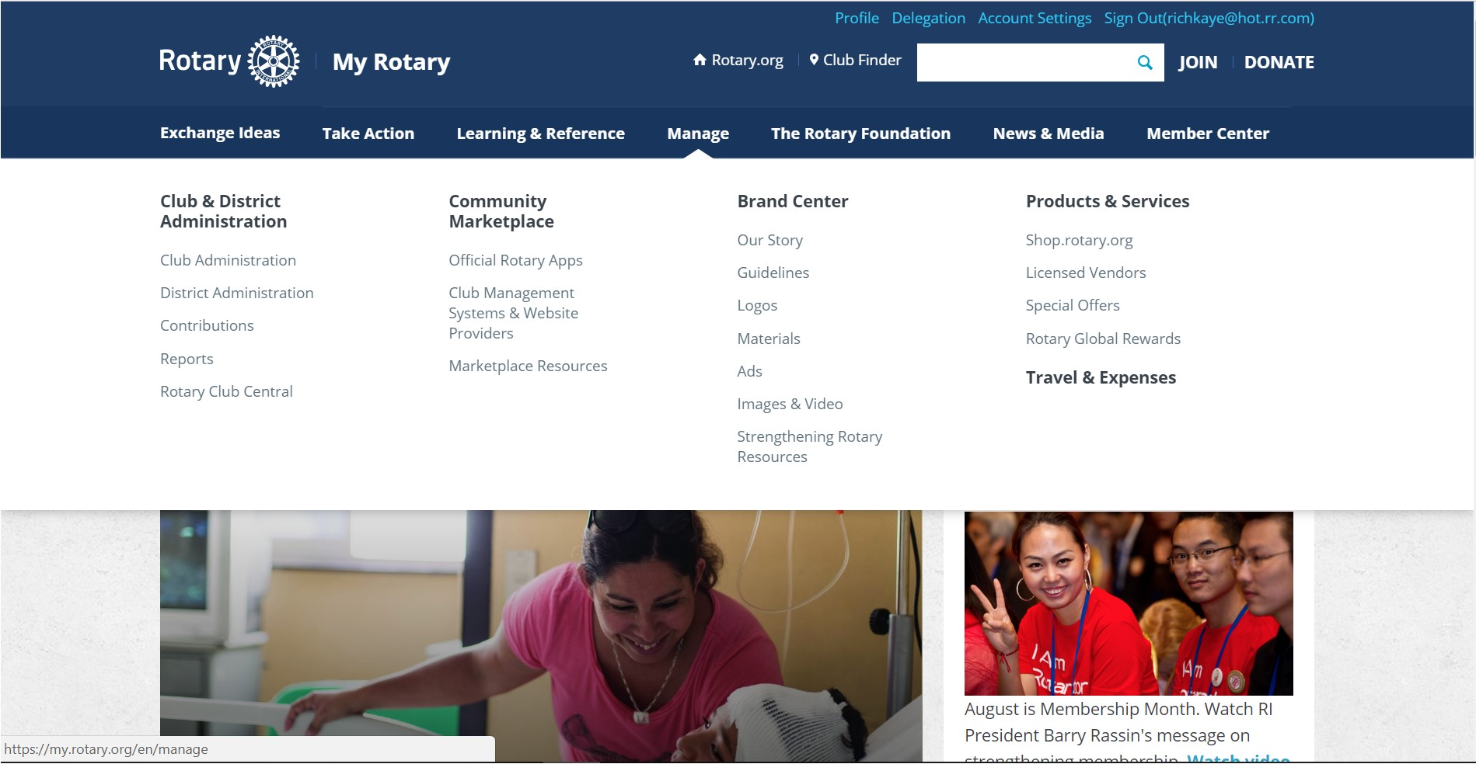
How to Find and Retrieve
Foundation Reports
Hover over
Manage
Click or tap on
Club & District Administration

Slide 4
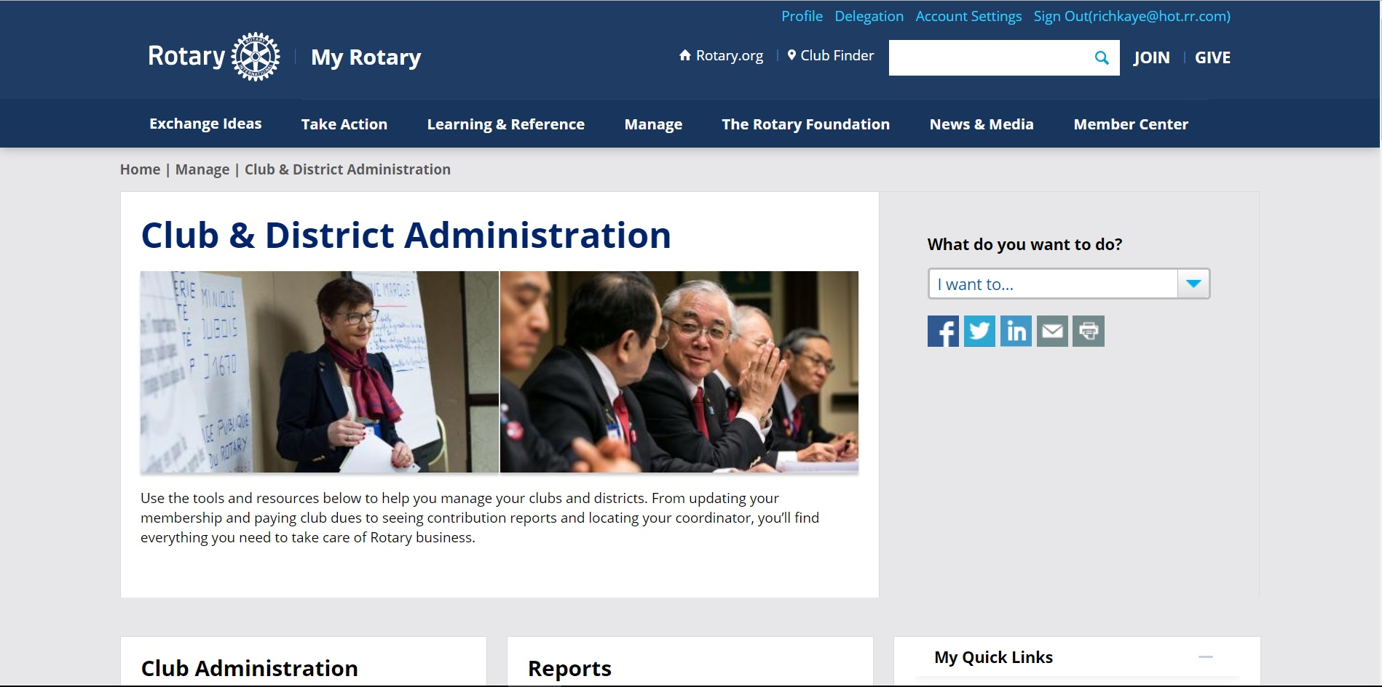
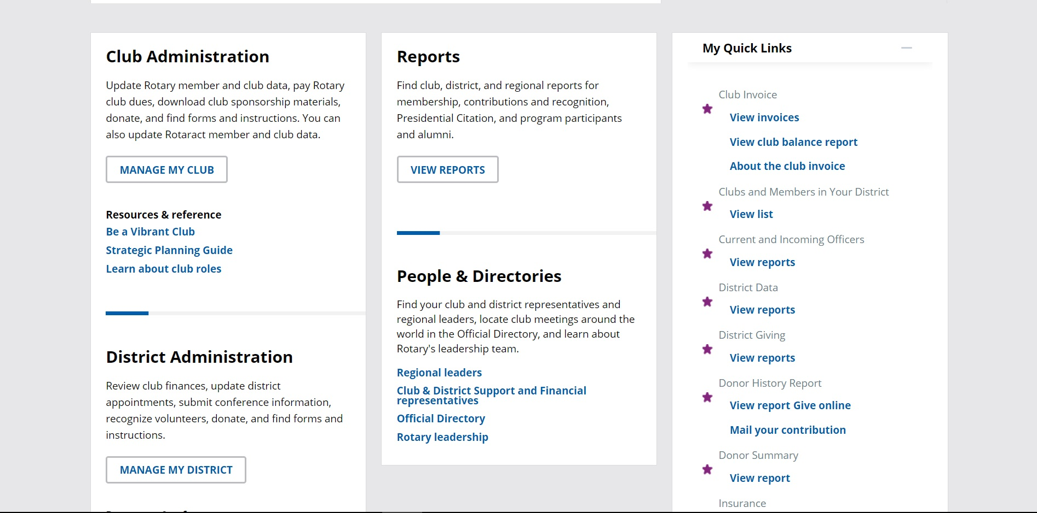
How to Find and Retrieve
Foundation Reports
On the Club & District Administration page, scroll down to the Reports section
Click on or tap
View Reports

Slide 5
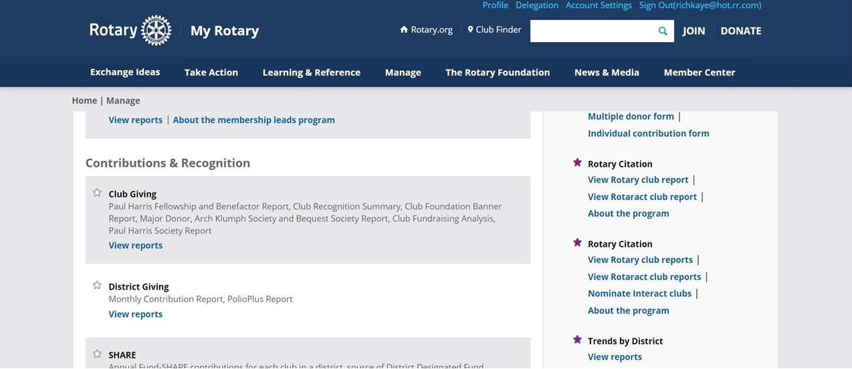
How to Find and Retrieve
Foundation Reports
On the Reports page, scroll down to the Contributions & Recognition section
Tip: Click the STAR to adde the item to My Quick Links
Click on or tap View Reports

Slide 6
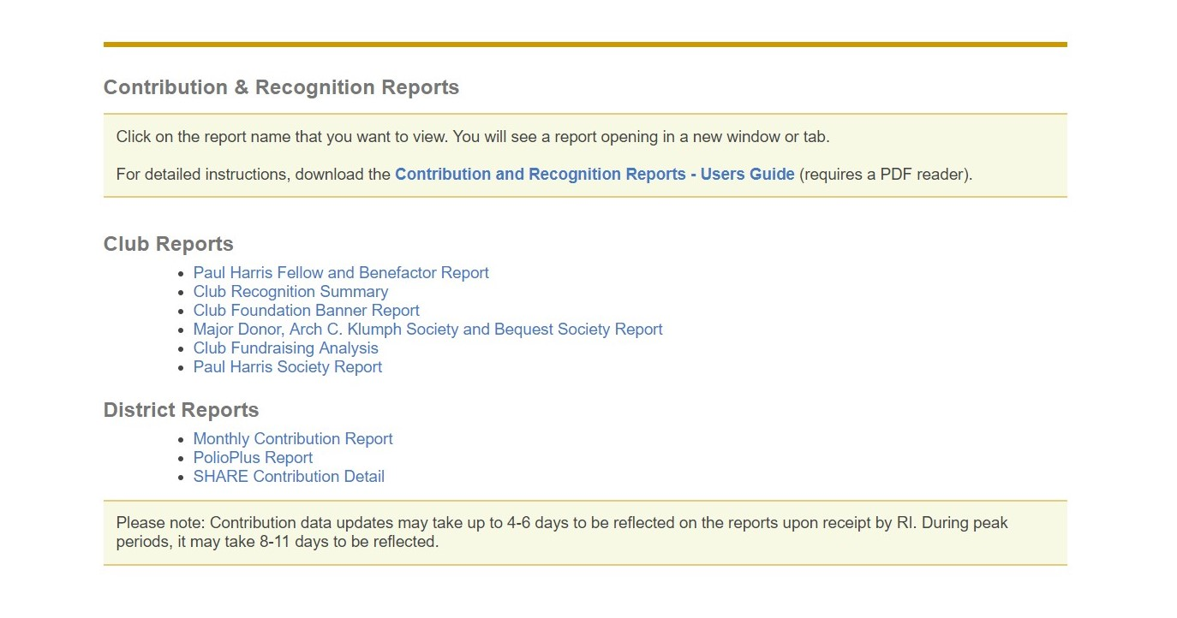
How to Find and Retrieve
Foundation Reports
Click or tap on
one of the reports

Slide 7
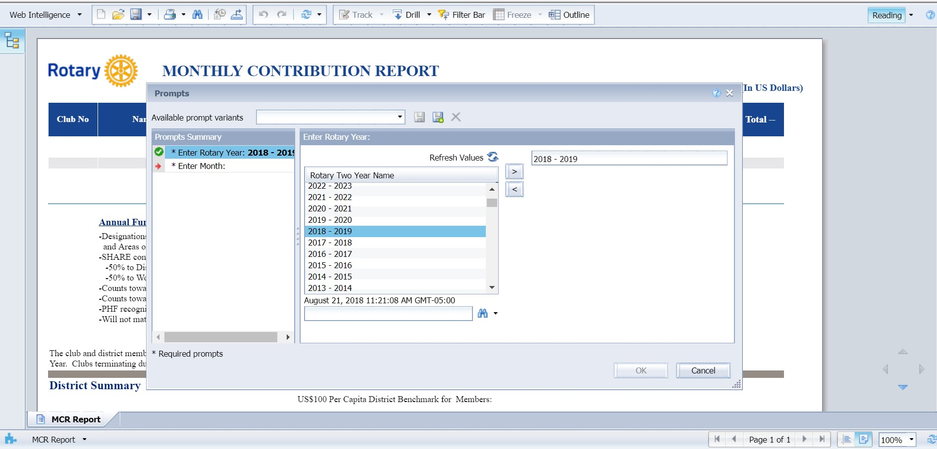
How to Find and Retrieve
Foundation Reports
First
double click or tap on
2018-2019
Then
click or tap on
Enter Month

Slide 8
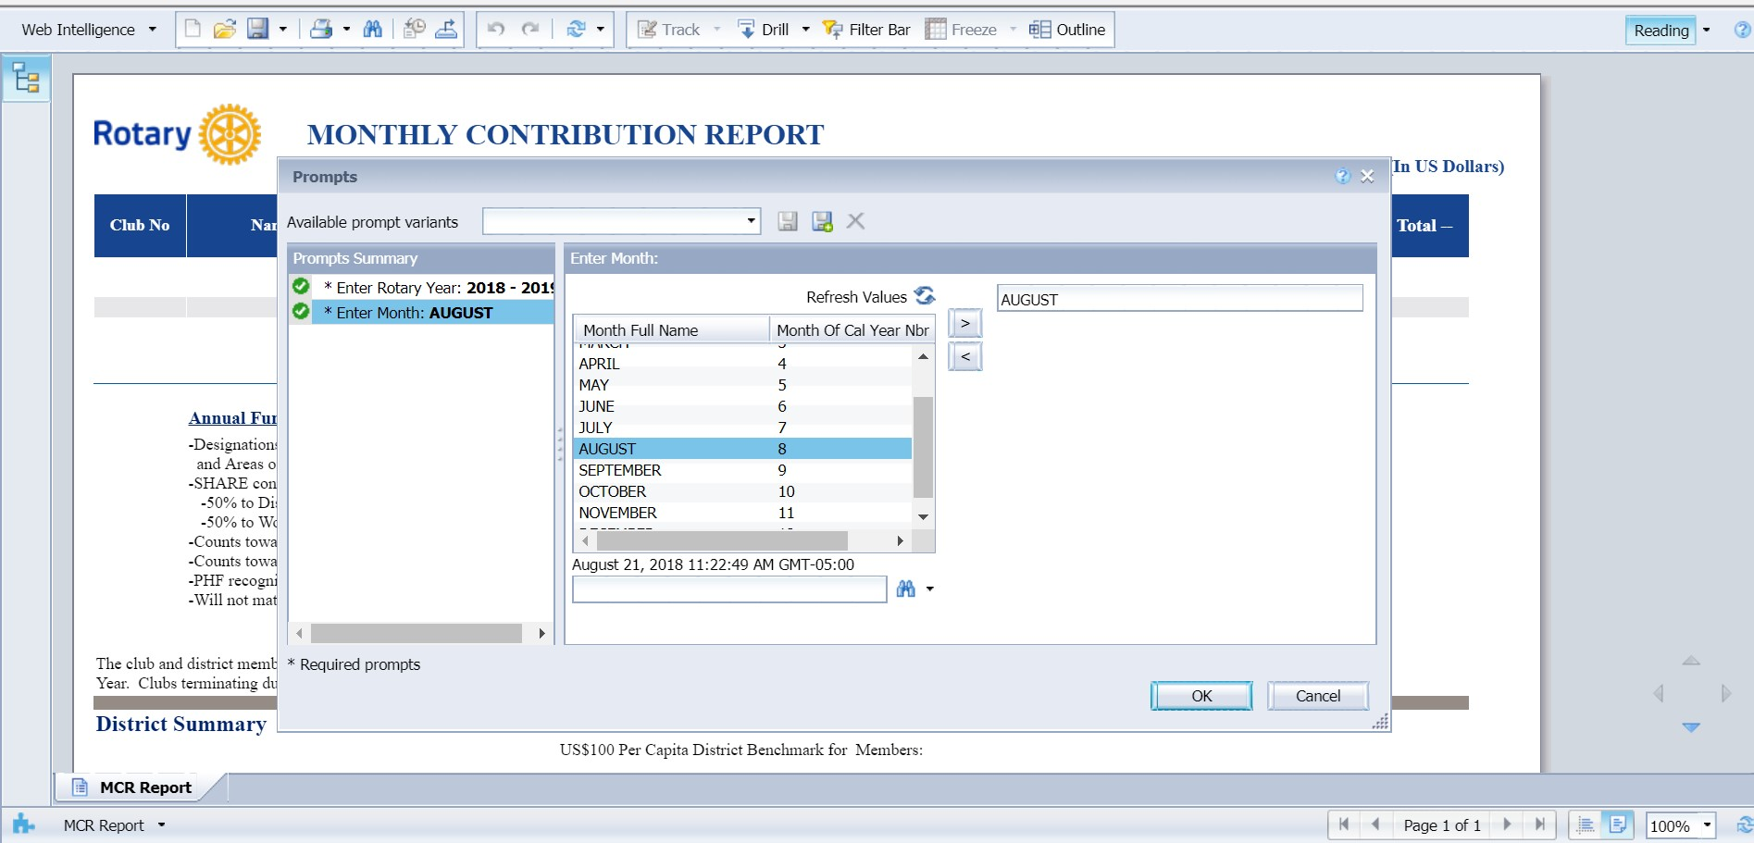
How to Find and Retrieve
Foundation Reports
First
double click or tap on
Month
Then
click or tap on
OK

Slide 9
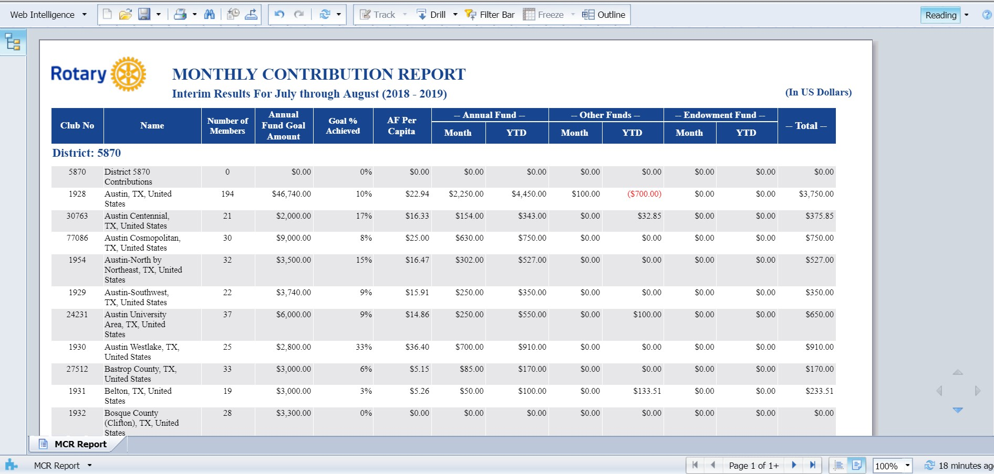
How to Find and Retrieve
Foundation Reports
Click on this icon to download the report
Paginate using the
Arrows

Slide 10
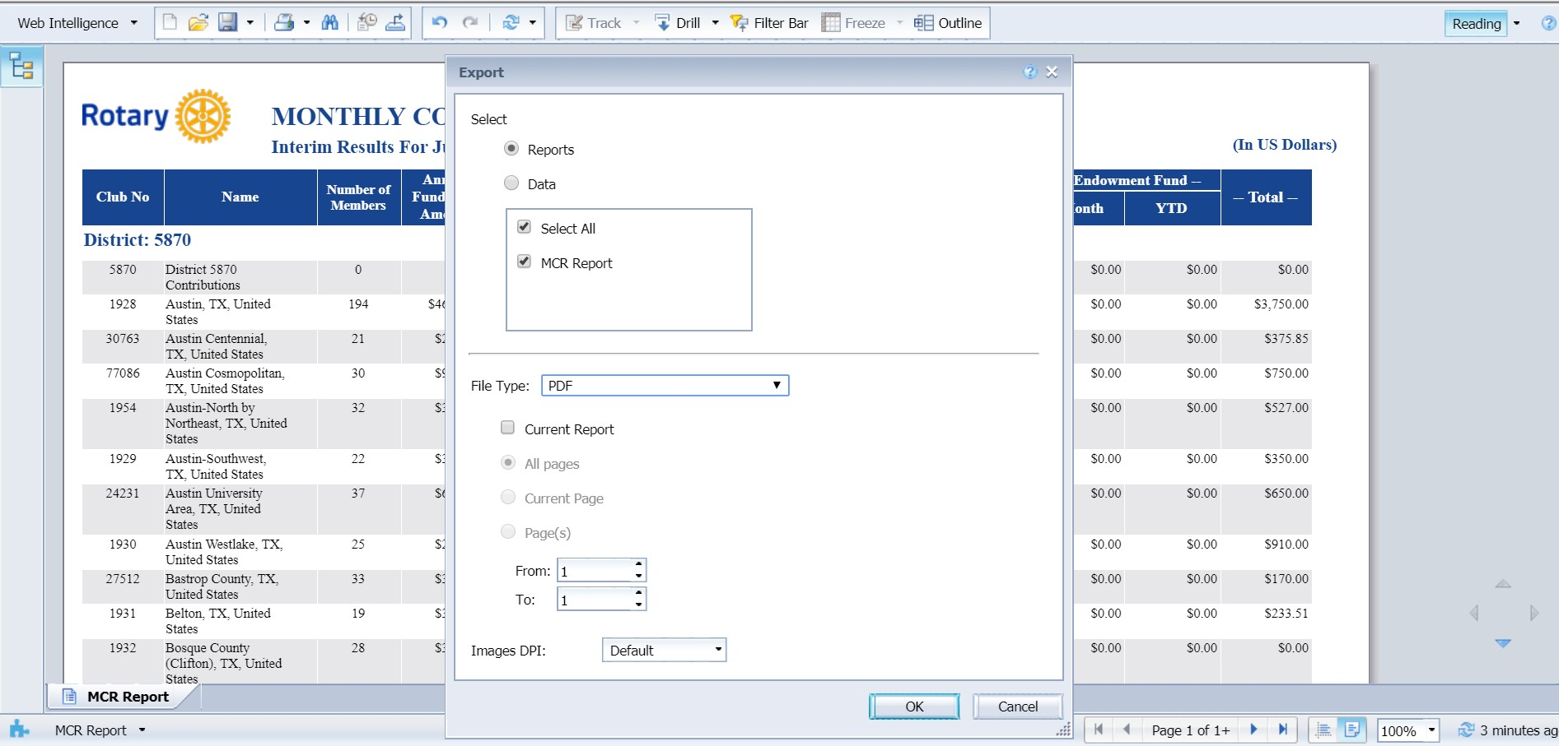
How to Find and Retrieve
Foundation Reports
First
choose the format
PDF
Excel (.xlsx)
Excel (.xls)
CSV Archive
Text
Then
click or tap on
OK

