Slide 1
D5840 All-Hands
October 9, 2024
Title Page Option

Slide 2
Summary:
Membership to Date: +20 per Rotary International
Membership Olympics is Active NOW! Prizes available for the winners!
There will be a Service Companion Club and Corporate Membership Event on November 7th at 530pm
Membership Chair Mixer – Date and Time TBD
Membership Committee could use help at the membership booths at various events
MEMBERSHIP
Chair, Holly Croom
croomrealtygroup@gmail.com

Slide 4
Summary:
Grant funds have been received from Rotary International and we are starting to distribute checks to clubs
Several Pints for Polio events have been scheduled and can be found on the District Website Calendar
Clubs participating in Pints for Polio events can use the Contribution Forms (single and multiple) found on the District Website
https://rotary5840.org/sitepage/foundation
Two Global Grant Scholars have started their scholastic year in Spain and Switzerland
Foundation Goal - $184,340 with $51,287 as of end of Sept
Polio Plus Goal – $52,065 with $9,027 as of end of Sept
Major Donors – 3 Major Donor Level 1; 1 Major Donor Level 2 as of end of Sept
FOUNDATION
Chair, IPDG Monica Gutierrez
monica97aggie@gmail.com

Slide 5
Summary continued:
Upcoming events:
World Polio Day Challenge on October 24th
Foundation seminar via Zoom on Nov 14 from 6:30PM-7:30PM
Committee Needs:
Would like members to participate in World Polio Day Challenge
Would like clubs to do something in November for Foundation month, for example
Invite speakers on Foundation during club meetings
Hold Foundation dinner to raise money for the Foundation
Participate in Giving Tuesday and donate to the Rotary Foundation
Additional Updates:
Foundation FUNdraiser on April 4th at Aggie Park Event Center
FUN activities to raise money for Foundation Annual Fund
Recognize those that give to the Endowment fund as part of RI’s goal 2.025B by 2025
FOUNDATION
Chair, IPDG Monica Gutierrez
monica97aggie@gmail.com

Slide 6
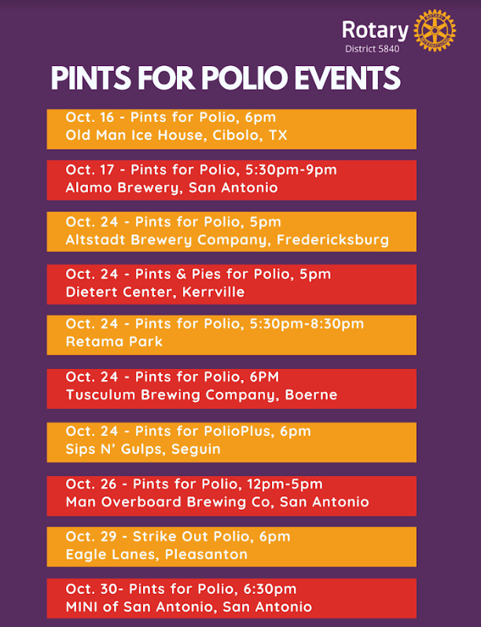

Slide 7
subhead
2025 DISTRICT 5840 FIESTA MEDAL
FIESTA in San Antonio!
Profit from medal sales will go to the Annual Fund Share!

Slide 8
Summary:
Current Public Image Campaigns:
Rotary Rockstar Challenge – 50% of Clubs are participating thus far; 3 have completed it already
Welcome New Rotarian – Find link on Homepage
Member Spotlight – Find link on Homepage
Public Image Road Signs – The District will provide funding for one sign per Club. Fill out an application on District Website/Public Image
Reserve a Public Image Banner for Event – Fill out form to reserve and choose banner
New Public Image Tools Canva Rotary Branded Templates
Public Image Audit
Websites are 88% brand compliant, 38% have current content on websites. Facebook pages 86% are compliant based on timeline photo. Still have issues with profile pictures. We need to do more training. 92% of the Clubs post regularly.
Public Image Training Event – November How to use Cloud Events to set-up a registration and demo of Club Runner Nova
PUBLIC IMAGE
Chair, Sandy Cordell
cordellsandy@gmail.com
Website/Social Media, Pam Blankenzee
pblankenzee@rotary5840.org

Slide 9
Summary:
International Service Projects
Hospital in Hondo has donated breast pumps to the clinic in Acuna, Mexico
RC of Del Rio is working to bring toilet seats to Acuna for the schools and supplying uniforms for the children. Also providing support for the Children’s Shelter which has 36 children. The RC of San Marcos is also providing support for the Children’s Shelter.
Bi-District Conference with Acuna, Mexico is being planned for March 21-23, 2025 at the Embassy Suites in San Marcos
District Service Project
More Delightful Than Frightful
Morgan’s Wonderland
Weekends, September 27th through October 31st
SERVICE
Chair, Gloria Wilson
gloriageorgina@stx.rr.com

Slide 10
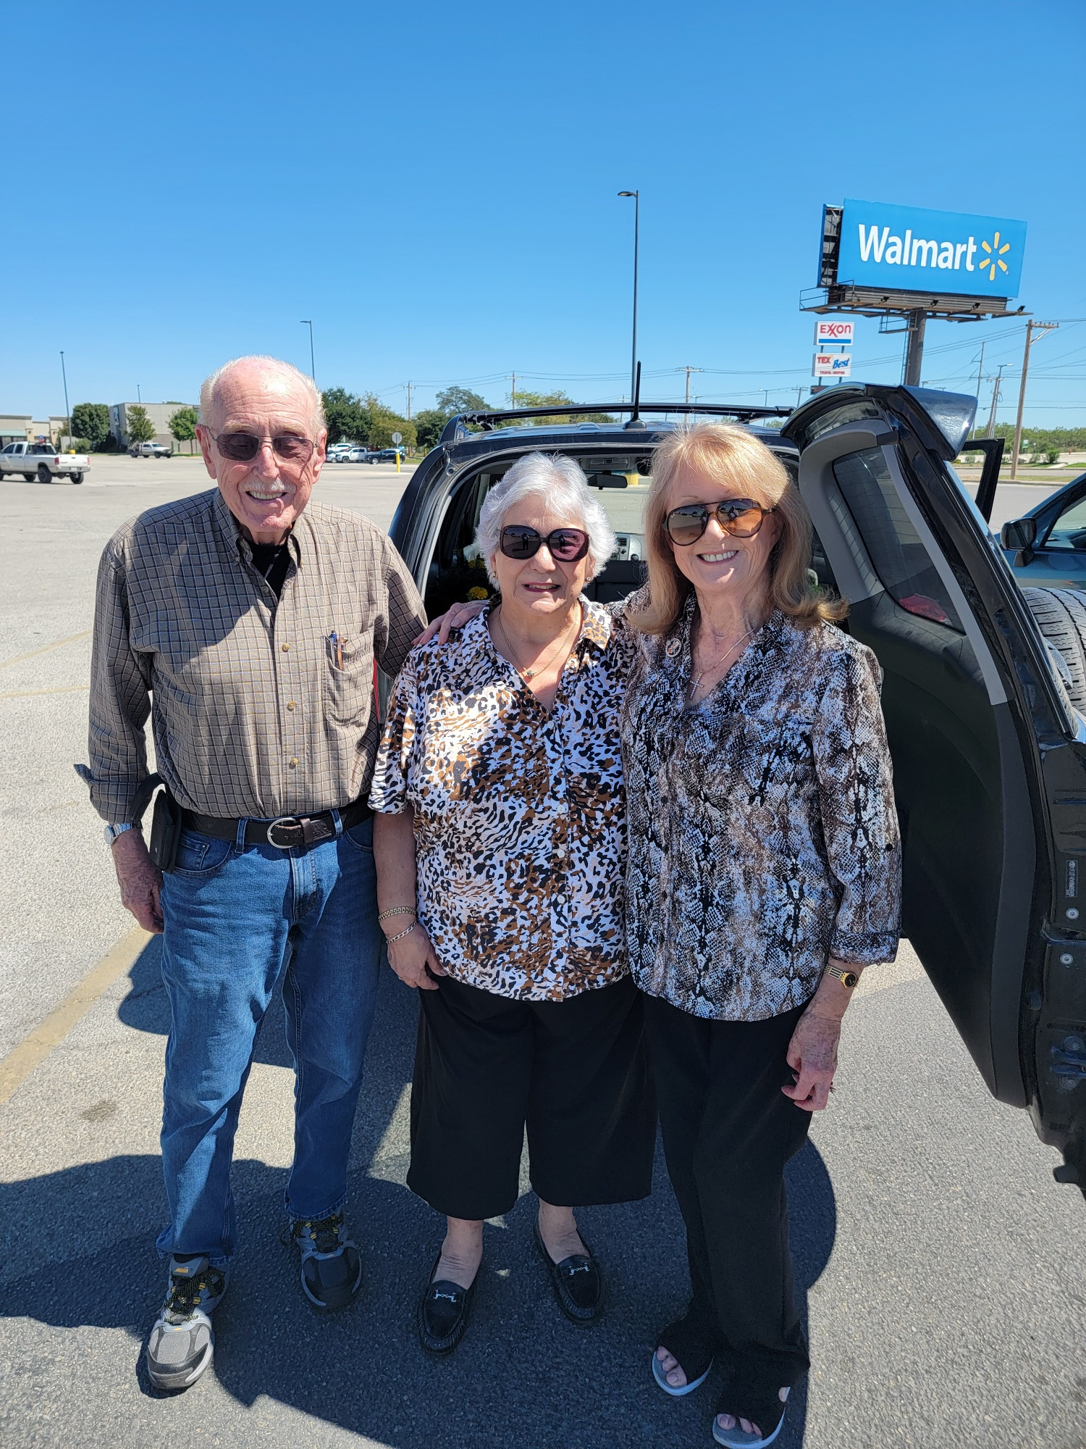
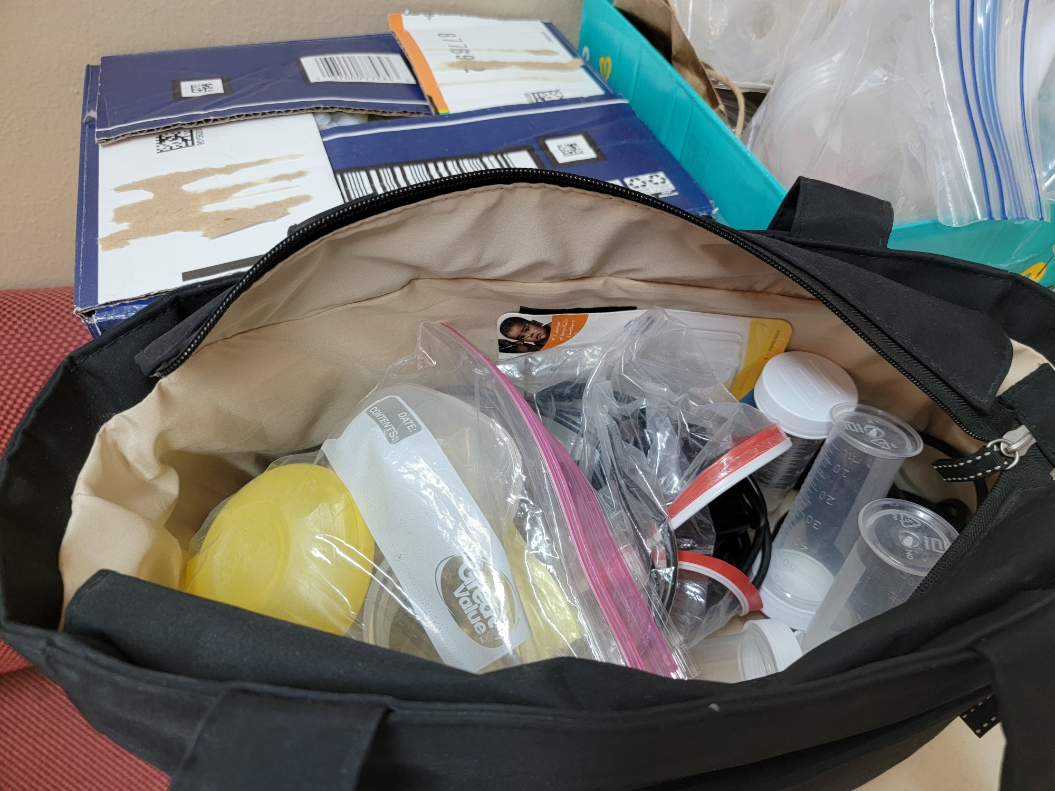
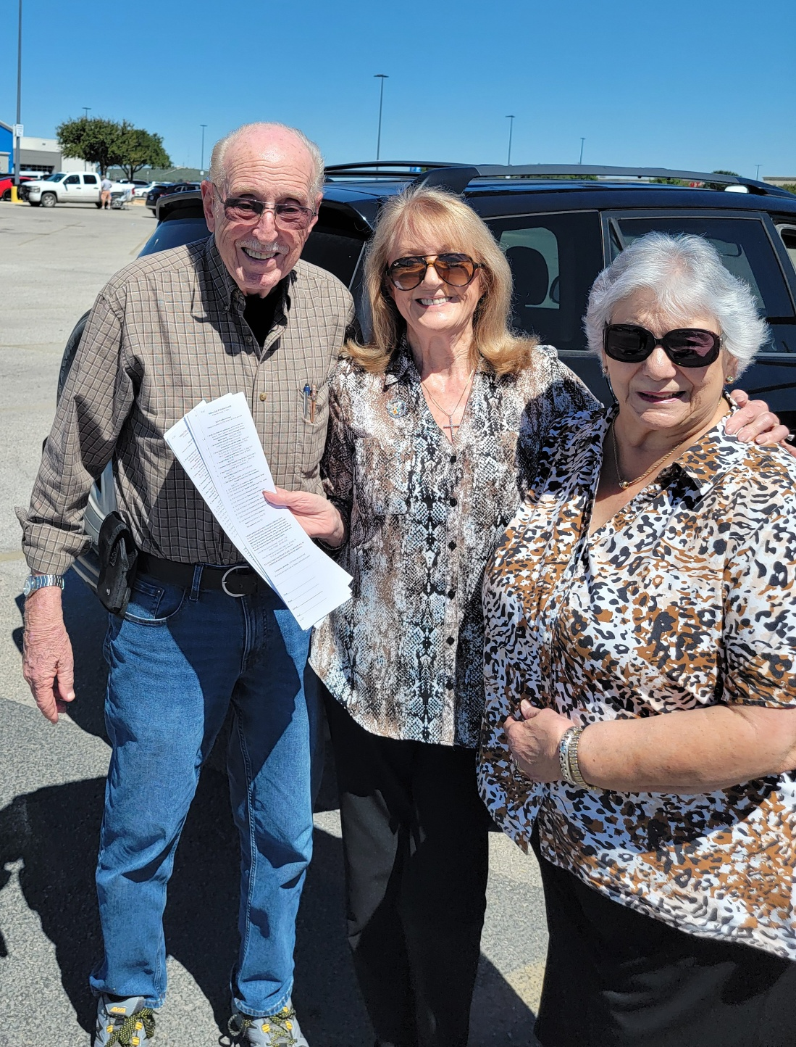

Slide 11
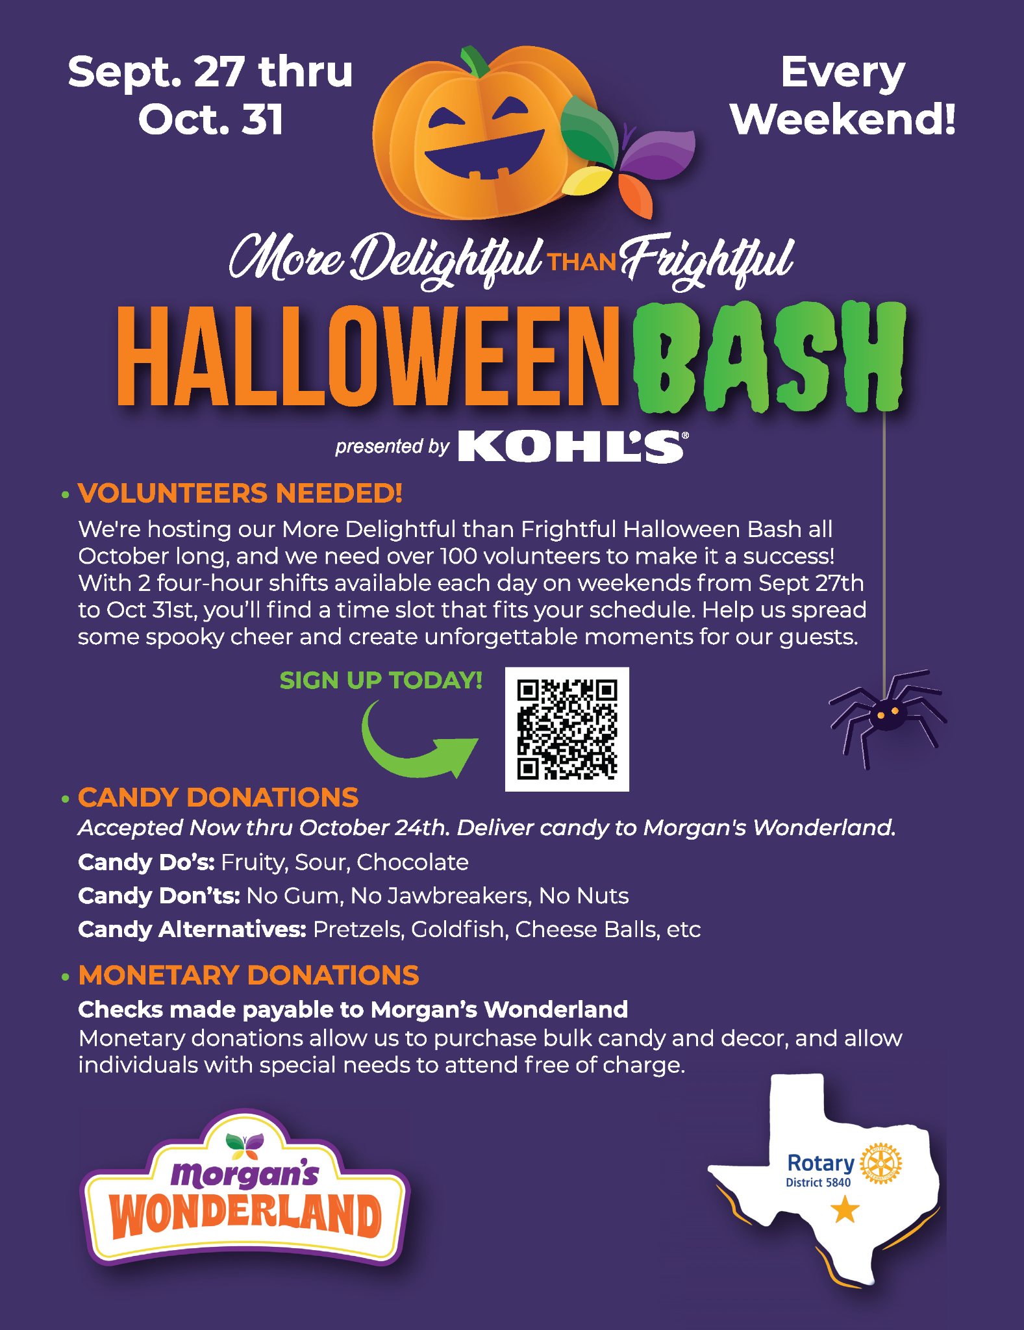
Register at https://docs.google.com/forms/d/e/1FAIpQLSfMG83M_6icbtDmYtAukJlm9HT9YDUxkvFbhG-n9PMlRH1b1A/viewform or us the QR code on the flier.
We have more days to serve and make a bigger impact!

Slide 12
Summary:
Youth Services is comprised of Early Act, Interact, Rotary Youth Leadership Awards (RYLA), and Rotary Youth Exchange.
Early Act: A second zoom meeting will be schedule with all Rotary liaisons and sponsors to share ideas for the Early Act upcoming celebration. February 22, 2025 is the Early Act Celebration from 9:00-11:00 am. The site will be determined at a later date. The theme for the district EA clubs will center on seniors and assisted living.
Interact: The chair of this committee continues to follow-up with Rotary clubs to ensure they register their Interact Club(s) with Rotary International and the chair reports most clubs are now registered with RI. This is a great improvement at this time compared with recertification of Interact clubs at this time last year. The District Interact Conference is set for November 9, 2024 from 9:00 am to 2:00 pm at the Winston School San Antonio located at 8565 Ewing Halsell Drive (in the South Texas Medical Center). All information has been sent out to all Interact Sponsors. As of October 3, a new Rotary Interact Club has been formed at New Braunfels High School. The Interact Club will be sponsored by the New Braunfels Rotary Club. Mike Canales met with the Interact sponsor to review the procedures to form and register a new club.
YOUTH SERVICES
Chair, Dr. Charles J. Karulak
chakarulak@gmail.com

Slide 13
Rotary Youth Leadership Award (RYLA): Team Leaders (TL) were selected in August for the RYLA event. There are a total of 30 TL’s selected at this time. four-day are students who participated in RYLA last year as juniors and demonstrated leadership ability to facilitate the program as seniors. RYLA letters (packet of information) to club presidents and school counselors have been completed and mailed out the first week in September. RYLA will be held on January 17-20, 2025 at the John Newcombe Tennis Ranch at 325 Mission Valley in New Braunfels. The first TL’s meeting was held on September 28th at the Alamo Heights Baptist Church. At this meeting, the RYLA committee handed out several important documents used by the TL’s to facilitate the event. Some of the items covered were food, lodging, leadership games, the four day schedule, etc. Almost all selected TLs attended this initial meeting considering all of the school activities that occur during the regular school year. The next and final TL meeting is tentatively scheduled for Saturday, November 16 at 11:00 am.
Rotary Youth Exchange (RYE): On Sunday, September 15th, the committee met with the recent ROTEX (returned) exchange students and their parents to share ideas of how we can expand the program and generate more student participation. On Saturday, October 12th the committee will hold the initial interviews for the 2025/2026 outbound students. Our committee is desperately in need of a marketing/social media presence. We can devise content, but the act of organizing and presenting that content in a manner that is attractive to young people and in a social media format seems beyond the abilities of our predominately older members, including the committee chair. All students have arrived for the coming year. We have a total of 5 girls and 1 boy. Students are from the countries of Brazil, France, Spain, Italy, Sweden & Switzerland. On Friday, September 13th the YRE six students from our district and three from the Ft. Worth District attended their first orientation where they got to meet with District Governor Kristen. On Saturday, September 14th during the orientation weekend, students participated in a community service project held at a local church in San Antonio packaging food for families in Africa.
YOUTH SERVICES
Chair, Dr. Charles J. Karulak

Slide 14
Youth Protection: Youth Protection Officer performed research on other Rotary districts for their Youth Protection Plans. He is currently working on a draft for a Youth Protection Plan for our district. Once the draft is completed, there is a need for a lawyer from our district to review the document before it is presented for discussion and subsequent approval. Link for Rotary International Youth Protection:
https://my.rotary.org/en/knowledge-and-resources/resources-and-reference/youth-protection
District Youth Services Chair: RYLA brochures were made to distribute to Rotary club presidents, school officials, and interested students/parents.
The Youth Committee Chair Activities:
will present information with handouts on Early Act, Interact, RYLA, and Rotary Youth Exchange to all the Boerne School PTO presidents on Friday, November 1st at the BISD Central Office.
attended the first Team Leader meeting for RYLA on September 28 and passed out a brochure explaining RYLA to be given to school counselors.
has attended several Rotary Club meetings suggesting Rotarians who work directly with youth to take the RI Youth Protection Training program.
YOUTH SERVICES
Chair, Dr. Charles J. Karulak

Slide 15
Summary:
Plans to schedule club visits to discuss the Learning Center and support needed.
Lone Star PETS – Feb 27th thru Mar 2nd
LEARNING & FACILITATION
Chair, Arden Riley
arden.riley@gmail.com
Upcoming sessions January 11, 2025 and April 5, 2025. Feedback on using NW Vista was positive!

Slide 16
EXECUTIVE AG / ACTION PLAN CHAMPION
Summary:
The AGs have a standing Zoom meeting each month to discuss what’s happening in their respective clubs.
77.77% of clubs have had club ratings updated in Rotary Club Central
Confirmation emails are sent to the AG ahead of the DG Visit to confirm meeting details
AGs are encouraged to attend club events such as socials, service projects, and Polio events.
AGs are also asked to keep the lines of communication open to and from the Executive AG
Executive AG, Dan Clark
beaconboy23@gmail.com
DanClark@ibc.com

Slide 17
Summary:
First Peace Pole was installed on the International Day of Peace at the San Antonio Peace Center
International Convention in Calgary, Canada
Register for the Celebration of Districts!!!!
DISTRICT GOVERNOR
Kristen Salazar
Ksalazar@salazarsolutionsllc.com

Slide 18
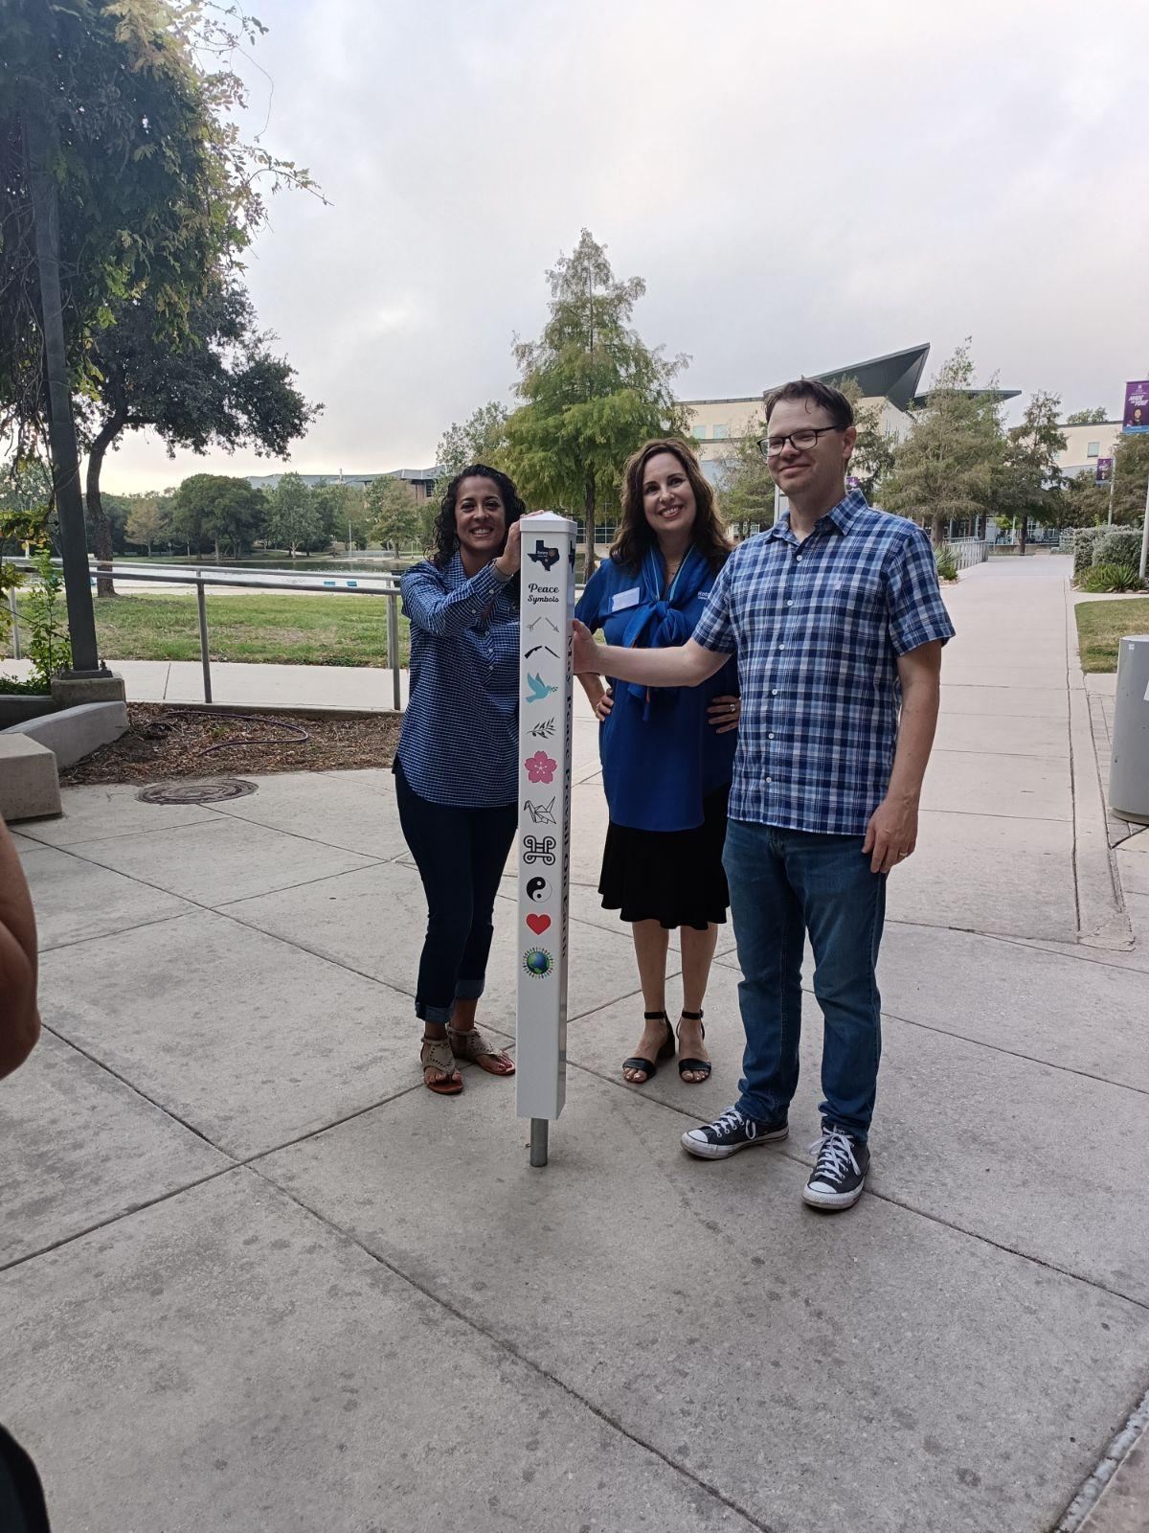
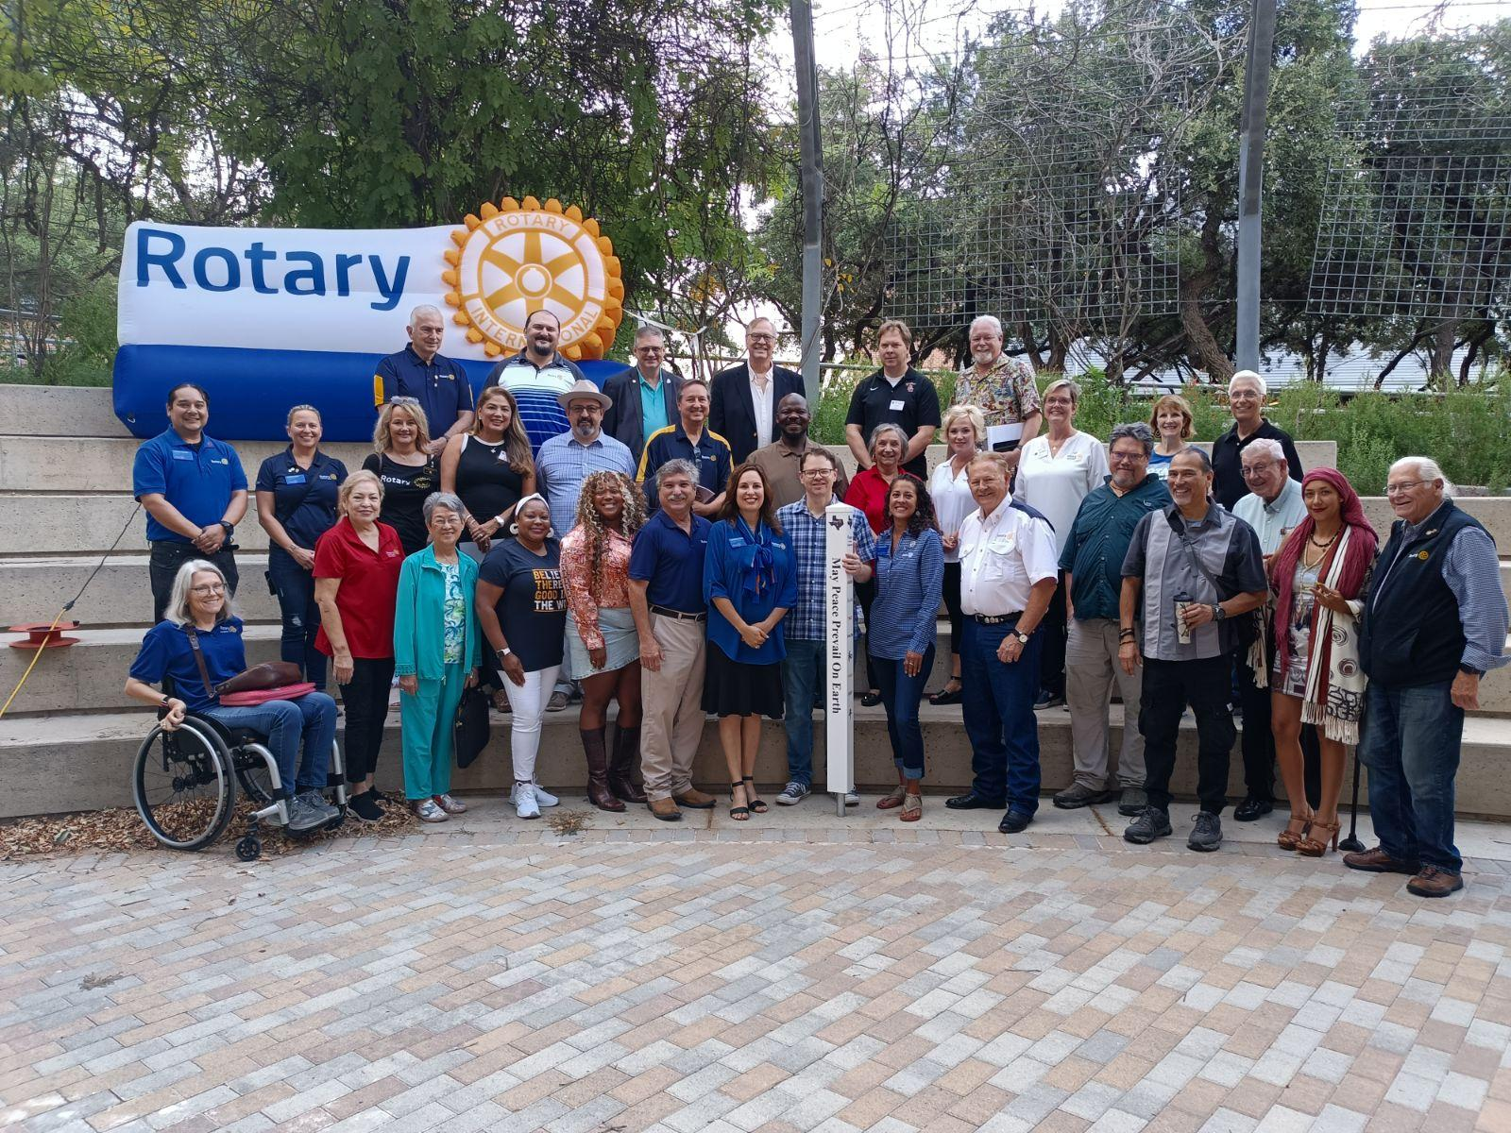
subhead
Peace Pole Presentation
The first Peace Pole in District 5840 was presented to the San Antonio Peace Center on September 21st which was also the International Day of Peace. This specific pole will mark the start of the compassion corridor that will run from San Antonio to Monterrey, Mexico!

Slide 19
Early Bird Registration ends 12/15/2024
Discounts for Rotarians under 30 and children age 5-18
Option to pay for House of Friendship access only
28 Rotarians from our District are already registered
https://convention.rotary.org/en-us/
Title Page Option

Slide 20
Register at https://rotary5840.org/events/celebration-of-districts/
$175 per attendee (doesn’t include the hotel stay)
FUN CELEBRATION!!!!!
Speakeasy Casino Night
Service Project
Awards Ceremony
Networking Opportunities
Sponsorships are available for clubs, corporations or individuals

Slide 21
THANK YOU

