Slide 1
D5840 All-Hands
February 5, 2024
Title Page Option

Slide 2

Summary:
  Membership Goal: Net increase of 25 members
  Membership to Date: +24 per Rotary Club Central
  Recognition Event for Rotarians 20+ Years of Membership – March 25, 2024 (Email and Postcard will be sent to Honorees)
  Membership Olympics is Active NOW! Gift certificates from Russell Hampton
  Start 3 new Clubs in District – Rotary, Rotaract or Service Companion
  Retention Goal of 95% - Communication is Key!
  Clubs combine Service Projects with Membership Recruitment activities
  Feb 27th: Zoom meeting for D5840 Club Membership Chairs, Presidents, AGs Zoom to discuss Membership Recruitment, Retention, Alumni, Rotaract, New Clubs, Leads Mgt & Membership Olympics
Membership
Co-Chair, PDG Kristy Vandenberg
Co-Chair, Holly Croom

Slide 3

subhead

Slide 4


subhead
Membership Recruiting/Volunteer Opportunities
FIESTA in San Antonio!
Friday - April 19, 2024
Saturday - April 27, 2024

Slide 5
Summary:
  Annual Fund Giving Goal: $206,926
  Annual Fund Giving to Date: $116,899
  Polio Fund Giving Goal: $58,431
  Polio Fund Giving to Date: $47,341
  Number of New Paul Harris Fellows Awarded: 97
  Number of New Paul Harris Society Members: 0
  Number of New Major Donors: 4
foundation
ARFC, PDG Jerry Hardy

Slide 6


subhead
Rotary Foundation Challenge Results

Slide 7
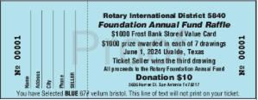
subhead
Rotary Foundation Raffle Tickets
Ticket booklets will be distributed to Club Presidents-Elect at P.E.T.S at the end of February.
7 drawings of $1000 Gift Card; Ticket seller wins on the 3rd drawing.
Ticket stubs will be collected by Assistant Governors or mailed to the address provided on the ticket by May 17, 2024.
Ticket stubs must be turned in unstapled.
Drawing will take place on Saturday, June 1, 2024 at the El Progreso Memorial Library in Uvalde, TX at noon.

Slide 8



subhead
GG: Seeds of Hope
International Peace Leadership Academy
A partnership between International Rotary Clubs
and the Understanding Conflict Trust (Northern Ireland).

Slide 9
Summary:
Working on goal for 90% and higher brand compliance for all Clubs on websites and social media
Completed second Public Image Audit in November for websites and social media
34 websites – 97% are Rotary Brand Compliant; 82% use a Club Masterbrand
51 Facebook Pages – 57% logo brand compliant for profile picture; 86% compliant for timeline photo
Held a training on Social Media Best Practices – the video is available on the Public Image Resources page
New Public Image Resources Introduced in December to help Clubs with content creation for social media, website and newsletter
Upcoming social media promotion to “Celebrate International Women’s Day with Rotary
Public image
Chair, Sandy Cordell
Website/Social Media, Pam Blankenzee

Slide 10


subhead
New Public Image Resources
Member Spotlight, Membership Rack Card, Rotary Birthday, Guest Speaker – requires a Canva account. Send us request for templates and include your Canva account email.
Rotary Theme Monthly Graphics – find folder on the
Public Image Resources Page

Slide 11

subhead
Upcoming Social Media Campaign
We invite all Rotarian women to participate in our special campaign by sharing a photo of themselves proudly wearing their Rotary shirts. Let's showcase the power and unity of women within the Rotary family!
How to Participate:
Put on your favorite Rotary shirt.
Strike a pose that reflects your strength and passion.
Snap a photo and share it on your social media with the hashtags #D5840ServiceStrong #RotaryWomenRock #WomenInRotary
Share it with the District (pblankenzee@rotary5840.org) so we too can promote District 5840 Women in Rotary!

Slide 12
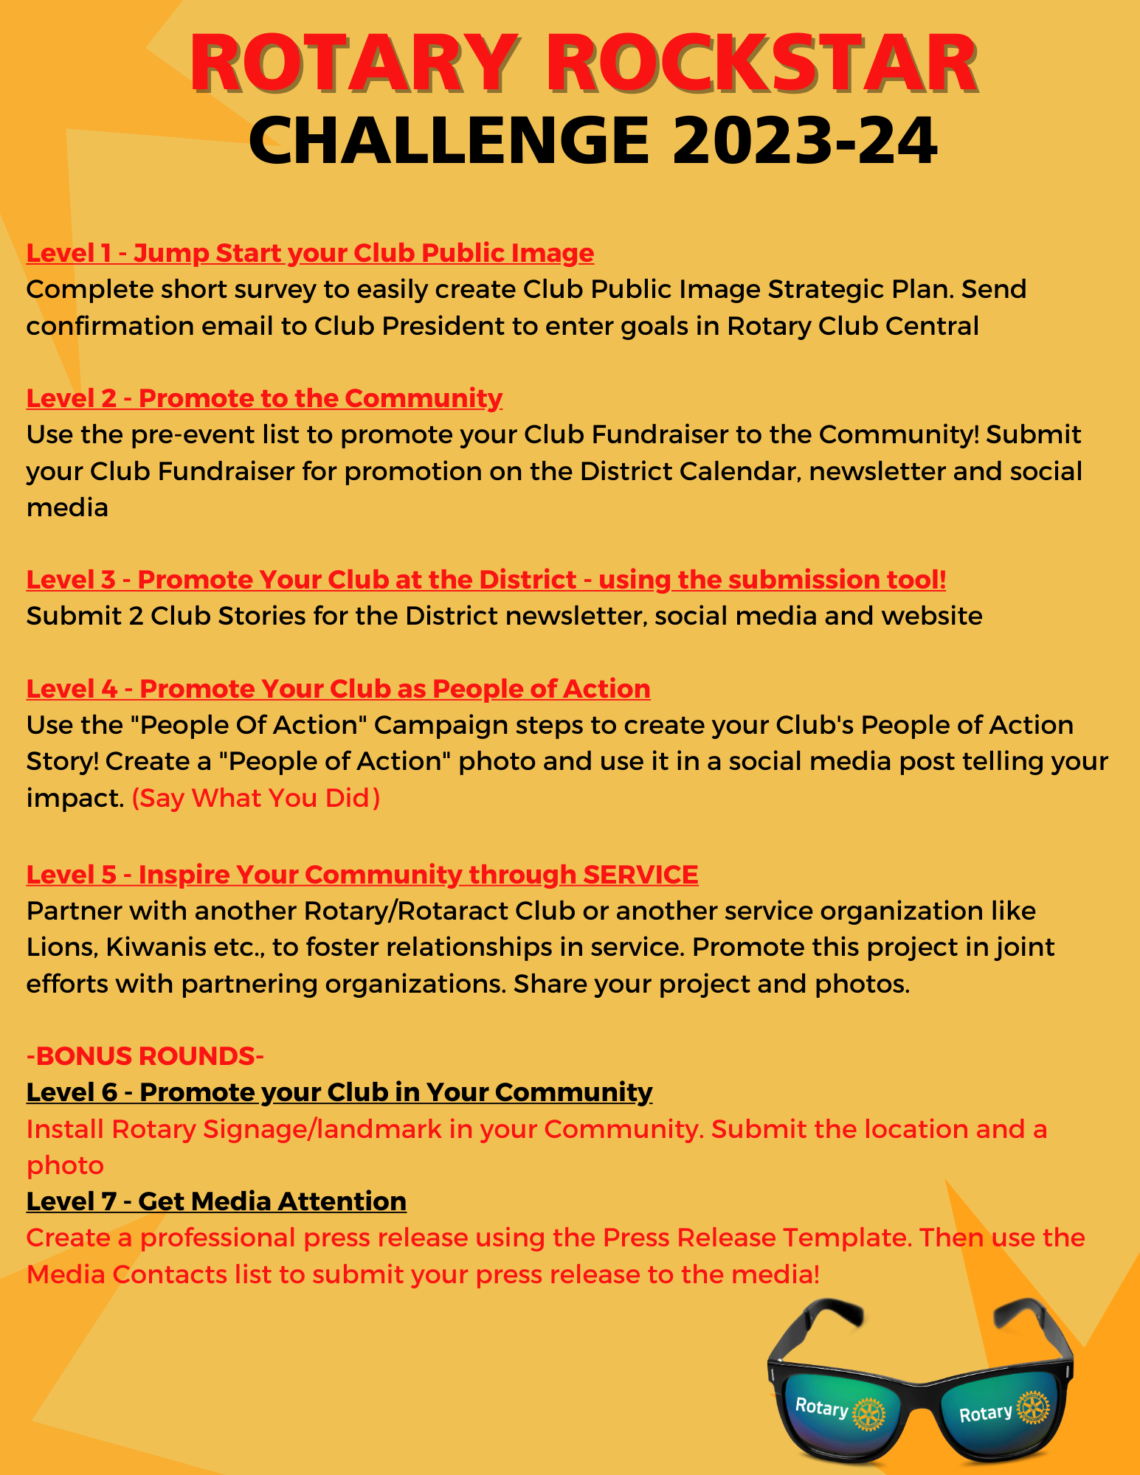
subhead
Rotary Rockstar Challenge
OPPORTUNITY TO WIN CASH PRIZE
Rotary Rockstar Challenge was developed to help Clubs increase their public image skill set.
Each level game introduces you to tools and resources to promote your Club to your members, around the District, your community and Rotary International.
The more you promote your Club, the better the odds are at increasing your membership. It is a win-win all around!
Check the Public Image Tab, Rotary Rockstar Scoreboard to see your status
Deadline May 1, 2024

Slide 13

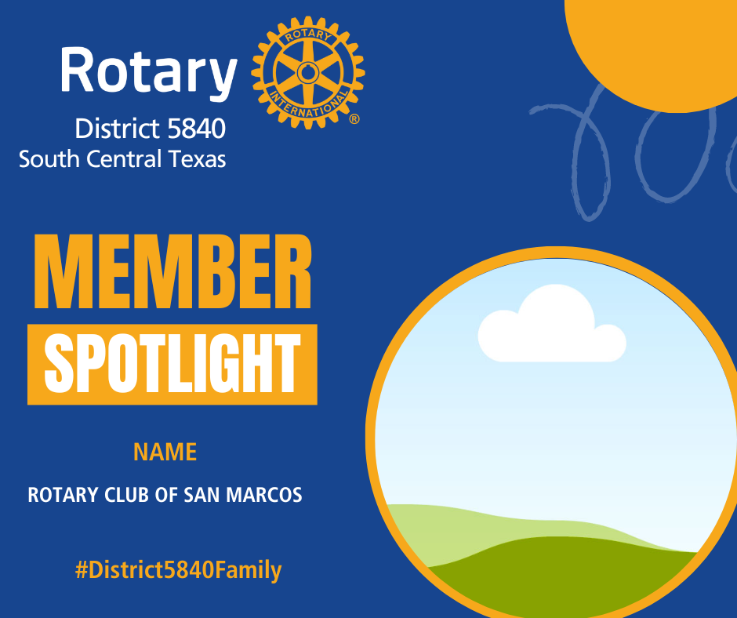
subhead
Promote Your Members
We want to CELEBRATE & WELCOME your new Rotary Member! We will provide you with a graphic that can be shared on your Social Media Pages and we will also share the graphic on the District Facebook page!
We want to help you PROMOTE & CELEBRATE YOUR MEMBERS! We will provide you with a graphic that can be shared on your Social Media, newsletter and website.
Visit the District website, rotary5840.org and scroll down the page to the section “PROMOTE YOUR MEMBERS”. Click on the button to submit photo and name.

Slide 14
Summary:
International Service Projects
  RC of San Marcos supporting a school in Uganda
  RC of Del Rio supporting an orphanage in Acuna
  RC of Eagle Pass supporting a women’s shelter in Piedras Negras
  RC of Boerne Sunrise supporting a school in Acuna
  District Service Project
SAVE THE DATE:
Rotary Day SA – hosted by RC of San Antonio
Saturday, March 23, 2024
McAllister Park
service
Chair, Gloria Wilson

Slide 15
Summary:
Youth Services is comprised of Early Act, Interact, Rotary Youth Leadership Awards (RYLA), and Rotary Youth Exchange.
  Early Act: Early Act has surpassed its district goal for new clubs by adding 4 for a total of 7. A brochure was produced on “How to Start an Early Act Club”. A Zoom meeting was held on January 15, 2024 to discuss the annual “Early Act Celebration” on Saturday, February 24, 2024. The district project for Early Act will be collecting dog training treats for “Paws for Purple Hearts”. The Early Act chair plans to create a video on how to start an Early Act Club.
  Interact: There are currently 43 Interact Clubs in our district . There were a few Rotary clubs that invited Interactors to speak about RYLA and/or Interact to their clubs. All Interact clubs in the San Antonio Metropolitan Area have been invited to participate in Rotary Day SA on March 23, 2024 at McAllister Park. The District Governor is planning a district-wide project with the origami cranes on April 6, 2024 at the Winston School of San Antonio.
Youth services
Chair, Dr. Charles J. Karulak

Slide 16
  Rotary Youth Leadership Award (RYLA): RYLA was held on January 12-15, 2024 at the John Newcombe Tennis Ranch. The program was shortened by more than a day due to inclement weather. There will be a wrap-up meeting in Fredericksburg in mid-March to begin planning for the 2025 program. Randy Coats, a professional leadership trainer, was added to the committee. He has some great new ideas on increasing the impact for this program. The 2025 Team Leaders will be selected within the next couple of months. The RYLA committee continues to seek new members.
Rotary Youth Exchange (RYE): Rotary Youth exchange fell short of its goal by budgeting for 8 long term students, but at this time only 3 are scheduled for the exchange. This represents a one student increase over last year. There will be six short term students doing summer exchange in 2024. Prior to the pandemic, 10-12 students would participate in long term exchange. It is difficult to say whether an increase of one student is a positive trend or whether it is an aberration. In the committee’s participation in South Central Rotary Youth Exchange, our district is doing better than most member districts, many of which have no students (as of last year). This “shortage” of students has had an impact on finances as 10 students is the optimum number logistically and financially.
The Youth Exchange Committee hoped to expand by adding a few new members. Several members have dropped out officially and “unofficially”. There remains a good core group of committed and involved individuals, but I see the day when even those may be stepping aside. There is a need to recruit one or two members with some marketing and social media skills. If the committee was able to add a person with these skill sets, it would have a positive benefit for all aspects of RYE.
Youth services
Chair, Dr. Charles J. Karulak

Slide 17
Summary:
  Review Training Tab on District 5840 website for updates. RLI manuals, Information about Learning Center.
  Lone Star PETS – Feb 29th thru Mar 3rd
  Save the date! ** Club Leadership Workshops **
  Lone Star RLI – April 20, 2024
Learning & Facilitation
Chair, Arden Riley

Slide 18
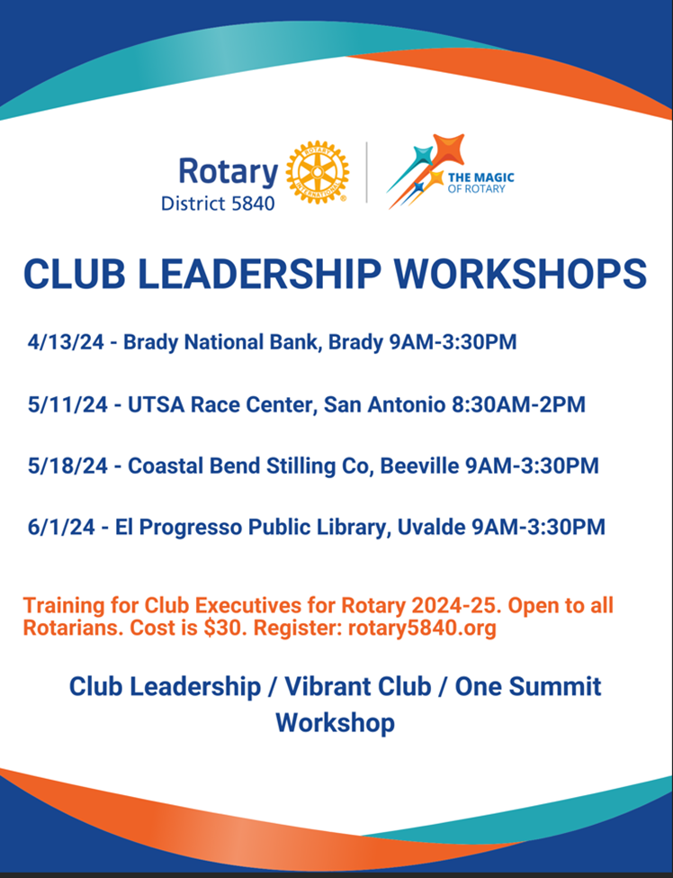
Title Page Option

Slide 19

subhead
50 cabins already booked
Final payment due Feb 17, 2024
RI President’s Rep is Christine Etienne from D6290
Itinerary (DRAFT):
Wednesday, May 1
  Bus from San Antonio to Galveston (TBD)
  1-night hotel accommodation (TBD)
  Social with D5890 & D5910 (TBD)
Thursday, May 2
  Embark Carnival Cruise Ship
  Evening at Sea
Friday, May 3
  Fun day at Sea
  Pre-dinner reception
Saturday, May 4
  Disembark Carnival Cruise Ship
  Joint Service project with RC of Cozumel
    Gardening at their 1st “Green School”
    Provide new or gently used non-string musical instruments
  Embark Carnival Cruise Ship
Sunday, May 5
  D5840 “Cinco de Rotary” Celebration
  Fun day at Sea
Monday, May 6
  Disembark Carnival Cruise Ship
  Bus from Galveston to San Antonio (TBD)

Slide 20


subhead
Mental Health Awareness Month – May 2024
D5840 Cranes for Hope Installation Ceremony
ASIST (Applied Suicide Intervention Skills Training)
2-Full Days of training that is FREE for Rotarians

Slide 21

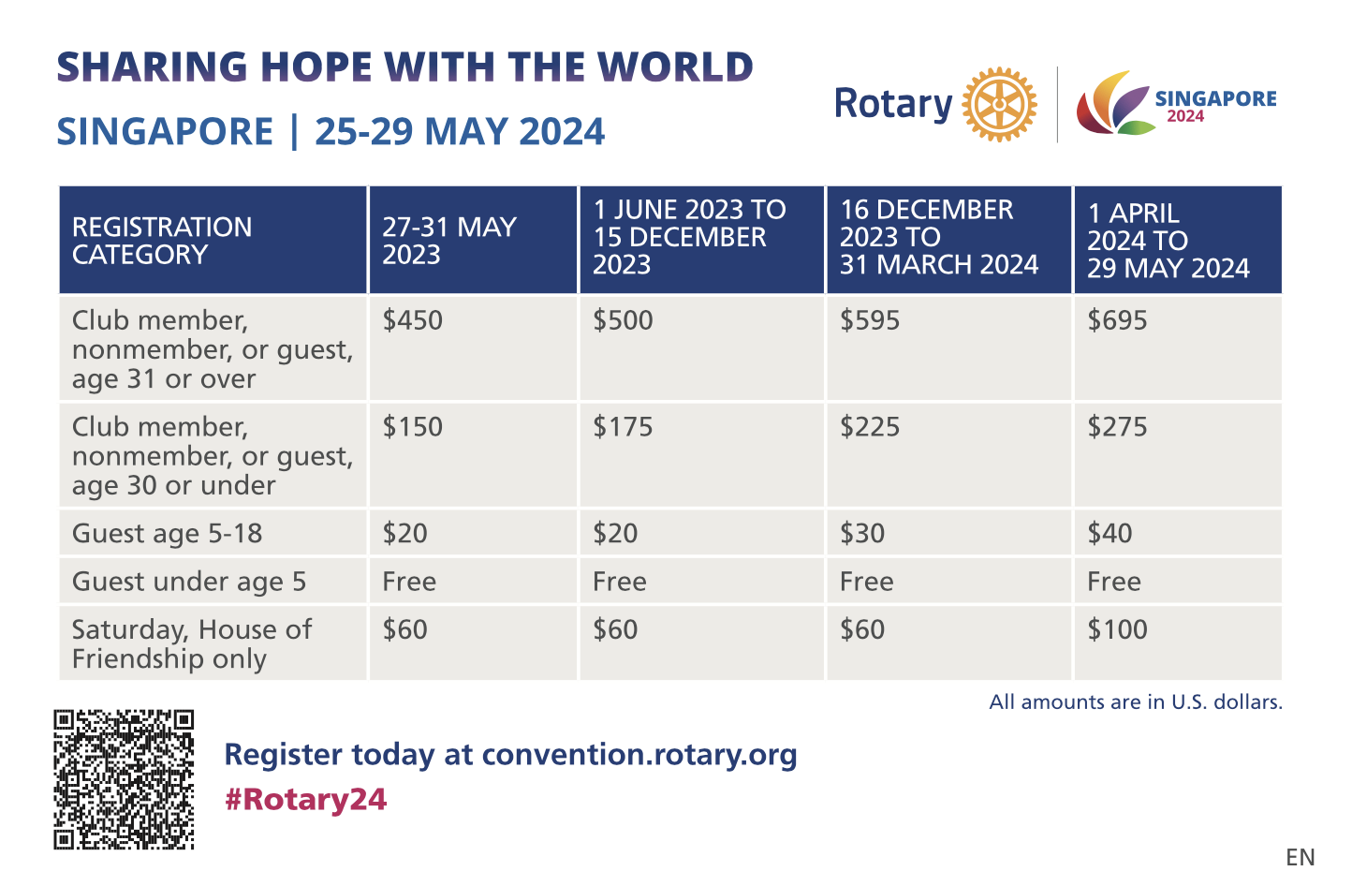
Title Page Option

Slide 22
THANK YOU

