Slide 1
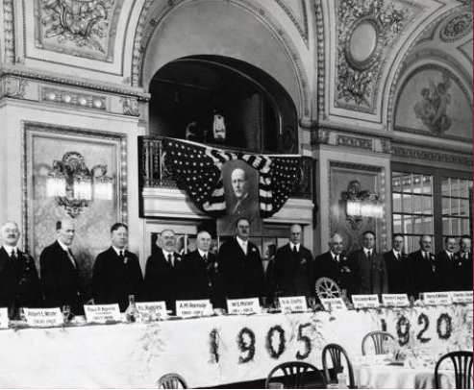
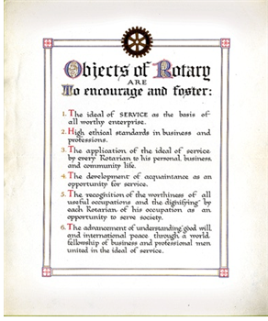
Notes:
Ideal of Service
High ethical Standards
Application of the ideal of service to all endeavors
Development of acquaintances as an opportunity for service
Worthiness and dignity of all occupations
The advancement of understanding and advancement of good will, and international peace

Slide 2
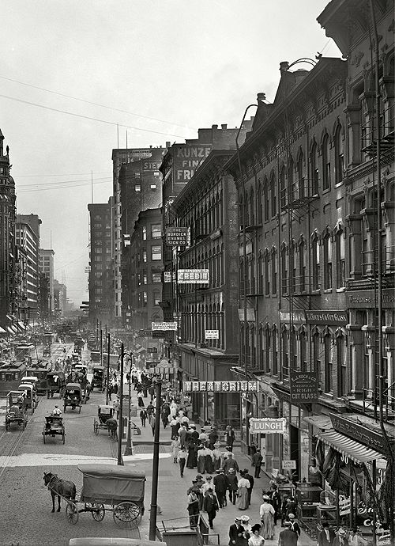
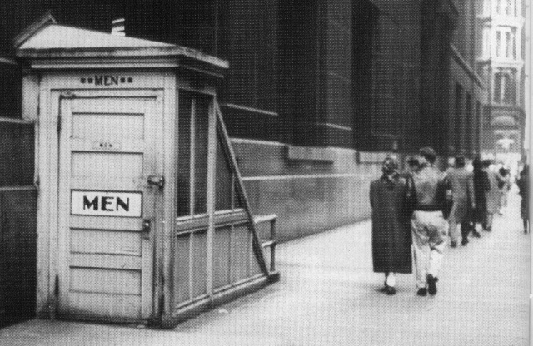
Notes:
Trivia Question: What was the first project that put Rotary on the civic map in Chicago in 1907?
A WASH project (Water and Sanitation) – Public Toilets! On the NE corner of Washington and LaSalle streets.
The head of the Y.M.C.A. expressed the prevailing sentiment when he said, “The Rotary Club of Chicago has now shown reason for its existence.”

Slide 3
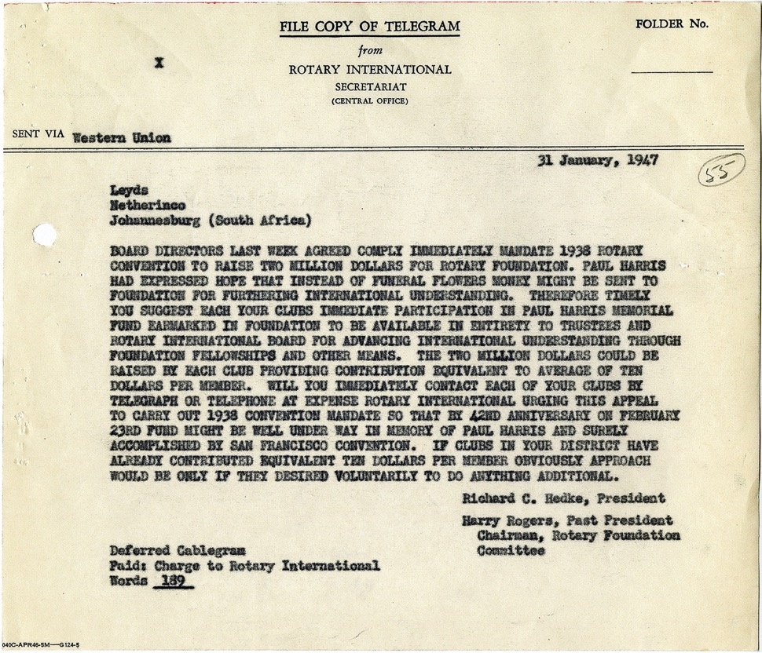

PAUL HARRIS’ vISION
“Paul Harris had expressed hope that instead of funeral flowers, money might be sent to [the] Foundation
for furthering international understanding.”
Notes:
While The Rotary Foundation came into being at the 1917 Atlanta Convention, the foundation we know really began in 1947, when Paul Harris died after a prolonged illness. Rotary’s beloved founder had told friends that if they wanted to honor him, they should donate to the Foundation. So Rotary established a special fund for the contributions that flooded headquarters as news of Paul’s death spread.
In just 18 months, the Foundation received $1.3 million (or $15.5 million today). Contributions continued to increase over the years, and they first topped $1 million in a single year in 1965.
At the 1978 convention in Tokyo, Rotary announced a two-year 75th anniversary fund, which would receive more than $7.2 million.
In 2004, the Foundation started the Every Rotarian, Every Year (EREY) campaign to stimulate giving to the Annual Fund, which supports Foundation grants.
In 2019-20, that fund received $126.3 million in contributions.

Slide 4

Your Rotary Foundation at Work
Notes:
Trivia Question: What was the first project that put Rotary on the civic map in Chicago in 1907?
A WASH project (Water and Sanitation) – Public Toilets! On the NE corner of Washington and LaSalle streets.
The head of the Y.M.C.A. expressed the prevailing sentiment when he said, “The Rotary Club of Chicago has now shown reason for its existence.”
What was Rotary’s second project?

Slide 5

KEY MESSAGING
Annual Fund, Polio+, Grant Support and Directed Gifts make an impact today
Notes:
Great examples.
What is a major gift?
Where can a major gifts be directed?
To ANY Rotary Foundation program -- including the Annual Fund, Polio , Peace and Conflict Resolution, to the Endowment, to one of the Areas of Focus.
The donor can choose to make those funds available to be used right away -- or invested in the endowment, to grow, and provide long term support.
We use the term “Legacy Giving” to refer to gifts made to support the endowment. Rotary’s Endowment ensures a strong future by providing a perpetual stream of funding for Foundation programs into the future.
In The Rotary Foundation, we think of legacy gifts as gifts to our endowment.

Slide 6






Providing
Clean Water
Supporting
Education
Fighting
Disease
Saving Mothers
and Children
Growing
Local Economies
Promoting
Peace
Notes:
Right – these are our areas of focus. In addition, gifts may also be made to Endowment Fund-SHARE – Gifts to EF SHARE will support global and local projects and provide DDF to the donor’s designated district. And next year we’ll add the environment…

Slide 7
HOPE
HAPPINESS
GRATITUDE
JOY
PRIDE
PEACE
Notes:
And, for the recipient and donor, all of these things can be achieved through gifts to both the annual fund and endowment. And now I’d like to share with you how endowments work, why ours is so important and giving options you should be aware of.

Slide 8
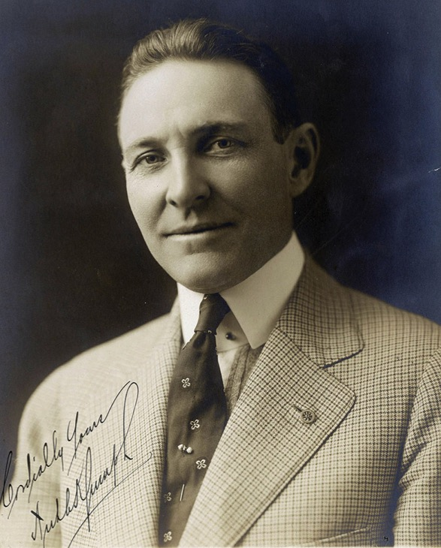
Arch Klumph’s Vision — 1917
It seems eminently proper that we should accept endowments for the purpose of doing good in the world, in charitable, educational or other avenues of community progress …
— Arch Klumph, 1917
6th President of Rotary
Notes:
As president of the Rotary Club of Cleveland, Ohio, USA, in 1913, he advocated for the club to build a reserve that would ensure its means to do future good work. As president of Rotary in 1916-17, he proposed this idea to a larger audience.
In his speech to the 1917 convention in Atlanta, he said: “It seems eminently proper that we should accept endowments for the purpose of doing good in the world, in charitable, educational or other avenues of community progress …”
Arch’s vision of an endowment would eventually become The Rotary Foundation, and his call for “doing good in the world” was to become the Foundation’s motto.

Slide 9

KEY MESSAGING
Planning a gift to Rotary’s Endowment supports these same life-changing programs forever.
Notes:
Let’s look at what our endowment/s support. (Next slide)

Slide 10
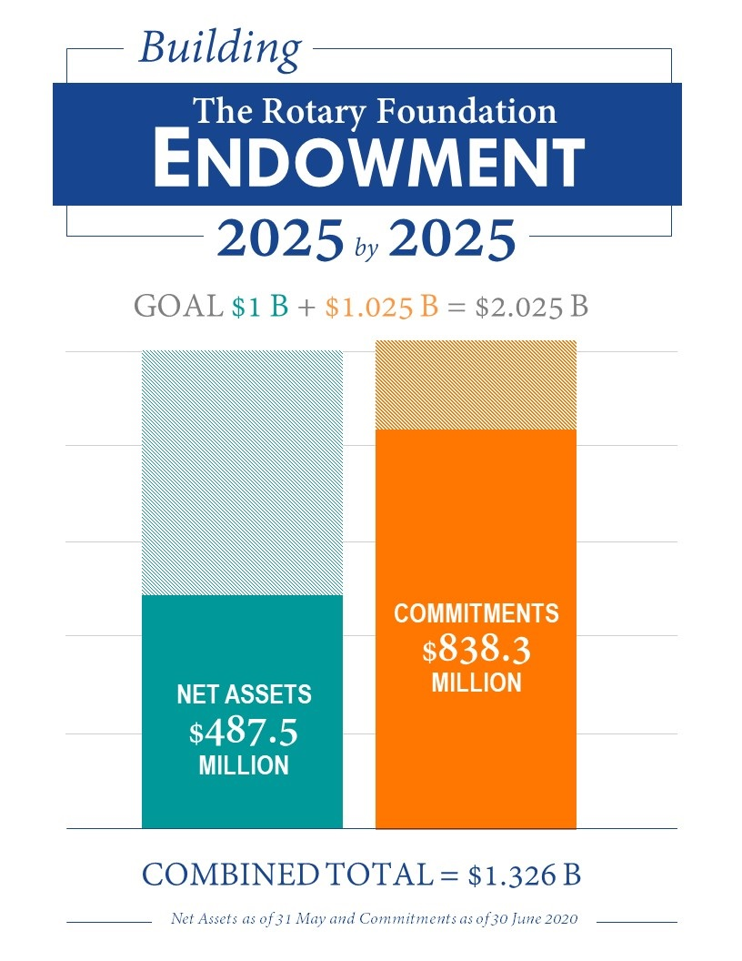
Notes:
As of June 30, 2020. (update graph regularly)

Slide 11

A $25,000 gift made to the Endowment
can yield approximately $1,000 in spendable
earnings for Rotary programs every year.
Notes:
Outright gifts or planned (estate) gifts of $25,000 or more entitle the donor to a named endowed fund. You can see by this example what the earnings on a gift of this size would produce.

Slide 12
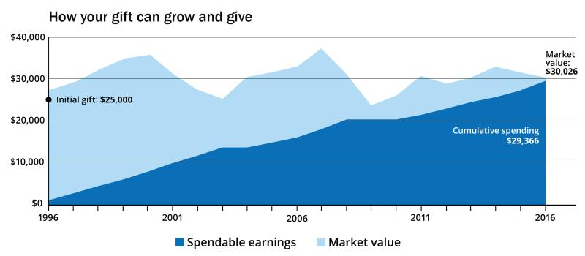
20-YEAR GROWTH SNAPSHOT
Notes:
This is an example using a real named endowed fund created in 1996. The fund was established with a gift of $25,000. Despite some ups and downs in the market during this time frame, the fund has grown to $30,026 and has also generated nearly $30,000 in spendable earnings that have been used to support the humanitarian work of the Foundation.

Slide 13


LONG-TERM IMPACT
$50.0 million
$15.5 million
$7.5 million
2007-08
2017-18
2024-2025
Notes:
In the 2007-08 Rotary Year there were $7.5 million of spendable earnings available from the Endowment. Ten years latter, the amount increased to $15.5 million, more than double what it was a decade ago.
When we reach our 2025 by 2025 goal, our endowment will have $1 billion in net assets and provide approximately $50 million in spendable earnings each year. Imagine the good that will be done by Rotarians of the future using these financial resources to meet the needs of the future.

Slide 14
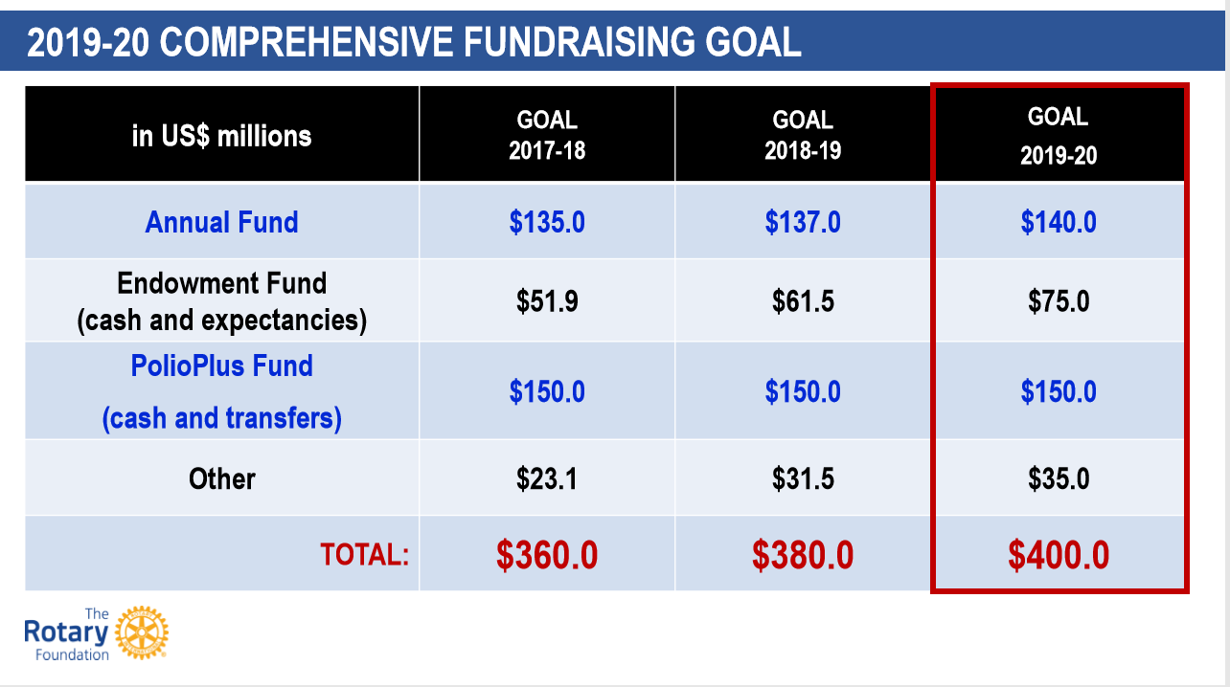
Notes:
And here’s how we plan to get there! These are ambitious but doable goals. Now Pam will talk about how we can work as a team to help educate our districts and clubs about the endowment.

Slide 15
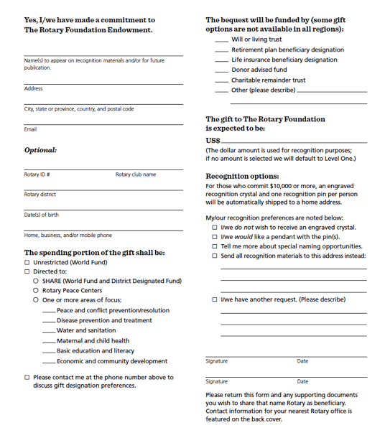

YOUR ROTARY LEGACY COMMITMENT NOTIFICATION CARD
Notes:
Your Rotary Legacy. Every Rotarian can make an impact now and forever.
Outright contributions to the Endowment count toward Major Donor and Arch Klumph Society recognition, give the donor a glimpse of their legacy’s future impact, and allow Rotary to recognize their generosity with their family and Rotary friends.
Including a commitment to The Rotary Foundation in a will or estate plan ensures that a donor’s charitable goals will be fulfilled for many years to come. Committing a fixed amount or a percentage of assets in an estate plan shares a donor’s resources after they no longer need them. The Trustees are pleased to confer membership to the Bequest Society on these donors and their spouse/partner for commitments of US$10,000 or more. As members of this elite group of dedicated humanitarians, they will receive special Foundation updates, invitations to events, an engraved crystal, and an exclusive pin or pendant. When they invest in the Foundation’s future, donors retain their Bequest Society membership regardless of fluctuations in their financial portfolio or other assets.
Whether a member of your club makes an outright gift or a commitment to The Rotary Foundation Endowment in their long-term estate or financial plans, they are continuing a 100-year tradition of uniting leaders from all continents, cultures, and industries for the common good.

Slide 16


Individual Retirement Accounts - IRAs
Income tax deduction
No gains tax
Do good with your Required Minimum Distribution (RMD) from your IRA (up to $100,000/yr!)
Reduce income tax with a deduction or the Qualified Charitable Distribution (IRA Rollover)
Prevent double taxation on inheritances
See your gift in action today
Receive Major Donor recognition and Arch Klumph Society membership
Outright Gift
Donor
1
2
Notes:
Amounts given directly to Rotary from your IRA will count as part of your required minimum distribution and qualify for a tax deduction.
If you are 70 1/2 you can avoid having to claim the gift amount’s income at all under the special IRA rollover provisions. Please note that this type of gift does not apply to 401(k), SEP (simplified employee pension), and other retirement accounts.
There is no minimum gift amount. You are allowed to direct that up to $100,000 each year be used to make charitable gifts. Married couples with separate IRAs can make transfers up to $200,000 ($100,000 per person).
Did you know that if you leave retirement funds to your heirs, the funds can be subject to both estate tax and income tax? By leaving retirement plan remainders to the Rotary Foundation while using other assets to provide for heirs, you may reduce the overall tax burden on your family and create a personal, lasting legacy in Rotary and around the world.

Slide 17

LIFE INCOME AGREEMENTS
Income tax deduction; Reduced gains tax; Fixed payments
Charitable Gift Annuity
Fixed payments for life - backed by the unrestricted assets of The Rotary Foundation.
Charitable Remainder Unitrust
Variable payments for life backed by the assets in the trust.
  Partial charitable income tax deduction
  Minimize capital gains tax
  Face value counts towards Major Donor or Arch Klumph Society membership
  Continues doing good in the world in Rotary’s Endowment
  For charitably minded, rates may be higher than certificates of deposit
Gift of Cash or Securities
Donor
1
2
CGA
3
Notes:
A Charitable Gift Annuity is a great way for individuals and couples who are at least 50 years old to turn low-yielding assets into a regular income stream.
Giving in this way is quite simple. You donate a minimum of $10,000 in cash or appreciated securities to Rotary in exchange for Rotary’s agreement to make fixed payments to you or your loved ones for life.
Payments are backed by the unrestricted assets of The Rotary Foundation and will not change with fluctuations in the market.
Rates vary from 4 to 9 percent depending on the age of beneficiaries when your annuity is funded.
You can opt to defer your payments for a higher tax deduction and higher rate of payment.
After all lifetime payments have been made, the balance of your gift annuity will be used to provide ongoing support for Rotary Foundation programs.
This giving option can also reduce capital gains tax while earning Major Donor recognition and Arch Klumph Society membership for the full face value of your gift.

Slide 18
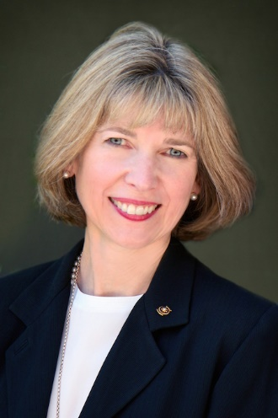
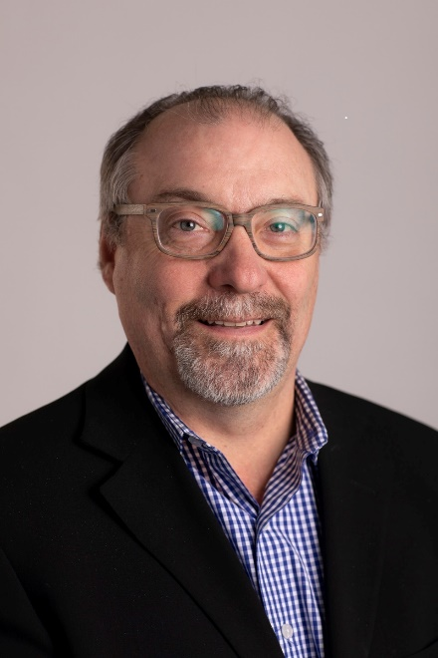
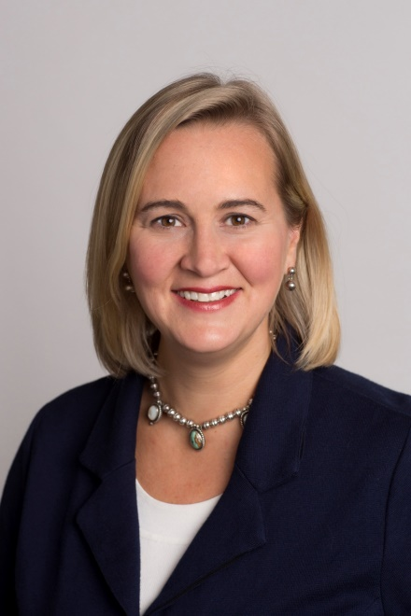
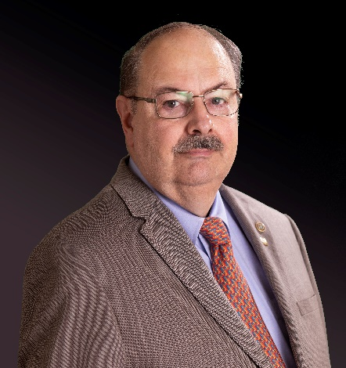
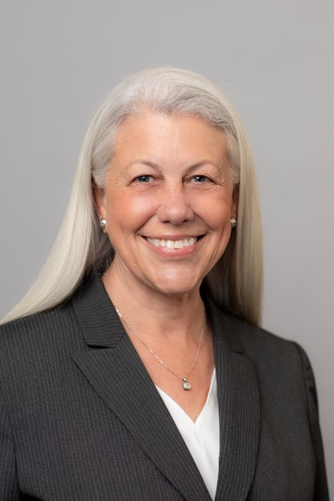
Zone 26/27 Endowment/Major Gift Resources
E/MGA Wyn Spiller
Zones 26/27
E/MGA Tom Walker
Zones 26/27
MGO Eric Thompson
Rocky Mountains
Senior MGO Elizabeth Cruft-Anderson
Pacific Northwest, Alaska
Northern California
MGO Beth Garrow
California, Southwest, Hawaii
Notes:
Pam: We want you to know that we are resources for you, your districts, subcommittees and donors. In our new zone 26/27 pairing, Beth and I will continue to be your primary contacts and resources for major gifts and endowment needs. We also want you to know that we are a team of resources supporting these two zones.

Slide 19
Zone 26/27 Endowment/Major Gift Resources
Zone 26/27 Website: www.Zone2627.org/the-rotary-foundation-updated-march-2014/
  Endowments, Major Gifts & Planned Giving Dropbox
  District Endowment/Major Gift Subcommittee Webinars
  Million Dollar Dinner Planning Materials
  Your Rotary Legacy and other Major and Planned Giving Material
TRF Legacy Website: www.rotary.org/legacy
  Describes TRF priorities, need, impact and donor stories
  Connects to TRF Giving and additional resources
  Links to Club and District Legacy Toolkit
E/MGAs & MGOs
  Zone and District Training, Endowment & Major Gift Subcommittee Training
  Identification, Cultivation, Solicitation and Recognition support and strategies for growing major gifts and bequests in districts and in working with individual donors
Notes:
We have a lot of resources available to you. Jesse can you take us to these websites?

Slide 20
MAJOR GIFTS
Raise Awareness | Personal & Confidential Conversations | Great Stewardship
GLOBALLY
Notes:
Pam: Here’s the strategy:

Slide 21
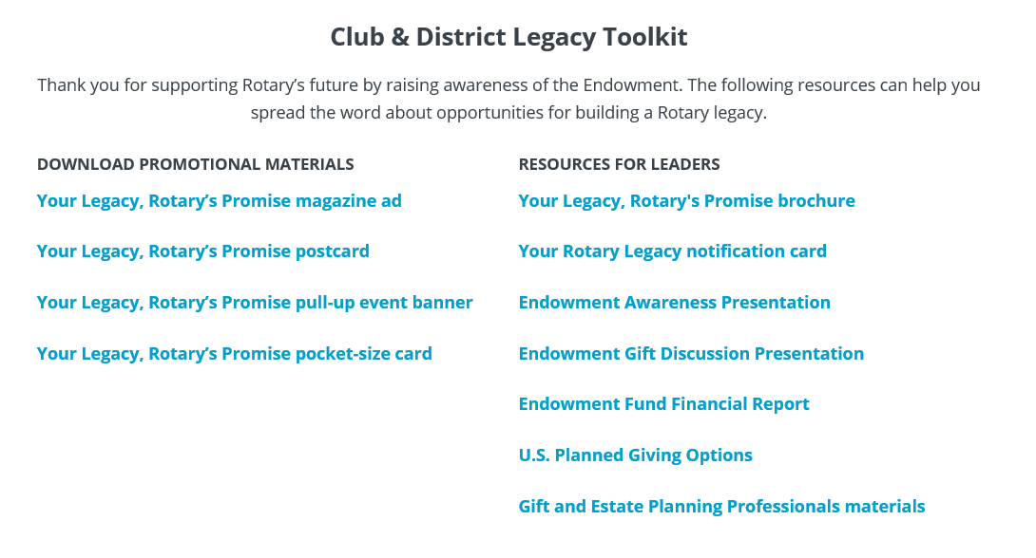
MONITOR THE LEGACY TOOLKIT FOR NEW RESOURCES
Rotary.org/legacy
Notes:
There are so many resources available to you and your districts on-line. Beth and I will be sharing these tools in more detail in our breakout session, but all of you can share these resources easily by going to www.Rotary.org/legacy
Jesse will link to these resources in chat.

Slide 22
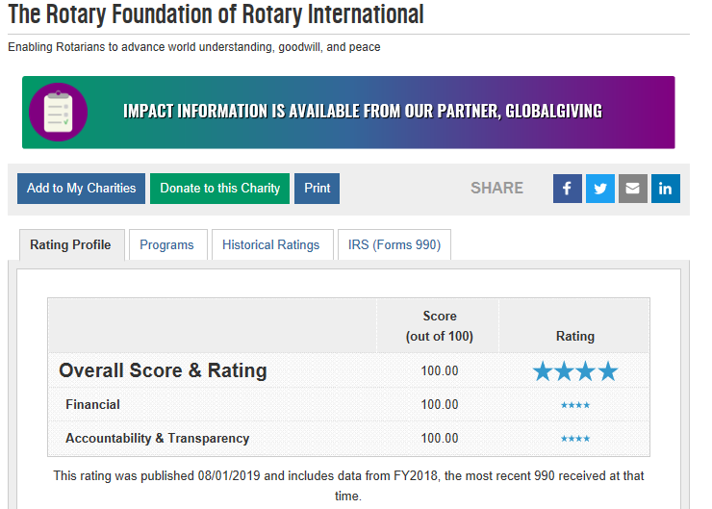
Charity Navigator
https://www.charitynavigator.org/index.cfm?bay=search.summary&orgid=4553
https://www.charitynavigator.org/index.cfm?bay=topten.detail&listid=18
Notes:
For the 15th year in a row, The Rotary Foundation has been rated as a four-star charity by Charity Navigator –
The largest and most prestigious independent evaluator of non-profits in the US.
The Foundation in the top one percent of U.S. based charities for adhering to good governance, best practices and consistently executing its mission in a financially responsible way.
The Rotary Foundation was named the World’s Outstanding Foundation for 2016 by the Association of Fundraising.
And of course, we’ve seen an increase in press and media coverage for polio eradication efforts which we lead in partnership with the Bill & Melinda Gates Foundation and global health partners such as the CDC and the United Nations.

Slide 23
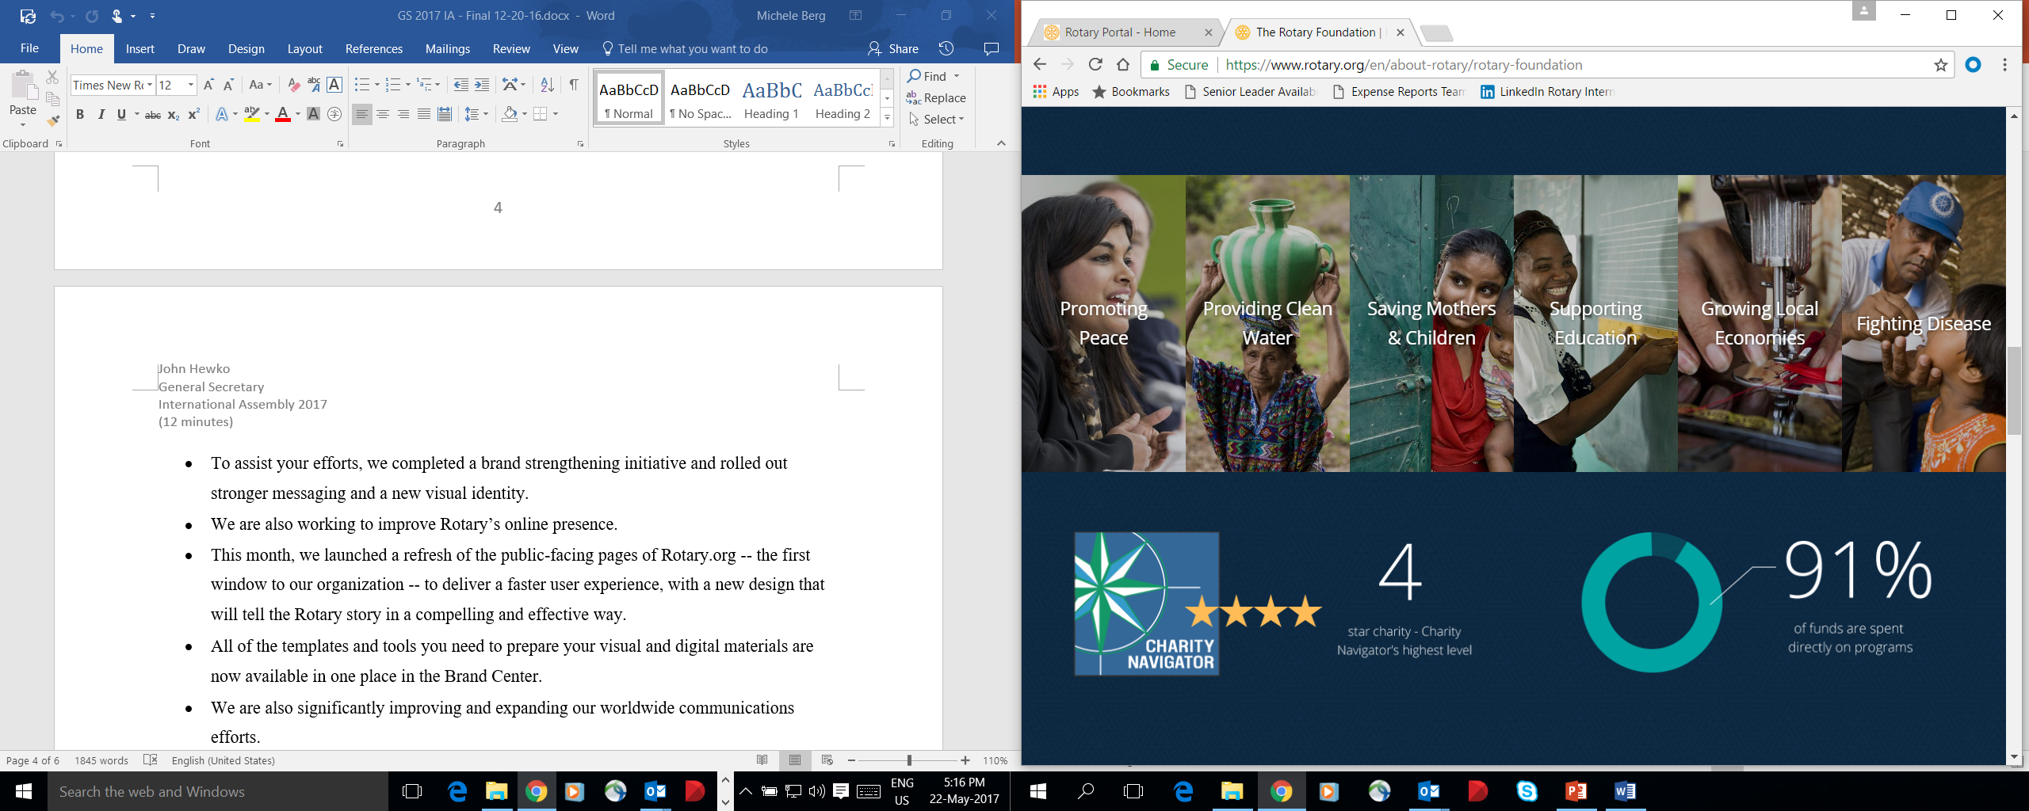
Notes:
For the 15th year in a row, The Rotary Foundation has been rated as a four-star charity by Charity Navigator –
The largest and most prestigious independent evaluator of non-profits in the US.
The Foundation in the top one percent of U.S. based charities for adhering to good governance, best practices and consistently executing its mission in a financially responsible way.
The Rotary Foundation was named the World’s Outstanding Foundation for 2016 by the Association of Fundraising.
And of course, we’ve seen an increase in press and media coverage for polio eradication efforts which we lead in partnership with the Bill & Melinda Gates Foundation and global health partners such as the CDC and the United Nations.

Slide 24
Thank You Video
  Vimeo Link:
  https://vimeo.com/351453425/40e568306a
Notes:
Rotary sincerely appreciates the dedication of our donors and will provide ongoing stewardship to ensure that each individual’s charitable goals are fulfilled.
One hundred years of Rotarian dedication made The Rotary Foundation’s success possible. What you do today will shape the next century of service.
Please encourage your members to learn more about building a Rotary legacy by visiting rotary.org/legacy. This new Endowment webpage features a overview of what I’ve shared with you today, more quotes from real donors, and a legacy toolkit for club and district leaders full of promotional materials you can share in newsletters and at events to inspire more legacy gifts to Rotary’s Endowment.
Please send a message to legacy@rotary.org to ask questions or request modifications.

Slide 25
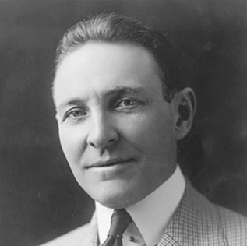
Arch Klumph Message
“
“
Rotary’s tomorrow depends
on what we do today.
– Arch C. Klumph
What Will Your Rotary Legacy Be?

