Slide 1
GRANT MANAGEMENT SEMINAR
KEY PROGRAMS OF
THE ROTARY FOUNDATION
&
GRANT CERTIFICATION
March 5, 2026
DRFC Bob Vaughn
District 6840
bobvaughn6840@gmail.com
832-671-6700

Slide 2
Why I Contribute To the Rotary Foundation.
START WITH WHY?
Nelson Mandela Quote
“What counts in life is not the mere fact that we have lived. It is what difference we have made to the lives of others that will determine the significance of the life we lead.”

Slide 3
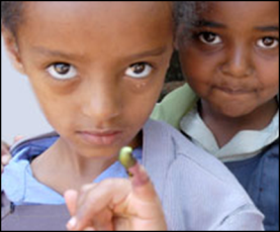
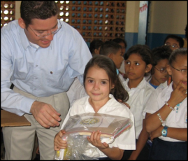
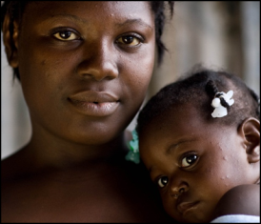
SUPPORTING THE ROTARY FOUNDATION
PolioPlus Fund
End Polio Now
Annual Fund
For support today
Endowment Fund
To secure tomorrow
Notes:
We have talked about why we give. Now let’s visit how we give and how we can use our gifts to fund our projects which we are passionate about. We know we can give to polio which means a gift to The Rotary Foundation, PolioPlus Fund. We can also give to the Annual Fund and to the Endowment Fund. The Annual Fund helps us to fund our current projects while the Endowment Fund provides funding for the types of projects we are passionate about well into the future.

Slide 4
Our Rotary Foundation ….
THE ROTARY
FOUNDATION
POLIO PLUS
ANNUAL
FUND
ENDOWMENT
FUND
Polio Eradication Efforts
Provides Long Term Funding
Funds
Global Grants &
District Grants

Slide 5
Disaster Response Grants
Disaster Grants help provide immediate response, short term assistance and long-term rebuilding following a disaster
The maximum grant award is $25,000
D6840 has used these grants during COVID and after Hurricane Ida
We also participated with other districts to provide a disaster grant for Ukraine
Notes:
We heard some examples earlier of district grants and many of our clubs do these smaller, short-term projects in our local communities and some even use these funds to do smaller, shorter term international projects.

Slide 6
ANNUAL FUND - SHARE
District makes contributions
Contributions are invested over 3 years
Contributions are divided into …
47.5% District Designated Fund
Use up to half for a district grant
Donate to PolioPlus, Rotary Peace Centers, and more
47.5% World Fund
Supports grants and programs available to all districts
Fund global grants and receive World Fund match
Notes:
When you give money to The Rotary Foundation Annual Fund, SHARE program, in 3 years 47.5% of this comes back to your district for grants. This is what we call District Designated Funds or DDF. Your district can allocate up to 50% of its DDF for district grants and the remaining 50% for global grants.
The 47.5% of our contributions goes to the World Fund which can be used to match your global grants, and 5% is used for operating expenses.

Slide 7
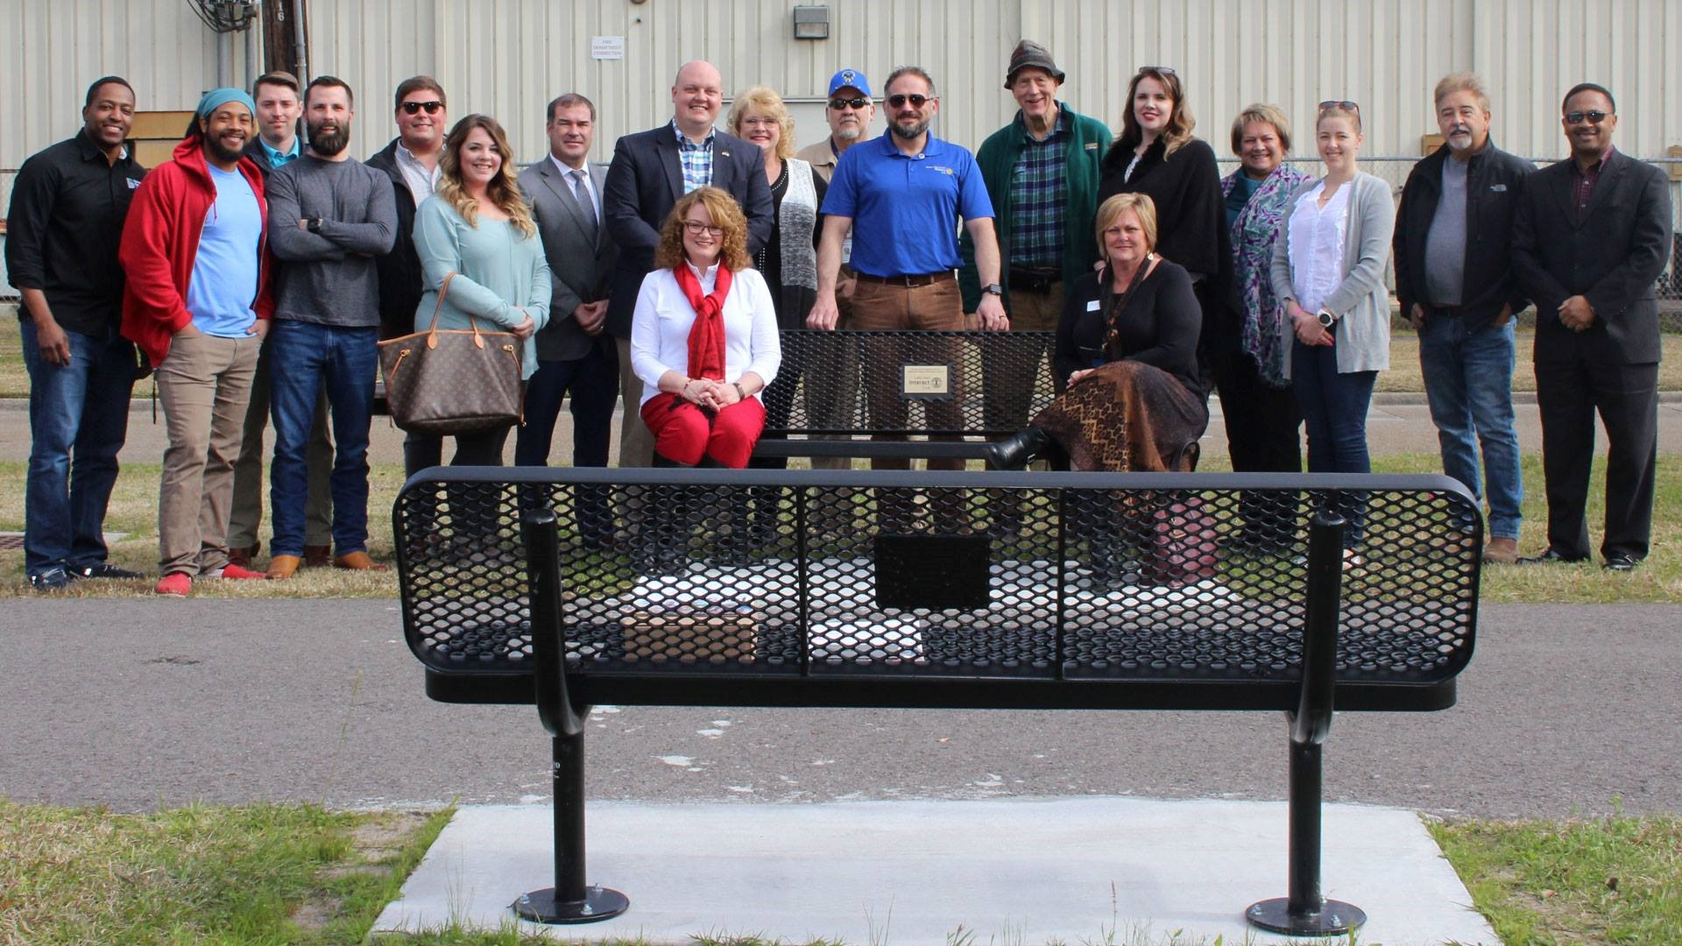
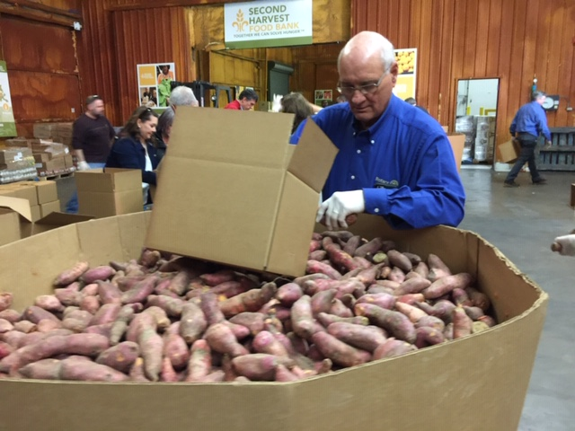
District Grants
Smaller activities and projects
Funds both local & international activities
Activities must be consistent with the mission of Rotary
You must attend a Grant Management Seminar (GMS) and complete a Memorandum of Understanding (MOU)
Notes:
We heard some examples earlier of district grants and many of our clubs do these smaller, short-term projects in our local communities and some even use these funds to do smaller, shorter term international projects.

Slide 8
District Grants Important Information
For Rotary year 2025 – 26, the district awarded 56 district grants totaling $52,800. 25 clubs participated.
The grants were allocated into the following categories: Education - 23, Health – 24, Community Development – 4, Economic Development – 2, Environment – 1, and Peace – 2.
Of the 56 grants, 2 were international projects.
For 26 – 27, the district will have approximately $48,000 to distribute in District Grants.
Notes:
We heard some examples earlier of district grants and many of our clubs do these smaller, short-term projects in our local communities and some even use these funds to do smaller, shorter term international projects.

Slide 9
District Grants Important Information
Deadline for submitting district grants - May 31, 2026
Deadline for completing and filing final reports – March 31, 2027
All grant requests must include a Public Image component
A club may submit no more than 3 grant requests
A club’s district grants are limited to its contributions to the Rotary Foundation
Only the Rotarian who is qualified may submit the grant request
Notes:
We heard some examples earlier of district grants and many of our clubs do these smaller, short-term projects in our local communities and some even use these funds to do smaller, shorter term international projects.

Slide 10
District Grants Important Information
District grants are graded on the following:
On a per capita basis, how much is given to the Rotary Foundation. To be considered, the club’s contribution must be at the Foundation by May 31, 2026
The club’s financial contribution to the project compared to the amount it requests as a grant
Successful, timely closing of current year grants
Club members’ grant training
Notes:
We heard some examples earlier of district grants and many of our clubs do these smaller, short-term projects in our local communities and some even use these funds to do smaller, shorter term international projects.

Slide 11
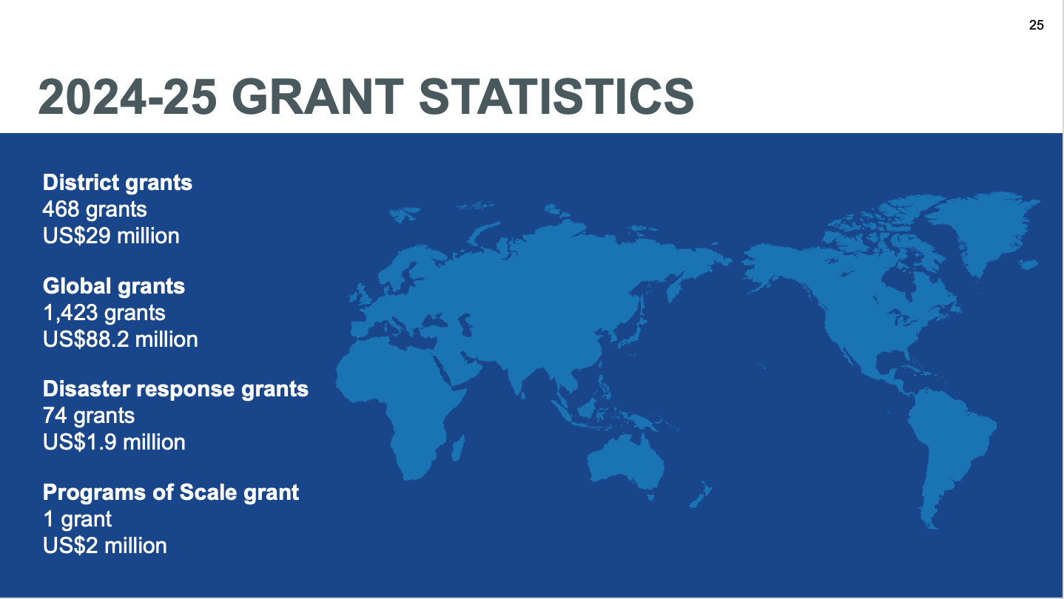
Notes:
In 2024-25, Rotary awarded:
468 district grants with total funding of US$29 million
1,423 global grants with total funding of US$88.2 million
74 disaster response grants with total funding of US$1.9 million
1 Programs of Scale grant with total funding of US$2 million

Slide 12
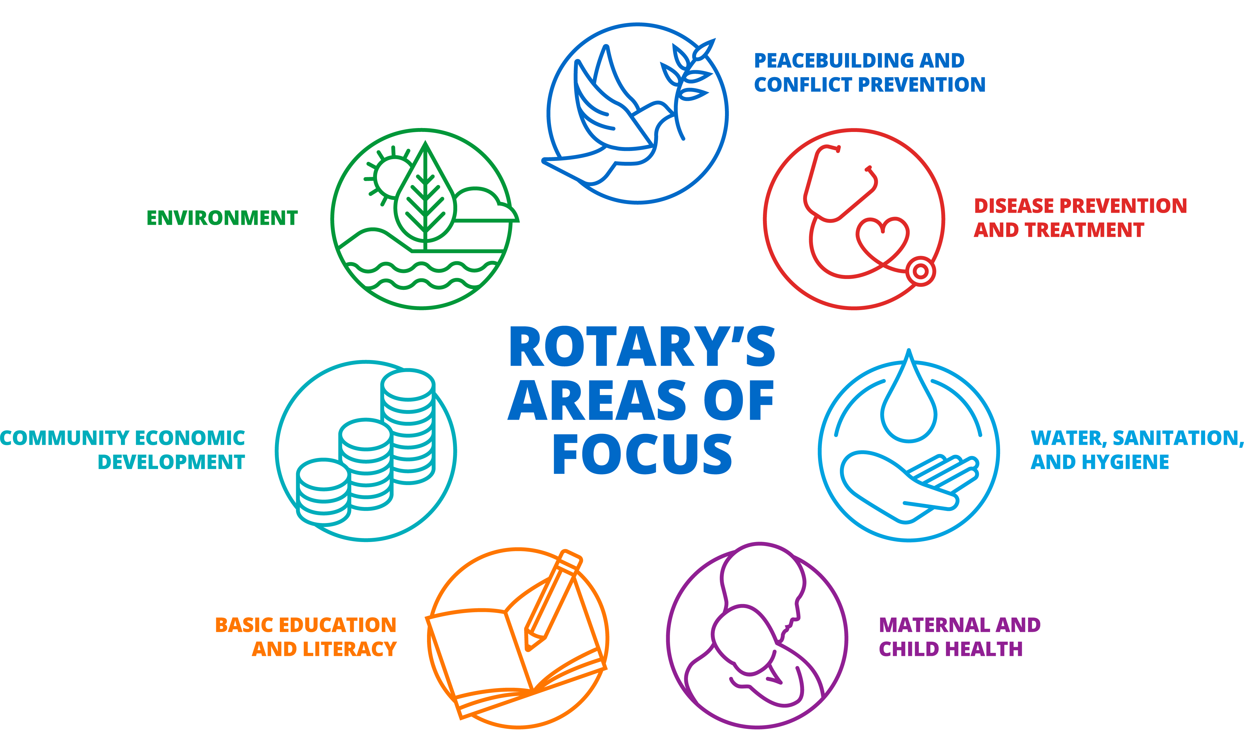

Seven Areas of Focus
Notes:
Remember we now have 7 areas of focus, as we added the Environment.

Slide 13
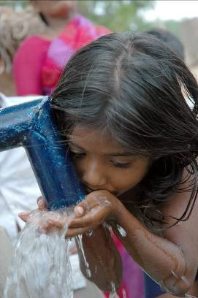
Global Grants
Longer-term projects
Sustainable impact
Support One of Rotary’s 7 Areas of Focus
Larger amount ($30,000-$400,000)
Address an important need identified in the community
Strengthen the community’s capacity to address its own needs
Notes:
Global grants are by nature longer-term, larger grants and as such have additional requirements set by The Rotary Foundation to ensure that the projects are sustainable with measurable and lasting outcomes and that the grant funds are managed responsibly. A global grant must also meet an important need of the community within one of Rotary’s 7 areas of focus and help improve the community’s capacity to address its own needs.

Slide 14
before applying for a global grant: preliminary review
Contact your Regional Grants Officer and request a Preliminary Review
Complete Application Template + Community Assessment Form
Feedback will include:
      Is the project eligible?
      Is there anything missing?
      How can we further strengthen the project?
Notes:
605-conducting-community-assessments-en.pdf

Slide 15
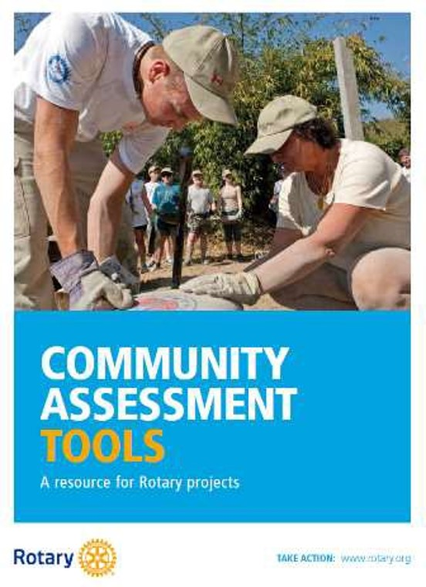
Community Needs Assessment
Remain open minded
Choose participants carefully
Include overlooked or marginalized groups
Consider yourself an outsider
Avoid promising a project before your club makes a formal decision
Empower stakeholders
Notes:
Don’t presume you know what the community needs, choose a group of diverse participants (gender, age, ethnicity, religion, income levels, and vocations), include women, young, elderly, religious and ethnic minorities, speak with your participants not at them, AND don’t overpromise – your club may not vote for the project you think they will.
https://cdn5.dcbstatic.com/files/r/o/rotary_docebosaas_com/1615006800/W-Wo-pLWd9dLdToTcGu0iA/item/5d01f098d1568a33e85c1aee5e332af82abfc1a6.pdf

Slide 16
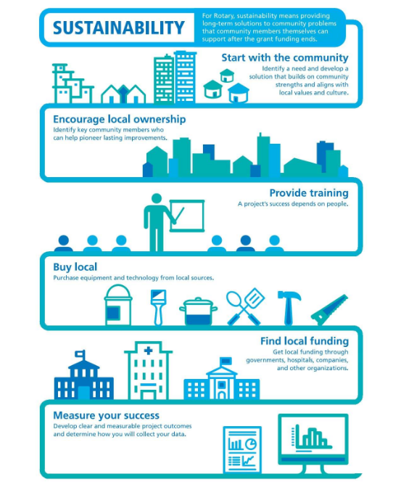
Notes:
Global grants must have sustainable impact. Here we have 6 steps to sustainability. Start with the community to identify a need and develop a solution that builds on community strengths and aligns with local values and culture. This means we need to start with a community assessment – ask the community what they need rather than deciding what you think you would like to do. You may want to provide school uniforms, but the community may have a greater need for clean water or for trained teachers and books. Identify key community members to assess their needs and become partners committed to the project and maybe even create new jobs or sell goods and services. Provide training and education so that the community knows how to take over the project when the grant funding is gone. Buy local, getting at least 3 bids, and make sure spare parts will be available locally. Get local funding through governments, hospitals, companies or other organizations. Develop clear, measurable project outcomes and engage the community in collecting data and evaluating the outcomes.

Slide 17
Budget & funding requirements
$30,000 minimum budget; Maximum World Fund match of $400,000
80% World Fund match for DDF contributions
No World Fund match for cash contributions
At least 15% of contributions that fund humanitarian projects need to come from outside the project country. This rule does not apply to scholarships and vocational training teams (VTTs).

Slide 18
Grant Certification …
Grant Certification …
District & Global Grants

Slide 19
Club Qualifications
Require at least one (1) Club members (preferably the incoming Club President) to participate in a Grant Management Seminar. Two Club members is better.
Agree to implement the club Memorandum of Understanding (MOU) and provide other necessary documents.
Notes:
Our 5 districts have differing requirements for district grant funding but all require certification of the club for Rotary Foundation funding which includes attending a grant management seminar (such as this) and completing a Memo of Understanding. I know that most of us also suggest that more than one club member participate in a grant management seminar simply because one may leave your club.

Slide 20
Club Qualifications
Implement the Financial Stewardship Requirements in the MOU
Develop a Financial Management Plan
Have a Dedicated Bank Account for Each Global Grant
Keep a Separate Ledger for Each Project
Each Account needs 2 Signatories
Have a Club Bank Account Succession Plan
Notes:
We have financial stewardship requirements for each club which you will see on your screen and which are designed to provide standard, best practices for the use and protection of our grant funds.

Slide 21
Club Qualifications
Recordkeeping System to Organize & Maintain Required Documents
Store Documents a Minimum of 5 Years
Report Any Misuse to District
Complete District Grant Management Training
Know Your District Qualification Requirements
Notes:
We also need to have recordkeeping policies and procedures. Finally, remember to check with your district for any district-specific qualifications requirements.

Slide 22
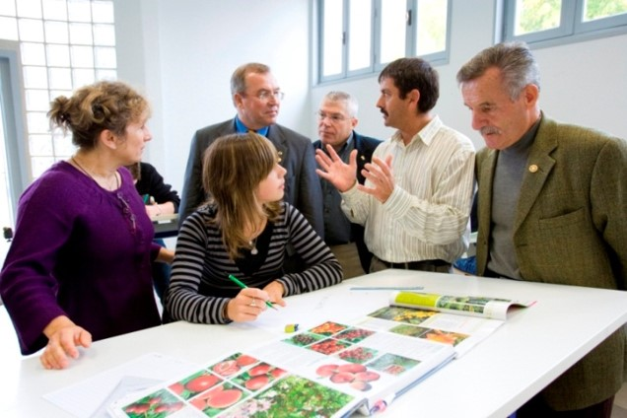
Financial Management Plan
How will your club select vendors and set its project budget?
Who will be responsible for approving purchases and paying those bills?
Where will your club keep documents like receipts, banks statements, project ledgers, and inventory lists?
What process will you use to replace a contact or signatory if someone leaves the project before it is finished?
Notes:
Your financial management plan will include procedures for a standard set of accounts, handling of receipts and disbursements, segregating duties, establishing any equipment inventories, and complying with laws.

Slide 23
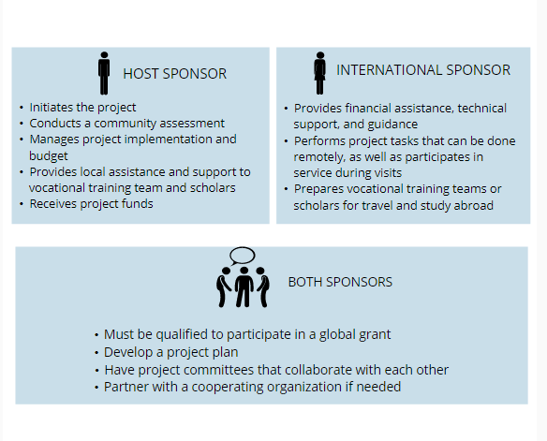
Partner to Maximize Your Impact
Notes:
Both Rotary and community participation are needed for a successful, sustainable project. To apply for a global grant, two qualified clubs or districts must work together. The host sponsor is the partner in or near the community that’s implementing the project. The international sponsor works with the host sponsor and is located outside of the host sponsor’s country. Both the host and international partners must form committees of at least 3 members each. Avoid conflicts of interest and look for committed members who have expertise, are accessible, respected, responsive, and multilingual. Remember you will also be collaborating with community members and other organizations to maximize your project’s impact. Clearly define responsibilities; have a detailed plan of action; develop clear and open lines of communication; have knowledgeable and motivated partners; show mutual respect; and anticipate potential barriers.

Slide 24
Locating Partners
Rotary Conventions
Project Fairs
Rotary Action Groups Rotary Action Groups
Rotary discussion groups
Rotary Service Project Center Service Project Center
Notes:
You can find in a variety of ways. Your district leaders may help with this, you may also find partners at Rotary events like Rotary International Conventions or Project Fairs, as well as through Rotary related groups and online tools like discussion groups and Rotary Ideas. rotary-action-groups-flier-en copy.pdf

Slide 25
Global Grant Reports
Your Global Grant report should include:
Number of beneficiaries and how they benefited
Specify your measurement methods
Establish baseline
How areas of focus goals were met
How funds were spent (itemize/document)
Notes:
Also remember that reports are due for both district and global grants. Global grant reports establish baselines, measurement methods, your goals, how you spend funds, and more importantly who benefited and how.

Slide 26
Global Grant Reports
Timeline for reporting: (true for all kinds of grants)
Progress reports are due within 12 months of first payment
Follow up reports are due every 12 months throughout the term of the grant
Final report is due within two months of completion
Arrangements must be made to utilize unused funds or these must be returned to Rotary
Notes:
Failing to timely report may cause you to be unable to receive future funds or cause issues with your current project. Any funds not used for the project as set forth in your application, must be returned to The Rotary Foundation.

Slide 27

The Polio Eradication Story ….
Rotary’s Polio Eradication Efforts …
Notes:
Jan – Mar 2025: 7 cases, (6 Pakistan, 1 Afghanistan); Jan - Mar 2024: 3 cases
2024 Totals: 99 (74 Pakistan, 25 Afghanistan)

Slide 28
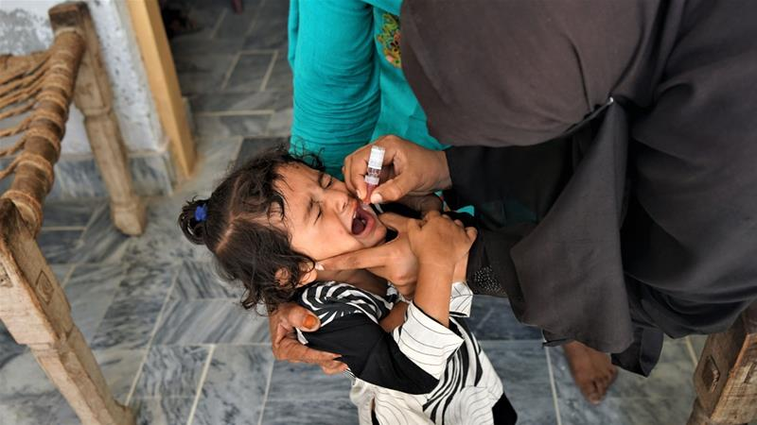
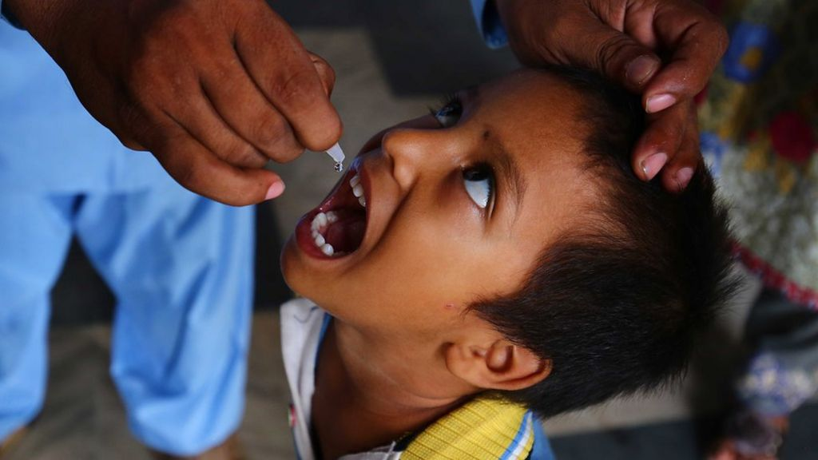
The Job: Just Two Drops

Slide 29
What Have We Accomplished?
Polio Eradication
The following have been accomplished by Rotary’s polio eradication efforts:
  3 billion children have been vaccinated in 40 countries (400 million / year)
  20 million children were not stricken with polio
  1.5 million children did not die from polio
  All countries except Pakistan & Afghanistan are ”Polio Free”
  $146.3 million was spent on Polio Plus in 23-24 with $2.6B committed since 1988

