Slide 1
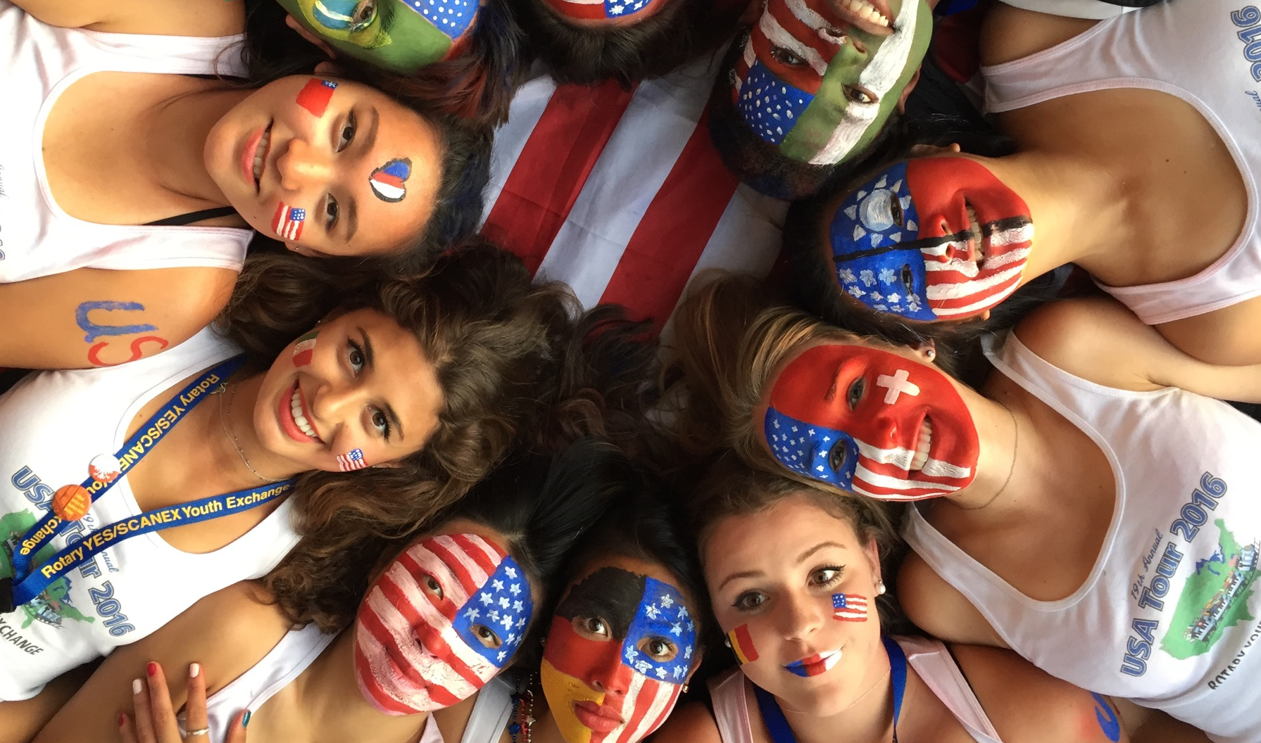
rotary
youth
exchange
District 5340
Title Page Option

Slide 2
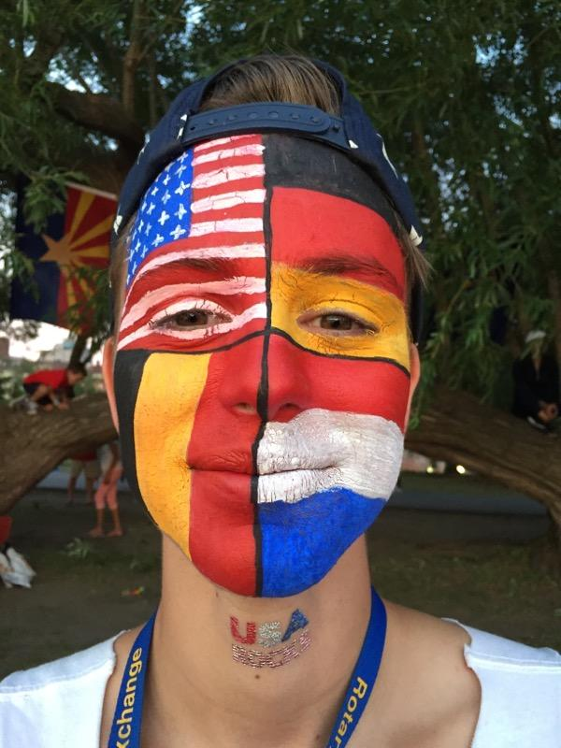
rotary youth
exchange
builds peace and
understanding
one exchange student at a time…

Slide 3

Rotary’s Motto: “Service Above Self”
We are People
of Action
1.2 Million Members in 200 Countries
Our Service Projects Help People Live Better to Be Better
Notes:
What is Rotary International?
We put Service before our Selves in helping to our communities better
A non-profit international service organization founded in 1905 in Chicago
Over 1.2 million members in 200 countries with 33,000 members worldwide
Service projects address critical issues:
Hunger, sanitation, water, illiteracy, medical needs, etc.
Eradication of polio is most notable Rotary project
Development of YOUTH a major focus for Rotary

Slide 4

Interact
Music Competition
Rotary Youth Leadership Award
Youth Exchange
Model UN
Rotary Supports its Youth!
Notes:
A principal area of service since it’s inception has been the development of youth. Rotary has four programs for high school students!
Interact/Rotaract Clubs
For high school/college students
Rotary Youth Leadership Award (RYLA)
3-day leadership camp for HS Jr. students
Rotary Youth Exchange
For high school students eager to grow

Slide 5
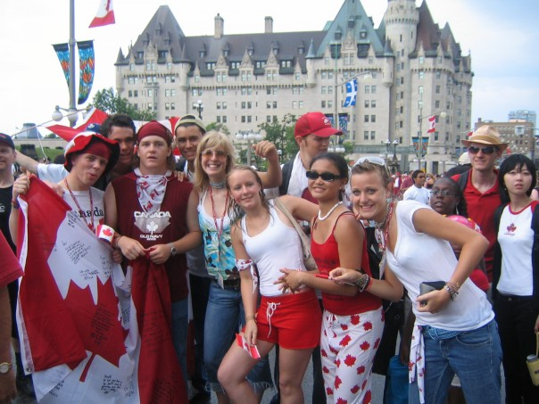
Did You Know?
Rotary International is the
only Non-governmental Organization to have a seat
in the United Nations
7,000+ exchange students
per year from 80 countries
Locally our organization
sends out 50-75 students
each year.
Notes:
Each year over 8,000 exchange students from 80 countries enrich their lives
Students see another part of the world through RYE
RYE began right here in California in 1939!
SCANEX (a multidistrict organization which includes District 5340) supports 50-100 exchange students each year!

Slide 6
Why Rotary Youth Exchange?
more aware of how you impact others
more willing to tolerate new ideas
speak in a different language
build new lifelong friends
become more confident in yourself
build a larger family
establish a greater understanding of the world
Notes:
Why Rotary Youth Exchange?
Promotes cultural understanding and peace
Become better world citizens
Be Rotary Ambassadors
Develop conflict resolution skills
Personal growth

Slide 7

Watching out for our Youth
At Home and Abroad

Slide 8

Three Types of Exchange Programs:
Long Term Exchange
Short Term Exchange
Summer Camp

Slide 9
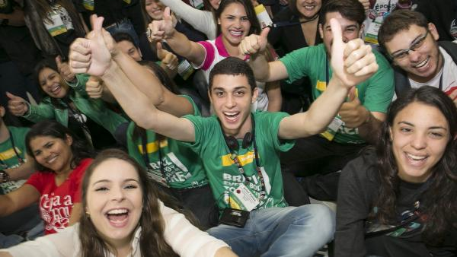
Long Term Youth Exchange
Notes:
Starting with Long Term Exchange, our flagship exchange program!
We’ll talk about this program first because it’s the most involved and with the greatest potential!

Slide 10

Long Term Exchange – Summary
Exchange lasts for one full academic year (approximately 10 months)
Students are hosted by 2-3 Host Families during their exchange
Have a good academic standing
Multiple group trips throughout the exchange year
Must be 15–18½ years old at departure
Students are supported by a host
Rotary club, a YEO, and Counselor
Notes:
Eligibility Notes
A willingness to learn the language and culture of the country assigned.
Leadership qualities:
Adaptability and flexibility
Positive character.
Recommended by your local Rotary Club
Adhere to Rotary, host family, and school rules
A family member is not required to be a member of Rotary in order for student to qualify.

Slide 11
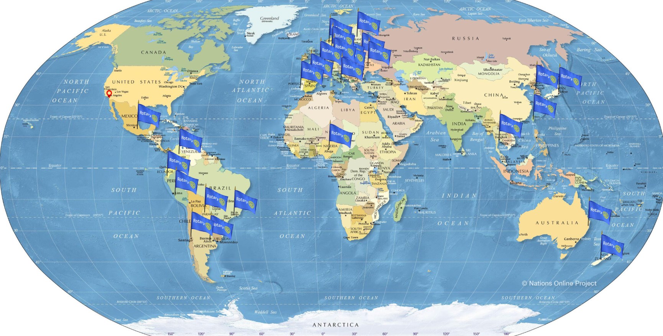
Where Can You Go?
Notes:
Country Selection
When a student submits their application, they are asked to give their top 3 country choices
Based on a number of factors including orientation interviews, readiness for the desired country, etc.. the selection is made
Presently we have exchange contracts with 36 countries
Good time to talk about how each country goes through a rigorous vetting process to be cleared/approved for exchange.

Slide 12
List of Available Countries (36 Total)
Argentina, Australia, Austria, Belgium, Brazil, Chile, Columbia, Croatia, Czech Republic, Slovakia, Denmark, Ecuador, Finland, France, Germany, India, Italy, Japan, Mexico, Netherlands, New Zealand, Nigeria, Norway, Peru, Poland, Portugal, Romania, South Korea, Spain, Sweden, Switzerland, Taiwan, Thailand, Ukraine, Uruguay
*subject to change
Notes:
Eligibility Notes
A willingness to learn the language and culture of the country assigned.
Leadership qualities:
Adaptability and flexibility
Positive character.
Recommended by your local Rotary Club
Adhere to Rotary, host family, and school rules
A family member is not required to be a member of Rotary in order for student to qualify.

Slide 13
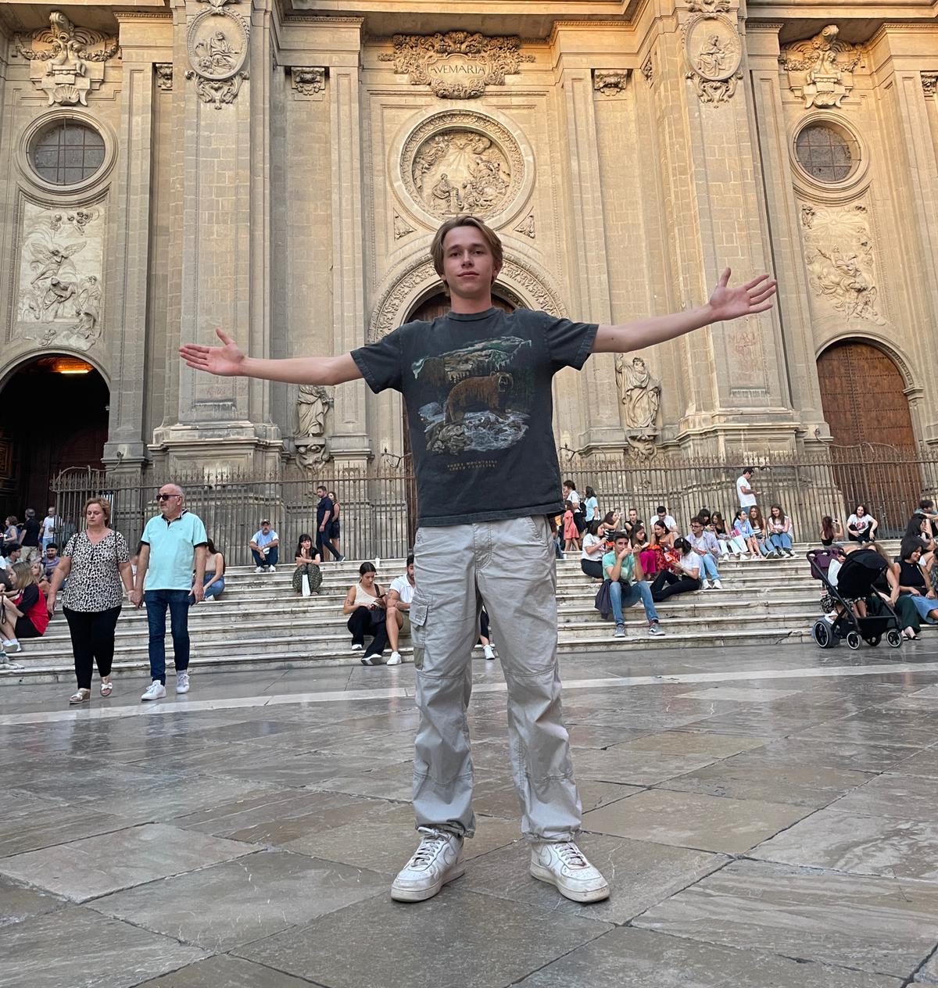


Long Term Exchange Costs
Application Fee: $500
Host club provides student room & board, school tuition and fees, and a monthly stipend of $100 in local currency.
Combined scholarship
Value: $24,000
Round trip airfare
Student visa
2 weekend orientation sessions
Rotary blazer, emblem, and cards
Administrative fees
Program Fee: $6,000 (includes application fee)
Notes:
Program Costs
Rotary youth exchange program is administered entirely by volunteers, keeping costs low

Slide 14

Timeline for Outbound Students
Conduct Student/ Parent Interviews
Feb 2-4
1st orientation for student only applicants (Westchester, CA)
Dec 31
Preliminary Application Completed
Mar 1st
Student application completed & submitted
Mar 15-17
2nd orientation with student and parents (Simi Valley, CA); receive country assignment
June-July
Receive travel visa and flight itinerary. Finalize travel arrangements.
May
Meet (virtually)
host family
August
Depart for Your Adventure of a Lifetime!
Notes:
Application process done entirely online.
Preliminary Application
Interviews with Student, Parents – done by YEO/Counselor
Preliminary Application: Student/family info, essay by student and parent, photos, medical and dental records
Completed Application
School and rotary recommendation
Signed authorization
School transcript
Passport

Slide 15

Some Restrictions
May Apply
“Gap Year” students may participate, cannot be older than 18-1/2 at departure
Some countries require language proficiency for placement in schools
Rotary Exchange Students must attend school. It’s an adventure…not a vacation!
Notes:
Gap Year students cannot be older than 18-1/2 at departure
May be required to attend a language school prior to attending school

Slide 16



What Makes a Good Exchange Student?
Curious
Flexible
Positive
Notes:
The key attributes about students which help to ensure a rewarding experience.

Slide 17
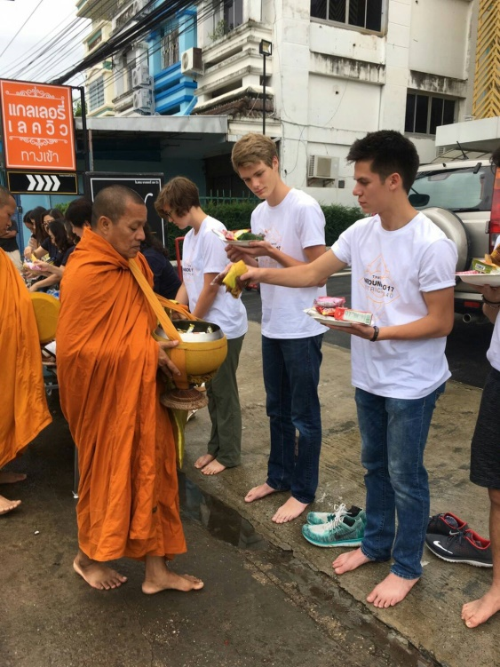
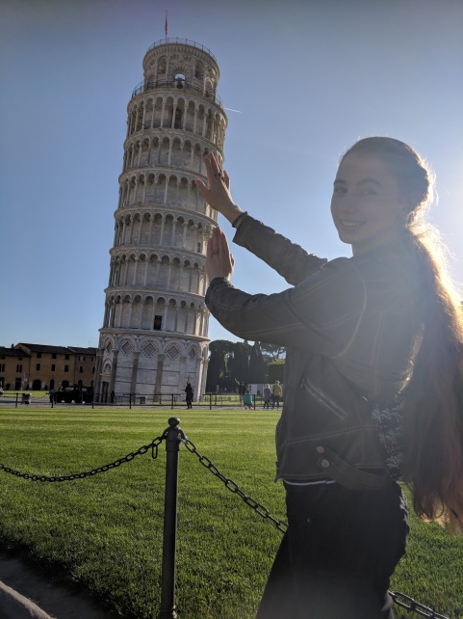
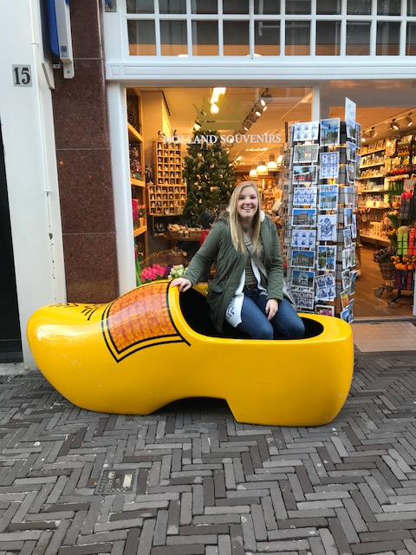
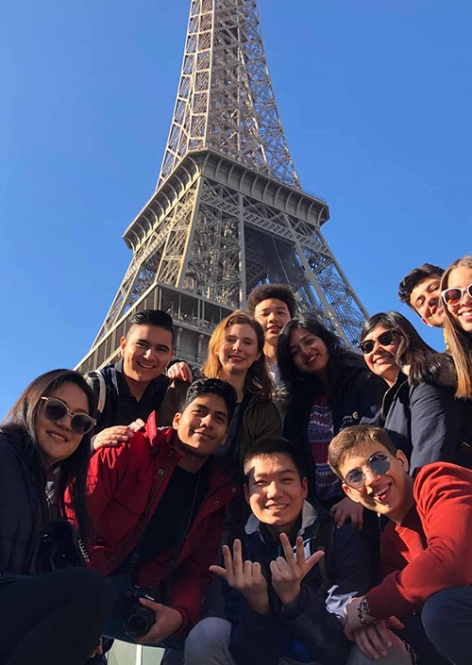
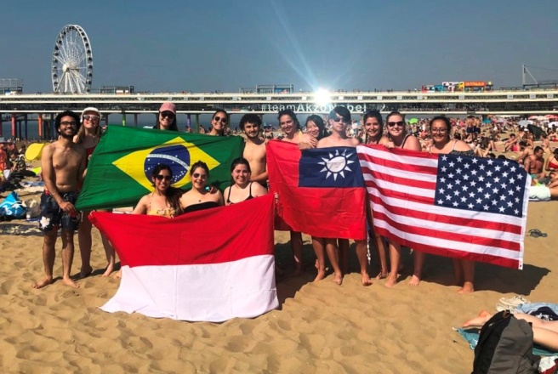
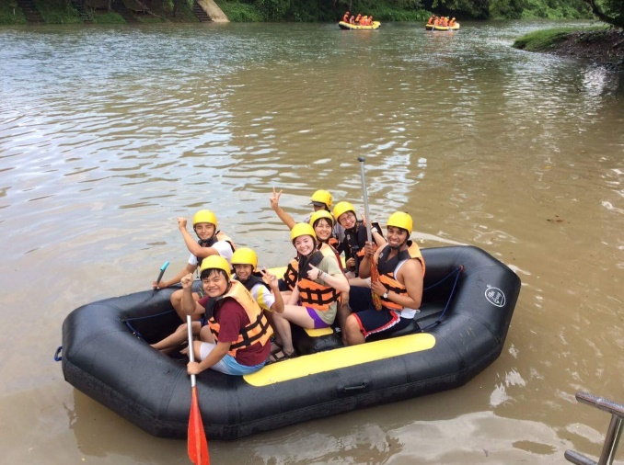
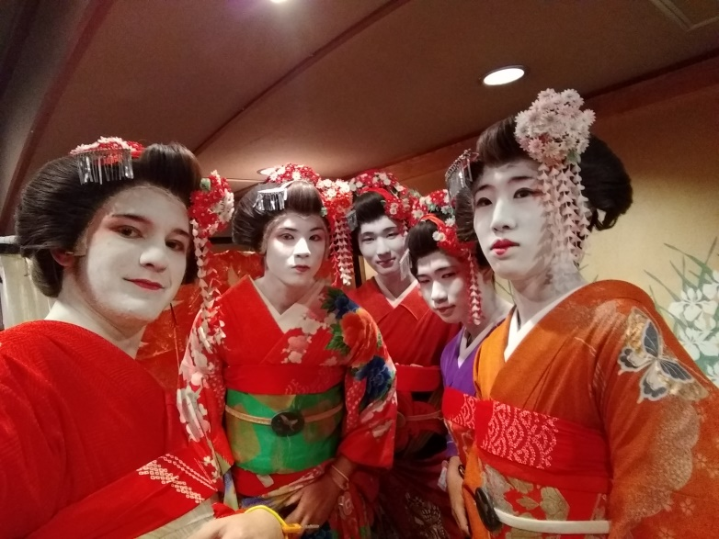
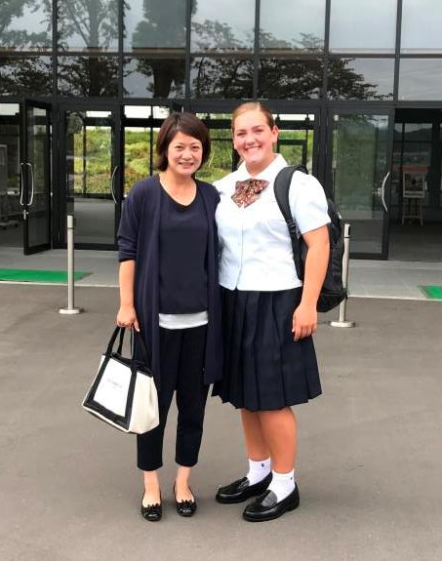
What Students Get

Slide 18

Short Term Youth Exchange

Slide 19
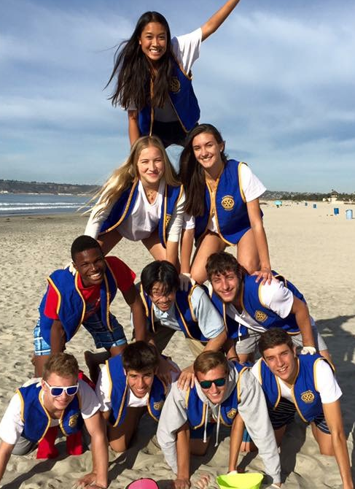
Short Term Exchange Description
One-to-one with another student & family
15-18½ years old at time of departure
Hosted by one Family
Each student spends 2-3 weeks in each country
Conducted during summer, no school attendance
$300 fee (includes health insurance). Student/family are responsible for airfare, passport, and incidentals.
Applications due by January 15th for interviews
Notes:
As the name suggests, short term lasts 4-6 weeks during the summer
A great way to experience an exchange without having to attend school
Largely the same characteristics as long term exchange except:
No school attendance
Held during the summer
One host family in each country
Lower program cost

Slide 20
Timeline for Outbound Students
Jan 15-30
Student application completed & submitted
By Dec 31
Request Application
Feb
Schedule Interview and Home Visit
Mar – May
Matching Process
June
Orientation
May
Connect with Host Sibling
Summer 2025
Depart for Your Adventure of a Lifetime!
Notes:
Application process done entirely online.
Preliminary Application
Interviews with Student, Parents – done by YEO/Counselor
Preliminary Application: Student/family info, essay by student and parent, photos, medical and dental records
Completed Application
School and rotary recommendation
Signed authorization
School transcript
Passport

Slide 21

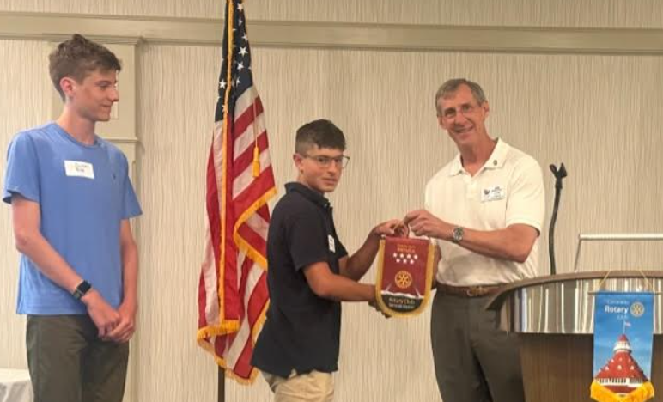
Making Friends for Life!

Slide 22
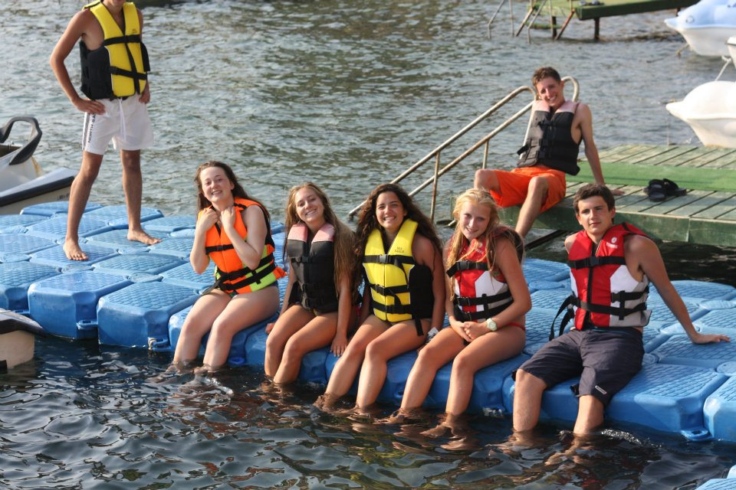
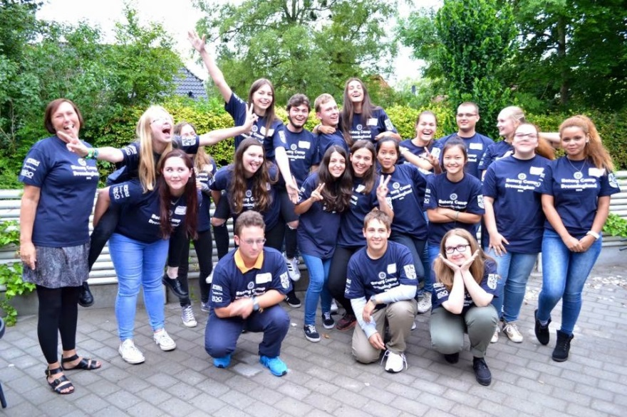
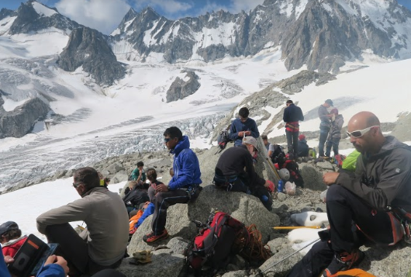
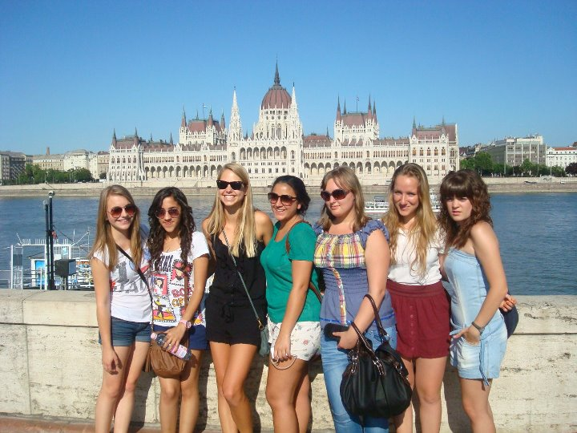
Summer Camp

Slide 23
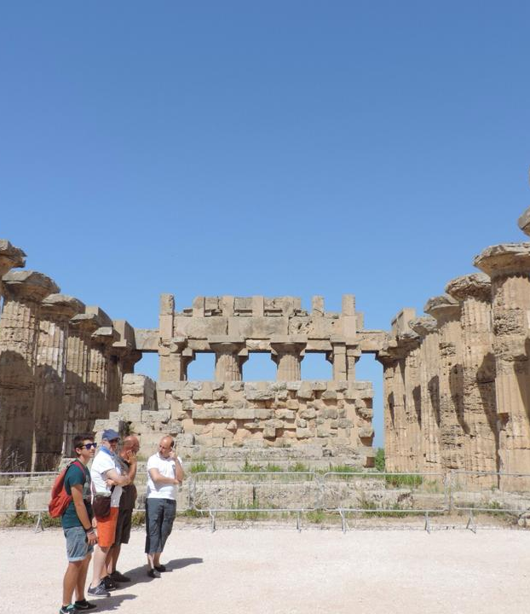
Summer Camp
Unique “camp” programs built around themes
2-3 weeks and held during June - September
15-30 students per camp ranging in ages 15-25 years old
Great opportunity to meet students from around the world
Administrative Fee: $300 (includes insurance); student/family is responsible for camp fees, airfare, passport, and incidentals
Summer camp costs range from approximately $400 to $1250
Applications due by January 15th
Notes:
Truly a unique program to see a country, meet students, and enjoy activities, new food, and more.
If selected, you will be the only student representing your country; quite an honor
Themes span everything from cultural, sports, activities, culinary, and more.

Slide 24
Timeline for Outbound Students
Jan 15-30
Student application completed & submitted
By Dec 31
Request Application
Feb
Schedule Interview
Mar – May
Camp Selection Process
June
Orientation
May
Follow up with Camp Coordinator
Summer 2025
Depart for Your Adventure of a Lifetime!
Notes:
Application process done entirely online.
Preliminary Application
Interviews with Student, Parents – done by YEO/Counselor
Preliminary Application: Student/family info, essay by student and parent, photos, medical and dental records
Completed Application
School and rotary recommendation
Signed authorization
School transcript
Passport

Slide 25
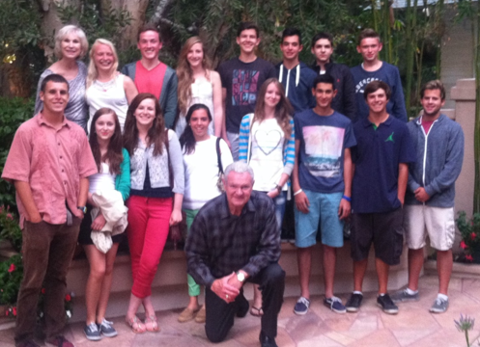
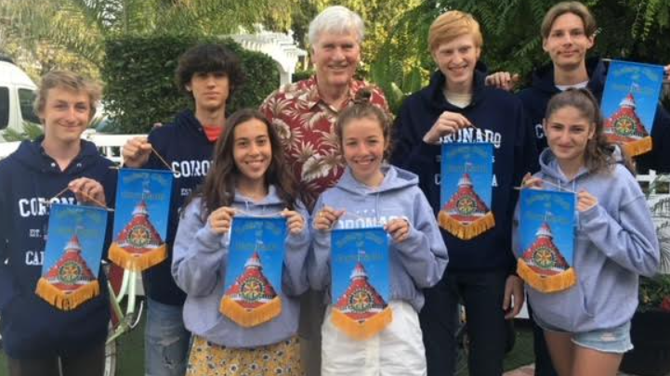
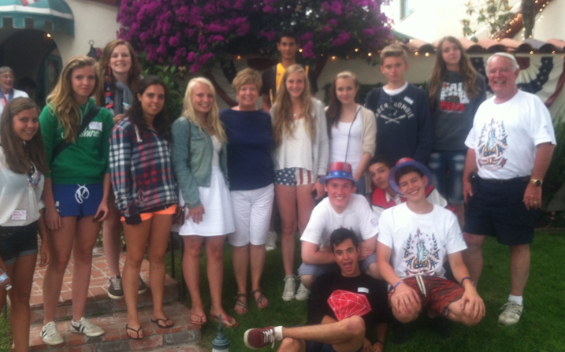
Inbound
Summer Camp

Slide 26
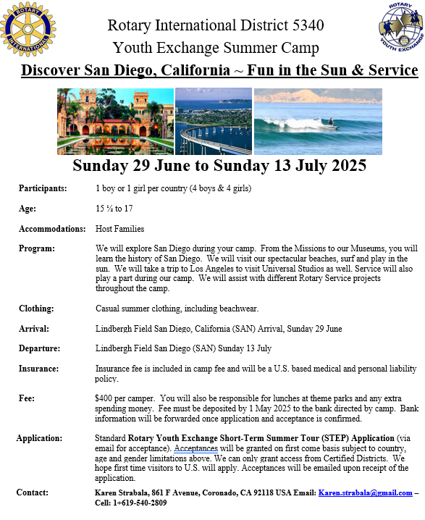

Slide 27

Open your heart and home –
won’t you HOST our student?
Notes:
Host families are the critical element to Rotary being able to offer the exchange programs.

Slide 28
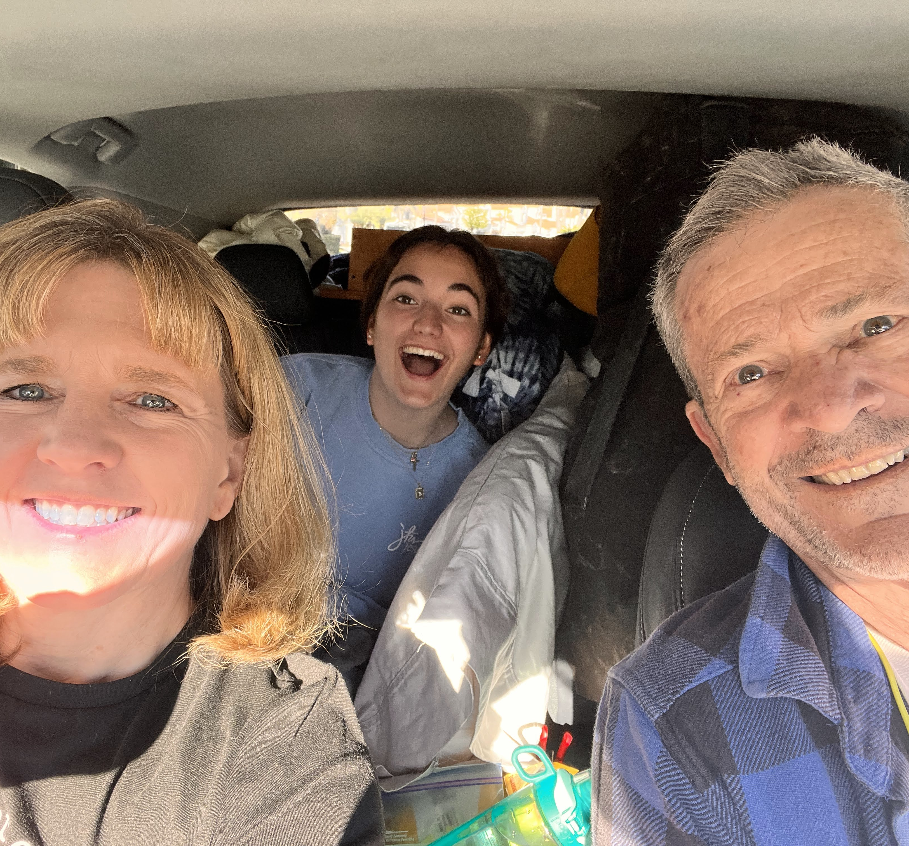
You Can Host a Student Too!
Exchanges not possible without host families
Introduce a student to your home, family, culture, and more
Learn their language
and culture
Families sending a
Long-Term student
are required to host
an exchange student
Typical hosting lasts 3-to-5 months
Notes:
Long Term families of students going outbound are required to host a student.

Slide 29
Youth Exchange
It changes lives of
students
and
host families too!

Slide 30

rotary
youth
exchange
Interested or want more info?
Visit our website at:
https://youthexchange5340.org/
When you are ready to get your club involved, email
Karen.strabala@gmail.com

