Slide 1
GLOBAL GRANTS TRAINING SEMINAR
Rotary District 5340
For Rotary year 2023-2024

Slide 3
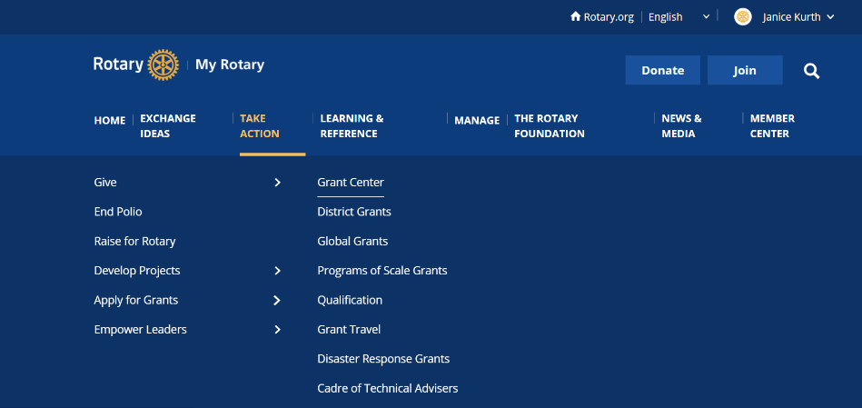
My.Rotary.org
1
3
2

Slide 4
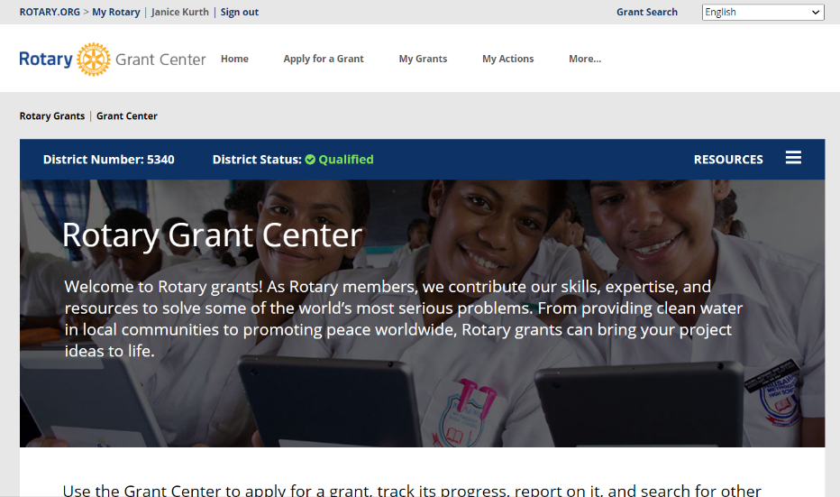

Slide 5
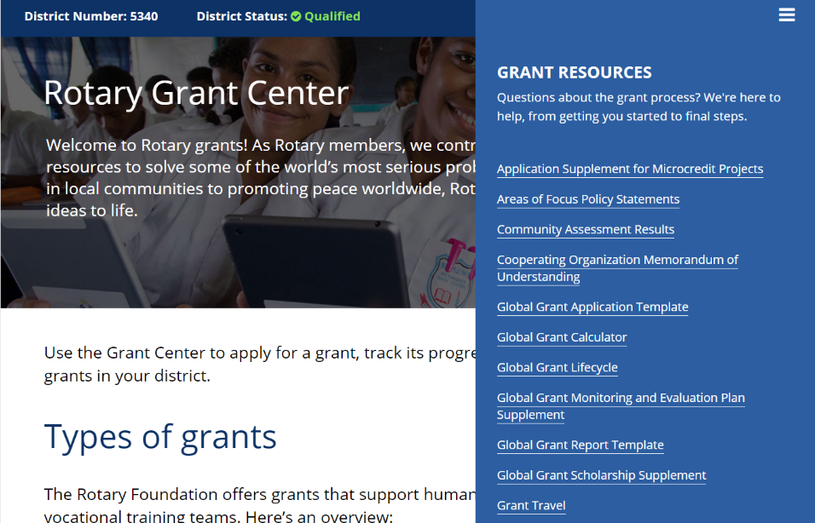

Slide 6
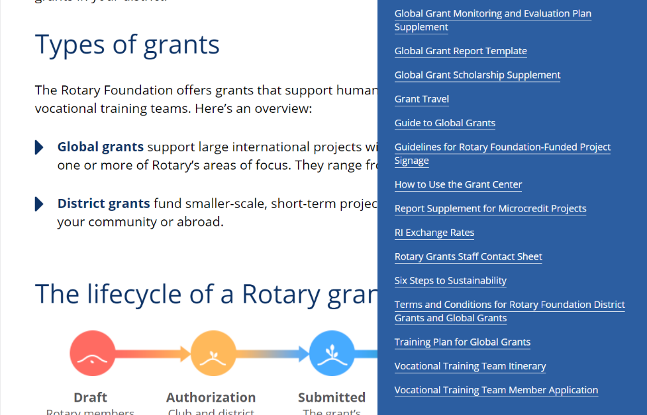

Slide 7
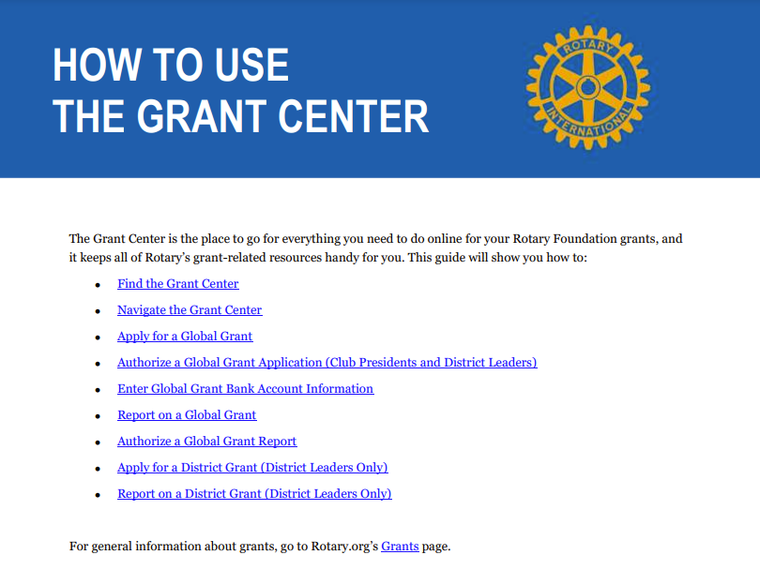

Slide 8
subhead
GLOBAL GRANTS
Large, long-term projects
Sustainable, measurable outcomes
Alignment with areas of focus
International partnership
Notes:
Now let’s move on to the next grant type: global grants. Global grants support large international activities with sustainable, measurable outcomes in Rotary’s areas of focus. A key feature of global grants is partnership, between the club or district where the activity is carried out and a club or district in another country. Both sponsors must be qualified before they can submit an application.
Global grants have a minimum budget of $30,000 and a maximum World Fund award of $400,000. Grant sponsors can use a combination of District Designated Funds (DDF), cash, and/or directed gifts and endowment earnings to fund a global grant. The Foundation will provide a 100 percent World Fund match for all DDF contributions.
For those of you that have worked with global grants before you will notice a change regarding the World Fund match. Due to the great success of global grants, the demand for the grants is soon expected to dramatically exceed the resources of the World Fund. Because of this, the Foundation Trustees decided to stop matching cash contributions to grants. That change took effect 1 July. Grants that had already been approved are not affected. And cash can still be contributed — it just won’t be matched. The Trustees also decided to no longer require a minimum World Fund match for global grants.
Global grants can support humanitarian projects, scholarships, and vocational training teams. Global grant scholarships support international graduate and post-graduate study for a period of 1-4 years. Global grant vocational training teams support groups of professionals to travel abroad to provide or receive training.

Slide 10
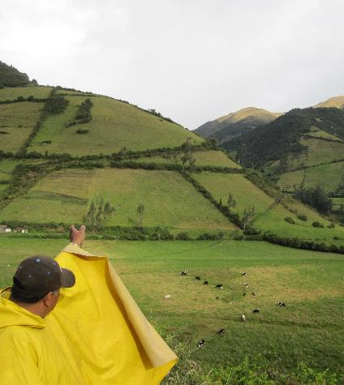
SUSTAINABILITY OF PROJECTS IS IMPORTANT FACTOR IN TRF CONSIDERATION
Giving a community the skills and knowledge to maintain project outcomes for the long term, after grant funds have been expended.

Slide 13
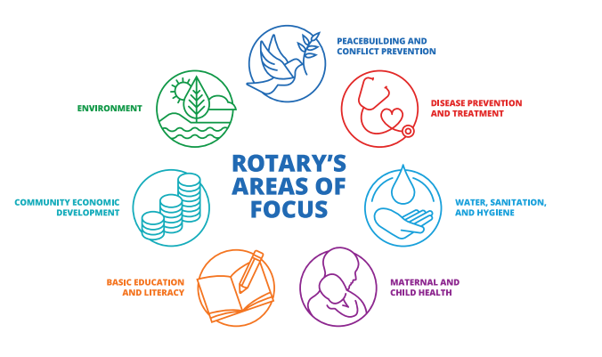

Slide 15
MOST IMPORTANT BIT OF GRANT ADVICE
Only pick only ONE area of focus no matter how many areas of focus you think you project fits in to!

Slide 17
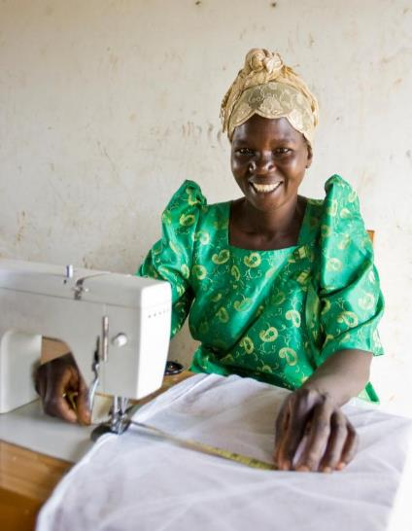
GLOBAL GRANTS
Are BIG!
$30,000 minimum total budget
World Fund match
No minimum
Maximum $200,000 (without additional review)
Notes:
Global grants support large international activities.
The minimum budget for a global grant activity is $30,000. The Foundation’s World Fund provides a minimum of $15,000 and maximum of $200,000. Clubs and districts contribute District Designated Funds (DDF) and/or cash contributions that the World Fund matches. DDF is matched at 100% and cash is matched at 50%.

Slide 19
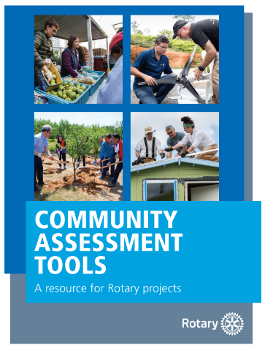
COMMUNITY ASSESSMENT IS REQUIRED!
Base projects on real needs
Identify resources that your club and potential partners have
Talk to the community
To find this search
“Rotary Community Assessment Tools”
Notes:
Speaking points:
Asking members of the community what they need and what strengths they bring to the project results in greater support and involvement, which leads to a more sustainable, lasting impact.
Once the needs are identified, your club should consider which can be addressed with the resources, skills, and availability of your club and its potential partners, including other Rotary clubs, districts, The Rotary Foundation, and non-Rotary organizations.
Continue involving the community during the selection of the project and its planning and implementation.
The Rotary publications Communities in Action and Community Assessment Tools offer information and resources for conducting a community needs assessment.

Slide 20
METHODS USED FOR ASSESSMENT
Survey
Community meeting
Interview(s)
Focus group
Asset inventory
Community mapping
Other

Slide 22
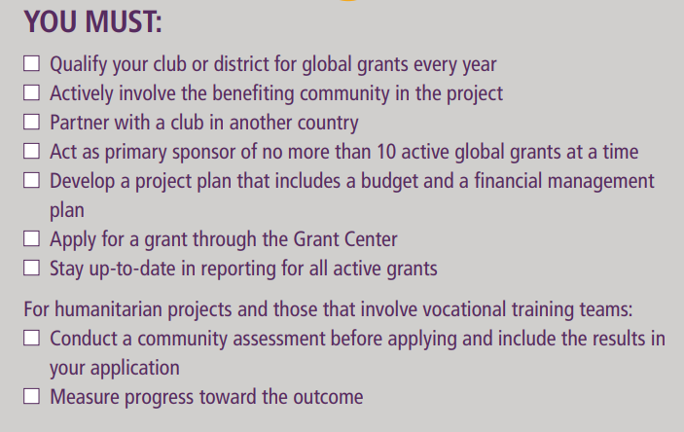

Slide 23
CLUB QUALIFICATION
To qualify for global grant DDF, club must have achieved a minimum of $100 per capita giving to the Annual Fund or a club total of at least $20,000 for the 2022-2023 Rotary year.
All District and RI dues must be up to date.

Slide 24
CLUB QUALIFICATION
Two club members must attend this training and complete the assessment quiz.
TRF Memorandum of Understanding must be signed.
Signed by 2023-2024 & 2024-2025 presidents
Email signed form to PDG Mel Gallegos at melgallegos1819@gmail.com

Slide 25
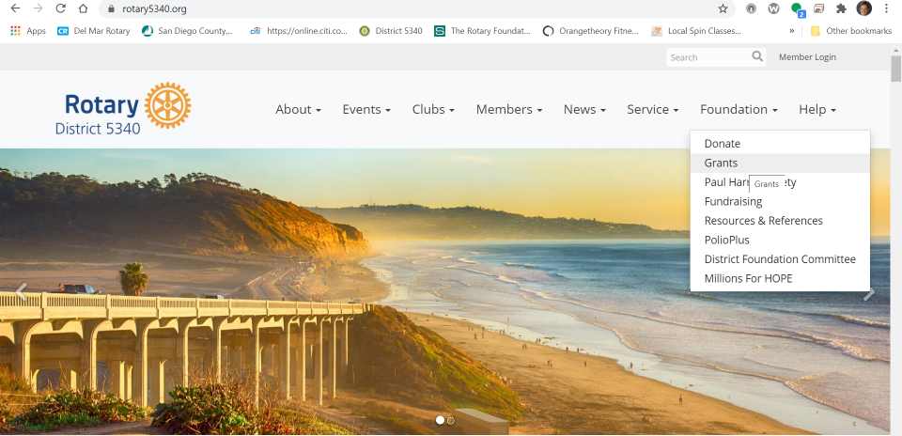
To download MOU:
Go district web site rotary5340.org
1
2

Slide 26
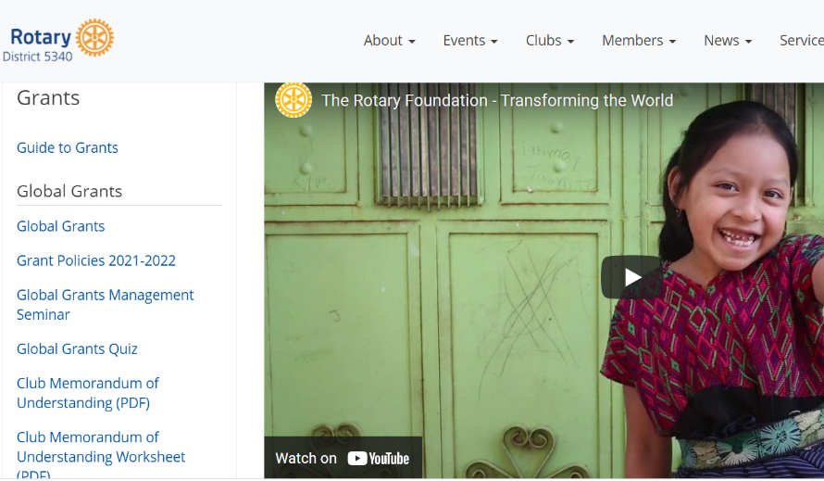
Rotary5340.org

Slide 27
CLUB QUALIFICATION
All grant reporting must be up to date.
No more than 10 active global grants.
The club’s Rotary Foundation giving goals for 2023-2024 must be entered by the club president (or elect).

Slide 29
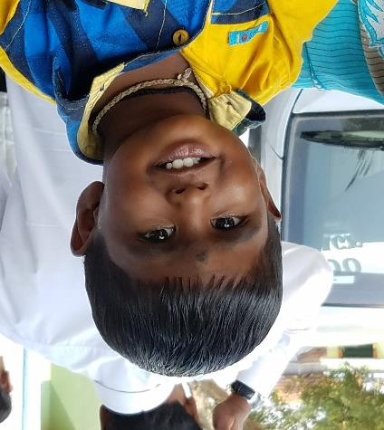
GLOBAL GRANTS REQUIRE
International partnership
Host
International Club
must contribute at least 15% of funding
Exceptions
Term gifts involved
Notes:
Global grants are sustainable, with measurable outcomes in Rotary’s areas of focus. A key feature of global grants is partnership, between the district or club where the activity is carried out and a district or club in another country. Both sponsors must be qualified before they can submit an application.

Slide 30
HOW TO FIND ROTARY PARTNERS FOR GLOBAL GRANTS
Rotary Convention
Project fairs
LinkedIn
Facebook
Rotary events
www.matchinggrants.org/global
www.rotary.org/rotaryideas

Slide 31
YOUR GLOBAL GRANT “COMMITTEE”
Both the Host and International Clubs must have:
Primary Contact
Two additional club members for the grant committee

Slide 33
DISTRICT 5340 GLOBAL GRANT RULES
Each Club eligible for up to $10,000 in District Designated Funds (DDF) for 2023-2024 Rotary year.
Club cash contributions are matched 1:1 up to $10,000.
Clubs encouraged to work together to do bigger grants
No more than $40,000 in DDF collectively for a single grant
Grants must be fully pledged on MatchingGrants.org before DDF will be allocated for your project.
Grants must comply with D5340 Youth Protection Policy (if applicable)

Slide 34
ROTARY FOUNDATION MATCHING FUNDS
Cash donations by Clubs
No Rotary Foundation match
Note: 5% must be added to club cash contributions for administrative costs
(May be avoided by contributing directly to project account)
District Designated Funds
Matched 80%

Slide 35
ROTARY FOUNDATION MATCHING FUNDS
Example:
$15,000 Clubs’ cash
$15,000 District Designated Funds
TRF Match
$12,000 for DDF
Total Funds for project -- $42,000

Slide 37
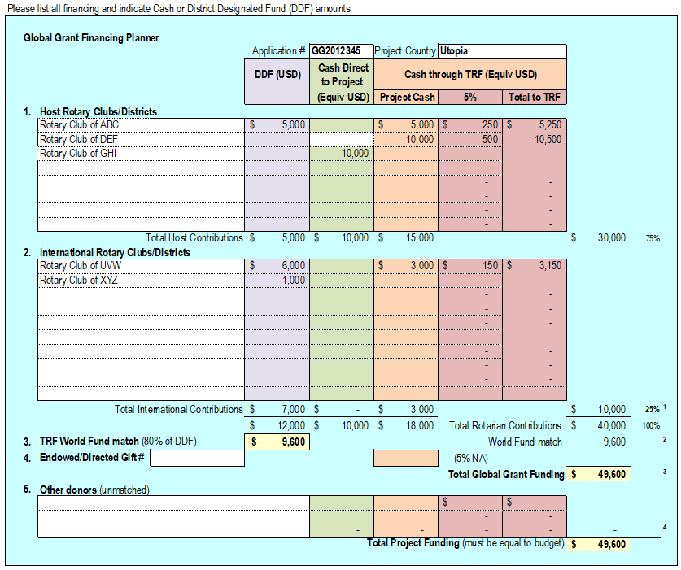

Slide 38
WHEN YOUR GRANT IS APPROVED…….
Project specific bank account must be established.
All cash must be sent to TRF or bank account.
5% surcharge for funds sent to TRF – get Paul Harris credit
No surcharge if funds sent directly to project bank account
TRF will wire funds to bank account, including DDF.

Slide 39
WHEN YOUR GRANT IS APPROVED…….
NOTE
(and answer to a very common question)
The DDF portion is never in the District’s hands. We don’t need to do anything once the grant is approved to transfer these funds to the project account. The Rotary Foundation does this directly.

Slide 40
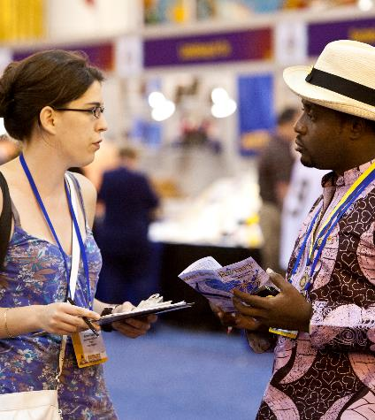
Grant Management
Ensures that projects
Have proper financial controls
Adhere to technical standards
Meet the needs of beneficiaries
Fulfill their objectives
Safeguard funds
Grant management and reporting is the responsibility of both the international and host grant committees.

Slide 41
Grant Management
Document ALL expenditures
Save all receipts and invoices
Keep a log of all expenses
Retain all bank statements. They are required as part of your reporting.
Reports due annually and 2 months after project completion.
Submit reports online through Grants Center
Take pictures of the project before initiation, during your work and after completion.

Slide 42
Grant Management
Spend grant funds only on items in the grant application
If you need to alter your spending plan significantly, contact TRF in advance for approval.
If you are underbudget, you may contact TRF in advance for permission to spend remaining funds in some other manner.
Any unspent funds will need to be returned to TRF.

Slide 45
STEPS FOR MONITORING AND EVALUATION PLAN
Establish clear project goals in the planning phase.
Identify applicable Rotary Foundation standard measures.
Identify additional project‐specific measures.
Establish baseline data and the methods you’ll use to collect data.
Submit the plan as part of the online application.
Collect data during the project and monitor progress.
Evaluate data and submit results to the online report.

Slide 46
EXAMPLES OF ROTARY FOUNDATION STANDARD MEASURES
Number of direct beneficiaries
Number of indirect beneficiaries
Number of people trained
Number of participants
Number of people receiving service
Number of events
Number of jobs created
Number of benefitting facilities
Number of communities with less conflict

Slide 48
TRF Reporting Requirements
Every 12 months throughout the project duration
AND
Within 2 months after grant completion

Slide 50
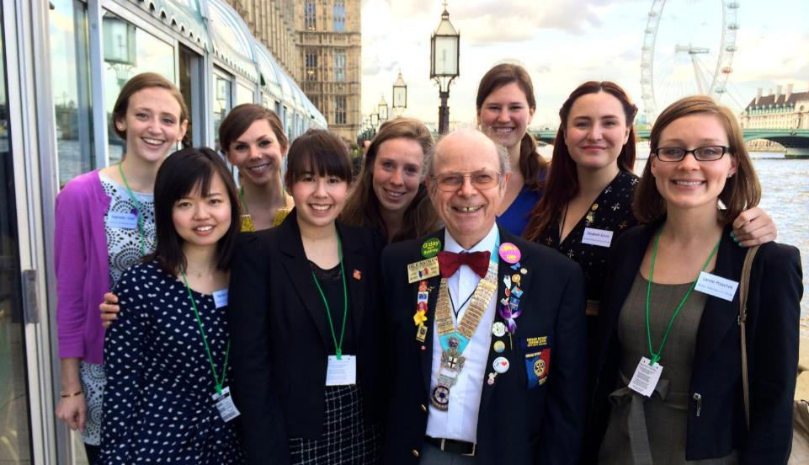
GLOBAL GRANT SCHOLARSHIP
Notes:
Rotarians in the US and the UK teamed up to provide a global grant scholarship to Reagan Thompson (center, back row) to receive a Master’s of Science (M.Sc.) degree in International Affairs with a Concentration in Conflict Prevention at the London School of Economics (LSE). Before beginning this program, she obtained a Master’s in Chinese Diplomacy at Peking University in China. She plans to pursue a career in government service focused on encouraging collaboration between the US and China. This grant falls within peace and conflict prevention/resolution area of focus.

Slide 51
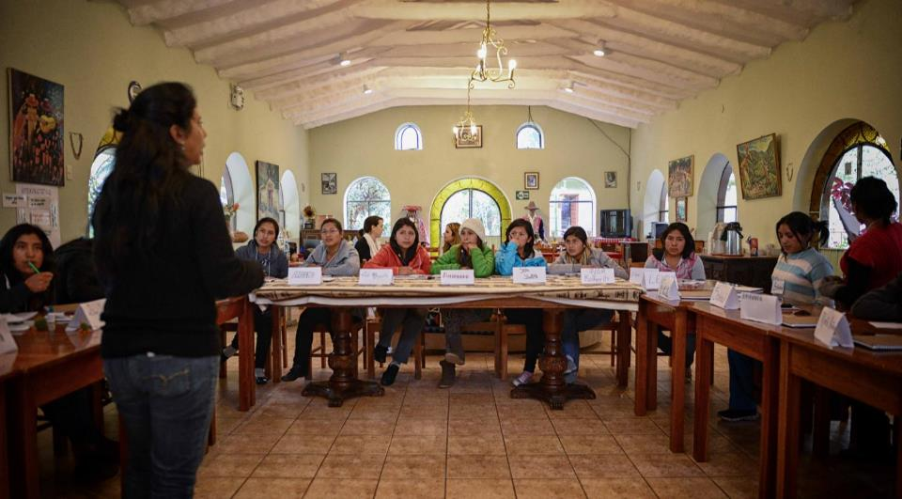
GLOBAL GRANT VOCATIONAL TRAINING TEAM
Notes:
Rotarians in Peru and the US worked together to get a global grant to support a leadership institute for young women in Peru. The goal of the program is to enhance the young Andean women’s self-awareness, leadership skills, and professional development to improve their opportunities to succeed academically and professionally. Secondly, the program engages the women to create their own visions for change and lead projects that deal with sustainable development initiatives appropriate for and desired by their families and communities. Rotarians from the US traveled to Peru to lend their professional expertise to the training sessions.

Slide 52
To get approval for your grant DDF allocation from our District, you MUST enter your grant on matchinggrants.org and show that it is fully pledged.

Slide 53
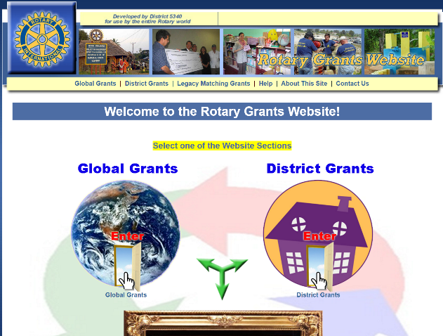
APPLYING FOR A GLOBAL GRANT
Enter your project on Matchinggrants.org

Slide 54
APPLYING FOR A GLOBAL GRANT

Slide 55
APPLYING FOR A GLOBAL GRANT

Slide 56
APPLYING FOR A GLOBAL GRANT

Slide 57
APPLYING FOR A GLOBAL GRANT

Slide 58
APPLYING FOR A GLOBAL GRANT

Slide 59
APPLYING FOR A GLOBAL GRANT
When you are working on matchinggrants.org, click refresh if you don’t see your work reflected on the screen!

Slide 60
GLOBAL GRANT DDF APPROVAL
Grants are considered on an ongoing basis until funds are depleted.
Approximately $140,000 available for 2023-2024
Submit early!
Projects evaluated with consideration of project merit and club Annual Giving to The Rotary Foundation.

Slide 62
APPLYING FOR A GLOBAL GRANT

Slide 63
APPLYING FOR A GLOBAL GRANT

Slide 64
APPLYING FOR A GLOBAL GRANT

Slide 65
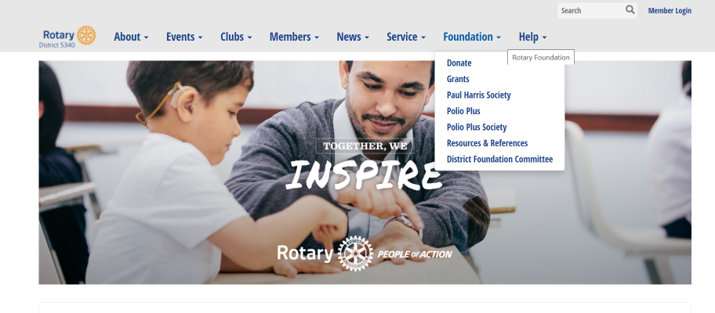
Rotary5340.org

Slide 66
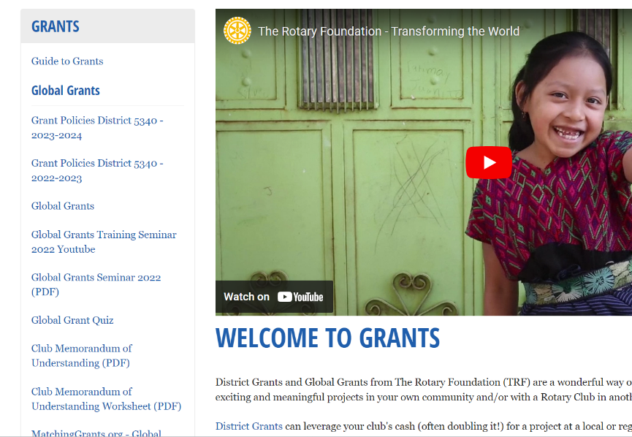
Rotary5340.org

Slide 67
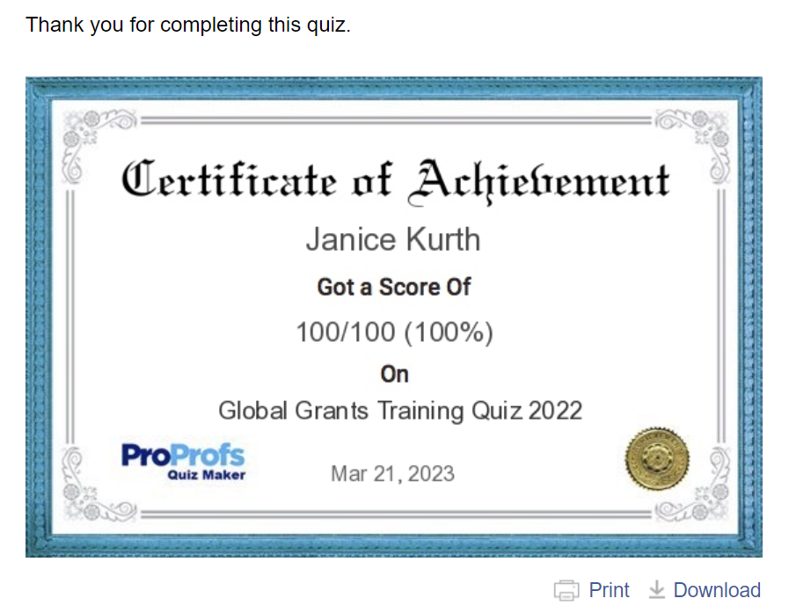

Slide 68
IMPORTANT ANNOUNCEMENT
DDF allocations for Global Grants for the 2023-2024 Rotary year will be considered starting immediately!

Slide 69
RESOURCES
www.rotary.org/myrotary
“Grants Center”
www.rotary5340.org
“Foundation”
“Resources & References”
www.rotary2627.org
“Club/District Resources”
then “Our Foundation”
then “Foundation Resources”
then “TRF Resource Guide”
Notes:
We have a number of resources available to help you take full advantage of grant opportunities.
Rotary’s website has a wealth of general and detailed information about grants.
The learning center offers training resources to help you apply for Foundation grants.

Slide 70
THE ROTARY FOUNDATION SAYS:
Thank you!
And I thank you too.
Contact me at janice@janicekurth.com with questions
and/or clarifications.

