Slide 1
STATE OF ROTARY MEMBERSHIP
As of 1 July 2019
[Presenter name]
[Date]
Notes:
NOTES TO SPEAKER: Customize this presentation to meet your region’s needs. At minimum, you will need to customize two slides:
Slide 1: Insert your name and the date.
Slide 6: Where you see X’s, replace them with data from Rotary Club Central or delete them. Unhide the slide (use the Slide Show menu) so it’s visible during the presentation. Make comparisons between regional and global trends.
SPEAKER:
Our members are our greatest assets. And when Rotary’s membership is strong, our clubs are more vibrant, Rotary has greater visibility, and our members have more resources to help communities flourish.
If we want to continue to create lasting change in our communities, in our world, and in ourselves, we have to act on what we know. With that in mind, Rotary conducted several large-scale surveys this year that gave us a clearer understanding of why people join Rotary, why they leave, and the challenges clubs face as they try to make a difference in their communities.
I’m going to share that information with you today to reinforce the importance of growing Rotary.

Slide 2
5-YEAR MEMBERSHIP TRENDS, 1 JULY
2015
1.204
2016
1.203
2017
1.202
1.2 Million Members
2018
1.195
2019
1.189
Notes:
Over the past five years, we’ve remained at around 1.2 million members. Although we experienced a slight decrease last year, overall our membership is still strong.
To accomplish all the good in the world that we want to do, we need a commitment and a continued emphasis on growing Rotary and Rotaract from our club, district, and zone leaders. Keeping Rotary relevant and thriving into our second century, while continuing to enhance our members’ lives, requires a willingness to be innovative, seek out diversity, and adapt to changing needs.

Slide 3
35,890
clubs
1,189,466 members
MEMBERSHIP OVERVIEW
23% women
46%
age 50-69
5% under 40
Notes:
As you look at the information on this slide, think about your own club. Does your membership reflect the diversity in the community you serve? When our membership is diverse, it makes our clubs more vibrant and helps members understand and respond to the needs of our community.
Diversity is one of our core values. The RI Board of Directors passed a diversity, equity, and inclusion statement to help us become a more open and inclusive organization, “Rotary will cultivate a diverse, equitable, and inclusive culture in which people from underrepresented groups have greater opportunity to participate as members and leaders.”
As of 1 July, we had:
1,189,466 Rotarians, which is a decrease of 5,461 members since 1 July 2018.
35,890 clubs, an increase of 209 from last year. Starting new clubs expands our reach and increases our capacity for service around the world. Alternative membership types and club experiences, including corporate memberships and flexible meeting times, can help clubs address the needs of current and potential members.
Information in Rotary Club Central suggests that most of our members are ages 50 to 69, though definite figures are hard to gauge because 37 percent of our members don’t indicate their age in their profiles.
Women make up 23 percent of our members, an increase of about 1 percent since 1 July 2018. However, women are still underrepresented in leadership positions at every level of Rotary. The Board of Directors set a goal for women to make up 30 percent of our members and leaders by June 2023.

Slide 4
179
countries
172,030
members
10,000 clubs
+1,223 clubs
in 2018-2019
ROTARY.ORG/ROTARACT
Notes:
Let’s talk about Rotaract. The 2019 Council on Legislation amended our constitutional documents to include Rotaract clubs as members in Rotary International. This action elevates Rotaract and positions Rotary for a future that’s innovative, inclusive, and better able to adapt to the world around us.
This has been an incredible year for Rotaract. More than 1,200 new Rotaract clubs were chartered during the 2018-19 Rotary year. There are now over 10,000 Rotaract clubs and more than 170,000 reported members globally.

Slide 5
REGION | 2019 | 2009
Asia | 32% | 26%
Canada, the Caribbean, and the United States | 28% | 32%
Africa, Europe and the Middle East | 25% | 25%
Latin America | 8% | 8%
Great Britain and Ireland | 4% | 5%
Australia, New Zealand, and the Pacific Islands | 3% | 4%
Notes:
In the past 10 years, we’ve seen a change in the regional makeup of our Rotary membership. In Asia, for example, more than 50,000 people have joined clubs since 2014. It now has 32% percent of the world’s Rotarians. Japan, after many years of decline, has not only slowed its losses but is beginning to gain.
Unfortunately, during the same period, Canada, the Caribbean, and the United States together lost over 50,000 members — dropping from 32% percent of all Rotarians to 28% percent.
One way we can grow and strengthen our membership is by delivering value to our members. It can be the difference between someone who stays in Rotary for just three years and someone who stays for a lifetime. Here’s what people in each region value most:
In Asia, people place significant value on reputation, traditions, and established customs.
In Australia, New Zealand, and the Pacific Islands, members need to feel they can contribute and make a difference. They also appreciate flexibility and innovation that make the club experience more vibrant.
In Canada, the Caribbean, and the United States, members value the personal and professional growth that they get from being a Rotary member.
And in Africa, Europe, and the Middle East, service projects are what makes members feel engaged and motivated.

Slide 6
xxxx MEMBERS
+/-xxx from 2016
xx CLUBS
+/- from 2016
DISTRICT xxxx:
TREND, AS OF (INSERT DATE) | DISTRICT | WORLDWIDE
Men / Women | XX% / XX% | 77% / 23%
New Member Retention | XX% | 79%
Existing Member Retention | XX% | 77%
Members Under Age 50 | XX% | 16%
Members 50+ | XX% | 46%
Age Not Reported | XX% | 37%
Notes:
NOTE TO SPEAKER: Age and gender trends are found on the dashboard of Rotary Club Central. Only leaders at the district-level and above can access the reports listed below.
Where you see X’s on the slide and in the notes below, replace them with data from Rotary Club Central or delete them. Unhide the slide (use the Slide Show menu) so it’s visible during the presentation. Draw comparisons between regional and global trends, and add your own observations.
Under Reports in Rotary Club Central:
Clubs in a District provides current club and member counts.
Member Viability and Growth calculates retention trends over three years.
5-Year History of Rotary Club Membership Figures provides membership trends.
Club Viability and Growth tracks club development trends over five years.
SPEAKER:
Here’s the district profile for DXXXX, as of <XXdateXX>.
GENERAL MEMBERSHIP TREND Currently we have xx clubs and xxxx members.
RETENTION Our district’s retention profile for the three years from July 2016 to June 2019 is shown here: New member retention is xx percent; existing member retention is xx percent.
Retention is calculated on a three-year cycle, so we’re treating a “new” member as someone who joined within the past three years.
xx percent of members who joined before 1 July 2016 are still members.
xx percent of members who joined after 1 July 2016 are still members.
[Add your observations:]
AGE AND GENDER PROFILE Our district’s members are xx percent men and xx percent women, and this has changed [greatly/a little/somewhat] over three years. xx percent of members are age 50 or above.
[Add your observations:]

Slide 7
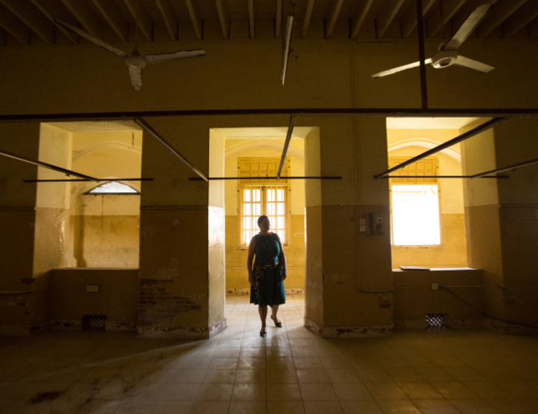
158,000 MEMBERS
164,500 MEMBERS
52% have been members for
less than three years
Notes:
Rotary doesn’t have a problem generating interest in membership. More than 158,000 people joined this year. But as you see, an almost equal number of people left. And half of those who leave were members for less than three years.
Before they join, 90% of prospective members have very positive impressions of Rotary, and were inspired by our history and mission. Yet after they join, only 44% percent still anticipate being lifelong members. And only half of our current members would recommend Rotary to their families, friends, and colleagues.
So what’s happening — or not happening — between when they join and when they leave?

Slide 8
WHY MEMBERS LEAVE
34%
Cost and/or time
20%
Club environment
17%
Unmet expectations
34% would not recommend Rotary
Notes:
According to the study, 34 percent of former members cited cost or time as the No. 1 reason they leave.
RI President Mark Daniel Maloney reminds us that: “The job of a Rotarian should never be seen as a time commitment too great for a busy professional to consider. Otherwise, we’re closing the door to the contributions of the people we need most in Rotary — the ones with the potential for decades of Rotary service and leadership. We need to meet people right where they are, at whatever stage of life they are in, and welcome them.”
Take the example of a young club president who set “Rotary Work Hours” for herself. She dedicates time on Tuesdays and Thursdays to Rotary work, giving her the ability to focus, brainstorm, and do long-term planning. It makes her more effective, provides the balance she needs in Rotary and her career, and ultimately makes her more passionate about her work as club president.
Many departing members also cite the club environment and say their expectations weren’t met. Imagine being excited to be a Rotarian, only to discover that the experience you were promised isn’t available. One former member says, “If I was given my club constitution at the beginning and had clearly understood what was expected of me, I wouldn’t have joined.”
Bringing in more members to replace the ones we lose isn’t the answer. We need to be honest with potential members about our club experience if we hope to change these numbers.
And we need to be flexible so we can accommodate the needs of our members and the community. Clubs have more freedom than ever to structure themselves in ways that work for every member. There is a club for everyone. And if there isn’t one in your community, we need to create one.

Slide 9
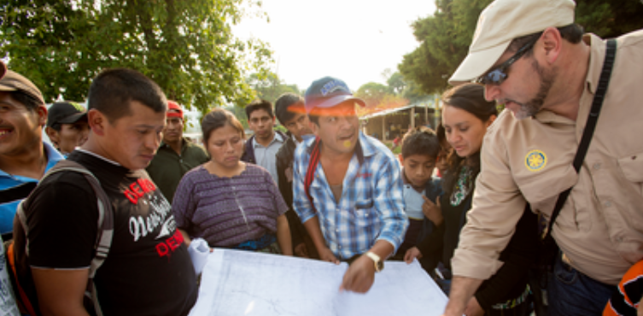
Prospective and current members value LOCAL COMMUNITY SERVICE
Notes:
So why Rotary? What do we offer that’s unique? Here’s what current members said:
“Rotary is a worldwide organization with the power to make meaningful change.”
“It affords a platform for personal growth and development, quality friendships, leadership development, and the opportunity to give back to the society.”
What’s encouraging is that these responses reflect our vision statement. Members clearly understand the value of Rotary.
When we look at what potential and current members value most, some interesting trends appear. Both list “participating in service projects to positively impact my community” as the opportunity they value most. But potential members also want to make change globally and foster their careers through professional development and networking.
Current members, however, value community service, friendship and fellowship, and connecting with people outside work and their circle of friends. So even when both groups cite making a positive impact through service as their top reason for joining or staying, they each have different motivations. If those desires aren’t met, they may no longer have a reason to say yes to Rotary.

Slide 10
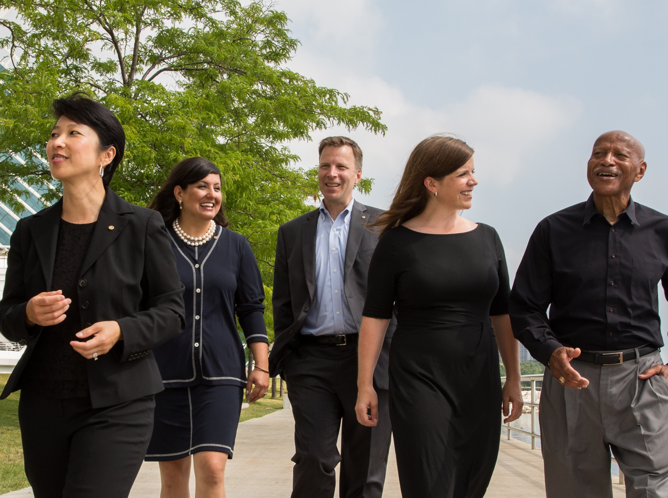
PROFESSIONAL
DEVELOPMENT
“When we say yes to Rotary, I don’t think many people understand the scope of what they’re saying yes to.
The great joy is finding that out.” – A Rotarian
Notes:
Our research shows us that prospective members are looking for opportunities to grow personally and professionally. Rotary offers them that.
Consider the Rotarian who was terrified of public speaking and trembled her way through her first 5-minute speech. She was later asked to speak at an institute in front of 500 people, and now trains others in public speaking.
Think of the member who counts her experience in Rotary as why she attained a new job as a community engagement manager: “I wouldn’t have gotten it if I wasn’t a part of Rotary.”
You don’t have to offer a formal professional development strategy for members to achieve their goals. Every service project or event you hold is a chance for someone to lead and grow. Members can also take online courses through Rotary’s Learning Center, or you can hold a Leadership in Action session for club members and your community. Find information for creating your own Leadership in Action session on My Rotary.
The next time someone asks you about Rotary, you can say: “You’ll achieve more than you ever thought possible. And you won’t do it alone.”

Slide 11
IS YOUR CLUB
HEALTHY?
ROTARY.ORG/MEMBERSHIP
Notes:
If someone walked into your club meeting — uninvited but curious to learn more — what would they find? Would they be warmly welcomed? Would your members appear engaged? Would they leave understanding who you are and how you’re helping your community? And would someone follow up with them to see what they thought about the experience?
One of the most important things we can do is assess our clubs regularly and make sure they’re welcoming to prospective members. If you find that your club needs to improve, Rotary offers resources to help. You can find them at rotary.org/membership. Remember this address — write it down, take a picture of it. And visit as often as you need to.

Slide 12
CHALLENGES FACED BY CLUB LEADERS
43%
Attracting new members
26%
Accommodating the varied needs of members
ROTARY.ORG/MEMBERSHIP
Notes:
With more than 50 resources available to you at rotary.org/membership, finding the one that meets your needs can seem like a challenge. Earlier this year, we developed a new resource called the “Club Planning Assistant.” This interactive tool asks a series of simple questions and then recommends resources for addressing those specific challenges.
In fact, we were so excited about this that we invited every club president and membership chair in the world to take it and share with us their biggest membership challenges.
The majority listed “Attracting New members” as their biggest challenge. But many also said that Accommodating the needs of prospective and current members (busy schedules, family or financial obligations, etc.) was a challenge too. Addressing both of these challenges effectively requires us to think differently and adapt to change more quickly.

Slide 13
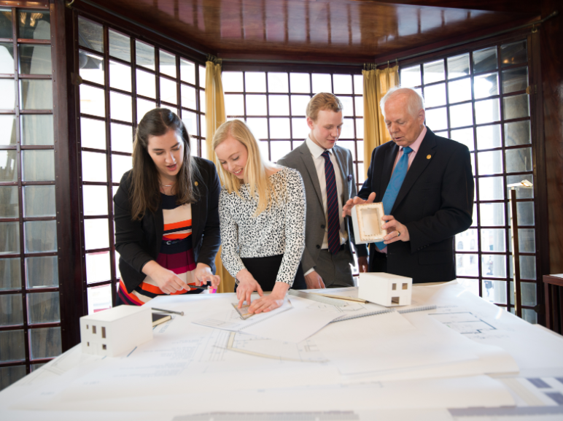
37% women
71% NEVER CONTACTED
19,500 leads/year
MEMBERSHIP LEADS
50% have a
personal connection to Rotary
59% under 40
Notes:
Bringing in more members than we lose is not the answer. But there is one opportunity that all clubs and districts should pay closer attention to.
Membership candidates are prospective members who use Rotary’s come through rotary.org/join to express interest in joining a club. A notice of their interest is sent to a district, and district and club leaders can track those notices through the Manage Membership Leads page of My Rotary. Last year, 19,500 people contacted Rotary this way.
Unfortunately, clubs contacted less than a third of the prospective members assigned to them last year. In fact, in places that experienced the highest decline in membership, an equally high percentage of membership leads were never contacted.
In the US, for example, membership declined by around 5,711 members in 2018-19. In the same time period, the US received 7,282 membership leads. Imagine what our overall membership would look like if we followed up on every lead. Although not every one of these prospective members will be a viable prospect, each one provides an opportunity to identify the value they might bring to the Rotary. The opportunity cost in North America was almost $450,000 in RI dues alone! Now, add in your club and district dues and imagine what you might have been able to achieve through those additional funds.
Managing prospective members is an opportunity. When we don’t respond to inquiries, we miss more than just the chance to expand our clubs — we lose a chance to build goodwill in the community and a positive impression of Rotary.

Slide 14
Take your
club in a
NEW DIRECTION
ROTARY.ORG/FLEXIBILITY
Notes:
The second challenge club leaders mentioned is accommodating the varied needs of their members. If your current structure is working, there’s no need to change it. But clubs actually have more freedom than ever to create an experience that works for their current and prospective members.
Clubs around the world are taking advantage of this flexibility. Here are some ways clubs are meeting the diverse needs of their members and their communities:
Starting a satellite club to give qualified people who can’t attend club meetings a chance to join Rotary.
Changing how, when, and how often clubs meet. Some examples are meeting just twice a month, switching from a sit-down meal to a less formal — and likely less expensive — gathering, or replacing a regular meeting with a social event or service project.
Offering a new membership type. For example, offering a corporate membership to attract multiple members of the same company, or an associate membership for younger professionals who want an option that costs less or requires less time.
Meeting online to attract members who can’t attend in-person meetings.
Developing a cause-based club to attract and engage members who are passionate about a specific issue, like water or peace.
You can find more information at rotary.org/flexibility.

Slide 15
TAKE ACTION
LEARN
ASK
VISIT
ROTARY.ORG/MEMBERSHIP
Notes:
What can you do with all of this information, especially if some of it is new to you? I suggest three things:
Take time to understand membership data and trends in your region. We can offer you a global look at the state of membership, but Rotary Club Central makes it easy for you to see the trends closest to you.
Ask members what matters most to them. Find out what they value, what they might be missing, and what they need to stay a member for life. And make sure you deliver that.
Finally, visit rotary.org/membership for resources to support you. Whether you need access to club assessments, directions on how to manage your membership leads, or even guidelines for starting new clubs and membership types, there is likely a resource designed to help.

Slide 16
Notes:
When people join a Rotary club, their potential to make a difference in the world grows exponentially. That’s because they’re joining a network of over 1.2 million people who take action — volunteers from all over the world who share a goal of improving people’s lives.
But simply joining isn’t going to change lives or make those connections. That happens when members get involved and take every opportunity to get the most out of their Rotary membership. Whether they’re connecting with their club, community, or the larger Rotary world, let your members know they’re connecting for good.
Our members are our greatest assets: a diverse group of professionals who share the drive to serve their communities. And together, we see a world where people unite and take action to create lasting change — across the globe, in our communities, and in ourselves.
Thank you.
Are there any questions I can answer?
NOTE TO SPEAKER:
Write to membershipdevelopment@rotary.org with any questions.

