Slide 1
If You Need Help…
Kelly Giovanine
District Foundation Grants Subcommittee Chair
RotaryDistrictGrants@gmail.com
309-236-5808
Laura Kann
District Foundation Chair
LKK1@comcast.net
678-315-2406

Slide 2
District Grant
Management
Training Seminar
Kelly Giovanine
Pecatonica Rotary Club
District Grants Subcommittee Chair

Slide 3
Introduction
Agenda
  The Rotary Foundation
  District Grants – What they are and how to successfully apply
  Questions and Closure
Learning objectives – At the end of this seminar, participants will
  Be able to successfully apply for a District Grant
  Know where to get help when needed

Slide 4


Slide 5
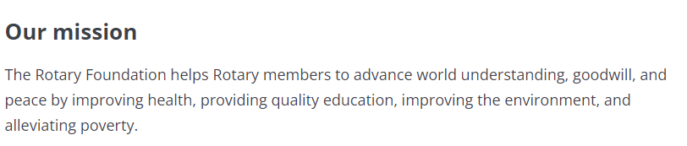
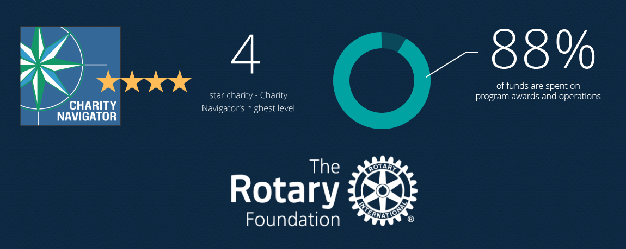
The Rotary Foundation
Notes:
When you give money to the Rotary Foundation – it can go to one of these three places.

Slide 6
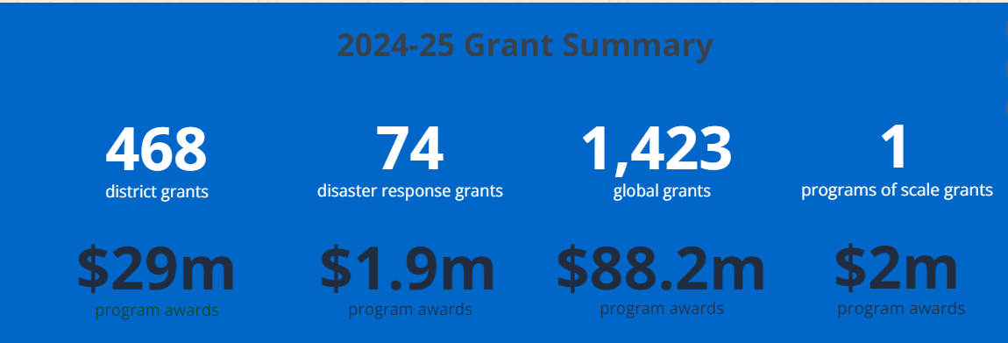
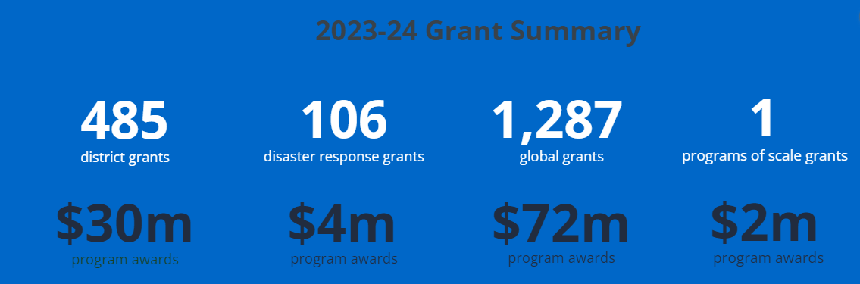
The Rotary Foundation
Notes:
When you give money to the Rotary Foundation – it can go to one of these three places.

Slide 7



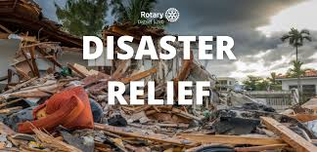
Four Funds
Polio Plus
The Annual Fund
The Endowment
Disaster Relief
Notes:
When you give money to the Rotary Foundation – it can go to one of these three places.

Slide 8
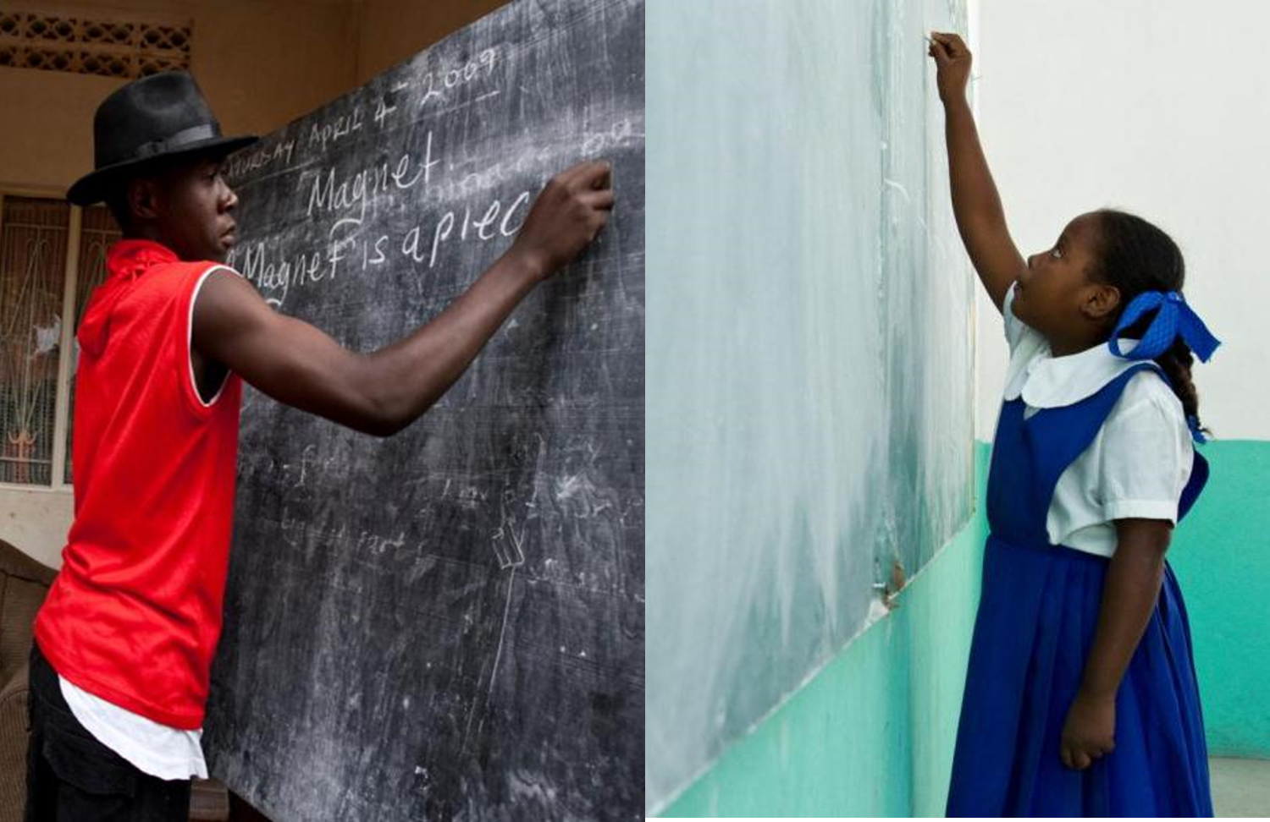
The Annual Fund SHARE System
48%
District Designated Funds (DDF)
52%
World Fund
(Includes 5% for operating expenses).
Notes:
When you give money to the Annual Fund half of the money you donate eventually – after 3 years - comes back to our District – District 6420 – in the form of DDF or District Designated Funds. The other half goes to the World Fund.
For example, let’s say you make a gift of $1,000 to the Annual Fund-SHARE…
For three years, your contribution is invested. At the end of the three years, the money that was donated is made available to fund projects.
Fifty percent of the contribution, or $500 in our example, comes back to our district through DDF. This is the money our District uses to fund District Grants and to help fund other local and international projects. As a District – we get to decide how to use it. Obviously – very few foundations offer this kind of involvement in the use of donated funds.
The other 50 percent or $500 in our example goes to the World Fund and is used to fund other Foundation programs – specifically Global Grants including Peace Scholarships, Global Scholars, and Vocational Training Teams as I mentioned earlier.

Slide 9
District Grant Eligibility Requirements
By May 1, 2026 (Pre-Requisites)
2026-2027 Club Goals submitted to Rotary Club Central
Club or members contributed to the Annual Fund during the 2023-2024, 2024-2025, or 2025-26 Rotary years
Club has identified a Foundation Chair for the 2026-2027 Rotary year.
Final report for 2025-2026 District Grant submitted
2026-2027 Club President completed this Seminar
2026-2027 Club Grant Chair or Foundation Chair completed this Seminar during 2024, 2025, or 2026

Slide 10
District Grant Basics
NOT a competitive grant!
Up to $1266 available for each club that must be matched for a total impactful grant project of at least $2532.
Application due May 15, 2026
Email submission only please
Locally focused
One per club – multiple clubs may work together
Eligibility requirements
Project requirements

Slide 11
RI Guidance for District Grant Project Requirements
Consistent with Terms and Conditions for Rotary Foundation District Grants

Slide 12
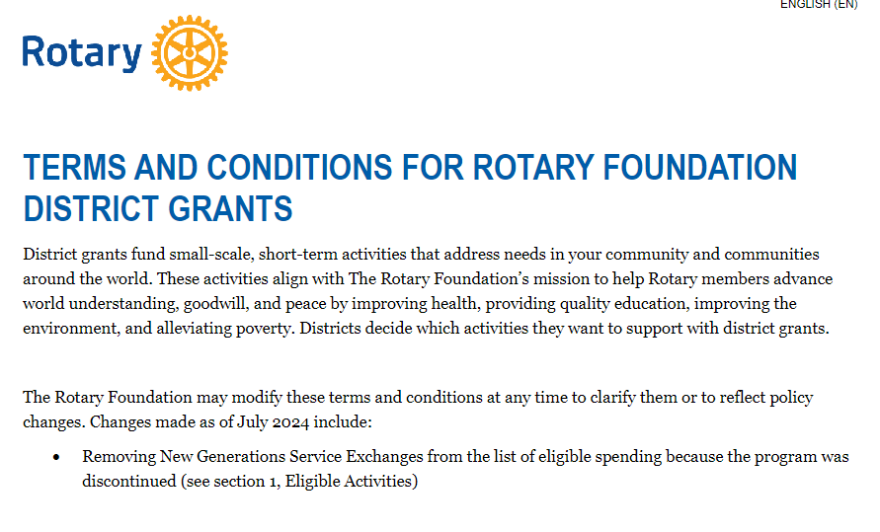

Slide 13

Seven Areas of Focus

Slide 14
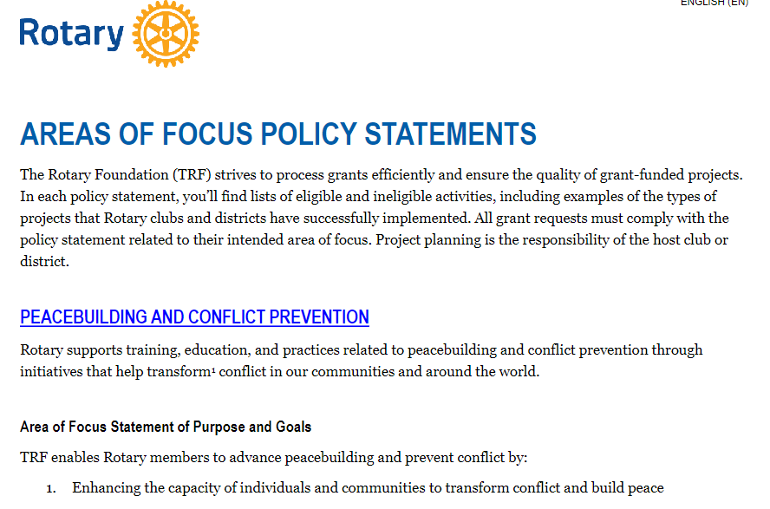

Slide 15
RI Guidance for District Grant Project Requirements
Consistent with mission of The Rotary Foundation – To enable Rotarians to advance world understanding, goodwill, and peace through the improvement of health, the support of education, and the alleviation of poverty.
Address a humanitarian, public safety, or educational need in your community

Slide 16
RI Guidance for District Grant Project Requirements continued
Is a new project not started and not done as part of a District Grant for at least 3 years
Is not a beautification project
Is not a fund-raising project
Involves active participation of Rotarians
Cost estimates for all vendors included in application
Will be promoted via local media and social media
Will be completed and Final Report submitted no later than May 1, 2027

Slide 17
District Grant Timeline
PLAN – Winter 2026
LEARN – January 17, March 14, or March 18, 2026
DRAFT - Spring 2026
SUBMIT - before May 15, 2026
RECEIVE - late July 2026
BEGIN - August 2026 (after check is received)
FINISH & SUBMIT REPORT – before May 1, 2027

Slide 18
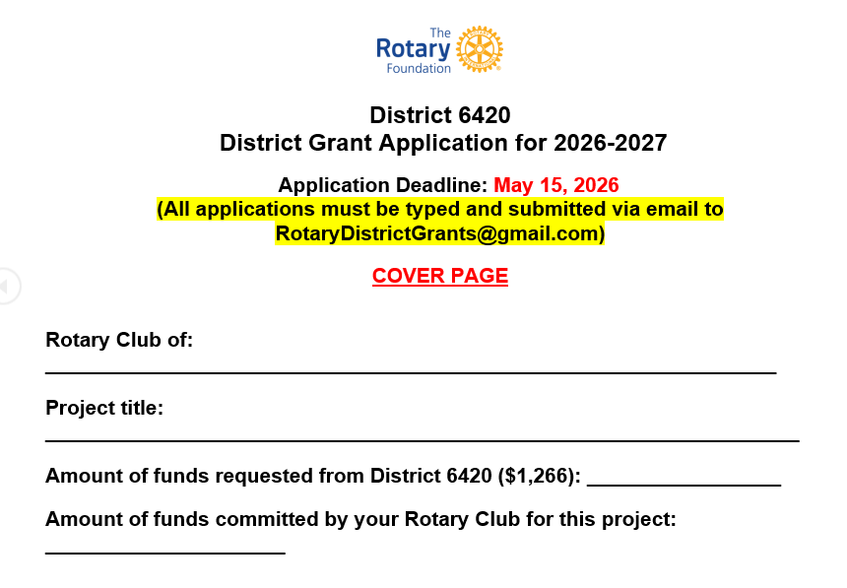
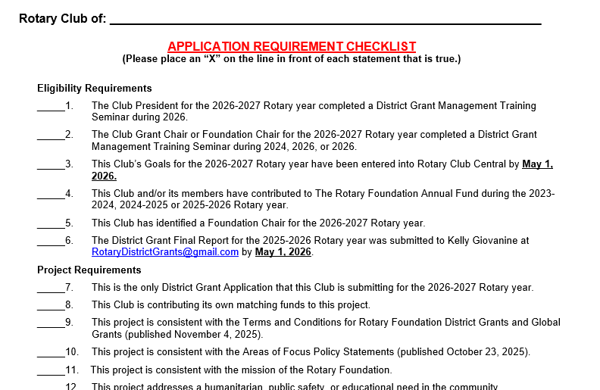
Fillable Forms
Not fillable on signature lines

Slide 19
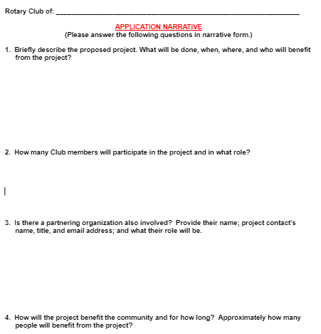

Slide 20
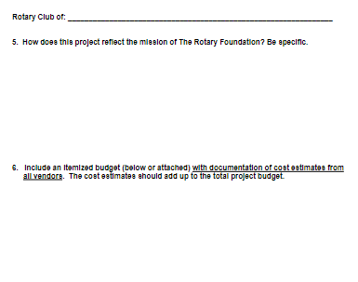
Application Narrative, Continued

Slide 21
District Grant Project Requirements continued
3 MOU’s (Memos of Understanding)
Partnering organization MOU completed for all partnering organizations
  Part of application for every project that includes a partnering organization
  Allows for a partnering organization to pay the provider of goods or services
The Rotary Foundation Club Qualification MOU completed
District 6420 MOU Addendum completed

Slide 22
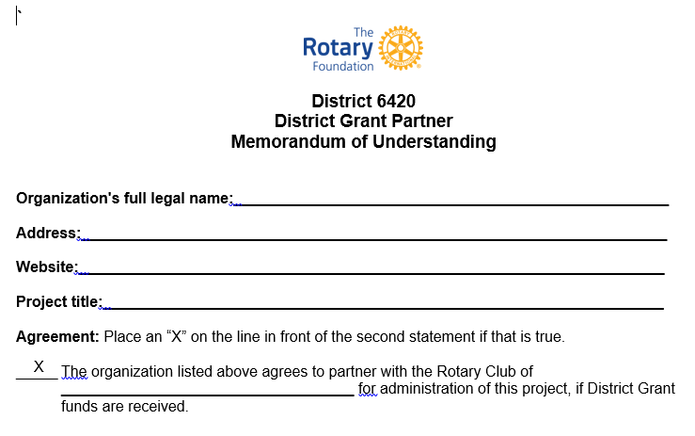
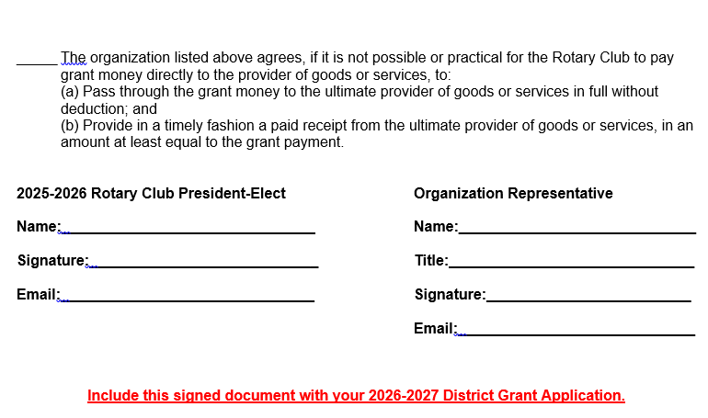
Attach to App!

Slide 23
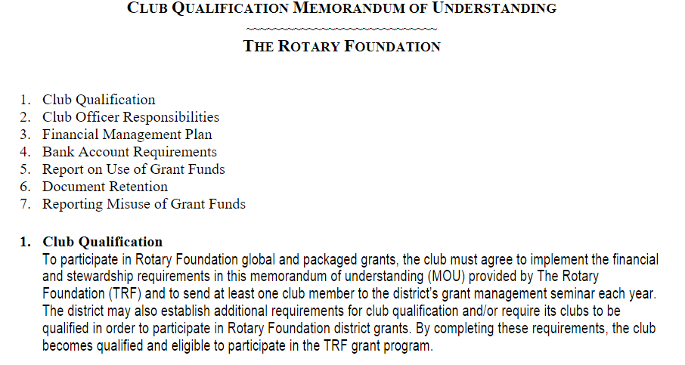
Club Qualification Memorandum of Understanding
Attach to application
Notes:
Stewardship

Slide 24
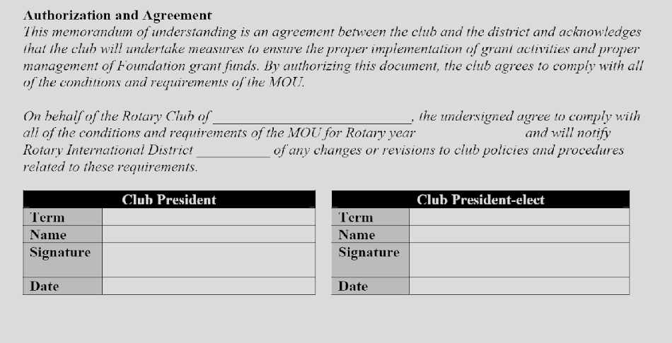
Club Qualification Memorandum of Understanding – Signature Page
Central Perk
2026-2027
6420
2025-2026
2025-2026
Include this signed document with your 2026-2027 District Grant Application.

Slide 25
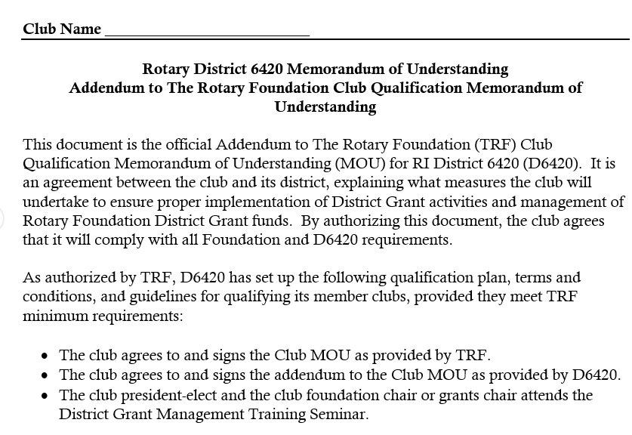
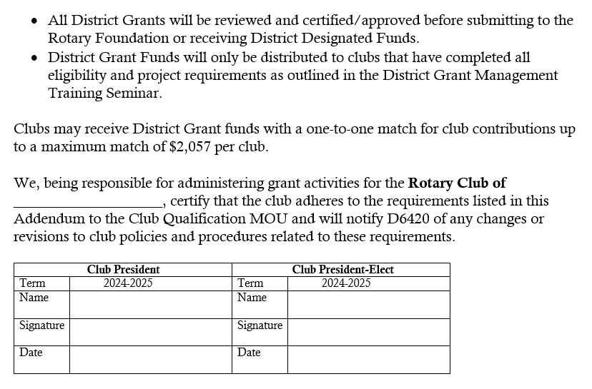
Attach to App!

Slide 26
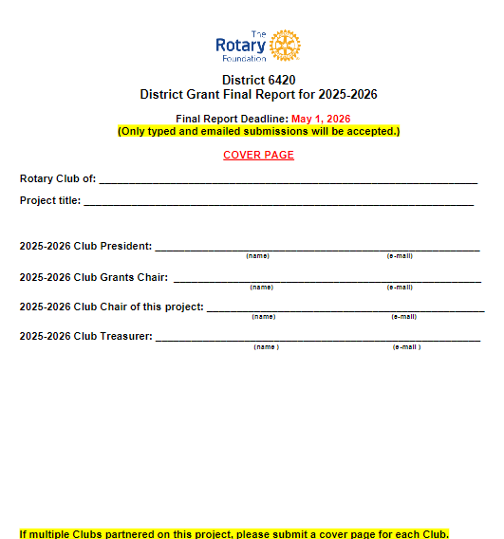
Due May 1, 2026

Slide 27
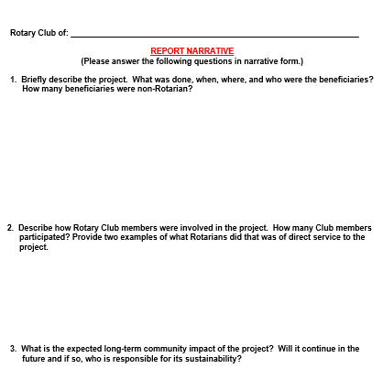

Slide 28
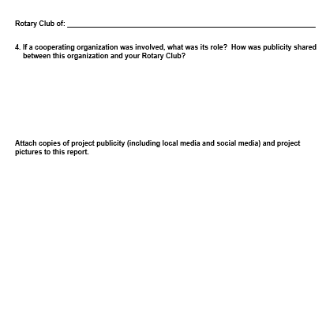

Slide 29
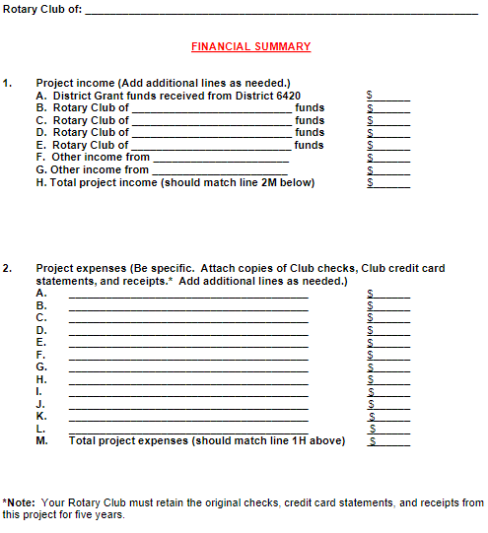
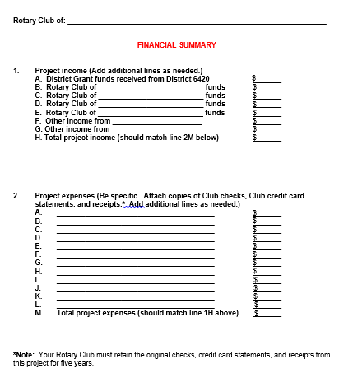

Slide 30
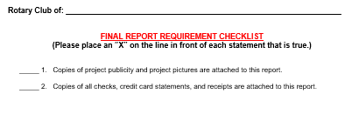

Slide 31
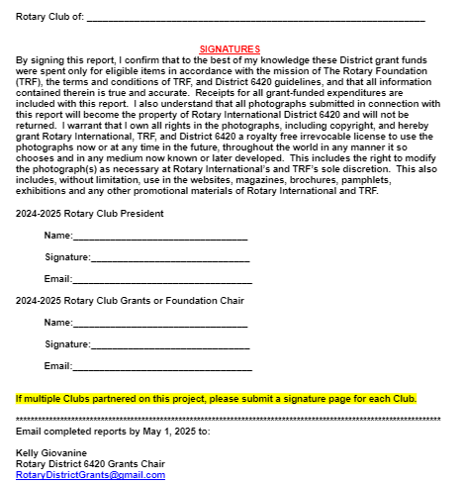
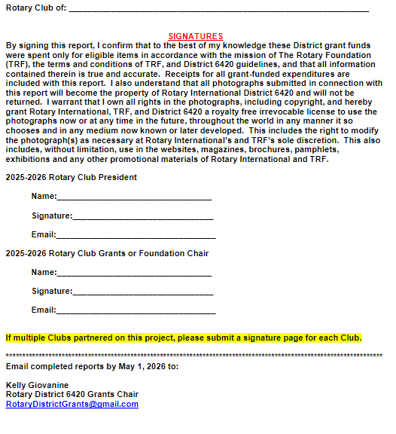

Slide 32
Where to Find the Forms
Go to District 6420 website -https://rotary6420.org
**26-27 Grant App, 25-26 Final Report, 3 MOAs are all currently linked on the main page, left side under File Downloads section**
Additional information including Areas of Focus Statements and Terms and Conditions Docs
Click on Foundation and then About Grants
Click on District Grants
Look on left navigation panel for Files

Slide 33
If You Need Help…
Kelly Giovanine
District Foundation Grants Subcommittee Chair
RotaryDistrictGrants@gmail.com
309-236-5808
Laura Kann
District Foundation Chair
LKK1@comcast.net
678-315-2406

