Slide 1
District Grant
Management
Training Seminar
Kelly Giovanine
Moline Rotary Club
District Grants Subcommittee Chair

Slide 2
District Grant Management
Seminar:
Zoom Guidance
Please:
Mute yourself unless talking.
Keep your camera on – be present.
Rename yourself – NAME, CLUB, POSITION (PE, Grants Management, Foundation, etc.)
Raise your actual hand or a virtual hand for questions or place questions in the chat box.

Slide 3
Introduction
Agenda
The Rotary Foundation
District Create The Magic Grants – What they are and how to successfully apply
Questions and Closure
Learning objectives – At the end of this seminar, participants will
Be able to successfully apply for a District Create The Magic Grant
Know where to get help when needed

Slide 5
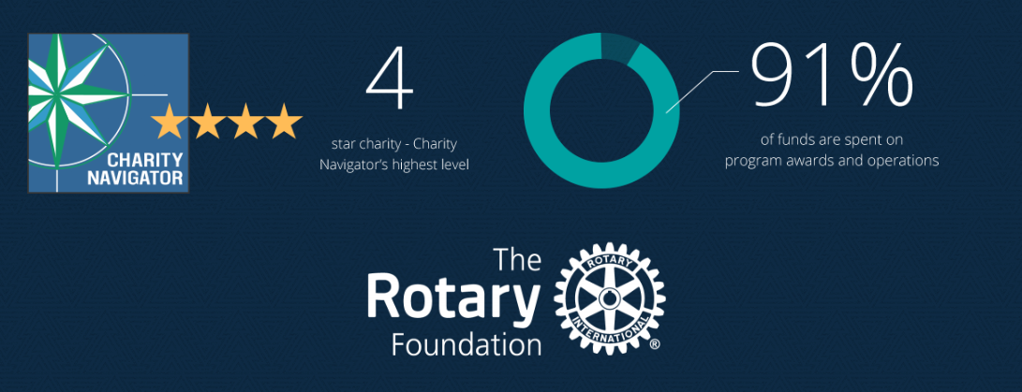
The Rotary Foundation
Notes:
When you give money to the Rotary Foundation – it can go to one of these three places.

Slide 6
The Rotary Foundation
Notes:
When you give money to the Rotary Foundation – it can go to one of these three places.

Slide 7
Four Funds
Polio Plus
The Annual Fund
The Endowment
Disaster Relief
Notes:
When you give money to the Rotary Foundation – it can go to one of these three places.

Slide 8
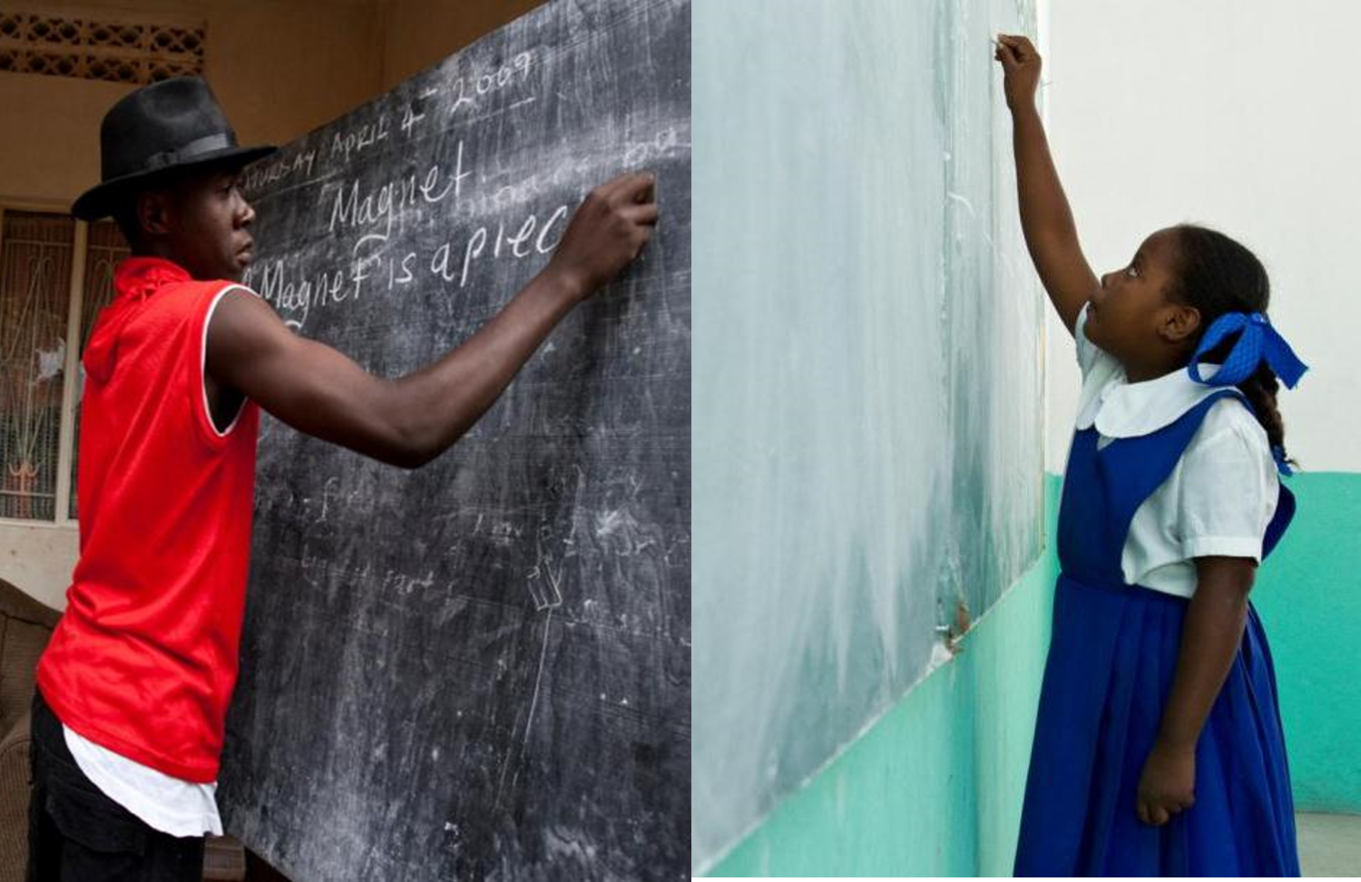
The Annual Fund SHARE System
48%
District Designated Funds (DDF)
52%
World Fund
(Includes 5% for operating expenses).
Notes:
When you give money to the Annual Fund half of the money you donate eventually – after 3 years - comes back to our District – District 6420 – in the form of DDF or District Designated Funds. The other half goes to the World Fund.
For example, let’s say you make a gift of $1,000 to the Annual Fund-SHARE…
For three years, your contribution is invested. At the end of the three years, the money that was donated is made available to fund projects.
Fifty percent of the contribution, or $500 in our example, comes back to our district through DDF. This is the money our District uses to fund District Grants and to help fund other local and international projects. As a District – we get to decide how to use it. Obviously – very few foundations offer this kind of involvement in the use of donated funds.
The other 50 percent or $500 in our example goes to the World Fund and is used to fund other Foundation programs – specifically Global Grants including Peace Scholarships, Global Scholars, and Vocational Training Teams as I mentioned earlier.

Slide 9
District “Create Hope” Grants
Notes:
So let’s turn to District Grants. As you just heard, District Grants are funded by DDF. The amount of DDF a district has available is determined by how much is donated to the annual fund 3 years ago. This is one of the many reasons it is important to give to the Annual Fund.

Slide 10
District Grant Theme: Create The Magic

Slide 11
District Create The Magic Grant Basics
Up to $1200 available (combination of $973 DDF and $227 District 6420 supplement funds) for each club that must be matched for a total impactful grant project of at least $2400.
Application due May 15, 2024
Email submission only please
Locally focused
One per club – multiple clubs may work together
Eligibility requirements
Project requirements

Slide 12
District Create The Magic Grant Eligibility Requirements
By May 15, 2024
2024-2025 Club President completed this Seminar
2024-2025 Club Grant Chair or Foundation Chair completed this Seminar during 2022, 2023, or 2024

Slide 13
District Create The Magic Grant Eligibility Requirements
By May 15, 2024
2024-2025 Club Goals submitted to Rotary Club Central
Club or members contributed to the Annual Fund during the 2021-2022, 2022-2023 or 2023-2024 Rotary years
Club has identified a Foundation Chair for the 2024-2025 Rotary year.
Final report for 2023-2024 District Grant submitted

Slide 14
District Create The Magic Grant Project Requirements
Consistent with Terms and Conditions for TRF District Grants and Global Grants

Slide 15
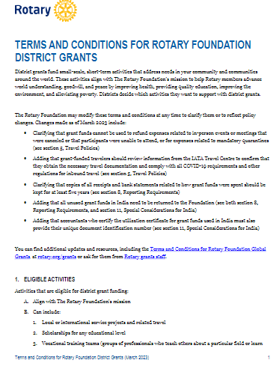

Slide 16
District Create The Magic Grant Project Requirements
Consistent with Areas of Focus Policy Statements

Slide 17
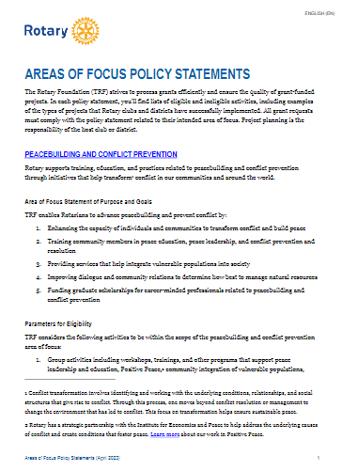

Slide 18
Seven Areas of Focus

Slide 19
District Create The Magic Grant Project Requirements
Consistent with mission of TRF – To enable Rotarians to advance world understanding, goodwill, and peace through the improvement of health, the support of education, and the alleviation of poverty.
Address a humanitarian, public safety, or educational need in your community

Slide 20
District Create The Magic Grant Project Requirements continued
Is a new project not started and not done as part of a District Grant for at least 3 years
Is not a beautification project
Is not a fund-raising project
Involves active participation of Rotarians
Will be promoted via local media and social media
Will be completed no later than May 15, 2025

Slide 21
District Create The Magic Grant Project Requirements continued
Cost estimates for all vendors included in application
Grant money paid directly to providers of goods and services

Slide 22
District Create The Magic Grant Project Requirements continued
3 MOU’s
Partnering organization MOU completed for all partnering organizations
Part of application for every project that includes a partnering organization
Allows for a partnering organization to pay the provider of goods or services
TRF Club Qualification MOU completed
District 6420 MOU Addendum completed

Slide 23
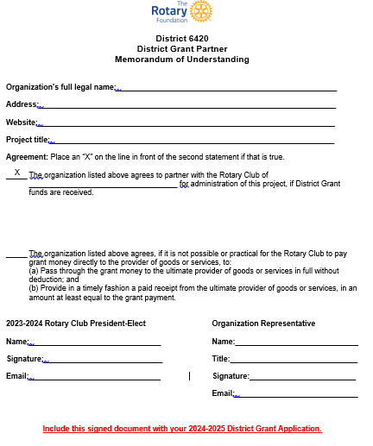
Attach to App!

Slide 24
Club Qualification Memorandum of Understanding
Attach to application
Notes:
Stewardship

Slide 25
Club Qualification Memorandum of Understanding – Signature Page
Central Perk
2024-2025
6420
2023-2024
2023-2024
Include this signed document with your 2024-2025 District Grant Application.

Slide 26
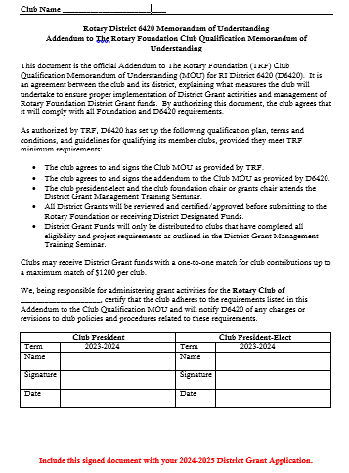
Attach to application

Slide 27
District Create The Magic Grant Project Requirements continued
Final report submitted by May 15, 2025

Slide 28
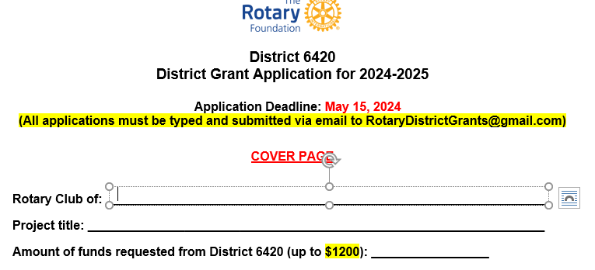
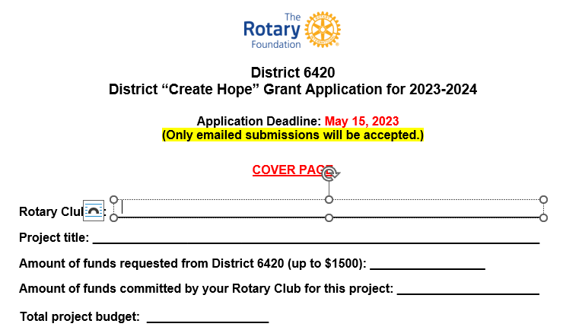
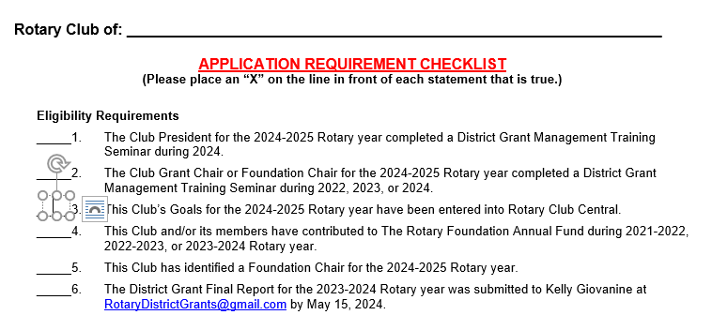
Fillable Forms
Not on signature lines

Slide 29
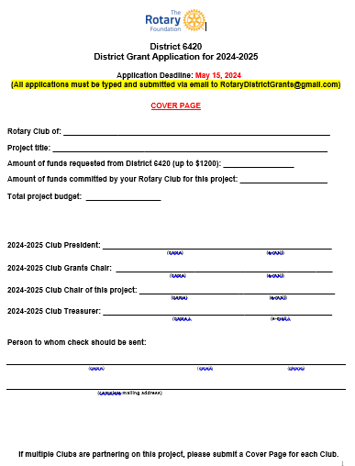
Due May 15, 2024

Slide 30
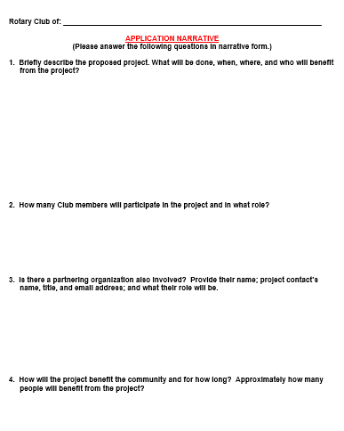

Slide 31
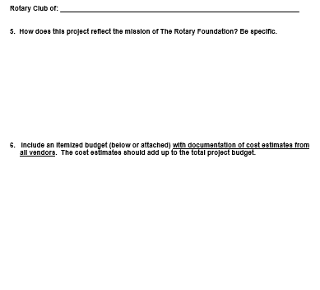

Slide 32
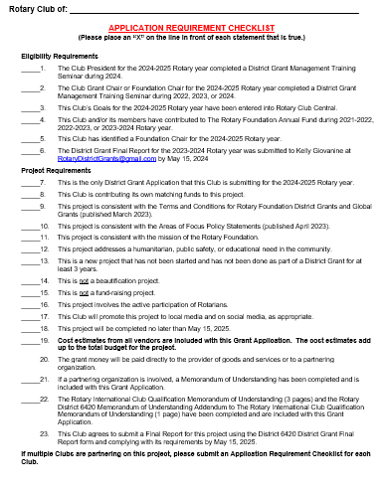

Slide 33
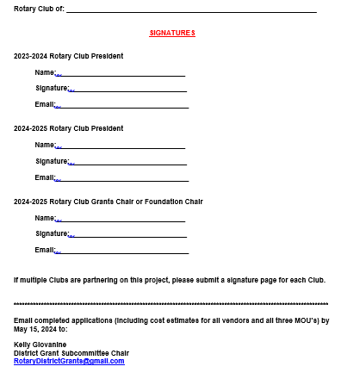

Slide 34
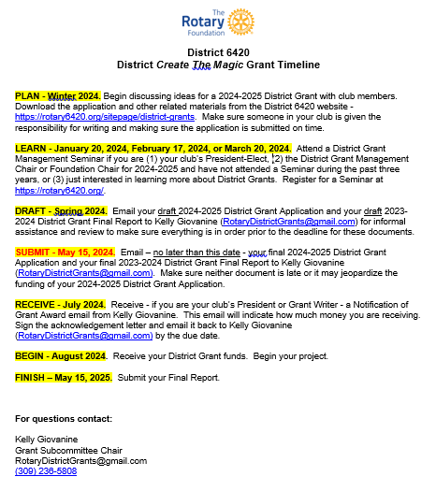
District Create The Magic Grant Timeline
PLAN – Winter 2024
LEARN – January 20, February 17, or March 20, 2024
DRAFT - Spring 2024
SUBMIT - May 15, 2024
RECEIVE - July 2024
BEGIN - August 2024
FINISH – May 15, 2025

Slide 35
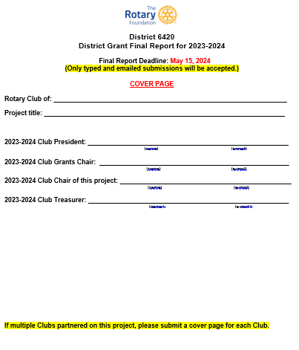
2024
Due May 15, 2024

Slide 40
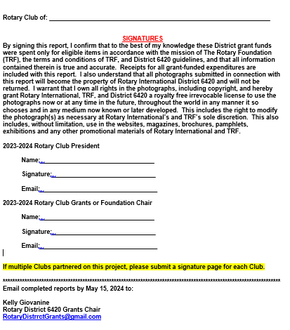

Slide 41
Where to Find the Forms
Go to District 6420 website -https://rotary6420.org
**24-25 Grant App, 23-24 Final Report, 3 MOAs are all currently linked on the main page, left side under File Downloads section**
And soon…
Click on Foundation and then About Grants
Click on District Grants
Look on left navigation panel for Files

Slide 42
If You Need Help…
Kelly Giovanine
District Foundation Grants Subcommittee Chair
RotaryDistrictGrants@gmail.com
309-236-5808
Laura Kann
District Foundation Chair
LKK1@comcast.net
678-315-2406

Slide 43
Questions?

