Slide 1
The Dictionary Project
https://
www.dictionaryproject.org
“A dictionary is a necessity”
Notes:
The Dictionary Project was formally established in 1995, though its origins are in 1992. The initial goal was to provide a dictionary to every 3rd grader in South Carolina. This was achieved in 1999. In 2002, a Wall Street Journal article brought The Dictionary Project to national attention and now includes students in all 50 states.
Unless cited elsewhere, all the information in this presentation is from this website.
And of course, my biggest fear is to have misspelled a word in a presentation on dictionaries, so please be kind.

Slide 2
Why Dictionaries?
Most states include dictionary skills in elementary language arts standards
(including Illinois https://www.isbe.net/Documents/ela-standards.pdf Language Standards K-5, Vocabulary Acquisition and Use, Grades 3-5: 4.d requires both print and digital)
Relevant, but limited, research: Poor readers have significantly slower and less accurate dictionary skills. (correlation vs. causation)
Beech, J.R. Using a Dictionary: Its influence on children’s reading, spelling, and phonology. Reading Psychology. 2004, 25, 19-36. (http://www.le.ac.uk/psychology/jrb/PDFs/Beech%202004%20dictionary.pdf)
Intuitively, using a dictionary:
builds knowledge and vocabularies.
cultivates problem-solving skills.
requires critical thinking.
Notes:
While all 50 states include dictionary-related skills, 46 specifically cite using a dictionary.
No causation is identified. The Dictionary Project is not a research organ, so it is incumbent on researchers in the field to provide the requisite studies.
Personally (Andy Axup, District Literacy chair), I always enjoyed using a dictionary because of all the other words I came across en route to the target word.

Slide 3
Word of the Month: The Dictionary Project March 2015 Newsletter
Literacy: /lidərəsē,ˈlitrəsē/, noun:
1. the ability to read and write
"Obviously, every child should be given the best possible opportunity to acquire literacy skills." - Hugh Mackay
2. knowledge in a particular area
"To succeed, you will soon learn, as I did, the importance of a solid foundation in the basics of education - literacy, both verbal and numerical, and communication skills.“ - Alan Greenspan
Notes:
Hugh Mackay is an Australian psychologist, sociologist, and author of “The Good Life: What makes a life worth living.”
Alan Greenspan is an American economist who served as Chairman of the Federal Reserve for 5 terms from 1987 – 2006.

Slide 4
Rotary Statistics
First year: 2002
As of June 2018
Clubs participating: 3,554
Total donations: 35,868
Total books donated: 15,059,198
Notes:
These statistics include Rotary clubs, districts, and Rotaract clubs. The values are possibly low as in smaller clubs with less developed financial streams some Rotarians buy books as individuals and are then reimbursed from their clubs. As of June 2018, dictionaries delivered to date = 30,192,919: Rotary % = 49.9%

Slide 5
Sponsor a Project
How to Donate Books
Steps to follow
Fundraising Ideas
What Rotary does well
Resources
Book Labels
Letters of Intent
Distribution Day
FAQ’s
Notes:
On the website, there is a pull-down menu “Sponsor a Project” with these sub-headings. For more information on any of these topics, please investigate the website.
Generally, Rotary Clubs know how to raise money, so I will not be discussing Fundraising Ideas.

Slide 6
How to donate books
Step 1: Find a School
Step 2: Choose a Book
Step 3: Place a Donation
Step 4: Receive books within 2-3 weeks
Step 5: Attach Labels
Step 6: Visit the School, Meet the Kids…
… Deliver the Dictionaries!
Notes:
Start locally. A Rotarian with children (or grandchildren) in the local school is a natural avenue to the teacher.
Shown later, there are a wealth of books available from dictionaries and thesauri to gazetteers to bi-lingual translators.
A phrase that means “buying the books.”
With no tax or shipping costs.
A nice all-members project to get the dictionaries ready.
The fun part.
On the Dictionary Project site, The Rotary Club of Daniel Island is featured as a Dictionary Project from Start to Finish. https://www.dictionaryproject.org/sponsor-project/

Slide 7
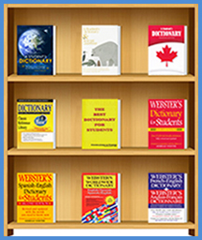
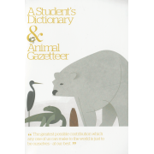
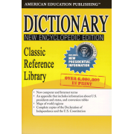
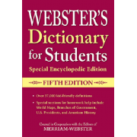
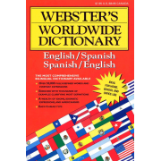
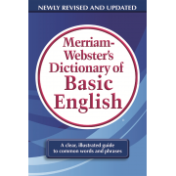
The Bookshelf
Notes:
Like the following page, this is a small sampling of the books available through The Dictionary Project website. Under the “Other” sub-heading is “Samples.” One sample kit is a variety of dictionaries and another is a sampling of other reference books. These are useful in order to show the teachers what you are talking about so they can select one most appropriate to their classrooms.

Slide 8
Order Here
A Student's Dictionary: $60.00 per Box of 24
This dictionary contains all the elements of the Best Dictionary for Students; it also includes over 150 pages of supplemental information in the back. Key features include the Constitution of the U.S., the Declaration of Independence, brief biographies of...
Best Dictionary For Students: $36.00 per Box of 24
This dictionary features over 32,000 words with simple, child-friendly definitions, plus pronunciation and part of speech. Additional information about punctuation, the nine parts of speech, weights and measures, longest word, Roman numerals, sign language...
Webster's Dictionary & Thesaurus: $60.00 per Box of 24
The 215-page dictionary includes more than 20,000 words with definitions and part of speech. Following the dictionary is a 212-page thesaurus with 50,000 synonyms and antonyms. Each section includes information about how to use the resource. ...
Webster's Dictionary for Students; Special Encyclopedic Edition: $60.00 per Box of 24
This book contains all the elements of Webster's Dictionary for Students with an additional encyclopedic section containing world maps, countries of the world, states and territories of the U.S., Declaration of Independence, information about U. S. governm...
Webster's Spanish ~ English Dictionary for Students: $60.00 per Box of 24
This bilingual dictionary contains over 40,000 entries in Spanish-to-English and English-to-Spanish sections. It includes conjugation of Spanish verbs, irregular English verbs, and common Spanish abbreviations ...
Webster’s American English Dictionary; Expanded Edition: $60.00 per Box of 24
This new edition provides definitions, pronunciations and variant spellings for the words that make up to core of the English language. In addition special sections provide useful information for readers and writers. Features • More than 40,000 clear, conc...
Notes:
This is a small sampling of the books available through The Dictionary Project website. Under the “Other” sub-heading is “Samples.” One sample kit is a variety of dictionaries and another is a sampling of other reference books. These are useful in order to show the teachers what you are talking about so they can select one most appropriate to their classrooms.

Slide 9
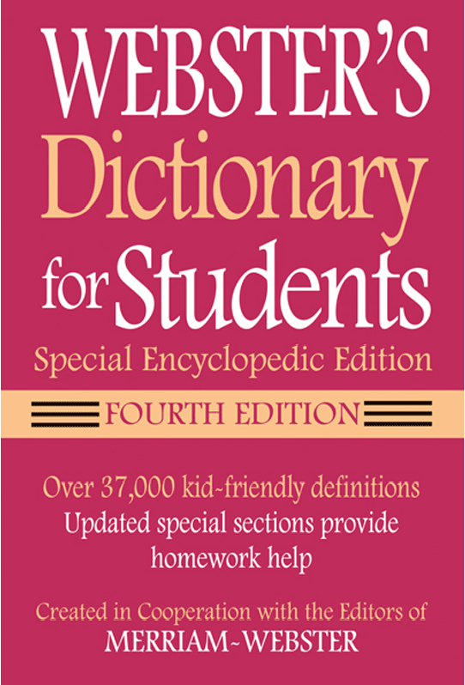
Webster's
Dictionary for Students;
Special Encyclopedic Edition
Publisher: Federal Street Press ISBN-13: 978-1-59695-125-9 Language: American English Year Published: 2011 Format: Paperback Pages: 544 Suitable Grade: 3+ Price per Book: $2.50 Books per Box: 24 Availability:In Stock
Price: $60.00 per Box
Notes:
A close up of a selected dictionary. Note the per book cost of $2.50.
Book prices range from $1.50 to $2.50 for American English dictionaries and from $2.50 (Spanish-English) to $20.50 (Tagalog*-English) for translation dictionaries. Translation dictionaries include 15 languages from Arabic to Tagalog (Philippines) and three “other” English dictionaries for British and American Caribbean and Canadian.
*Note: Pronunciation of Tagalog = ta-GALL-ug

Slide 10
Book Labels
THE FOUR-WAY TEST of the things we think, say or do Is it the TRUTH? Is it FAIR to all concerned? Will it build GOOD WILL and BETTER FRIENDSHIPS? Will it be BENEFICIAL to all concerned? This dictionary belongs to ________________________________ Donated by the {your club name} Rotary Club
Notes:
Under the “Resource” sub-heading, you can find links for various sources for labels. Here is a sample label. Opens an opportunity to talk about Rotary and The Four-Way Test. Includes a line for the student’s name. Can be customized to acknowledge your club as well. These can then be printed on self-adhesive labels (Avery 5168).

Slide 11
Letters of Intent
Superintendent
Principal
Parents
Notes:
How you initiate contact with a classroom, school, or district will vary from project to project. Within the “Resources” sub-heading are sample letters for each of these purposes.
If you are looking at the whole district, contacting the superintendent is a good way to go.
For large schools with several 3rd grade classrooms, the principal is a logical starting point.
For most Rotarians, the natural starting point is to talk with a teacher. See what the teacher thinks so you have information to carry with you as you go up the chain of command.
As mentioned earlier, Illinois includes dictionary skills in its Elementary Language Arts standards, so teachers should be open to obtaining resources FOR EACH CHILD to further that goal.
Contact with the parents can accomplish several goals. In addition to explaining what the project is about, it is an opportunity to share Rotary and its values with families.

Slide 12
“Thank you for the dictionary!”
“Thank you for realizing how much I needed my own dictionary.”
“It makes me feel like I am special.”
“The book makes me feel like I can do everything.”
“My mom and dad even use it sometimes.”
Notes:
Expressions of heartfelt gratitude can alone make a project worthwhile. For some children, the dictionary you give them is the first book that they can call their very own. Yes, the dictionaries belong to the children, not the classroom. While they may stay in the classroom for the school year, when they commence from 3rd grade, they take their dictionaries with them. Hence, this is an annual project to be continued year after year. Many clubs in our district are now in their fourteenth year of providing dictionaries, some donate thousands of dollars to distribute dictionaries to an entire school district, others raise $60 to help out an individual classroom. Whatever the size of your club, there is a dictionary project out there.

Slide 13
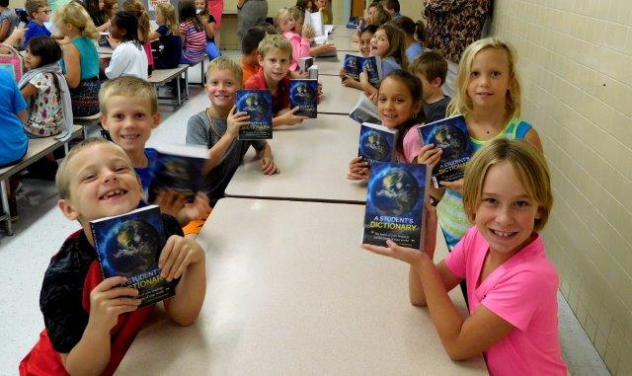
“Thank you for realizing how much I needed my own dictionary.”

Slide 14
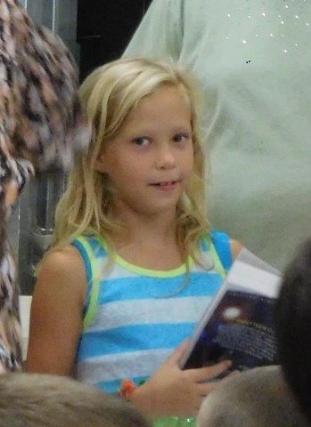
“It makes me feel like I am special.”

Slide 15
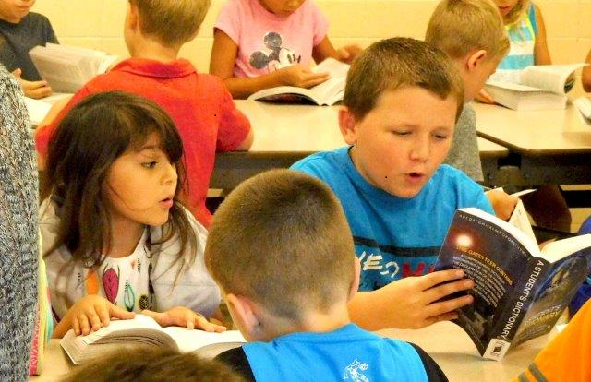
“The book makes me feel like I can do everything.”

Slide 16
“My mom and dad even use it sometimes.”

Slide 17
Thank you for listening
Questions?
Notes:
Contact information for:
Andy Axup, District Literacy Committee chair.
AxupAndrewW@sau.edu
563-424-6194

