Slide 1
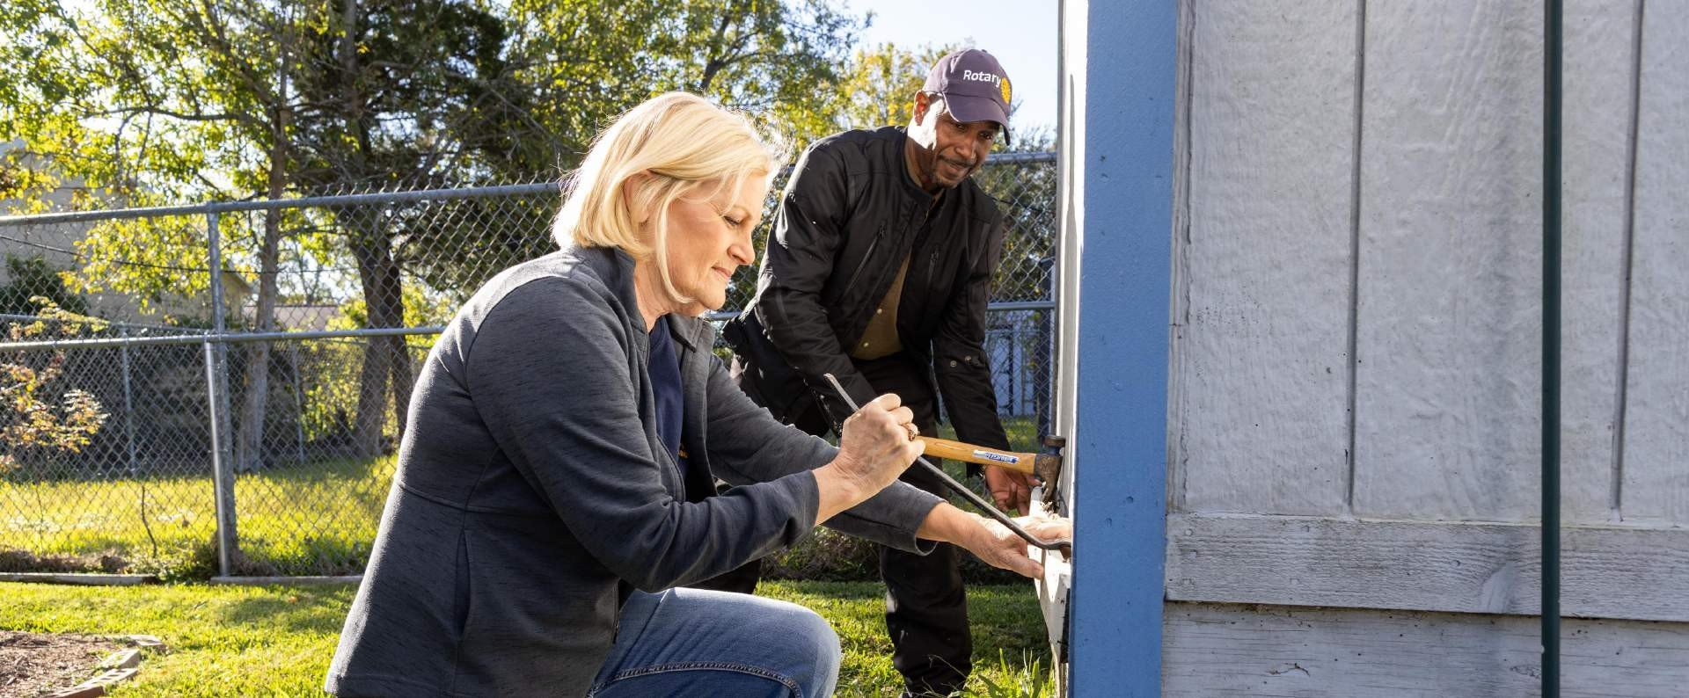
1
YOUR PUBLIC IMAGE CAMPAIGN
PROMOTING YOUR MEMBERS AS PEOPLE OF ACTION THROUGH THE YEAR

Slide 2
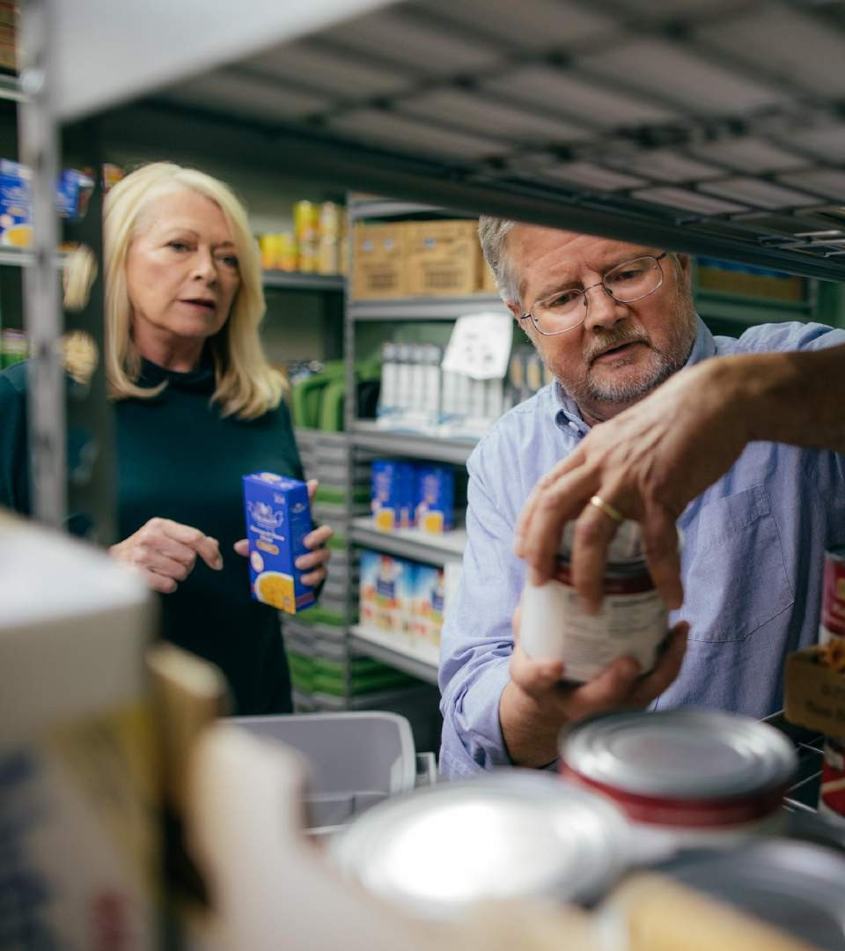
2
People of Action is more than just messaging.
It’s who we are
and what we do.

Slide 3
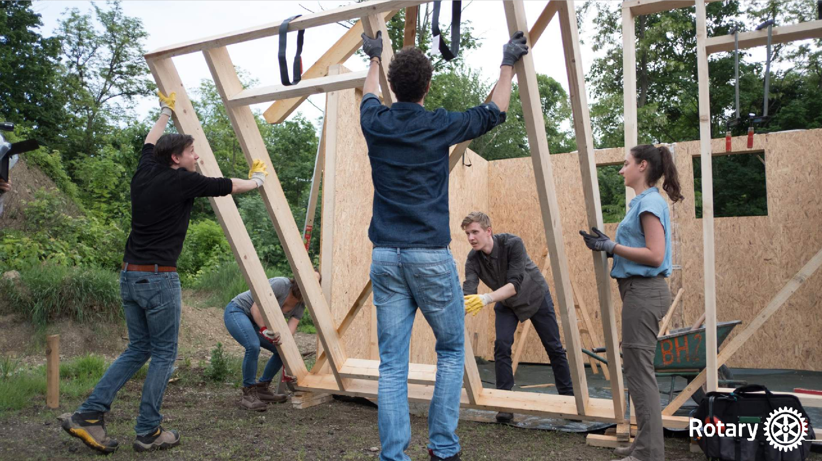
LOCAL STORIES
3
We increase people’s understanding of Rotary by telling and showing communities
who we are and what we do.

Slide 4
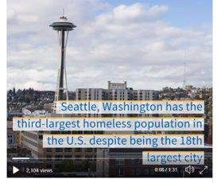
LOCAL STORIES
4
Focus on a local issue or challenge.
Work together to find a solution. Mobilize resources and take action. Talk about the impact you made.

Slide 5
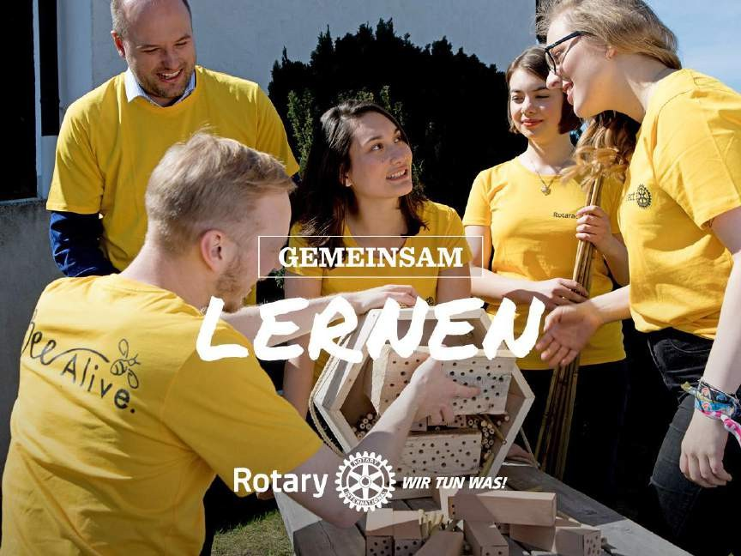
PEOPLE OF ACTION
5
Planning your promotions

Slide 6
6
July
Maternal and child health
September
Basic education and literacy
October
World Polio Day
PEOPLE OF ACTION
Planning your promotions

Slide 7
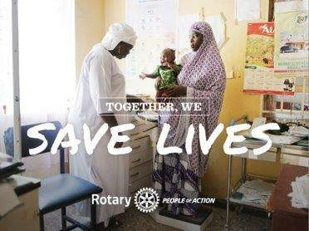
Maternal and child health
7
PEOPLE OF ACTION
Aligning with community themes
Use People of Action resources to create a post that showcases your club’s work to support women and children in your community.

Slide 8
Basic education and literacy
8
PEOPLE OF ACTION
Aligning with community themes
Use People of Action resources to create a post that showcases your club’s work to support education in your community.

Slide 9
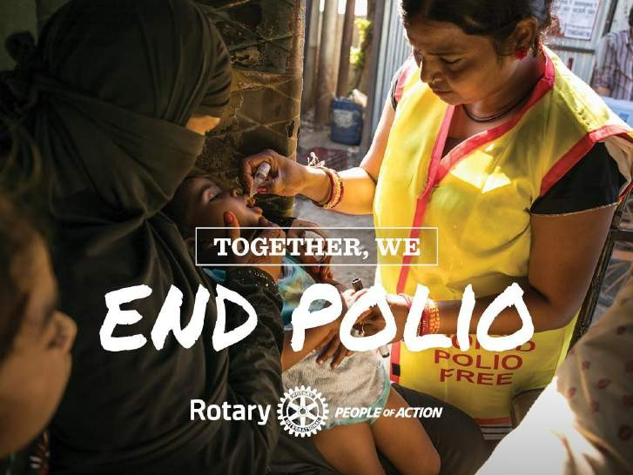
World Polio Day
9
PEOPLE OF ACTION
Aligning with community themes
Use People of Action resources to create a post that showcases your club’s local events that support Rotary’s work to eradicate polio.

Slide 10
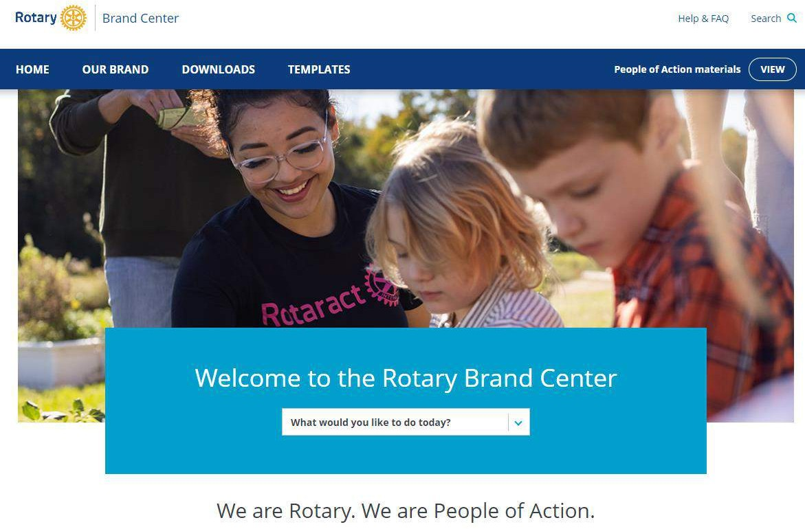
PEOPLE OF ACTION RESOURCES
10
Using the Brand Center
brandcenter.rotary.org

Slide 11
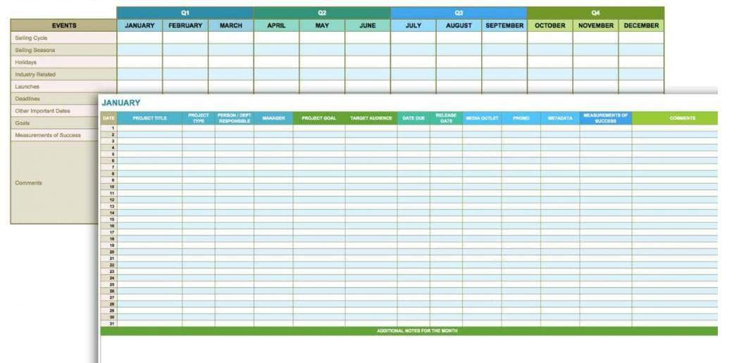
EDITORIAL CALENDAR
11
Keeping your promotions organized

Slide 12
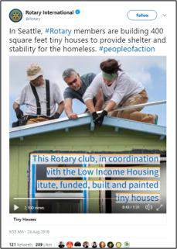
12
SHARE YOUR POSTS
Sharing to expand your reach

Slide 13
QUESTIONS?
13

