Slide 1
Why Your Club’s Public Image MATTERS
Notes:
<Introduce yourself: Say your name, your club name, your Rotary role, and your professional role, if it’s relevant.>
Example: My name is <Name>. I’m a member of <club name> and I’m the <club and/or district roles>. Today, we’ll discuss why your club’s public image matters and some easy ways you can enhance it.

Slide 2
OUR BRAND
Notes:
When we think about our public image, we have to start with our brand. Have people heard of Rotary? Do they recognize our name? Our logo? What do they know about us?
Although we all know Rotary and appreciate the value Rotary brings, sometimes it’s easy to forget that others don’t see or know Rotary like we do.

Slide 3
Notes:
Rotary’s brand is much more than just our wheel.

Slide 4
Benefits of a strong public image
Engagement
Members and participants
Partners and donors
Relevance
Advocacy and impact
Notes:
Why do we care about having a strong public image?
A strong public image helps us engage and attract more members, participants, donors, and partners.
It helps us stay relevant in a changing world and allows us to be effective advocates for change who make an impact.

Slide 5
WHAT’S OUR PUBLIC IMAGE?
While many people have heard of Rotary, most don’t understand who we are or what we do.
Notes:
And how do others see us? We regularly conduct research around the world to assess what people know and think about Rotary.
The responses vary, but one thing remains the same – although some of the descriptions are accurate, there are a lot of misperceptions about us.

Slide 6
AWARENESS OF ROTARY
Have you heard of an organization called Rotary?
Source: 15 Country Omnibus Research, Leger (Dec 2022)
Notes:
When we ask people if they’ve heard of an organization called Rotary, on average more than half recognize our name.
But it’s clear that recognition varies greatly around the world, from 91% awareness in Taiwan to 27% in Poland and everything in between.

Slide 7
UNDERSTANDING OF ROTARY
How familiar are you with the work that Rotary does?
73%
52%
57%
54%
41%
26%
20%
24%
18%
18%
18%
13%
Source: 15 Country Omnibus Research, Leger (Dec 2022)
Notes:
When we ask people what they know about Rotary, we find better results in some markets than others.
We also find that a high level of brand awareness doesn’t always correspond to understanding.

Slide 8
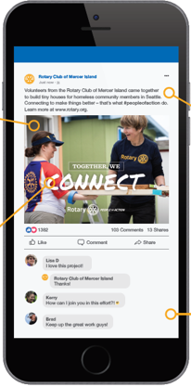
Objective:
Enhancing Rotary’s public image relies on our 1.4 million members
sharing their stories with the public.
Increase public awareness of Rotary – our impact, our benefits, and our relevance
Notes:
So, one of our objectives is to increase awareness and understanding of Rotary around the world.
How do we do that? How do we help people perceive Rotary the way we do?
We can start by highlighting the impact that clubs and members are making in their communities and presenting Rotary in a consistent and compelling way to those who don’t know us.
No one understands the benefits of Rotary better than our members. That‘s why we rely on our more than 1.4 million members to share their stories with the public.

Slide 9
People of action
More than just messaging
Portrays Rotary members as people who address community needs
Narrows the gap between awareness and understanding
Allows others to imagine themselves as part of Rotary
Notes:
People of Action is the messaging we use with external audiences to enhance Rotary’s public image.
It shows members taking action to make an impact in their communities.
It also provides a consistent, current way to describe Rotary to those who don’t know us.
And importantly, it shows people there are others like them making a difference and lets them imagine themselves as part of Rotary.

Slide 10
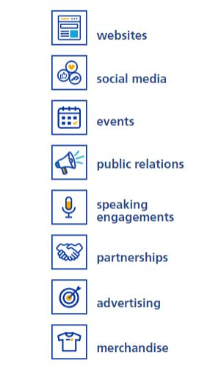
HOW to Promote rotary
Notes:
You have lots of ways to communicate Rotary’s impact, including your club website, social media, events, partnerships, and more.
All of them can be effective, but especially so when they build upon each other.
Telling stories of local impact consistently across several communication channels will help build Rotary’s public image.

Slide 11
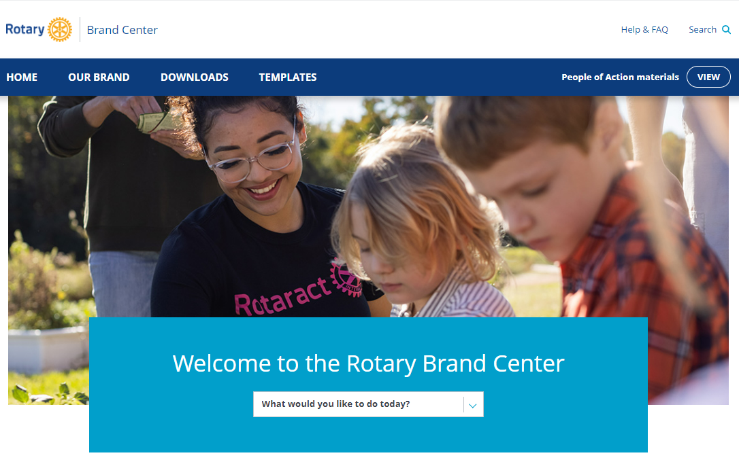
WHAT you can do today
Use the Brand Center resources
Always use the correct branding
Show your club in action
Invite public participation
Use content from Rotary International
Appoint a public image chair
Show people outside Rotary that we are people of action.
Notes:
You can be an ambassador who shows the world that Rotary members are people of action!

Slide 12
QUESTIONS?
Notes:
Thank you for your time and attention. Does anyone have questions?

