Slide 1
Three “Essential Elements”
Membership-Brand-Foundation
Liz Mark, Co-Membership Chair
Brian Flaherty, Membership Chair Elect
Title Page Option

Slide 2
Three “essential elements”
MEMBERSHIP
FOUNDATION
BRAND
Notes:
(click)
Membership
(click)
Brand
(click)
Foundation
Membership OVERLAPS with Brand and Foundation.
How do they overlap and help each other?

Slide 3
Brand – Membership – Foundation
BRAND
MEMBERSHIP
FOUNDATION
CLUB WEBSITE
SOCIAL MEDIA
ATTRACTION
CLUB WEBSITE
SOCIAL MEDIA
RETENTION
Notes:
BRAND IS IMPORTANT because it is the OUTWARD FACING ADVERTISEMNT for your Rotary Club. This is one method of ATTRACTING new members.
Other methods of Attraction are PROJECTS – promote projects on your website / social media.
IF the members stay in Rotary for more than 3 years, and find a passion they believe in, they might become EREY and donate to TRF
Good projects help our Brand and help our Foundation. Friendship builds with working along side each other, traveling together doing Rotary Projects… Club Socials … Hosting a fireside chat… All this is the “ stickiness factor” for Rotary Friendship.
People come to Rotary for volunteering in the community, but stay for the friendships!!

Slide 4
Interesting statistics
DISTRICT TERMINATION REPORT 2018-2023

Slide 5
Notes:
This report is located in My Rotary under the District Termination profile.

Slide 6
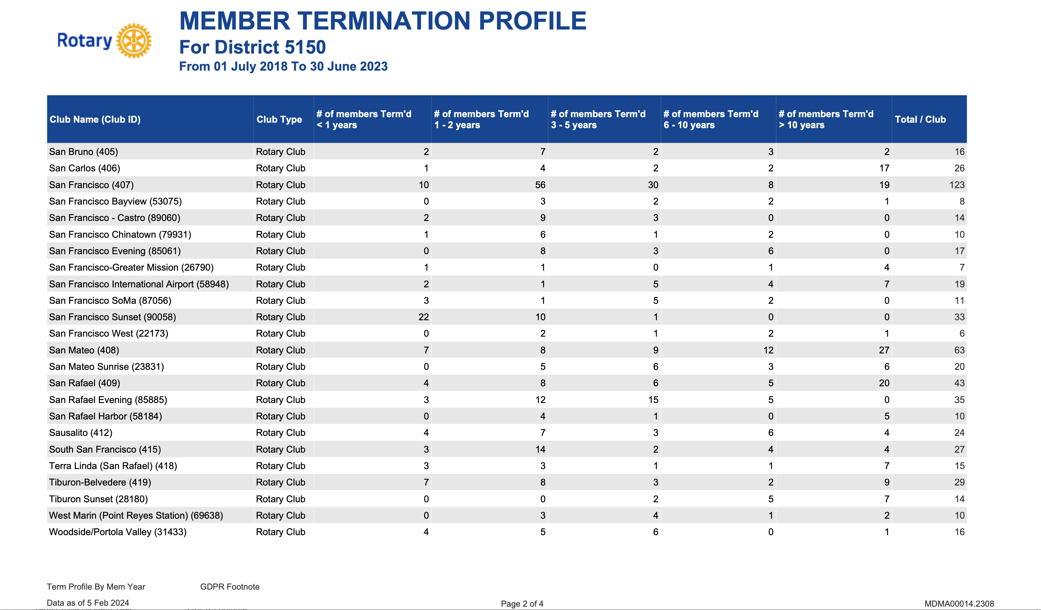

Slide 7
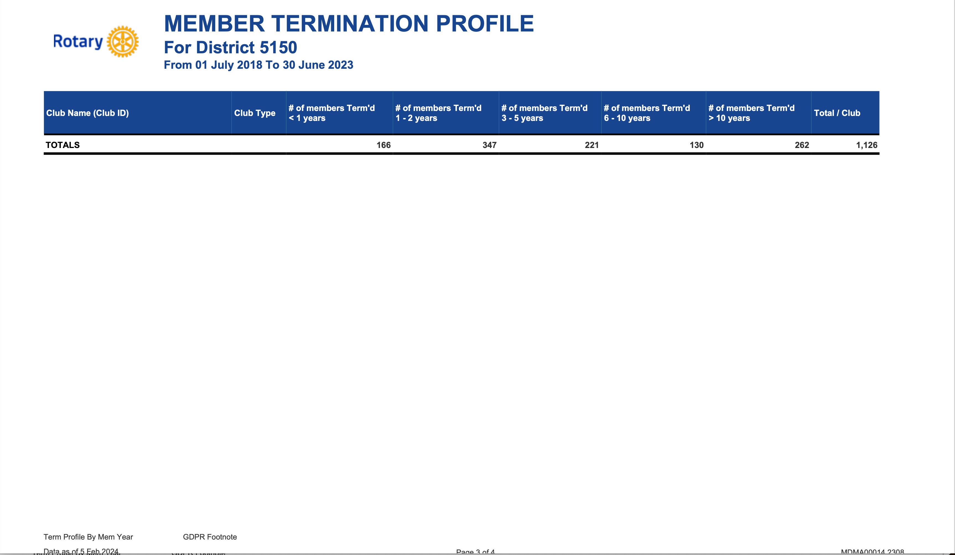
513
46%
of members left Rotary within 2 years
1,126
Notes:
Let’s look at the Termination Report a little closer …
(click)
513 members left within 2 years. A total of 1,126 members left within 5 years.
(click)
That’s 46% of members leaving Rotary within 2 years of after joining Rotary

Slide 8
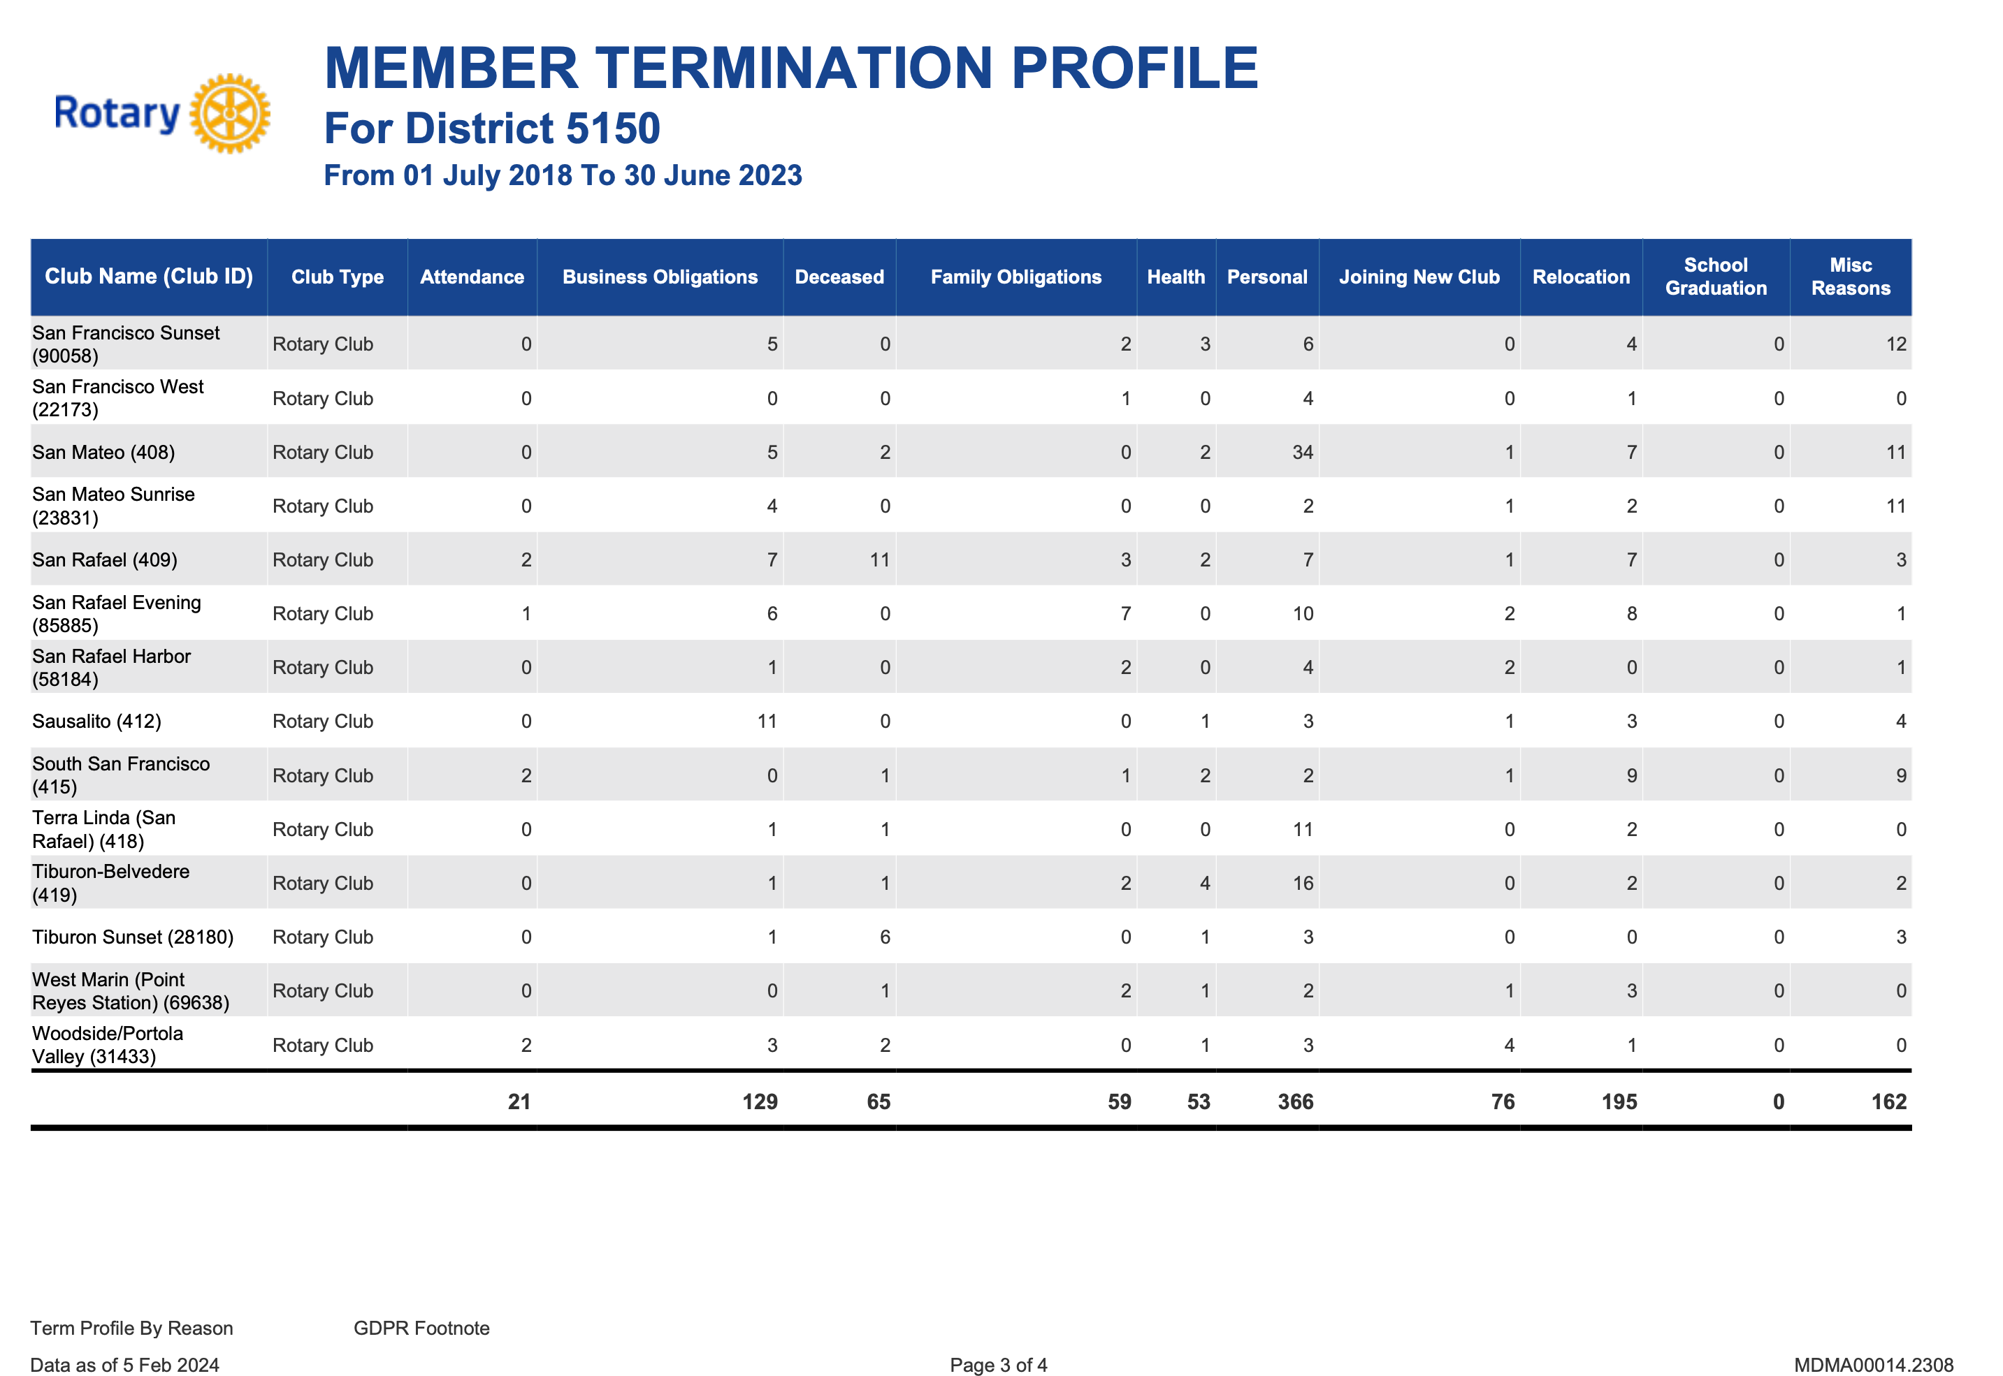
WHY DID THEY LEAVE?

Slide 9
WHY DID THEY LEAVE?

Slide 10
What can be Done?
COULD BRAND - PUBLIC IMAGE OR FOUNDATION
HELP ATTRACT NEW MEMBERS
OR REDUCE THE NUMBER OF TERMINATIONS?
Notes:
The importance of a vibrant website, facebook page, instagram posts. Participating in community projects wearing your Rotary vests, hats, shirts. Having a hand out or cards at community events. Example Alzheimer’s walk this past year. We brought our banners and had a booth.
Preventable terminations come down to improved communication. Don’t rush to get your new members in too fast. Let them take their time and get to know you, join socials, projects. The importance of ONBoarding… Clear expectations, join committees, involvement, mentoring. Phone calls, coffee time to touch bases. Ask for their opinions, what projects they want to do. LISTEN.

Slide 11
QUESTIONS
Notes:
Be sure to come and or send some of your members to our District Assembly Membership break out sessions ( there will be 2). We will be focusing on The Action Plan for Membership: Strategy for Attraction, Onboarding, Engagement and Retention. Best practices.

Slide 12
Liz Mark
Co-Membership Chair
lizzypoong@gmail.com
Brian Flaherty
Membership Chair Elect
yanebrian@gmail.com

Slide 14
subhead
MAKE A BOLD STATEMENT

Slide 15
subhead
MAKE A BOLD STATEMENT

