Slide 1
The Rotary Foundation “Doing Good in the World”

Slide 2
Rotarians, like you, to advance world understanding, goodwill, and peace through the improvement of health, the support of education, and the alleviation of poverty.
I believe the two most important words to remember are “enable Rotarians”. The Foundation is here to support the work that each of you are doing locally in district as well as around the world. In order to do that, we raise funds for the initiatives that are important to you and your community.
THE ROTARY FOUNDATION’S MISSION
The Rotary Foundation helps Rotarians to advance world understanding, goodwill,
and peace by improving health, providing quality education, improving the environment,
and alleviating poverty.

Slide 3
Rotary’s Seven Areas of Focus

Slide 4
TRF Funding Programs
Annual Fund- SHARE (Every Rotarian Every Year)
PolioPlus
Disaster Response Fund
The World Fund
Peace Centers/Fellowships
Endowments

Slide 5
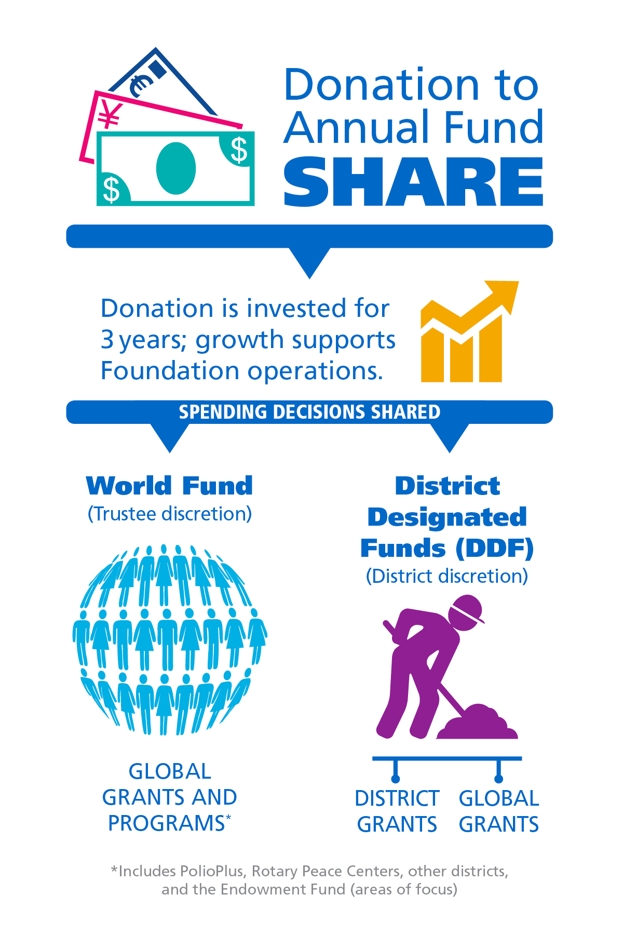
HOW DOES THE ANNUAL FUND SHARE WORK?
Donations to the Annual Fund SHARE are held by TRF for 3 years.
Then funds are SHARED between the World Fund, District Designated Funds (DDF) and 5% administration.
Almost half of Annual Fund SHARE donations are returned to our District in the form of District Designated Funds. (DDF)

Slide 6
WORLD FUND
PROVIDES TRF MATCH FOR GLOBAL GRANTS
SUPPORTS POLIO PLUS, ROTARY PEACE CENERS, ENDOWMENT FUND.
ALL DDF EARNED BY CLUBS ARE ALLOCATED TO CLUBS
CLUBS DECIDE HOW TO SPEND THEIR DDF:
DISTRICT GRANTS, GLOBAL GRANTS, POLIO PLUS, ROTARY PEACE CENTERS, OTHER DISTRICTS AND THE ENDOWMENT FUND (7 AREAS OF FOCUS).
DISTRICT DESIGNATED FUNDS (DDF)

Slide 7
HOW CAN YOUR CLUB USE its DDF?
District Grants
Global Grants
PolioPlus
Disaster Response Fund
Rotary Peace Center
Rotary Endowment Fund
Rotary World Fund

Slide 8
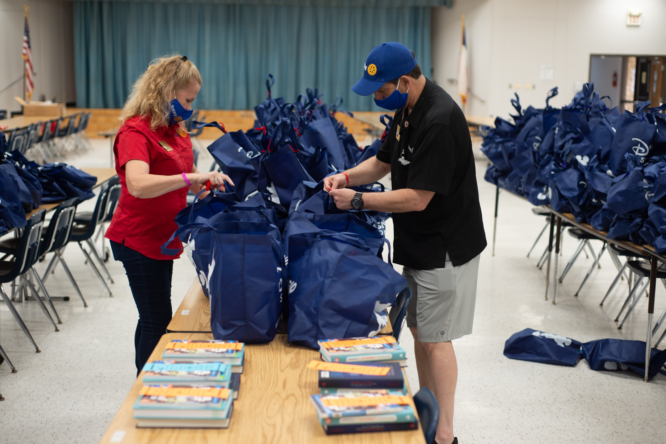
DISTRICT GRANTS

Slide 9
GLOBAL GRANTS

Slide 10
Ways to Support The Rotary Foundation
Every Rotarian Every Year (EREY) Campaign
www.rotary.org/donate
Focused donations, Memorials and Tributes
www.endpolio.org
Bequests
Endowments

Slide 11
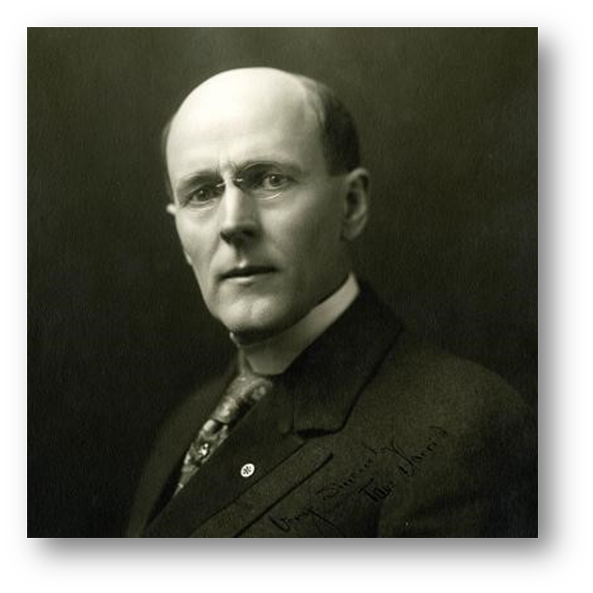
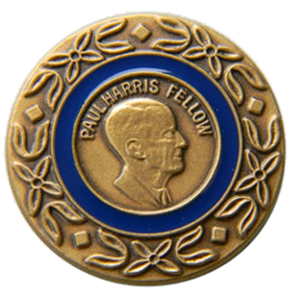
The Foundation’s signature recognition
Paul Harris Fellow
Individuals become PHFs when they reach 1,000 recognition points.
This can be done a giving to:
The Annual Fund
PolioPlus
An eligible grant
Reaching 1,000 points through a combination of outright giving and points.
Name an individual a PHF by transferring points to them.

Slide 12
Paul Harris Society
A Commitment to The Foundation
More than 23,000 philanthropic leaders across the globe
PHS members give nearly 18% of Annual Fund donations
Donations fund local and international projects
Recognition earned for donors
$1,000 commitment annually
Annual commitment can be met by giving as little as $85 dollars a month through Rotary Direct

Slide 13
POLIO PLUS SOCIETY

Slide 14
Donor Recognition
Paul Harris Fellow
Paul Harris Society
PolioPlus Society
Bequest Society
Major Donor
White Hat Society
Arch Klump Society
Legacy Society

Slide 15
CHARITY NAVIGATOR
The Rotary Foundation has been annually awarded a perfect 100%
4-Star rating by Charity Navigator for the past 15 consecutive years.

Slide 16
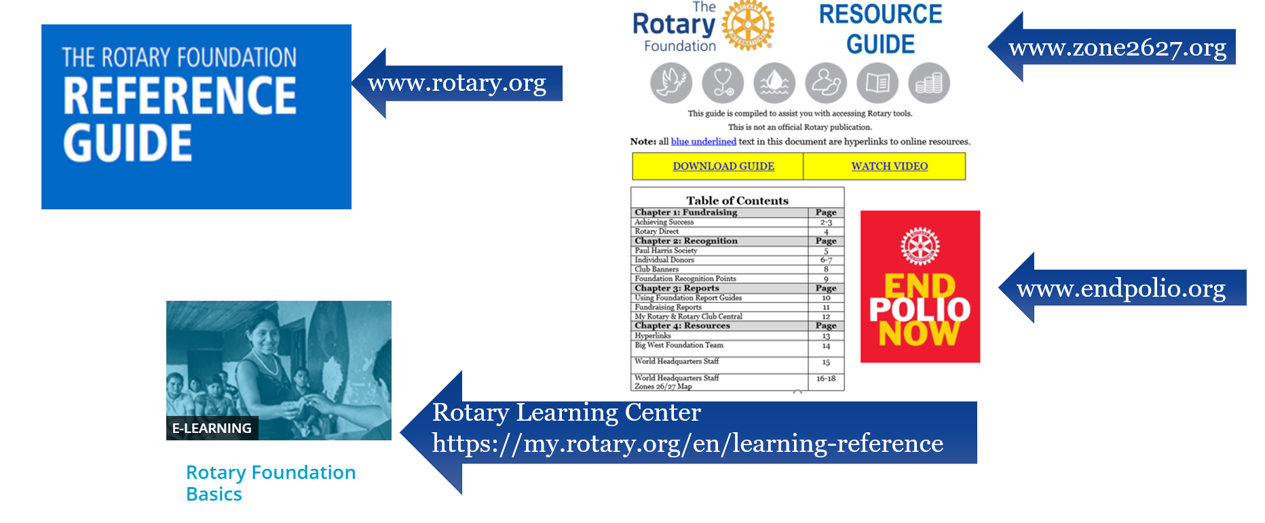
RESOURCES

Slide 17
The rotary foundation

Slide 18
THANK YOU FOR DOING GOOD IN THE WORLD

