Slide 1
5150 International service - why ??
Ron Harness
5150 International Service Chair
Rotary Club of Novato

Slide 2
international service what can we do for your club ??
AWARENESS
INSPIRATION
EDUCATION

Slide 3
international service -- AWARENESS --
AWARENESS
of International Service projects that you can lead or support ;
Four International Service Workshops per year
Examples of Successful Projects
Connection to other Clubs
Connection to other Countries

Slide 4
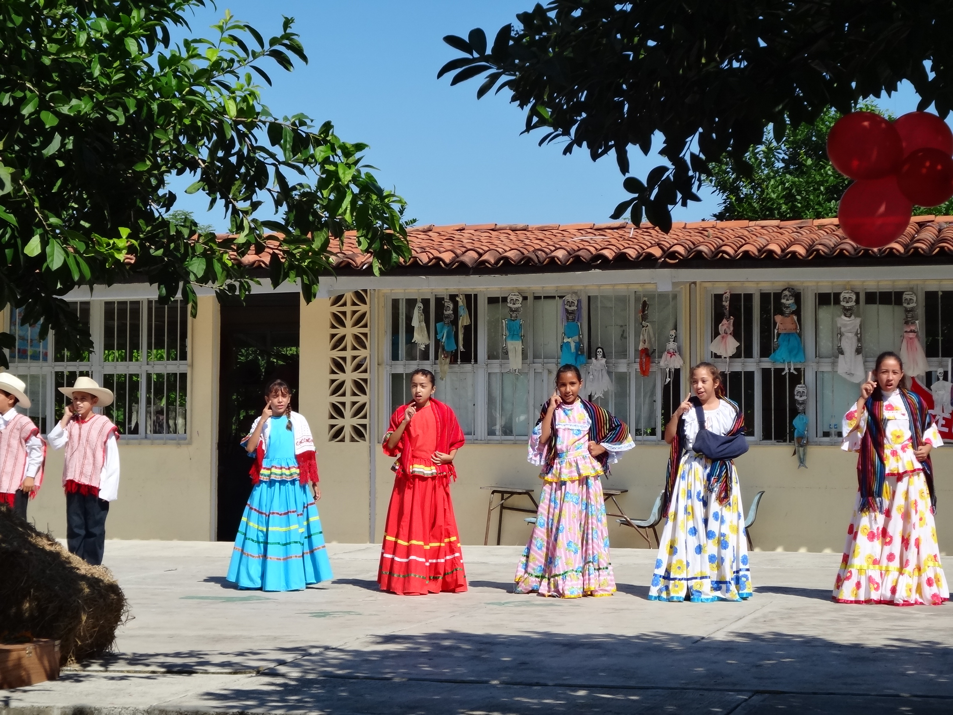
Project Amigo

Slide 5
international service -- inspiration --
INSPIRATION
and Help to Create your own International Service Projects ;
Connection to Existing or Aspirational International Projects
Connection to International Project Fairs
Presentations at Your Clubs
Travel to International Projects

Slide 6
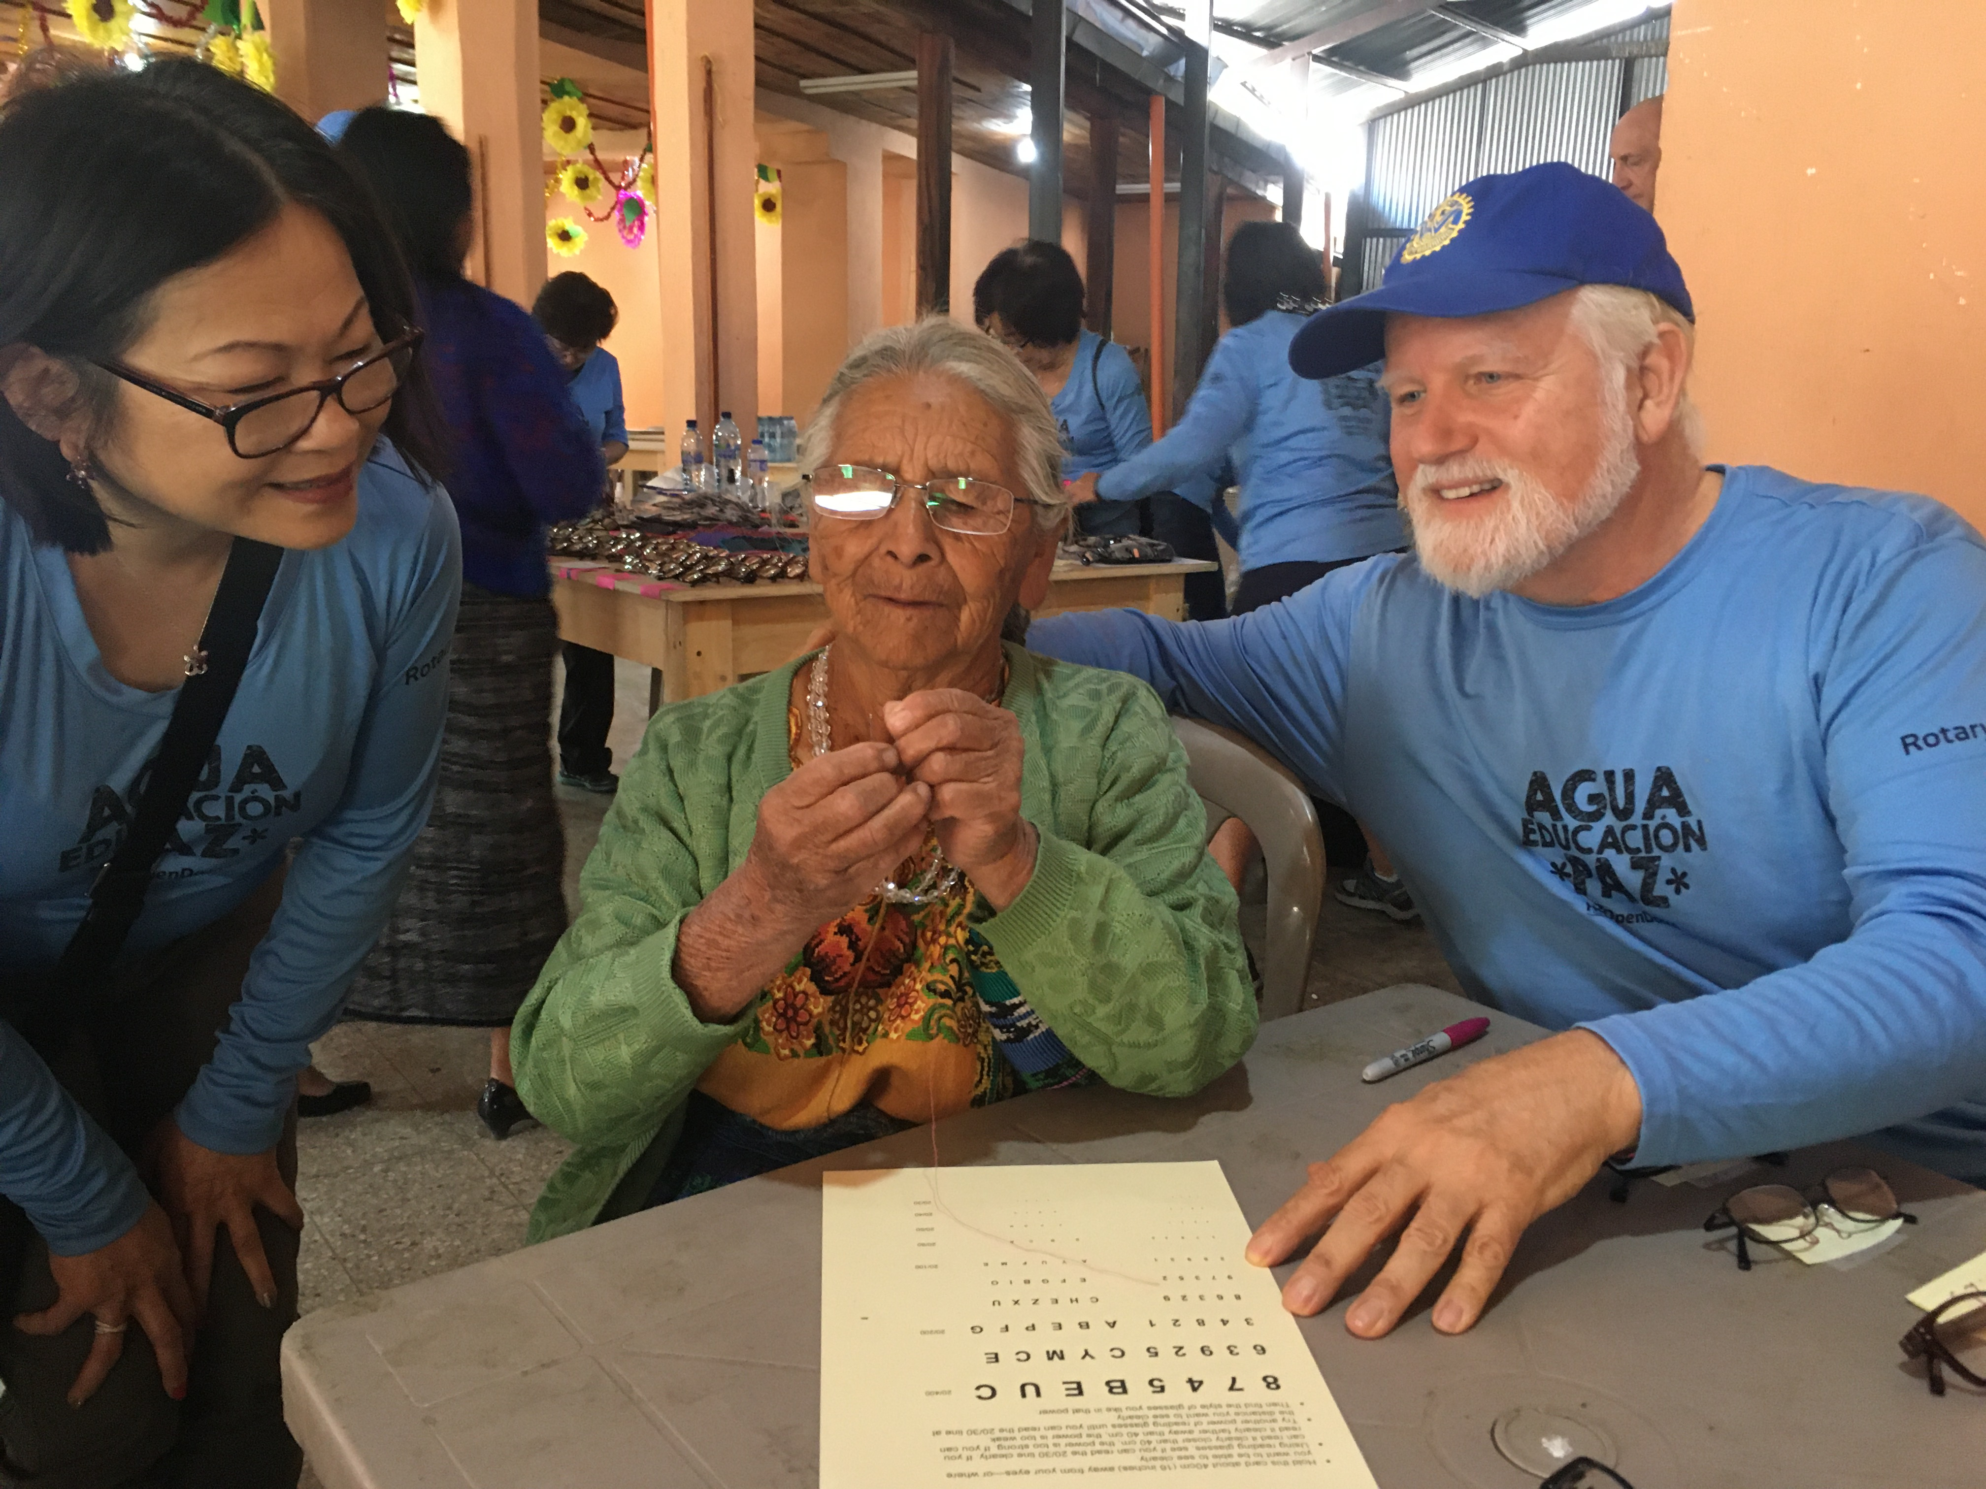
guatemala

Slide 7
international service -- education & support --
EDUCATION & SUPPORT
How are International Projects Created
How to Plan & Carry Out International Projects
How to Fund Projects – Various Sources
Help with the RI process for Global Grants

Slide 9
Please complete your evaluation
Notes:
Thank you for your participation, and also our SAA’s for their help today!! Please complete your evaluation
Time check: 12:15pm

