Slide 1
Bob Gutgsell
District Secretary
2023-2024
AG 2024-2026
Peninsula Starlight

Slide 2
MyRotary.org
What is MyRotary.org
Sign into MyRotary.org
Scroll down to enter club officers and goals Note: Your screen may look different then mine!
No Club is the same so placement of links may differ!

Slide 3
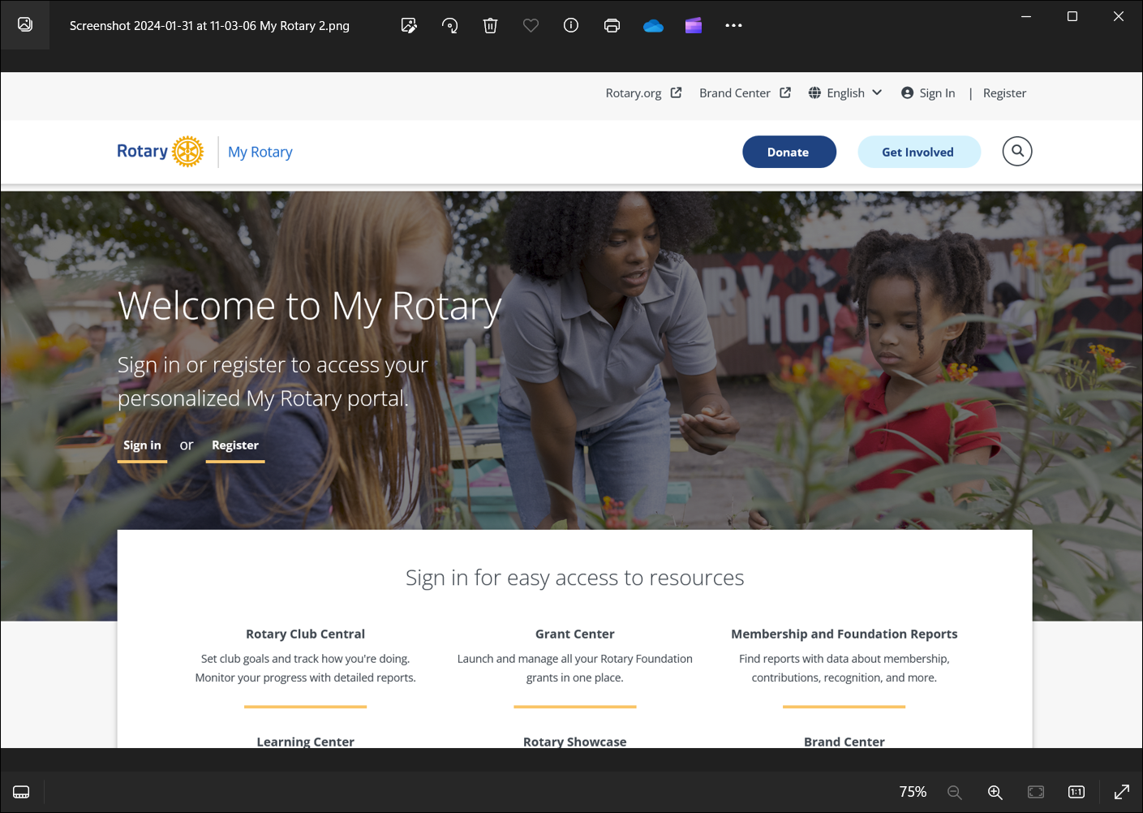

Slide 4
Create an account
Log on or create an account. Your screen may look different then mine! Both MyRotary.org and ClubRinner is very SLOW

Slide 5
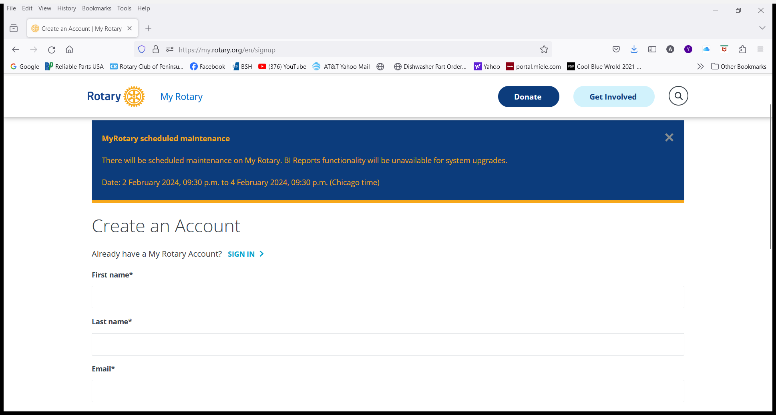

Slide 6
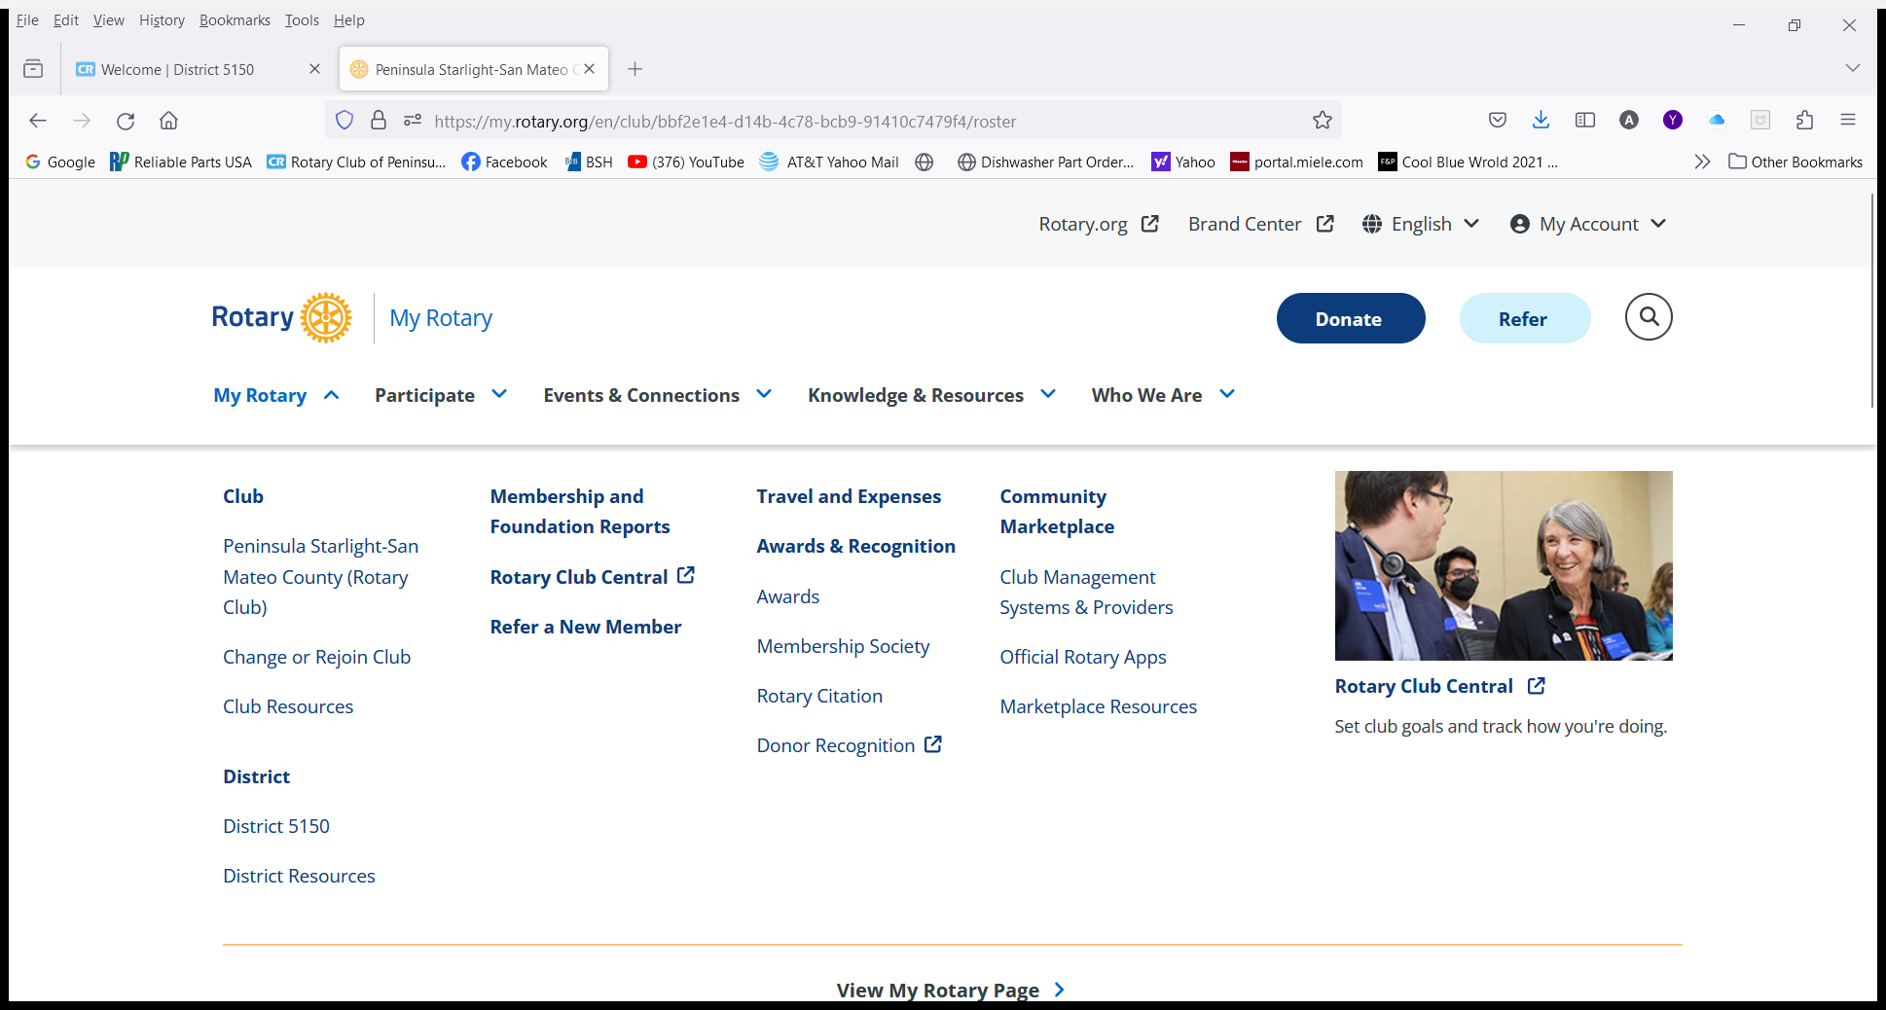

Slide 7
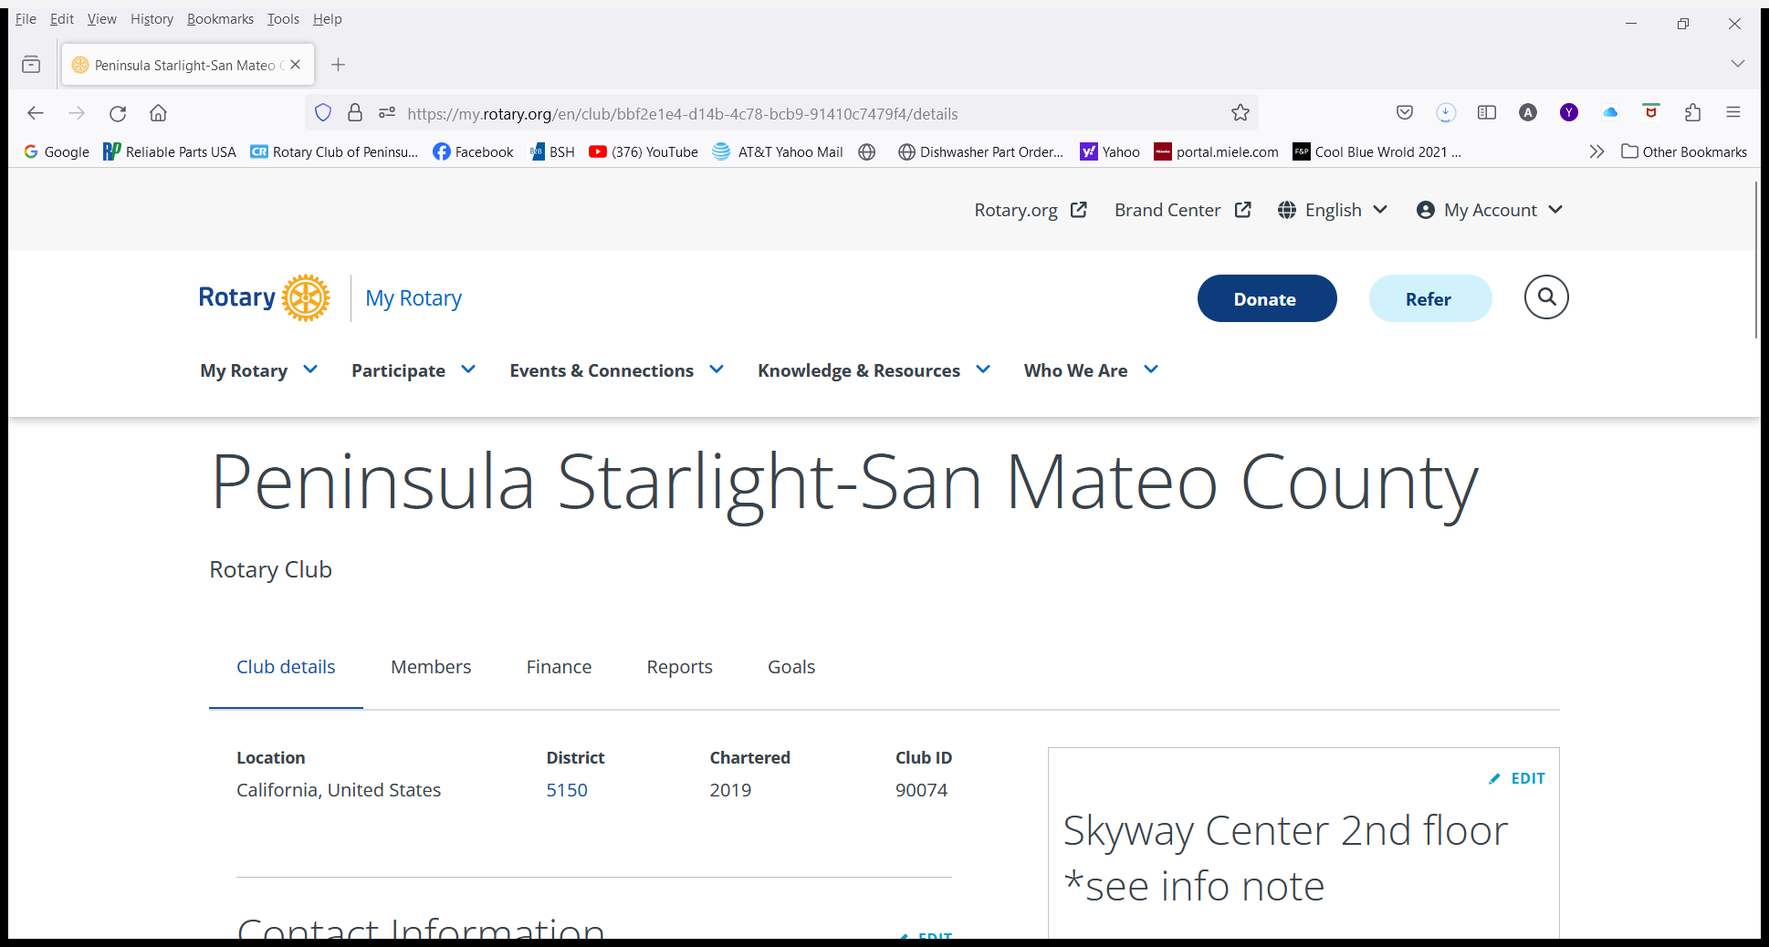

Slide 8
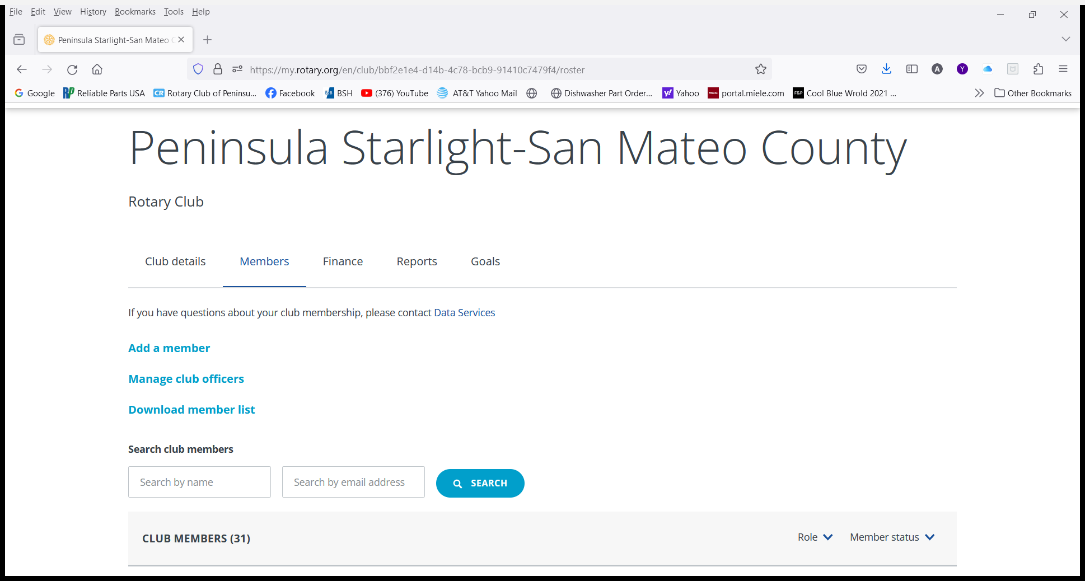

Slide 9
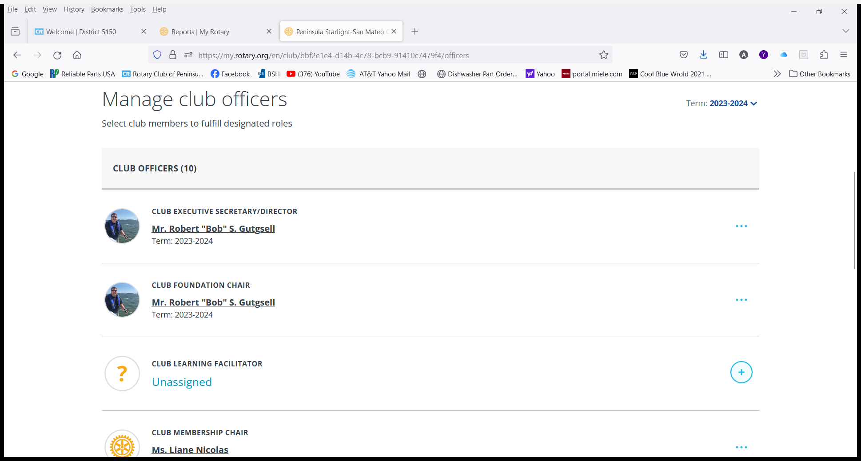

Slide 10
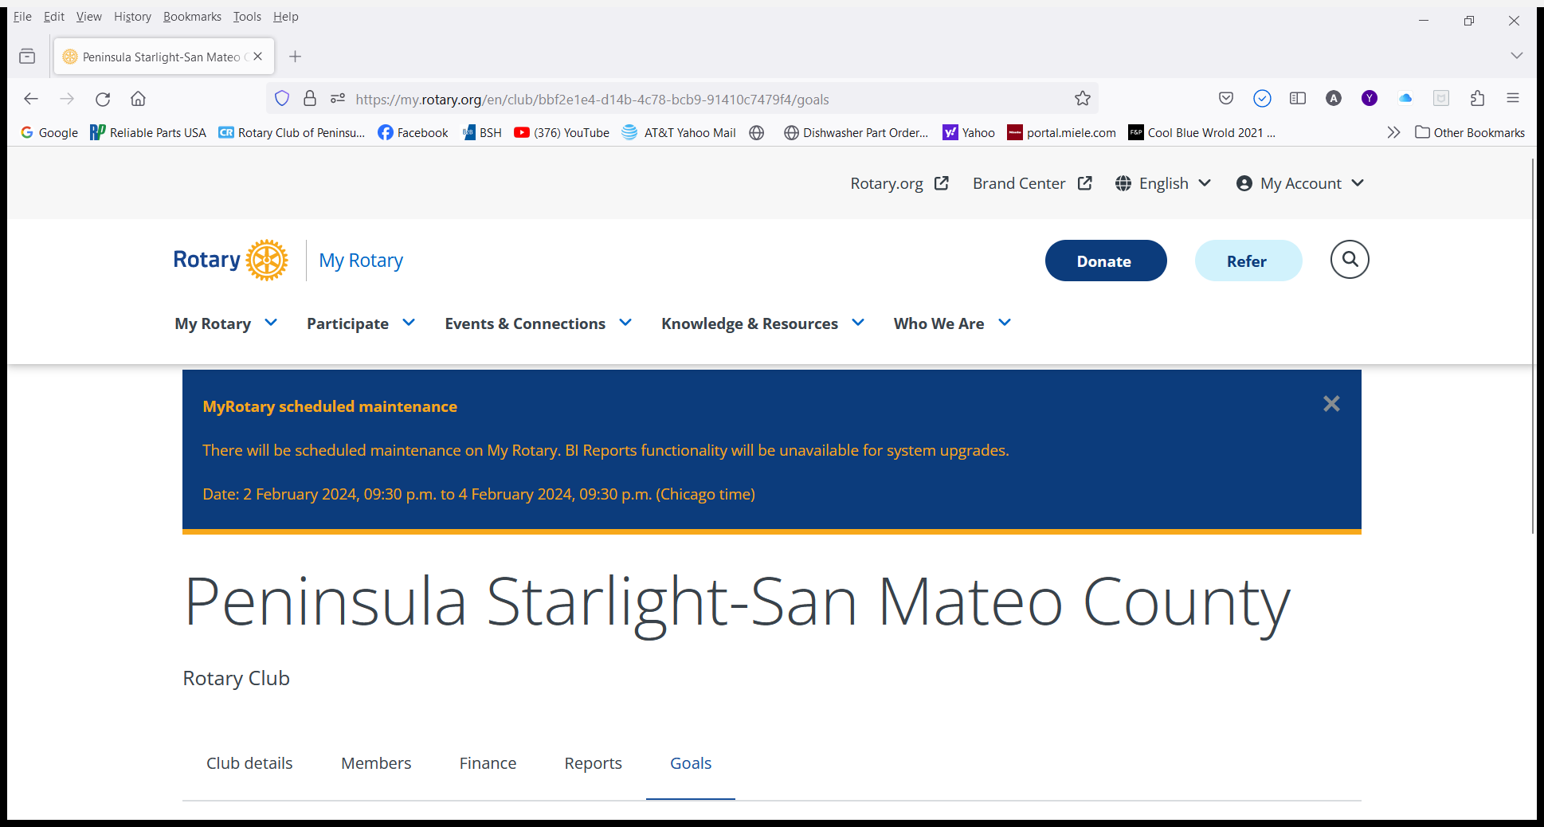

Slide 11
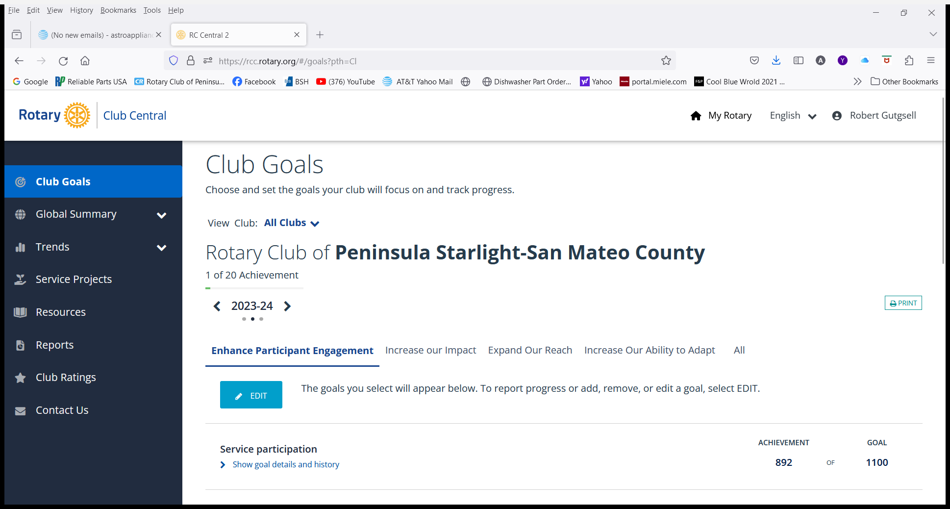

Slide 13
Always ready to support YOU
Notes:
Thank you for your participation, and also our SAA’s for their help today!! Please complete your evaluation
Time check: 12:15pm

