Slide 1
Youth Service
Sylvia Barry
Youth Service Chair
Rotary Club of Novato Sunrise
Notes:
What is Youth Service in Rotary?
What are the Components of Youth Service?
Who do we Serve?
How do we serve our Youth?
What is the connection among the components and to Areas of Focus and Areas of Service?
Why is Youth Service Important to Rotary?

Slide 2
Youth service
Youth Service
recognizes the Importance of
Empowering
Youth and Young Professionals
through
Leadership Development Programs

Slide 3
Youth service
Youth
Club Youth Service
Youth Protection Program
Interact
Rotaract
Rotary Youth Leadership Award
Rotary Youth Exchange Program
Notes:
TESTEETSETE

Slide 4
Interact Club Support
Schools interested
School Teacher as Champion
Rotary Club Sponsor / Rotarian Advisor
Clubs working together to Sponsor
Interact District Events
Presidents Kick-Off
Interact 101 Training
Fall Leadership Conference
Spring Leadership Conference
College / Career Workshop
Chair – John Dean, RC SF Chinatown
Ages 12-18, Sponsored by Rotary Clubs, but self-governing and self-supporting.
Rotary International has
14,911 Interact Clubs
342,953 Interactors
145 Countries with Interact Clubs
District 5150
49 clubs – Pre-Pandemic
23 clubs - Current
Goal – Add two clubs before July 1

Slide 5
Potential Clubs
San Mateo – 7 Clubs
San Francisco – 3 clubs
Marin – 1 club
Rotaract Club Support
School-Based
School interested
School Advisor
Rotary Club Sponsor / Rotarian Advisor
Clubs working together
Community-Based
CHAIR – ?
Ages 18 to 30, similar status as Rotary clubs Rotary International has
10,698 Rotaract Clubs
203,298 Rotaractors
180 Countries with Rotaract Clubs
District 5150 Rotaract Clubs
Dominican University
San Francisco State University
University of San Francisco
Menlo College
Possibly starting a Community Rotaract Club in San Rafael

Slide 6
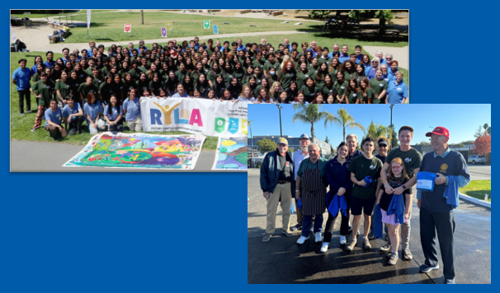
Interact Connection
40% Interactors (pre-Pandemic)
27% Interactors (post-Pandemic)
Rotaract Connection
Looking at partnering with AVID – Advancement via Individual Determination
Chair – Lynn Luckow, RC SF
RYLA 2024
5 Days Leadership Development Summer Camp
July 29 – August 2, 2024
Redwood Glen Camp and Conference
Transportation Provided
160 New Students (16 teams)
(Freshmen / Sophomores / Juniors)
24 Alumni Leaders
32-34 Adult Counselors
$600 per camper
www.RYLA5150.org

Slide 7
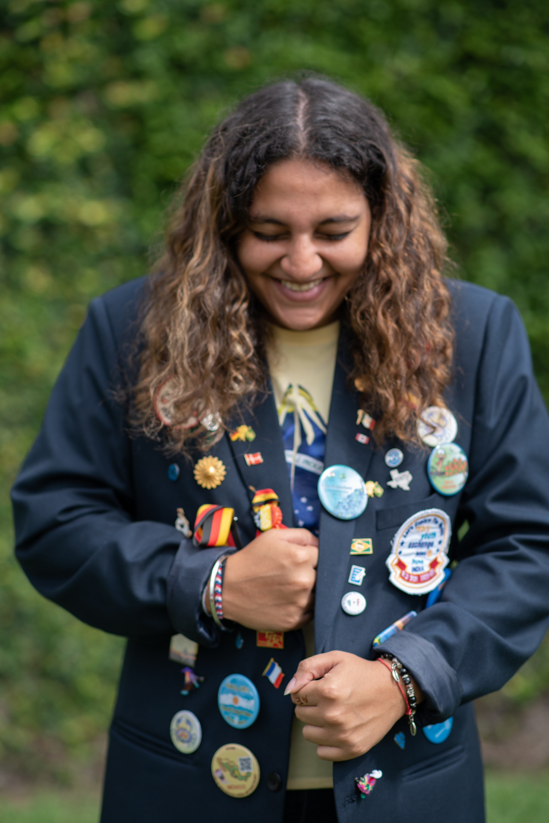
Students are interested in going on the Student Exchange Program both ways
Looking for Host Families in the Bay Area …
Rotary Club of Half-Moon Bay would like to host a student each year
San Mateo German Exchange
Novato Rotary
Can be Rotarians or local families
$150/$200 monthly allowance for the students
Chair – Marc Freedman, Burlingame
Rebuilding Rotary Youth Exchange Program
Youth Student Exchange is sponsored by
The US Department of State
The U.S. Department of Education
International Students contribute to Service Hours and help with US Public Diplomatic Efforts from 60+ countries
2,100 state sponsored and 20,000 private funded high school students participated

Slide 8
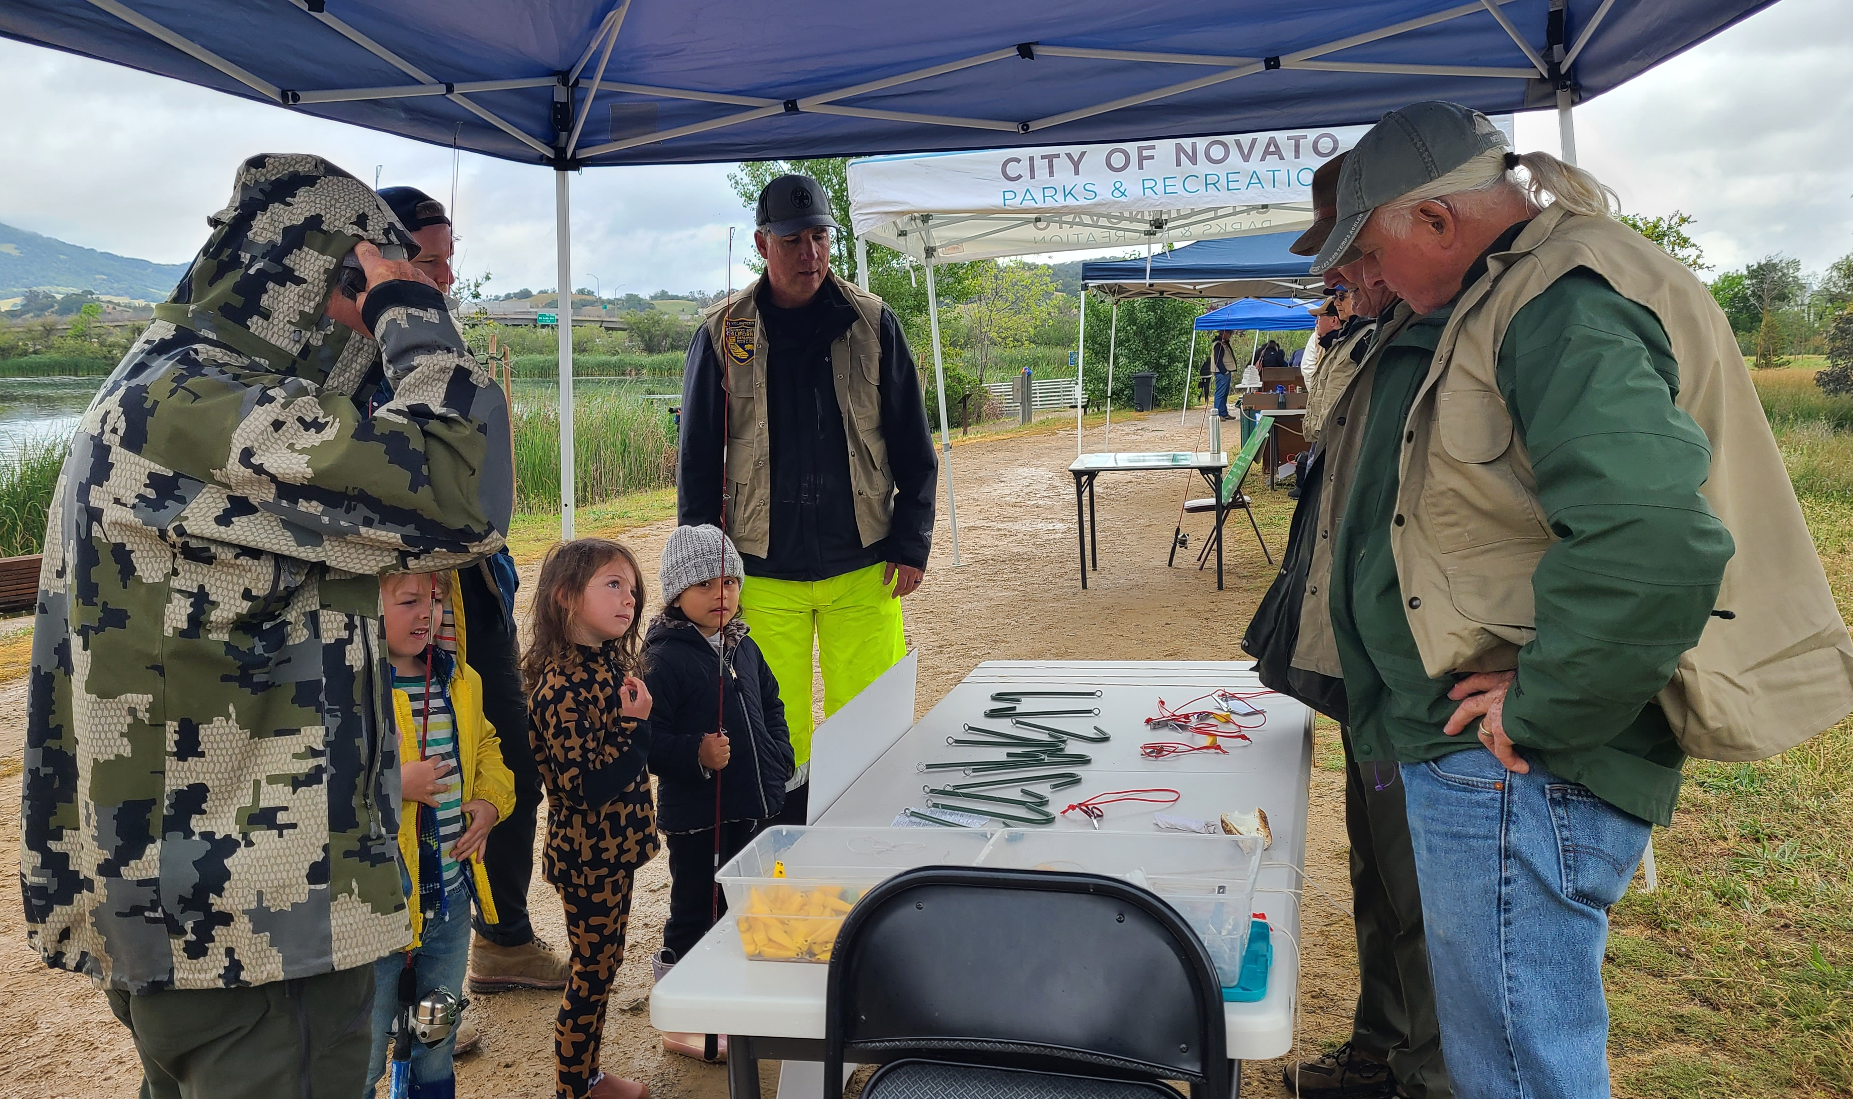
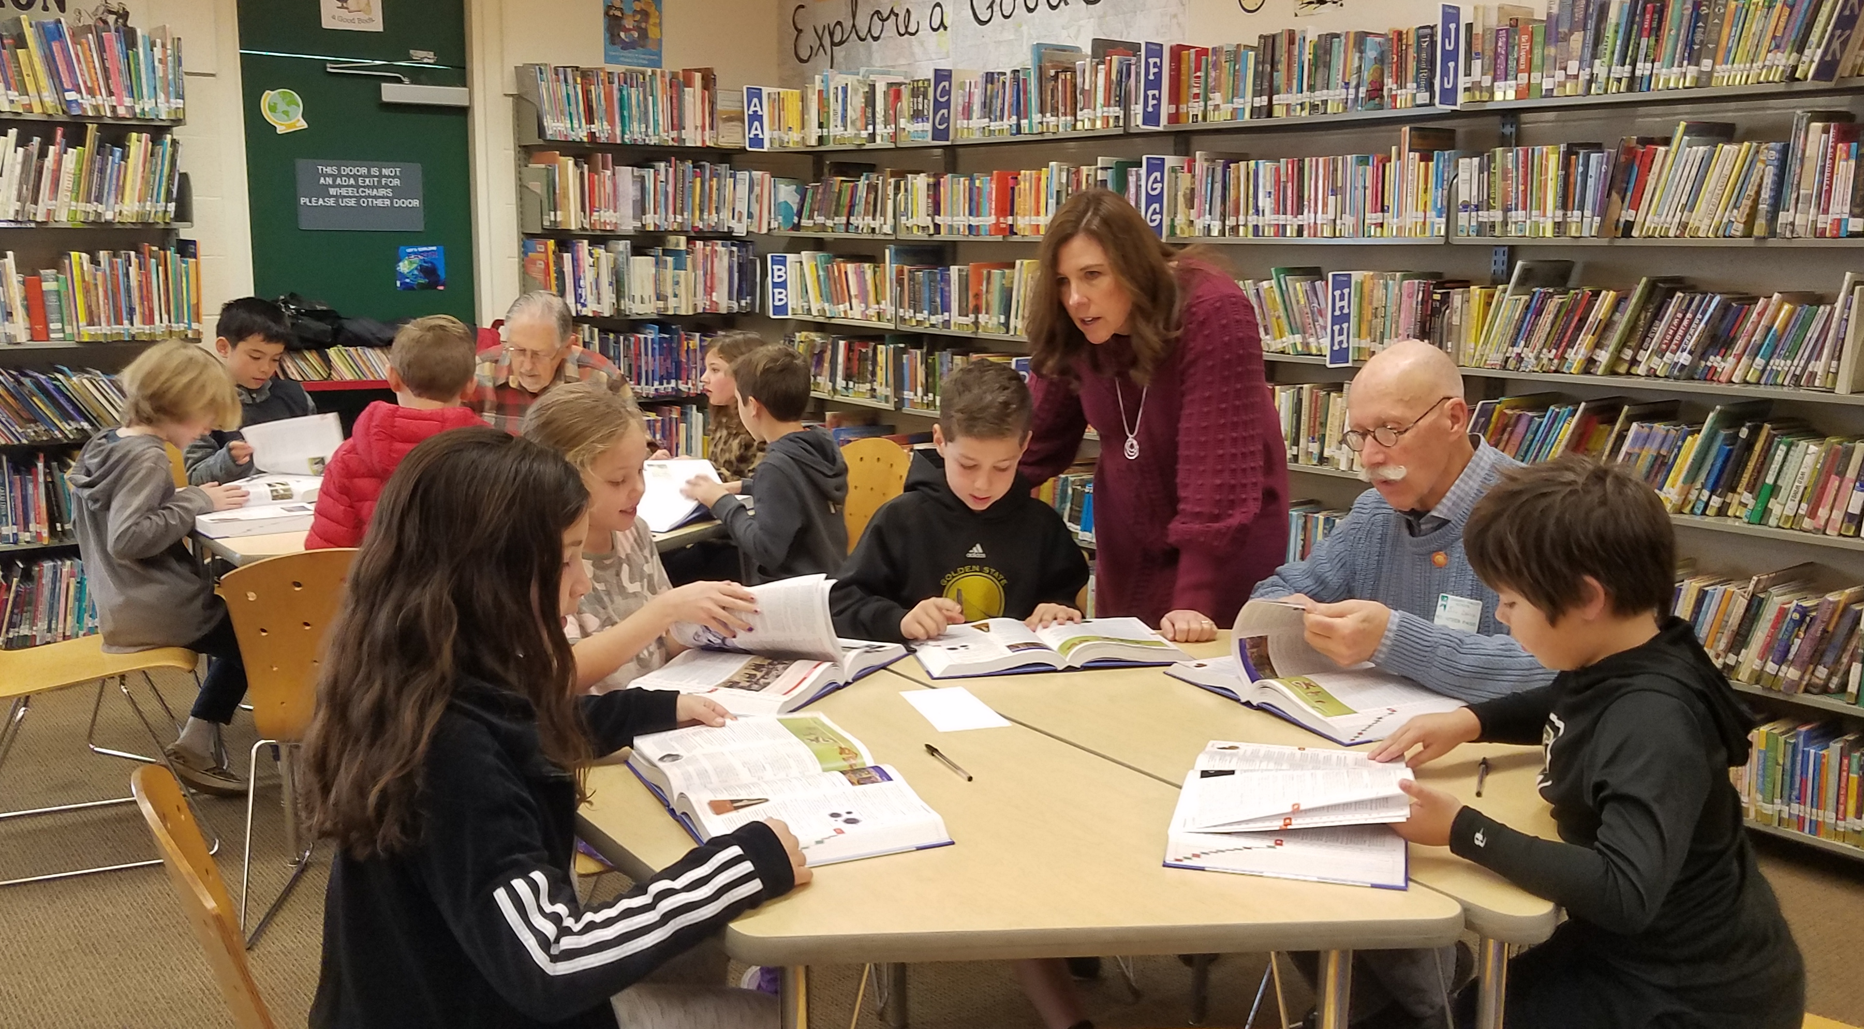
YOUTH PROTECTION PROGRAM
Chair – David Bertini, RC Pacifica
Incoming Chair – David Dye, RC SF
Policy & Procedures involving Youth Service
Risk Management – One on One
Youth Protection Certificate

Slide 9
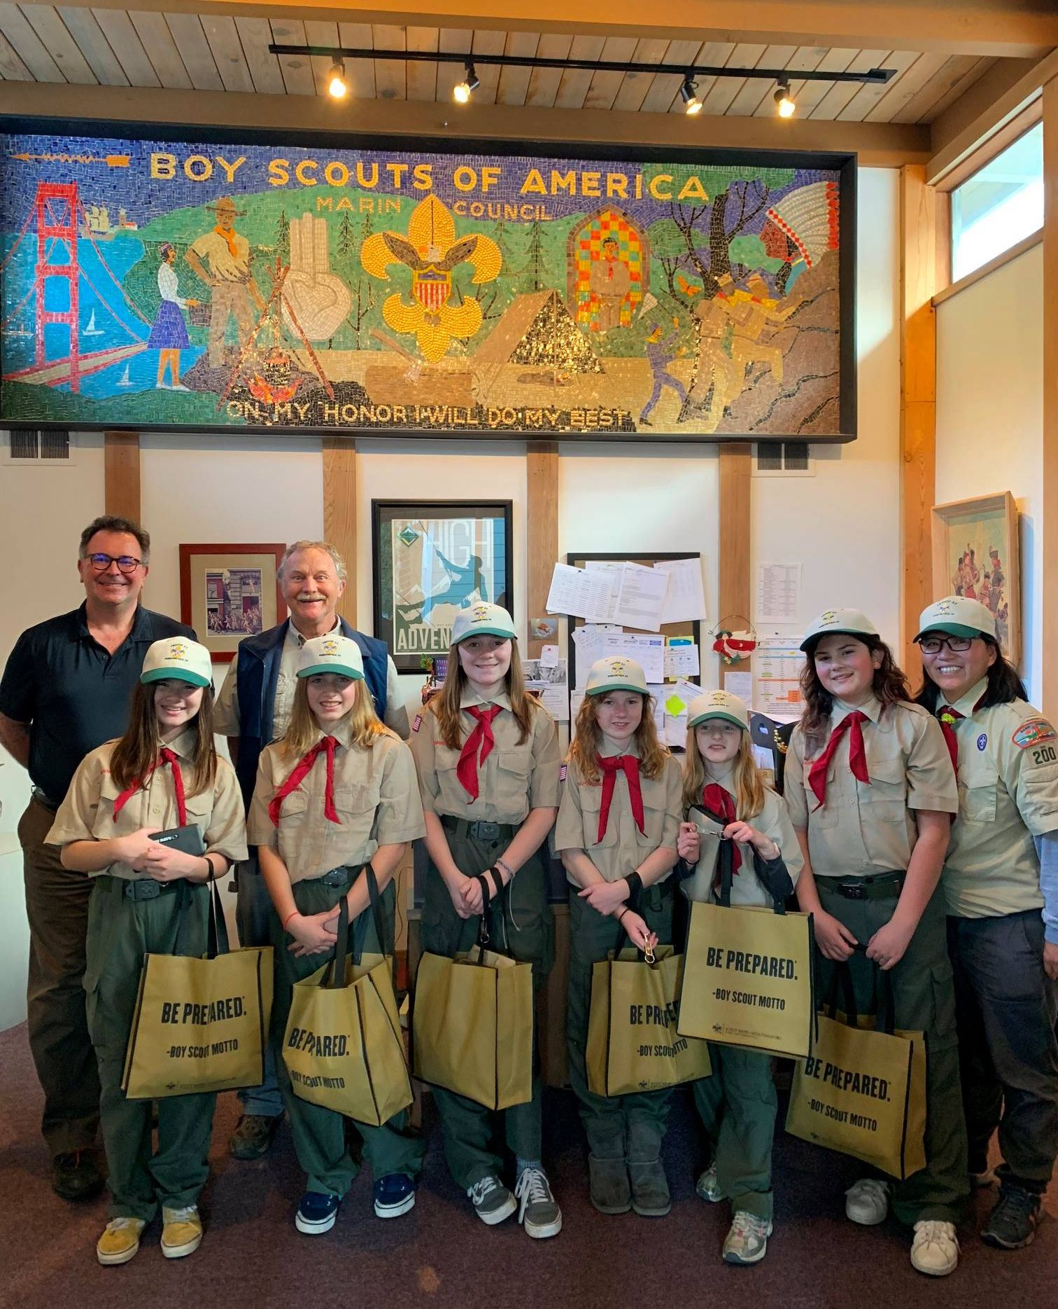
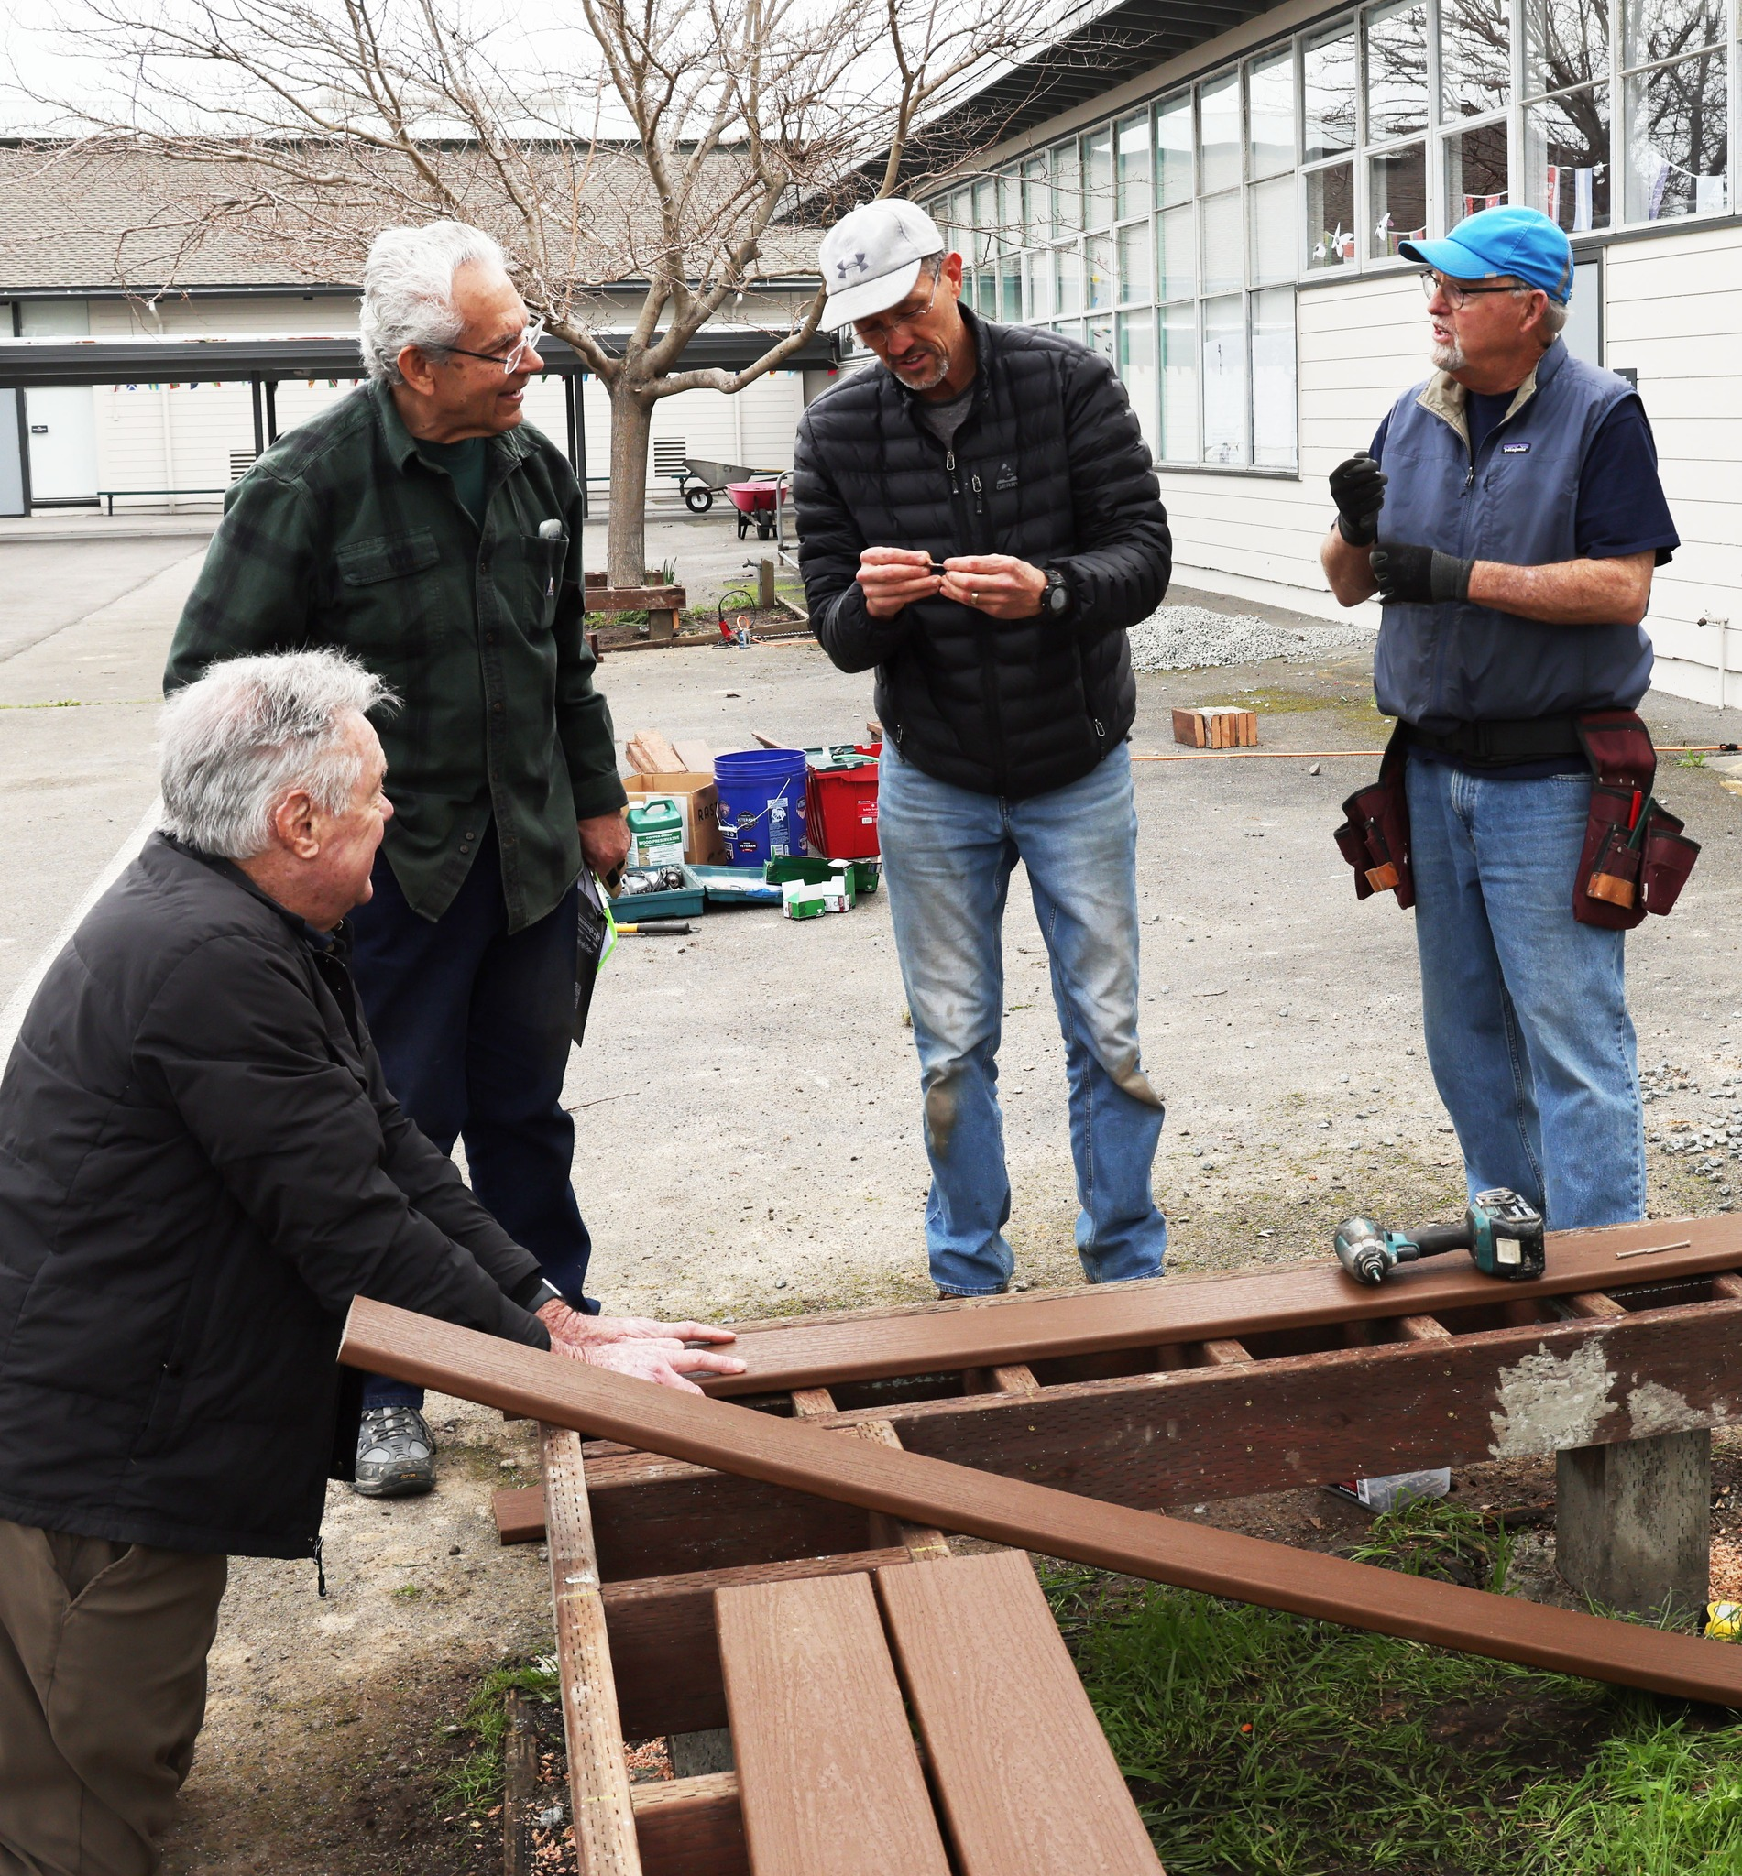
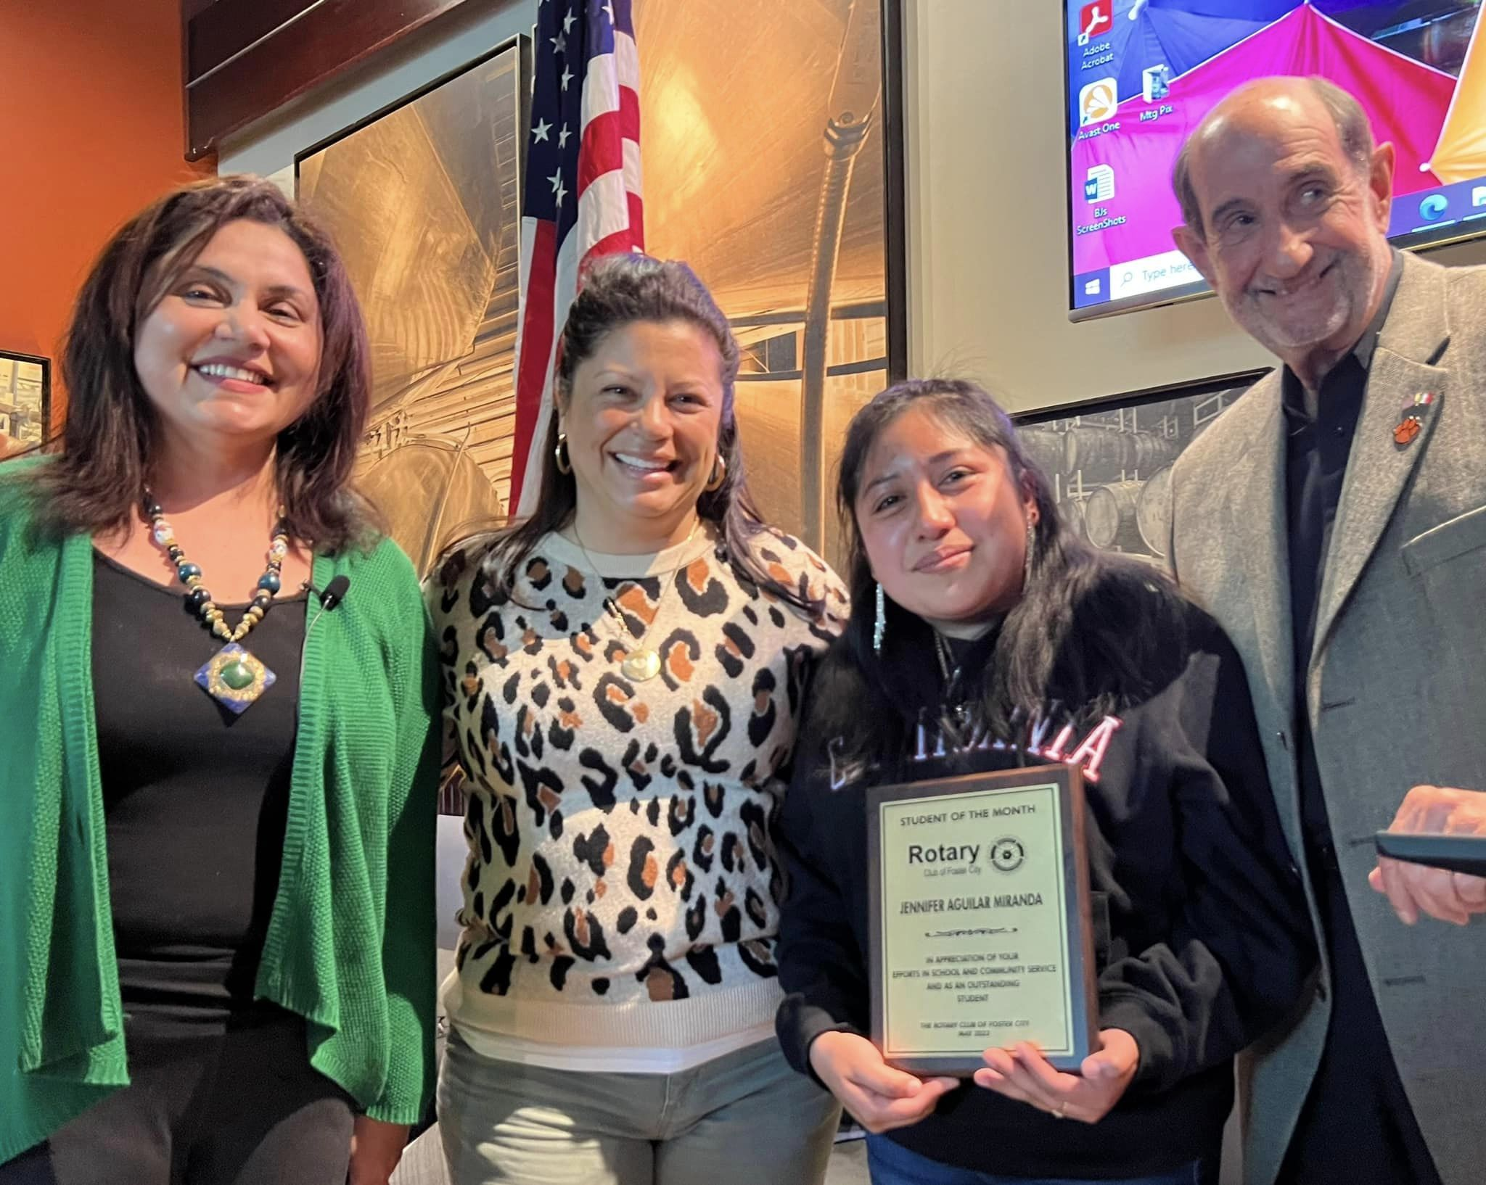
CLUB YOUTH PROJECTS

Slide 10
Youth service
Rotary Club
Rotaract
Interact
Rotary Youth Exchange
Rotary Global Scholar
RYLA
Rotary Peace Fellow

Slide 11
Youth service
Youth
Community
Vocational
International
Fundraising
Membership

Slide 13
Please complete your evaluation
Notes:
Thank you for your participation, and also our SAA’s for their help today!! Please complete your evaluation
Time check: 12:15pm

