Slide 1
District 5150 President Elect Training

Slide 4
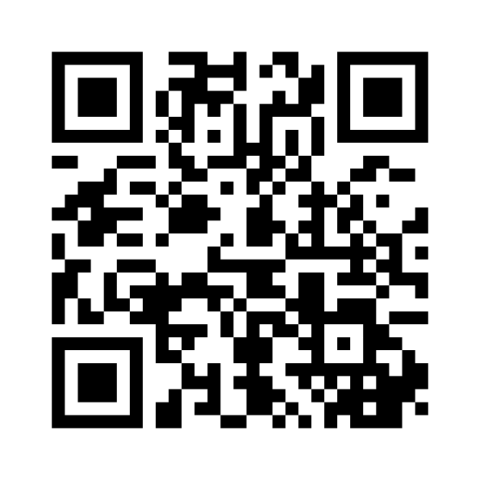
Rotary International
Join at menti.com
Use code 7996 8326
Notes:
Michael
How many full time staff members does RI have
835
How Many Geographical Regions Have Clubs
Over 222
How Many Rotarians (Including Rotaractors) Does District 5150 Have 1638

Slide 5
Notes:
Annual Giving Officer
Financial Representative

Slide 6
regional experts
Annual Giving Officer
Finance Representative
Regional Grants Officer
Major Gifts Officer
Regional Membership Officer
Planned Giving Officer
Geoff.Cochran@rotary.org
Laura.Ovalle@rotary.org
Cecelia.Walter@rotary.org
Angela.Lopez@rotary.org
Erin.Groble@rotary.org
Tabitha.Sparks@rotary.org

Slide 7
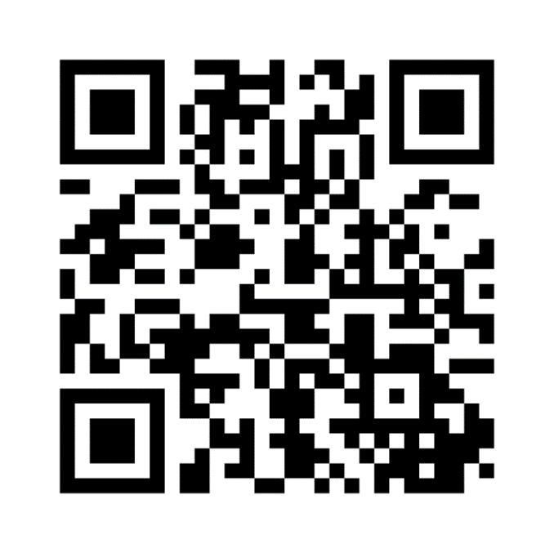
Club Identity
Join at menti.com
Use code 7996 8326
Notes:
Nick
What is one word to describe your club
Menti poll to be used to make a word art thing

Slide 8
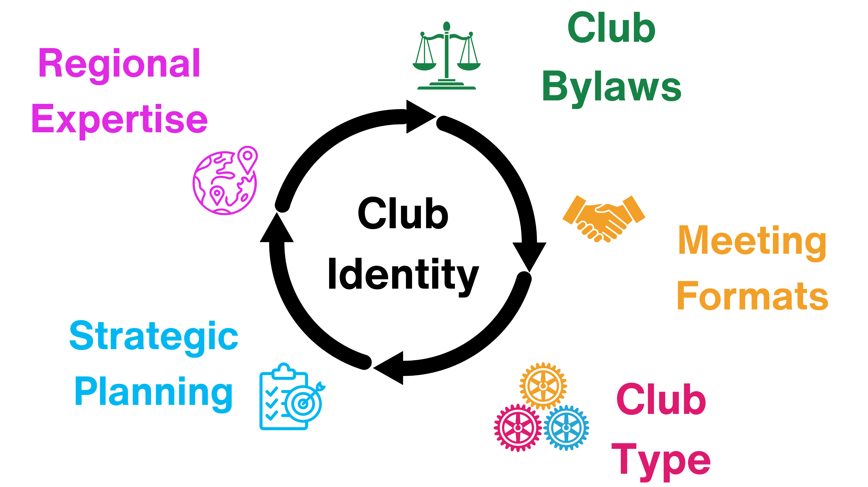
Notes:
Nick
Club bylaws
Meeting Formats
Regional Expertise
Club Type
Strategic Planning/Swot Analysis
Make a circular visual for all of these things

Slide 9
Conflict
Join at menti.com
Use code 7996 8326

Slide 10
Conflict
Your Role
Different Types/Levels of Conflict
Contact CDS@rotary.org if you receive any allegations of Harassment or Sexual Harassment
Notes:
Your Role in Conflict
Different Levels of conflict
Club, District, inside and outside of club meetings/events
Preventing conflict
Club culture, Vision and goal, Unity, Bylaws, Open lines of communication, Transparency
Navigating conflict
Working with leaders and staff

Slide 11
My Rotary / RCC
Join at menti.com
Use code 7996 8326
Notes:
Question:
True Or False: As A Club President Elect I Will Have Access To Set Goals On Rotary Club Central

Slide 12
My Rotary and Rotary Club Central
My Rotary/RCC
Are you listed as President Elect Yes or No
Screenshots/Impersonation
Check to see if they are listed
How to access online tools
RCC Goal Setting

Slide 14
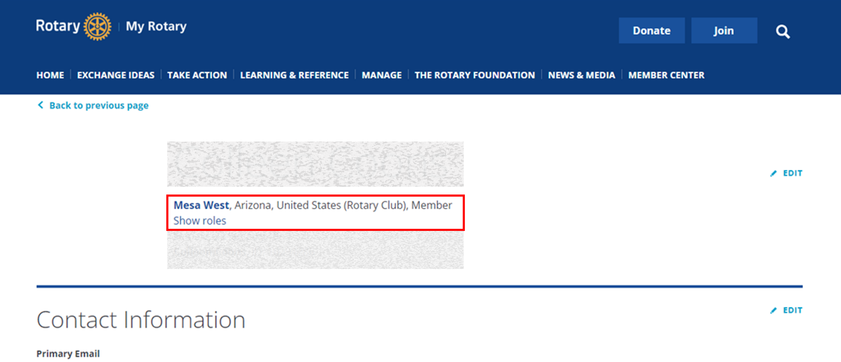

Slide 15
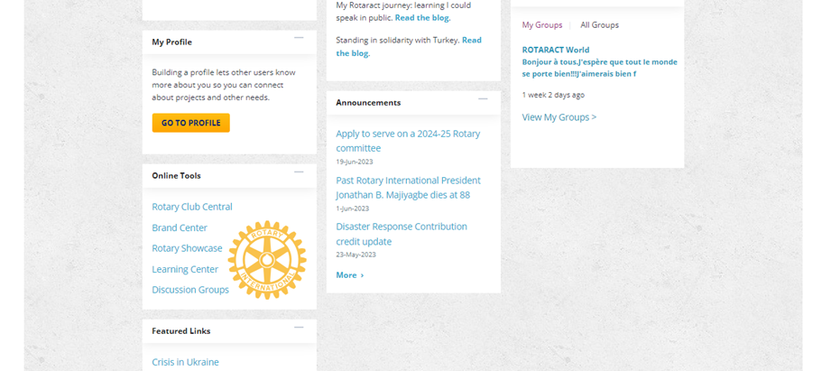

Slide 16
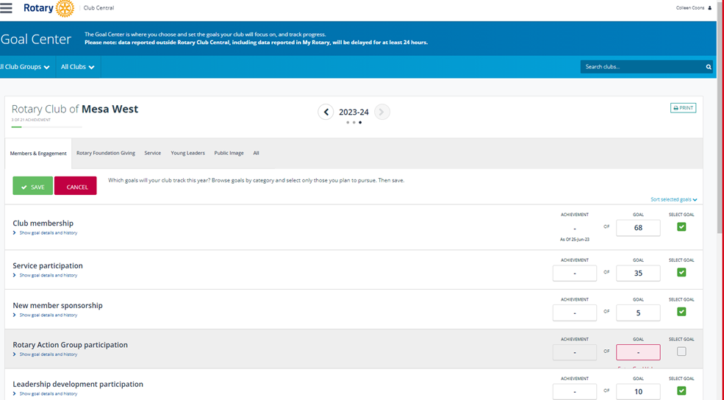

Slide 17
Notes:
July 1st, 2023 – start as Club President Elect
July 2nd, 2023 – December 31st, 2023 – Plan your President
Make sure you are listed as President Elect on My Rotary
Input goals, Input officers for next year, plan events
March 1st, 2024 – Far West PETS in San Jose, California
May 30th, 2024 If not done already, have 2023-2024 club officers Input your Club Officers for 2024-2025
July 1st – Start year as Club President

