Slide 1
Rotary Year 2024-2025
Welcome
Title Page Option

Slide 2
AGENDA
Pictures
Three Essential Elements
D5150 Officers/Committee Chairs
Announcements
Lunch
Grants Management Training

Slide 3

ROTARY INTERNATIONAL LOGo 24-25

Slide 4
AGENDA
THREE MAIN COMPONENTS
Membership
The Rotary Foundation
Public Image

Slide 5
DISTRICT Secretary
Why important?
MyRotary
Officers
Goals

Slide 6
DISTRICT TREASURER
Club Budgets
District Budget
OPM

Slide 7
QUESTIONS

Slide 8
BREAK!!!
10 Minutes

Slide 9
DISTRICT COMMITTEE CHAIRS
International
Vocational
Community
Youth
DEI

Slide 10
Updates & announcements
PETS – Time and parking and keys
TRF Plans – Handouts
Hands-on Awards - Updates

Slide 11
SOME DISCLOSURES REQUIRED
Email Courtesy – Respond Please
Conduit – not a Dam
Lead, Follow or Move Aside
Social Media and the Four-Way Test Meets the First Amendment
Global Scholars Update
Successor for Your Role – Your PN – Your Partner
Giants Spring Training?
Sargent-At-Arms (SAA’s) Needed for District Assembly

Slide 12
SOME DISCLOSURES REQUIRED
Dues Review
$100 New Club Donation for Novato Evening
Resources –
  Club & District Support – Michael.DeGrandis@Rotary.org
  Zone2627.org
  “I should Know That” – Bob Jacobsen is Escape Hatch
  PE Page on D5150 Website
Rolling Calendar – Calendaring Events on Rotary5150.org

Slide 13
EVENTS
Assembly. March 23rd, 2024
Better Together District Conference. May 17th – 19th, 2024
RI Convention in Singapore. May 25th – 29th, 2024
USS Hornet – Foundation Event. Oct 12th, 2024
World Polio Day. Oct 19th, 2024
2025 District Conference. May 15th – 18th, 2025

Slide 14

DISTRICT ASSEMBLY & PROJECT FAIR

Slide 15

Value of the District: Events
District Conference

Slide 16

Singapore international convention

Slide 17
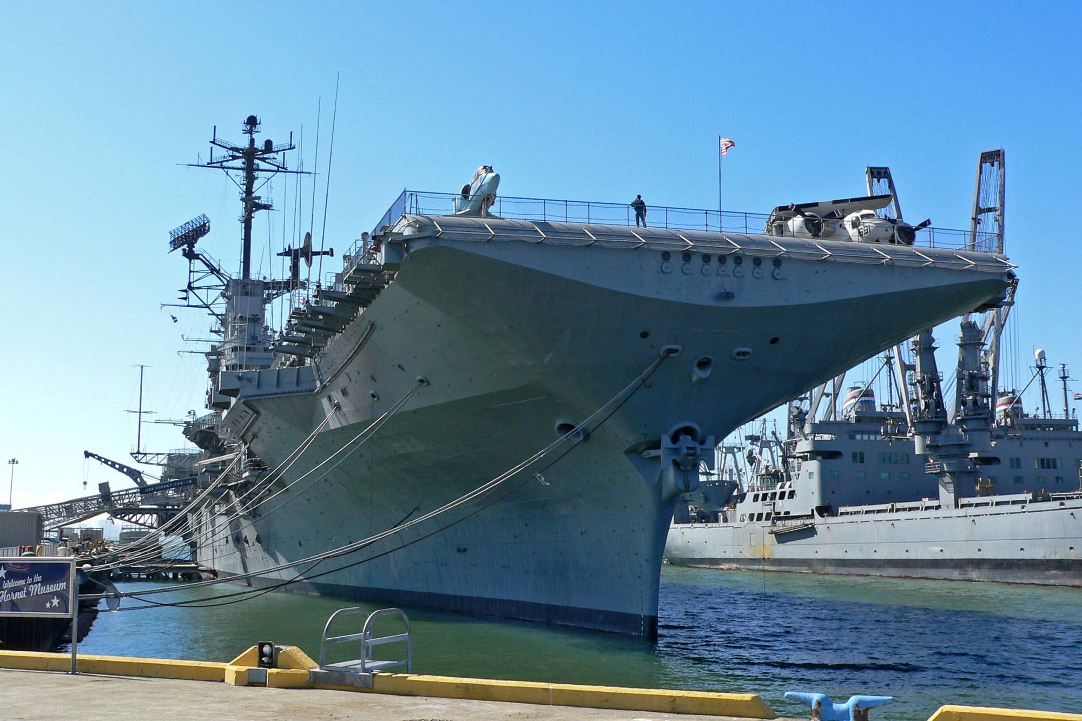
USS Hornet (CV-12) Oct. 12, 2024
Learn its history with a docent tour
  In service from 1943-1970
  Served in WWII, Korea and Vietnam
  Recovered Apollo 11 and 12 astronauts when they returned from the moon
  Museum opened in 1998

Slide 18

WORLD POLIO DAY OCT. 24

Slide 19
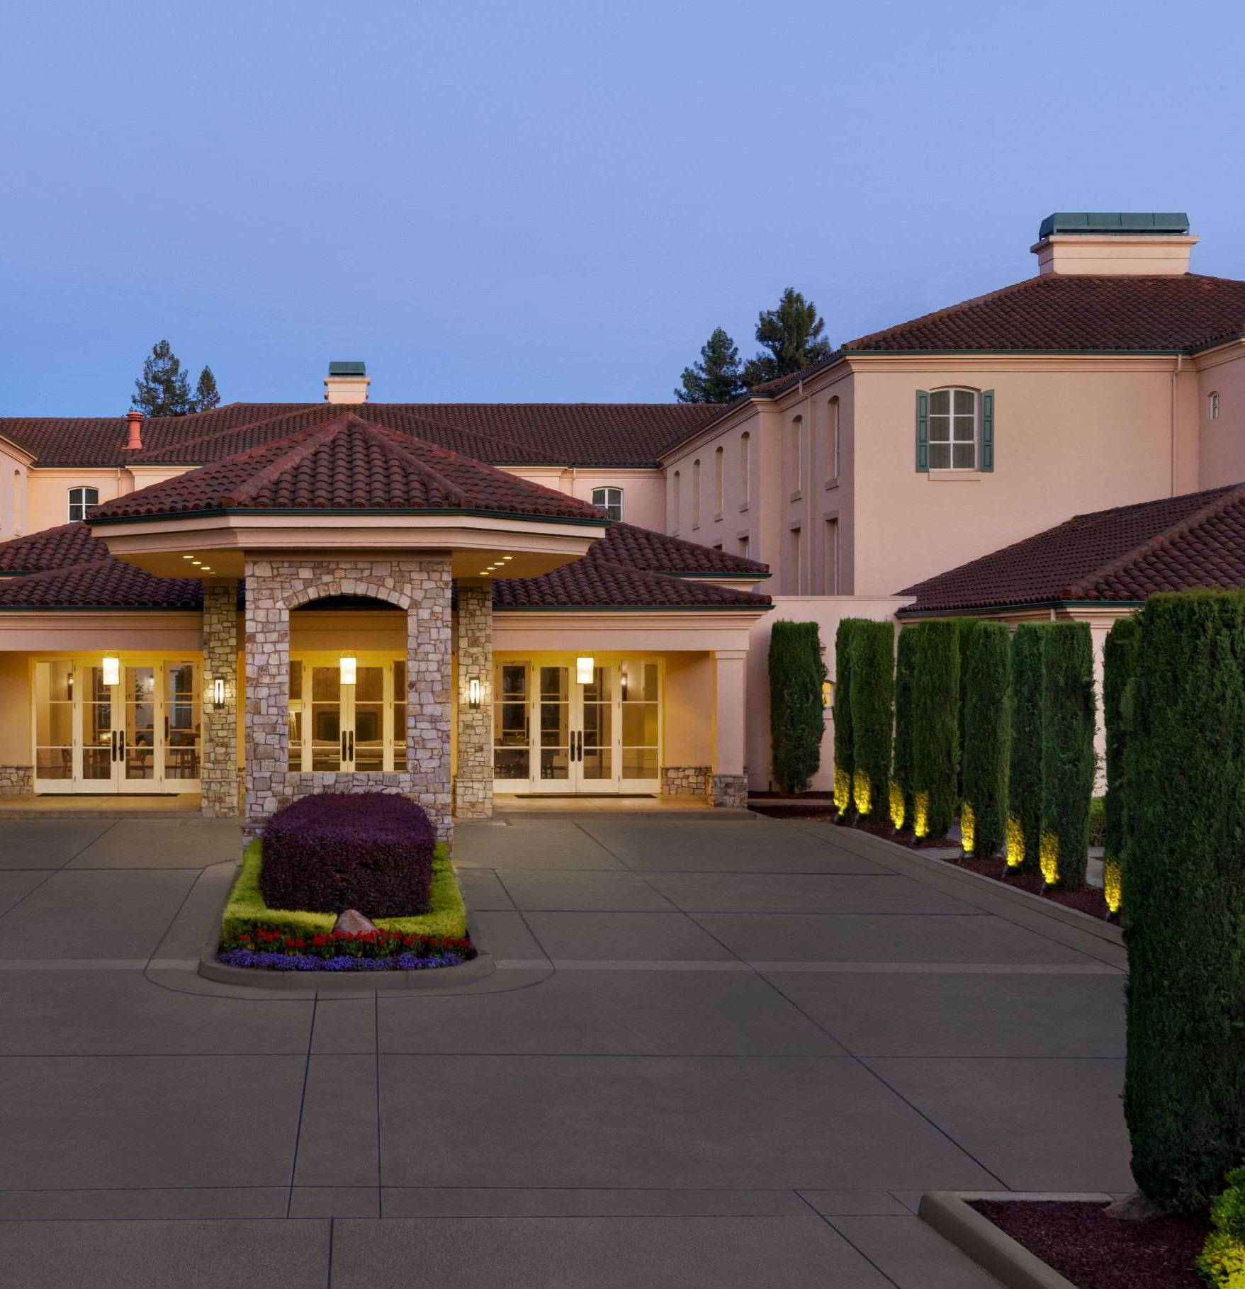
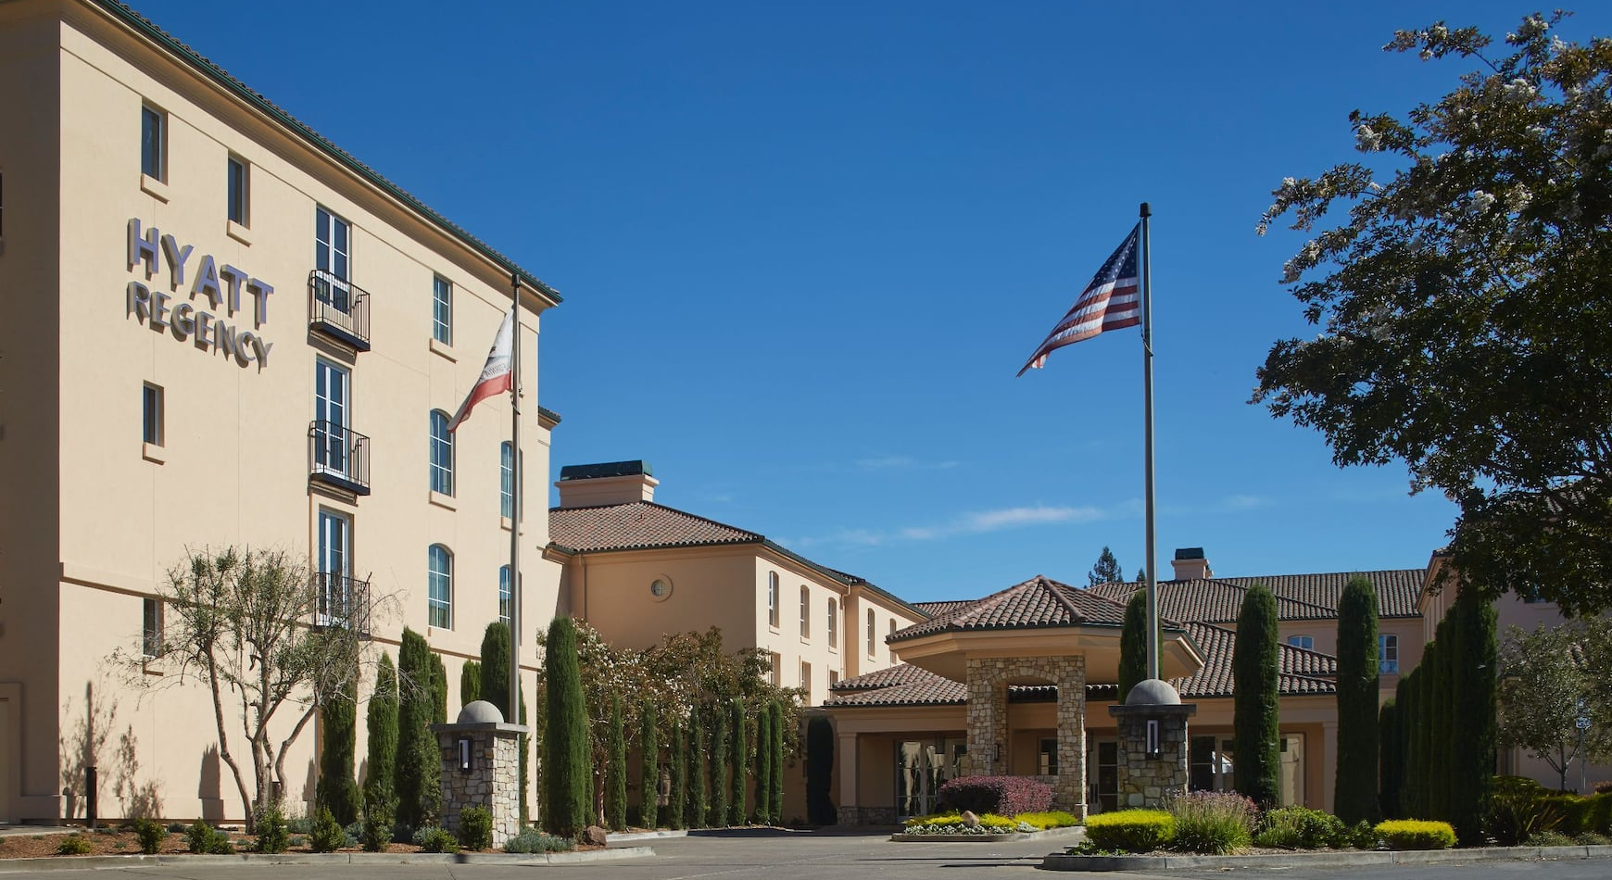
DISTRICT CONFERENCE MAY 15-18, 2025

Slide 20
QUESTIONS

Slide 21
ROTARY IS LOVE
Sherry Sims’ Video here

Slide 22
Why is there A district?
To Support
the Clubs!

Slide 23
TRF – The Gameplan
Plan is Ready – Just add Money!
  1) EREY – 100% (currently 58%, last year 74%)
  2) EREY - $51.50 – 2 Donations in 18 months
  3) EREY/Annual Fund Team Trained/Deployed
  4) Heavy emphasis on Bequest Society
  5) Gary/Team before & after – Guest Speakers

