Slide 1
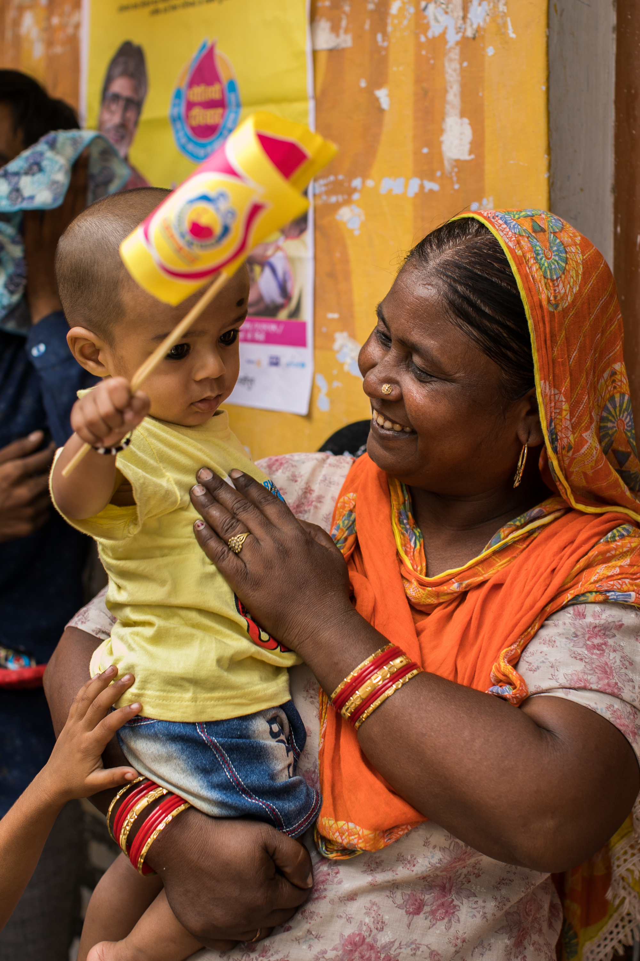

The Rotary Foundation
District Grants District 9910

Slide 2
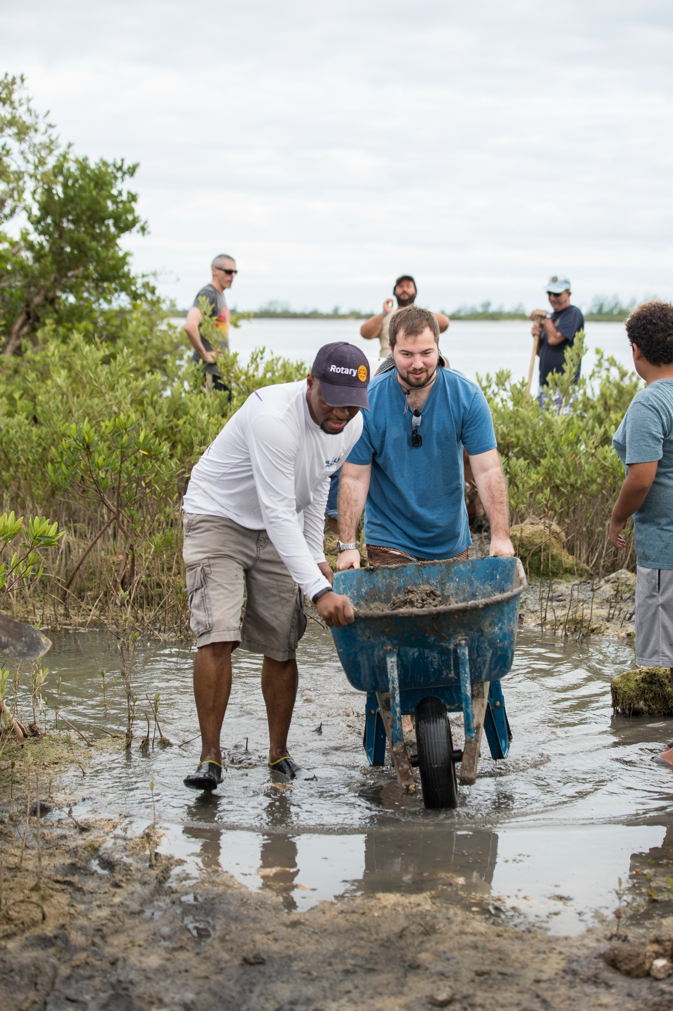
OUR LEGACY IS OUR PROJECTS

Slide 3
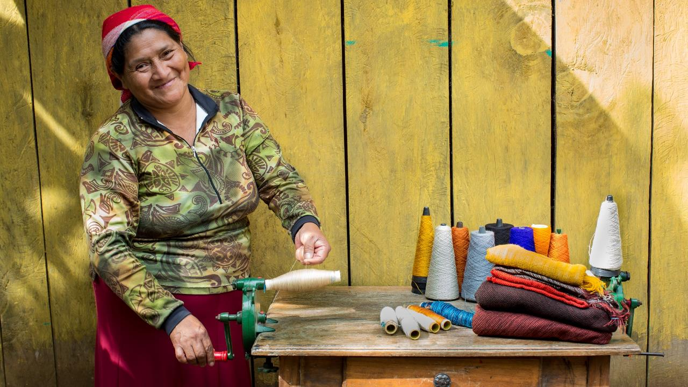
subhead
DISTRICT GRANTS
Smaller, short-term grants aimed at local community needs
It’s about building visibility and creating impact
Funded by District Designated Funds (DDF)
In 2026 – 2027 there are 20x $1,500 grants available
Clubs must be qualified
Every Club (that is qualified) can apply
Grants are matched $1: $1 to a maximum of $1,500

Slide 4
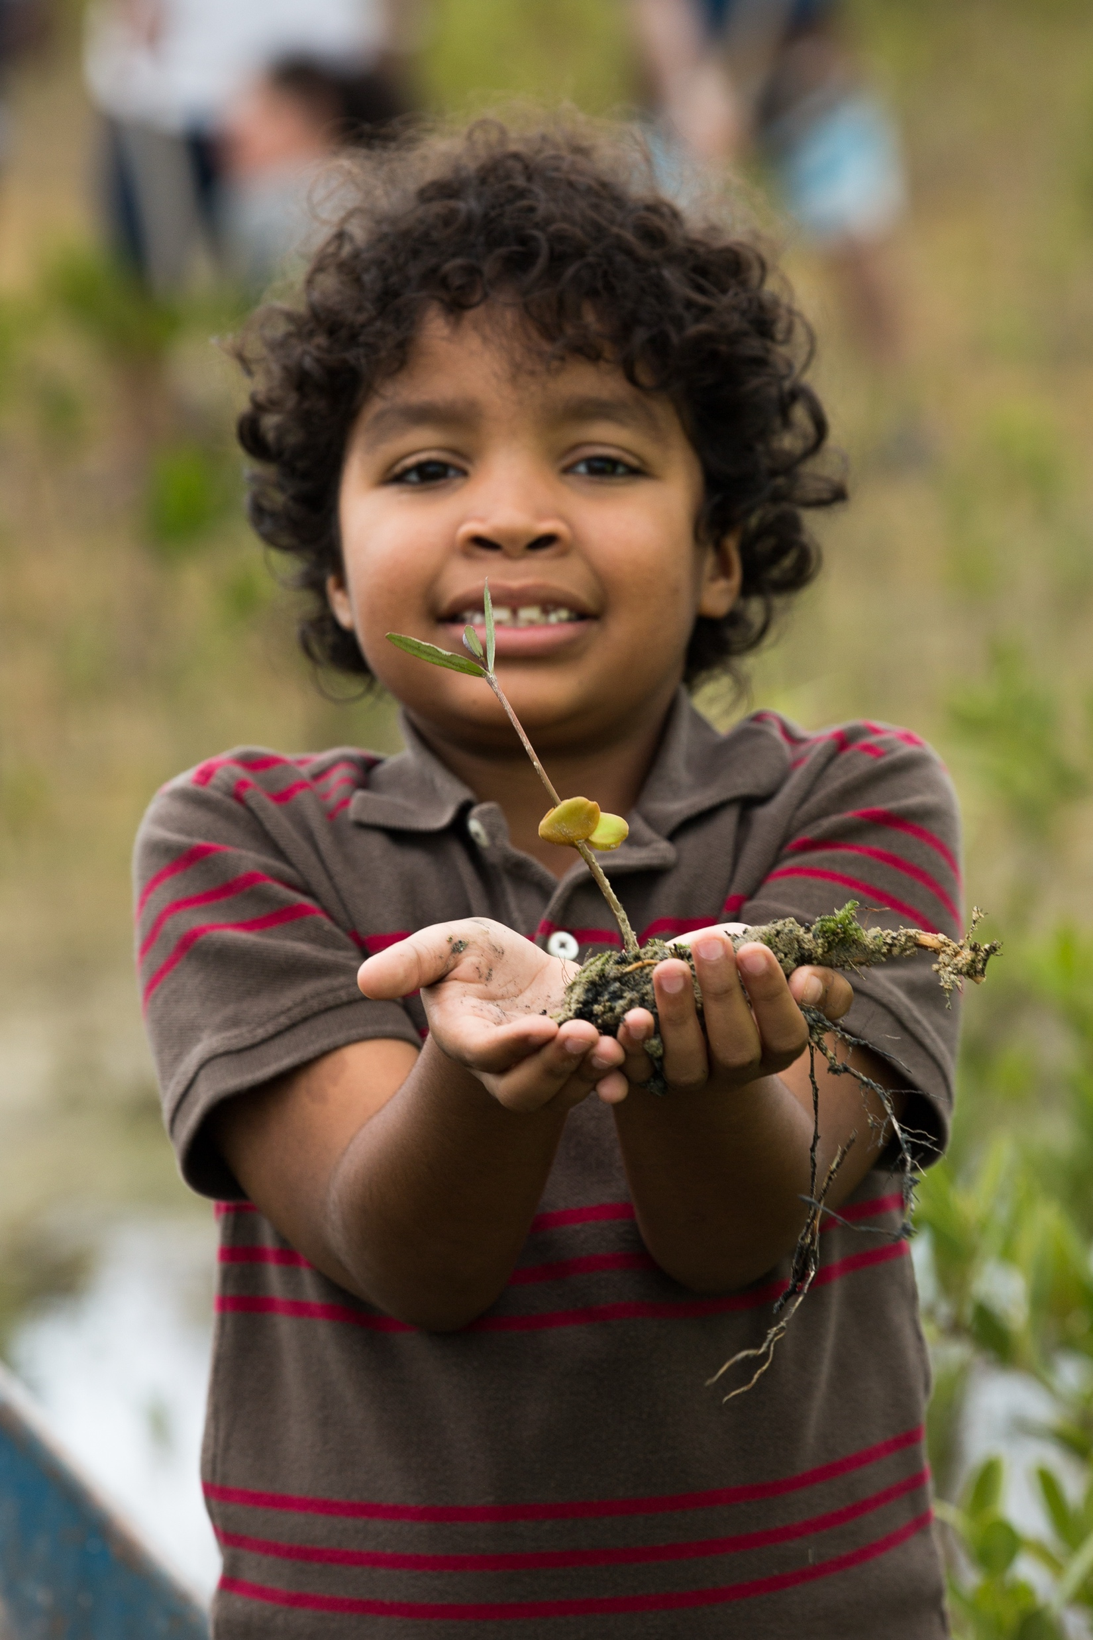
HOW ARE WE GOING TO FUND IT?
Notes:
A well-planned project that fits the community’s culture and context is more likely to succeed, and conducting a thorough community assessment significantly increases your chances for success.

Slide 5

How the math works
Rotary Club of A donates $5,000 USD to TRF
Combined District 9910 donations to TRF = $50,000 USD
2023

Slide 6
District 9910 gives $30,000 NZD from their DDF towards District Grants
(20x $1,500)
District 9910 received 47.5% of the total donations in 2023 back as DDF ($23,750 USD = $41,580 NZD
The remaining 47.5% has gone to the World Fund with 5% going for overheads/expenses
$1,500 comes from a District Grant
District Grants Projects
$60,000 NZD
$1,500 is funded by the Club
Club A identifies a project worth $3,000
2026
[3 Years Later]
Club B identifies a project worth $3,000
$1,500 comes from a District Grant
$1,500 is funded by the Club

Slide 7
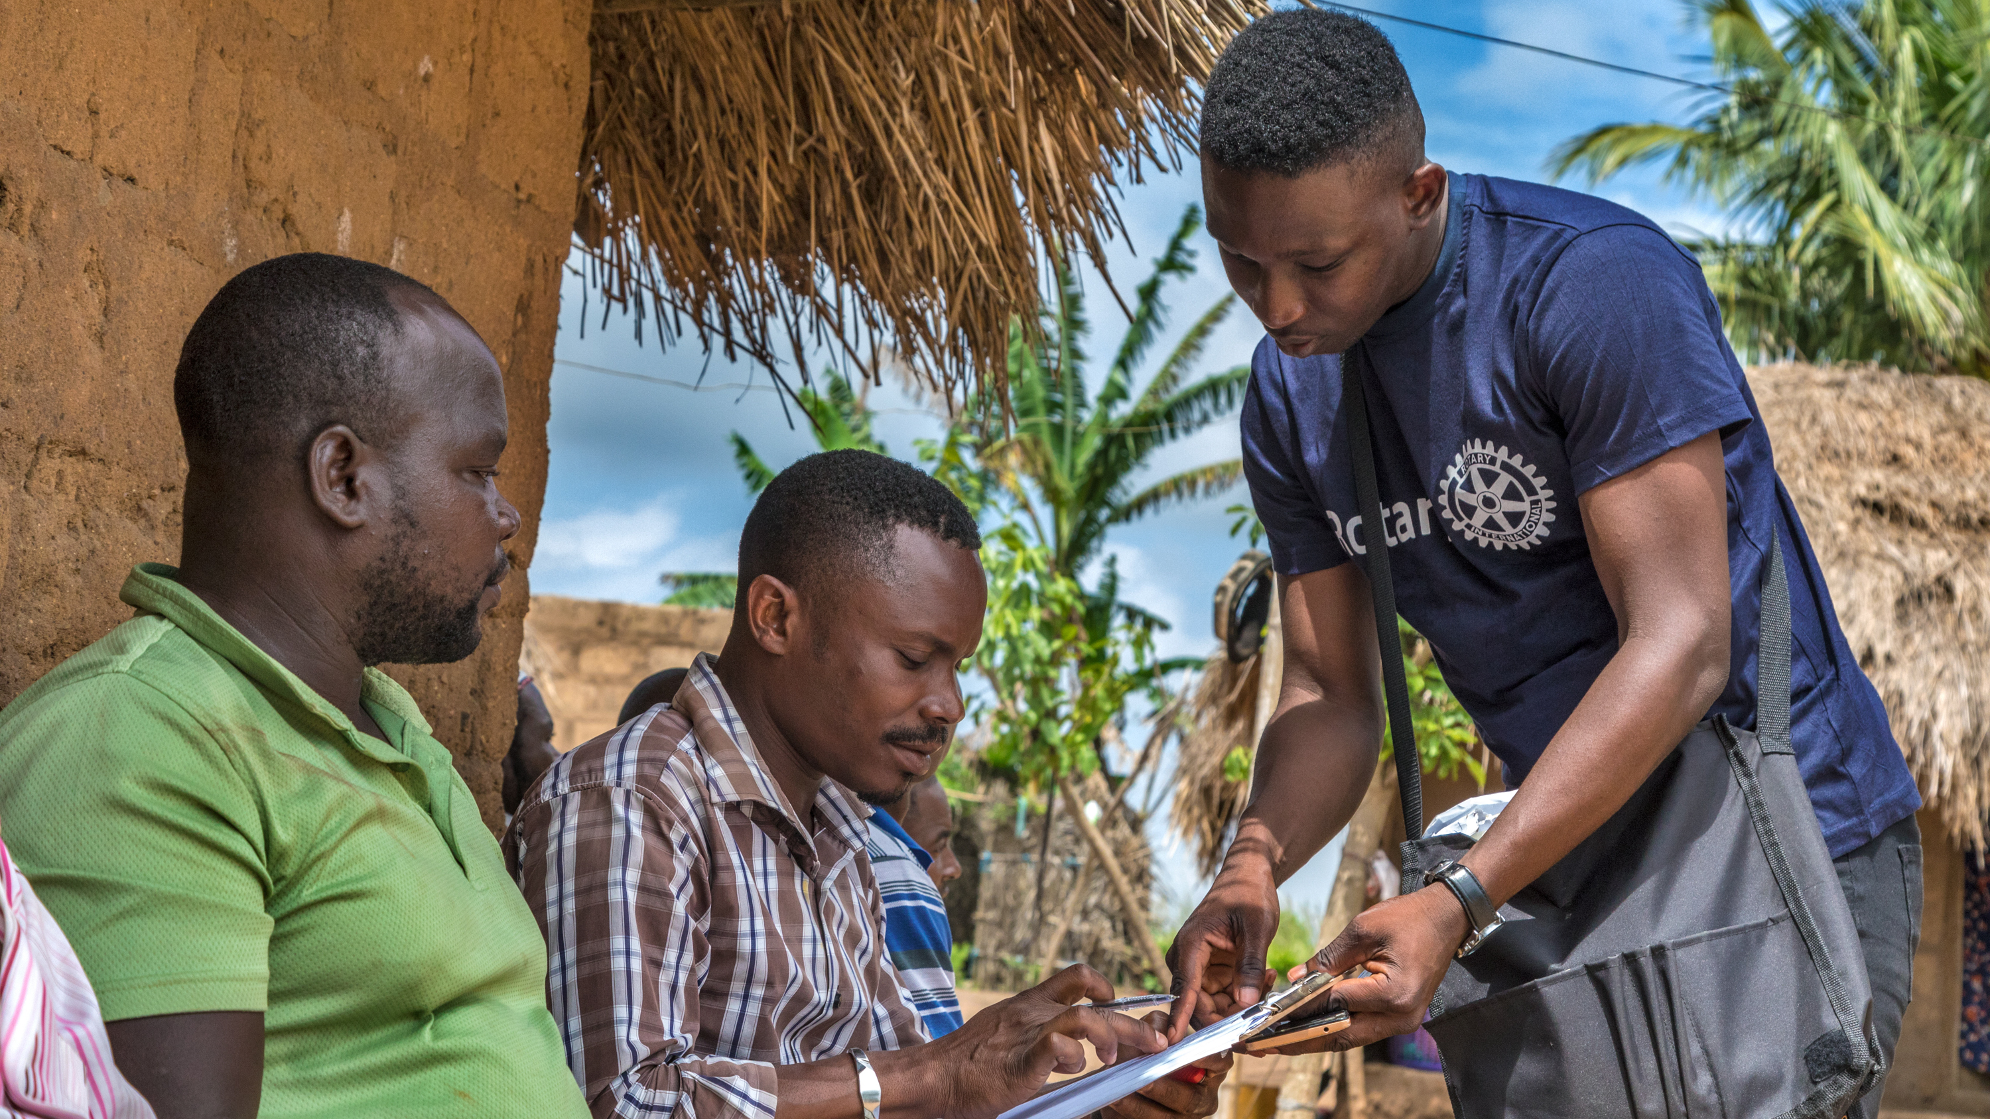
subhead
CLUB QUALIFICATION
Attend CLS – and if you missed it - complete the Grant Seminar Lesson on Rotary’s Learning Center
Remind your Club to give to The Rotary Foundation
Update your Foundation and Polio giving goals in Rotary Club Central
Ensure your club has paid their RI and District dues
Sign the MOU (on the District website)
Return the reporting form from last year
Apply before 30th September 2026

Slide 8
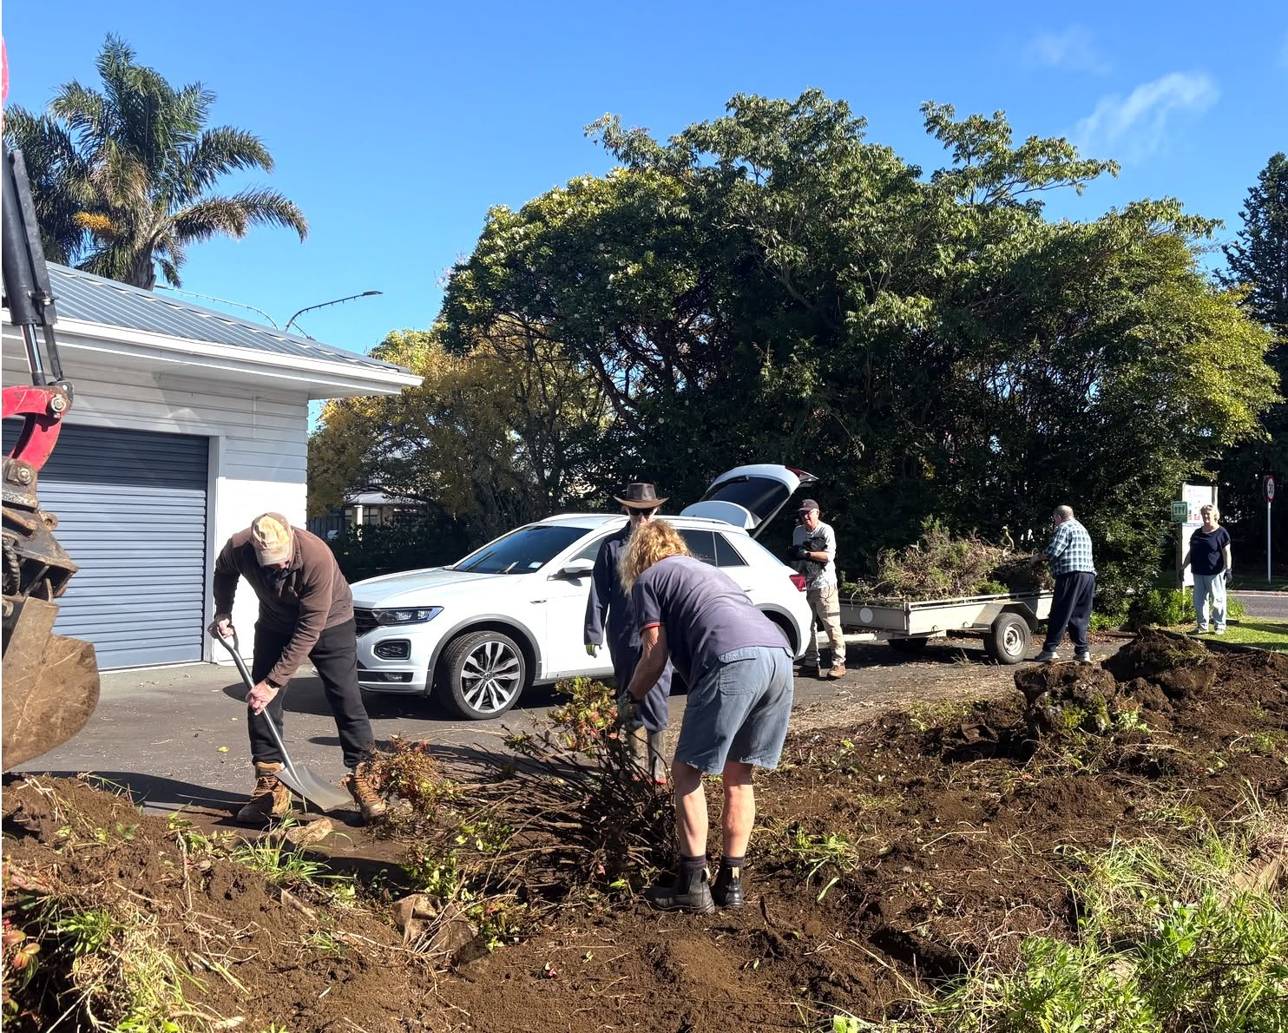
What makes a good District Grant project?
Consider what your community needs – ask around! Be receptive to new ideas
Get involved – how can your Rotarians be involved?
Ensure it has Rotary branding this creates profile and visibility
Consider the sustainability of the project – can you build on an existing partnership or involve other local businesses?
Take lots of photos and share them online (preferably with Rotary branding in them)

Slide 9
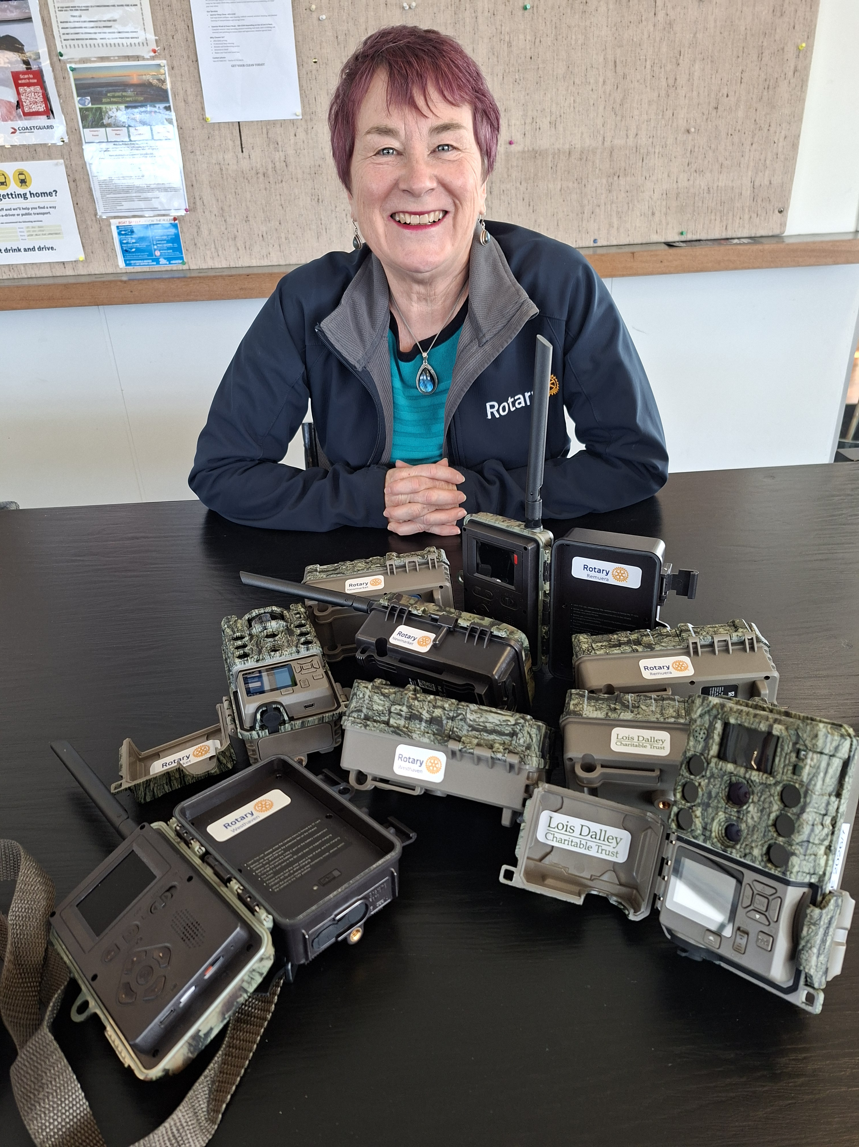
Other Nuts and Bolts stuff
Don’t start the project until you’ve received the funds
Ensure you have financial transparency and stewardship – keep receipts and good accounting practices
Consider branding opportunities in your grant application – adding a sign is often a small cost
Report on time
It’s vital we continue to showcase good stewardship of The Rotary Foundation’s funds.

Slide 10

subhead
TIPS for success
Start planning early including how you might raise funds
Got questions – get in touch
Create a project plan
Build partnerships
Consider branding and PR opportunities
Take photos and get testimonials
Take your club for a visit
Don’t forget your reporting

Slide 11
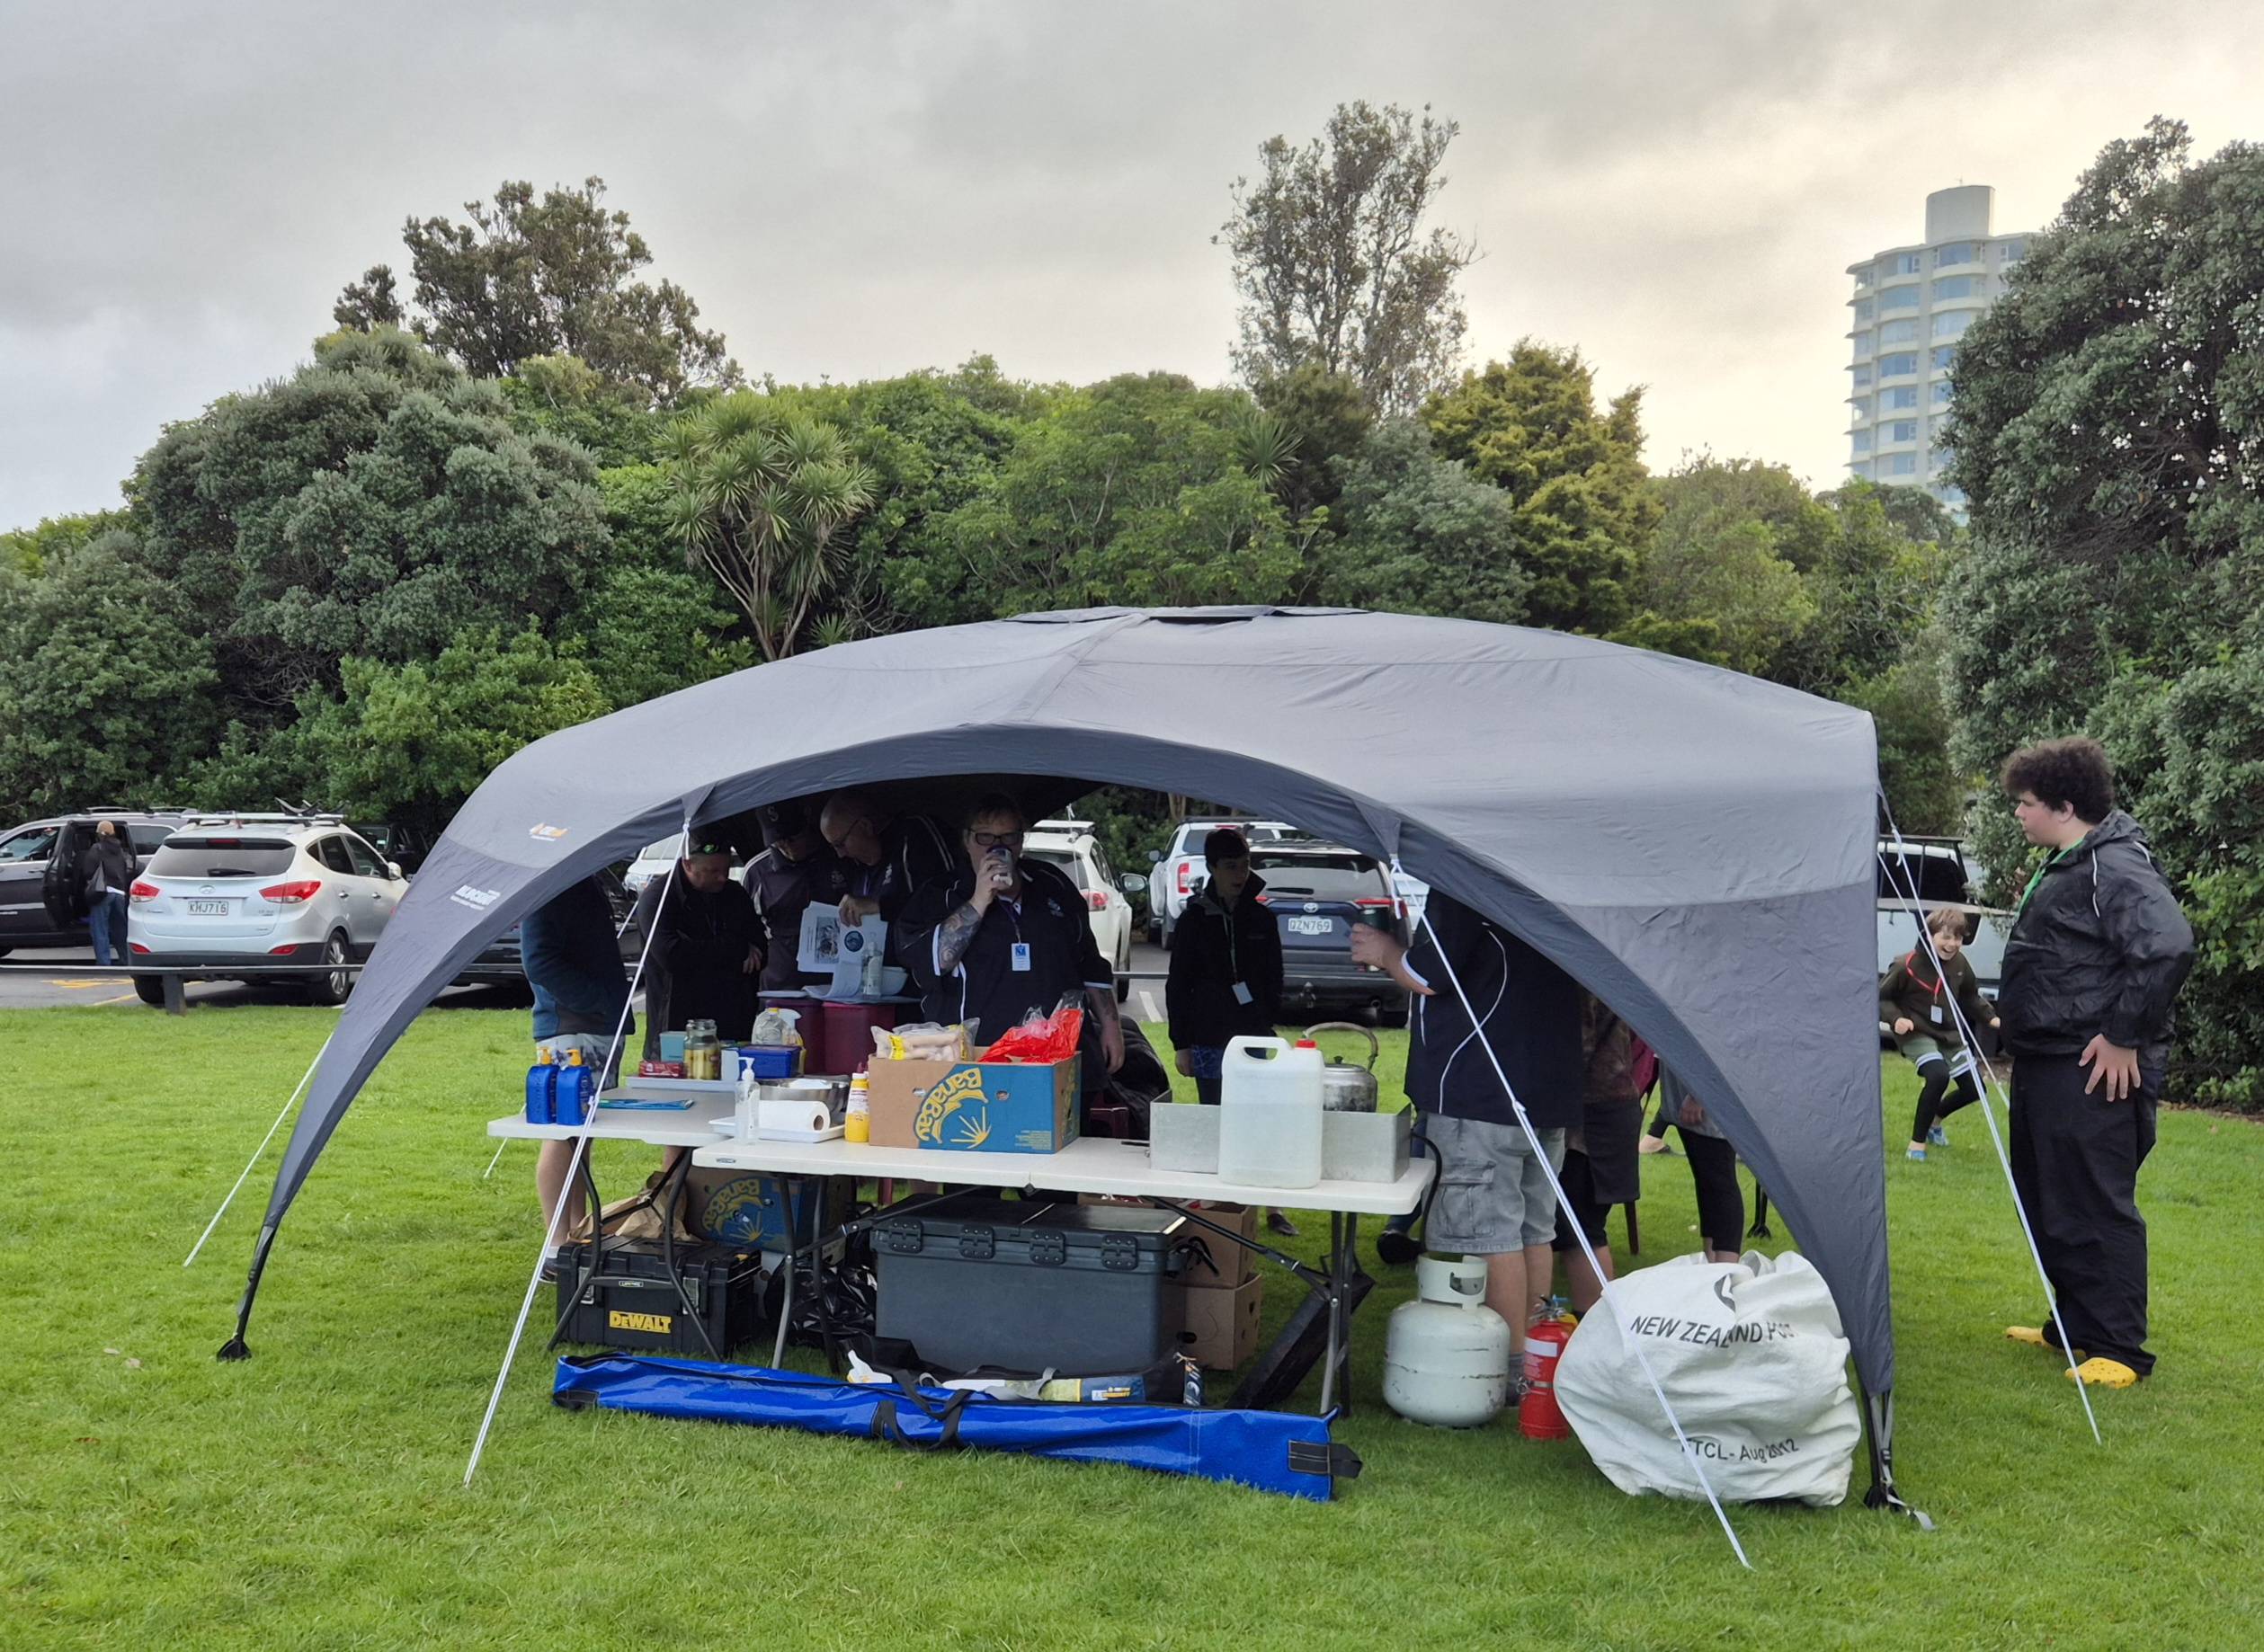
Examples of District Grants
Provision of a Calesca warming and thawing device for breastmilk for use by Special Care Baby Unit (SCBU) at North Shore Hospital. $1,800
Providing water filters for remote parts of Vanuatu. $3,000
Replacement sun umbrellas for Belmont Park Racquets Club. $2,126
BBQ tables and long tables to support Onepoto School Garden to Table project. $3,092
Providing school science and engineering kits for Matarau School. $2,720
Providing block out sunshades for Shackleton Sea Scouts. $1,830
Renew gardens, tidy sheds and provide planter boxes and a sunshade for Plunket Kerikeri. $4,000

Slide 12
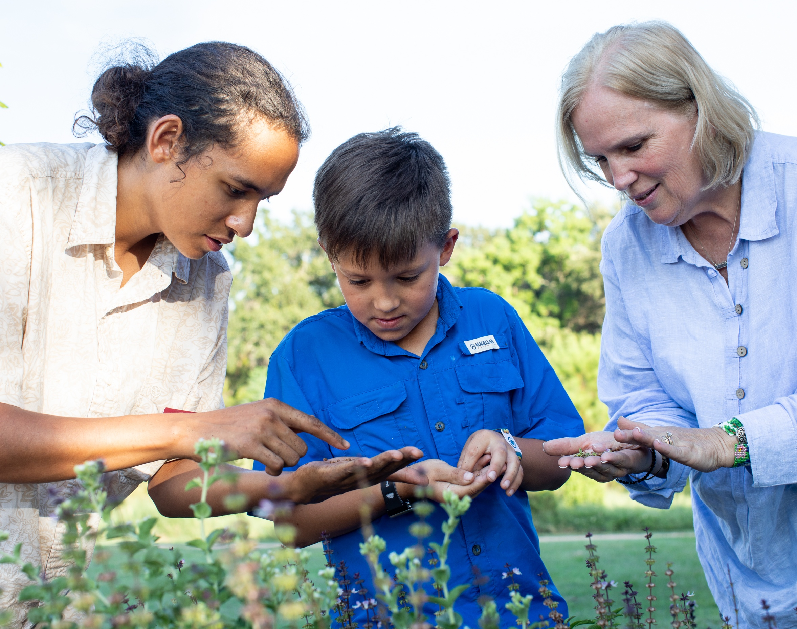
More info and resources
District website
Rotary Foundation website
Rotary Learning Center (For additional learning)
Recommend: Club Rotary Foundation Committee Essentials and Grant Seminar
Rotary Club Central (To load your goals)
Rotary Brand Center (To find logos and photos)
Rotary Service Project Centre (To find project ideas and project partners)
Rotary Foundation Australia (To find extra resources and further reports)

Slide 13

QUESTIONS?

Slide 14
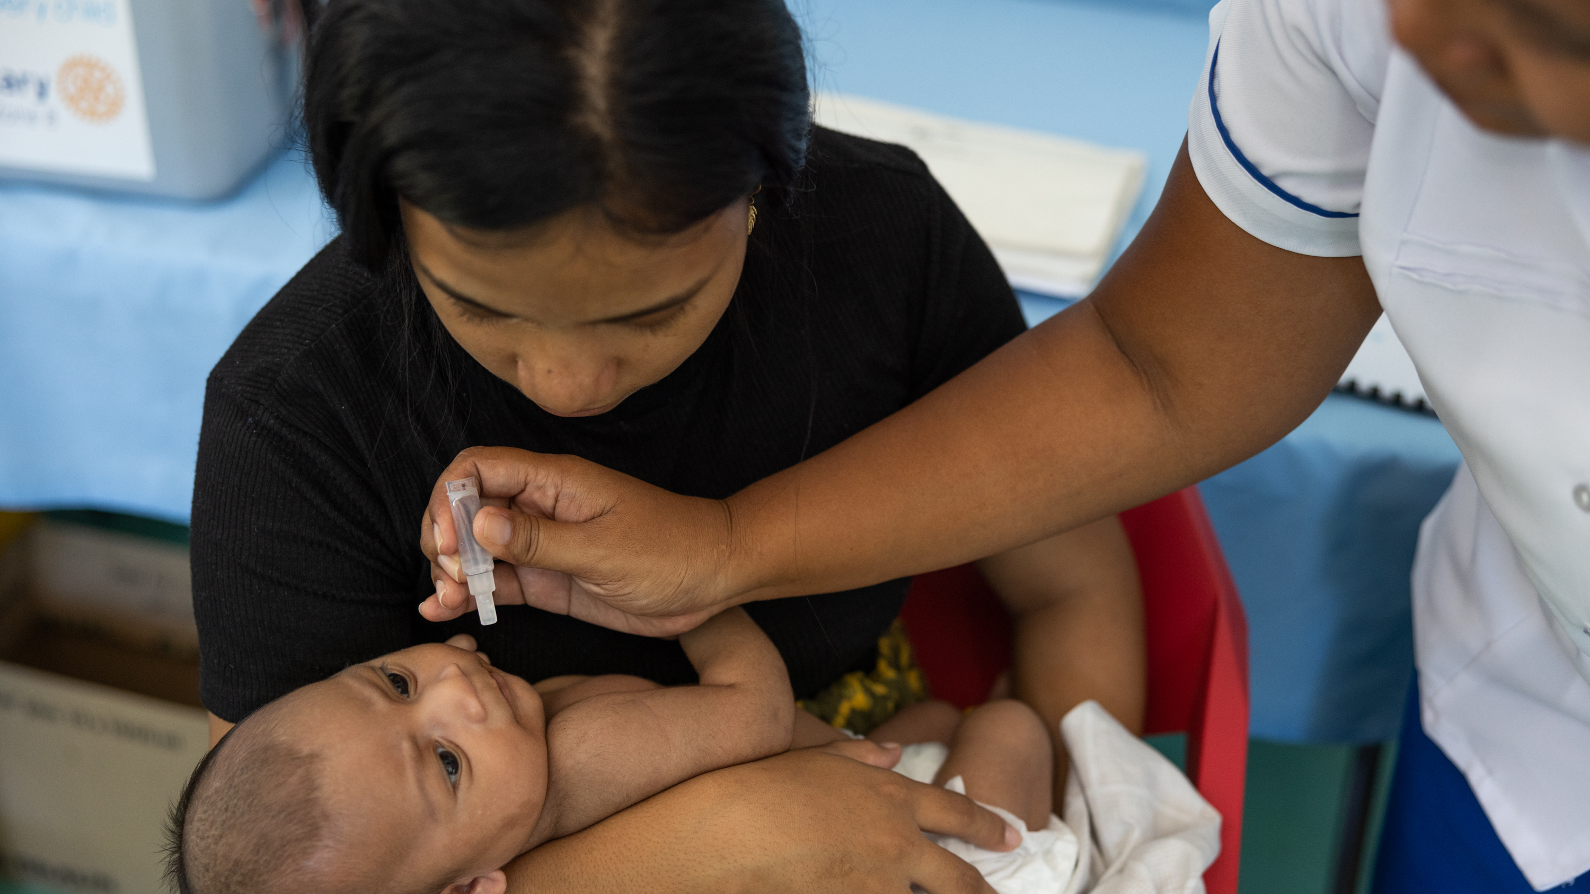
EVERY ONE CAN MAKE A DIFFERENCE

