Slide 1
PROMOTING ROTARY’S PUBLIC IMAGE
WORKBOOK CHAPTER 9

Slide 2
ROTARY PUBLIC IMAGE COORDINATOR
How I can work with you and your district:
1.
2.
3.

Slide 3
LEARNING OBJECTIVES
By the end of this session, you should be able to:
Understand the newest market research findings that inspired Rotary’s latest messaging and public image campaign
Use the new public image resources to enhance your communications efforts
Identify the qualities and skills of a successful district public image chair and appoint an effective public image team

Slide 4
BENEFITS OF PUBLIC IMAGE
Increased visibility
Increased membership and contributions
Engaged members
Partnerships and support for local projects

Slide 5
PUBLIC IMAGE RESEARCH FINDINGS
75% of respondents are aware of Rotary
35% are unfamiliar with any Rotary program
41% are familiar with local clubs
Members are “not like me”

Slide 6
PUBLIC IMAGE RESEARCH FINDINGS
We are attractive to purpose seekers
Individuals engage with us because of local impact
Members stay for relationships and shared values

Slide 7
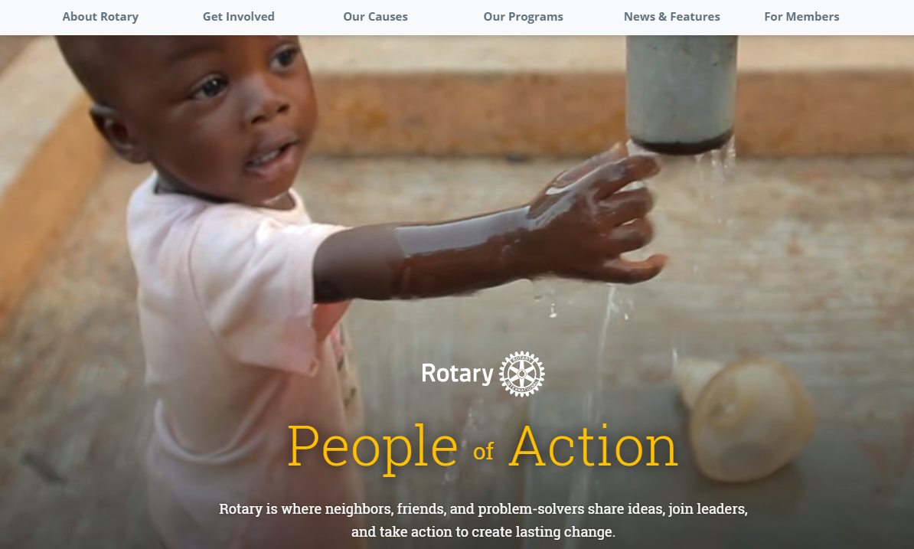
PEOPLE OF ACTION

Slide 8
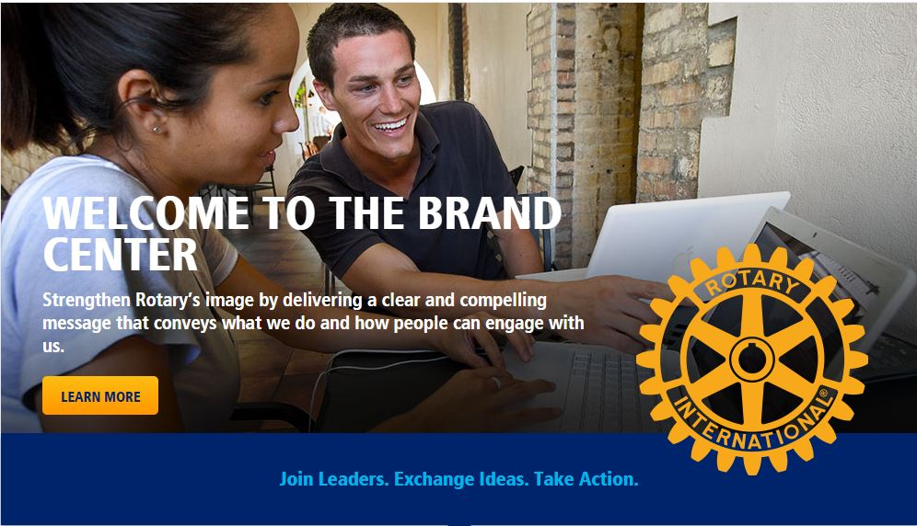
NEW AND ENHANCED RESOURCES
Messaging Guide
Helps tell Rotary’s story and engage audiences
Additional resources:
Event Planning Guide
Social Media and Public Relations guides

Slide 9
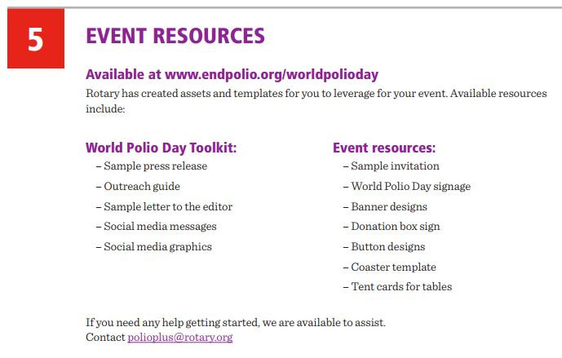
CREATE YOUR OWN TOOLKIT
Up-to-date facts and figures
Sample promotional channels
Suggested timelines
Key messages
Sample posts
Graphics
Infographics
Videos
Templates

Slide 10
SELECTING A PUBLIC IMAGE COMMITTEE
Professional background
Relationships with media professionals
Effectively conveys the essence of Rotary
Excellent speaking, presentation, and writing skills
Knowledge of media and communications
Thorough knowledge of club and district activities

Slide 11
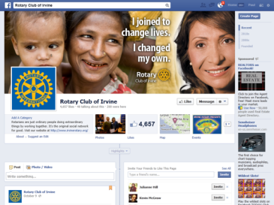
MAXIMIZE YOUR ONLINE PRESENCE
Is contact information easy to find?
Is it free of Rotary jargon?
Are there pictures?
Are there distinct sections for members and nonmembers?
Do you refresh your content regularly?

Slide 12
MEASURE IMPACT
Do local clubs have more recognition?
Is there less confusion about what Rotary is and does?
Do you have more opportunities to talk about Rotary?
Is it easier to tell the Rotary story?
Do you have stronger relationships with local media?

Slide 13
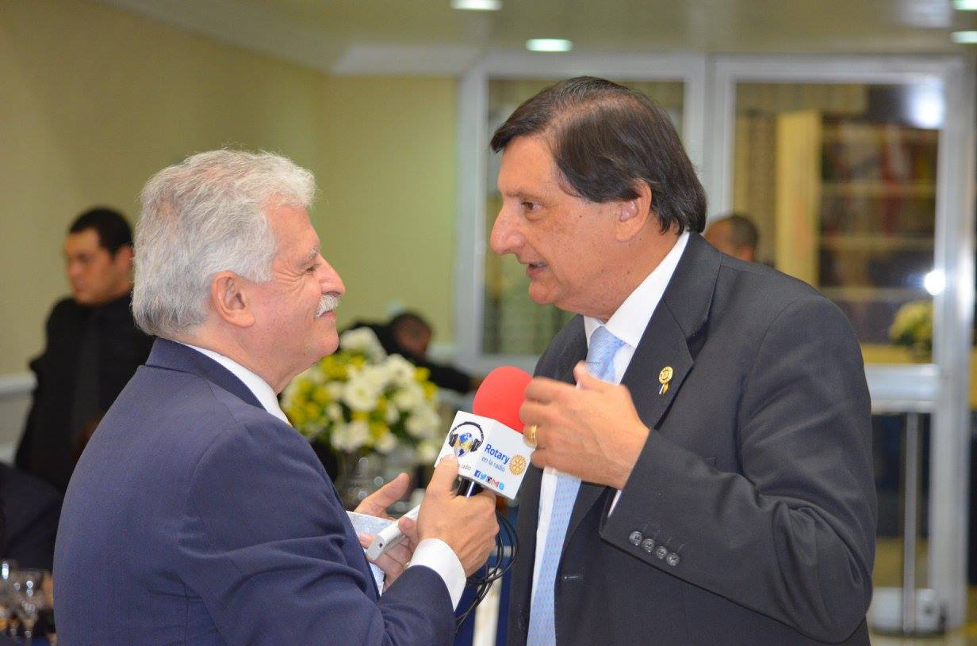
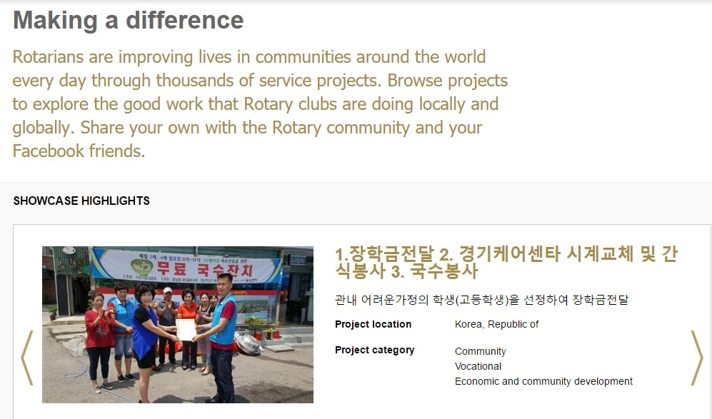
KEY RESOURCES
Brand Center
Press Center
Public Relations page
RPIC
Rotary Showcase

Slide 14
REVIEW OF LEARNING OBJECTIVES
By the end of this session, you should be able to:
Understand the newest market research findings that inspired Rotary’s latest messaging and public image campaign
Use the new public image resources to enhance your communications efforts
Identify the qualities and skills of a successful district public image chair and appoint an effective public image team

