Slide 1
Rotary Leadership Institute
PUBLIC IMAGE & PUBLIC RELATIONS
RLI - Part III
November 15, 2023
Dave Andrews

Slide 2
“As I further my Rotary journey, I will identify opportunities to promote the image of my club and Rotary to the benefit of my community and world”
Notes:
As I further my Rotary journey, I will identify opportunities to promote the image of my club and Rotary to the benefit of my community and world”

Slide 3
subhead
SESSION GOAL TONIGHT
Identify your club’s target audiences
and
how you can effectively reach them
Discover what resources are available to you
Notes:
Identify your club’s target audiences
and
how you can effectively reach them
Discover what resources are available to you

Slide 4
Public Relations and Public Image
Public relations efforts are vital to Rotary’s continued growth and service.
Creating a positive image for Rotary is the responsibility of every Rotarian, both locally and globally
Notes:
Public relations efforts are vital to Rotary’s continued growth and service.
Creating a positive image for Rotary is the responsibility of every Rotarian, both locally and globally

Slide 5


"In the promotion of understanding,
it is important to reach large numbers,
non-Rotarians as well as Rotarians,
and you cannot reach large numbers
privately.“
PaUl harris
said….
1935 (Peregrinations, vol II)
Notes:
"In the promotion of understanding,
it is important to reach large numbers,
non-Rotarians as well as Rotarians,
and you cannot reach large numbers
privately.“

Slide 6
WHY PUBLIC IMAGE
AND PUBLIC RELATIONS?
  Having strong public relations ensures that
  communities around the world know that…….
  Rotary is a credible organization that meets real needs.
  Worldwide, more than 2 million non-profits compete for
  limited volunteer hours, donor money, and other resources.
  Rotary has a great story to tell, but we need to tell it more simply and consistently.
Notes:
Having strong public relations ensures that
communities around the world know that…….
Rotary is a credible organization that meets real needs.
Worldwide, more than 2 million nonprofits compete for
limited volunteer hours, donor money, and other resources.
Rotary has a great story to tell, but we need to tell it more simply and consistently.

Slide 7
The Role of your club’s PR committee
To create and implement a plan
to tell Rotary’s story to the public and
to promote your club’s projects and
activities.
Notes:
To create and implement a plan
to tell Rotary’s story to the public and
to promote your club’s projects and
activities.

Slide 8
POSITIVE PUBLIC IMAGE
  When your Rotary Club has a positive public image:
  your current members are motivated to be active
        AND
  prospective members are eager to join your club.
Notes:
When your Rotary Club has a positive public image:
your current members are motivated to be active
AND
prospective members are eager to join your club.

Slide 9
Tonight’s presentation
This powerpoint presentation, in its entirety, can be seen on the ‘www.rotary7070.org’ District website
  Go to the “PUBLIC IMAGE” tab at the top of the page
  Scroll down and click on the tab “Public Image and Public Relations Presentation”
  And you will receive a copy from Susan after tonight’s session
Notes:
This powerpoint presentation, in its entirety, can be seen on the ‘www.rotary7070.org’ District website
Go to the “PUBLIC IMAGE” tab at the top of the page
Scroll down and click on the tab “Public Image and Public Relations Presentation”

Slide 10
Inserts & online MATERIALS RESOURCES
There are a number of the resource materials that will help YOU and your Rotary Club tell Rotary's story.
Take a look at them when you go home.
All available online.
To help your club carry out EFFECTIVE Public Relations practices
These resources really are the cornerstones you can use to create a positive Public Image for Rotary, and your Rotary Club.
Notes:
There are a number of the resource materials that will help YOU and your Rotary Club tell Rotary's story.
Take a look at them when you go home.
All available online.
To help your club carry out EFFECTIVE Public Relations practices
These resources really are the cornerstones you can use to create a positive Public Image for Rotary, and your Rotary Club.

Slide 11
MATERIALS / RESOURCES
1. The Refreshed Rotary Brand Center (Now available with AND without going into My Rotary - on the RI Website) .Try Googling “Rotary Brand Center”
2. Our Public Image Campaign:
People of Action ( in the Rotary Brand Center)
3. Media Crisis Handbook 515-EN
Rotary News and Features (My Rotary / News and Features)
Rotary Media Center
Notes:
1. Tell Rotary’s Story - Voice & Visual Identity Guide For
Rotarians 547A-EN
2. The Rotary Brand Center (My Rotary on the RI Website)
3. Our Public Image Campaign:
People of Action ( in the Rotary Brand Center)

Slide 12
MATERIALS / RESOURCES
6. “Public Relations” page (My Rotary/ Learning &
reference/Learn by Topic) on the RI rotary.org website
7. Public Image Tab of the Rotary7070.org website
Rotary Learning Center
Public Image Checklist
Web Presence Checklist
Notes:
4. Media Crisis Handbook 515-EN
5. Rotary News and Features (My Rotary / News and Features)
6. “Public Relations” page (My Rotary/ Learning &
reference/Learn by Topic) on the RI rotary.org website
7. Public Image Tab of the Rotary7070.org website

Slide 13
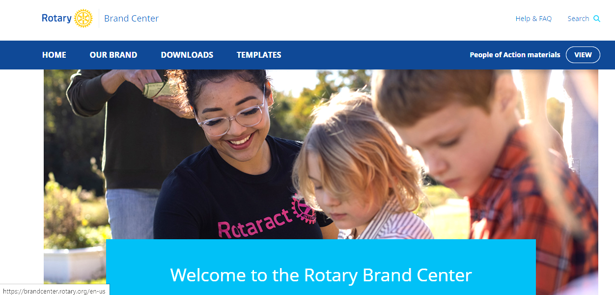
RESOURCE 1:
The Rotary Brand Center
It’s now easier than ever to strengthen Rotary’s image in your community
with the materials and resources available in the Rotary Brand Center.
Google: rotary brand center
OR
sign in to My Rotary
Notes:
It’s now easier than ever to strengthen Rotary’s image in your community
with the materials and resources available in the Rotary Brand Center.
Google: rotary brand center and
sign in to My Rotary

Slide 14
RESOURCE 1:
The Rotary Brand Center
The Rotary Brand Center:
  offers a simple and intuitive way to customize your club logo
  create a marketing brochure for your Club
  or give your newsletter AND WEBSITE a fresh look.
You’ll also find guidelines and answers to frequently asked questions as well as information about why telling our story is important.
Notes:
The Rotary Brand Center:
offers a simple and intuitive way to customize your club logo
create a marketing brochure for your Club
or give your newsletter AND WEBSITE a fresh look.
You’ll also find guidelines and answers to frequently asked questions as well as information about why telling our story is important.

Slide 15
RESOURCE 1:
The Rotary Brand Center
The Brand Center is organized into three sections:
Our brand — Learn about the elements that make up our brand, how to promote Rotary and your club, and how to use our People of Action materials to strengthen Rotary's brand.
Downloads — Download ready-made promotional materials, including print and digital ads, images, videos, and audio.
Templates — Create your own club, district, and zone logos and promotional materials with easy-to-use and customizable templates.
Notes:
The Brand Center is organized into three sections:
Our brand — Learn about the elements that make up our brand, how to promote Rotary and your club, and how to use our People of Action materials to strengthen Rotary's brand.
Downloads — Download ready-made promotional materials, including print and digital ads, images, videos, and audio.
Templates — Create your own club, district, and zone logos and promotional materials with easy-to-use and customizable templates.

Slide 16
RESOURCE 1:
The Rotary Brand Center
Find What You Are Looking For
The Brand Center is structured to make it easy for you to promote Rotary and your club in your community.
You'll find quick links to our most popular tools, recommendations for related resources, and more:
A quick link in the navigation bar takes you to all our People of Action materials.
A drop-down menu on the homepage links you to the right tools based on what you're trying to do.
Notes:
The Brand Center is structured to make it easy for you to promote Rotary and your club in your community. You'll find quick links to our most popular tools, recommendations for related resources, and more:
A quick link in the navigation bar takes you to all our People of Action materials.
A drop-down menu on the homepage links you to the right tools based on what you're trying to do.
Boxes labeled Top downloads and Top templates identify what's popular now.
Boxes labeled You might be looking for suggest resources that can help.
Boxes labeled You might be interested in offer related resources to explore

Slide 17
RESOURCE 1:
The Rotary Brand Center
Find What You Are Looking For
Boxes Labelled:
Top downloads and Top templates identify what's popular now.
You might be looking for suggest resources that can help.
You might be interested in offer related resources to explore.
Notes:
The Brand Center is structured to make it easy for you to promote Rotary and your club in your community. You'll find quick links to our most popular tools, recommendations for related resources, and more:
A quick link in the navigation bar takes you to all our People of Action materials.
A drop-down menu on the homepage links you to the right tools based on what you're trying to do.
Boxes labeled Top downloads and Top templates identify what's popular now.
Boxes labeled You might be looking for suggest resources that can help.
Boxes labeled You might be interested in offer related resources to explore

Slide 18
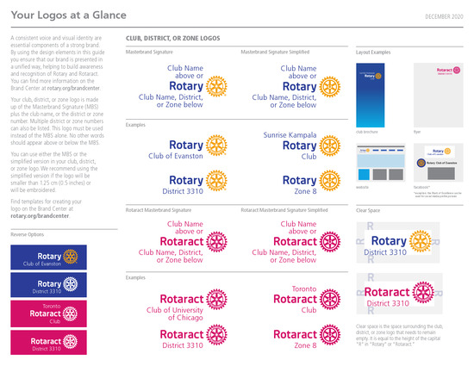
yOUR ROTARY LOGO
Notes:
The Brand Center is structured to make it easy for you to promote Rotary and your club in your community. You'll find quick links to our most popular tools, recommendations for related resources, and more:
A quick link in the navigation bar takes you to all our People of Action materials.
A drop-down menu on the homepage links you to the right tools based on what you're trying to do.
Boxes labeled Top downloads and Top templates identify what's popular now.
Boxes labeled You might be looking for suggest resources that can help.
Boxes labeled You might be interested in offer related resources to explore

Slide 19
yOUR ROTARY LOGO
A consistent voice and visual identity are essential components of a strong brand.
By using the design elements in the Brand Center, you ensure that our brand is presented in a unified way, helping to build awareness and recognition of Rotary and Rotaract.
Notes:
A consistent voice and visual identity are essential components of a strong brand. By using the design elements in this guide you ensure that our brand is presented in a unified way, helping to build awareness and recognition of Rotary and Rotaract.
Your club logo is made up of the Masterbrand Signature (MBS) plus the club name. This logo must be used instead of the MBS alone. No other words should appear above or below the MBS.

Slide 20
yOUR ROTARY LOGO
Your club logo is made up of the Masterbrand Signature (MBS) plus your club name.
This logo must be used instead of the MBS alone.
No other words should appear above or below the MBS.
Notes:
A consistent voice and visual identity are essential components of a strong brand. By using the design elements in this guide you ensure that our brand is presented in a unified way, helping to build awareness and recognition of Rotary and Rotaract.
Your club logo is made up of the Masterbrand Signature (MBS) plus the club name. This logo must be used instead of the MBS alone. No other words should appear above or below the MBS.

Slide 21
yOUR ROTARY LOGO
The word “Rotary” always appears before our emblem in all of our signatures
This official logo is our masterbrand signature, which should be used wherever possible.
The mark of excellence (the Rotary wheel) should not appear alone
Notes:
A consistent voice and visual identity are essential components of a strong brand. By using the design elements in this guide you ensure that our brand is presented in a unified way, helping to build awareness and recognition of Rotary and Rotaract.
Your club logo is made up of the Masterbrand Signature (MBS) plus the club name. This logo must be used instead of the MBS alone. No other words should appear above or below the MBS.

Slide 22



yOUR ROTARY LOGO

Slide 23




RESOURCE 2:
The People of Action
The People of Action message provides a simple, consistent answer to the question, “What is Rotary?” and rallies us around a single idea: telling — and showing — the world that we are people of action.
Notes:
The People of Action message provides a simple, consistent answer to the question, “What is Rotary?” and rallies us around a single idea: telling — and showing — the world that we are people of action.

Slide 24
RESOURCE 2: in the Rotary Brand Center people of action
Still going strong - our public image campaign: People of Action
  It is a multi year campaign that narrows the gap between public awareness and public understanding of ROTARY
  Download ads and materials TODAY
  This is our global brand strengthening initiative
Notes:
Still going strong - our public image campaign: People of Action
It is a multi year campaign that narrows the gap between public awareness and public understanding of ROTARY
Download ads and materials TODAY
This is our global brand strengthening initiative

Slide 25
RESOURCE 2:
The People of Action
People of Action: campaign materials now available in The Rotary Brand Center:
  Videos
  Print Ads
  Outdoor Ads
  Online Ads
  Radio ads and scripts
  Campaign style guide and guidelines
  Templates created for you to customize with local images and content
  Use an ad specific to YOUR story
Notes:
People of Action: campaign materials now available in The Rotary Brand Center:
Videos
Print Ads
Outdoor Ads
Online Ads
Radio ads and scripts
Campaign style guide and guidelines
Templates created for you to customize with local images and content
Use an ad specific to YOUR story

Slide 26

RESOURCE 3:
MEDIA CRISIS HANDBOOK 515-EN
An effective media crisis plan is based , first and foremost,
on the principles of truth, transparency, and sincerity
It is a “How To” guide of what to do:
  What to Do When Reporters Call
  What to Do If A Crisis Develops
  What To Do When the Media Contact You
  How to Maintain The Proper Attitude During Interviews
  What Mistakes To Avoid
  How Actions Speak Volumes
  How To Obtain Media Assistance From
  RI’s PR & Media Relations Staff
Notes:
An effective media crisis plan is based , first and foremost,
on the principles of truth, transparency, and sincerity
It is a “How To” guide of what to do:
What to Do When Reporters Call
What to Do If A Crisis Develops
What To Do When the Media Contact You
How to Maintain The Proper Attitude During Interviews
What Mistakes To Avoid
How Actions Speak Volumes
How To Obtain Media Assistance From
RI’s PR & Media Relations Staff

Slide 27
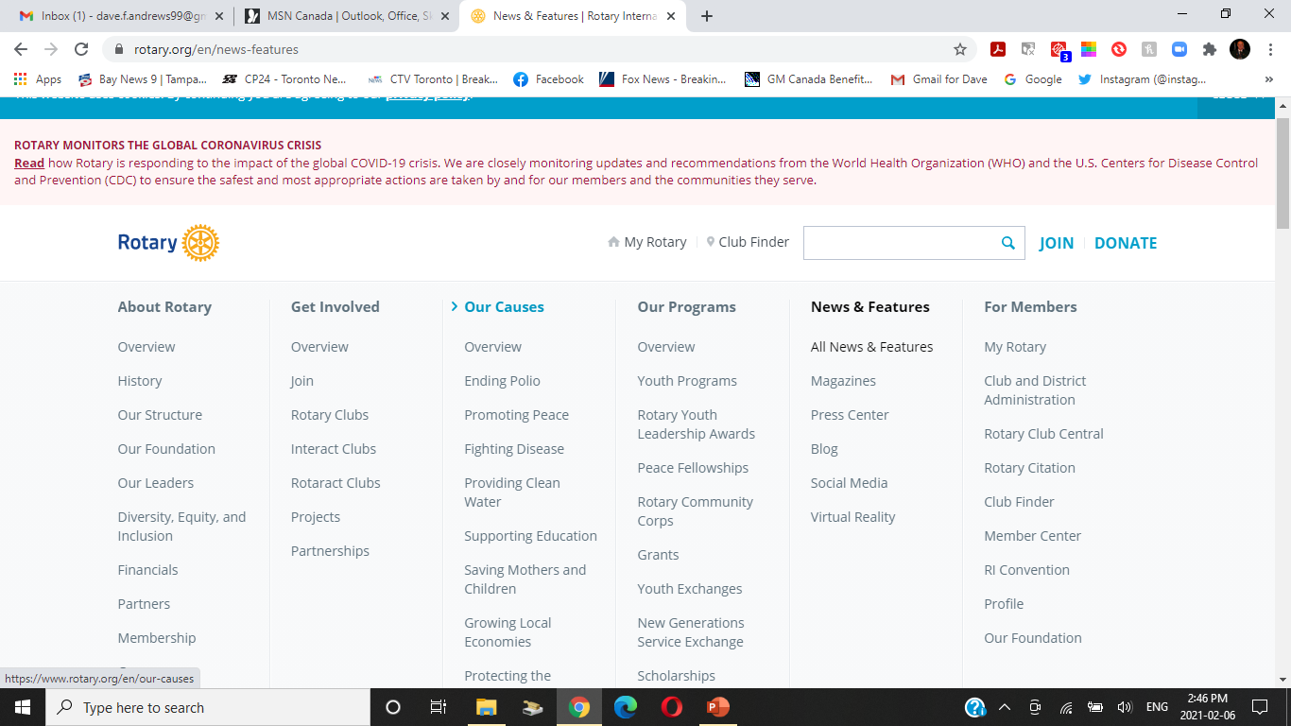
RESOURCE 4:
“news and features ”
ON THE ROTARY.ORG WEBSITE
Viewable on the rotary.org website.
  Go to the rotary.org website
  Get into My Rotary
  Go to the “News and Features” scroll bar
  Scroll down through and see
  All of the resource materials
  OR
  just google: rotary news and features
Notes:
Viewable on the rotary.org website.
Go to the rotary.org website
Get into My Rotary
Go to the “News and Features” scroll bar
Scroll down through and see
All of the resource materials
OR
just google: rotary news and features

Slide 28
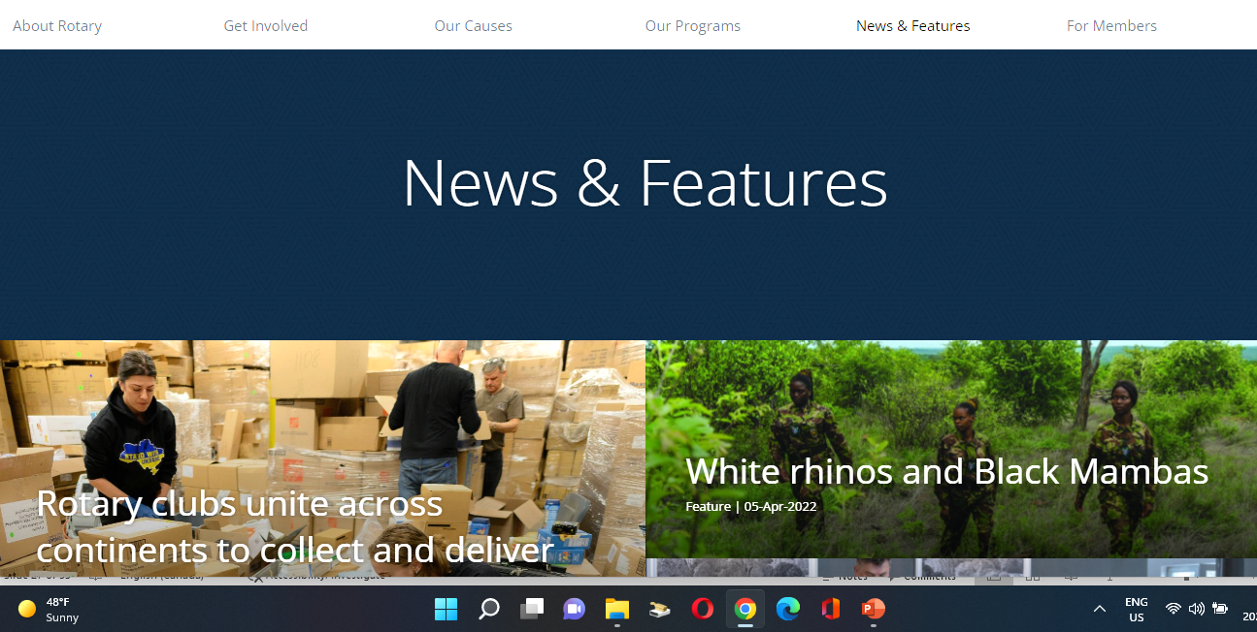
RESOURCE 5:
“ROTARY MEDIA CENTRE ”
This is Your Source for:
Rotary:
    News and Features (Press releases ;
    Fact Sheets ; Feature Articles;
    Rotary at a glance; Rotary and Polio)
    Rotary Magazine issues
    Rotary Press Center (Rotary Fact Sheets
    and News Releases)
    Links to all of Rotary’s Social Media Outlets
    Rotary’s Virtual Reality Films
Notes:
This is Your Source for:
Rotary:
News and Features (Press releases ; Fact Sheets ; Feature Articles;
Rotary at a glance; Rotary and Polio)
Rotary Magazine issues
Rotary Press Center (Rotary Fact Sheets and News Releases)
Links to all of Rotary’s Social Media Outlets
Rotary’s Virtual Reality Films

Slide 29
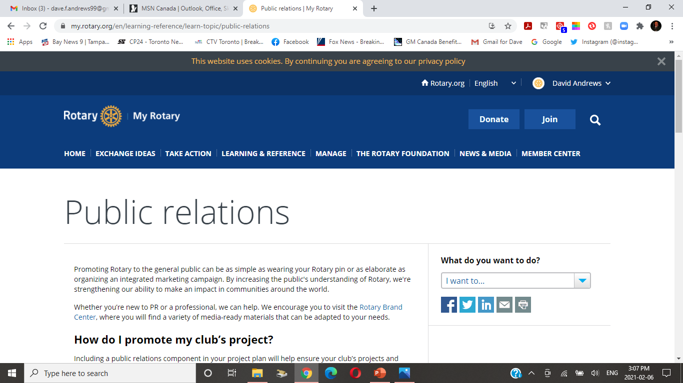
RESOURCE 6:
“Public Relations”
ON THE ROTARY.ORG WEBSITE
log in to “My Rotary” on the
rotary.org website
Go to the “Learning & Reference”
on the scroll bar
Go to “Learn By Topic” and
Hit: “Public Relations”
Notes:
log in to “My Rotary” on the
rotary.org website
Go to the “Learning & Reference”
on the scroll bar
Go to “Learn By Topic” and
Hit: “Public Relations”

Slide 30
RESOURCE 6:
“Public Relations”
ON THE ROTARY.ORG WEBSITE
This is one PR page on the RI website, filled with links and ideas that can help you create a successful campaign.
Know your local media – develop a media list, invite journalists to your meetings, ask them to join
Write a press release that journalists want to read - Including the five Ws in the opening paragraph of your press release: Who, What, Where, When, Why
Ideas for promoting Rotary – special events, starting a Facebook Page, advertising on Cable TV, placing an ad on a billboard, op eds, letters to the editor, club brochures, Post on your club website and social media outlets, including blogs, Facebook, Twitter, YouTube, Instagram
Excellent Resources and references
Notes:
is is one PR page on the RI website, filled with ideas that can help you create a successful campaign.
Know your local media – develop a media list, invite journalists to your meetings, ask them to join
Write a press release that journalists want to read - Including the five Ws in the opening paragraph of your press release: Who, What, Where, When, Why
Ideas for promoting Rotary – special events, starting a Facebook Page, advertising on Cable TV, placing an ad on a billboard, op eds, letters to the editor, club brochures, Post on your club website and social media outlets, including blogs, Facebook, Twitter, YouTube, Instagram
Excellent Resources and references

Slide 31
USE THE 5 W’s
You can use the five W’s to tell your Rotary story almost anywhere:
  in the first sentence of a press release
  in your club bulletins,
  The first sentence of a Facebook Page post and in other social media – just make sure that journalists want to read it
Who? - The main focus of your story; a person or group at the center of the story
What? - The event or project with which your club is involved
Where? - The location of the event, including a street address
When? - The time, day, and date of an event, or the time period involved for a person or project
Why? - The reason the event, person, or project is significant to the general public
Notes:
is is one PR page on the RI website, filled with ideas that can help you create a successful campaign.
Know your local media – develop a media list, invite journalists to your meetings, ask them to join
Write a press release that journalists want to read - Including the five Ws in the opening paragraph of your press release: Who, What, Where, When, Why
Ideas for promoting Rotary – special events, starting a Facebook Page, advertising on Cable TV, placing an ad on a billboard, op eds, letters to the editor, club brochures, Post on your club website and social media outlets, including blogs, Facebook, Twitter, YouTube, Instagram
Excellent Resources and references

Slide 32
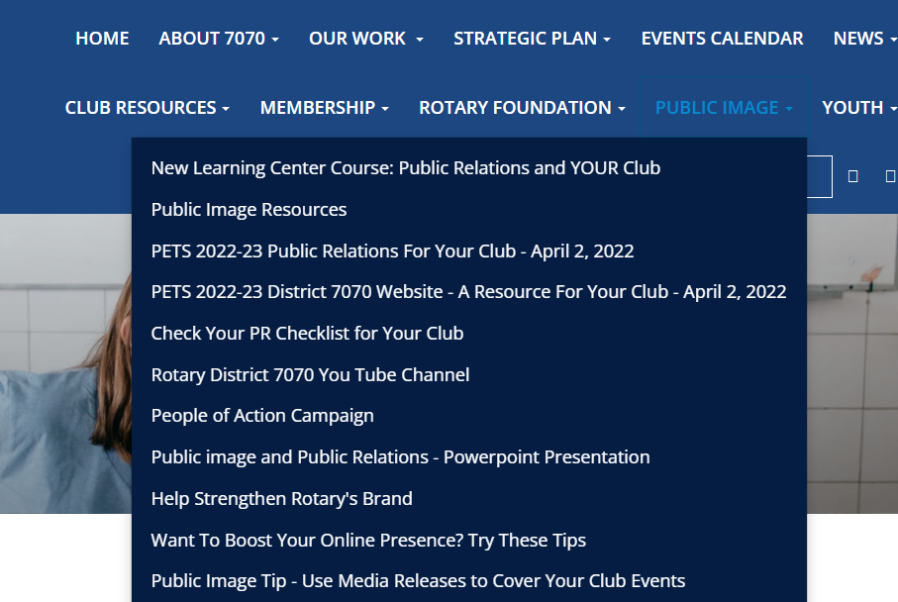
RESOURCE 7:
Public image tab
ON THE ROTARY7070.ORG WEBSITE
This is Your Source for:
New Learning Center Course: PR
Public Image Resources
PETS 2022-23 PR For Your Club
PETS 2022-23 Distr Website Resource
Check Your PR Checklist for your club
District 7070 You Tube Channel
People of Action Campaign
Public Image Newsletters
Promoting Rotary’s Public Image
Rotary’s Voice & Visual Guide
Public Relations Committee Manual
Promoting Rotary In Your Community
Our Rotary Identity At A Glance
What Is Rotary’s New Voice
Public Image & Public Relations Presentation
District 7070 Social Media
Notes:
This is Your Source for:
Public Relations Checklist for your club
Public Image Resources
District 7070 You Tube Channel
People of Action Campaign
Public Image Newsletters
Promoting Rotary’s Public Image
Rotary’s Voice & Visual Guide
Public Relations Committee Manual
Promoting Rotary In Your Community
Our Rotary Identity At A Glance
What Is Rotary’s New Voice
Public Image & Public Image Presentation
District 7070 Social Media

Slide 33
RESOURCE 8:
ROTARY LEARNING CENTER
9 COURSES ON PUBLIC IMAGE
GO TO the Rotary Learning Center (on the rotary.org website when you sign in to MyRotary) .
Here are the courses
  Building Rotary’s Public Image
  Club Public Image Committee Basics
  District Public Image Committee Intermediate
  Our Logo: Representing Rotary
  Promoting Rotary On Social Media
  Promoting Your Club as People of Action
  Public Image
  Public Relations and Your Club
  The Rotary Brand

Slide 34
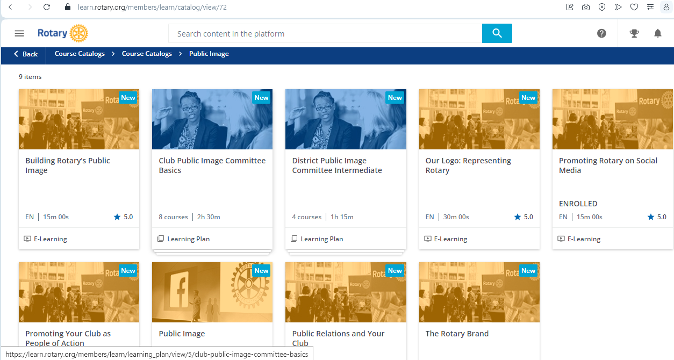
RESOURCE 8:
ROTARY LEARNING CENTER
9 COURSES ON PUBLIC IMAGE
Notes:
This is Your Source for:
Public Relations Checklist for your club
Public Image Resources
District 7070 You Tube Channel
People of Action Campaign
Public Image Newsletters
Promoting Rotary’s Public Image
Rotary’s Voice & Visual Guide
Public Relations Committee Manual
Promoting Rotary In Your Community
Our Rotary Identity At A Glance
What Is Rotary’s New Voice
Public Image & Public Image Presentation
District 7070 Social Media

Slide 35
RESOURCE 9 & 10:
PUBLIC IMAGE CHECKLIST
& WEB PRESENCE CHECKLIST
Club Public Image Checklist from the Rotary International PR Team
https://clubrunner.blob.core.windows.net/00000050157/en-ca/files/sitepage/public-image/club-public-image-checklist/Club-public-image-chair-checklist-en---Jan-16--2023.pdf
Club Web Presence Checklist from the Rotary International PR Team
https://clubrunner.blob.core.windows.net/00000050157/en-ca/files/sitepage/public-image/club-web-presence-assessment/Web_Presence_Assessment-en.pdf

Slide 36
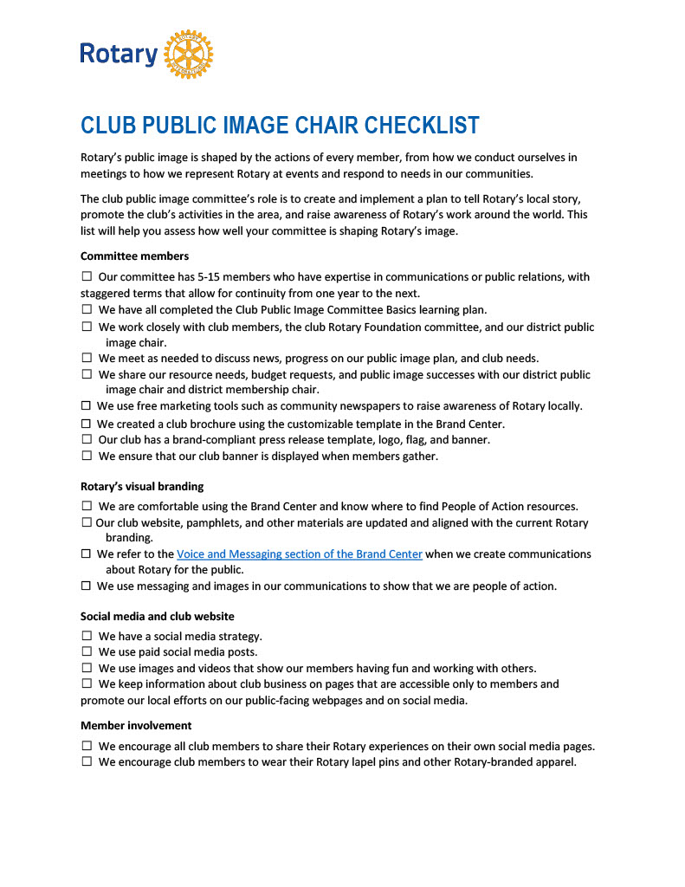
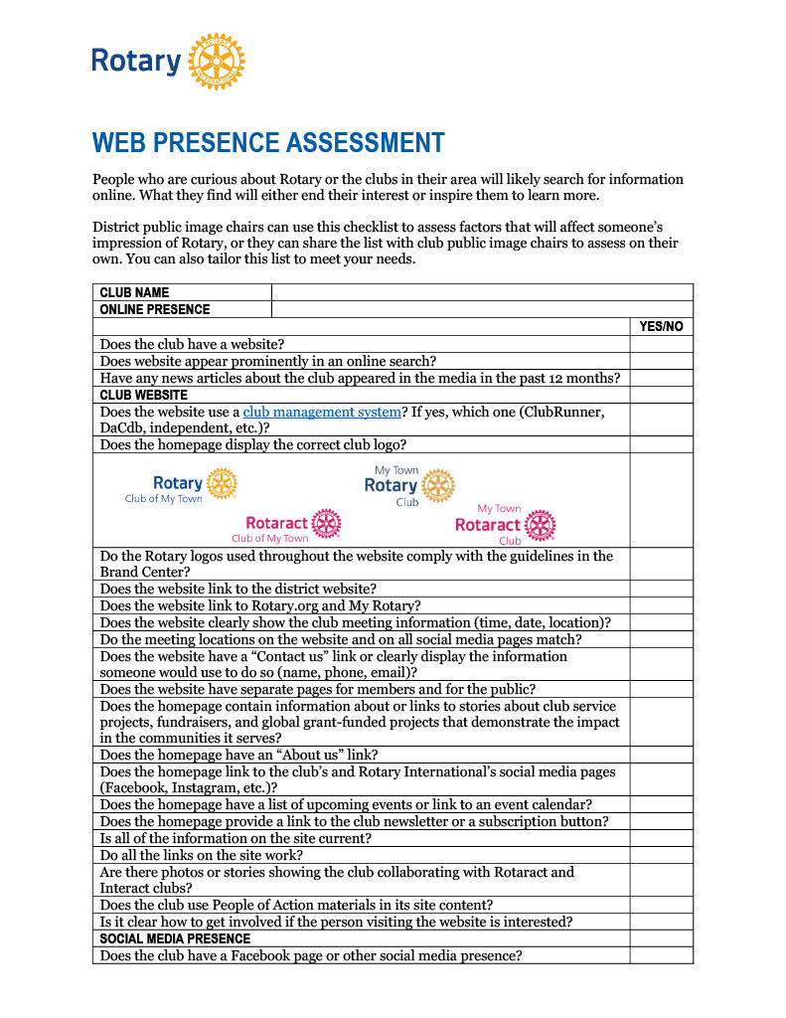
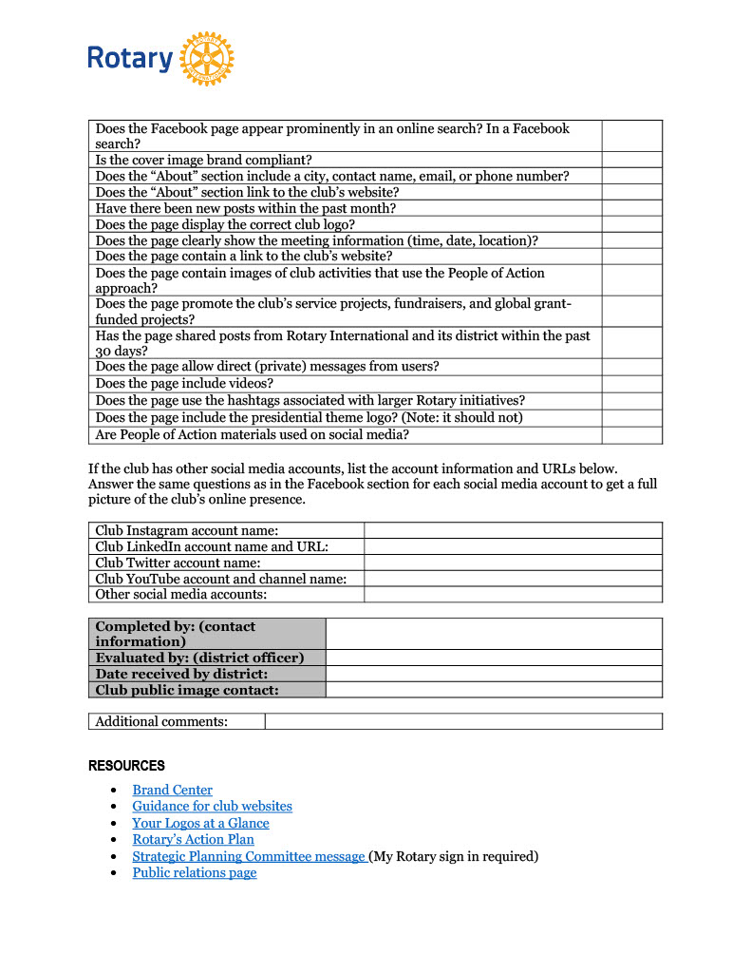
RESOURCE 9 & 10:
PUBLIC IMAGE CHECKLIST
& WEB PRESENCE CHECKLIST
Club Public Image Checklist Club Web Presence Checklist

Slide 37
Publicity, Public Relations, and Public Image
  What is the difference? Which ones can we control?
  PUBLICITY
  the activity of creating a good opinion among people about your Rotary Club
  that makes people notice your Rotary Club
Notes:
What is the difference? Which ones can we control?
PUBLICITY
the activity of creating a good opinion among people about your Rotary Club
that makes people notice your Rotary Club

Slide 38
Publicity, Public Relations, and Public Image
  What is the difference? Which ones can we control?
  PUBLIC RELATIONS
  the relationship between your Rotary Club and the public
Notes:
What is the difference? Which ones can we control?
PUBLIC RELATIONS
the relationship between your Rotary Club and the public

Slide 39
Publicity, Public Relations, and Public Image
  What is the difference? Which ones can we control?
  PUBLIC IMAGE
  is the concept that the ideas and the opinions that the public have about your Rotary Club may or may not be what they really are
Notes:
What is the difference? Which ones can we control?
PUBLIC IMAGE
is the concept that the ideas and the opinions that the public have about your Rotary Club may or may not be what they really are

Slide 40
Who Are Your Publics?
Who are your publics or target audiences?
Notes:
Who are your publics?
Who are your target audiences?

Slide 41
Who Are Your Publics?
the media
local government officials
the business community
civic leaders and other organizations
prospective members
Your current members
people directly affected by Rotary service projects.
Notes:
the media
local government officials
the business community
civic leaders and other organizations
prospective members
Your current members
people directly affected by Rotary service projects.

Slide 42
What is the image of Rotary in your community?
  Focus on “Your Rotary Club” and not on your particular members
  If you asked someone “on the street”:
  Would they know there is a Rotary Club in your community? How would they know?
  Would they know it is YOUR Rotary Club? How would they know?
  Would they know what your Rotary Club does in your community and beyond? How would they know?
Notes:
Focus on “Your Rotary Club” and not on your particular members
If you asked someone “on the street”:
Would they know there is a Rotary Club in your community?
Would they know it is YOUR Rotary Club?
Would they know what your Rotary Club does in your community and beyond?

Slide 43
  Lets have a DISCUSSION: 10 minutes
Focus on “Your Rotary Club”
  How does the public know there is a Rotary Club in your community?
  How does the public know it is YOUR Rotary Club?
  What are some ways that your club tells the public
  - who you are and what you do in your community and beyond?
What “Tools of the Trade” does your club use to tell who you are and
what you do in the community
Give us some examples of success stories
Notes:
BREAKOUT ROOM DISCUSSION: 10 minutes
Get into 2 Groups - Group # 1 and # 2
When we come back , we will need one Spokesperson to tell us all about what you talked about
GROUP # 1
Focus on “Your Rotary Club”
How does the public know there is a Rotary Club in your community?
How does the public know it is YOUR Rotary Club?
What are some ways to let the public know what your Rotary Club does in your community and beyond?

Slide 44
How can your club BOOST YOUR PUBLIC IMAGE?
  Visible, sustainable hallmark projects
  Promoting club activities and programs in the traditional and social media (newspaper, radio, TV,
  magazine, Facebook, Twitter, Instagram, etc)
  Signage in your community
Web presence – do you have one? Is it up to date?
  Individual Rotarians keeping Rotary in the forefront of their personal & business life
  Wear your Rotary pin, display the Four Way Test and Objects of Rotary banners where you work
  Use a “Rotary” Zoom Background
Notes:
Visible, sustainable hallmark projects
Promoting club activities and programs in the media (newspaper, radio, TV, magazine, Facebook,
Twitter, Instagram, etc)
Signage in your community
Web presence
Individual Rotarians keeping Rotary in the forefront of their personal & business life
Wear your Rotary pin, display the Four Way Test and Objects of Rotary banners in your office
Use a “Rotary” Zoom Background

Slide 45
Tools of The Trade
– DO YOU USE THEM TODAY?
News Releases, Club Bulletins, Club Brochure
Your District Newsletter; District You Tube Channel
Websites: Rotary International; District Website; Your Club’s website
Electronic Media:
  Does Your Club have a Twitter Account, a Facebook Page, an Instagram Account (Rotary International does and so does our District)
  Do you send videos to You Tube (Rotary International does; our District has a Channel – go take a look and use them )
  Is your Rotary Club LinkedIn? (Rotary is)
Notes:
News Releases, Club Bulletins, Club Brochure
Your District Newsletter
Websites: Rotary International; District Website Your Club’s website
Electronic Media:
Does Your Club have a Twitter Account, a Facebook Page, an Instagram Account (Rotary International does and so does our District)
Do you send videos to You Tube (Rotary International does; our District has a Channel)
Is your Rotary Club LinkedIn? (Rotary is)

Slide 46
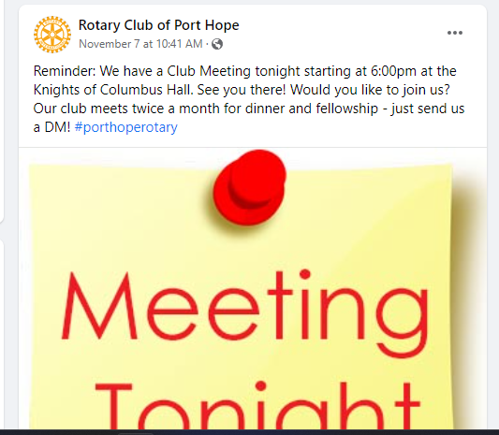
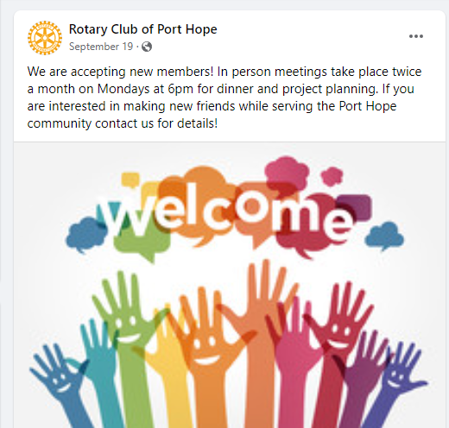
PORT HOPE – ASK YOUR VIEWERS TO JOIN
On Facebook:

Slide 47
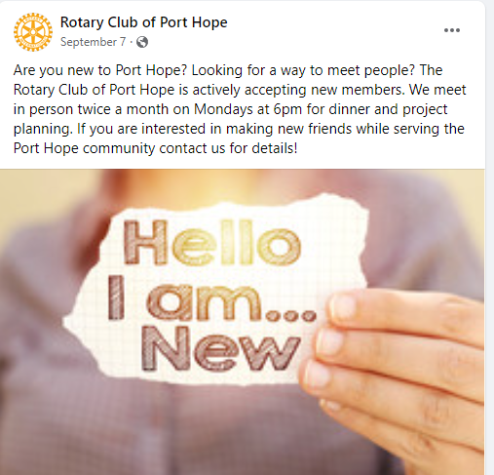
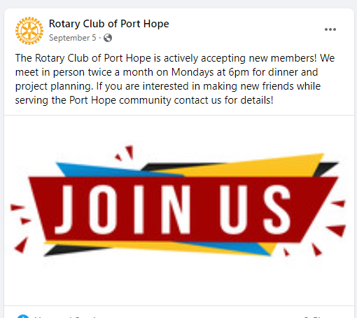
PORT HOPE – ASK YOUR VIEWERS TO JOIN
On Facebook:

Slide 48
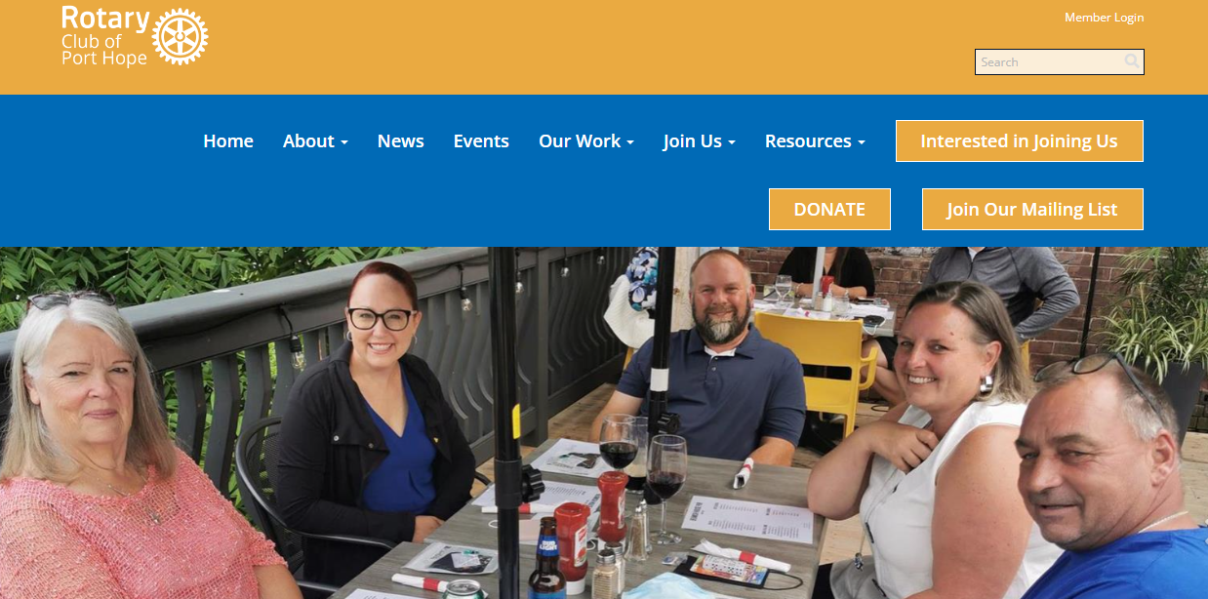
PORT HOPE – ASK YOUR VIEWERS TO JOIN
On Port Hope Rotary Website:

Slide 49
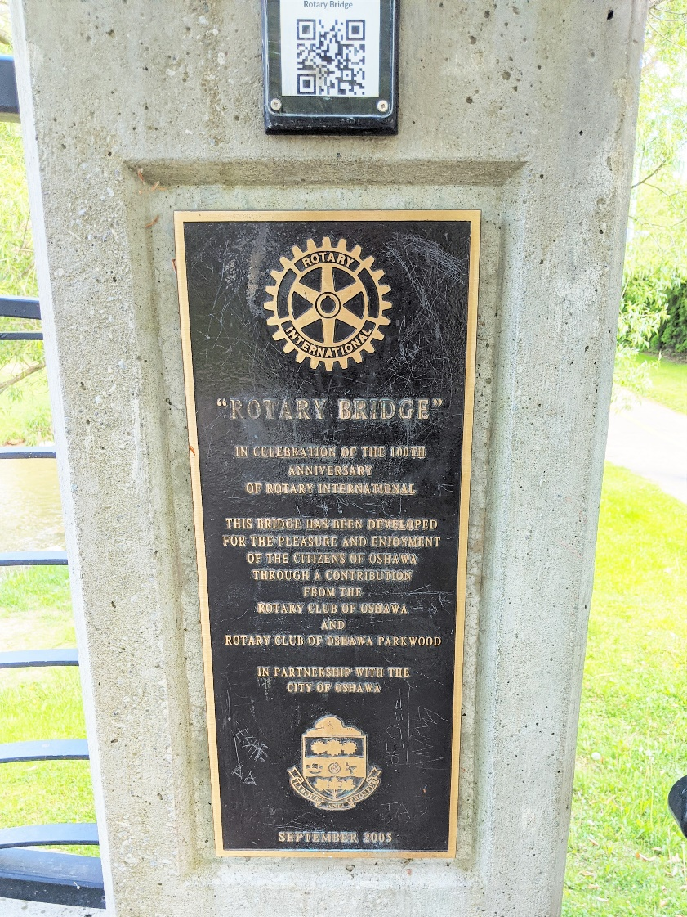
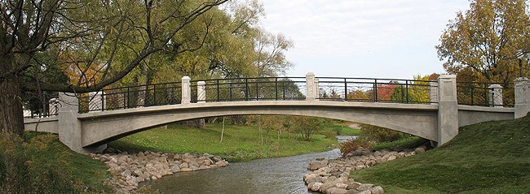
VISIBLE SUSTAINABLE HALLMARKS:
OSHAWA-PARKWOOD
Who we are and what we do:
1. Rotary Centennial Bridge

Slide 50
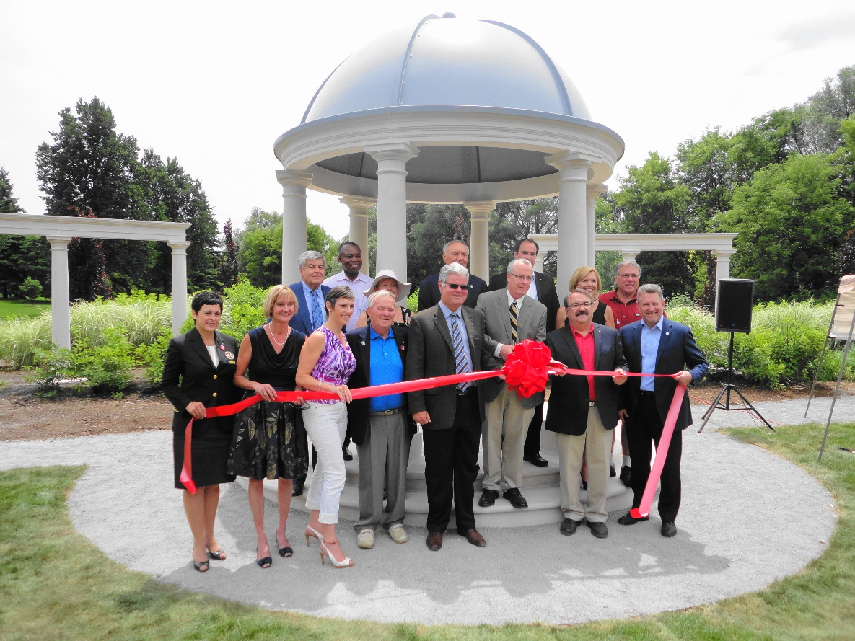
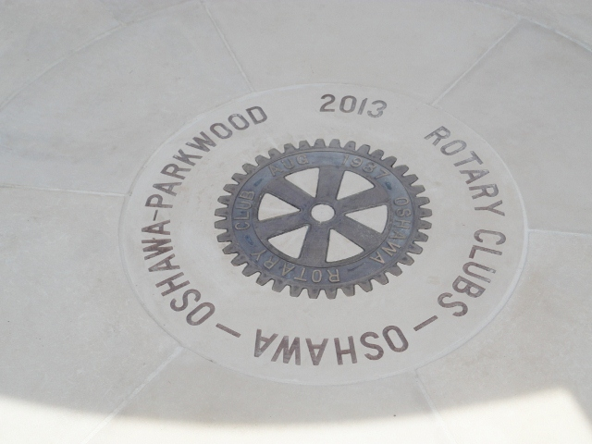
VISIBLE SUSTAINABLE HALLMARKS:
OSHAWA-PARKWOOD
Who we are and what we do:
2. Rotary Gazebo

Slide 51
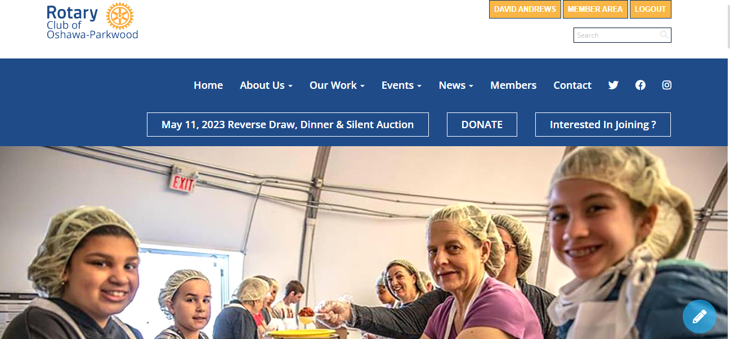
OSHAWA-PARKWOOD
Who we are and what we do:
Refreshed Club Website: rotaryoshawa-parkwood.org See the “Interested in Joining? “ tab?

Slide 52
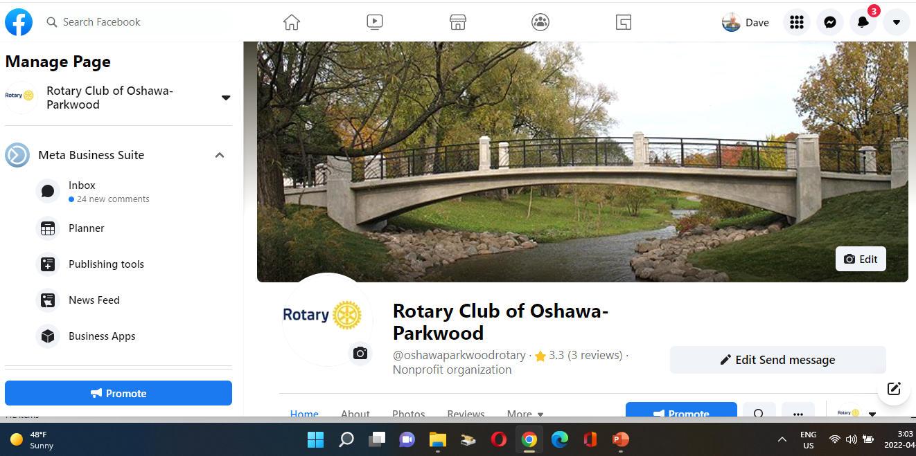
OSHAWA-PARKWOOD
Who we are and what we do:
Facebook:

Slide 53
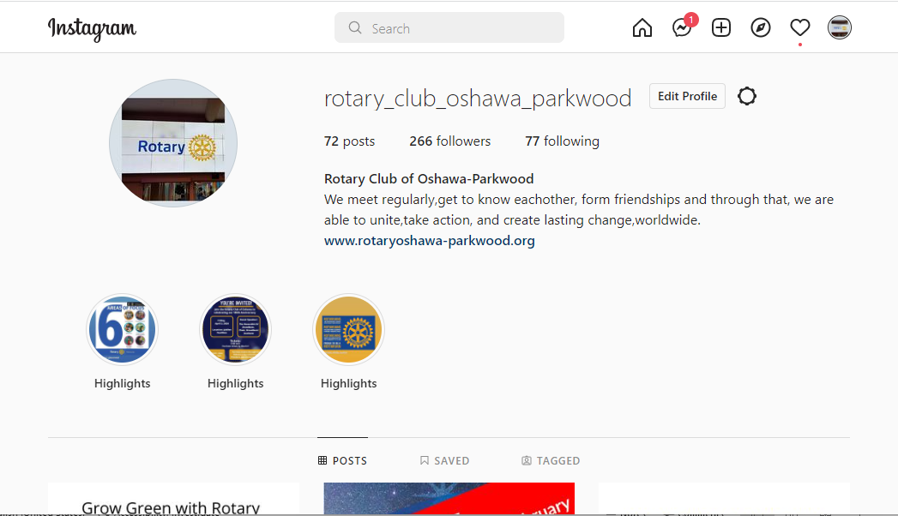
OSHAWA-PARKWOOD
Who we are and what we do:
Instagram

Slide 54
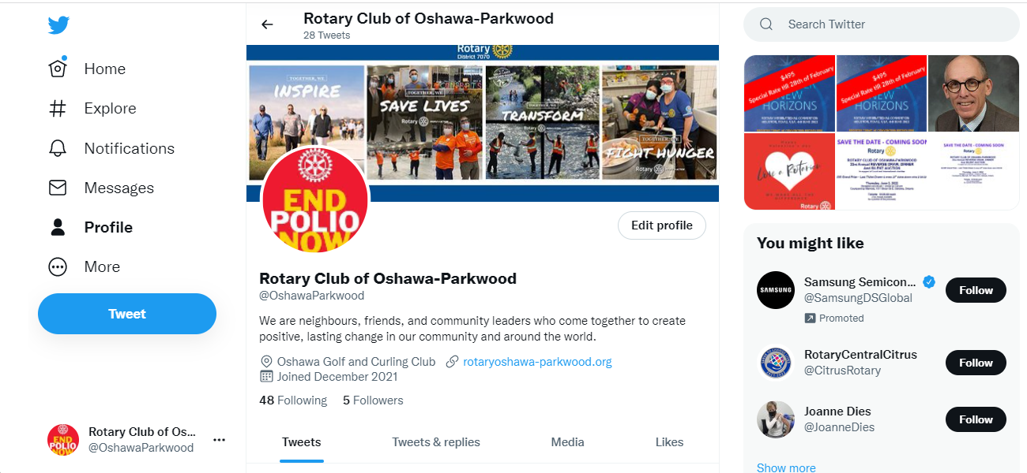
OSHAWA-PARKWOOD
Who we are and what we do:
Twitter

Slide 55
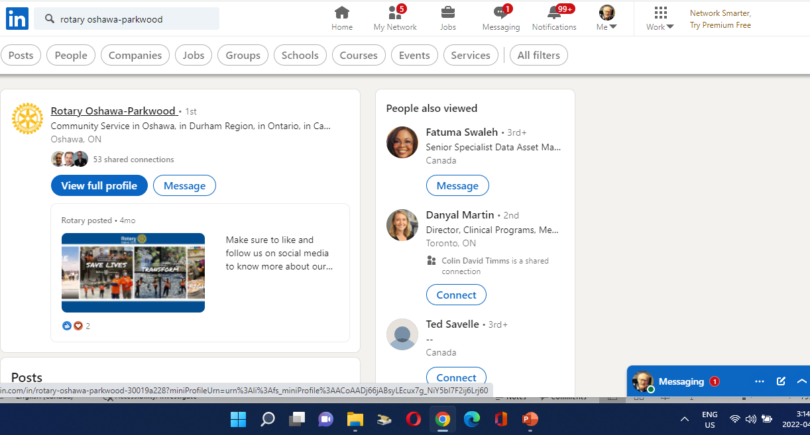
OSHAWA-PARKWOOD
Who we are and what we do:
LinkedIn

Slide 56
Now let’s look at your own Rotary Club…
TAKE-AWAYS
FROM
TONIGHT

Slide 57
TAKE-AWAYS
Download And Share With Your Club Members, the Materials / Resources from:
The Rotary Brand Center (My Rotary on the RI Website)
Our Public Image Campaign: People of Action ( in the Rotary Brand Center)
Media Crisis Handbook 515-EN
Rotary News and Features (My Rotary / News and Features)
Rotary Media Center
“Public Relations” page (My Rotary/ Learning & reference/Learn by Topic) on the RI rotary.org website
Public Image Tab of the Rotary7070.org website
Rotary Learning Center (9 Public Image Courses) .
Public Image Checklist
Web Presence Checklist

Slide 58
TAKE-AWAYS
Share With Your Club Members:
Has your club Checked your PR Checklist:
Does your club have a Public Image Director and Chair and a Committee?
Do you know the media in your area?
Do you send out press releases? Posts on Social media?
Are News media members of your club?
Who are your publics?
Tools of the Trade - Resources
Has your club participated in the District club website refresh program

Slide 59
We have just skimmed the surface of Public Image and Public Relations
If you would like a copy of this presentation, look on the District website www.rotary7070.org under the Public Image tab.
dave.f.andrews99@gmail.com
Public Image
And
Public Relations
Notes:
We have just skimmed the surface of Public Image and Public Relations
If you would like a copy of this presentation, look on the District website www.rotary7070.org under the Public Image tab.
dave.f.andrews99@gmail.com

