Slide 1
Presentation by
Area of Focus
District 7070
At the PELS Training Session
February 3, 2023

Slide 2
Introduction
We want to encourage Clubs to provide details to the appropriate committee on projects dealing with their Area of Focus to ensure they are aware of all project activities in the district.
The Area of Focus committees are here to provide education and would like to provide sessions/seminars leveraging outside speakers where appropriate for the district on each of their Area of Focus to enhance Rotarian engagement and their understanding of each Areas of Focus.
We are available to aid Rotarians and Clubs in the development of projects employing best practices.
Help clubs with preliminary review of Grant applications as they pertain to a particular Area of Focus.

Slide 3
What you (Club President) can do
Communication is Essential
Sharing of information is essential to create coordination of projects
The Areas of Focus Team needs a list of committee chairs and contact info. We can do more together.
As president of your club, you will likely get emails from clubs in different parts of the world with a Project looking for support.
District Project Board – Rotary Showcase attached to District Website

Slide 4
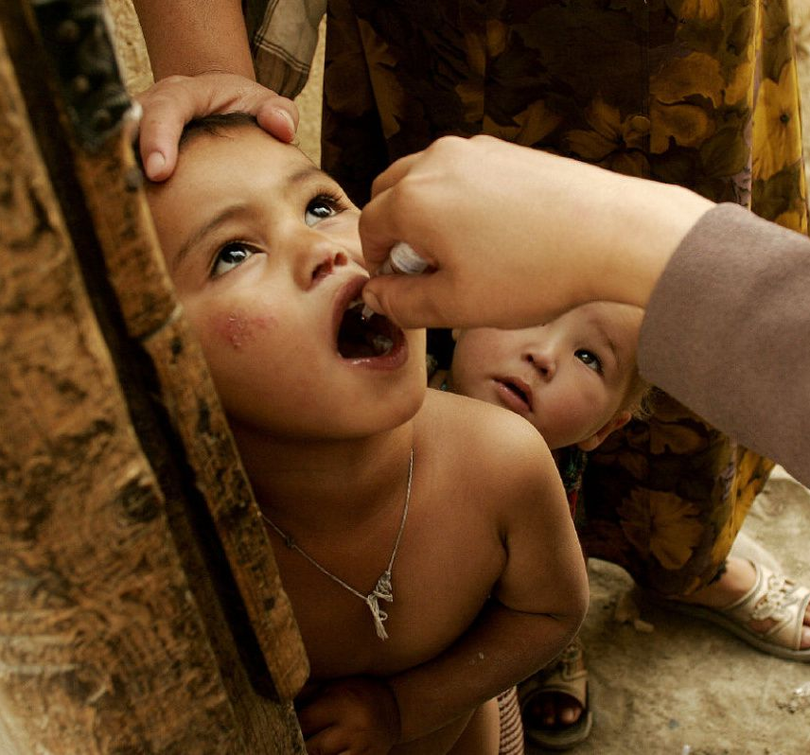
District 7070 –Area of Focus and Partnership Committee
Rotary International’s 7 Areas of Focus plus HIP
AOF Coordinators
Maternal & Child Health: Maureen Bird
Economic & Community Development: Khalid Hasan
Basic Education & Literacy: Joan Barrett
Peacebuilding & Conflict Prevention: Nevine Yassa
Disease Prevention & Treatment: TBA (Maureen Bird)
Environmental Action: Nilam Bedi
Water, Sanitation and Hygiene: Richard Mewhinney
Honouring Indigenous People (HIP): Bill Empy

Slide 5
Sum-Up
Action Items to consider:
For larger clubs, name a coordinator for each Area of Focus
As a smaller club, Name a single Area of Focus Coordinator to be a point of contact for the Area of Focus Committees. Perhaps this can engage a New member to help with their involvement and understanding of Rotary
Keep the Action and Partnership committee aware of all your projects or Area of Focus activities
Tap into the expertise of the Area of Focus Committees
Reach out to the Area of Focus Leaders to speak to your club
Remember, we are here to help your Clubs understand the Areas of Focus. In District 7070 we have a wealth of experience to share.
5

Slide 6
For International Projects…
Have good contacts in other countries
10 of our club’s International Service Committee have done work in other countries either through Rotary or other charities. These include Kenya, Uganda, Cambodia, Dominican Republic, Haiti, Guatemala, India, Tanzania, El Salvador, Malawi and Laos.
Other active clubs with overseas visits include Eglinton, Alliston, Newmarket, Belleville and Whitby Sunrise.
This has allowed us to establish local connections with both Rotary Clubs and individuals to make best decisions.
Leverage the experience and relationships already developed.

Slide 7
Contact Details
Area of Focus | Focal Person | Email | Mobile
Chair, AoF | Richard Mewhinney | rmewhinney@rogers.com | 416-418-6646
Maternal & Child Health | Maureen Bird | maureen.bird@rotarytoronto.com | 416-804-3726
Economic & Community Development | Khalid Hasan | khalid.hasan@resint.ca | 647-537-2444
Basic Education & Literacy | Joan Barrett | j-d-barrett@rogers.com | 647-284-4802
Peacebuilding & Conflict Prevention | Nevine Yassa | rotaryicccanada@gmail.com | 416-283-7924
Disease Prevention & Treatment | Maureen Bird | maureen.bird@rotarytoronto.com | 416-804-3726
Environmental Action | Nilam Bedi | nilam.bedi@gmail.com | 416-629-8907
Water, Sanitation and Hygiene | Richard Mewhinney | rmewhinney@rogers.com | 416-418-6646
Honoring Indigenous People (HIP) | Bill Empy | empy@prismeconomics.com | 416-482-4880
7

Slide 8
Thank you!

