Slide 1
MY ROTARY and CLUBRUNNER
Title Page Option

Slide 2
MY ROTARY
Rotary International Website
  Home page for the public
  Log into MY ROTARY

Slide 3
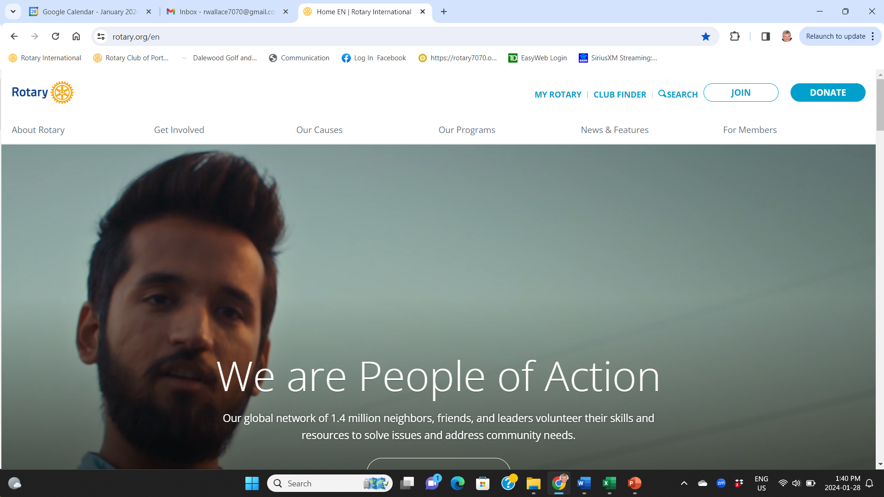



Slide 4
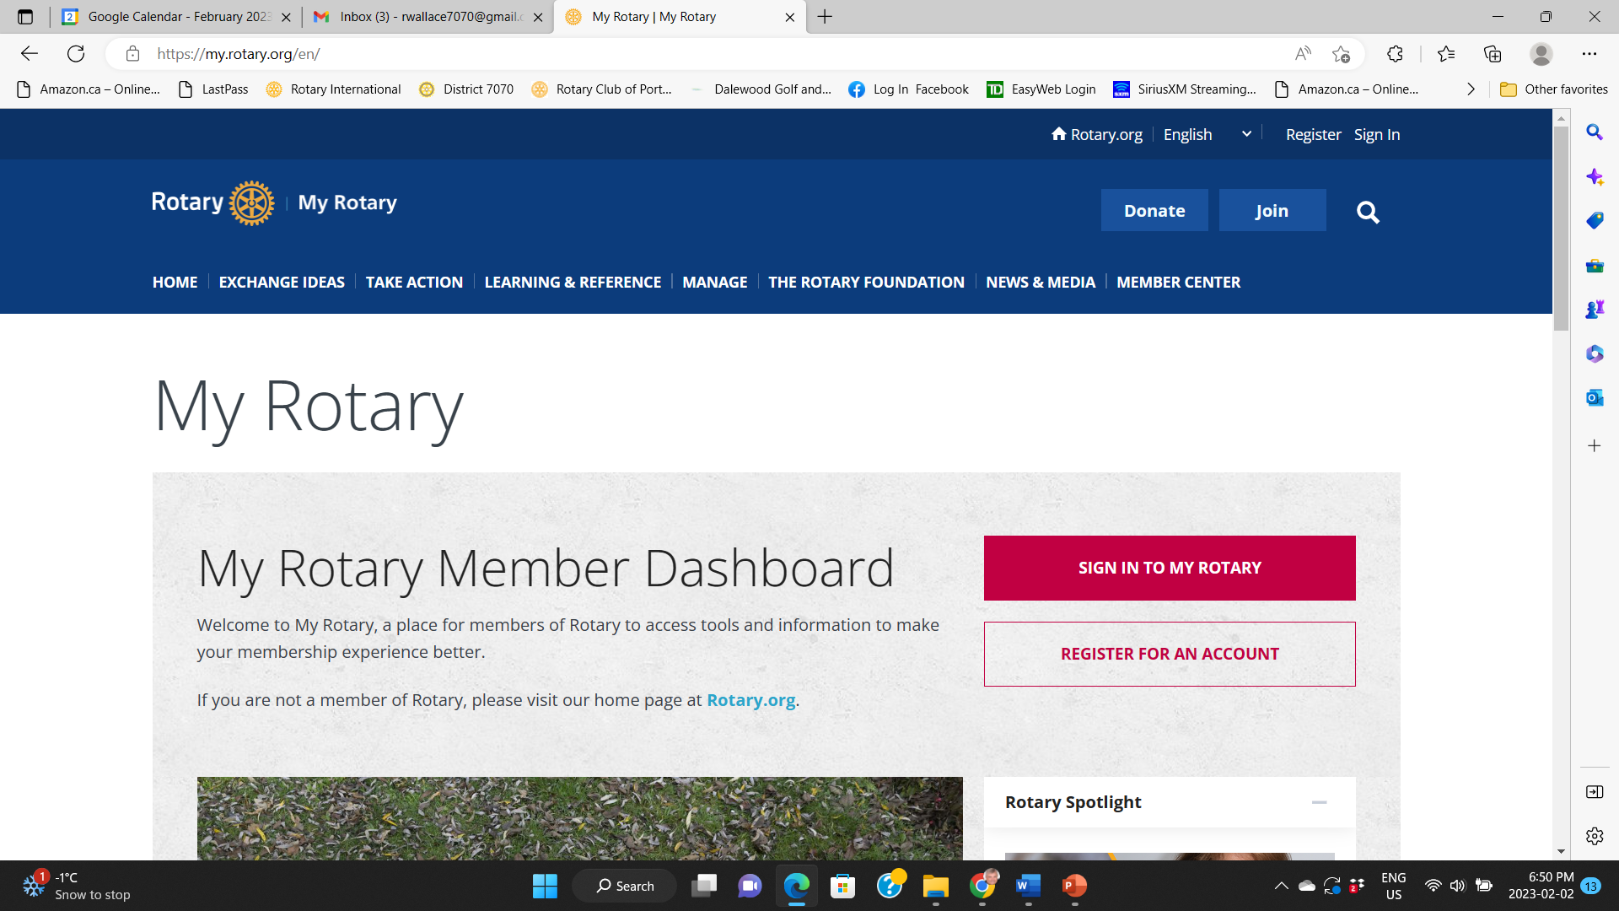



Slide 5
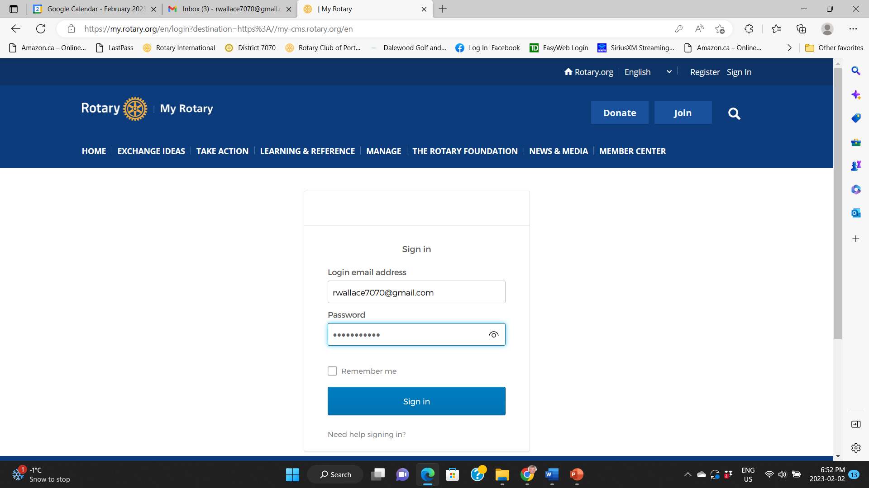



Slide 6
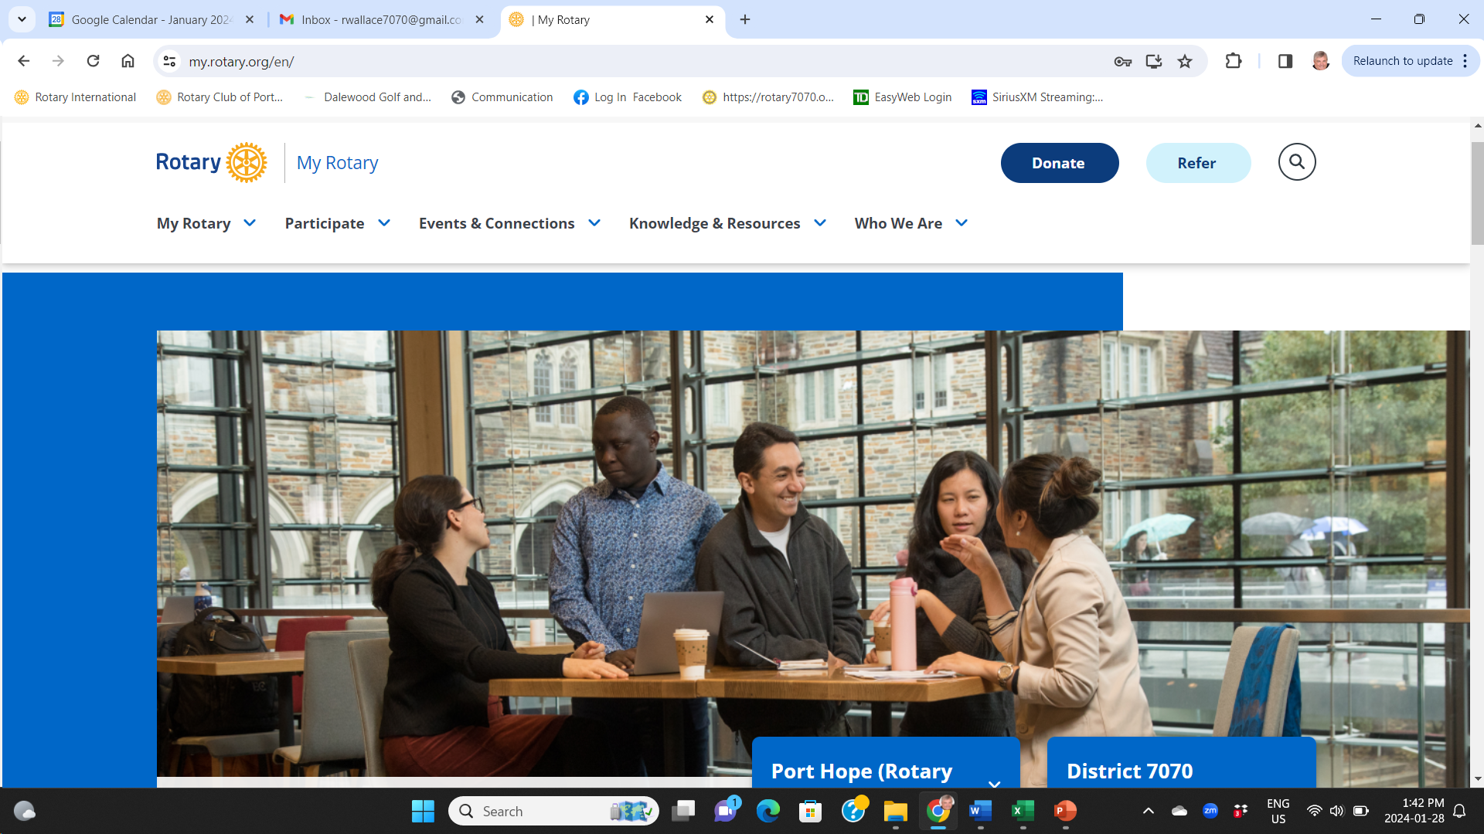

Slide 7
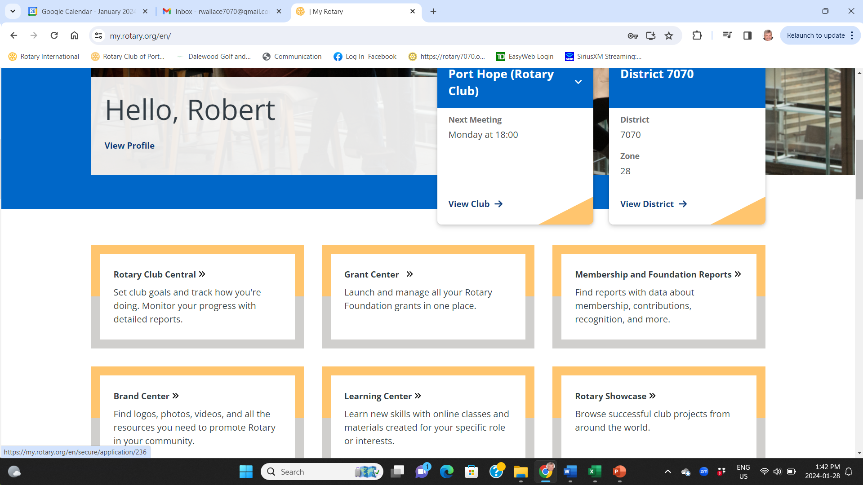



Slide 8
QUESTIONS

Slide 9
CLUBRUNNER
Club website
Club data base
Club event planner
Club Calendar

Slide 10
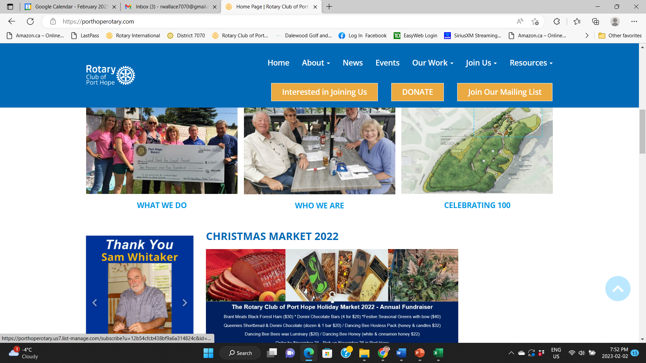

Slide 11
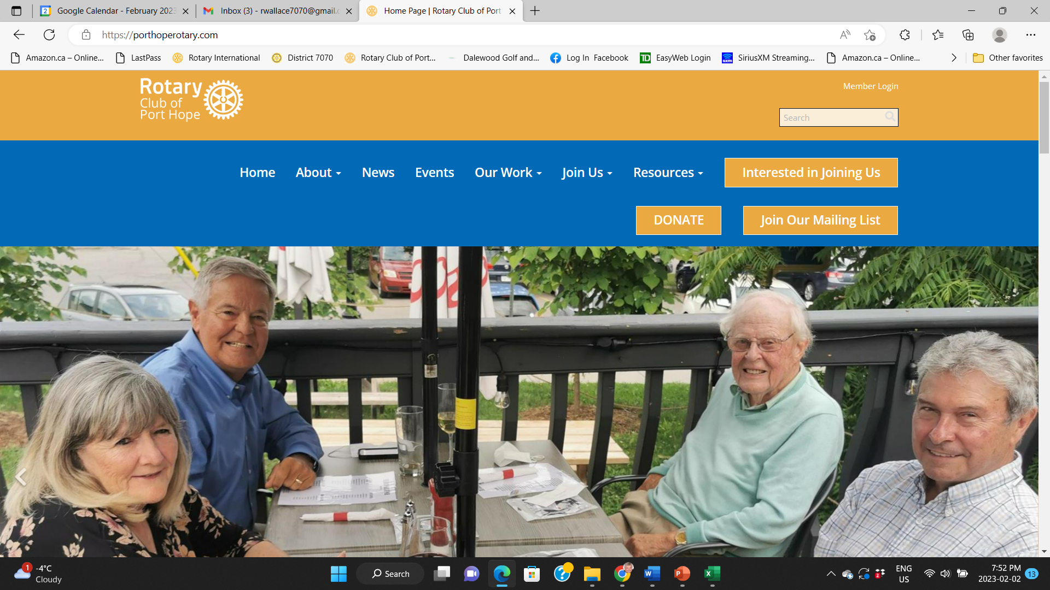


Slide 12
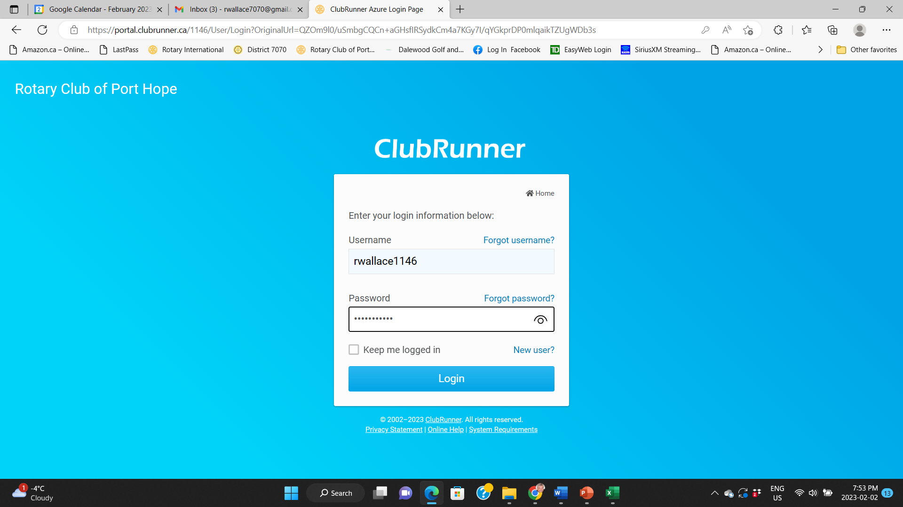

Slide 13
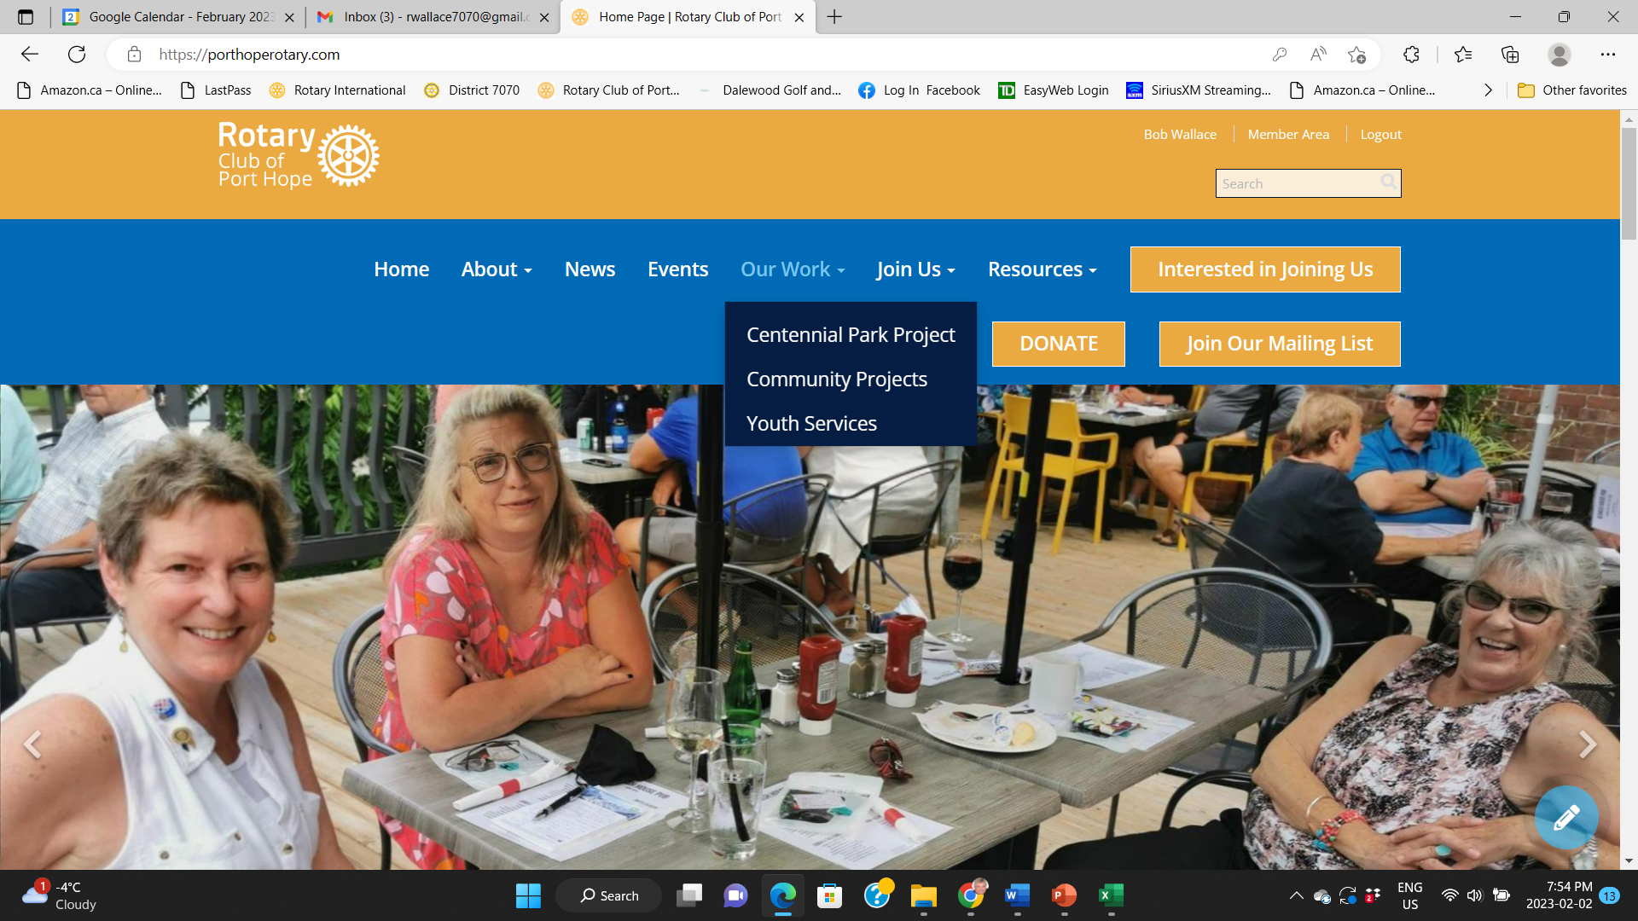


Slide 14
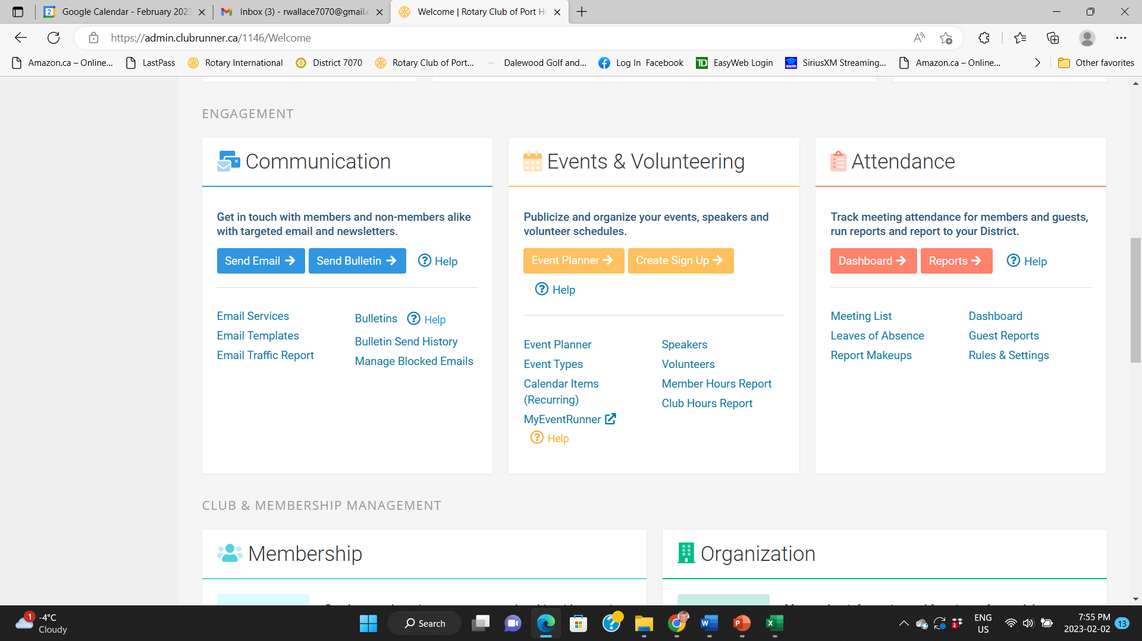

Slide 15
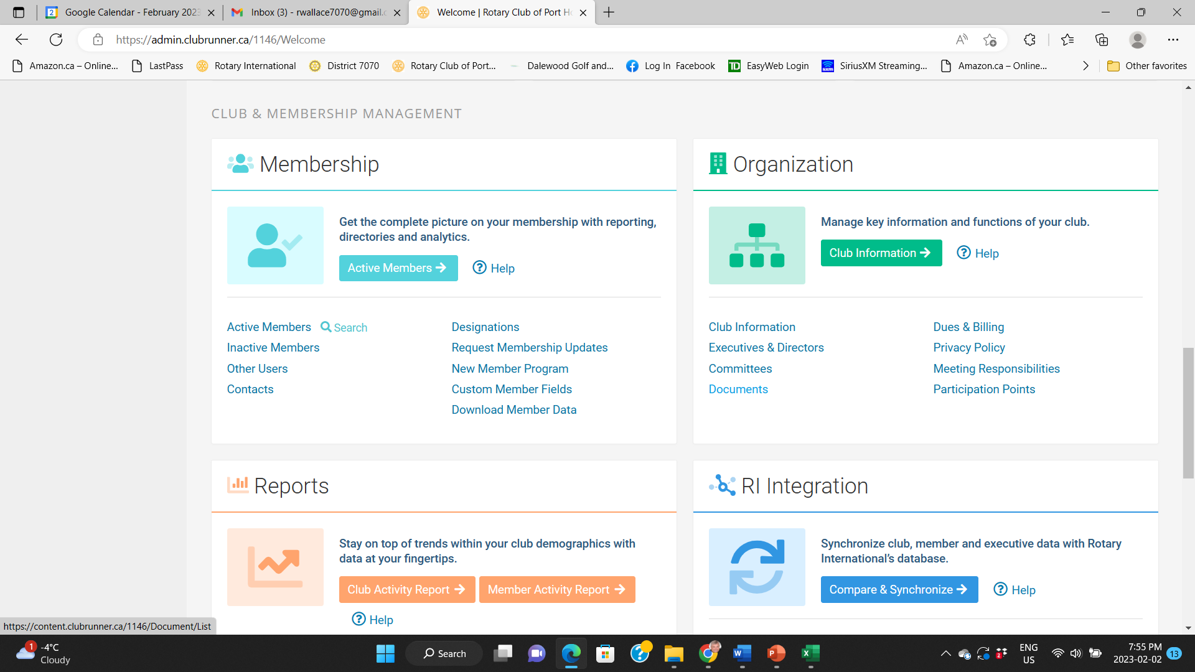

Slide 16
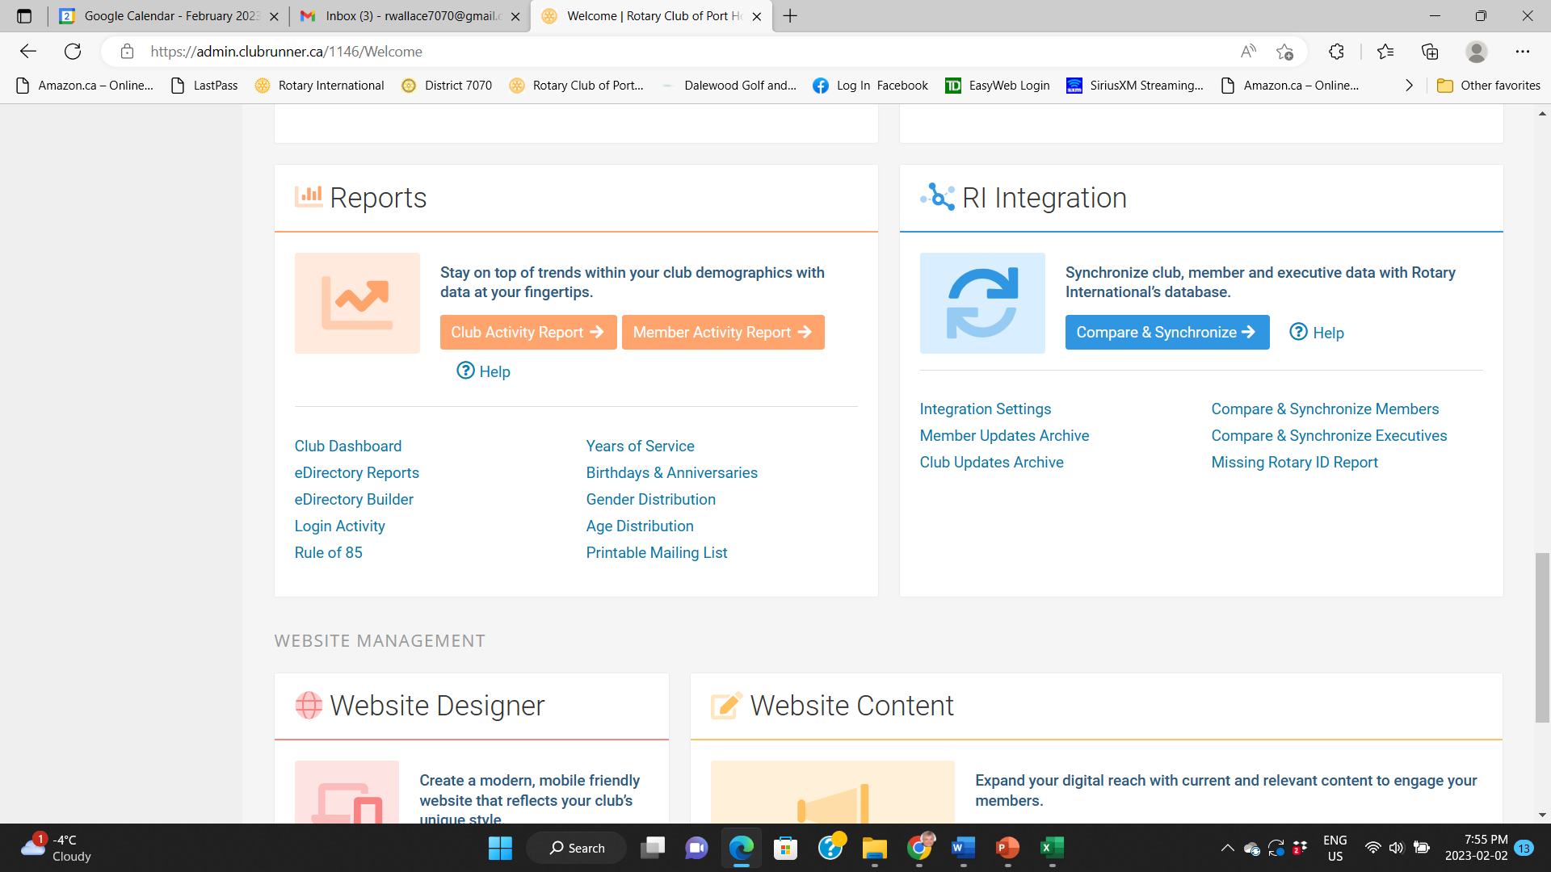

Slide 17
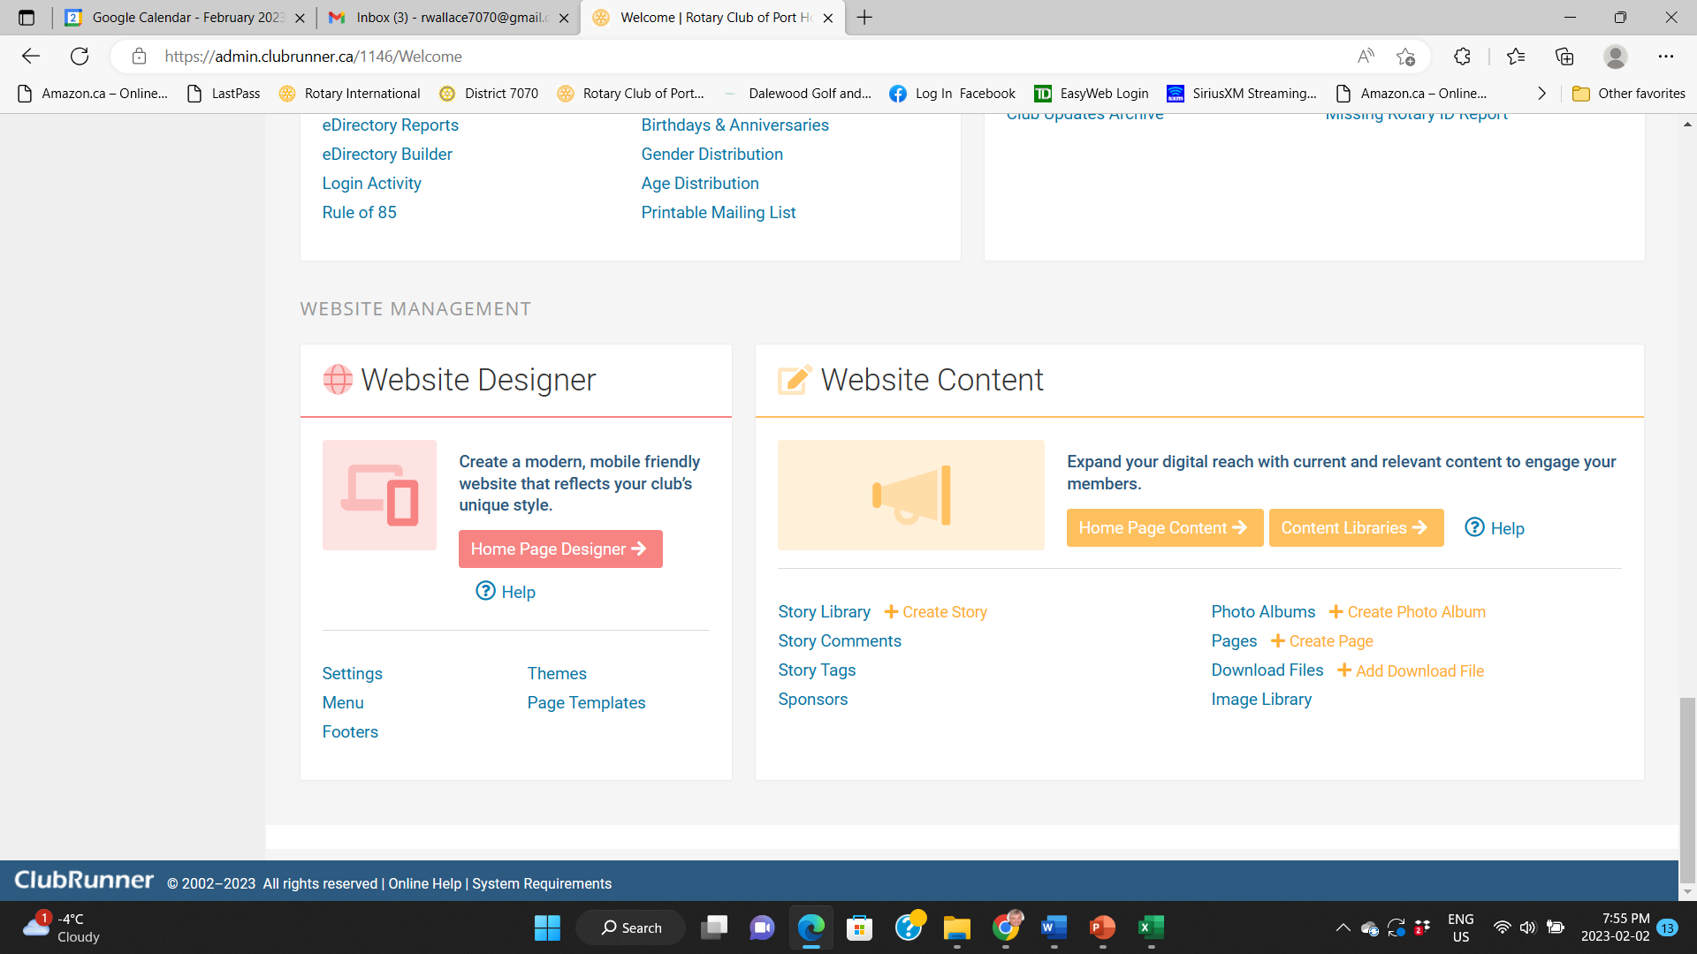

Slide 18
QUESTIONS

