Slide 1
President Elect Learning
Goals Setting in My Rotary

Slide 2
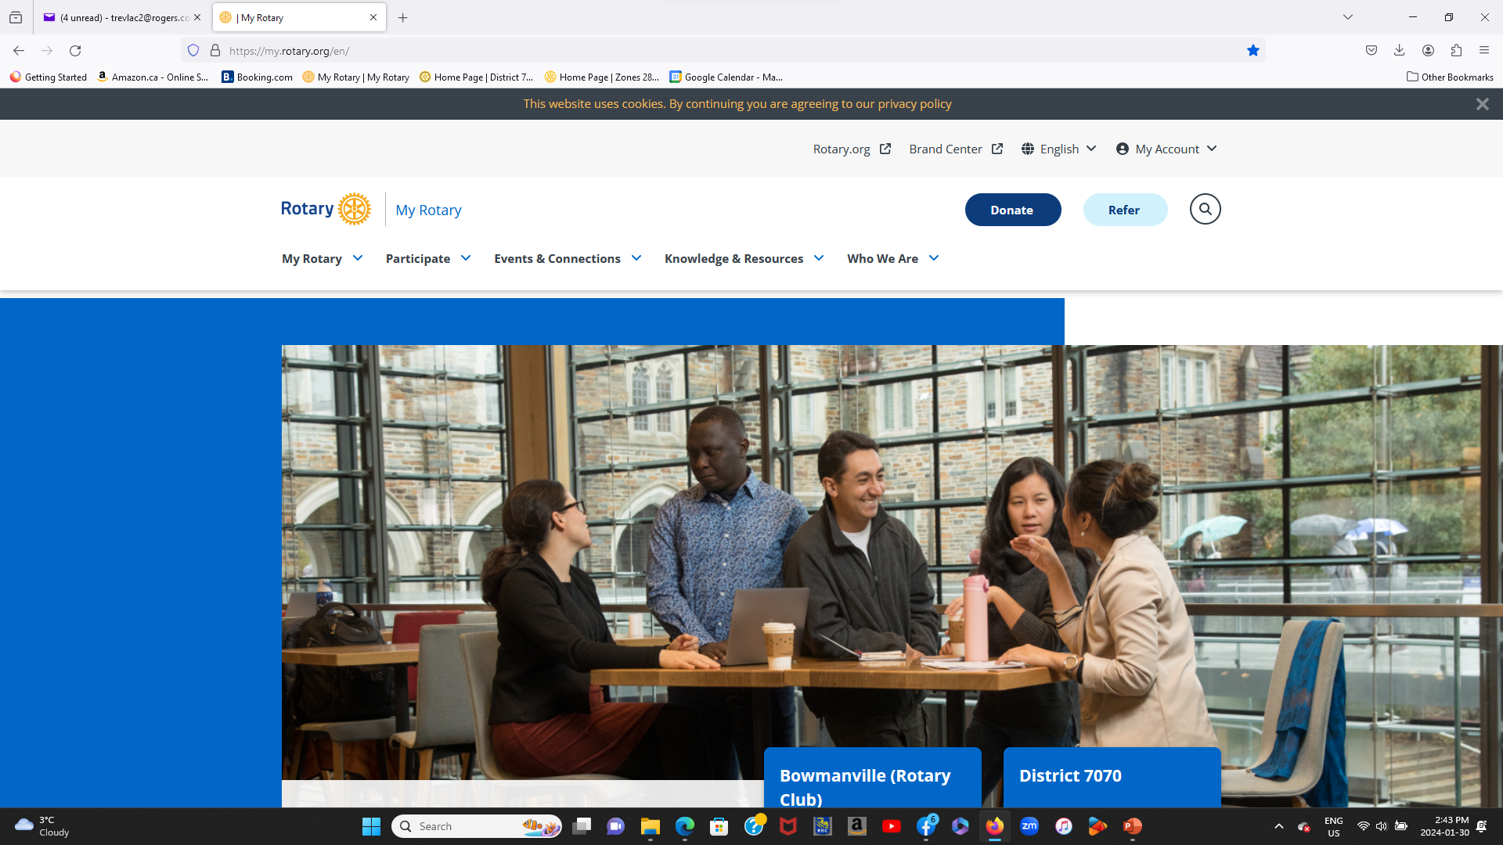
Log in to My Rotary

Slide 3
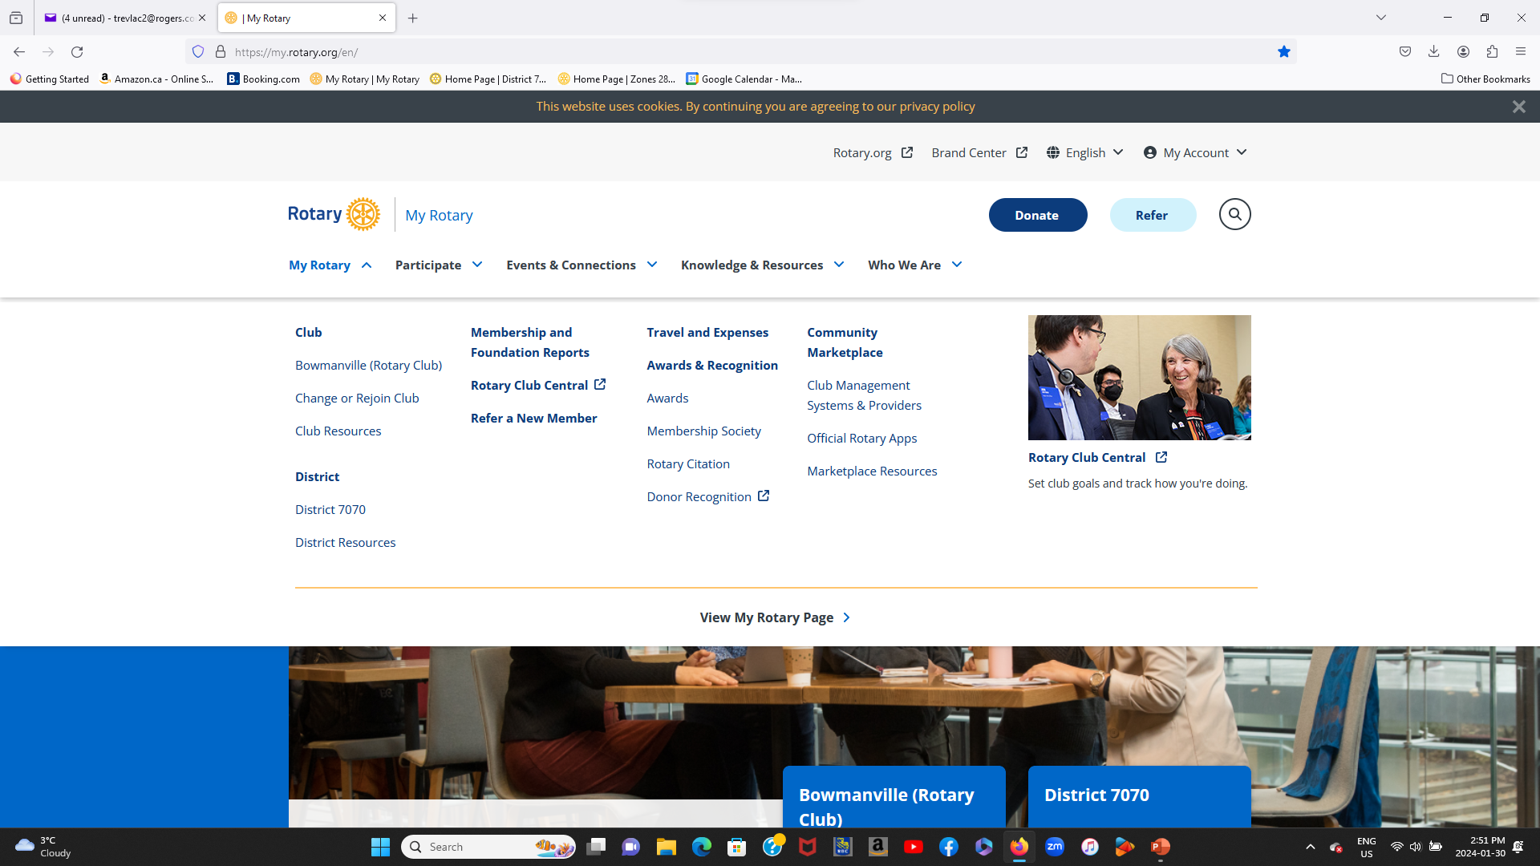
Select My Rotary

Slide 4
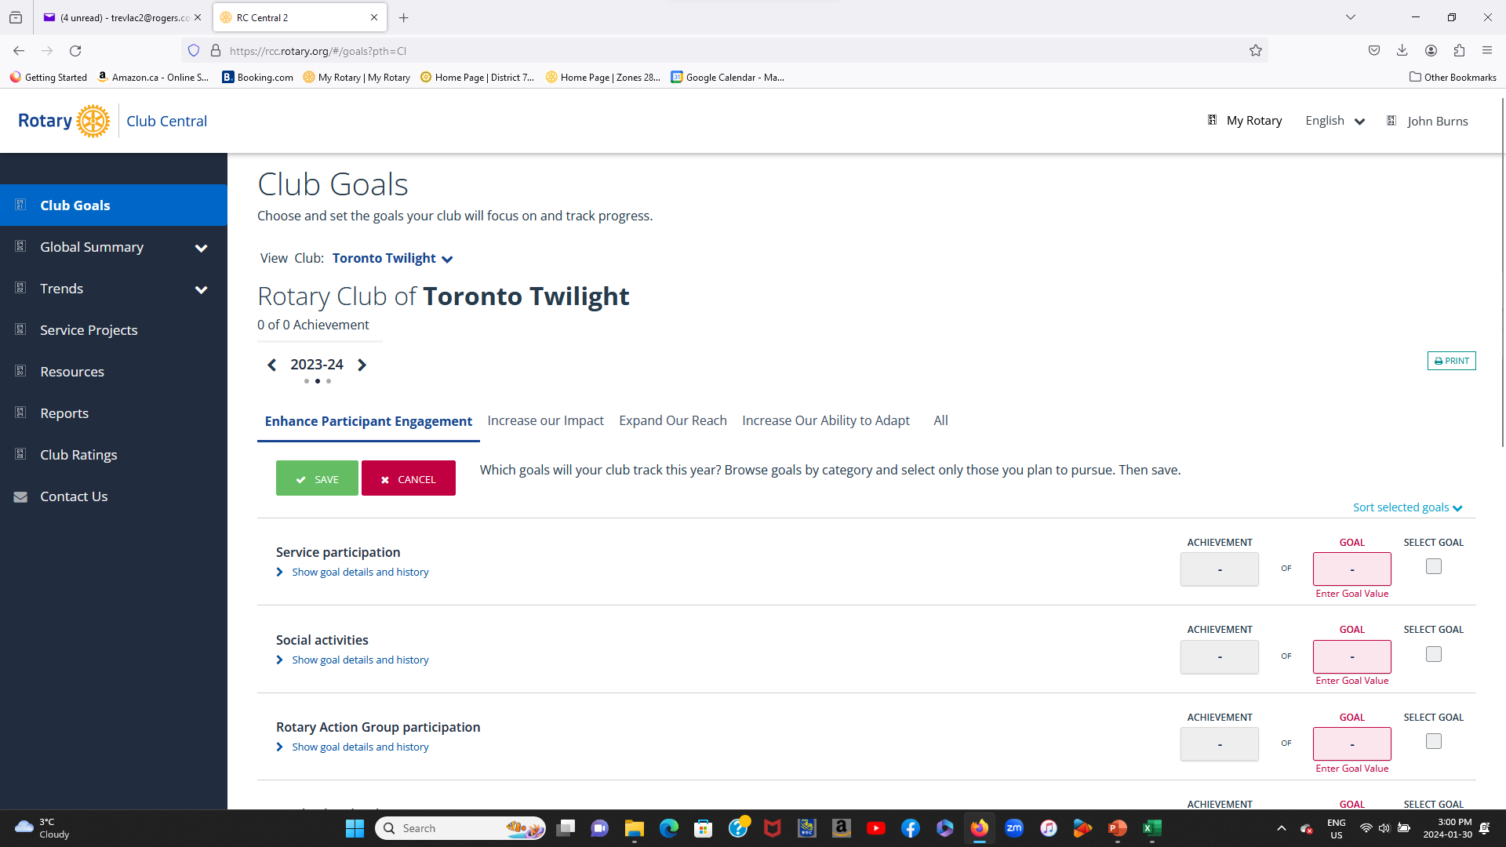
Select Rotary Club Central

Slide 5
Set the Year

Slide 6
Notice all the Tabs – Enhance Participant Engagement, Increase Our Impact, etc.

Slide 7
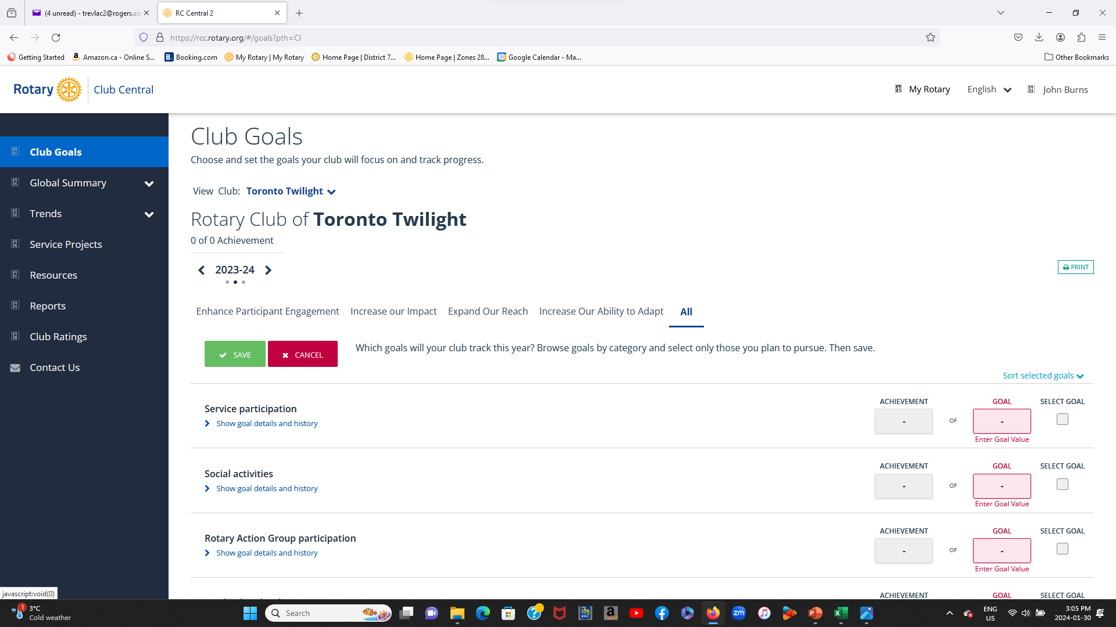
I find it easier to use the All tab.

Slide 8
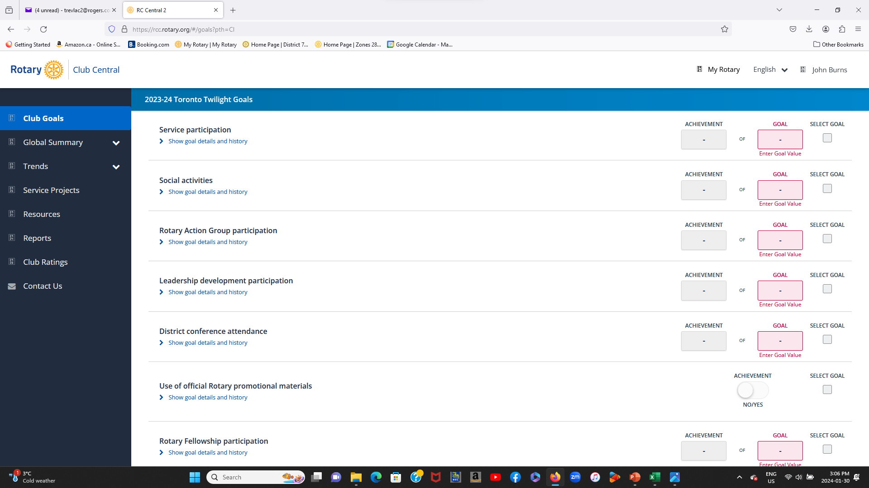
By scrolling down the page you can access all the goals. To the left side of each goal you will see in blue, “Show goal details and history”

Slide 9
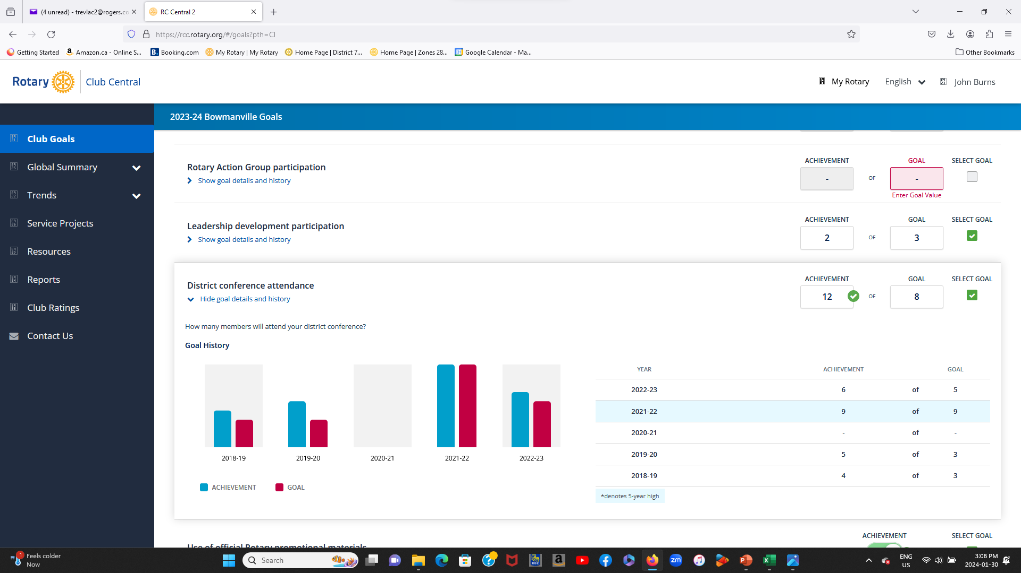
By clicking on the blue print you can view your clubs history over a few previous years on that particular subject. You will see the goal that was set and the achievement. You may find this to be a useful guide.

Slide 10
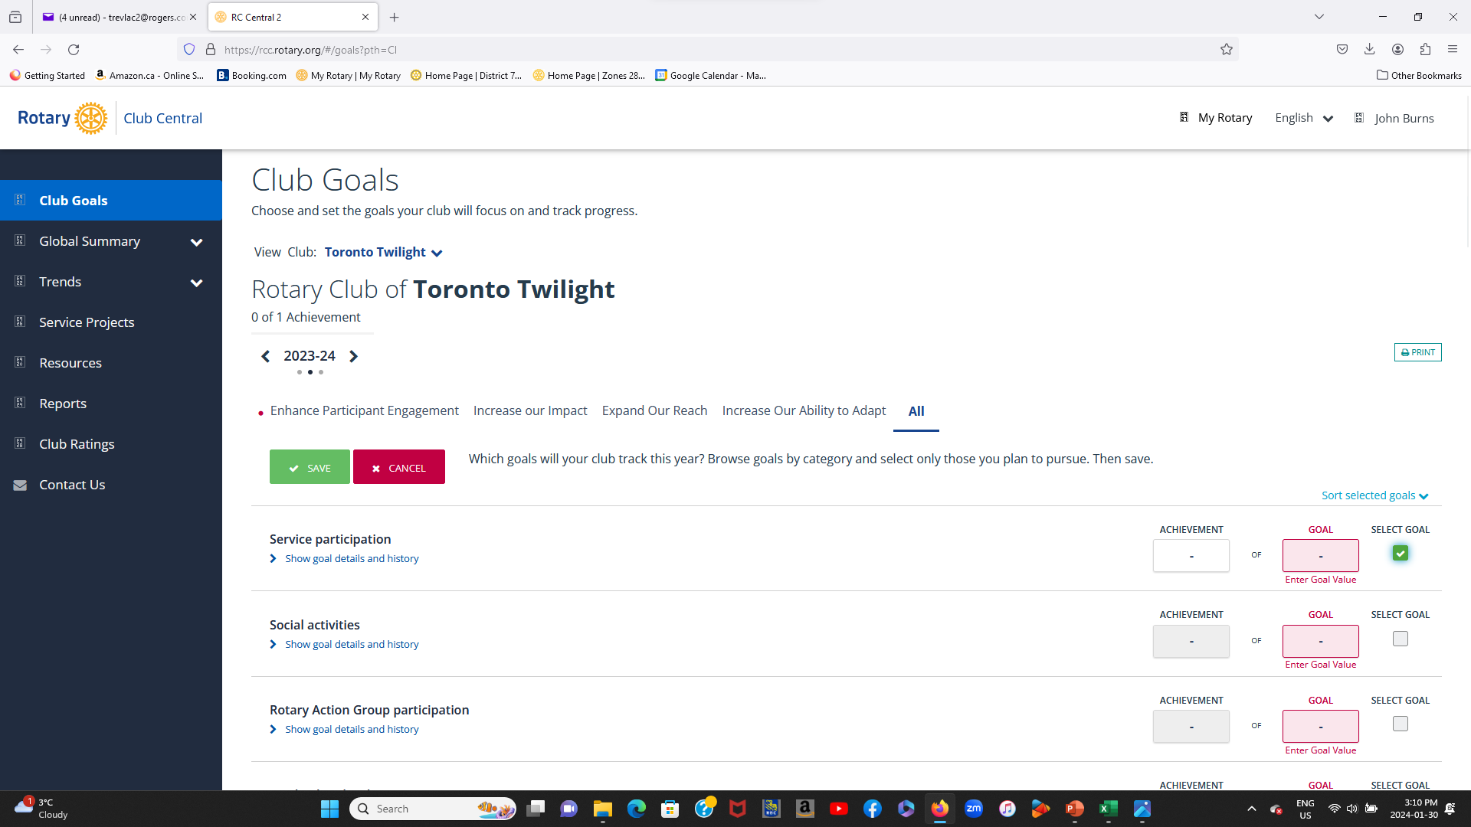
To enter a goal in the appropriate subject, click in the “SELECT GOAL” on the right. It will turn green and show a tick.

Slide 11
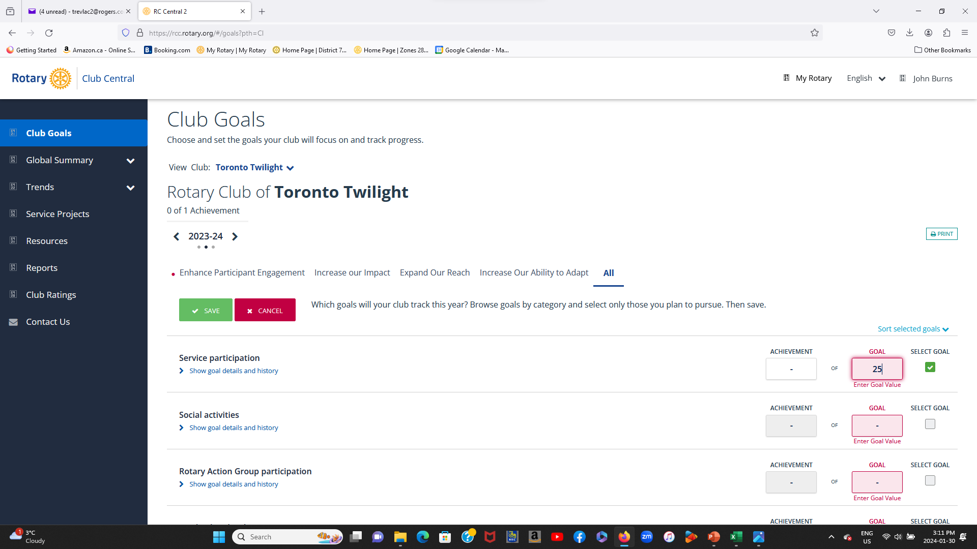
You can then enter in the selected goal a value in the pink box marked “GOAL”

Slide 12
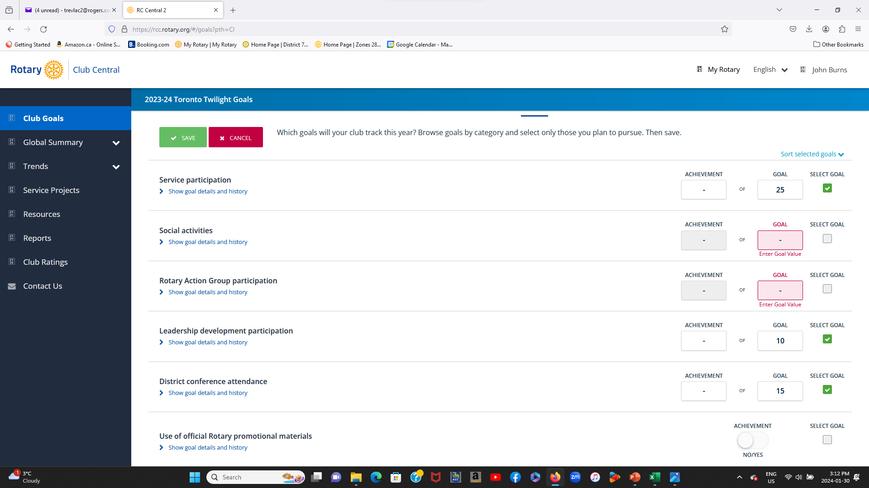
You can then continue to select and enter as many goals as you wish, by repeating the same process of “SELECT GOAL” and “ENTER GOAL VALUE”

Slide 13
When you enter contributions to Annual Fund or the Polio Plus Fund, it’s in US$

Slide 14
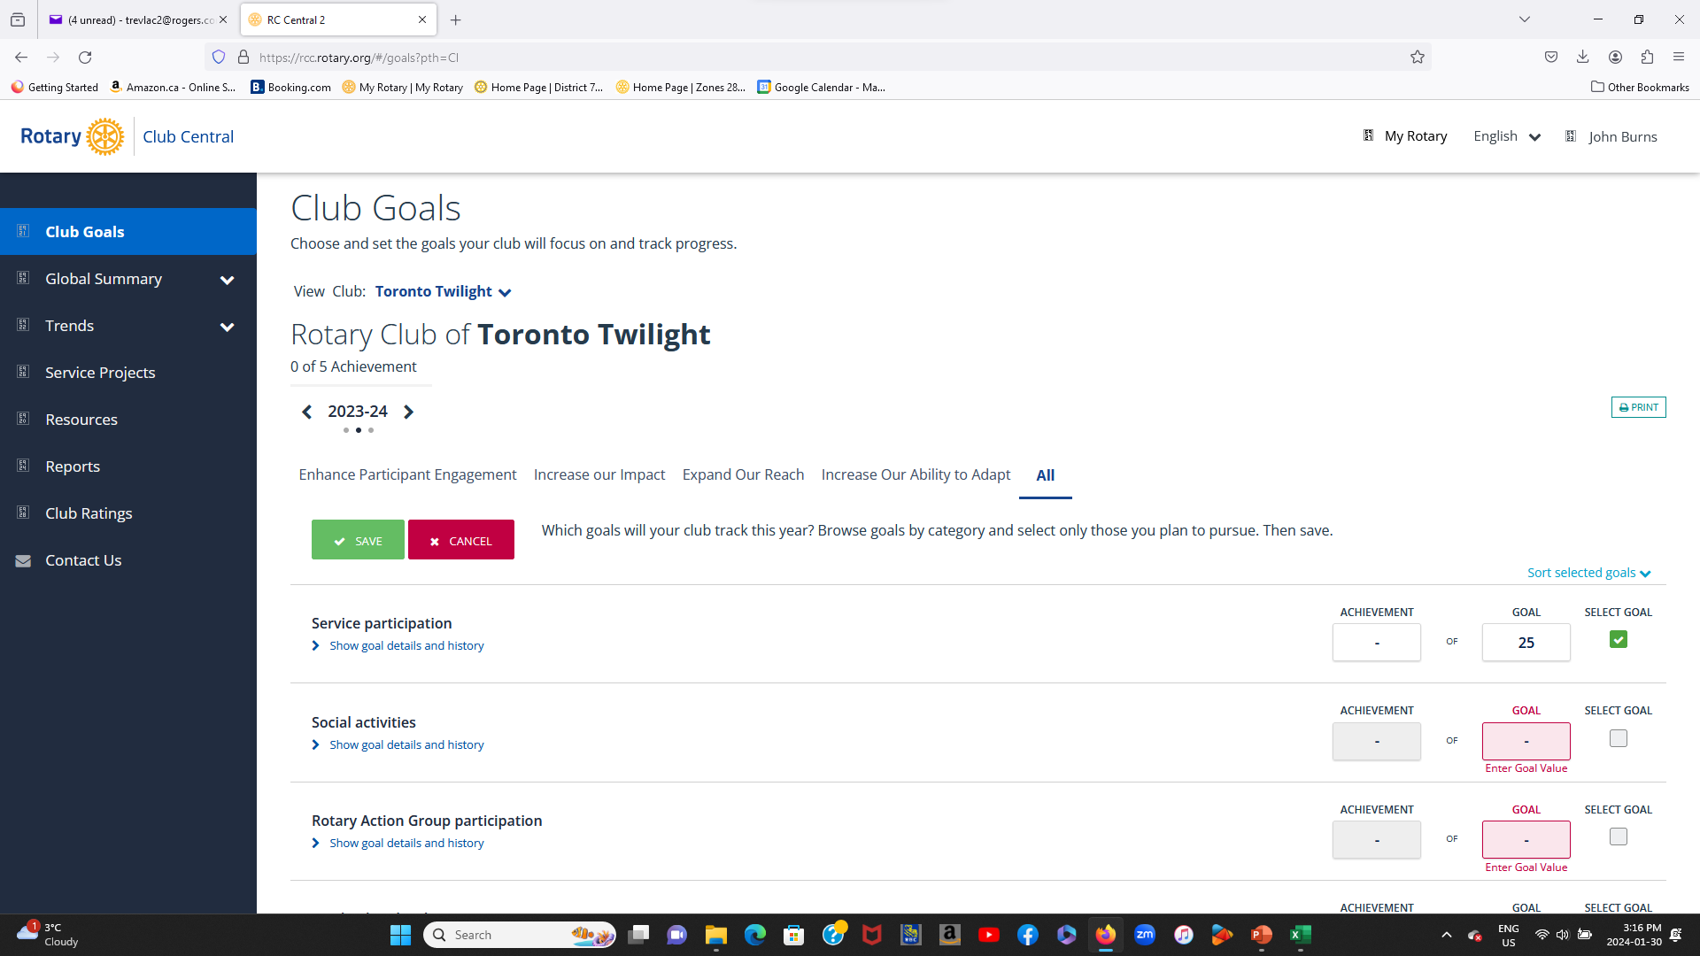
When you have completed all your entries or if you wish to leave the goal center, you must first scroll to the top of the page and select “SAVE”. If you don’t do this , “ALL YOUR ENTRIES WILL BE LOST”

Slide 15
Remember every time you leave The “GOAL CENTRE”
SAVE

Slide 16
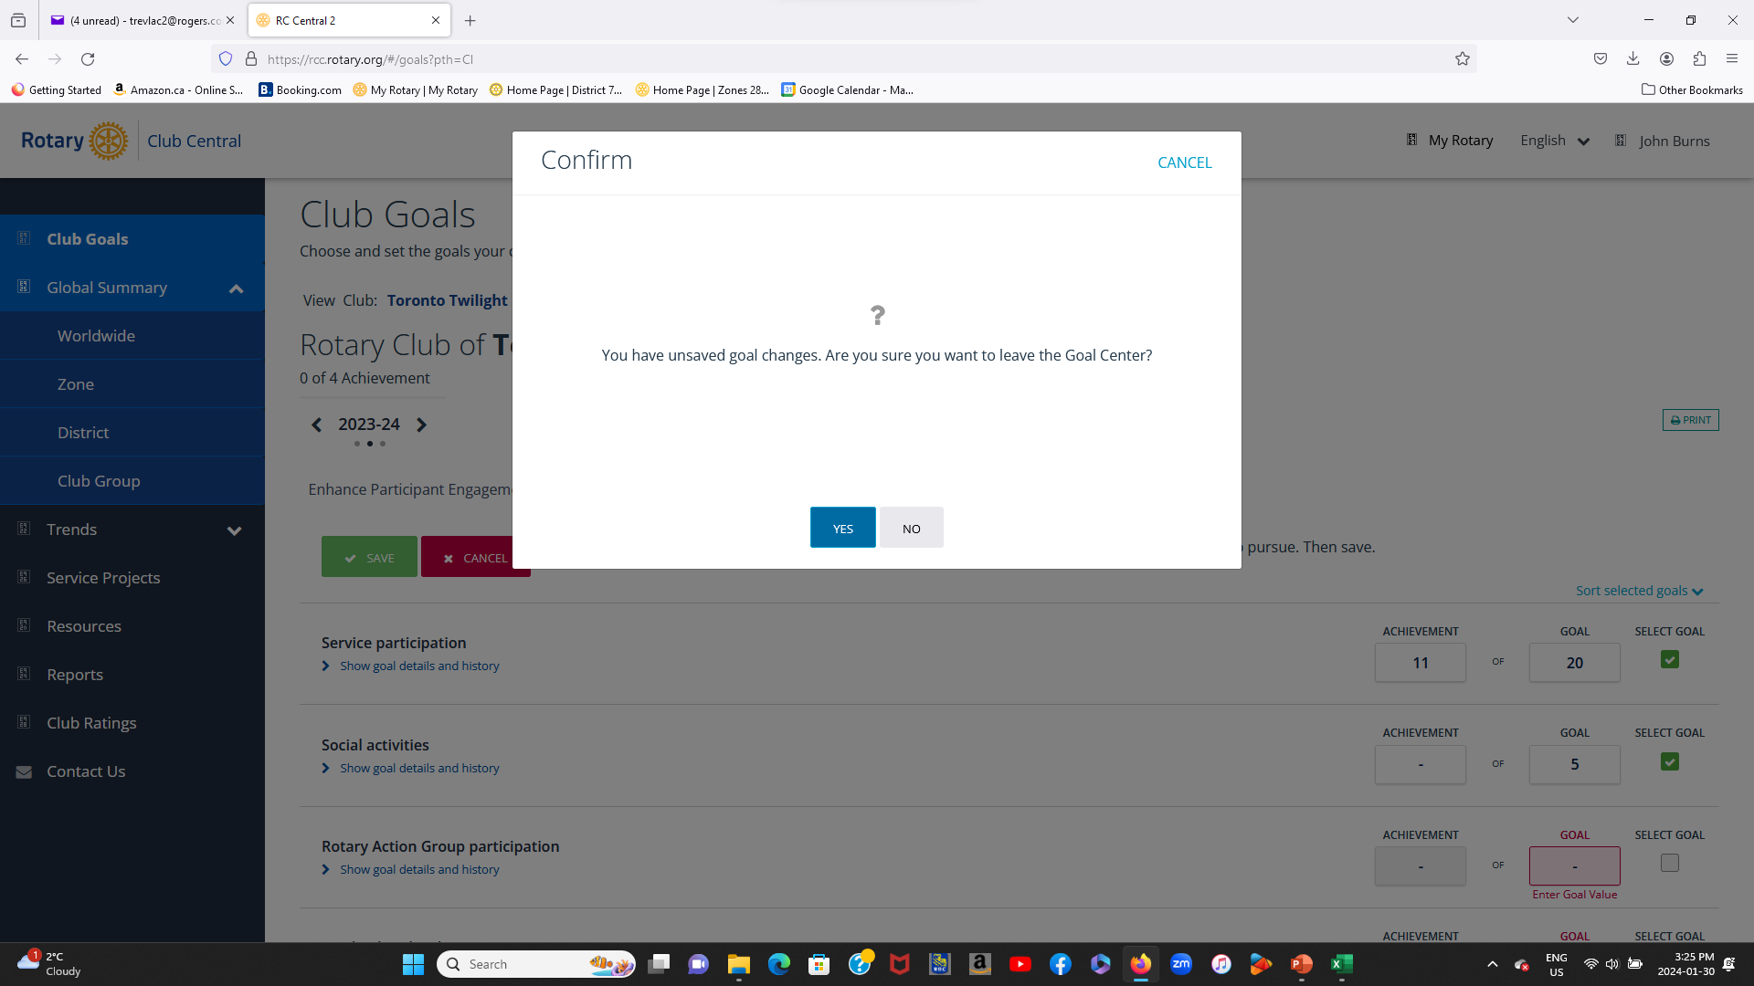
When you try to leave Goal Setting without saving, it does give you a warning.

Slide 17
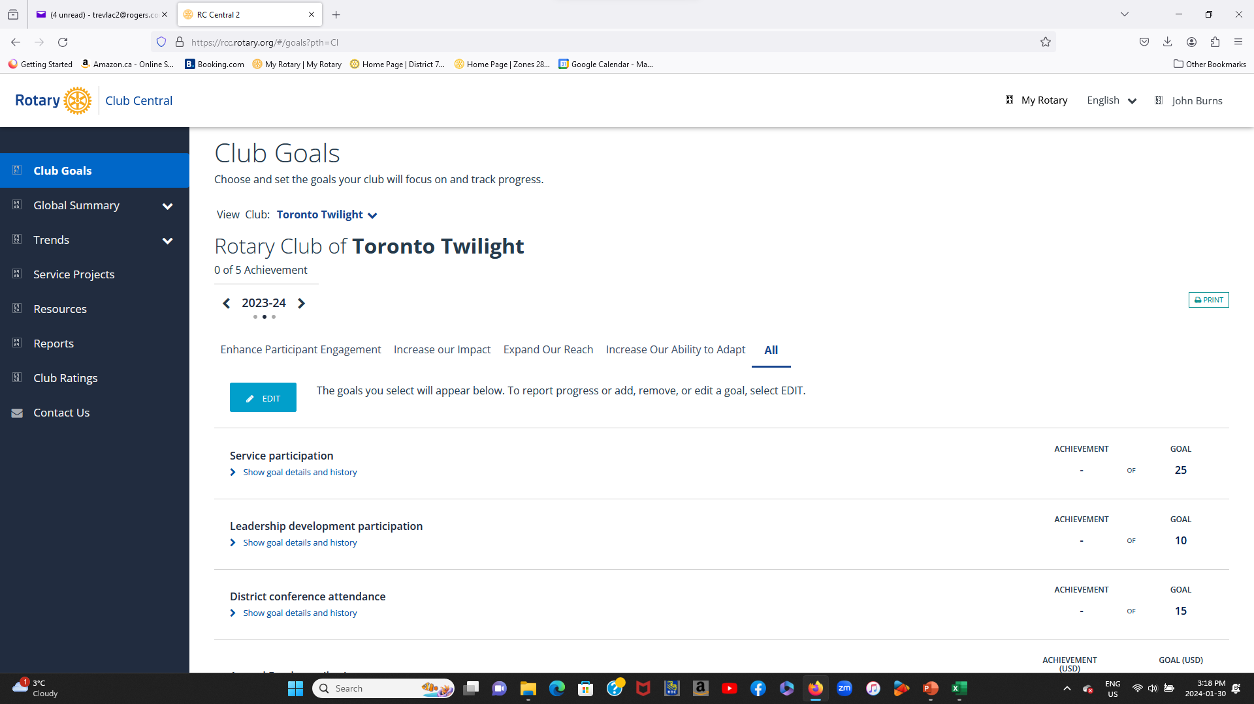
You can return to the Goal Centre as many times as you wish. When you return you will see a blue box on the left “EDIT”. When you click on this, you can “ADD, REMOVE or EDIT” your goals, you can also enter an “ACHIEVEMENT” value

Slide 18
To “EDIT” a goal value, simply place the cursor in the “GOAL” box and enter the new value. To enter an Achievement, Simply place the cursor in the box and enter a value

Slide 19
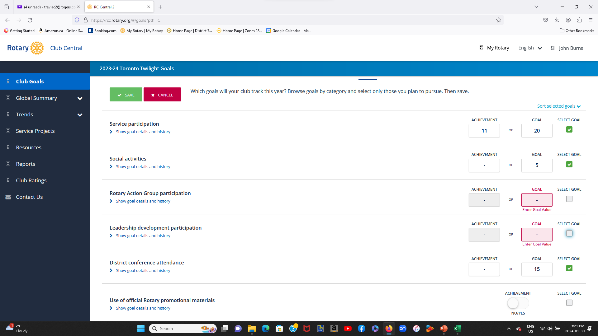
If you wish to “REMOVE” a goal, place the cursor on the “SELECT GOAL” box and left click

Slide 20
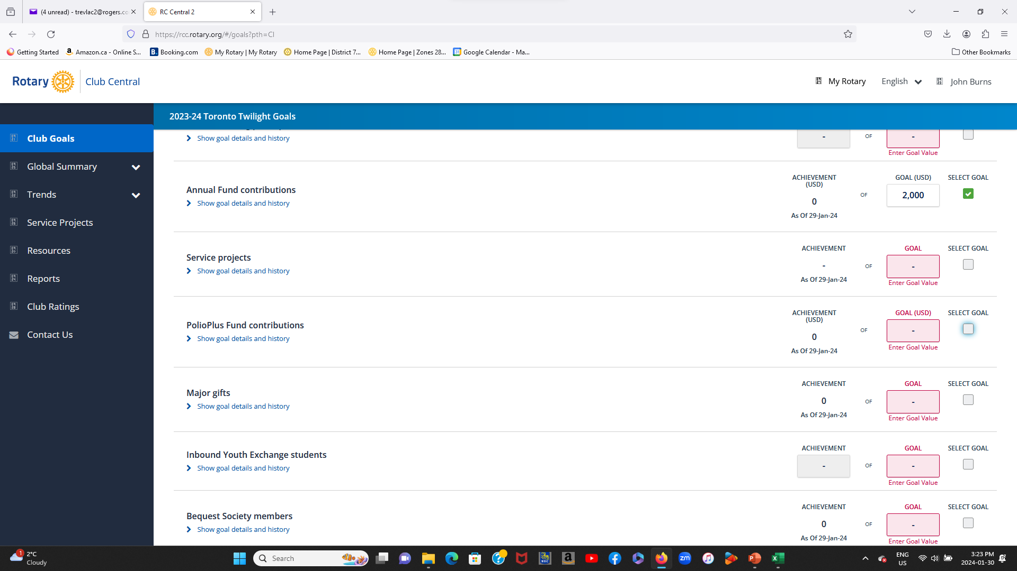
You can “ADD, REMOVE and EDIT” goals in the “ROTARY FOUNDATION GIVING” section, but you can not “ENTER an ACHIEVEMENT”. This action is carried out by “RI”.

Slide 21
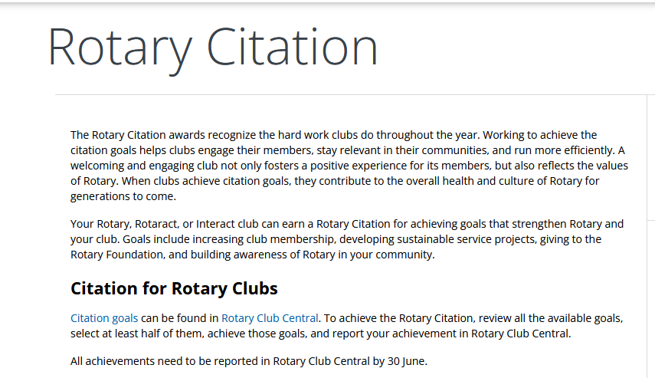
There are 26 possible goals. To be awarded the Rotary Citation a minimum of 13 of the goals must be achieved.

Slide 23
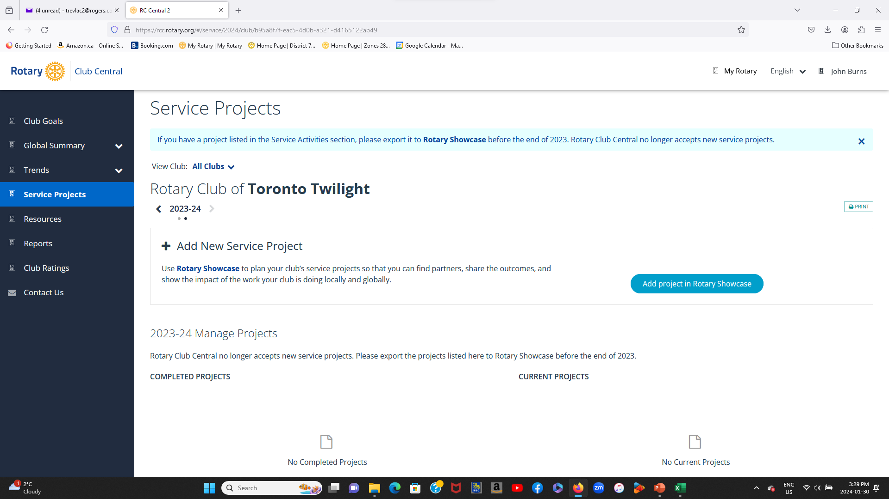
If you wish to set a goal involving service projects, they can no longer be entered in rotary Club Central. They must instead be entered into Rotary Showcase.

Slide 24
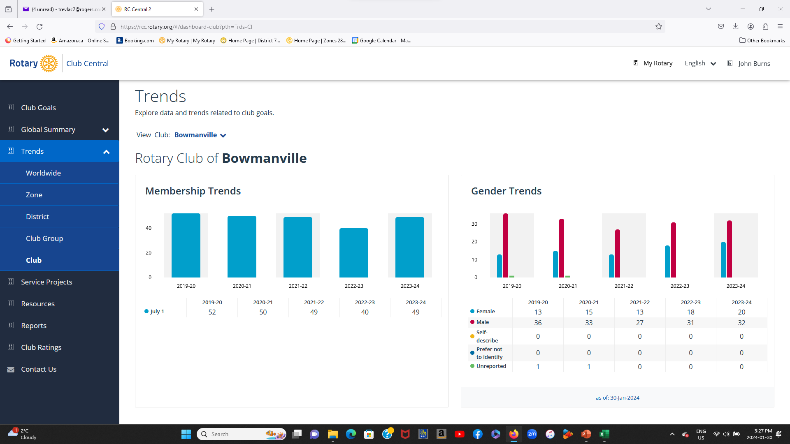
Rotary Club Central contains a very large amount of information which you may find usefull

Slide 25
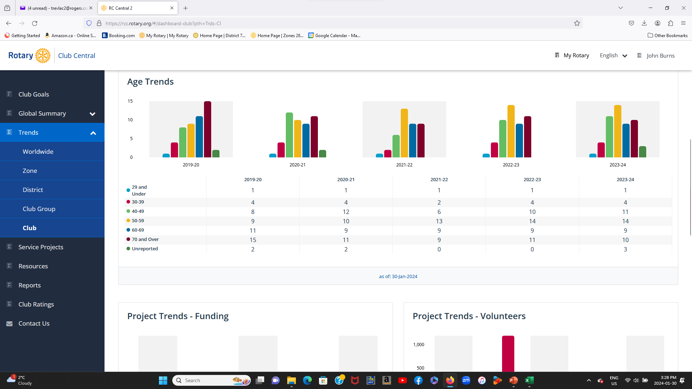

Slide 26
