Slide 1
2025 President Elects Learning

Slide 2

The Rotary Foundation helps Rotary members to advance world understanding, goodwill, and peace by improving health, providing quality education, improving the environment, and alleviating poverty.
Notes:
Thank you for having me here today to talk with you about The Rotary Foundation and, in particular, about our Annual Fund. I’d like to start by getting to know a little bit more about you and your interest in Rotary.
How many of you joined Rotary to make an impact through service? Raise your hands.
Rotary truly is a premier international service organization. As Rotarians, we see solutions to challenges in our communities, and we take action to bring those ideas to life. One of the benefits of being a Rotarian is having access to funding from The Rotary Foundation to create meaningful change both in your community and around the world.
It’s a foundation for Rotarians — it funds projects carried out by Rotarians, and it’s supported solely by voluntary contributions from Rotarians like you and friends of Rotary who share our vision of a better world.

Slide 3


Slide 4
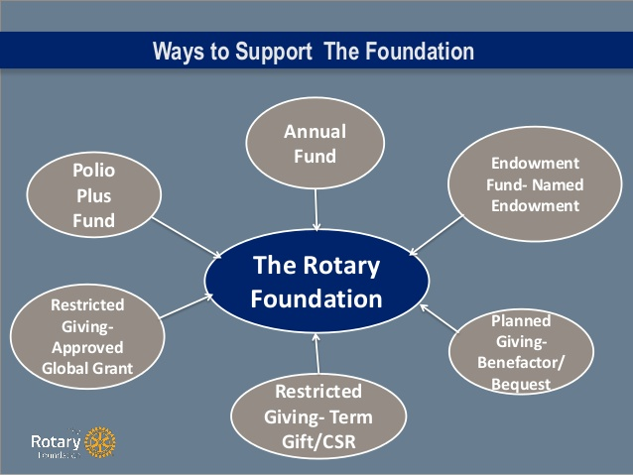
Ways to Donate

Slide 5
District Grants
Global Grants

Slide 6
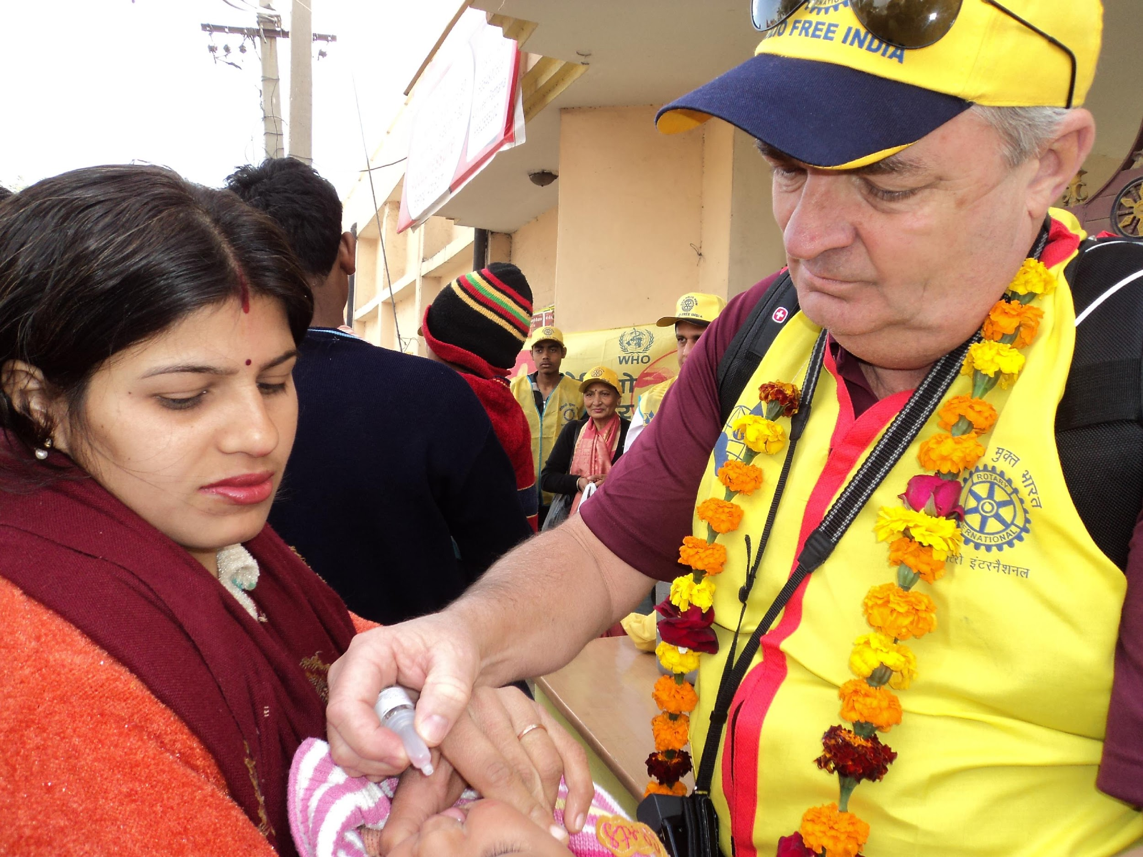
POLIO PLUS

Slide 7


Slide 8


Slide 9
What do you need to do to prepare for your year?

Slide 10
Learn about the Foundation
Appoint a Rotary Foundation chair and committee
Review your club’s Foundation participation
Set your clubs Foundation goals
Lead by example
Attend the Foundation Grants Workshop
Attend the Foundation Walk
Schedule a Foundation Program

