Slide 1



President Elect & Assistant Governor Learning Seminar 2026/2027
Rotary International President Olayinka Hakeem Babalola, member of the Rotary Club of Trans Amadi, Nigeria District Governor 7070 Elizabeth(Liz) Compton, from the Rotary Club of Toronto Leaside.
Saturday, 7th of February 2026 Oshawa Golf Club

Slide 2

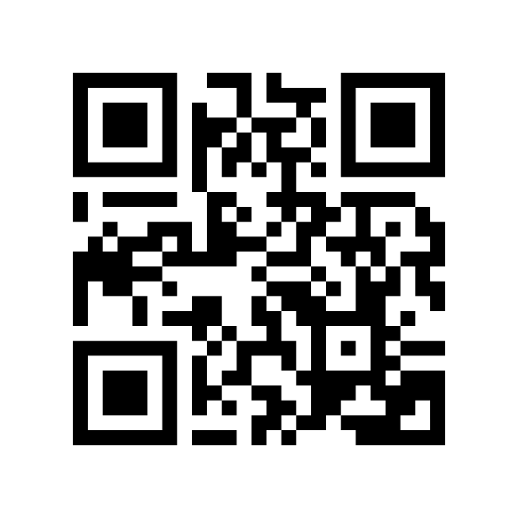

Charting Your Success: Setting the Stage for Your Presidential Year and Mastering Rotary Club Central
Link to MyRotary
NOTE: This is a different login credential than Clubrunner
Saturday, 7
th
February 2026
President Elect & Assistant Governor Learning - Oshawa
2

Slide 3
Why Goals Matter
Key Points:
Roadmap for your board and committees.
Requirement for the Club Excellence Award
Transparency for your club members.
Historical tracking - Seeing where the club has been and perhaps most importantly, where it is headed
Goals aren't just paperwork. They are the metric of your legacy. If it isn't in Rotary Club Central, RI doesn't know it happened.
“The Club Excellence awards, formerly the Rotary Citation awards recognize clubs that achieve specific goals throughout the year, such as increasing their membership, engaging members in sustainable service projects, giving to The Rotary Foundation, building awareness of Rotary in your community, and having an up-to-date strategic plan. When clubs achieve these goals, they contribute to Rotary's overall health and culture for generations to come.”
- Rotary International
Saturday, 7
th
February 2026
President Elect & Assistant Governor Learning - Oshawa
3

Slide 4
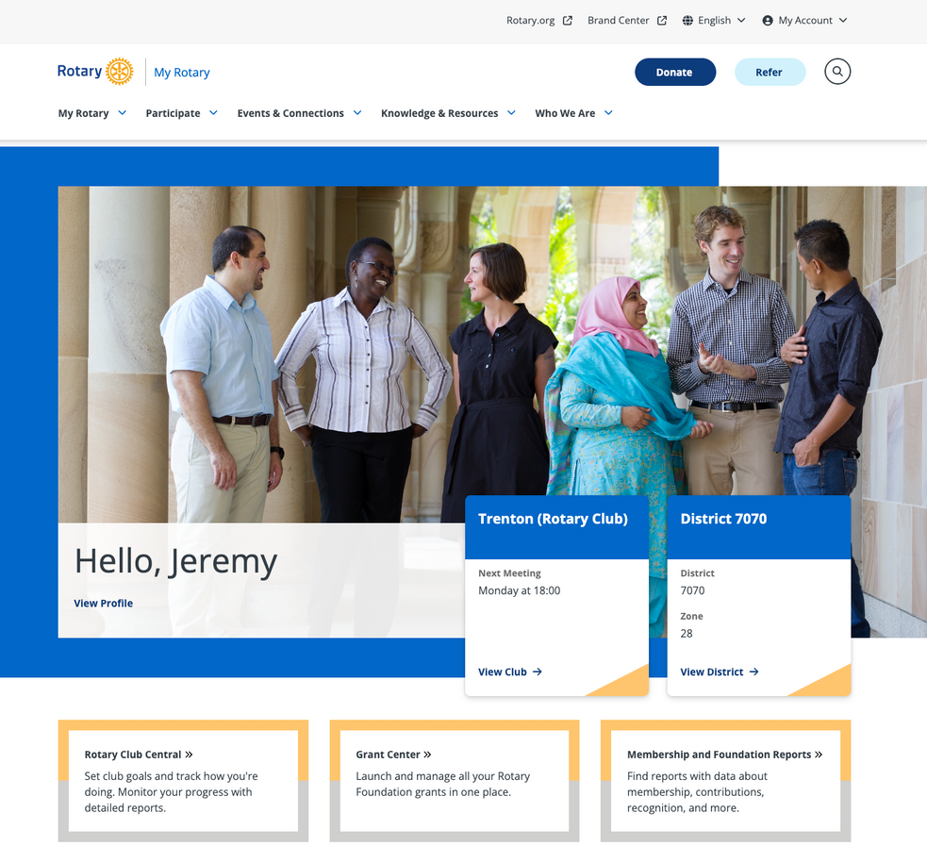
Getting In: The Technical Part
Key Points:
URL: https://my.rotary.org
Navigation: Member Dashboard -> My Rotary -> Rotary Club Central.
Note: You must be registered as PE, or an existing officer in My Rotary to have editing access.
Test you login this week. If you can’t get in, you need to contact your club secretary to ensure your officer role is reported.
Saturday, 7
th
February 2026
President Elect & Assistant Governor Learning - Oshawa
4

Slide 5
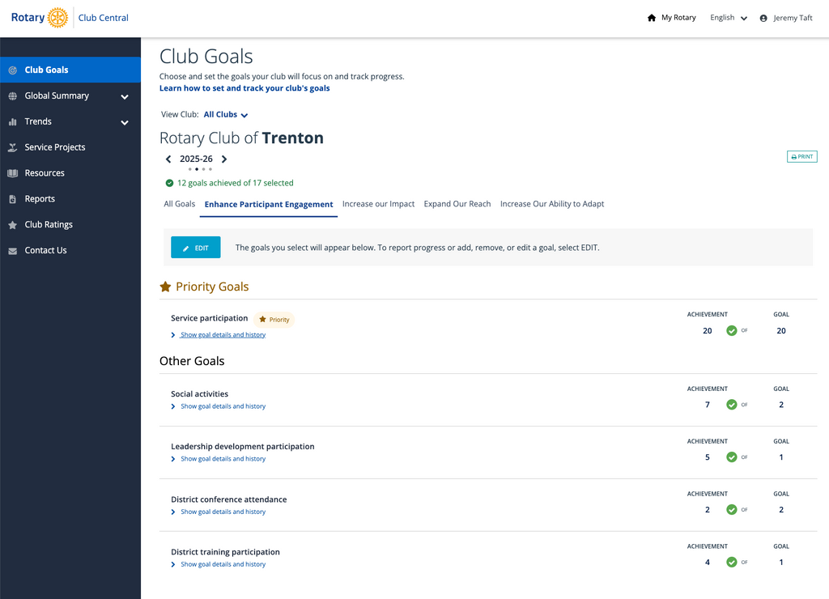
The Goal Center Overview
Key Points:
Select the correct year. Make sure you toggle to your upcoming year.
Tabs: All Goals, Enhance Participant Engagement, Increase our Impact, Expand our Reach, Increase Our Ability to Adapt
Saturday, 7
th
February 2026
President Elect & Assistant Governor Learning - Oshawa
5

Slide 6
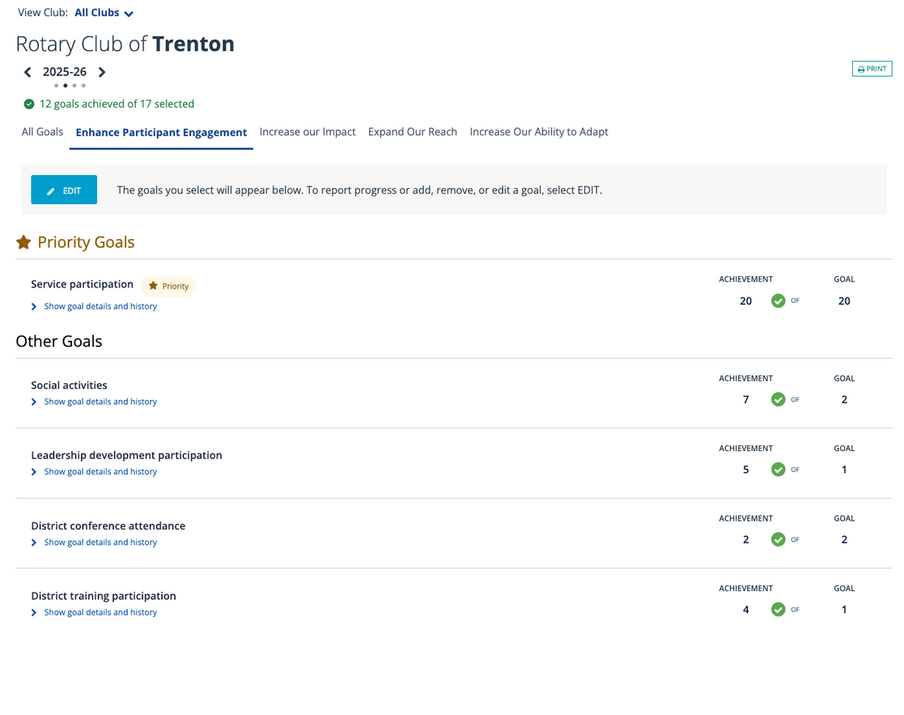
Enhance Participant Engagement
Saturday, 7
th
February 2026
President Elect & Assistant Governor Learning - Oshawa
6

Slide 7
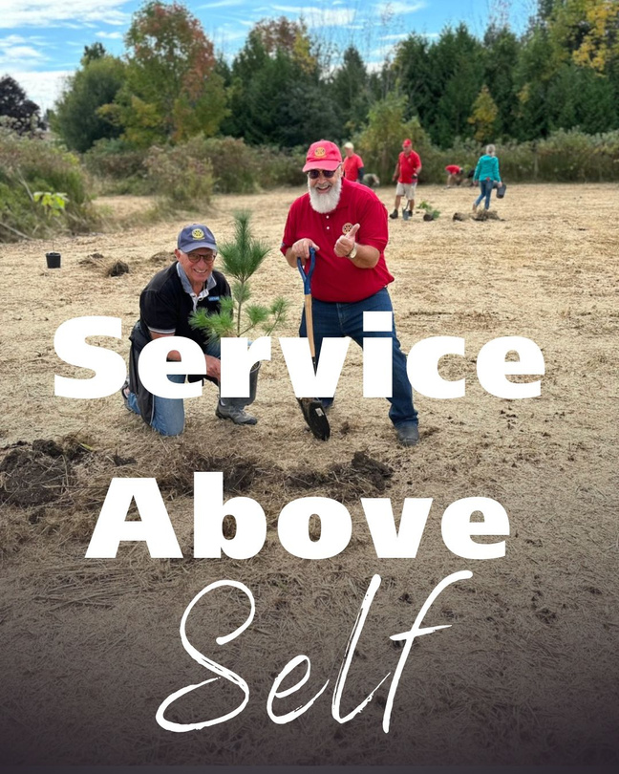
Enhance Patrticipant Engagement
Focus Areas:
Service Participation
Social Activities - Rotary is FUN!
Leadership Development - You’re Already Here!
District Conference Attendance
District Training Participation - PELS, Learning Tuesday, District Assembly, etc.
Saturday, 7
th
February 2026
President Elect & Assistant Governor Learning - Oshawa
7

Slide 8
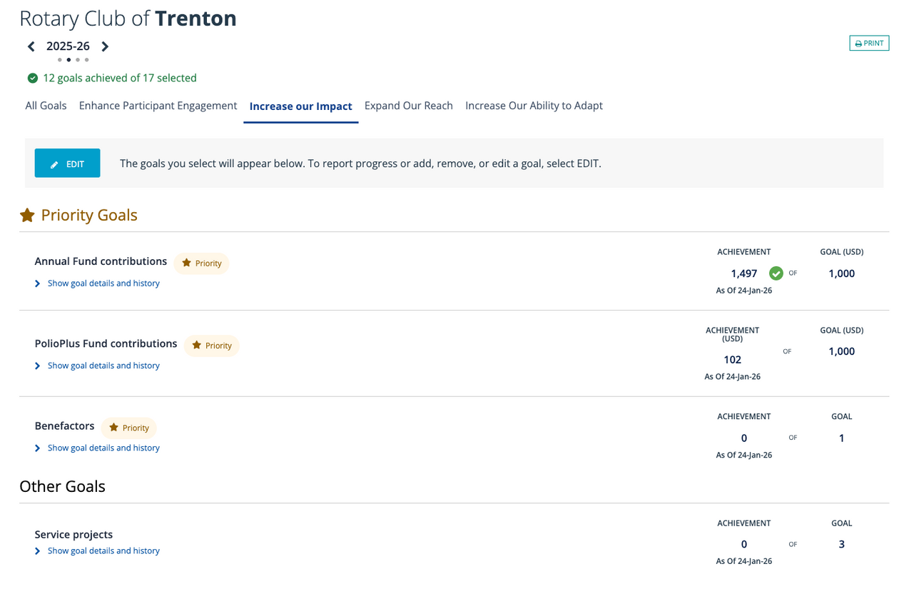
Increasing Our Impact
Saturday, 7
th
February 2026
President Elect & Assistant Governor Learning - Oshawa
8

Slide 9

Increasing Our Impact
Aim for maximum Foundation participation.
Two specific goals in this section are Every Rotarian, Every Year (EREY) and Sustaining Members.
The Point: Impact is a collective effort. It can be argued that a club where every member gives $25 has a deeper culture of impact than a club where one member gives $1,000.
Call to Action: Focus on the number of donors rather than just the dollar amount to build a sustainable foundation of support.
Prioritize the "Big Win" (PolioPlus Fund)
PolioPlus is a standalone goal under the Impact category. It is Rotary’s most significant measurable impact in history.
The Point: Meeting your PolioPlus goal is the most direct way for your club to contribute to a global, historical health milestone.
Call to Action: Set a PolioPlus goal that is at least 20% of your total Foundation giving to show your club’s commitment to PolioPlus.
Saturday, 7
th
February 2026
President Elect & Assistant Governor Learning - Oshawa
9

Slide 10
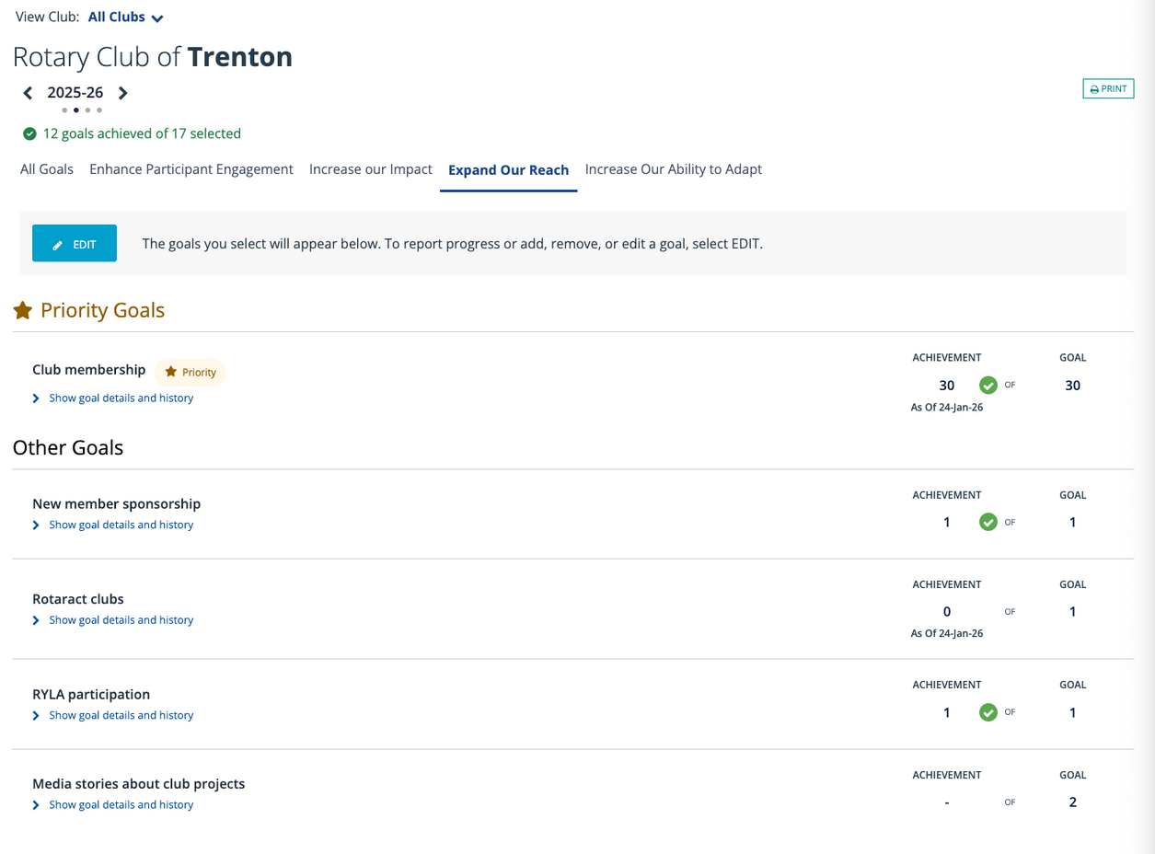
Expand Our Reach
Saturday, 7
th
February 2026
President Elect & Assistant Governor Learning - Oshawa
10

Slide 11
Expand Our Reach
Prioritize Your Core (Club Membership)
The Point: Club membership is listed as a Priority Goal for a reason. It is the foundation of expanding reach; you cannot grow your impact without a stable and growing member base.
Action: Set a realistic membership goal and track it throughout the year.
Invest in the Future (Rotaract & RYLA)
The Point: Expanding reach includes youth and young professional programs like Rotaract clubs and RYLA participation.
These programs bridge the gap between current leadership and the next generation of Rotarians.
Action: If you don't currently have a Rotaract club, set a goal to sponsor one or increase the number of students sent to RYLA.
Incentivize Mentorship (New Member Sponsorship)
The Point: Tracking "New member sponsorship" encourages existing members to take ownership of club growth.
This isn't just about finding new people; it's about recognizing the current members who act as ambassadors for Rotary.
Action: Aim for a specific number of members to sponsor at least one new person this year to distribute the "recruitment" workload.
Tell Your Story (Media Stories)
The Point: Media stories about club projects are a key metric for public image.
If the community doesn't know what you are doing, you aren't truly reaching them.
Action: Set a concrete goal to get at least 2 or more stories into local newspapers, podcasts or prominent digital news sites this year. Forward these to the District Public Image Committee.
Saturday, 7
th
February 2026
President Elect & Assistant Governor Learning - Oshawa
11

Slide 12
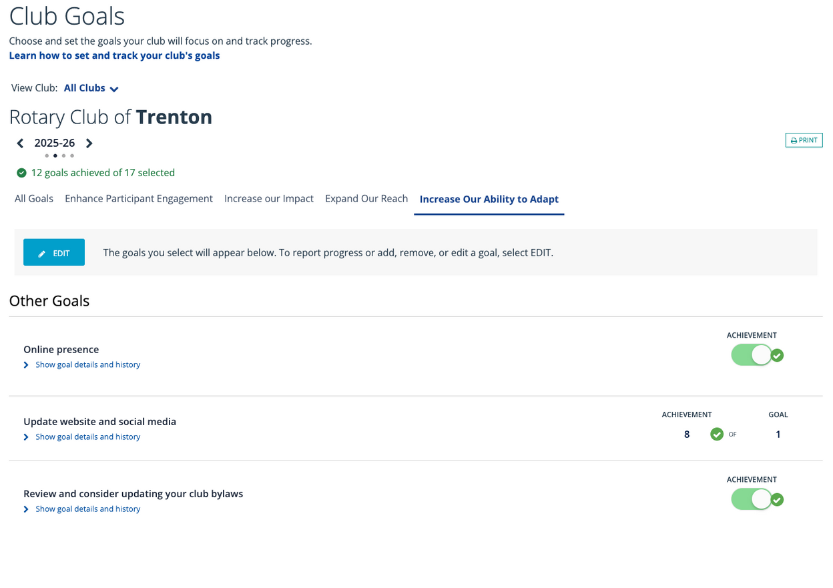
Increase Our Ability to Adapt
Saturday, 7
th
February 2026
President Elect & Assistant Governor Learning - Oshawa
12

Slide 13
Increase Our Ability to Adapt
Establishing a Digital Identity (Online Presence)
The "Why": In 2026, if your club doesn't exist online, it likely doesn't exist to potential members. This goal is a simple "Yes/No" toggle to confirm your club has a functional digital footprint.
Focus online accounts to target the audience you are looking for.
Modernizing Your Governance (Club Bylaws)
Review and consider updating your club bylaws.
The "Why": Adaptability requires a flexible foundation. Many clubs are operating on bylaws from decades ago that don't allow for modern needs like virtual meetings, corporatre membership or flexible attendance.
This is a Binary Goal (Yes/No). Make this a Q1 task with your board to ensure their "rules" aren't actually "roadblocks."
Keeping the Story Current (Website & Social Media)
Update website and social media regularly.
The "Why": Stale content is a red flag. Rotary Club Central allows you to set a specific goal for how many times you will refresh your digital content throughout the year.
Don't just set a goal of "1." Set a goal that reflects a monthly or quarterly update schedule to keep your community engaged.
Saturday, 7
th
February 2026
President Elect & Assistant Governor Learning - Oshawa
13

Slide 14
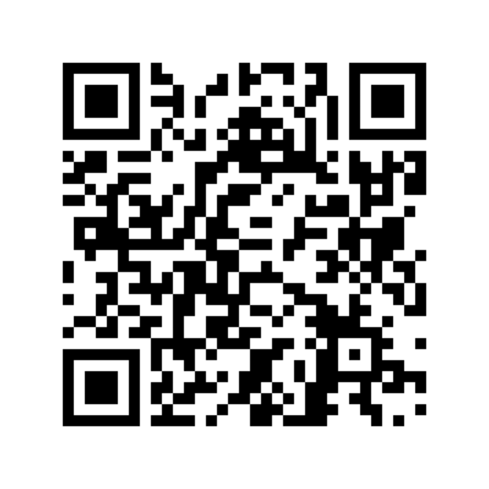
Resources, Support & Questions
Link to the District 7070 Organization Chart
Saturday, 7
th
February 2026
President Elect & Assistant Governor Learning - Oshawa
14

