Slide 1


President Elect & Assistant Governor Learning Seminar 2026/2027
Rotary International President Olayinka Hakeem Babalola, member of the Rotary Club of Trans Amadi, Nigeria
District Governor 7070 Elizabeth (Liz) Compton, from the Rotary Club of Toronto Leaside.
Saturday, 7th of February 2026 Oshawa Golf Club

Slide 2
Assistant Governor training
Welcome and introductions

Slide 3

Acknowledgements
PDG Kathy Gallagher (Michigan)
PDG Hector Ortiz (Pennsylvania)
PDG Brent Collingwood (District 5370, Alberta)

Slide 4
Objectives for the day
Understanding the role
How to support your presidents well
  developing strong relationships with your presidents
  where to go to get the knowledge & resources you need
How to support the DG well
  panel discussion after lunch

Slide 5
Agenda
Responsibilities, attributes and expectations of an AG
Assessing a club’s health
Scenario, for small group discussion
Supporting your clubs, supporting our DG, where to go for help
Scenario, for small group discussion
PDG panel “fireside chat” (after lunch)

Slide 6

Assistant Governor training
Responsibilities, attributes and
expectations of an AG

Slide 7
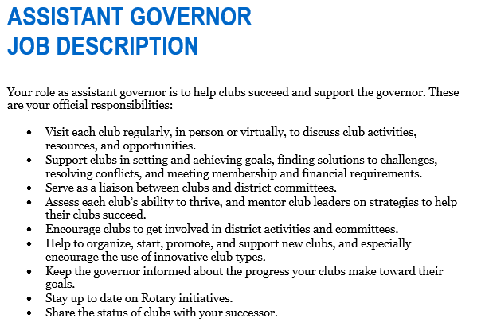
Assistant Governor Job Description

Slide 8
Attributes of high-performing AG’s
knowledgeable
collaborative
connector
influential
visible and involved
skilled communicator & good listener
good judgment
  a coaching relationship with your presidents
  keeping the DG informed
  decide, refer, consult, or defer?

Slide 9
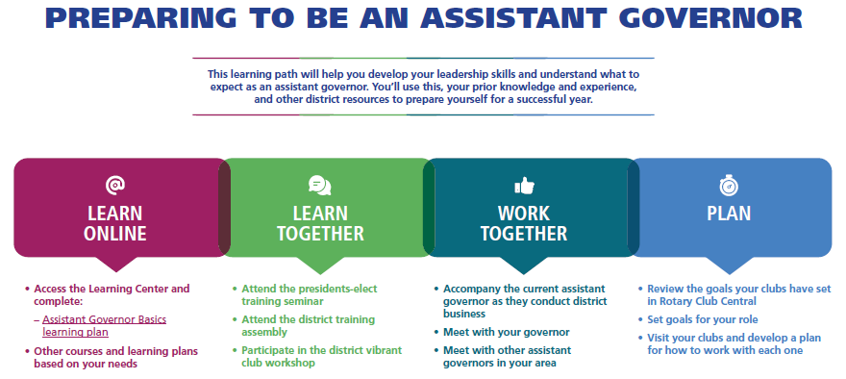
Expectations

Slide 10

Assistant Governor training
Assessing a club’s health

Slide 11
Objectives
Assess a club’s ability to thrive
Mentor club leaders on strategies for success
Identify warning signs of a struggling club
Work with a struggling club to become more vibrant
Using the “coaching” method to work with clubs

Slide 12
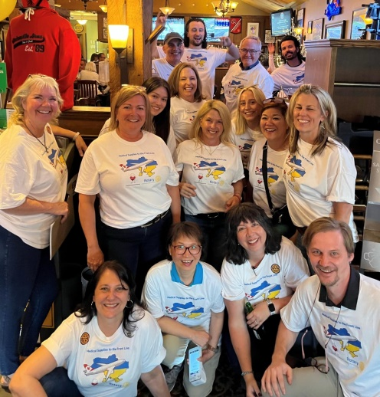
Healthy club indicators
conducts regular self-evaluation
makes long-term plans
sets annual goals
holds engaging meetings
leaders communicate regularly
leadership is a healthy mix of continuity and renewal
good chemistry / group dynamics
evidence of good financial management
committee structure is suited to the club’s size, culture, and formality

Slide 13
Struggling club indicators
club isn’t meeting regularly
attendance issues
member engagement issues
group dynamics issues
leadership succession issues
failure to set or meet goals
delayed payment of dues
disconnected from District events

Slide 14

Club Health Check
members’ club experience
club service & socials
membership recruitment, retention
engagement, diversity
public image
business and operations
a detailed checklist for you

Slide 15
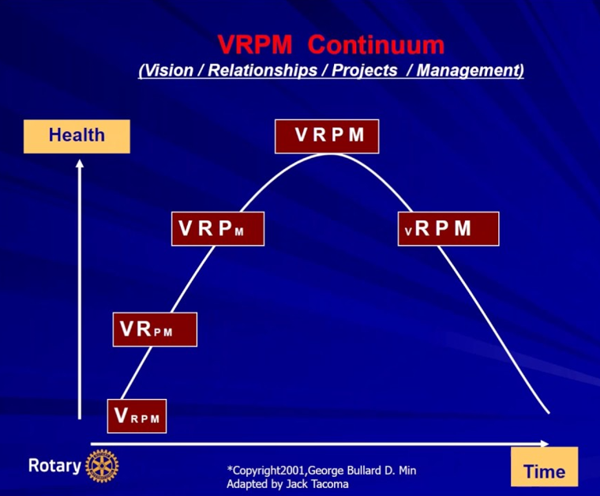
Where is the club on the life cycle continuum?

Slide 16
What can you do?
Be a coach to your president
Help with goal setting
Help to organize a club assembly or visioning session
Attend club meetings to monitor progress
Use the Club Health Check tool
Keep the DG informed

Slide 17
What should you avoid doing?
Telling the president what to do
Casting a shadow over the president in club meetings
Imposing solutions

Slide 18
Scenario # 1, for discussion
You visit one of your clubs from time to time. You notice that the club is moribund. Meetings are not engaging. The club goes through the motions of a standard business agenda. The club is not active in the community. Members donate to the club, to fund the club’s community donations and donations to TRF. The president is serving for the third time. The president is happy to have you attend but is not seeking advice from the District. There is no friction in the club but there is no chemistry either.
Questions:
Should you intervene? What are the risks?
If you choose to get involved, what issues would you expect to encounter and how would you manage through them?

Slide 19

Assistant Governor training
Supporting your clubs.
Supporting your DG.
Where to go for help.

Slide 20
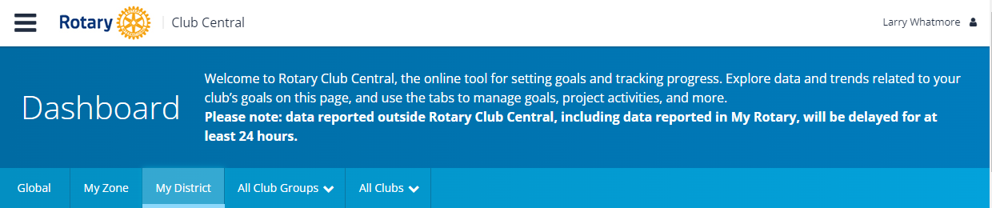
Supporting your clubs
Involve District subject matter experts
  membership, foundation, public image, governance
Help them navigate Rotary Club Central
Assist with leadership and renewal issues
https://rcc.rotary.org/#/dashboard

Slide 21
Supporting your DG
What does the DG needs to know?
What is the DG’s management style?
Which is the most appropriate approach?
  resolve the matter on your own
  assess & refer to the District’s subject matter expert
  consult your DG Coach before responding
  defer to the DG
Complete the AG Club Health Check form semi-annually

Slide 22
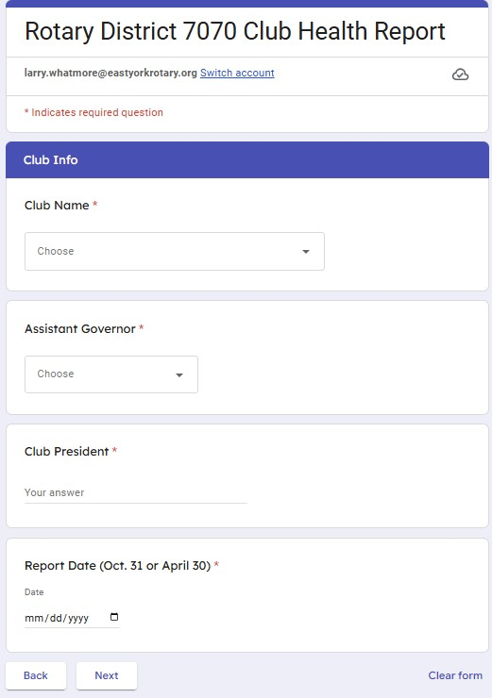
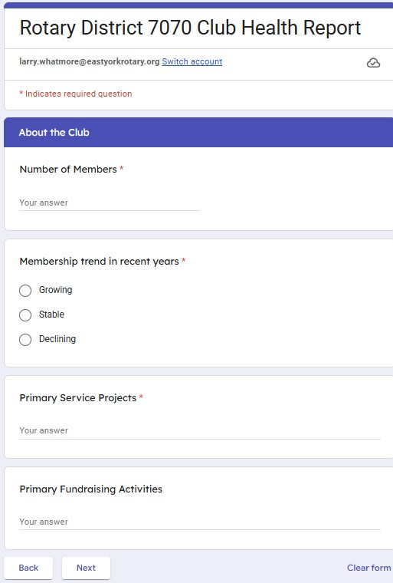

Slide 23
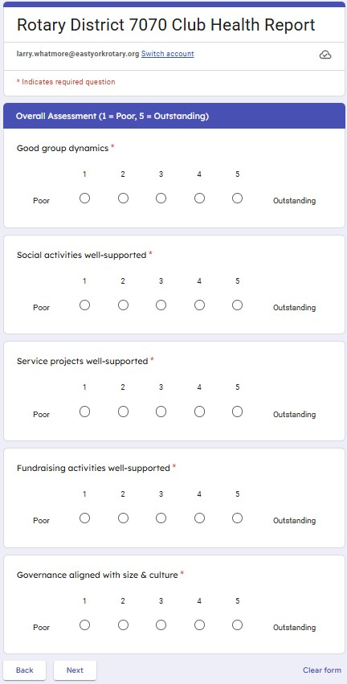
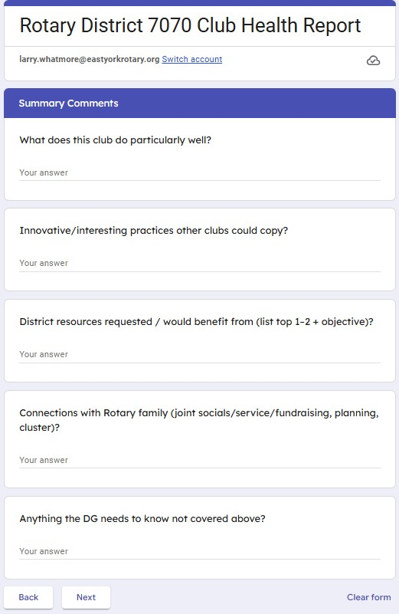
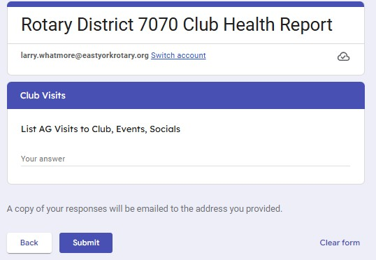

Slide 24
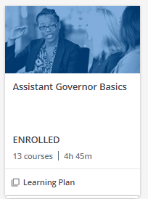

Where to go for help
MyRotary https://my.rotary.org/en
  Rotary Club Central
  Learning Centre
Your “sounding boards”
  AG Coach, other AGs
the DG
https://learn.rotary.org/members/learn/catalog/view/68

Slide 25
Scenario # 2, for discussion
One of your presidents is young, dynamic, new to Rotary, and a change agent by nature. The president wants to make significant changes to the club’s meeting format and service projects. The president feels these changes are needed to bring in new members. Some club members are enthusiastic; others are not and have stated they will resign if they go through. This has come to your attention although not from the president.
Questions:
Should you intervene? What are the risks?
If you choose to get involved, what issues would you expect to encounter and how would you manage through them?

